Slide 1
Undulator Demagnetization and
Related Issues in SPring-8 and SACLA
Takashi TANAKA
on behalf of SPring-8 ID Group

Slide 2
Demagnetization in IVUs
  In-situ magnetic measurement of IVUs
  Demagnetization in SACLA IVUs
  Demagnetization in SPring-8 IVUs
Radiation Induced Physical Damage in SPring-8 IDs

Slide 3
Demagnetization in IVUs
  In-situ magnetic measurement of IVUs
  Demagnetization in SACLA IVUs
  Demagnetization in SPring-8 IVUs
Radiation Induced Physical Damage in SPring-8 IDs

Slide 4
In-situ Measurement of IVUs
Portable system to inspect IVU quality
  Compact Hall sensor carriage and its dynamic alignment with laser instrum.
  Originally developed to check the final condition of IVUs for SACLA
“On-site” measurement possible w/o moving to a dedicated facility
  Helped a lot to find out mechanical malfunctions and demagnetization

Slide 5
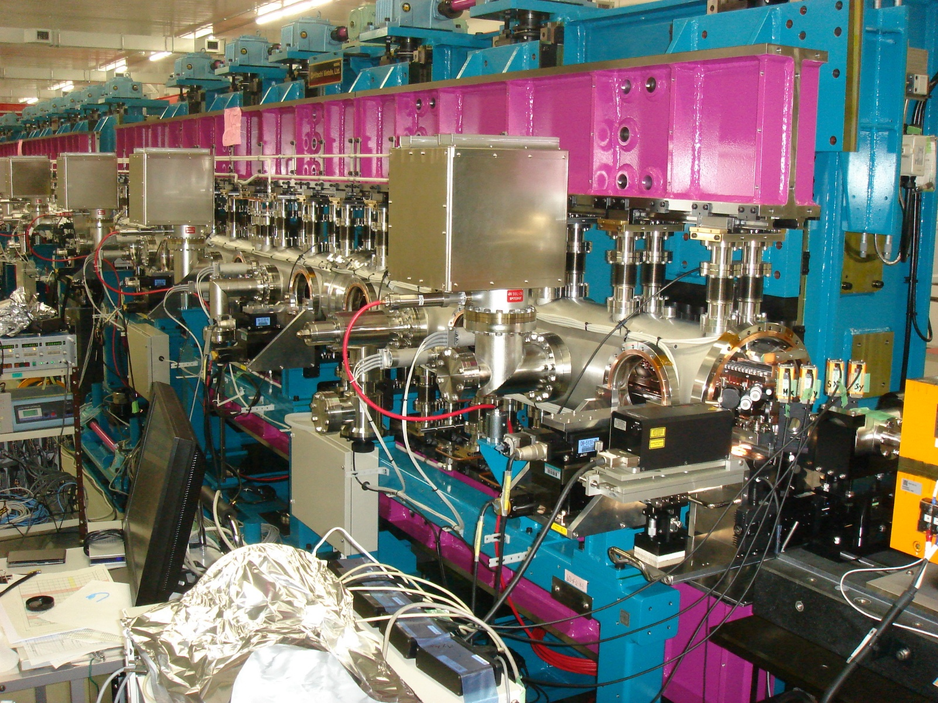
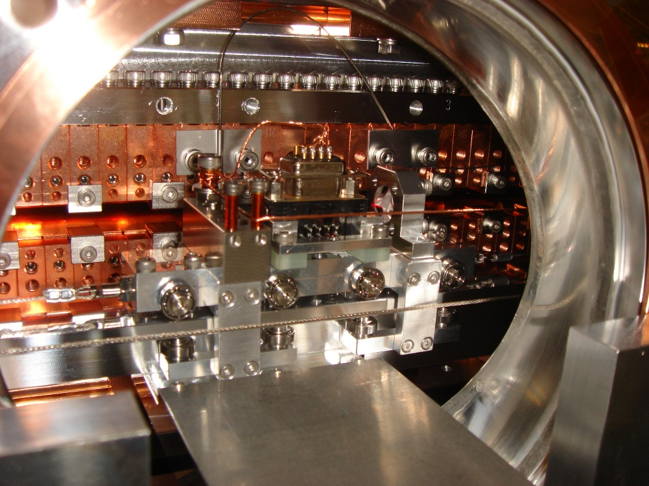
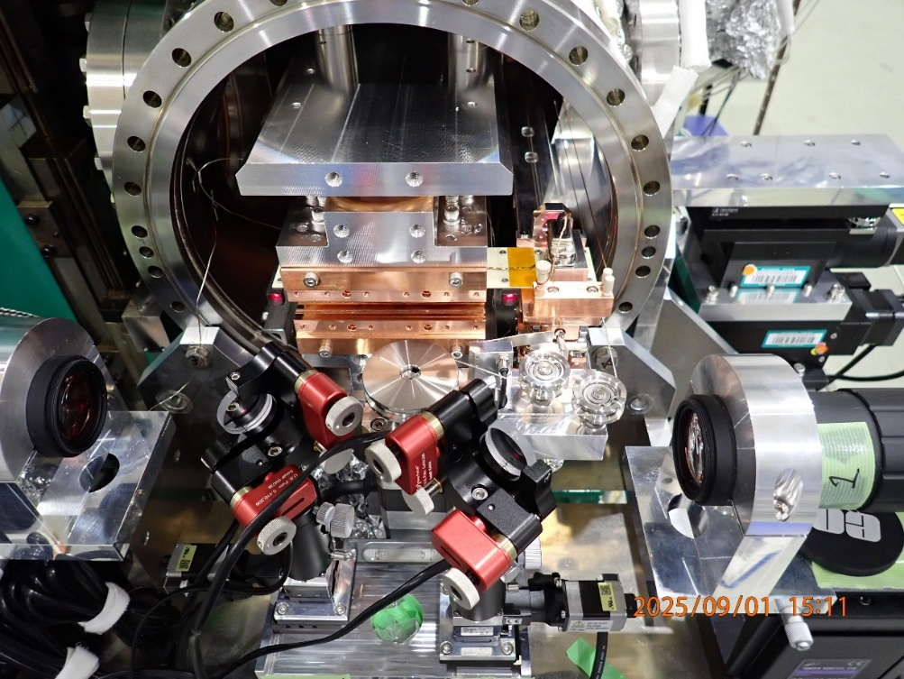
On-Site Measurement of a SACLA IVU
Laser Instrumentation
Hall Sensor Carrier

Slide 6
Demagnetization in IVUs
  In-situ magnetic measurement of IVUs
  Demagnetization in SACLA IVUs
  Demagnetization in SPring-8 IVUs
Radiation Induced Physical Damage in SPring-8 IDs

Slide 7
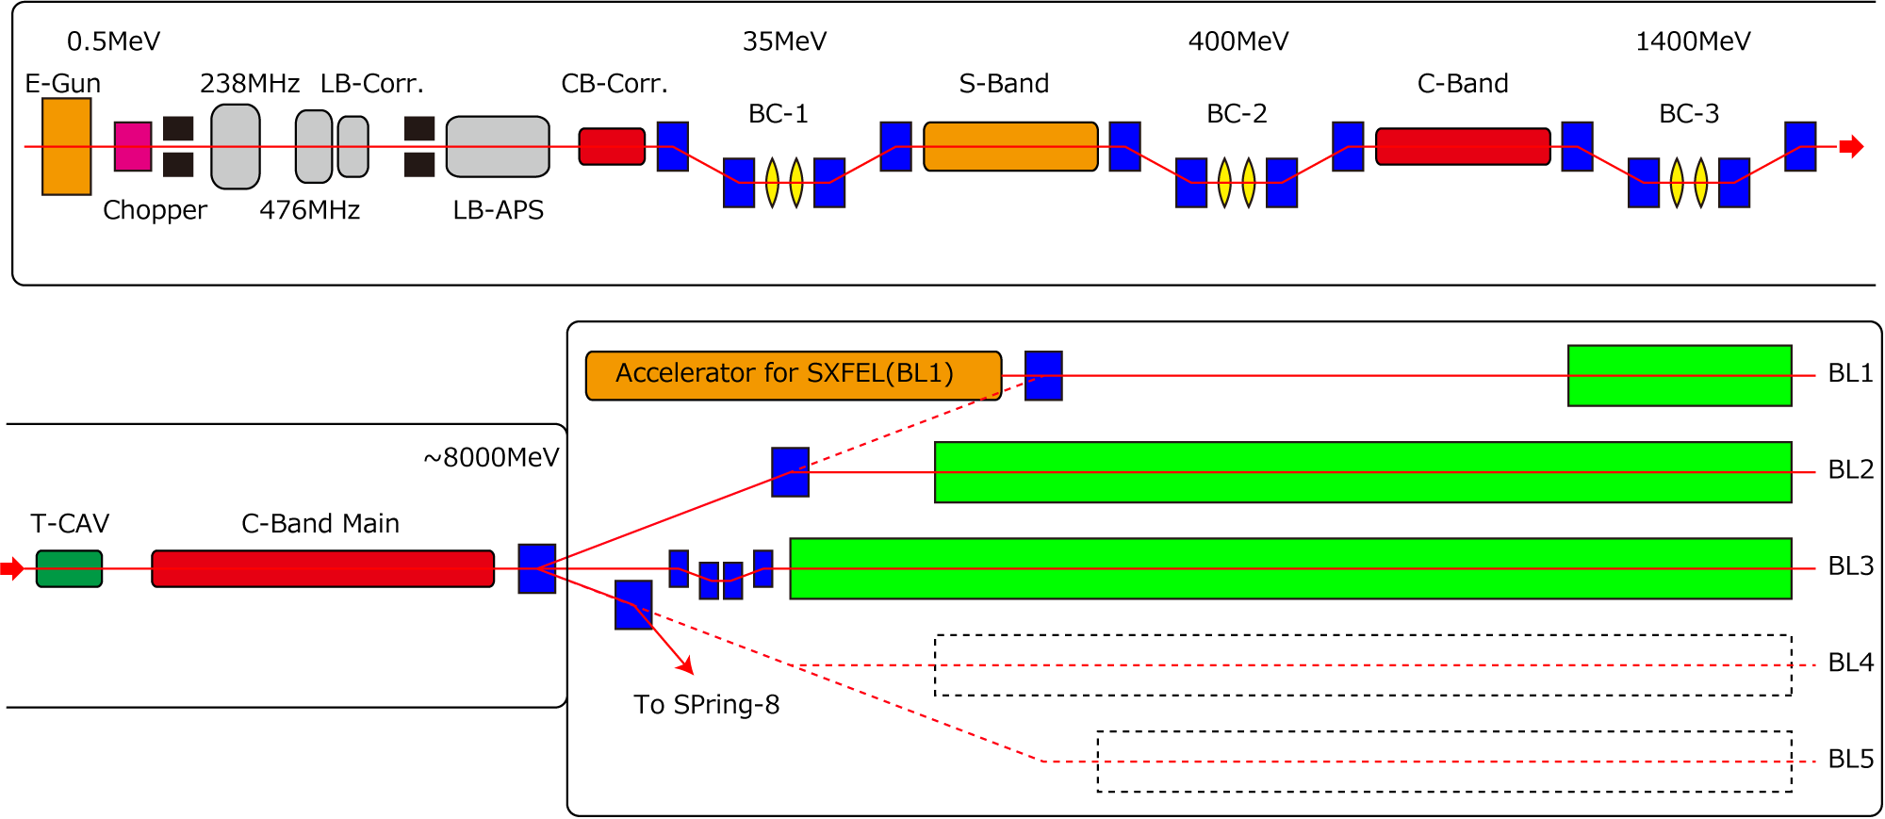
SACLA Accelerator Layout
0.8GeV
3IVUs
8GeV
18IVUs
8GeV
22IVUs
Accelerator
Bldg.
Undulator
Bldg.

Slide 8
Demagnetization in SACLA BL3#1-4

Slide 9
Surface Mapping of Demag. PM
e⁻ beam center at g = 4mm
B_{z}(T)
4mm
Mag. Reversal Region
8mm

Slide 10
Demagnetization in SACLA BL1

Slide 11
Discussions
Local demag. in BL3(&2)
  Extremely localized (~10 cm = 0.1%) and thus practically not a critical problem
Global demag. in BL1
  Phase error > 160º (#1); FEL gain greatly reduced (next slide)
  Much faster than BL2&3 regardless of lower e⁻ energy (bad β matching?)

Slide 12
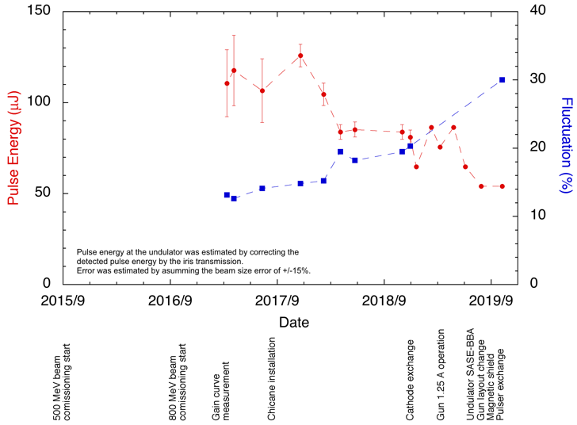
History of FEL Output in BL1
Courtesy of
K. Togawa

Slide 13
Countermeasures in BL1
Recover the FEL gain by
  Replacement of 2 IVUs with new ones (borrowed from BL2&3)
  Partially fixing 1 IVU (by introducing a local gap variation)
Reduce e⁻ to hit the magnet by
  Collimator at the upstream of BL1
  Opening the gap as much as possible (during e⁻ tuning etc.)
Routine on-site measurements have revealed that these measures work fine!

Slide 14
Demagnetization in IVUs
  In-situ magnetic measurement of IVUs
  Demagnetization in SACLA IVUs
  Demagnetization in SPring-8 IVUs
Radiation Induced Physical Damage in SPring-8 IDs

Slide 15
Background
SPring-8 is in the course of a major upgrade (SPring-8-II)
  Most of IVUs should be replaced; old IVUs are thrown away
Before disassembling, magnetic quality of an old IVU checked
  λ_{u}=32mm, L=4.5m, G_{min}=8mm
  Operated in BL29XU (ID29) in 1998-2025
In-situ measurement done to check demagnetization

Slide 16
Demagnetization in SP8-ID29

Slide 17
Mapping of Demag. Magnet Units
B_{z}
outer
(exp. hall)

Slide 18
Mapping of Upstream Magnet Unit
B_{z}

Slide 19
Detail of Upstream Unit
outer
(exp. hall)
Mag.
surface
e- (g=8mm)

Slide 20
Discussion
Demag. found only in the top units
  strongly suggests vertical misalignment of ID29 and/or e- beam position
Several demag. spots somehow “scatter”, unlike SACLA-BL3 case
  can injected beam (or its halo) behave in that manner?
In any case, not so critical because of the localization of demag.

Slide 21
Demagnetization in IVUs
  In-situ magnetic measurement of IVUs
  Demagnetization in SACLA IVUs
  Demagnetization in SPring-8 IVUs
Radiation Induced Physical Damage in SPring-8 IDs

Slide 22
Radiation Induced Physical Damage?
Malfunctions in SPring-8 IDs after a long-term operation
  Encoders: radiation damage in semi-conductors
  Others: literally due to “physical damage” in sensitive components
Two major problems encountered
  Linear guide tables to support the gap motion etc.
  Pinholes in cooling water channels

Slide 23
Two Major Problems
“End cap” of a linear guide table to accommodate bearings broken
  During the maintenance period, bearings are found ejected
  Made of plastic, became brittle
Pinhole in cooling water channels
  Resulted in a sudden increase in pressure of an IVU
Both of them need to be fixed; BLs are closed until that!!

Slide 24
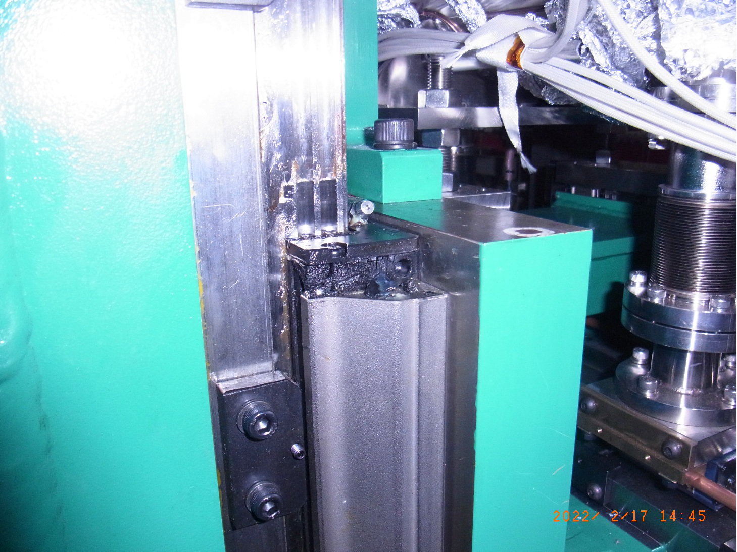
Linear-Guide Rail
“End Cap”
Linear-Guide Table

Slide 25
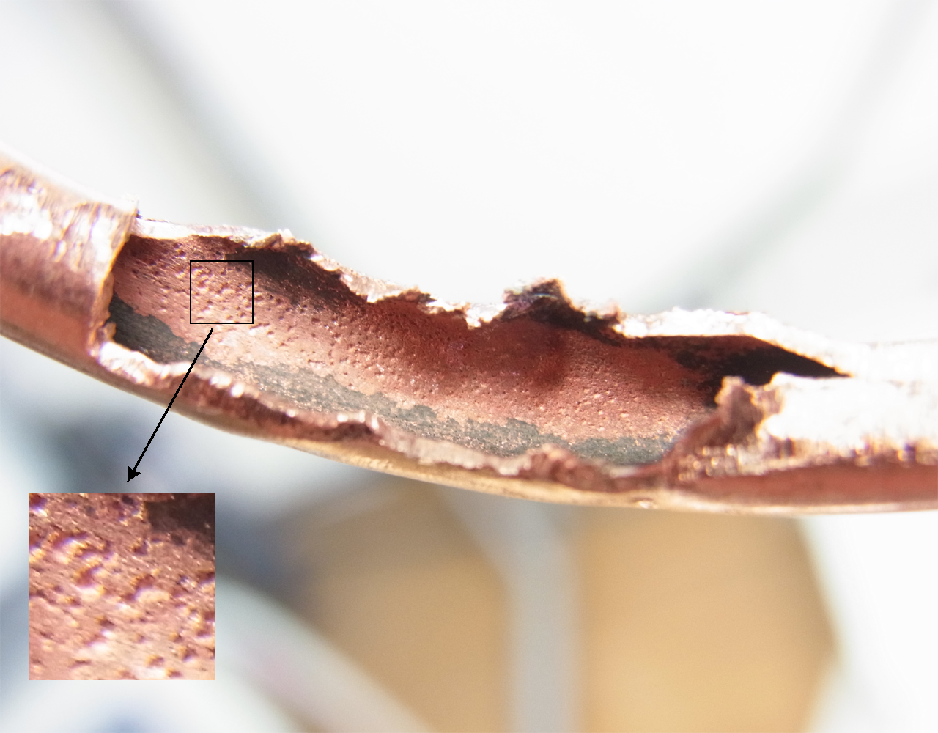
Interior Photo of Cu Tube with Vacuum Leakage (Cooling for Flexible Taper of an IVU)

Slide 26
Discussions
Locations of damaged components are specific: main source point?
  NG for LG tables at specific locations
  NG for Cu tubes for flexible taper, but no problem for magnetic array
Distribution of radiation dose measured by radiochromic films

Slide 27
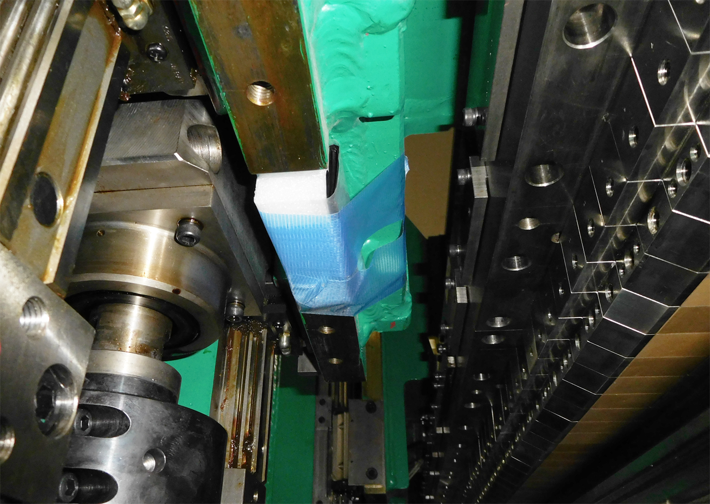
LG Rail
Radiochromic Film (inside)
LG Table
LG Rail
Magnetic
Array
LG Table

Slide 28
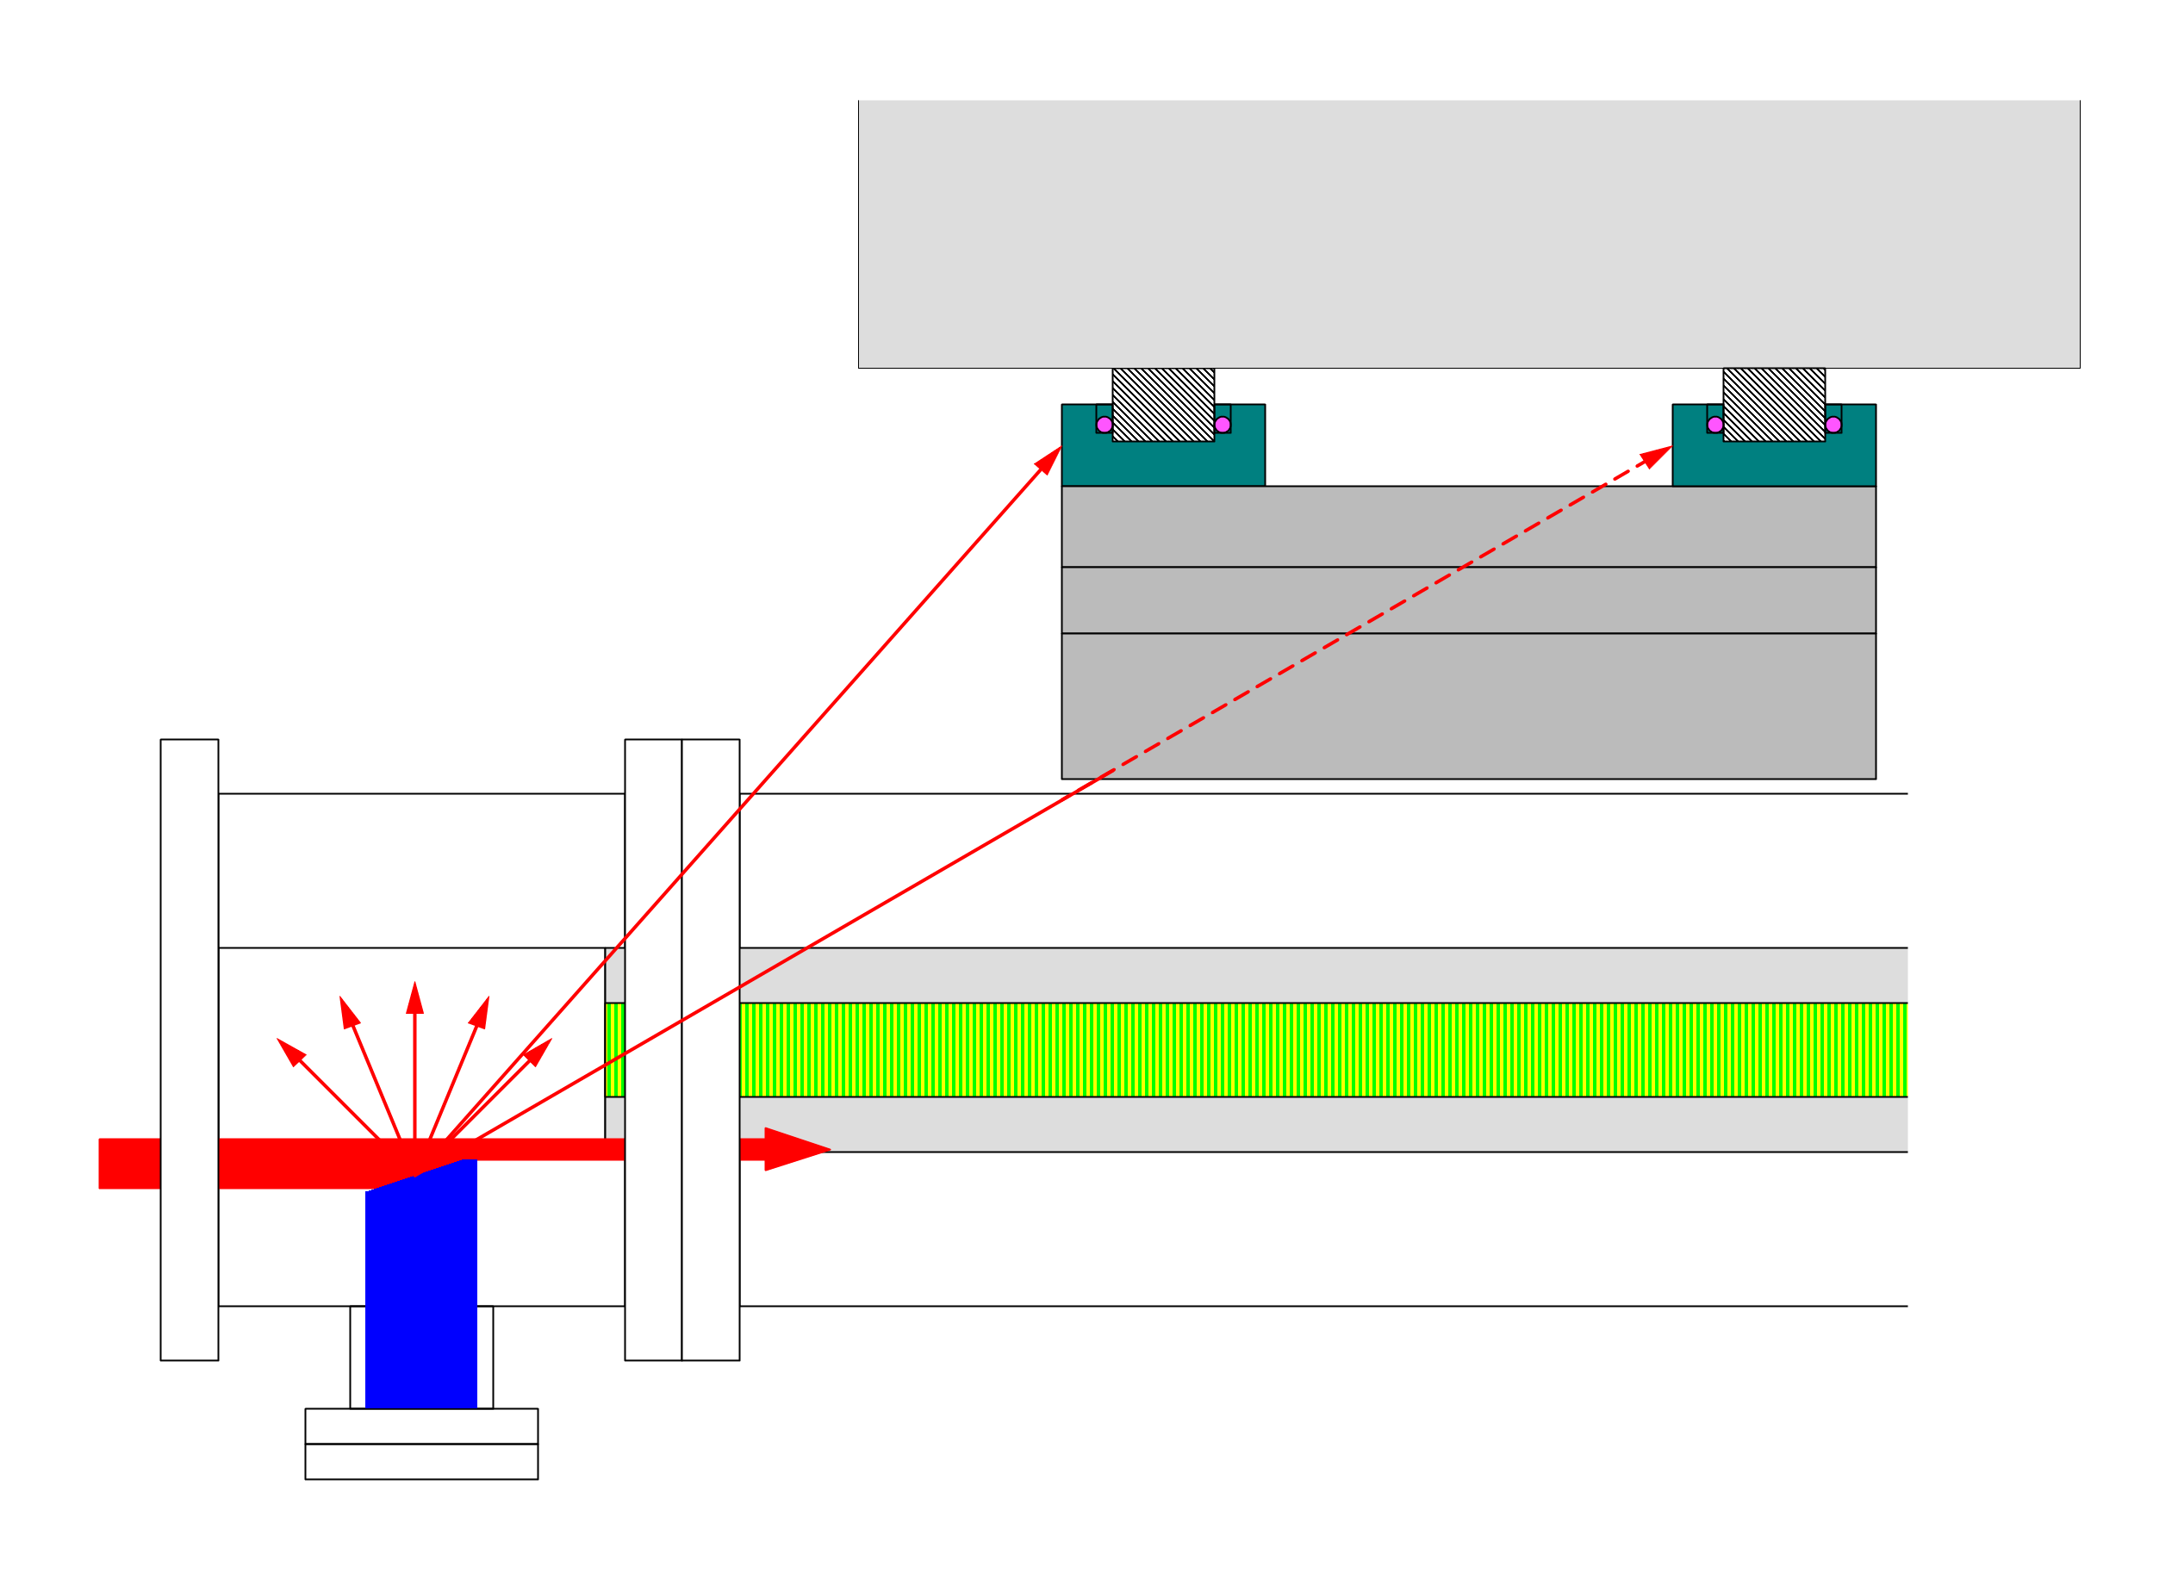
Locations of absorbers and broken LG tables
LG Table
NG
OK
Mechanical Structure (Steel)
Scattered
X-ray
Magnetic Array
SR from BM
Absorber
Protection from scattered x-rays needed; effective methods under consideration

Slide 29
Thank you for attention!

Slide 30
Spontaneous Radiation Spectrum

