Slide 1
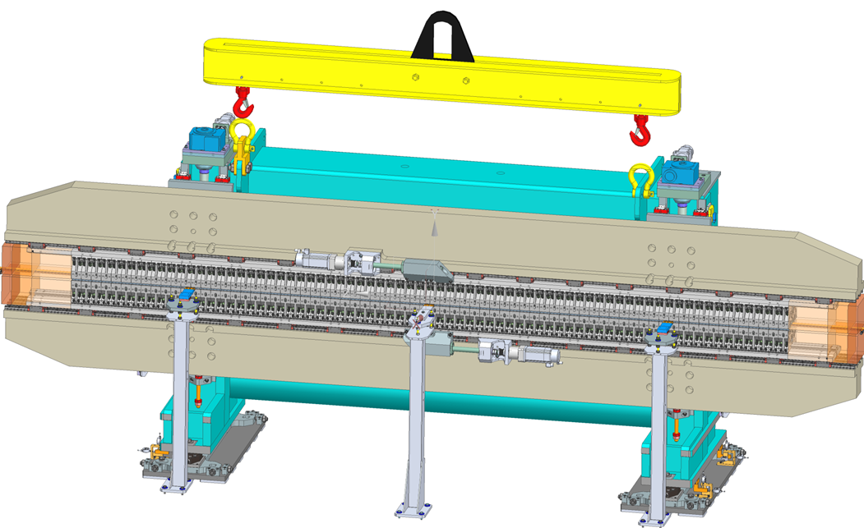
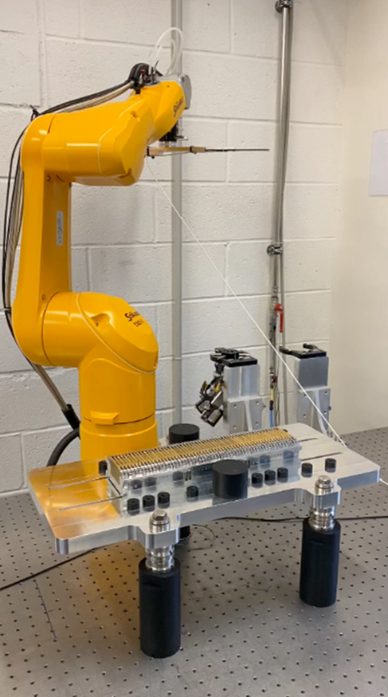
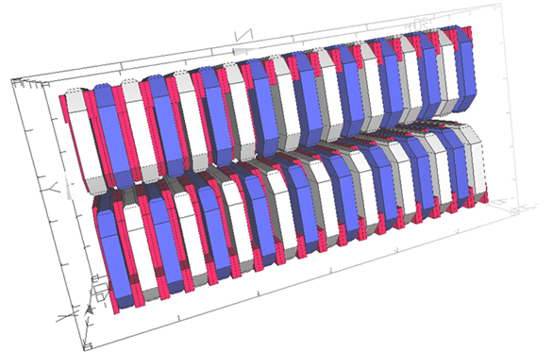
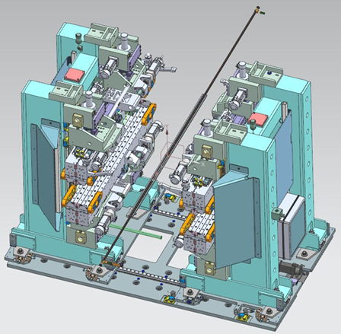
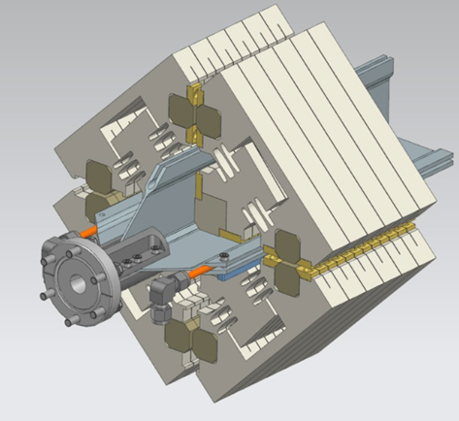

SOLEIL Insertion Devices and Prospects for the Upgrade
O. Marcouillé
on behalf of SOLEIL II Project Team
Insertion Device Workshop 2026, 15 – 16 May 2026 - Deauville

Slide 2
Contents
SOLEIL Synchrotron
Insertion Devices at SOLEIL
From SOLEIL to SOLEIL II
Three new Insertion Devices for SOLEIL II
Re-use of Insertion Devices for SOLEIL II

Slide 3
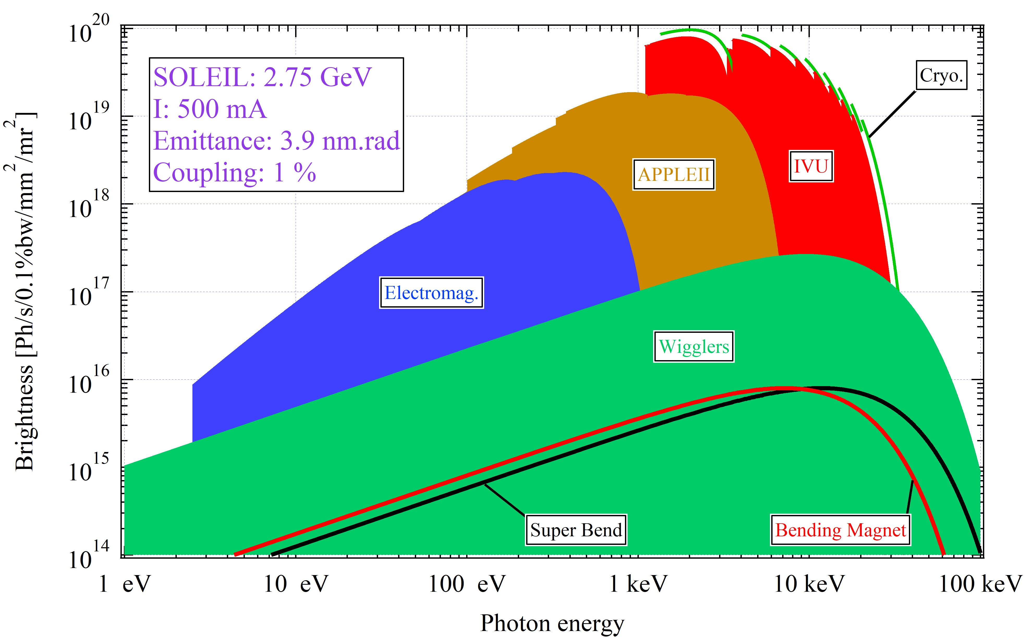
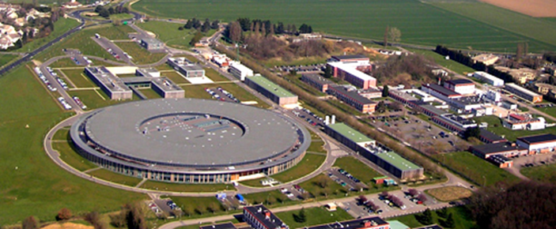
Technical and scientific environment:
SOLEIL Synchrotron
Synchrotron SOLEIL
Energy: 2.75 GeV
Current: 500 mA
Emittance: 3.9 nm.rad
Coupling: 1%
Energy spread: 0.125 %
24h/24h and 7j/7j
THz → Hard X-Rays:
9 BM based beamlines
20 ID based beamlines
  8 Short Straight Section
  8 Medium Straight Section
  4 Long Straight Section
IDs
Photon energy

Slide 4
Insertion Devices at SOLEIL
 | SOLEIL
 | Straight Section | Insertion Device
LUCIA | SDM16 | HU52
PSICHE | SDC03 | IVW50
PLEIADES | SDM04 | HU80 - HU256
DEIMOS | SDM07 | HU52 - EMPHU65
PUMA | SDM06 | W164
CRISTAL | SDC06 | CPMU18
GALAXIES | SDC07 | IVU20
TEMPO | SDM08 | HU80 - HU44
DESIRS | SDL05 | HU640
HERMES | SDM10 | HU64 - HU42
PXI | SDC10 | IVU20
PXII | SDM11 | IVU24
SWING | SDC11 | IVU20
ANTARES | SDM12 | HU60 - HU256
ANATOMIX | SDL13 | CPMU18
NANOSCOPIUM | SDL13 | CPMU18
SEXTANTS | SDM14 | HU80 - HU44
SIXS | SDC14 | IVU20
SIRIUS | SDC15 | HU36
CASSIOPEE | SDM15 | HU60 - HU256
Number | Technology | Type | Magnetic period (mm) | Length (m) | Type of polarization | Prefix
1 | Electromag. | Undulator | 640 | 10 | all | HU
3 | Electromag. | Undulator | 256 | 3.54 | LH/LV/Circ | HU
1 | Electro-PPM | Undulator | 65 | 1.8 | LH/LV/Circ | EMPHU
12 | APPLE II | Undulator | 36 to 80 | 1.8 | LH/LV/LT/Circ | HU
1 | Out-vacuum | Wiggler | 164 | 3.2 | LH | W
5 | In-vacuum | Undulator | 20 and 24 | 2 | LH | IVU
1 | In-vacuum | Wiggler | 50 | 2 | LH | IVW
3 | Cryogenic | Undulator | 18 | 2 | LH | CPMU
One of Long Straight Section accommodates large undulator period
One of Long Straight Section accommodates canted undulators

Slide 5
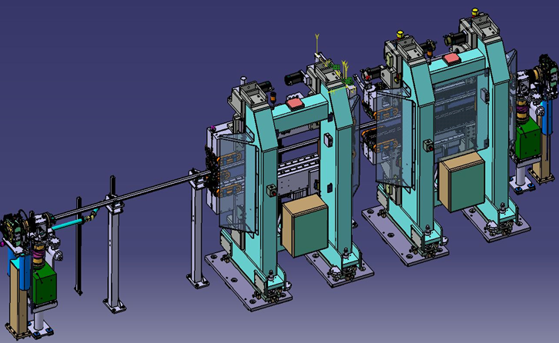
Insertion Device at SOLEIL: Polarized Insertion Devices
 | SOLEIL
 | Straight Section | Insertion Device
LUCIA | SDM16 | HU52
PSICHE | SDC03 | IVW50
PLEIADES | SDM04 | HU80 - HU256
DEIMOS | SDM07 | HU52 - EMPHU65
PUMA | SDM06 | W164
CRISTAL | SDC06 | CPMU18
GALAXIES | SDC07 | IVU20
TEMPO | SDM08 | HU80 - HU44
DESIRS | SDL05 | HU640
HERMES | SDM10 | HU64 - HU42
PXI | SDC10 | IVU20
PXII | SDM11 | IVU24
SWING | SDC11 | IVU20
ANTARES | SDM12 | HU60 - HU256
ANATOMIX | SDL13 | CPMU18
NANOSCOPIUM | SDL13 | CPMU18
SEXTANTS | SDM14 | HU80 - HU44
SIXS | SDC14 | IVU20
SIRIUS | SDC15 | HU36
CASSIOPEE | SDM15 | HU60 - HU256
6.6 m
1.8 m
1.8 m
Medium Straight Section → Up to 2 insertion devices

Slide 6
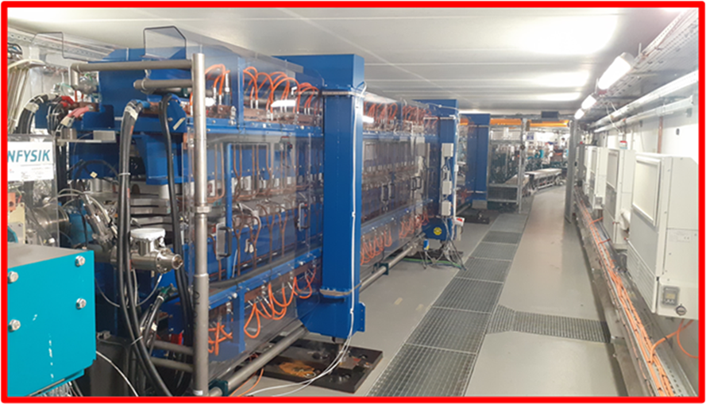
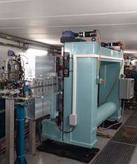
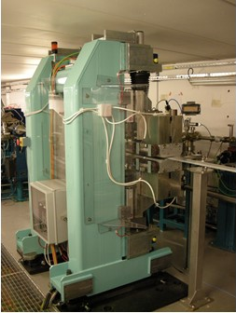
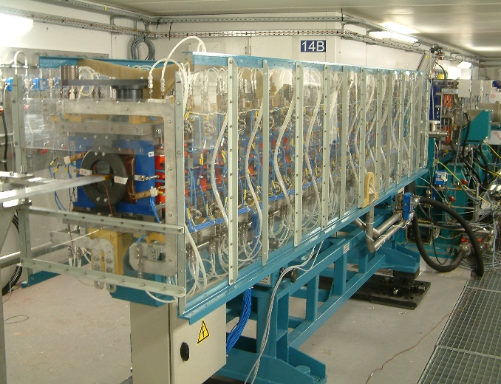
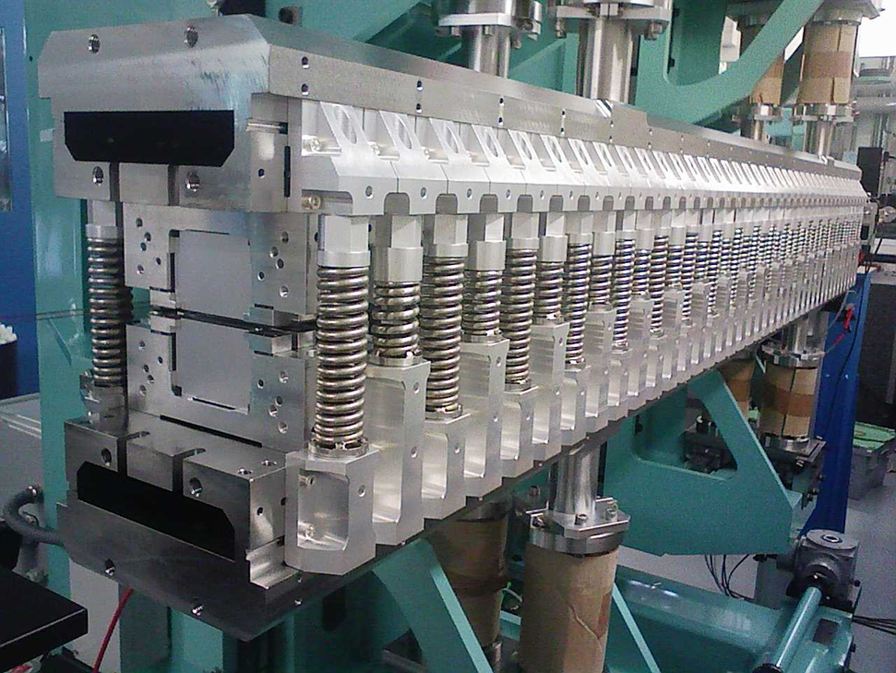
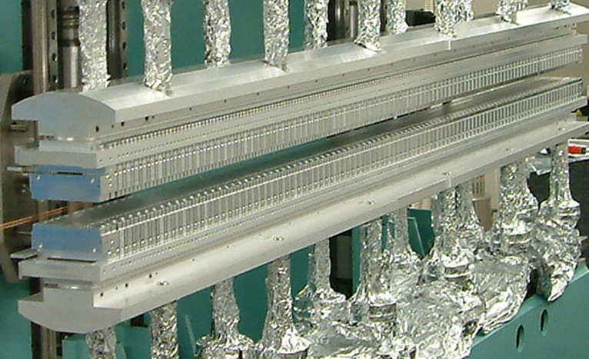
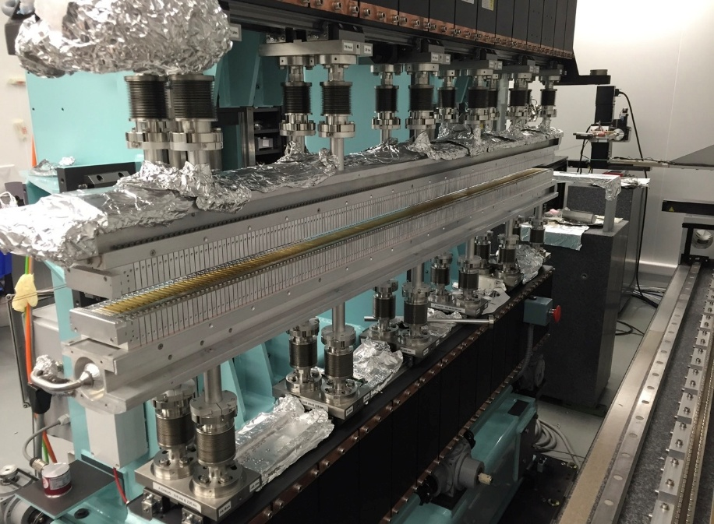
Insertion Device at SOLEIL
HU640
W164
APPLE II
HU256
IVU
CPMU18
IVW50

Slide 7
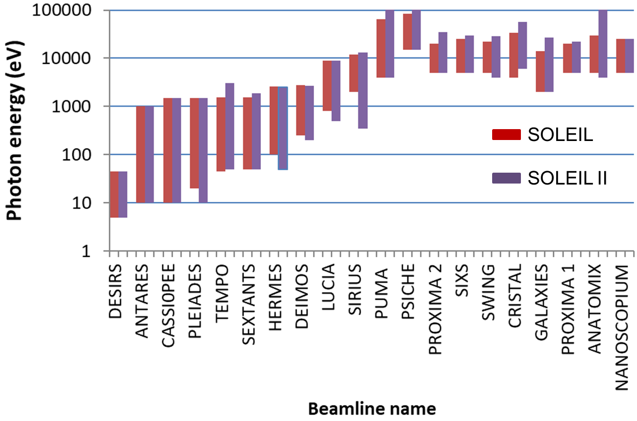
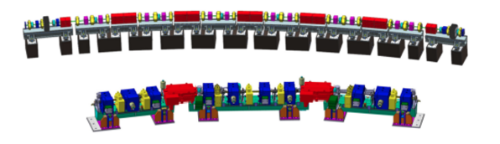
From SOLEIL to SOLEIL II: Straight Section length
SOLEIL II
Objective:
→Increase of the Brightness
(2 orders of magnitude)
→Decrease of the horizontal emittance
from 3.9 nm.rad to 85 pm.rad
→Strong Increase of the number of guiding equipments (Dipoles, Qpoles, Spoles …)
Spectral domain
Straight Section | SOLEIL | SOLEIL II | Unit
Long | 11.6 | 8 | m
Medium | 6.6 | 4.26/3.8 | m
Short | 3.6 | 3.1 | m
TOTAL | 128 | 90 | m
Ratio to circumference | ~40 | ~25 | %
SOLEIL II lattice
SOLEIL lattice

Slide 8
From SOLEIL to SOLEIL II: ID Phase1 (P1)
 | SOLEIL |  | SOLEIL II
 | Straight Section | Insertion Device | Straight Section | Insertion Device P1
LUCIA | SDM16 | HU52 | SD03C | IVU24
PSICHE | SDC03 | IVW50 | SD04C | IVW50
PLEIADES | SDM04 | HU80 - HU256 | SD05MC | HU60
DEIMOS | SDM07 | HU52 - EMPHU65 | SD06L | DUAL HU52 - EMPHU65
PUMA | SDM06 | W164 | SD07MC | IVU20
CRISTAL | SDC06 | CPMU18 | SD08C | CPMU18
GALAXIES | SDC07 | IVU20 | SD09C | IVU20
TEMPO | SDM08 | HU80 - HU44 | SD10ML | DUAL HU44 - HU80
DESIRS | SDL05 | HU640 | SD11L | APU250
HERMES | SDM10 | HU64 - HU42 | SD12ML | DUAL HU42 - HU64
PX-ID | SDC10 | IVU20 - IVU24 | SD13C | IVU20
SWING | SDC11 | IVU20 | SD14C | IVU20
ANTARES | SDM12 | HU60 - HU256 | SD15MC | HU80
ANATOMIX | SDL13 | CPMU18 | SD16L | CPMU18
NANOSCOPIUM | SDL13 | CPMU18 | SD16L | CPMU18
SEXTANTS | SDM14 | HU80 - HU44 | SD17MC | AX42
SIXS | SDC14 | IVU20 | SD18C | IVU20
SIRIUS | SDC15 | HU36 | SD19C | HU36
CASSIOPEE | SDM15 | HU60 - HU256 | SD20ML | DUAL HU44 - HU130
 |  |  |  | 3 New Insertion Devices
 |  |  |  | Start of SOLEIL II: mid2030
 | underline = | To be re-installed | bold = | To be constructed
Phase 1: Start of SOLEIL II
3 new insertion devices
All BL start with synchrotron radiation
  Some BL:with only 1 ID
  Some BL start with 2 IDs
Re-use of the majority of existing IDs:
  Polarized IDs: DUAL solution
  IVU-IVW-CPMU
    Gap: 5.5 mm →4.5 mm
    Minor mechanical changes

Slide 9
From SOLEIL to SOLEIL II: ID Phase1 (P1) and Phase 2 (P2)
 | SOLEIL |  | SOLEIL II
 | Straight Section | Insertion Device | Straight Section | Insertion Device P1 | Insertion Device P2
LUCIA | SDM16 | HU52 | SD03C | IVU24 | IVU24
PSICHE | SDC03 | IVW50 | SD04C | IVW50 | CPMW
PLEIADES | SDM04 | HU80 - HU256 | SD05MC | HU60 | AX63
DEIMOS | SDM07 | HU52 - EMPHU65 | SD06L | DUAL HU52 - EMPHU65 | DUAL HU52 - EMPHU65
PUMA | SDM06 | W164 | SD07MC | IVU20 | CPMU*
CRISTAL | SDC06 | CPMU18 | SD08C | CPMU18 | CPMU18
GALAXIES | SDC07 | IVU20 | SD09C | IVU20 | CPMU*
TEMPO | SDM08 | HU80 - HU44 | SD10ML | DUAL HU44 - HU80 | DUAL HU40-HU70
DESIRS | SDL05 | HU640 | SD11L | APU250 | APU250
HERMES | SDM10 | HU64 - HU42 | SD12ML | DUAL HU42 - HU64 | DUAL HU42 - HU64
PX-ID | SDC10 | IVU20 - IVU24 | SD13C | IVU20 | CPMU*
SWING | SDC11 | IVU20 | SD14C | IVU20 | CPMU*
ANTARES | SDM12 | HU60 - HU256 | SD15MC | HU80 | DUAL HU60 – HU90
ANATOMIX | SDL13 | CPMU18 | SD16L | CPMU18 | CPMU18
NANOSCOPIUM | SDL13 | CPMU18 | SD16L | CPMU18 | CPMU18
SEXTANTS | SDM14 | HU80 - HU44 | SD17MC | AX42 | CPMUE38
SIXS | SDC14 | IVU20 | SD18C | IVU20 | CPMU*
SIRIUS | SDC15 | HU36 | SD19C | HU36 | AX38
CASSIOPEE | SDM15 | HU60 - HU256 | SD20ML | DUAL HU44 - HU130 | DUAL HU44 - HU130
 | underline = | To be re-installed | bold = | To be constructed
Phase 2: towards full Perf.
All existing IDs will be
progressively replaced
CPMU: Period to be optimized

Slide 10
Re-use of existing polarized undulators:
DUAL solution
Undulators for DEIMOS Beamline
Undulators of HERMES Beamline
Undulators of TEMPO beamline

Slide 11
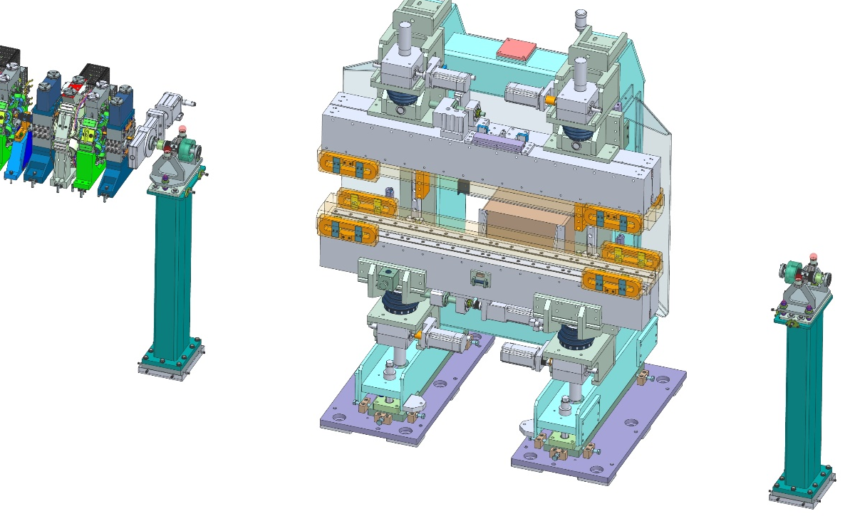
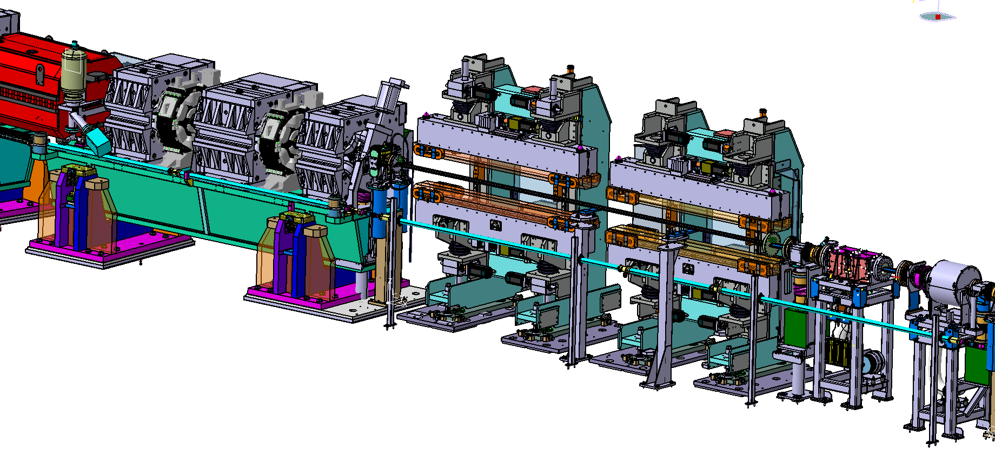
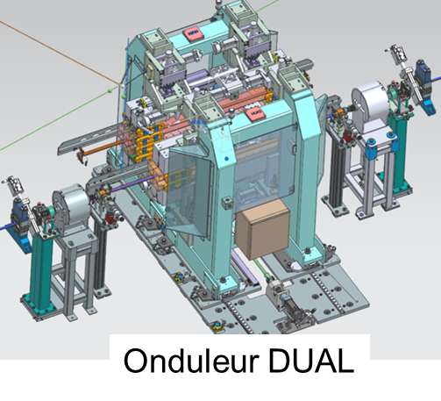
Implementation on Medium Straight Section
Undulator
« single »
SOLEIL II
SOLEIL
1.8 m
1.8 m
3.8/4.26 m
DUAL Undulator
6.6 m

Slide 12
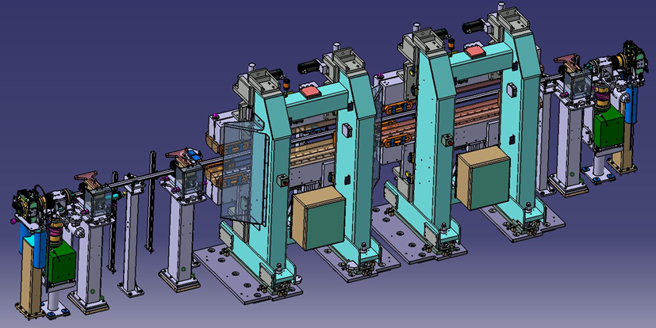
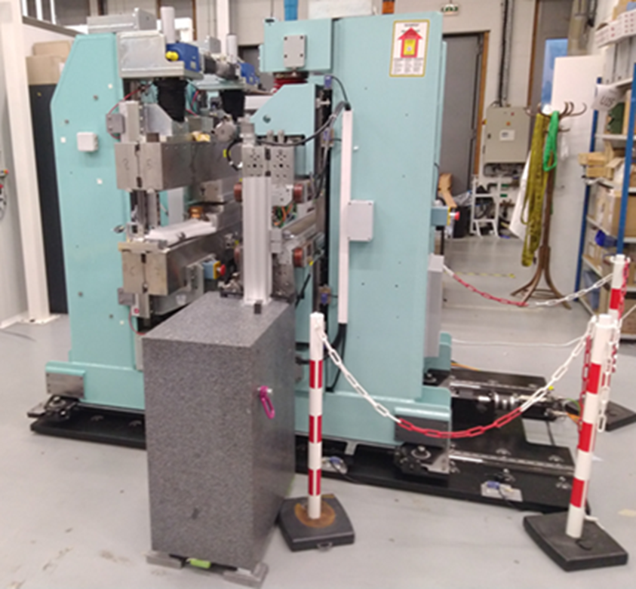
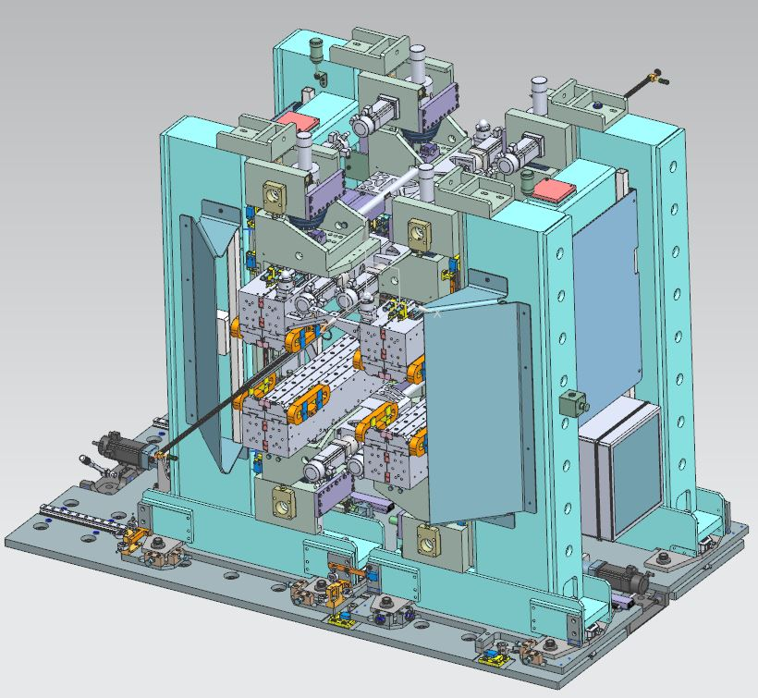
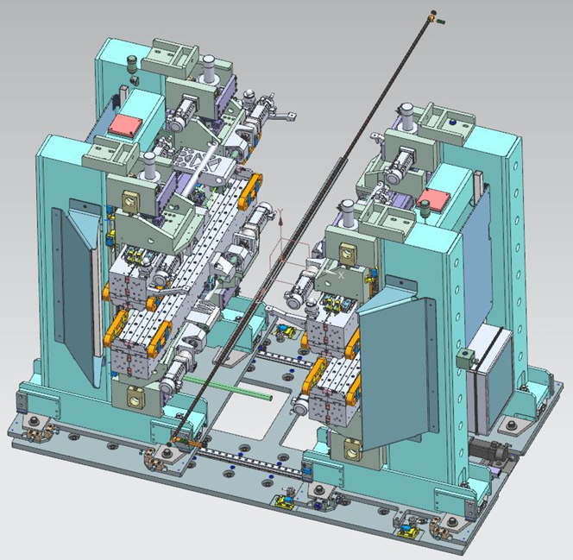
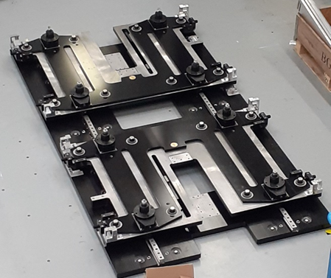
DUAL undulators
Development of plateform:
  For existing ID
  For new ID in a next step
Reproducibility of transverse re-positionning:
  Horizontal: 10 µm
  Vertical: 6 µm
Ground vibrations during motorized switch bw IDs
  Longitudinal: 200 nm
  Vertical: 40 nm
Motorized DUAL Plateform
2.5 m
In memory of Fabien …
Operation mode
Parking mode

Slide 13

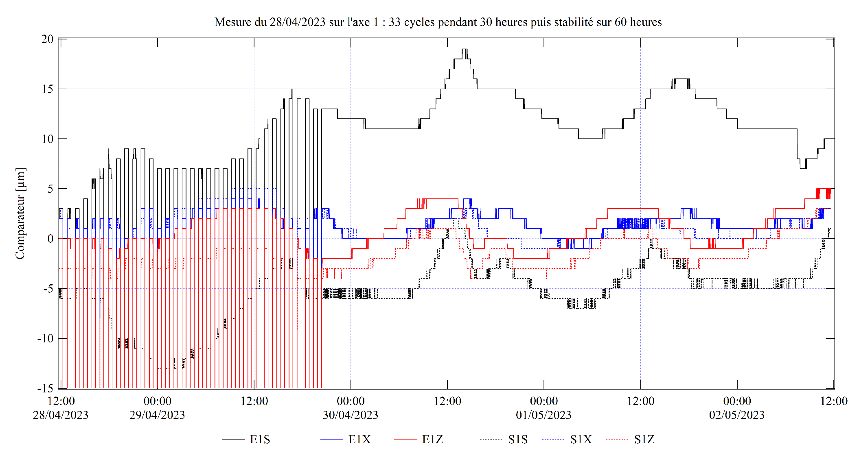
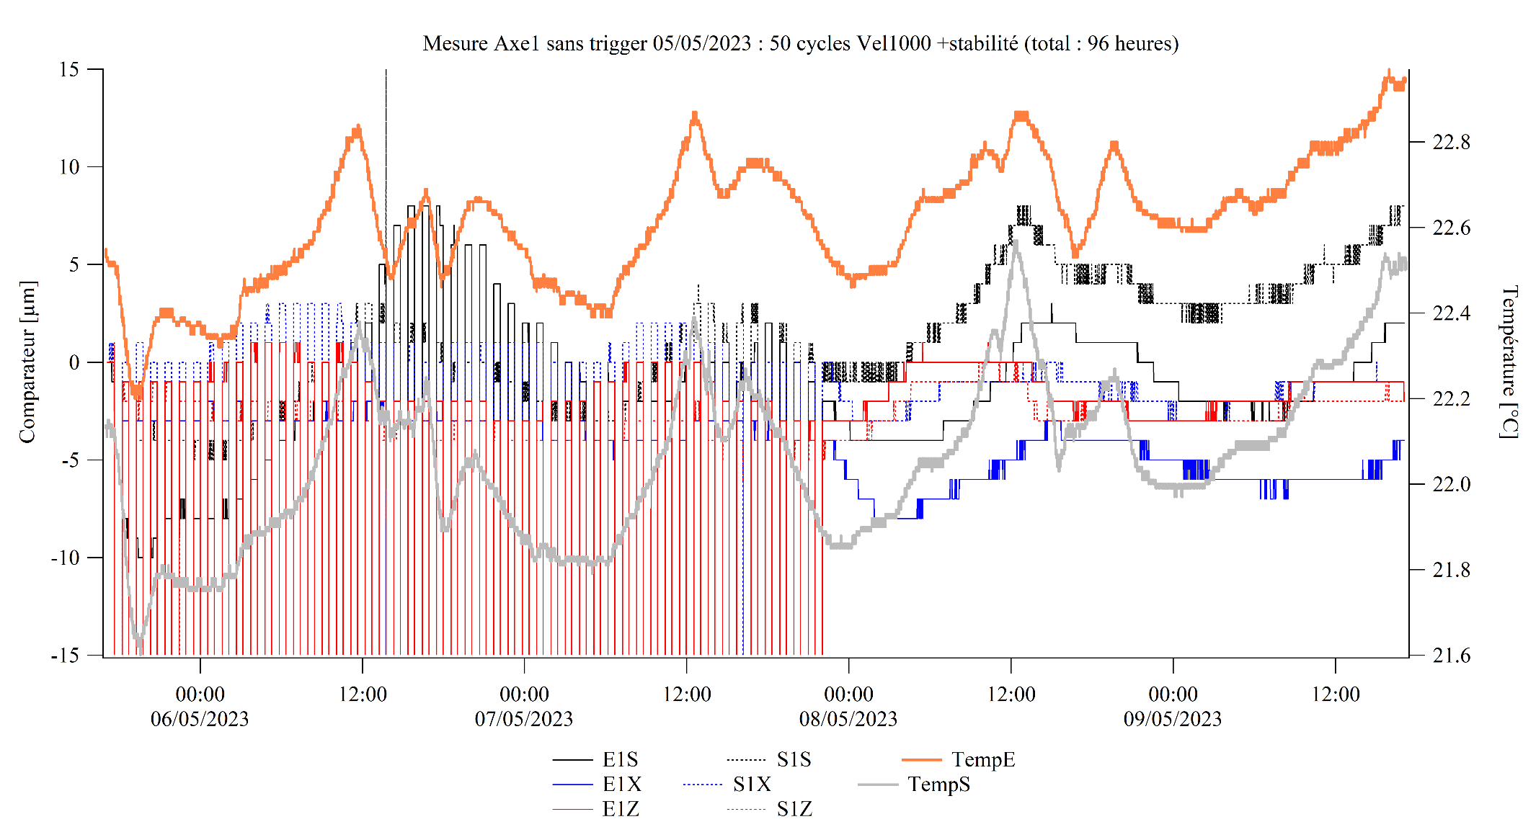
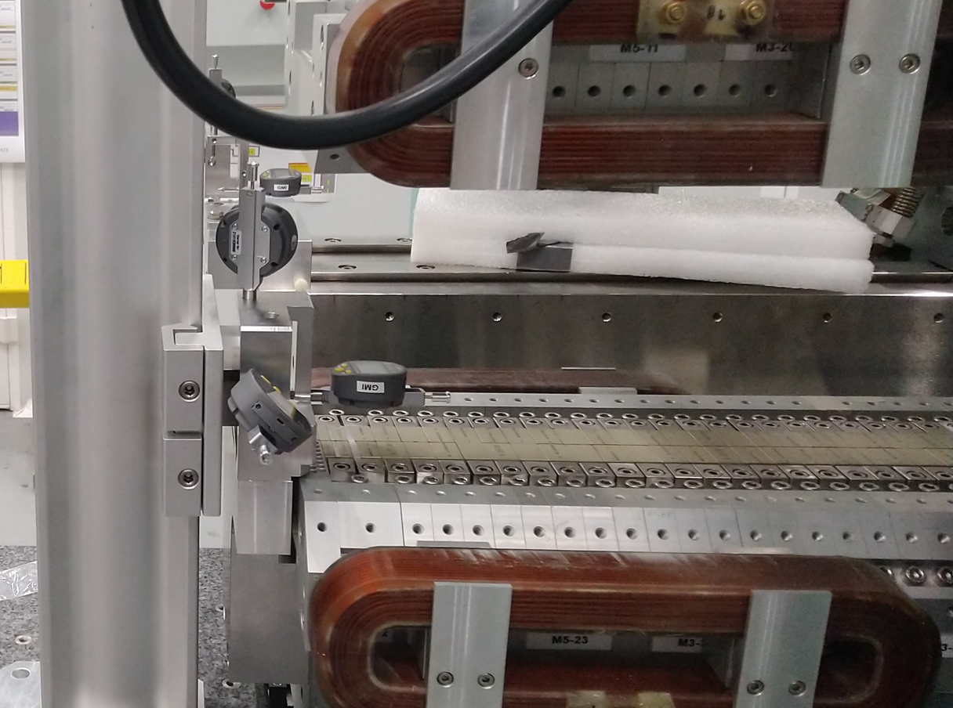
ID positionning
REPRODUCIBILITY AND STABILITY DURING 96 HOURS
50 CYCLES OF 1H00
33 CYCLES OF 1H00
Excursion (µm)
NO CYCLE
NO CYCLE
F. Briquez, M. Sebdaoui / SOLEIL
F. Briquez, F. Blache, M. Sebdaoui, B. Luluan

Slide 14
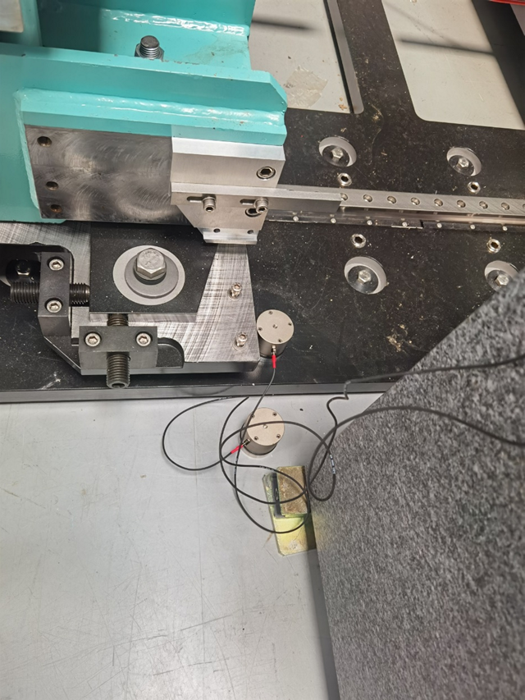
Vibrations during ID Switch
Fréquence (Hz) | Longitudinal displacement (µm)
285 | 0,036
352 | 0,015
375 | 0,011
202 | 0,015
228 | 0,013
251 | 0,011
152 | 0,018
401 | 0,006
135 | 0,010
142 | 0,008
42 | 0,024
88 | 0,007
Frequency (Hz) | Vertical displacement (µm)
277 | 0,170
407 | 0,082
43 | 0,139
228 | 0,026
91 | 0,031
173 | 0,016
133 | 0,020
84 | 0,030
Accelerometers
Z. Fan

Slide 15
Three New Insertion Devices
APU250 for DESIRS beamline
DUAL HU130-HU44 for CASSIOPEE beamline
APPLE X for SEXTANTS beamline

Slide 16
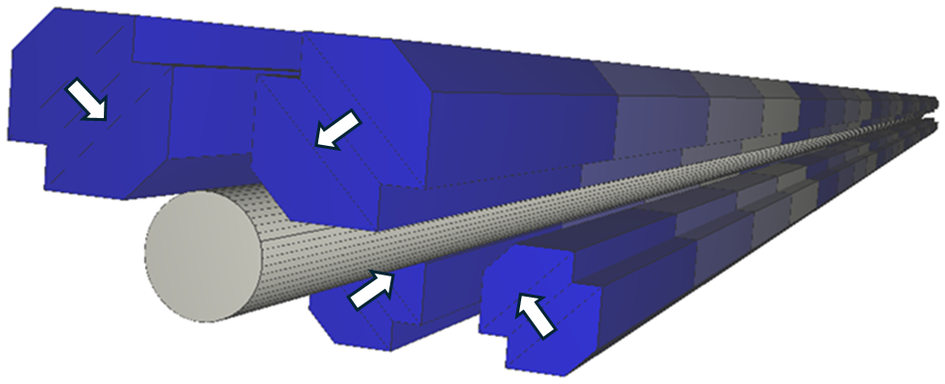
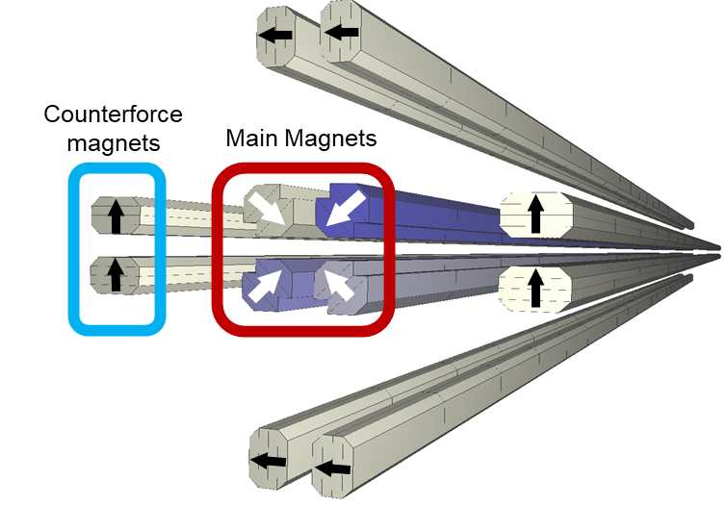
APU250* for DESIRS II Beamline : Phase dependant operation
Main system
Parameters | Values | Unit
Period number | 20 | -
Magnetic period | 250 | mm
Permanent magnets | NdFeB | -
Magnetization | 1.37 | T
Max. magnetic field | 0.46 | T
Spectral Domain | 5 - 40 | eV
Polarisation modes | All | -
11 mm
11 mm
Magnetic force reduction
Photon energy and polarization state changed
With dephasing of magnet arrays
Counterforce magnet: force reduction → 4 to 8
*: Carr. (1992). Design study for an adjustable phase undulator. Review of Scientific Instruments, 347-351.
25 mm

Slide 17
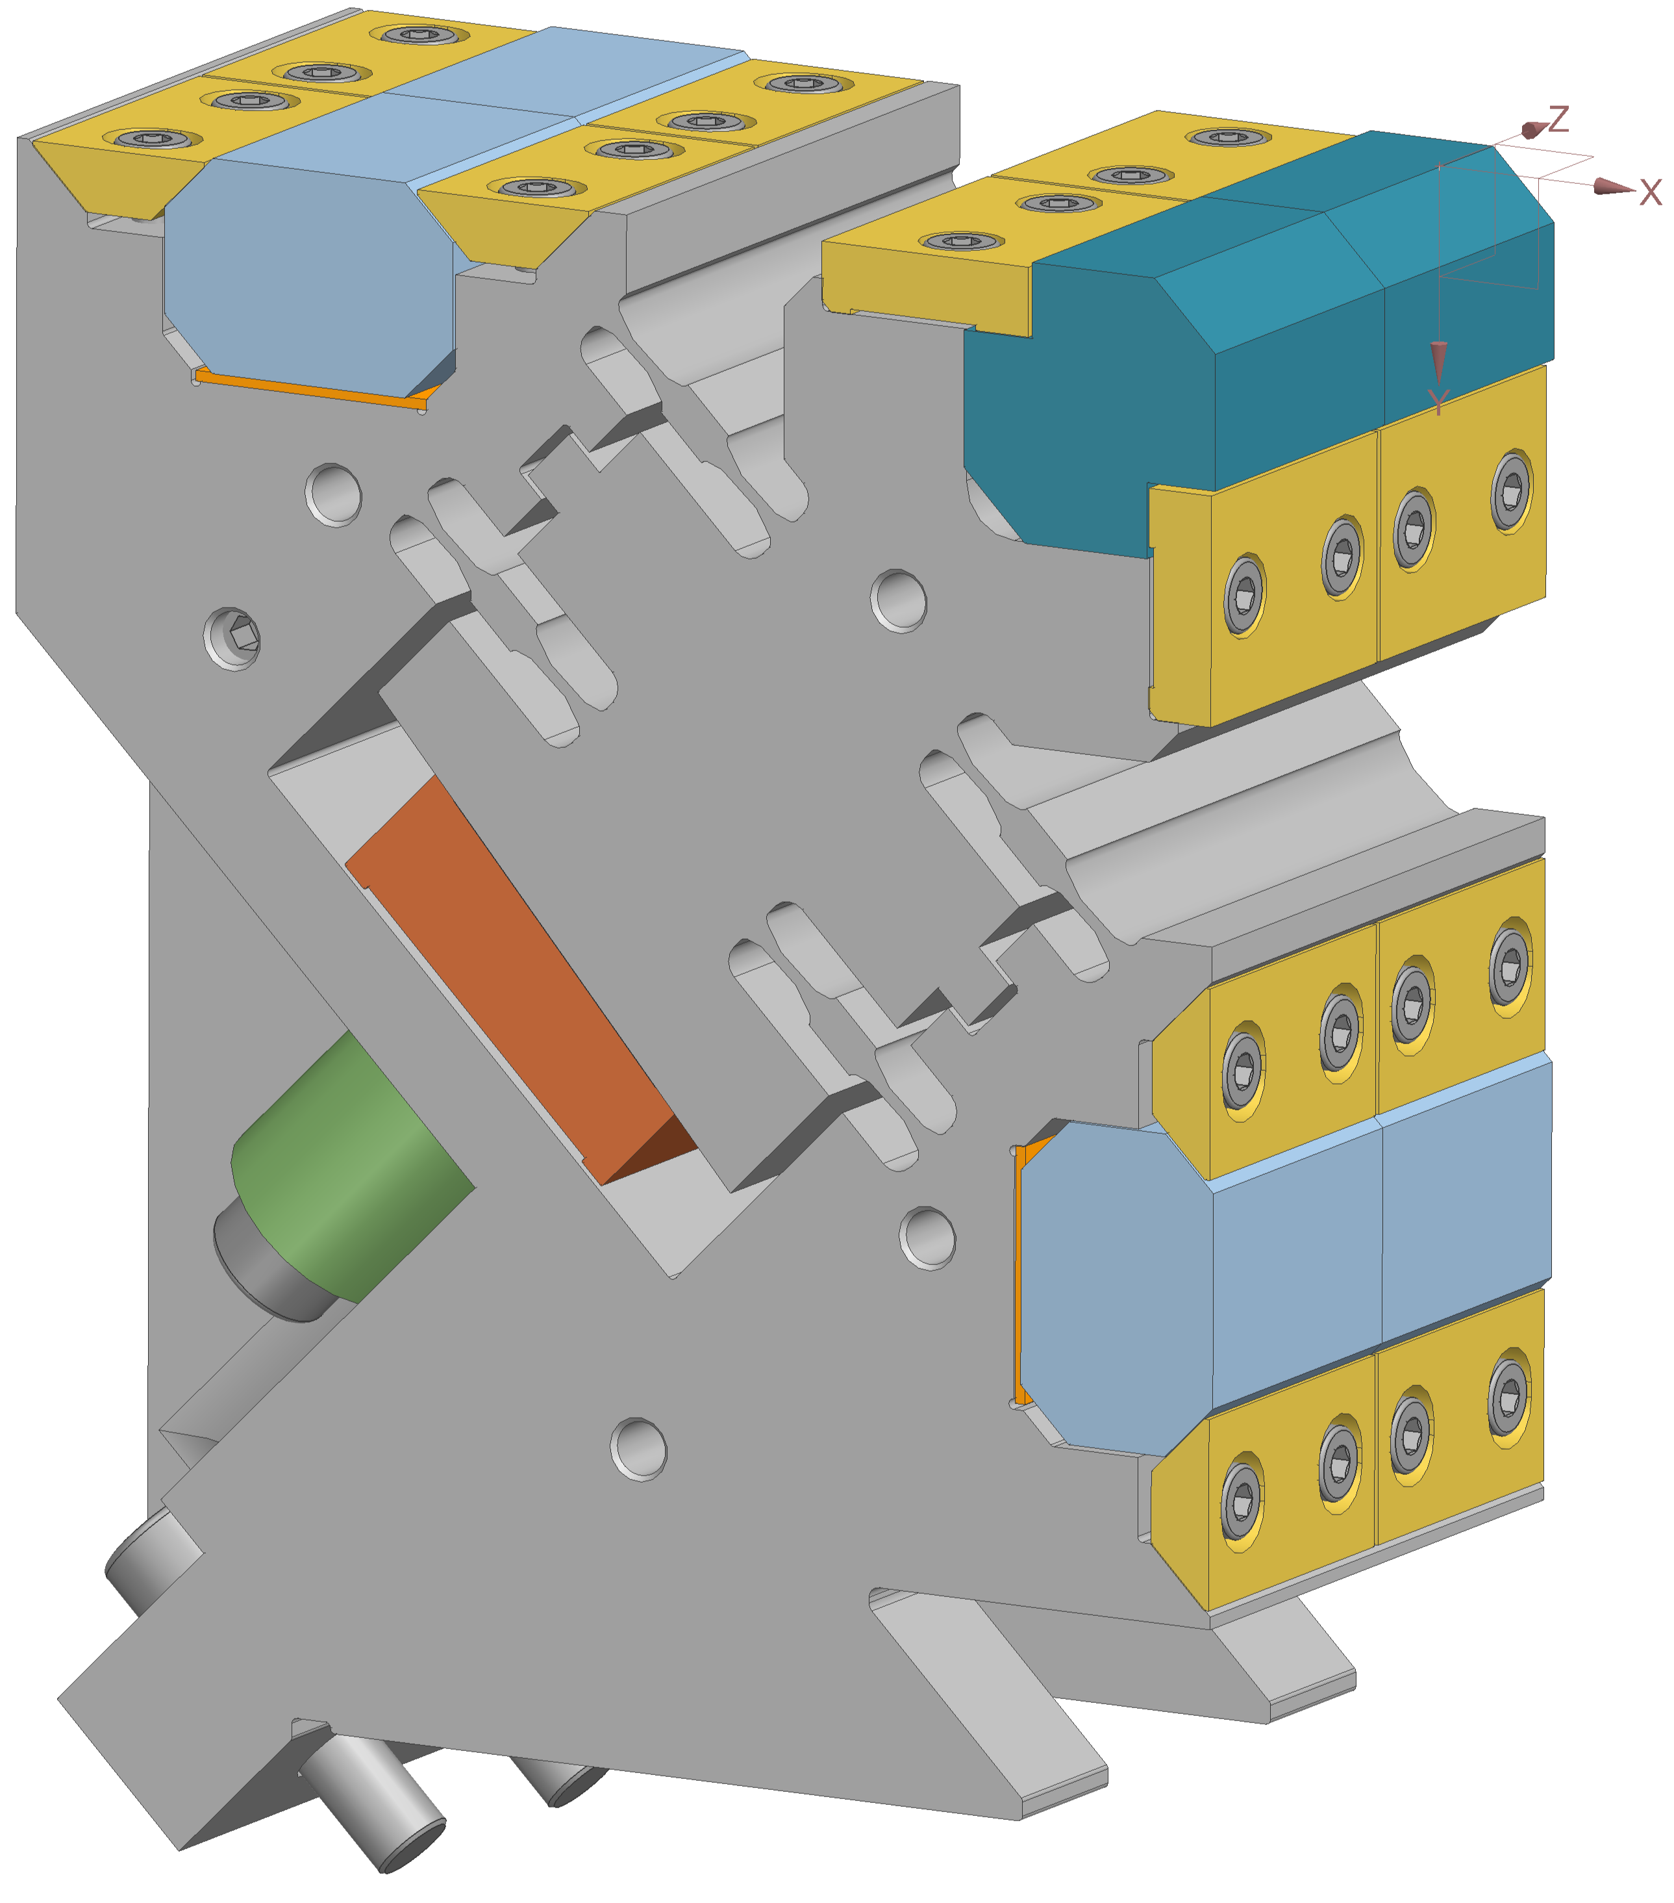
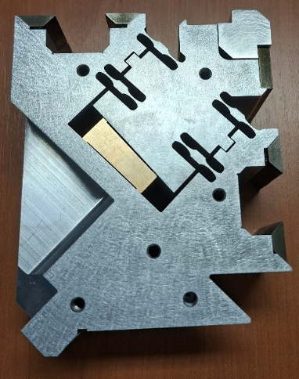
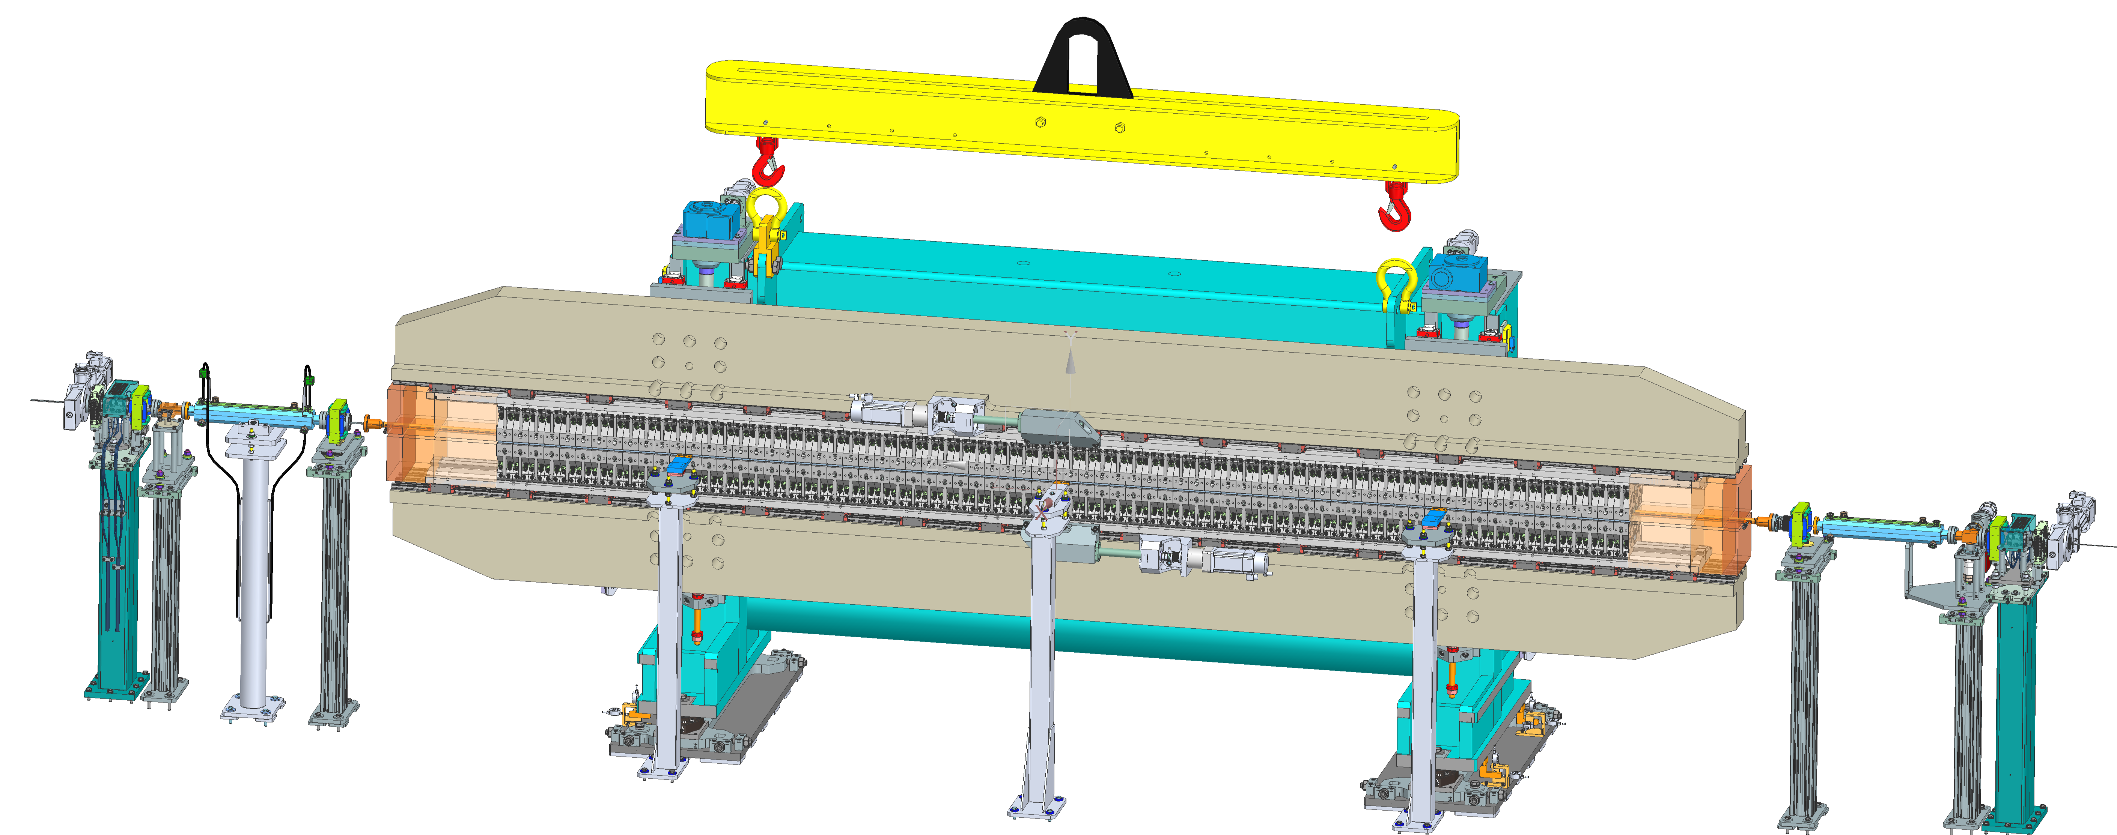
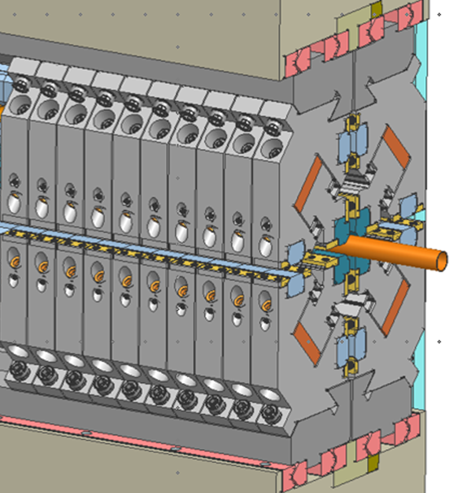
APU250 for DESIRS II Beamline: Mechanical design
Prototype of magnets support wire-machined at SOLEIL
150 magnets in fabrication for 3-period prototype using
  « Conventional » magnets by MAGSOUND (Ningbo, CHINA)
  Recycled magnets by MagREEsource (Grenoble, FRANCE)
  Sophie Rivoirard from MAGREESource will give more details in a dedicated talk
  → Check magnetic field, demagnetization and local deformation
S. Bonnin
5 m
A. Mary / A. Berlioux

Slide 18
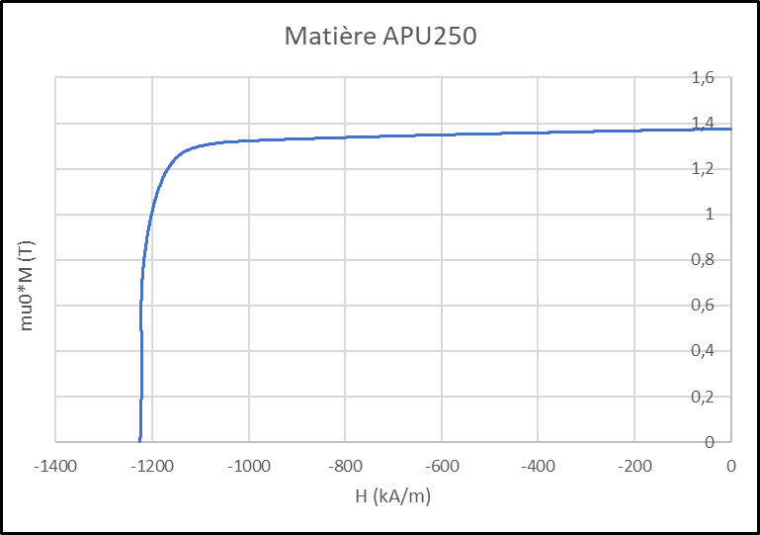
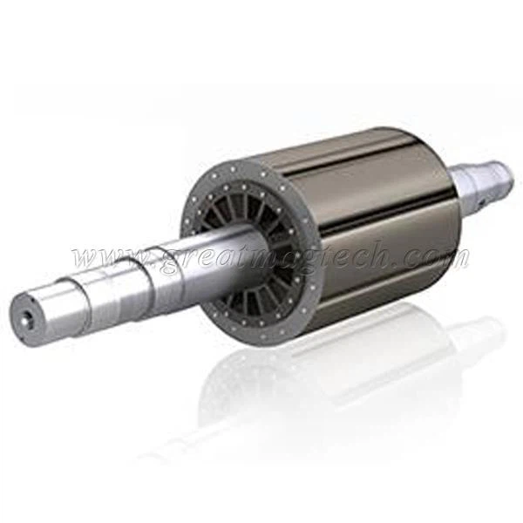
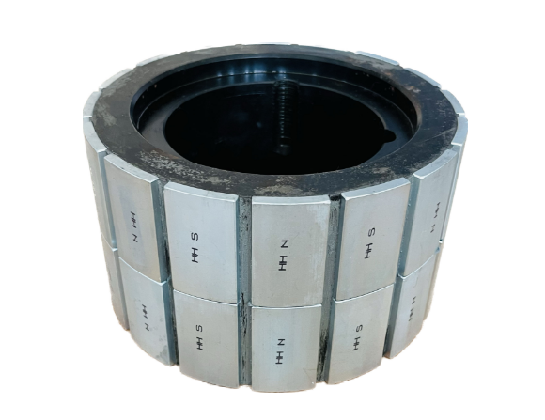
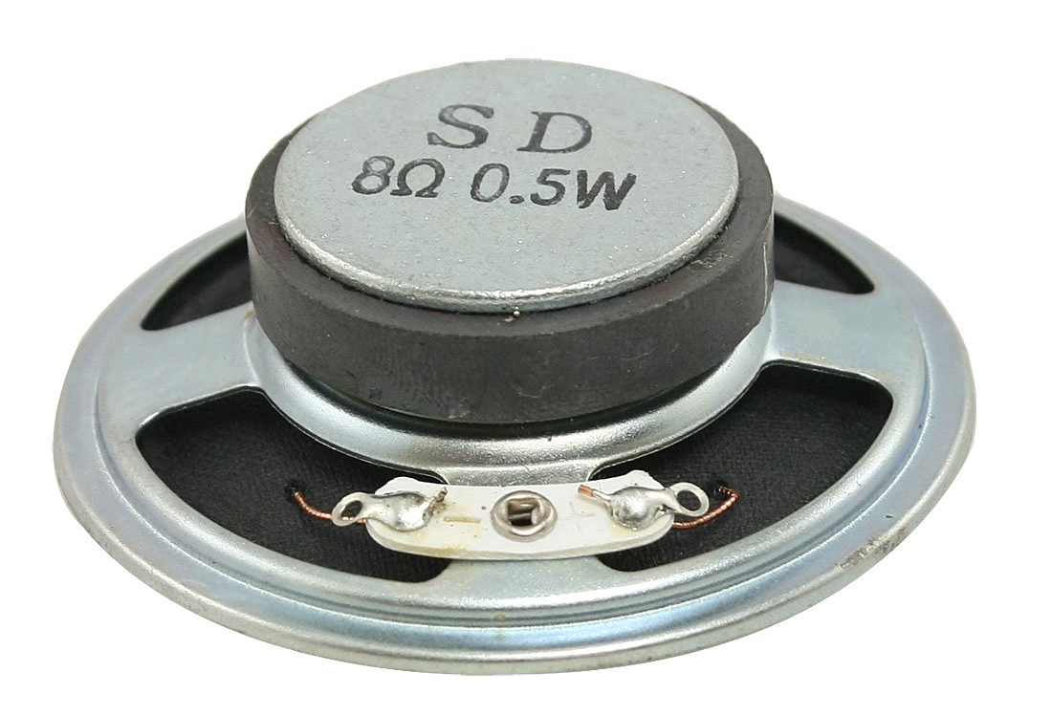
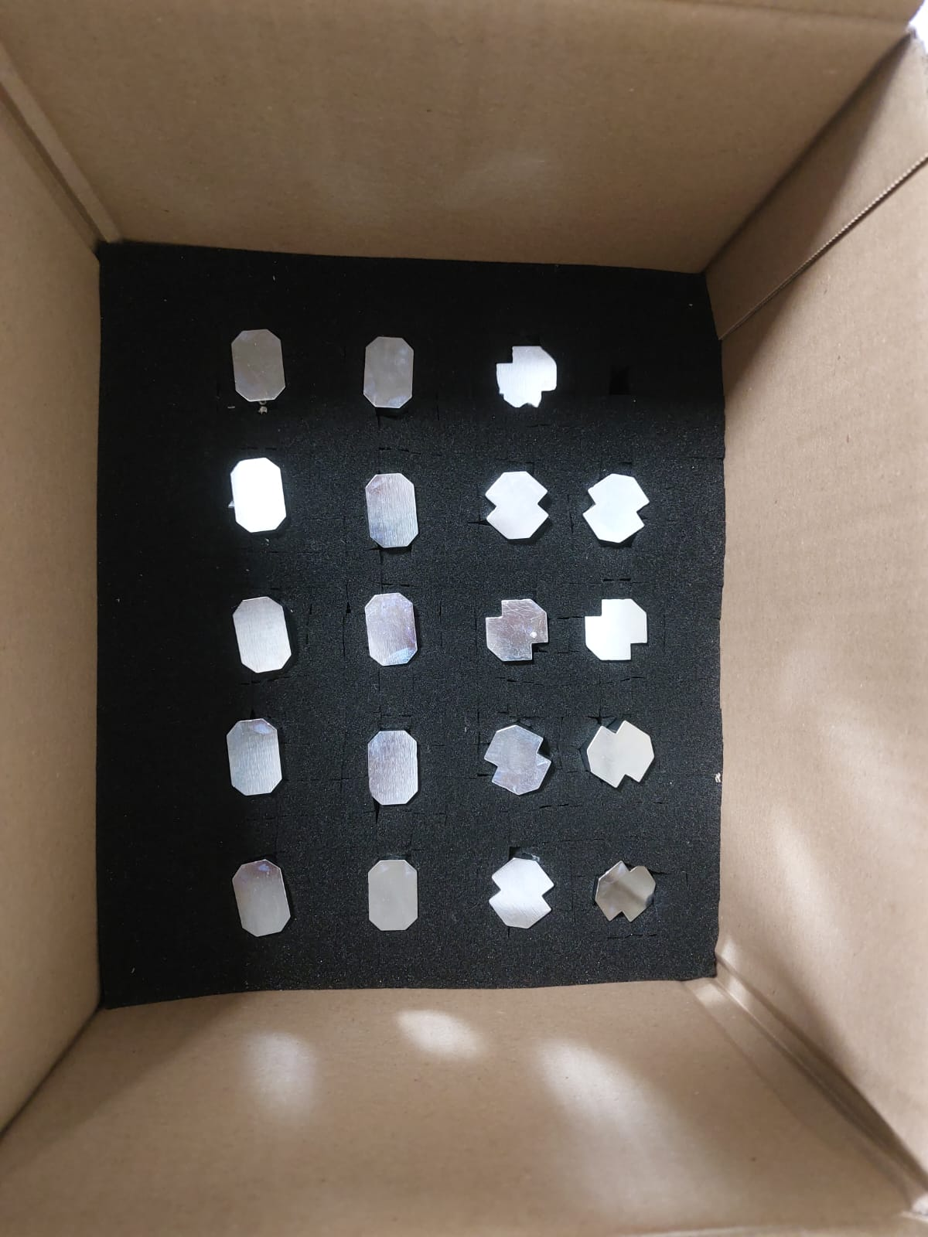
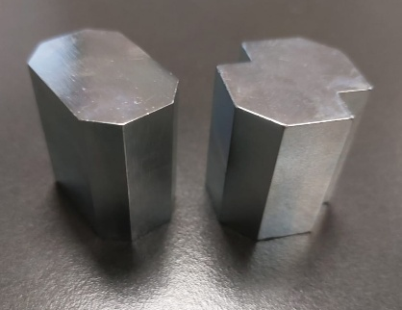
APU250 for DESIRS II Beamline: First Recycled Magnets
Sample | Matière APU250
Date | 24/03/2026
Temperature (°C) | 21,3
Applied magnetic field (T) | 5,0
Volume (mm3) | 1582
Shape | disk
N | 0,44
Q_dBtail | 3,8
Density | 7,50
Br (T) | 1,375
Mmax (T) | 1,449
HcB (kA/m) | 1047
HcJ (kA/m) | 1225
(BH)max (kJ/m3) | 364
(BH)max (MGOe) | 45,7
SQknee | 0,94
Grade | N45M
MagREESource
Main Magnets
Counterforce Magnets
Zn coating

Slide 19
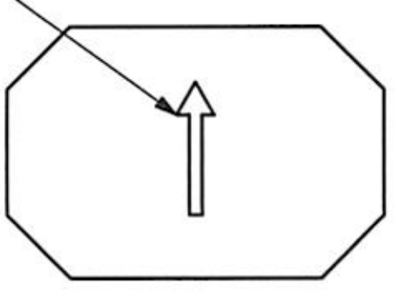
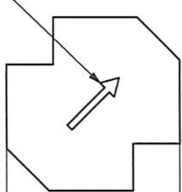
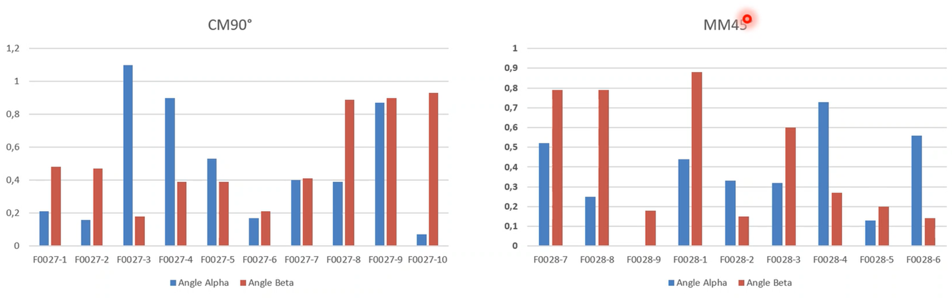
APU250 for DESIRS II Beamline: First Recycled Magnets
Magnetization angle < 1°
M
Alpha
Counterforce magnet
Main magnet
Beta
MagREESource

Slide 20
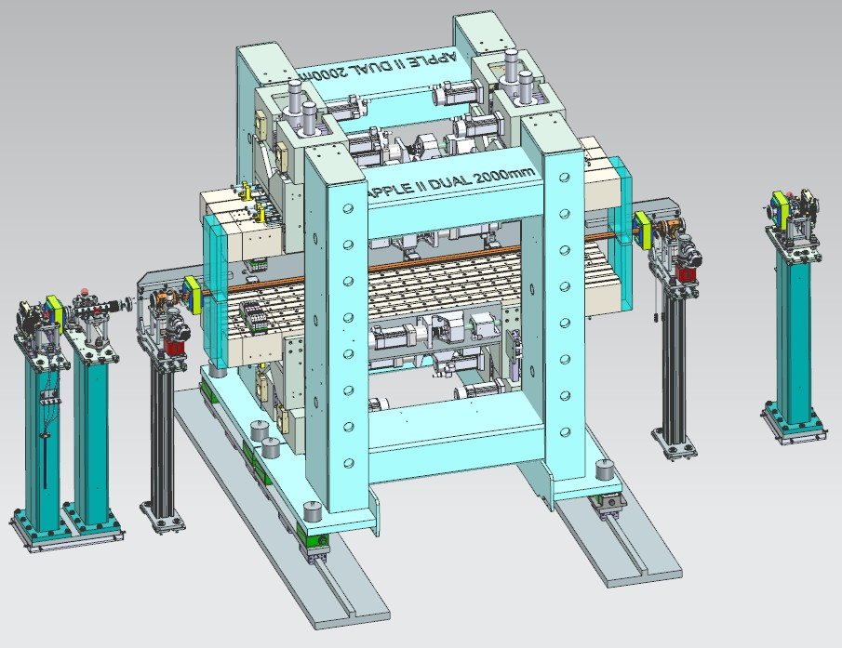
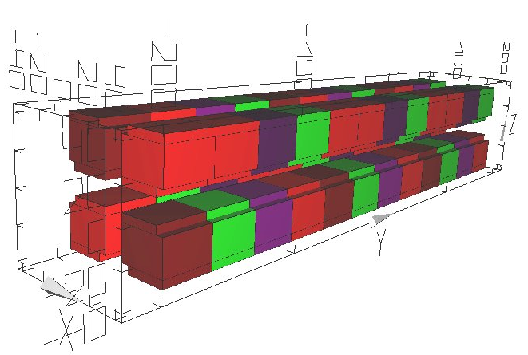
DUAL HU130-HU44 for CASSIOPEE II Beamline
Parameters | HU130 | HU44 | Unit
Type | APPLE I | APPLE II | -
Period number | 15 | 45 | -
Magnetic period | 130 | 44 | mm
Permanent magnets | NdFeB | NdFeB | -
Magnetization | 1.32 | 1.32 | T
Max. magnetic field | 0,873 | 0.87 | T
Spectral Domain | 10 - 300 | 300 - 1500 | eV
Polarisation modes | LH/LV/LT/Circ | LH/LV/LT/Circ | -
DUAL
A. Lejollec
APPLE I
APPLE II
HU130
G_{z} = 14 mm
HU44
G_{z} = 12.5 mm
M. Valléau
G_{x} = 14 mm

Slide 21
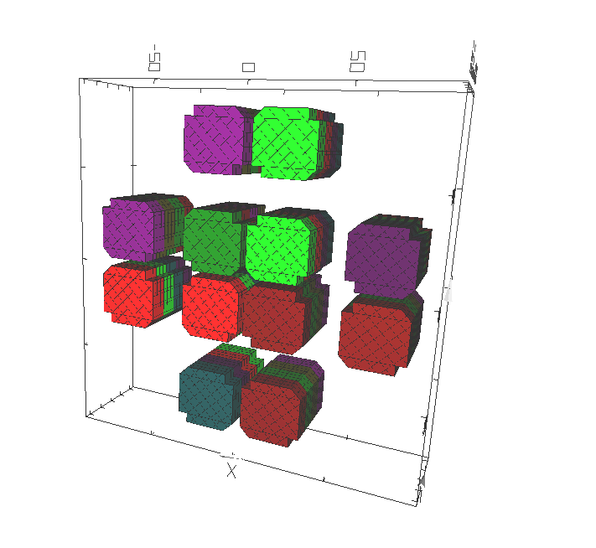

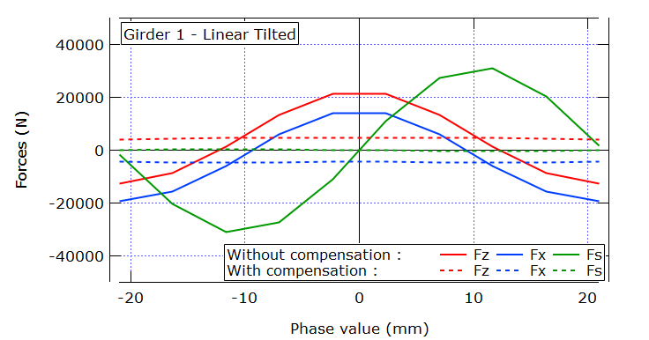
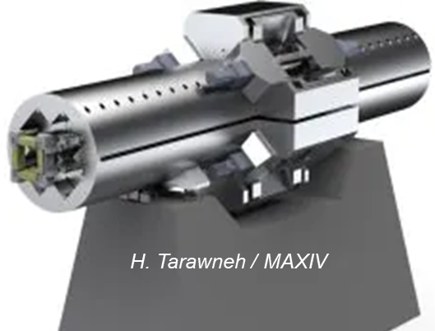
AX42 for SEXTANTS II Beamline
Parameters | Values | Unit
Period number | 47 | -
Magnetic period | 42 | mm
Permanent magnets | NdFeB | -
Magnetization | 1.37 | T
Max. magnetic field | 1,156 | T
Spectral Domain | 150 - 1800 | eV
Polarisation modes | LH/LV/LT/Circ | -
M. Valléau

Slide 22
IVU-CPMU at SOLEIL II
Technical changes
Towards shorter periods: CPMU12
Robotics developments

Slide 23
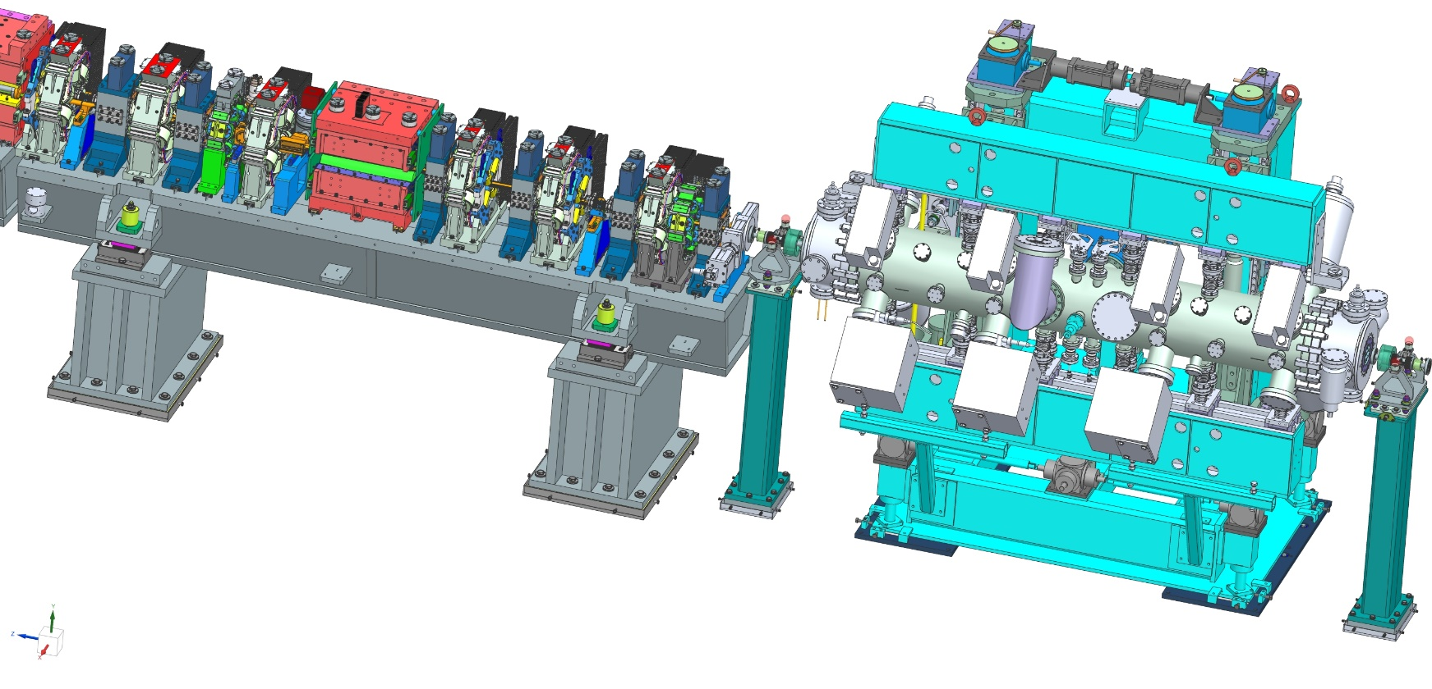

IMPLEMENTATION IN SHORT STRAIGHT SECTION
SOLEIL II
IVU/CPMU
SOLEIL
IVU/CPMU
2.378 m
3.1 m
Main issue
Space
Mechanical connexion
3.6 m

Slide 24





IVU/IVW/CPMU: TECHNICAL CHANGES
ID CORRECTOR | LENGTH (mm) | MAGNETIC FORCE (G.m) | MAGNETIC GAP (mm)
EXISTING | 100 | 5 | 100
UPGRADE | 50 | 5 | 50
Shorter ID correctors
Shorter valve
Compact system: BPM/bellows/ID correctors
Storage Ring-IVU interface to be changed
K. Tavakoli

Slide 25





Short period CPMU: CPMU12
Change of technical approach →Prototype: 1m long CPMU12 with 12 mm period in the frame of LEAPS INNOV
More details in Mathieu Valléau talk
Cu Super-module
S. Steel Super-module
Less time consumption
To install magnets
Single support
8-periods
M. Valléau / P. Berteaud / R. Baillier / S. Pautard / A. Berlioux / S. Bonnin

Slide 26




Robotics development
Objective: Automatization of repetitive tasks
Initial developments in 3 steps:
  Individual measurement of single modules
  Mounting of modules on girders
  Magnetic Corrections
Development for SuperModules
SuperModule measurement and tuning
3 laser arms
Hall probe
Single module measurements
Mechanical reference
26
L. Hernandez, M. Valléau
Magnet/Pole position
Magnet/Pole correction
Supermodule measurement
L. Hernandez, M. Valléau
L. Hernandez
M. Valleau
F. Briquez
More details in Mathieu Valléau talk

Slide 27
Conclusion
Overview of present insertion devices of SOLEIL
Three new insertion devices at the start of SOLEIL II
Re-use of IVU-IVW-CPMUs
Re-use of EPUs
Developments for SOLEIL II

Slide 28
Acknowledgements
Magnetism and Insertion Group
M.-E. Couprie, M. Valléau, P. Berteaud, F. Blache, R. Baillier, A. Esper, S. M. Khan, C. Kitégi, F. Marteau, T. Mutin, C. Tournier, J. Vétéran
Mechanical Engineering Group
S. Bonnin, A. Berlioux, A. Mary, S. Pautard, K. Tavakoli, Z. Fan
Electronic Group
L. Hernandez
Accelerators Physics Group
P. Brunelle, L. S. Nadolski
Beamline Scientists
F. Bertrand, P. Fertey, L. Nahon, N. Jaouen
THANK YOU FOR YOUR ATTENTION

