Slide 1
MAX 4^{U} Injector
Timing

Slide 2
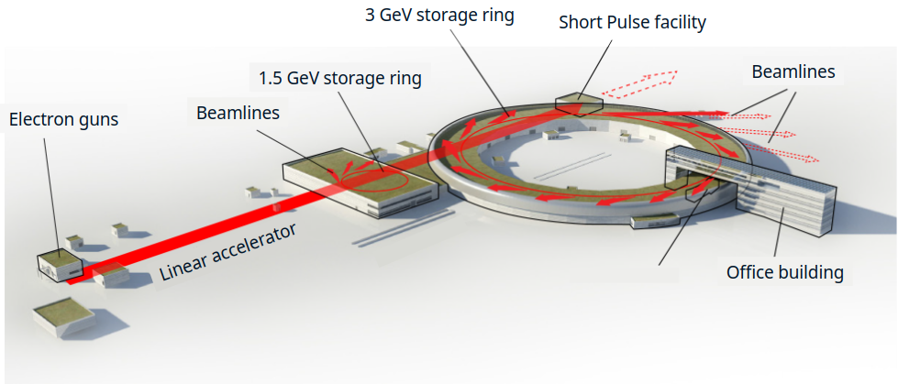
MAX IV Facility
Image courtesy of Sara Thorin
In the following, I occasionally make use of internal MAX-IV terminology:
“R1” => 1.5 GeV Ring
“R3” => 3.0 GeV Ring
“SPF => Short Pulse Facility

Slide 3
Year-to-date stats
1/1/2025 → 27/10/2025
Accelerator | Planned delivery | Total downtime | Uptime | MTTR | MTBF
1.5 GeV Ring | 4104 hours | 40.2 hours | 99.0% | 1.75 hours | 7.4 days
3.0 GeV Ring | 4104 hours | 133.5 hours | 96.8% | 2.90 hours | 3.7 days
SPF | 3816 hours | 103.38 hours | 97.3% | 0.24 hours | 8.8 hours

Slide 4
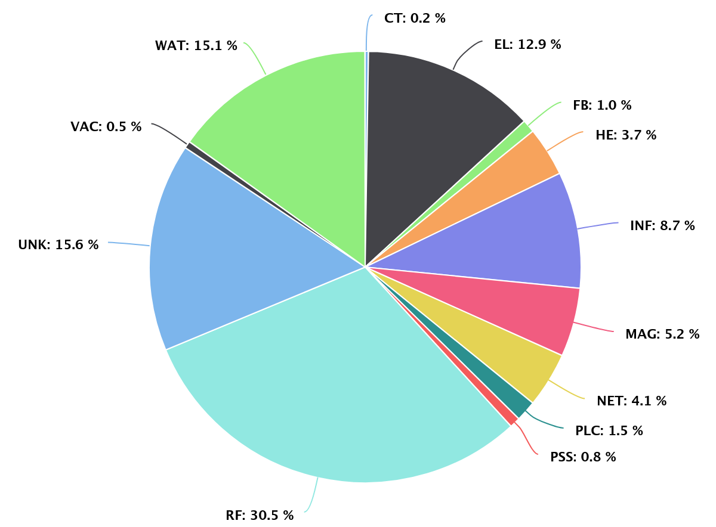
3.0 GeV Ring: Downtime codes
Water leak in magnet circuit caused during electrical work on a maintenance day. Lessons-learned resulted in replanning.
Failure of thermoswitches. Downtime extended due to difficulty in determining the cause.
A recent issue whereby we have a dump with no clear cause followed by significant issues reinjecting.
Under investigation this week.
Power loss to a critical cabinet with network switches. Old UPS batteries to blame. Labwide inventory of UPS’s being gathered.
Some other issues relating to magnet power supplies.
Klystron for the thermionicgun failed.
Photocathode gun was not yet ready for use as a replacement.
Significant progress has been made in this since then.
An unannounced change in the pressure from our cooling provider resulted in repeated RF failures.
Robust discussions underway with supplier

Slide 5
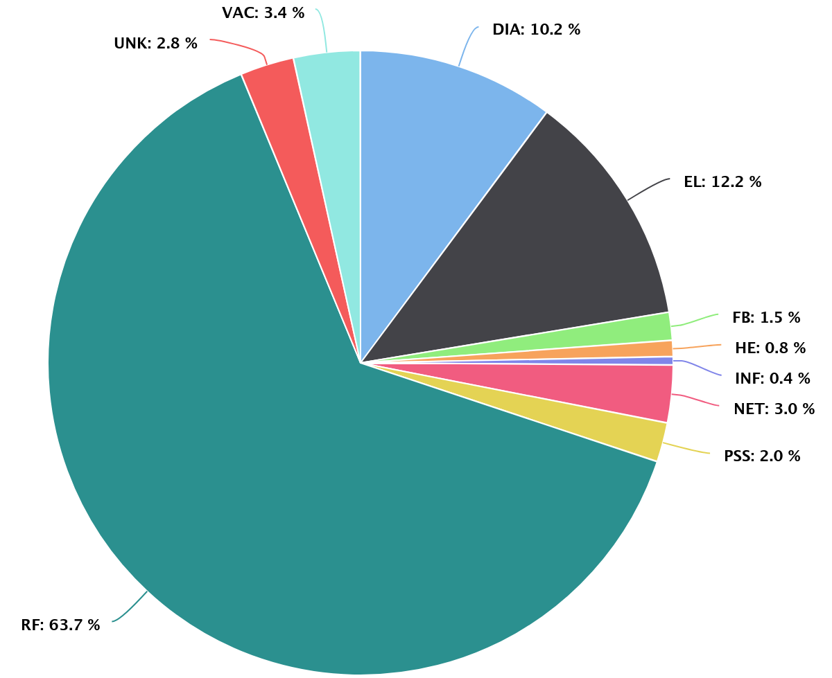
Causes of downtime: 1.5 GeV ring
Failure of controls for BPMs in one achromat.
Klystron for the thermionic gun failed.
Beam was not lost, but decayed below the downtime-limit.
Photocathode gun was not yet ready for use as a replacement.
Significant progress has been made in this since then.
Power loss to a critical cabinet with network switches. Old UPS batteries to blame.
Labwide inventory of UPS’s being gathered.

Slide 6
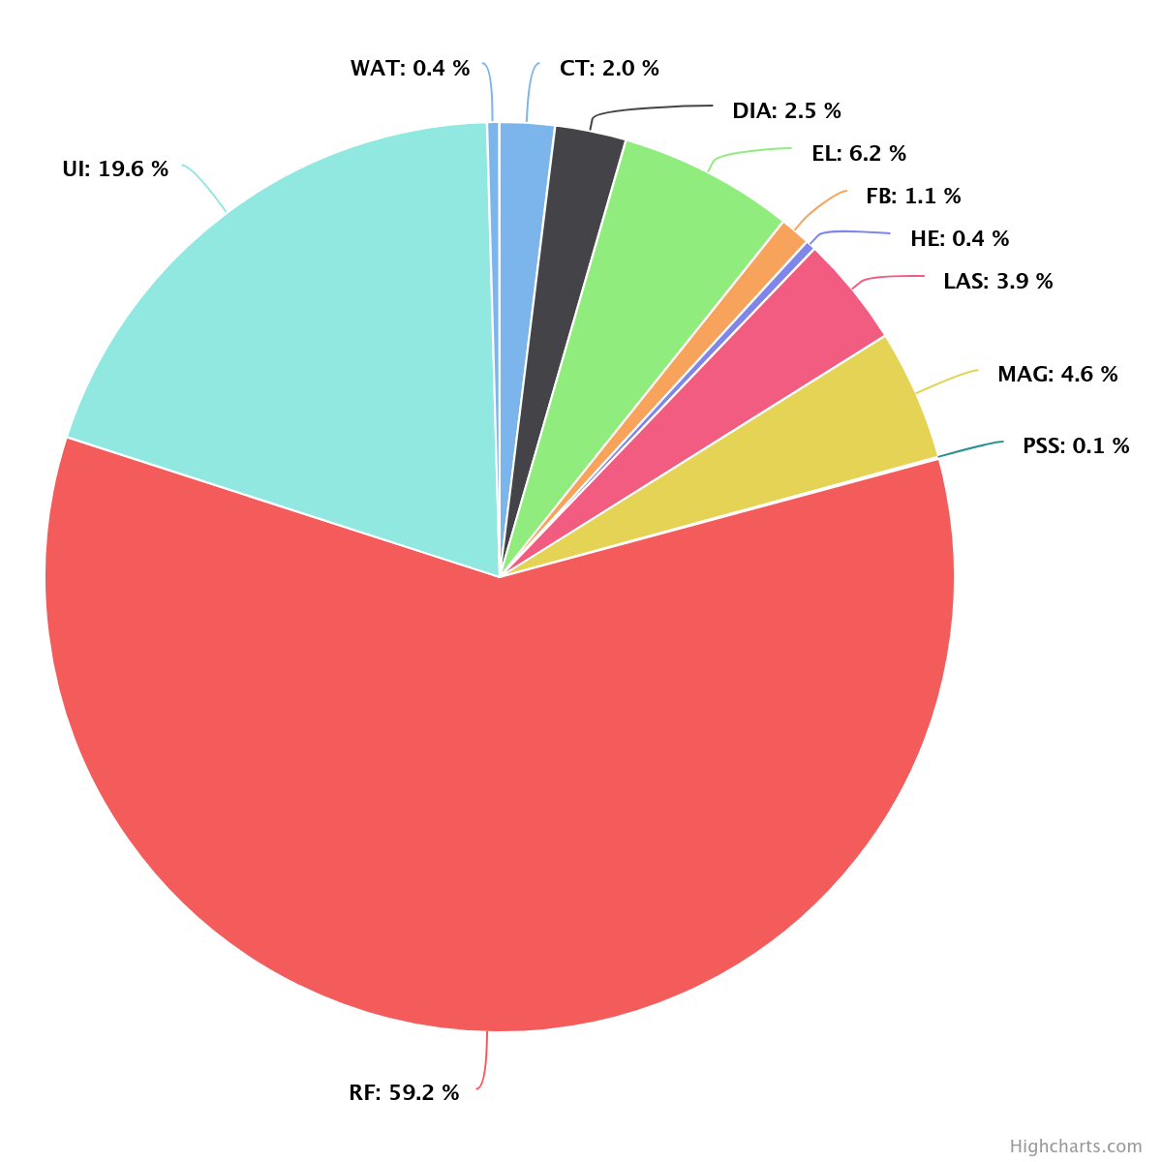
Causes of downtime: SPF
UI ("unscheduled injection") occurs due to recovery from beam-losses in the rings.
Power loss to a critical cabinet with network switches. Old UPS batteries to blame.
Labwide inventory of UPS’s being gathered.
Klystron for the thermionic gun failed.
No delivery due to ongoing efforts to use photocathode gun for ring injection.

Slide 7
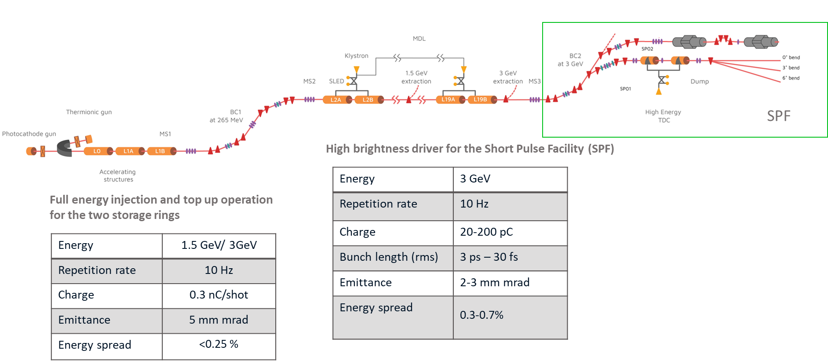
Linac as injector: thermionic gun
3 GeV Ring
chopper
A stripline chopper system shapes the electrons from the thermionic gun in 10-100 ns macro bunches with a separation of 10 ns to match the 100 MHz ring RF frequency.
10 ns
Energy | 1.5 GeV/ 3GeV
Repetition rate | 10 Hz
Charge | 300 pC/shot
Emittance | 5 mm mrad
Energy spread | <0.25 %
70 ns bunch train
High Charge per pulse
~8 buckets filled at every shot
~ 3 S-band bunches per ring bucket.
Requires large phase acceptance in the ring
Larger energy spread over the bunch train
Allows off-axis, on-energy injection scheme, with high injection rate
Not compatible with off-phase/off-energy injection schemes

Slide 8
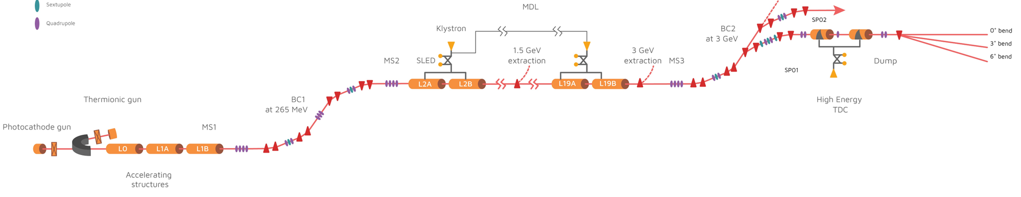

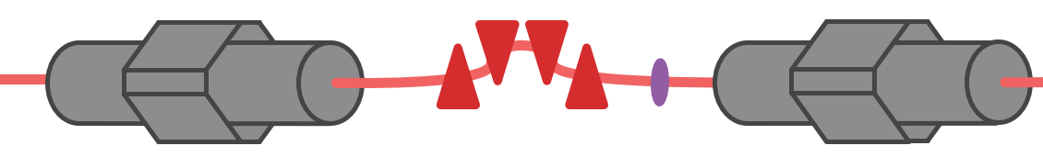
Linac as injector: photogun
3 GeV Ring
Photo cathode gun for ring injection
lower charge per pulse
1 bucket filled at every shot
1 S-band bunch per ring bucket.
Small phase extension, small bunch length and energy spread
Allows off-phase/off-energy injection schemes
Energy | 3 GeV
Repetition rate | 10 Hz
Charge | 200 pC
Bunch length (rms) | ~5 ps
Emittance | 2-3 mm mrad
Energy spread (rms) | ^{<0.1%}
Off-phase on-axis injection schemes similar to the one proposed by M. Aiba et al. appear a good fit for MAX IV due to linac injector and a 100 MHz RF system
M.Aiba et at, Phys. Rev. ST Accel. Beams 18, 020701

Slide 9
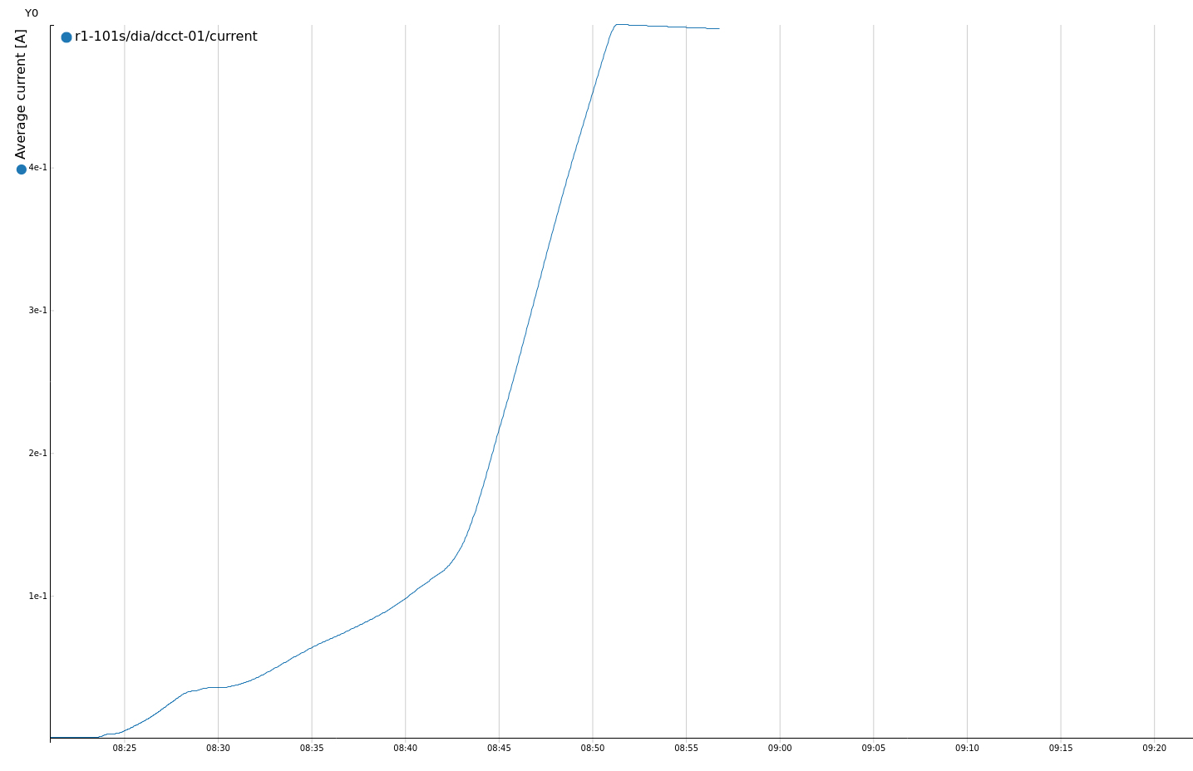
Experimental demonstration of photo gun injection
Results from 29/9:
PG injection in R1
140 mA/min
190 pC per shot @ 10 Hz
Injection from the photo gun has been demonstrated in both rings; work in progress
Photo-gun injection is a backup in case of thermionic gun problems
So far tested with off-axis injection only
Plans to test on-axis off-phase during fall
Current Injection parameters
Pulse duration ≃ 5 ps (0.18°)
Phase jitter ≃ 100 ps rms (4°)
Energy spread < 5 10⁻⁴
Energy jitter < 5 10⁻⁴
Charge ≤ 200 pC

Slide 10
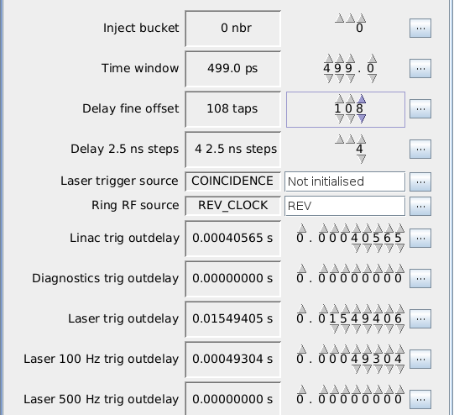
Coincidence system for injection timing
linac rf frequency is not a multiple of the ring frequency.
This is not an issue when using the thermionic gun given the long macropulse and the use of a chopper that imparts the ring time-structure onto the LINAC S-band pulse train
For injection from the photo-gun this is a crucial step
A coincidence detector gives a trig when a ring bucket and a possible shot from the photo cathode gun overlap in time. The linac is then triggered to produce an injection shot.
Rep rate 2-10 Hz (require coincidence system intervention to change)
Choose which ring bucket to inject into
Choose time window for coincidence.
- This sets the phase precision jitter. Smaller window means less phase jitter, but also fewer coincidences.
Delay of the injection shot.
- This sets where in the ring phase the injection occurs. Precision of 40 ps (1.5 ° )

Slide 11
Charge per injection shot
Typical linac charge per pulse using photogun today is 150 pC, about half of what the linac can deliver when fed by the thermionic gun
Maximum allowed by radiation safety @ 10 Hz is 200 pC
@10 Hz injection rate – time to fill up the ring from zero is 9.8 min
Top-ups every 10 minutes take ~9 s
The above parameters are adequate for injection into MAX 4^{U}
A future upgrade option is to increase the laser energy hitting the copper cathode to get up to 500 pC per shot
Higher charge per shot option for MAX4^{U}
New higher power laser system
Cathode material
Re-evaluation of radiation shielding
New risk analysis and permit application to SSM
Adds cost, complexity and time to the project

Slide 12
Off-phase, on-axis injection Schemes
Our injector (full-energy linac) and low (100 MHz) ring RF frequency puts us in a privileged position to implement these schemes
This approach
Allows advanced IDs with small horizontal gap.
Improves top-up transparency.
Eases accumulation into lattices with small dynamic aperture.

Slide 13

Off phase injection in MAX 4^{U}
Photo gun electrons from the linac
Electron bunch injected on-axis, off phase in the ring RF bucket
Fast kicker with minimal interference to the stored bunch
Ultra fast stripline kicker

Slide 14
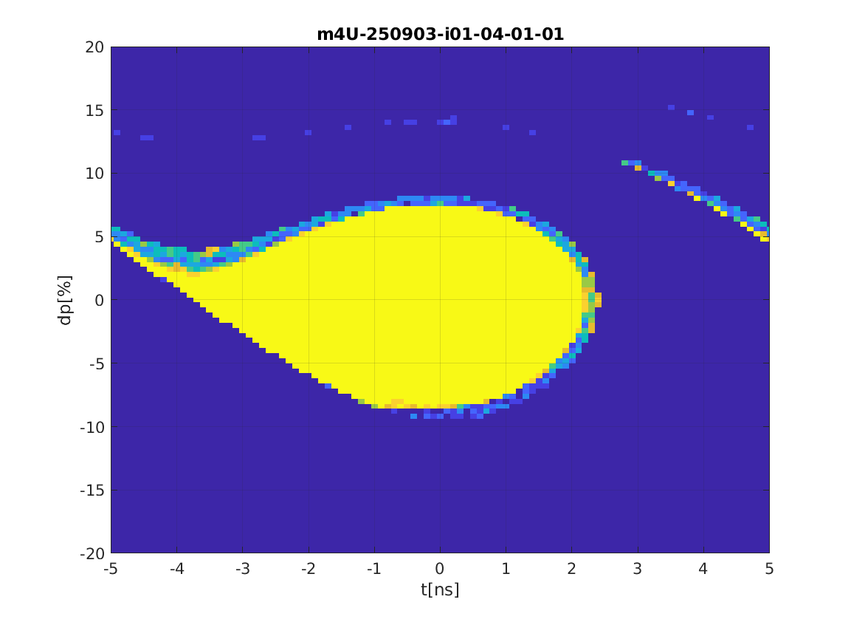
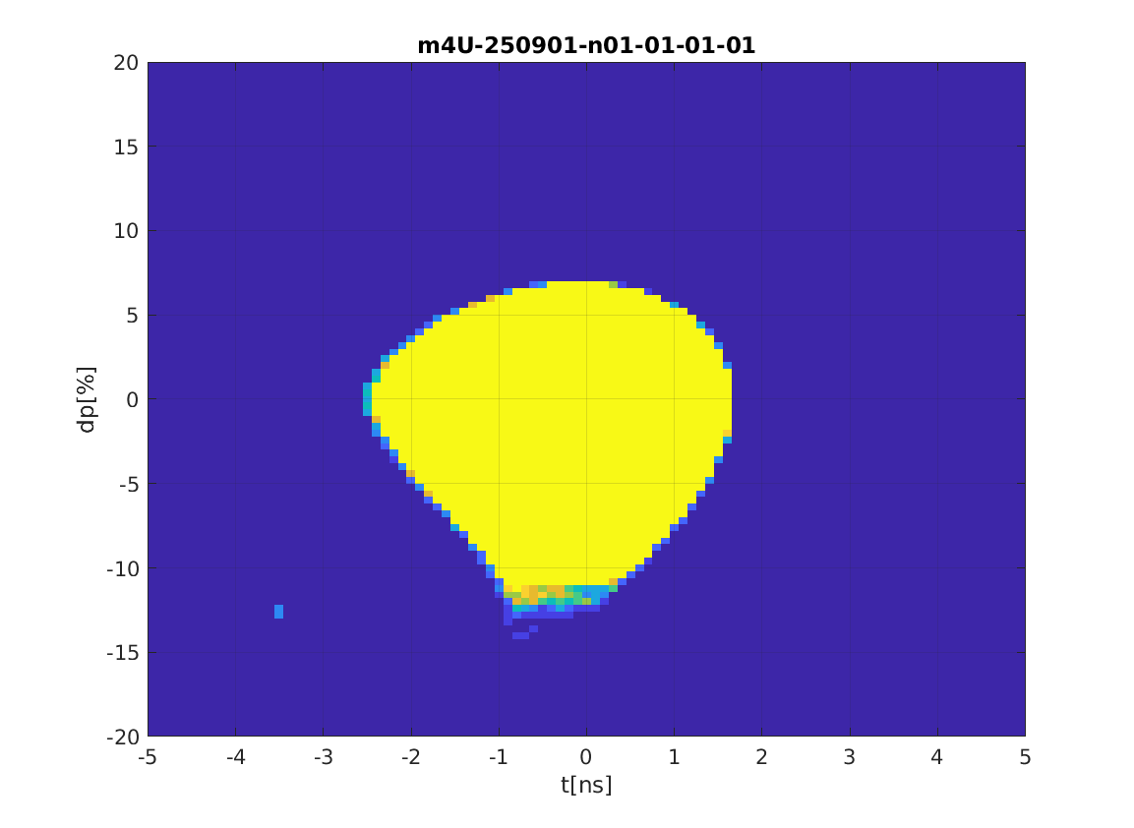
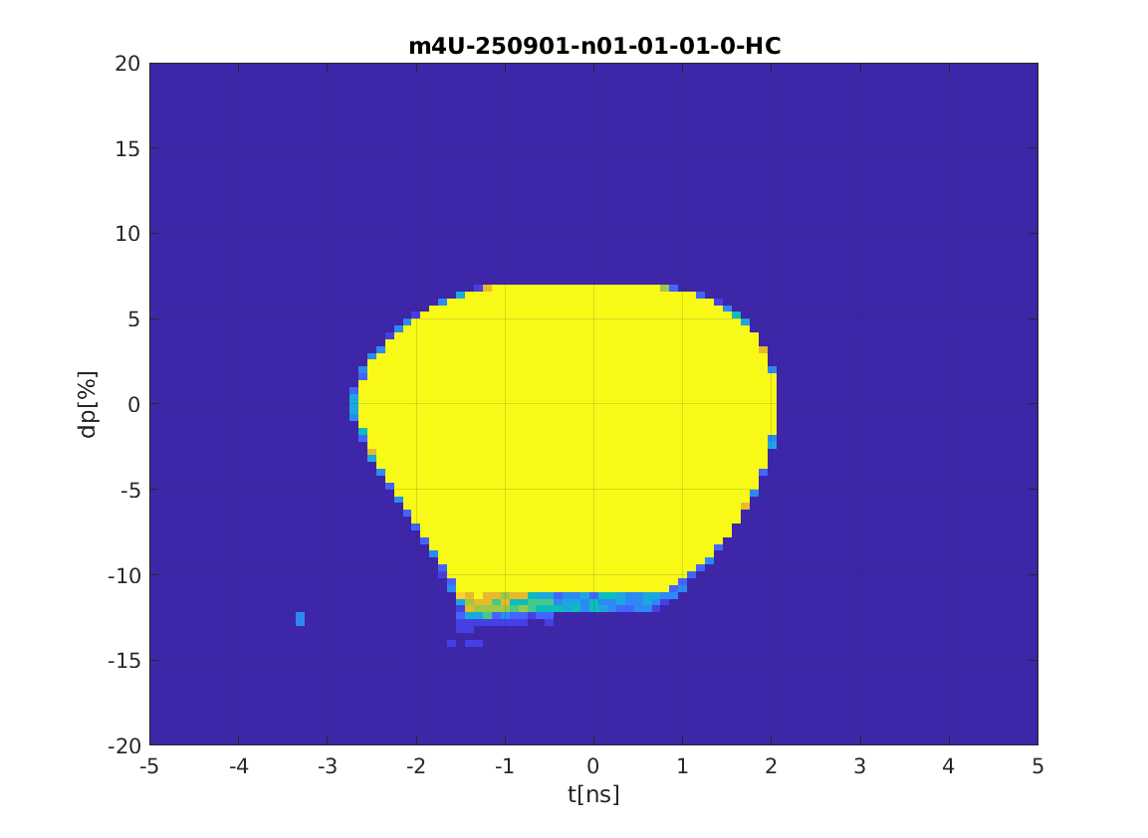
Off-phase injection into AR / SG lattices
AR AT2 6D tracking, including errors
AT2 6D tracking, including errors,
no Harmonic Cavity
AT2 6D tracking, including errors,
3rd Harmonic Cavity
From Pedro
From Pedro
Conditions for kicker and coincidence timing, more relaxed using a 3rd harmonic cavity

Slide 15
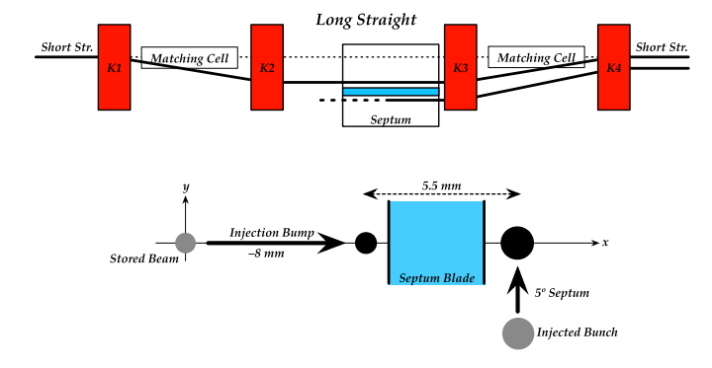
Injection
X
X
X
X
4 correctors with combined kick capability corresponding to the septum bend angle.

Slide 16
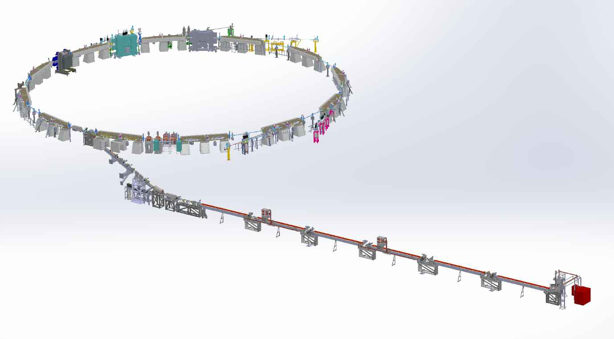
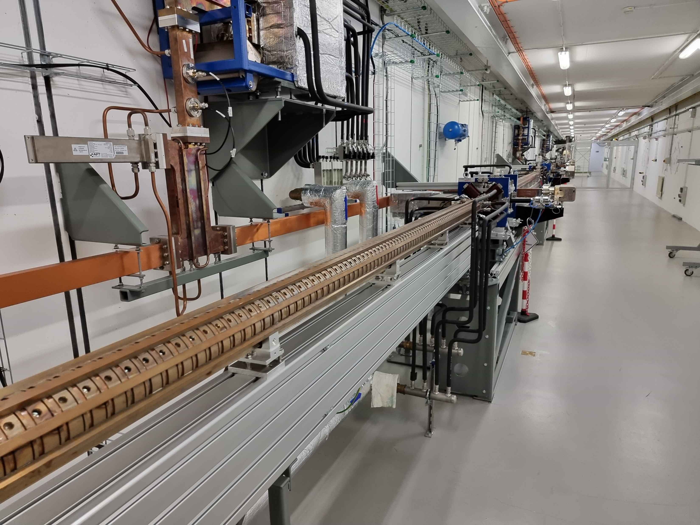
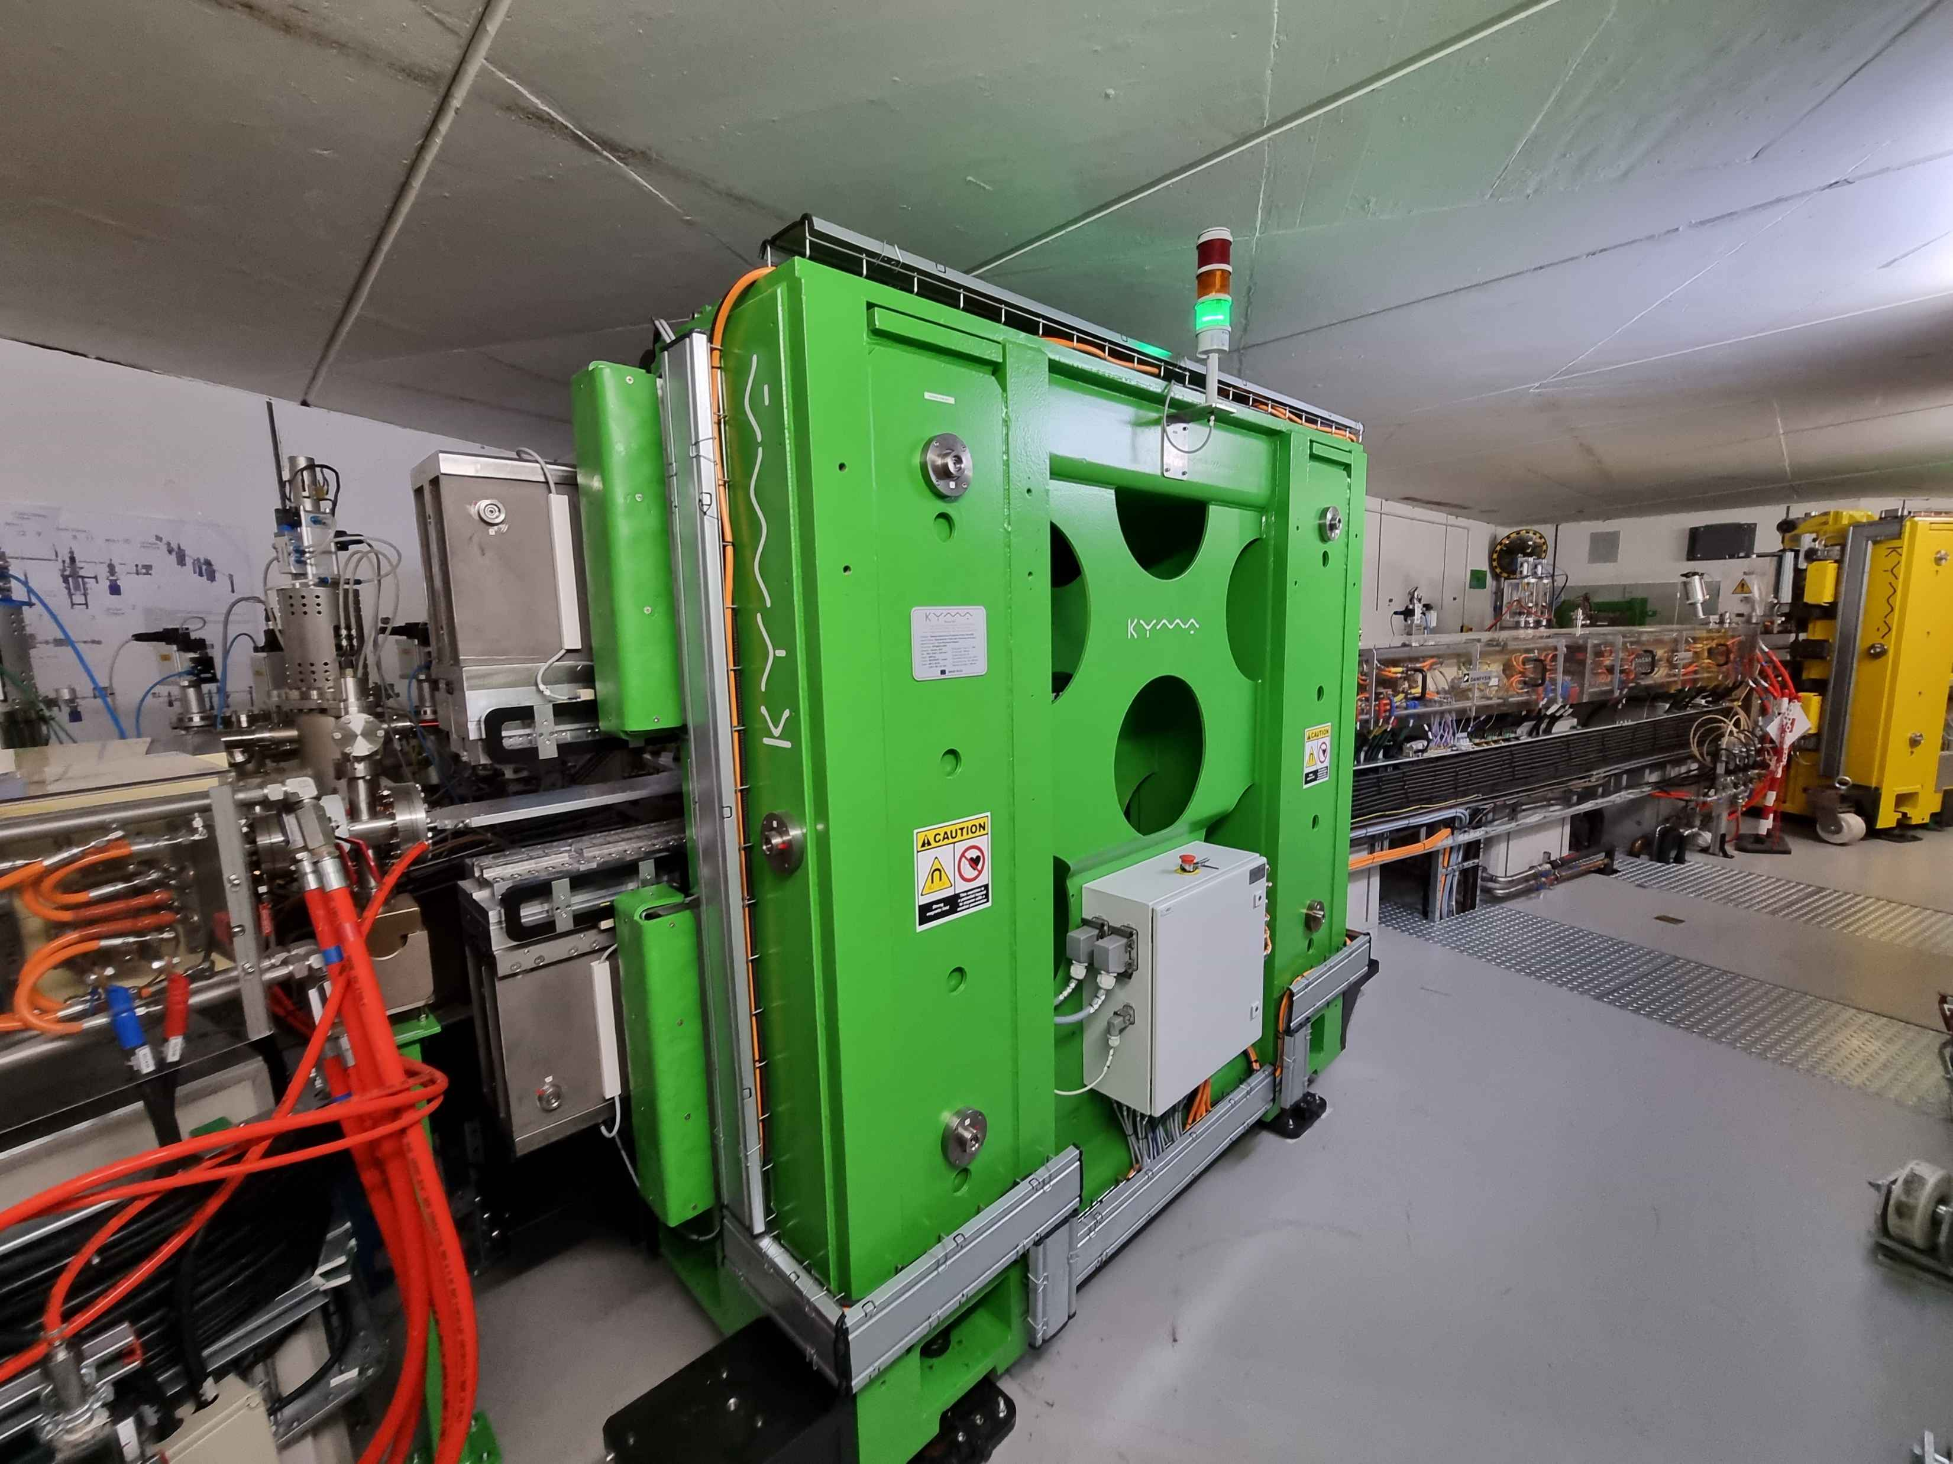
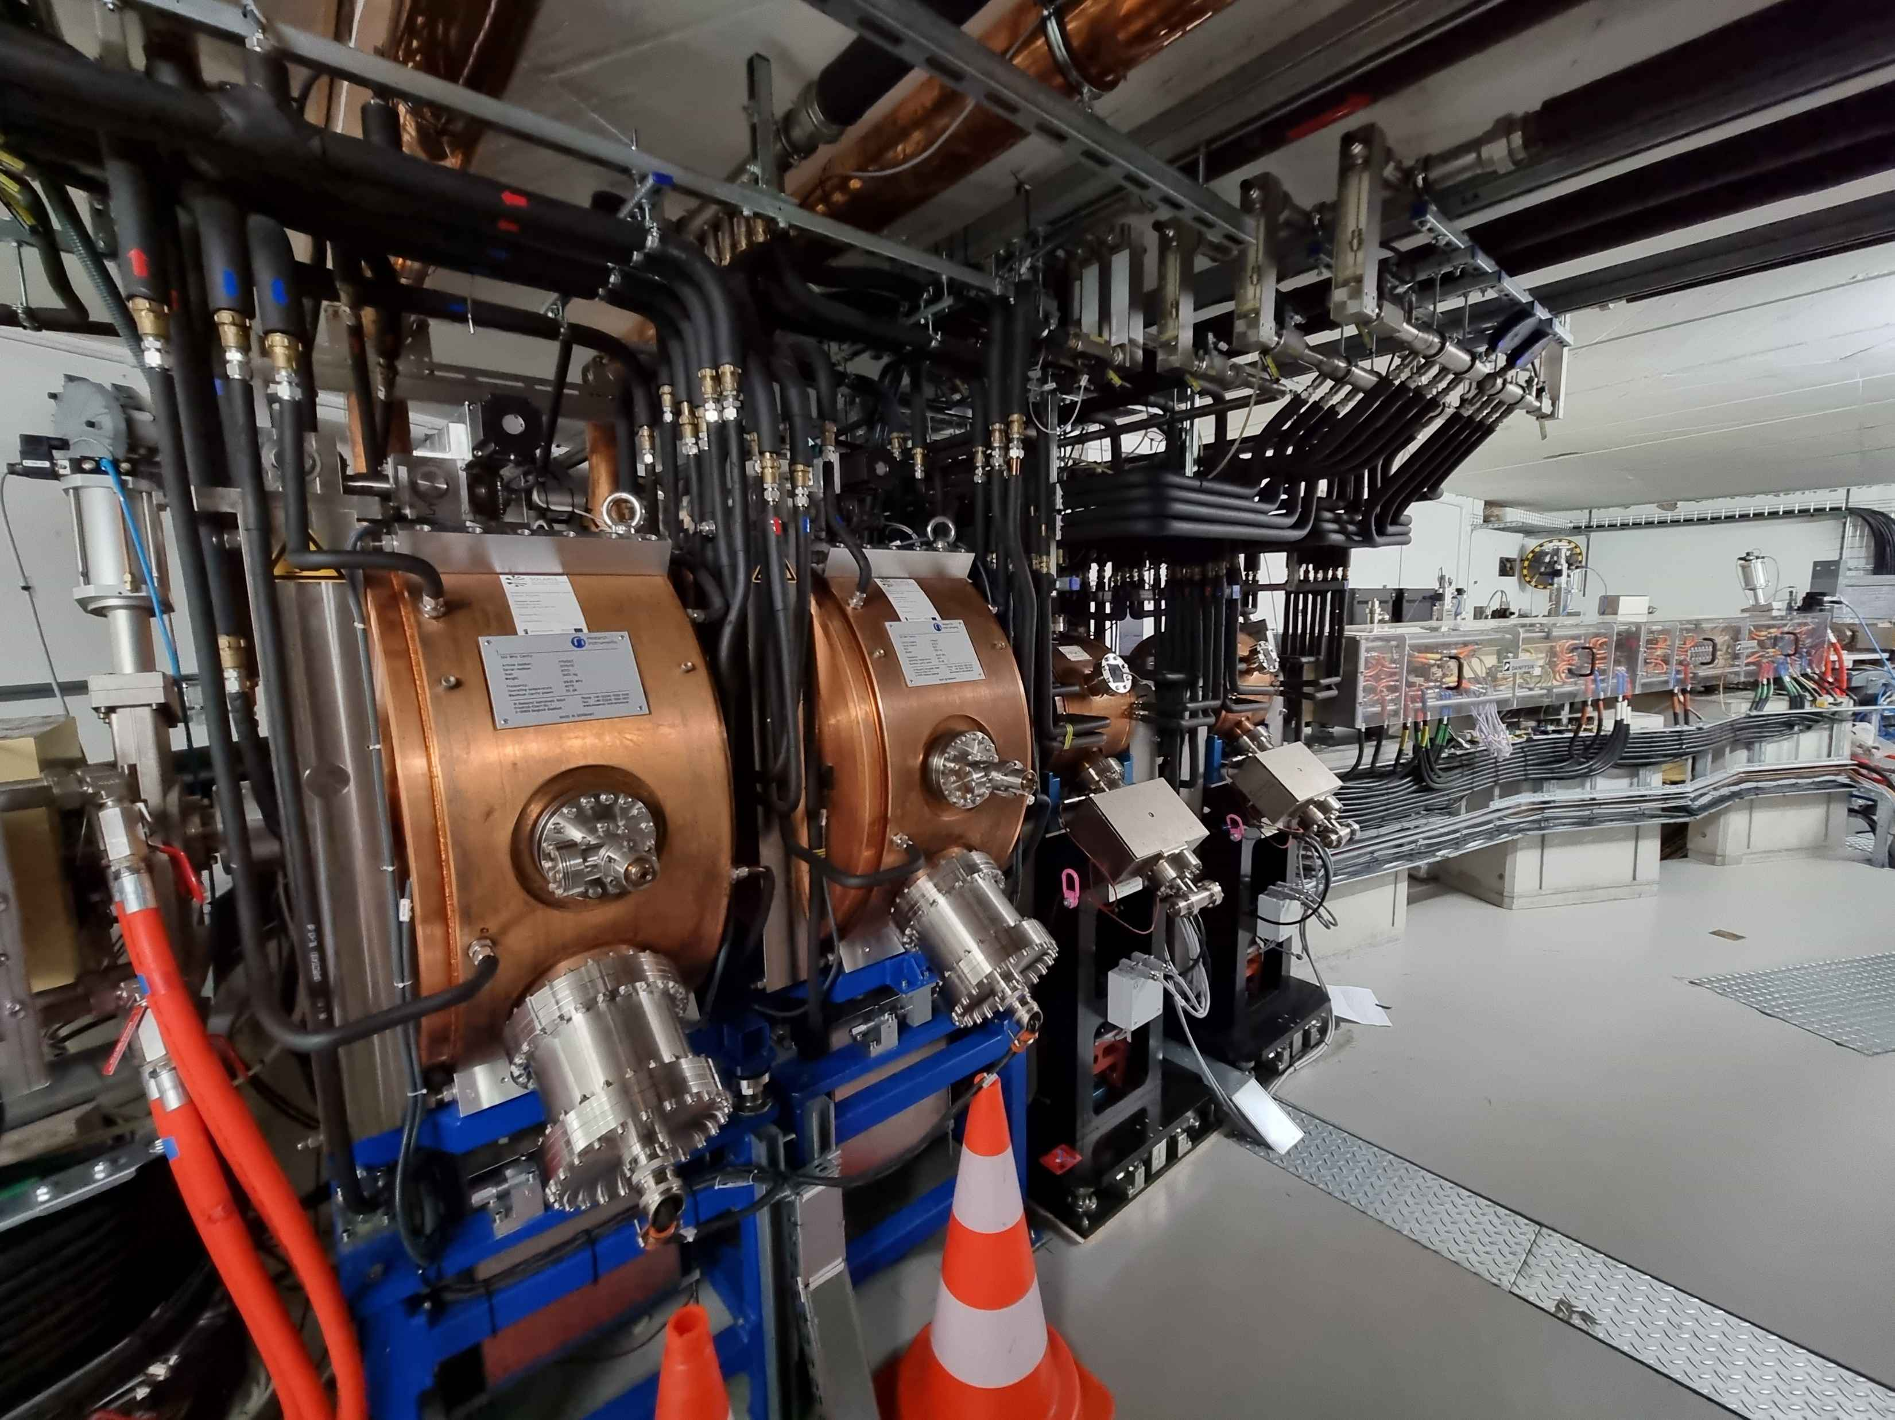
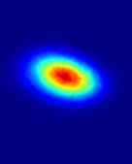
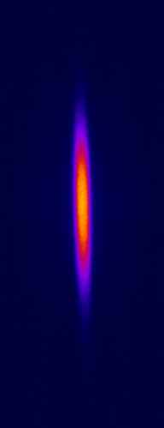

600 MeV Linac
RF Thermionic Gun
6 S-band 2998.5 MHz accelerating
structures
Accelerating gradient 20 MeV/m
3 RF Units & SLED cavities
Dog-leg vertical transfer line
In operation since Dec. 2014
1.5GeV Storage ring
12 DBA Cells – 96 m circumference
Space for ID’s (10 sections) ~ 3.5 m
10 straight sections for IDs
100 MHz RF system
300 MHz Landau Cavities
Injection dipole kicker
Ramping
In operation since May 2015
SOLARIS Accelerators
PINHOLE
LUMOS
Parameter | Value
Energy | 1.5 GeV
Max. current | 500 mA
Harmonic number | 32
Natural emittance | 6 nmrad
Lifetime | 13 h

Slide 17
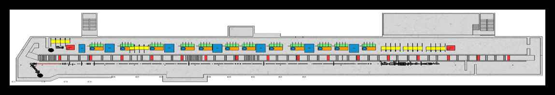

Challenges
The size of the tunnel is fixed and space is limited it can be demanding to fit all equipment in technological tunnel
Laser lab for the photocathode gun need to be established
Injection scheme with multipole kicker need to be optimised
Radiation protection shielding and beam dump need to be calculated and verified
Although the infrastructure (cooling and electricity) demands are fulfilled, there could be a need to develop new secondary cooling units, or liquid nitrogen cooling linac technology
Developing LLRF system for linac
For the future FEL or SPF the linac tunnel need to be expanded and experimental area need to be foreseen.

Slide 18
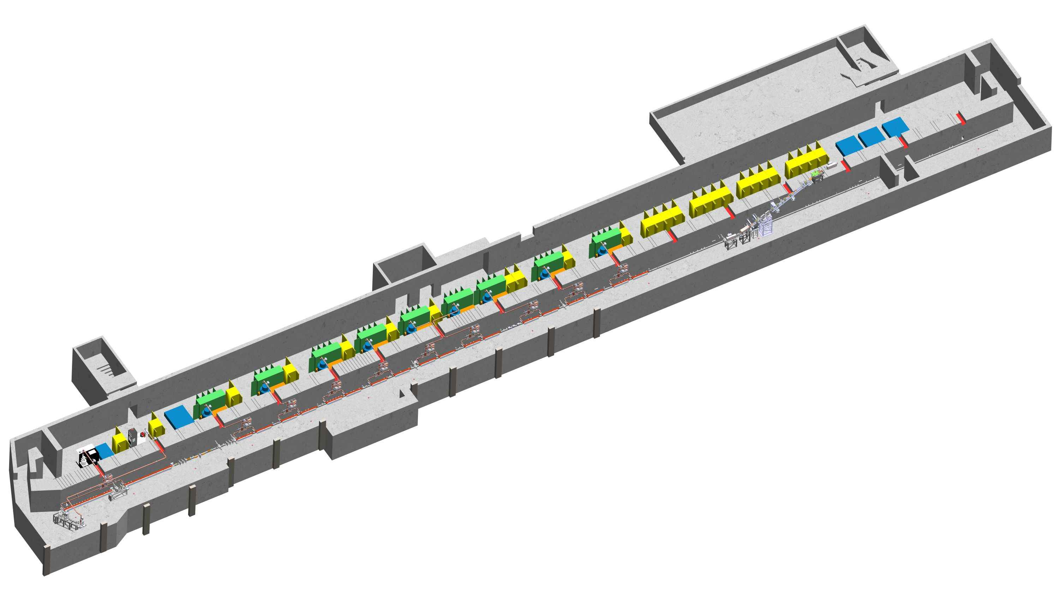
SUMMARY
Diagnostics development :
FOFB, BBFB, BLM, Tune FB and BPM system for SOLARIS I FCC ee.
Full energy linac development
Magnet Lab development including magnet diagnostic tools (stability, alignment), ID development
New beamlines development (CIRI, ARYA, SMAUG, MAVKA) and installation
Supporting operation and improving beam stability. High availability.

Slide 19







Acknowledgements
All SOLARIS TEAM
MAX IV TEAM
Marek Gąsior, Thibaut Lefevre, Michał Krupa (CERN)
Dmitry Teytelman
Alessandro Curcio (INFN, Univ. Of Rome)
Dmytro Butt, Rober Nietubyć (NCBJ - POLFEL)
PSI TEAM (Magnet Group, MAVKA BL team)
The project is executed under the provision of the Polish Ministry and Higher Education project “Support for research and development with the use of research infrastructure of the National Synchrotron Radiation Centre SOLARIS” under contract nr 1/SOL/2021/2.

Slide 20
Meeting in lundt and test during MD
9th and 10 March

