Slide 1
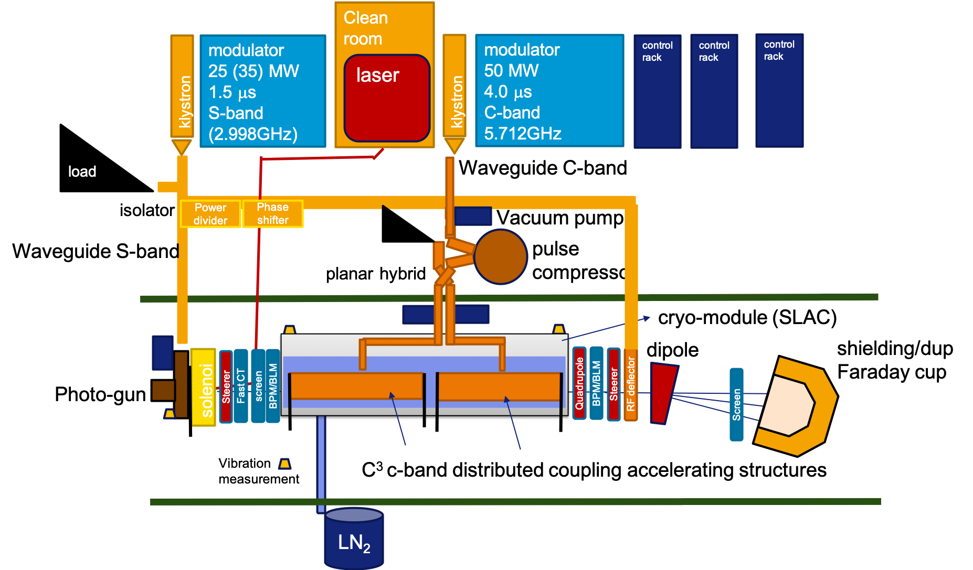
COLD and 6GeV Linac optics matching and optimization
More realistic assumptions for COLD and 6GeV linac space
Shorter linac module options
Magnet gradients
Effect of a gaussian or flat beam at cathode.
S.Liuzzo (ESRF), A.Latina (CERN)

Slide 2
Layout for High power RF tests and dark currents measurement with dimensions
Neutron monitor
BLM
Accelerating structures
shielding
shielding
Vaccum valve
Quadrupole
Faraday cup
Faraday cup
Quadrupole
Quadrupole
bellow
bellow
BLM
328 cm
10 cm
12 cm
20 cm
10 cm
20 cm
12 cm
12 cm
20 cm

Slide 3
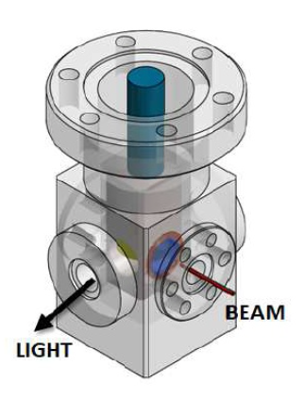
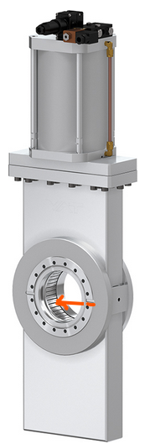
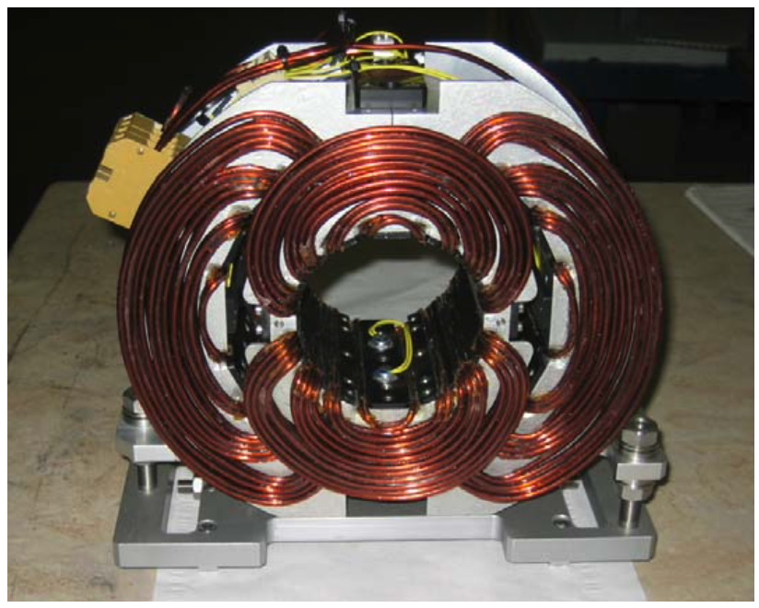
Electron beam Layout COLD Phase 1
A.Cianchi: https://jacow.org/e08/papers/MOPC068.pdf
L.Badano: https://jacow.org/d07/papers/TUPC11.pdf
Needed? How to power it?
To be designed or available?
Neutron monitor
For energy
shielding
on movers
on movers
sparc-mm-06/001
From Compact Light CDR
Faraday cup
destructive
stripline
SCREEN
stripline
stripline
BPM
Accelerating structures
GUN
SCREEN
shielding
Vaccum valve
BPM
SOLENOID
HV corrector
Laser input
Vaccum valve
BPM
Current transformer
Dipole
RF deflector
https://doi.org/10.1016/j.nima.2006.07.050
BPM
3xQuadrupole
HV corrector
SCREEN
Faraday cup
bellow
bellow
BLM
BLM
BLM
Neutron monitor
For emittance with quadrupole scan
Faraday cup
3.9m long
Neutron monitor
laser optics table
switchable
1x “6GeV linac module”, the #0
PC
10 cm
*12 cm
10 cm
12 cm
12 cm
12 cm
12 cm
20 cm
10 cm
20 cm
40 cm
20 cm
20 cm
40 cm
12 cm
12 cm
20 cm
1 single C-band RF-unit
Corrector around BPM

Slide 4
Electron Beam line Layout COLD Phase 2
A.Cianchi: https://jacow.org/e08/papers/MOPC068.pdf
L.Badano: https://jacow.org/d07/papers/TUPC11.pdf
Optimized length
Neutron monitor
Screen or valve alternating
For energy
Neutron monitor
shielding
on movers
on movers
on movers
Faraday cup
sparc-mm-06/001
From Compact Light CDR
stripline
SCREEN
destructive
stripline
stripline
stripline
BPM
328cm
278cm
Acc. structures
Acc. structures
GUN
Dipole
BPM
shielding
SCREEN
BPM
RF deflector
https://doi.org/10.1016/j.nima.2006.07.050
Vaccum valve
BPM
Vaccum valve
SOLENOID
HV corrector
Laser input
HV corrector
Current transformer
3xQuadrupole
BPM inside quad
Quadrupole
Compact Vaccum valve
SCREEN
Faraday cup
bellow
bellow
bellow
bellow
BLM
BLM
BLM
Neutron monitor
BLM
For emittance with quadrupole scan
3.9m long
3.1m long
laser optics table
Neutron monitor
1x “6GeV linac module”, prototype
1x “6GeV linac module”, the #1
GUN SECTION
DIAGNOSTICS/DUMP SECTION
PC
1 single C-band RF-unit

Slide 5
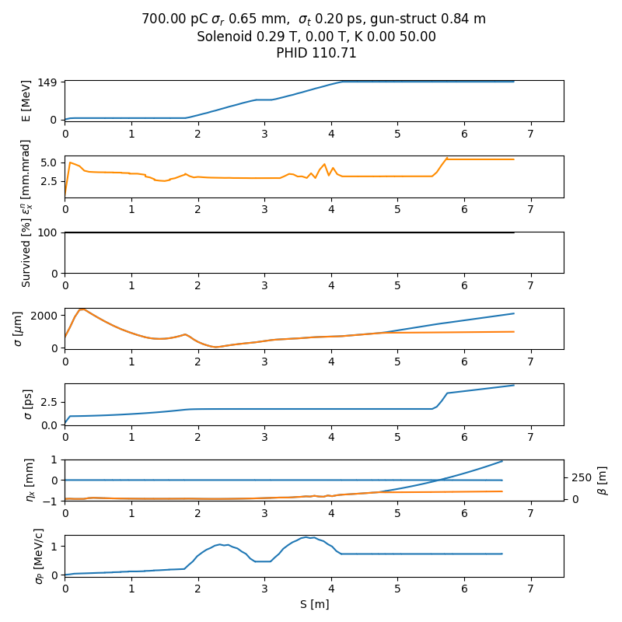
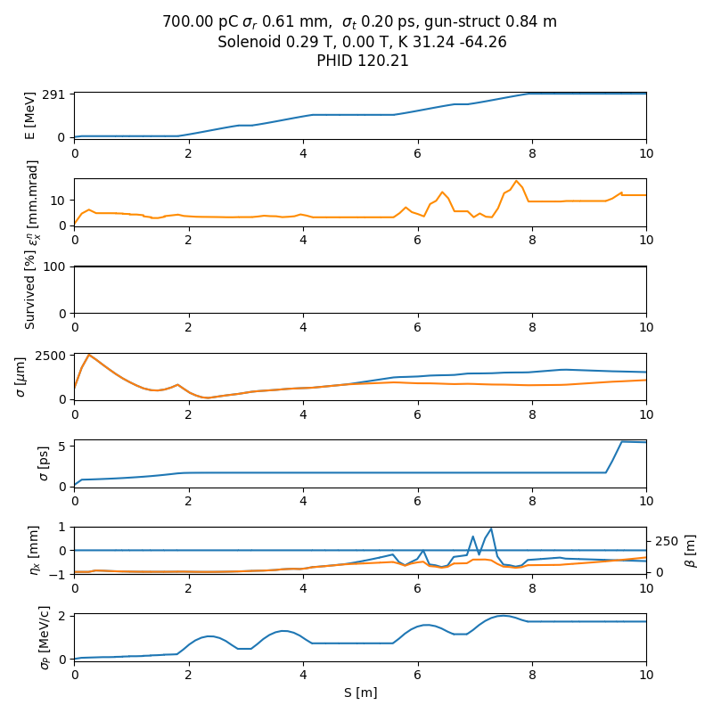
WP-11 Beam dynamics
The cryomodule adds more than 1m to the over all length. A more compact design will be studied for the second module to be installed.
Cryomodule length = 3.28m
1 Acc.Struct. Length = 1.06 m
Updated COLD simulations including all elements described above and full size QCM, for phase 1 and 2
Will update also full linac simulations, likely less energy margin and longer linac: 161m for a 6GeV linac. Instead of 110m for a 6.7GeV linac in previous simulations.
5mm.mrad
9mm.mrad
Phase 2
Phase 1
Thanks to A.Latina for correction and improvement of the simulations scripts

Slide 6
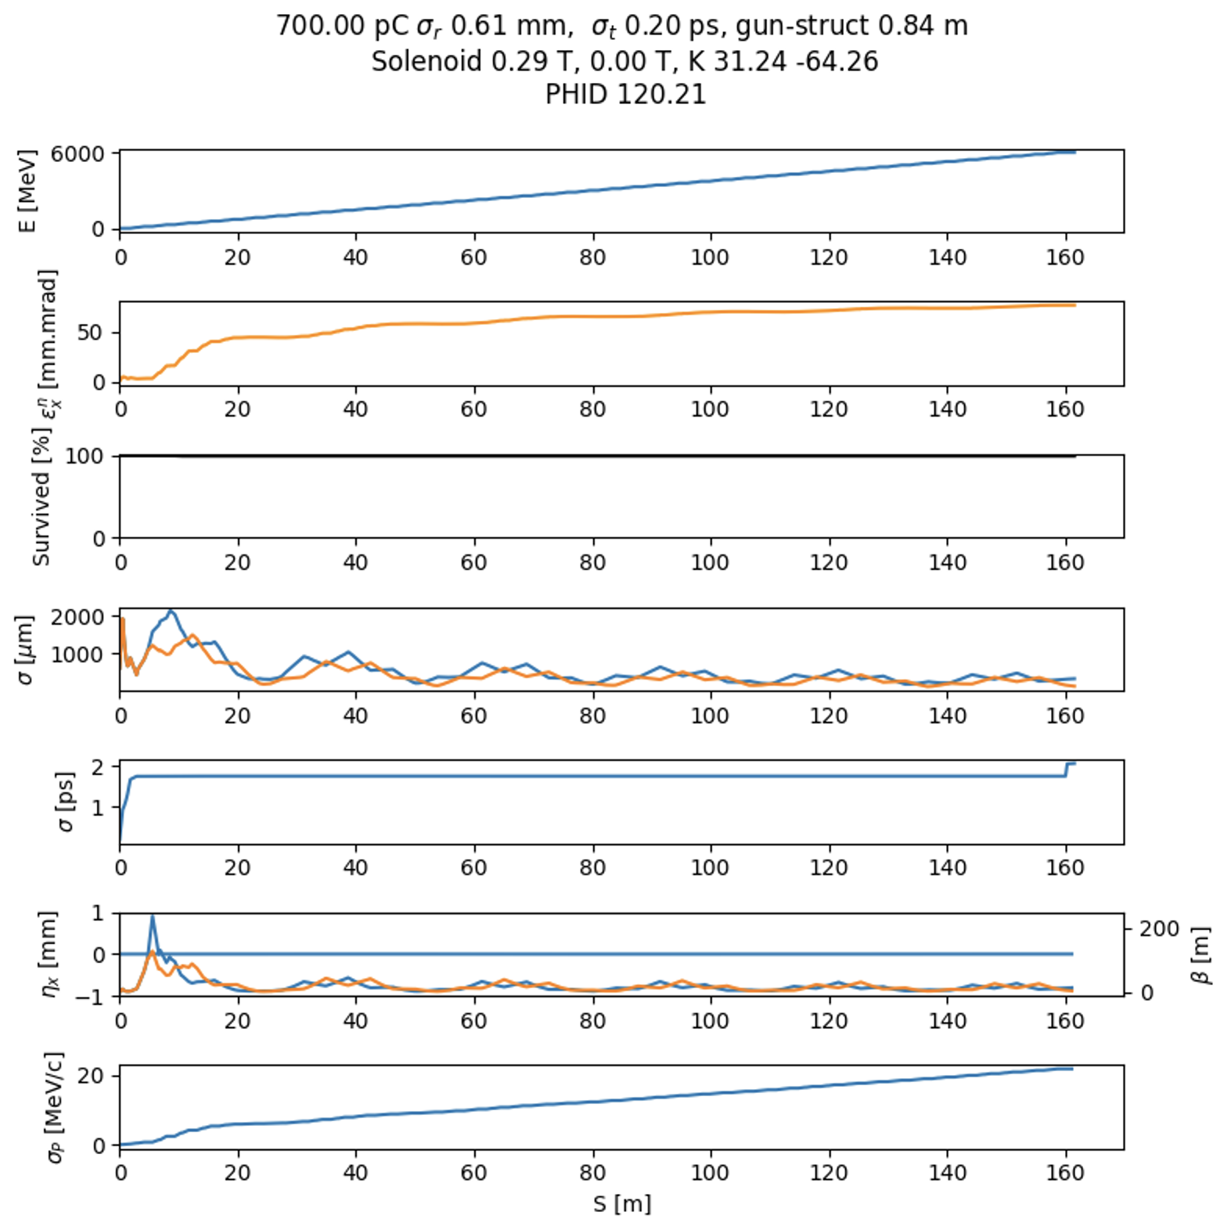
6GeV linac in 161m
/COLD/cold_6Gev_V0.py
A 6GeV linac using SLAC’s cryomodules is too long
Emittance blow up
Classic linear optics matching does not work, missing RF focusing, wake fields, Space charge,…

Slide 7
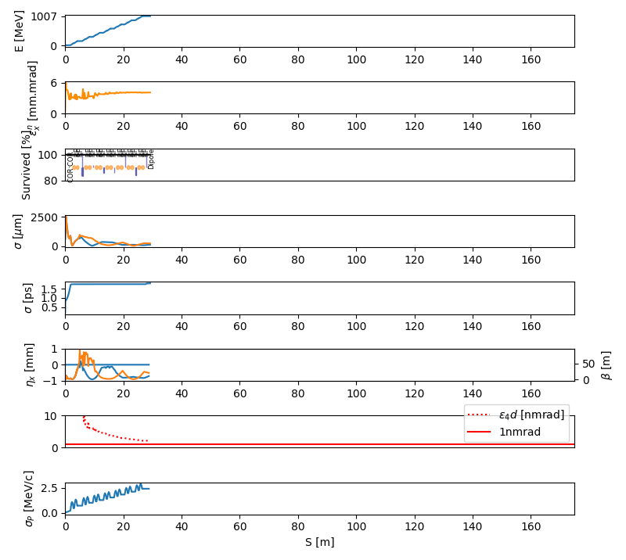
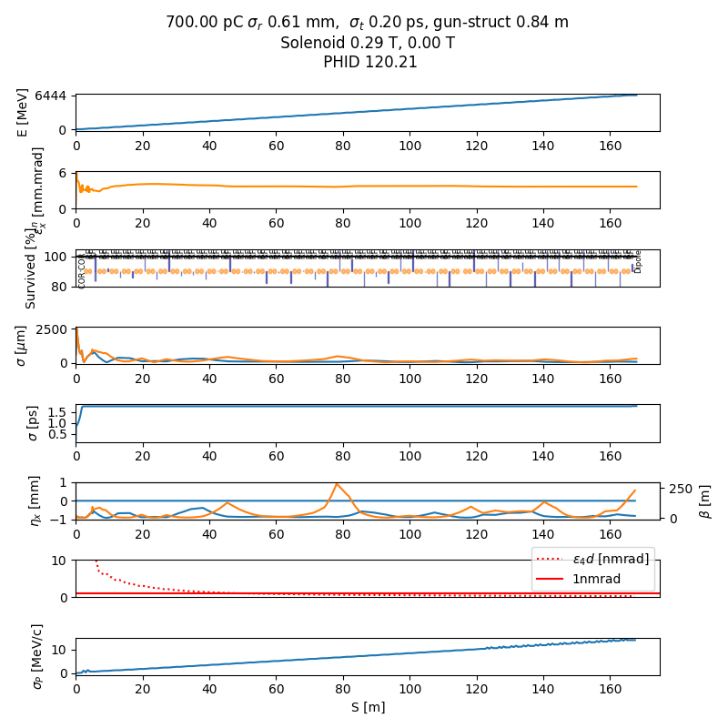
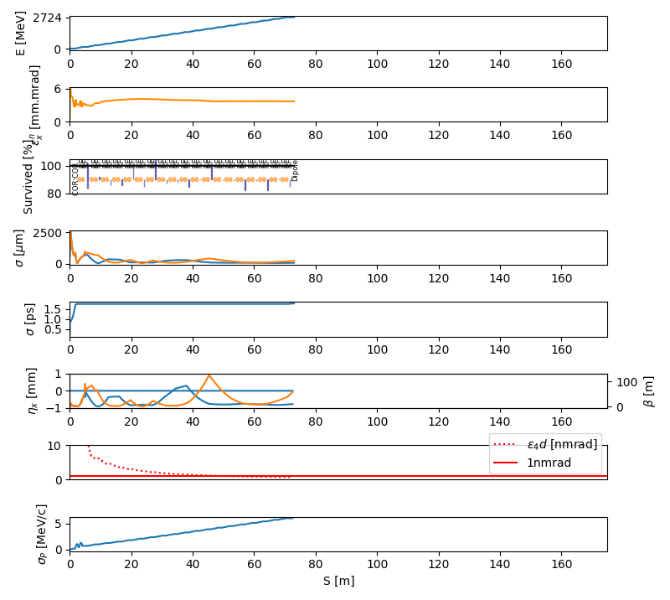
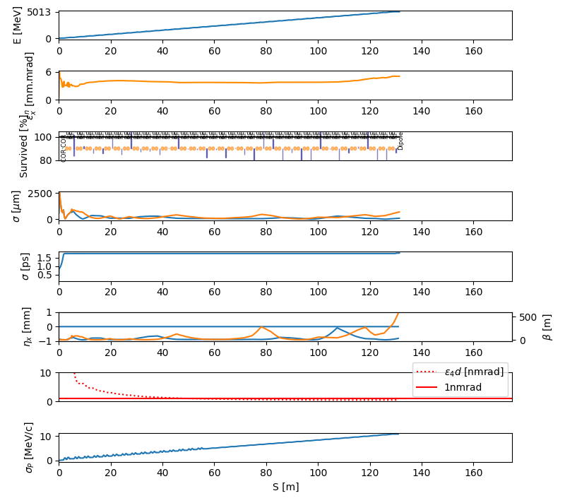
Slow, step by step optimization, including long cryomodules
1GeV
2.7GeV
5GeV
6.4GeV
170m
Step 3
Step 5
Step 7
Step 10
4mm.mrad, ~ 500pmrad@6GeV
Progressively frozen beam parameters for faster optimization
0.2% energy spread
0.5mm bunch length
Scripts in: /machfs/liuzzo/C3Linac/COLD/cold_ph**_V3.py

Slide 8
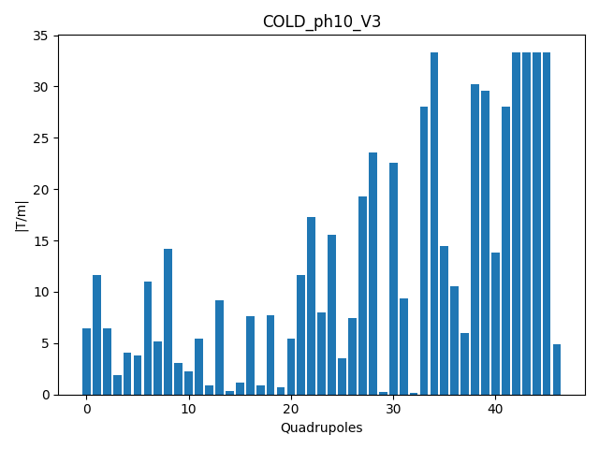
gradients

Slide 9
Shorter 6GeV linac unit module
on movers
Neutron monitor
on movers
on movers
stripline
stripline
Neutron monitor
stripline
328cm
278cm
278cm
Acc. structures
Acc. structures
Acc. structures
Acc. structures
BPM inside quad
BPM inside quad
Quadrupole
Compact Vaccum valve
Quadrupole
screen
BPM inside quad
Quadrupole
Compact Vaccum valve
bellow
bellow
bellow
bellow
bellow
bellow
bellow
The shorter the better!
5.7m possible? (one extra module)
BLM
BLM
50MW
PC
50MW
PC
BLM
Screen
7.8m
5.93 m
10cm
10cm
10cm
12cm
10cm
12cm
Is a 50cm shorter cryomodule possible?
For example assuming a single 2m long structure instead of 2 x 1m.
Quadrupole on mover around BPM stripline. bore radius of quadrupoles (10cm, 35T/m) needs to let space for BPM stripline and mover motions.

Slide 10
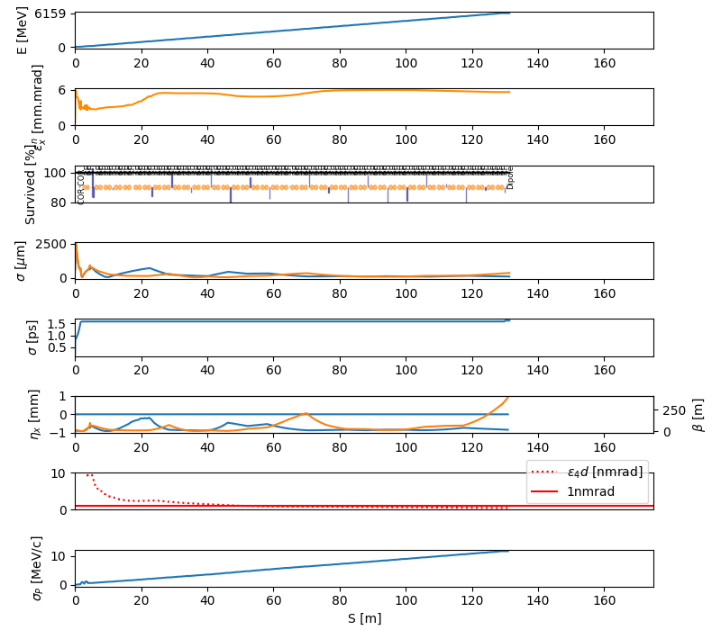
Shorter unit module 6GeV Linac
6.444 GeV in 170m, 21 x 7.8m modules
6.159 GeV in 132m, 21 x 5.93m modules
Fits on ESRF site
4mm.mrad, ~400pmrad@6GeV
5.6mm.mrad, ~500pmrad@6GeV
0.19% energy spread
0.18% energy spread
0.5mm bunch length
0.5mm bunch length

Slide 11
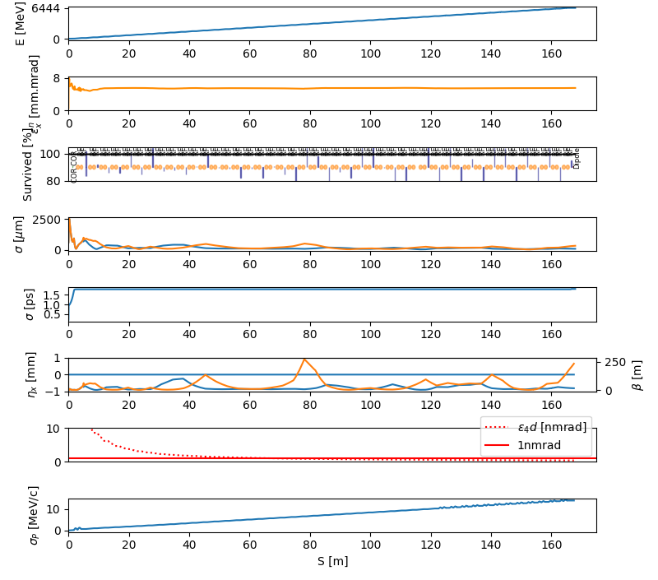
Gaussian beam instead of plateau
Flat beam “pleateau”
Gaussian beam
4mm.mrad, ~400pmrad@6GeV
5.3mm.mrad, ~500pmrad@6GeV
0.2% energy spread
0.2% energy spread
0.5mm bunch length
0.5mm bunch length

Slide 12
CONCLUSION
Beam dynamics model updated with more realistic dimensions.
Start-to-end simulations including space charge and short range wavefields for 700pC beam
Linac optics matching in presence of wakefields and space charge is not trivial. Improvements done.
A shorter linac unit module is needed for the 6GeV linac. Using the SLAC cryomodule design, the linac dimensions exceed the available space. A module length of 5.7m would allow for a 6.3 GeV in 132m (5% margin, one linac module).
A 5.93m long module, using half the quadrupoles and half the diagnostics, and assuming 50cm shorter cryomodules, would work with similar parameters. Error tolerances to be assessed.
Gaussian beam instead of flat top, would also be ok.

