Slide 1
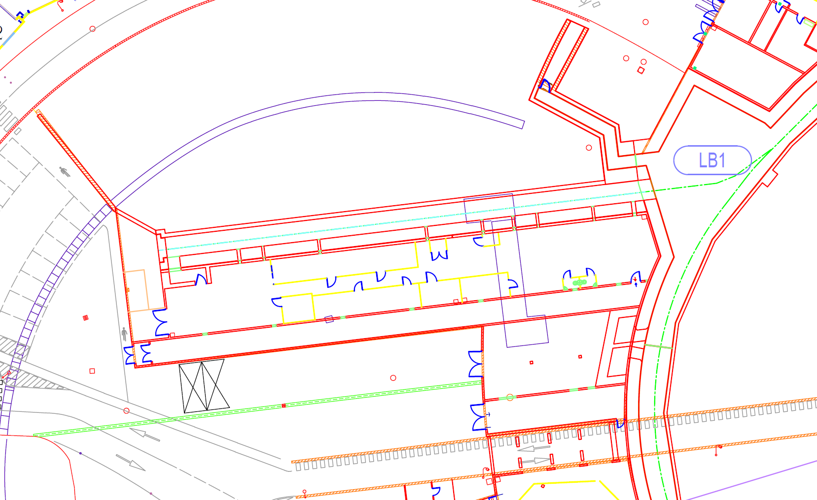
Deliverables of the Linac projects
WP06-operation: plan of installation
Linac refurbishment and Cold project deliverables
Safety issues (PSS, access, free space in corridors, LN2, ASNR authorization …)
40.5 m
19.5 m
8 m
60 m
Gun
Bunch
Section1
Section2
200 MeV
Mod S 1
Mod S2
Mod S3
All X_ray sources must be declared to ASNR
Safety will ask for a single authorisation for linac refurbishment and for COLD projects and not by phases. To be done in the coming weeks

Slide 2
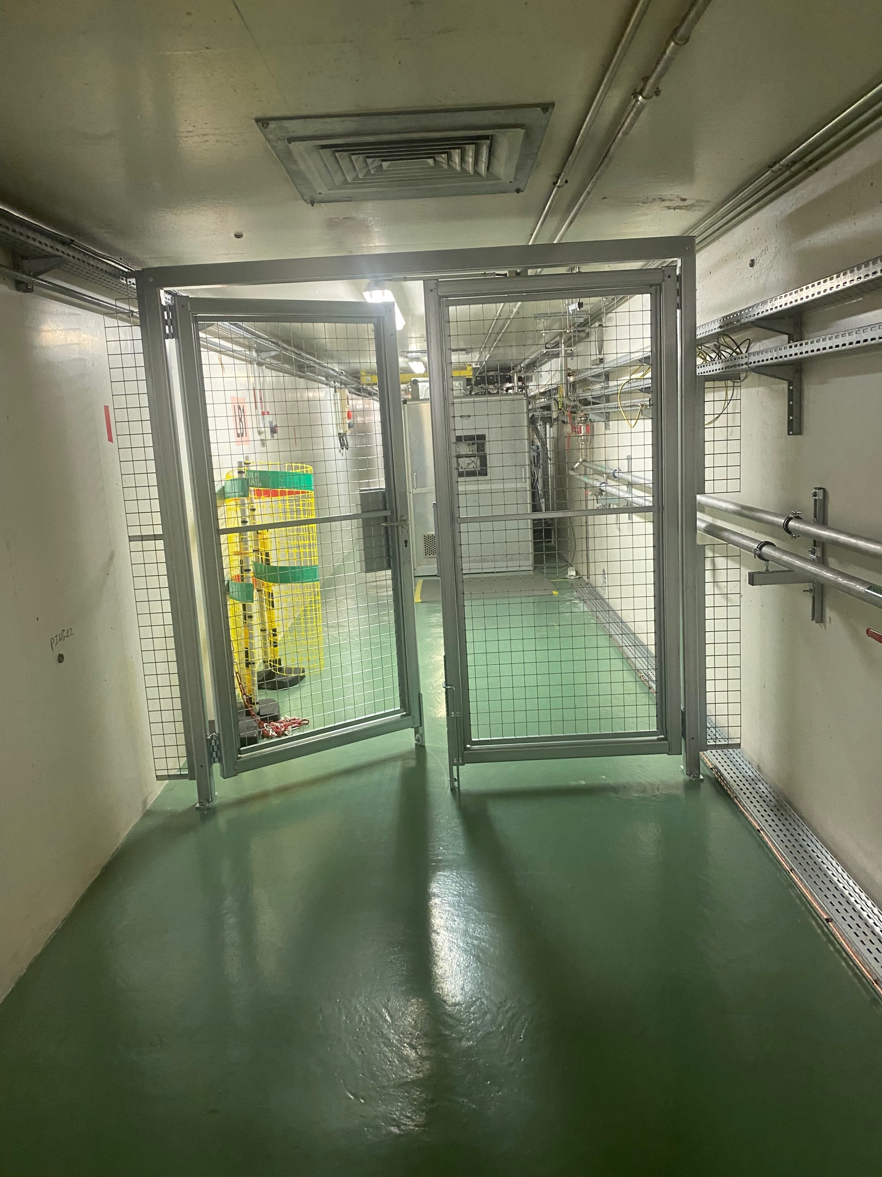
Deliverable 0: Injection in the booster
Tunnel height 2.2 m
Tunnel width 2.3 m
Present configuration (September 2025)
40.5 m
19.5 m
8 m
60 m
door
35 m
Gun
Bunch
Section1
Section2
200 MeV
Mod S 1
Mod S2
Mod S3
Status:
Operational
Door installed, all infrastructure done (earthling, piping ..)
Door to be connected to PSS in October or winter shutdown No specific PSS and separation foreseen for the linac projects intervention in the tunnel between injection, some injection could be skipped
Modulator 3 disconnected from present Linac, to be moved
Objective: Injection in the booster

Slide 3
Deliverable 1: Validation of spare section with RF and new modulator
Section 0 delivery delayed, entered during winter shutdown or later, coupler delayed after section
Modulator 0 on time
Partition wall at the linac entrance under study (Benoit)
Dedicated partition wall requested for safety of modulator to be discussed, may not be compatible with COLD
Project: Linac refurbishment
door
Section0
Gun
Bunch
Section1
Section 2
200 MeV
Partition door
mezzanine
Mod S3
Mod S 1
Mod S2
Mod S0
Gun
Scandinova
Status:
Modulator and spare section in construction
Infrastructure mostly prepared
Mod 0 RF unit end October
Section 0 entered during October 2026 shutdown (test of the door in //)
Objective: Validation of spare section with RF
RF Conditioning of spare section using Mod_S_3
SAT of Scandinova modulator Mod_S_0
Operational test of Scandinova modulator Mod_S_0
Assembly of spare gun in teststand

Slide 4
Deliverable 2: Validation of spare section with beam
Test with beam cancelled
Project: Linac refurbishment
Cancelled
135 MeV
door
Diag &Dump
Section0
Bunch
Gun
Gun
Bunch
Section1
Section 2
200 MeV
Partition door
mezzanine
Mod S_4
Mod S3
Mod S 1
Mod S2
Scandinova
Mod S0
Scandinova
Status:
Under Design
Decision taken for execution
Partition door to be studied
Objective: Spare section validation with beam
Installation diag and beam dump
Installation of the assembled gun in tunnel
Beam at 135 MeV
➔ full operational spares for the present Linac
Until may 2027 at latest

Slide 5
Deliverable 2 (option) : Validation of spare section with beam
Test with beam cancelled
Project: Linac refurbishment
Cancelled
135 MeV
door
Diag &Dump
Section0
Bunch
Gun
Gun
Bunch
Section1
Section 2
200 MeV
Mod S3
Mod S 1
Mod S2
Scandinova
Mod S_4
Mod S0
Scandinova
Status:
Under Design
Decision taken for execution
Partition door to be studied
Objective: Spare section validation with beam
Installation diag and beam dump
Installation of the assembled gun in tunnel
Beam at 135 MeV
➔ full operational spares for the present Linac
Until may 2027 at latest

Slide 6
Deliverable 3: SLAC C3 section validation with RF
Project: COLD
Section0
door
C3_1
Gun
Bunch
Gun
Bunch
Section1
Section 2
Mod S_4
Mod C1
Mod S3
Mod S 1
Mod S2
Scandinova
Scandinova
Mod S0
Scandinova
Status:
Design and collaboration
Procurement of modulators in process
Objective: SLAC C³ section validation with RF
SAT scandinova C_band modulator Mod_C_1 and modulator gun
Installation SLAC C³ section in the tunnel
C3 cooling operationnal
RF conditioning C³ section
From may 2027 at earliest

Slide 7
deliverable 4: SLAC C3 section validation with beam
ASNR authorisation needed to start the test
Full CDR of the whole COLD project
Strong Justification for building a new linac
Maximum energu and power deifined
Radiation mapping based on building profile (Paul)
3D drawing of buidings including eath under preparation (Brochard)
6 months minimum to get an answer
Project: COLD
Section0
170 MeV
door
Laser
Gun
C3_1
Diag &Dump
Gun
Bunch
Gun
Bunch
Section1
Section 2
200 MeV
Mod S_4
PC
Mod C1
Mod S3
Mod S 1
Mod S2
Scandinova
Scandinova
Mod S0
Scandinova
Status:
Design
Objective: SLAC C³ section validation with beam
Installation laser &Gun
Refurbishment diag and beam dump
Beam at 170 MeV

Slide 8
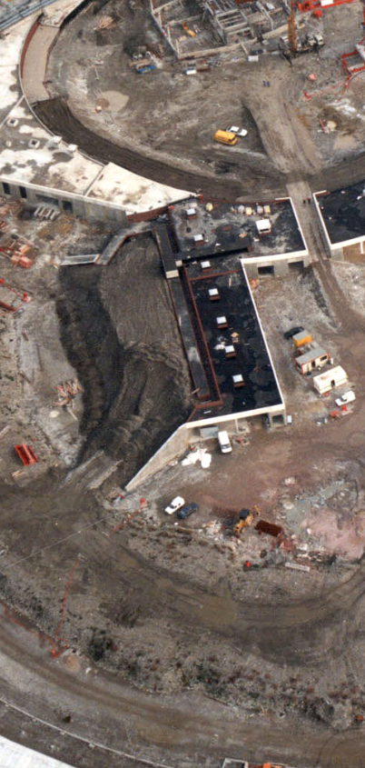
deliverable 4: SLAC C3 section validation with beam
ASNR authorisation needed to start the test
Full CDR of the whole COLD project
Strong Justification for building a new linac
Maximum energu and power deifined
Radiation mapping based on building profile (Paul)
3D drawing of buidings including eath under preparation (Brochard)
6 months minimum to get an answer
Project: COLD
Section0
170 MeV
door
Laser
Gun
C3_1
Diag &Dump
Gun
Bunch
Gun
Bunch
Section1
Section 2
200 MeV
Mod S_4
PC
Mod C1
Mod S3
Mod S 1
Mod S2
Scandinova
Scandinova
Mod S0
Scandinova
Status:
Design
Objective: SLAC C³ section validation with beam
Installation laser &Gun
Refurbishment diag and beam dump
Beam at 170 MeV

Slide 9
deliverable 5: SLAC C3 section validation with Xray beam
Project: COLD
Need a justification for this test
Section0
170 MeV
door
Laser
Gun
C3_1
Diag
Und.
Diag &Dump
Gun
Bunch
Gun
Bunch
Section1
Section 2
200 MeV
Mod S_4
PC
Mod C1
Mod S3
Mod S 1
Mod S2
Scandinova
Scandinova
Mod S0
Scandinova
Status:
Proposal
Undulator inside earlier
Objective: SLAC C³ section validation with Xray beam
Installation undulator
Refurbishment diag and beam dump
Beam at 170 MeV

Slide 10
deliverable 6: Preparation of a new linac as pre-injector
Project: COLD Phase 2
Section0
325 MeV
door
Laser
Gun
C3_1
C3_2
Diag &Dump
Gun
Bunch
Section1
Section 2
200 MeV
Mod S_4
PC
Mod C1
Mod S3
Mod S 1
Mod S2
Scandinova
Scandinova
Mod S0
Gun
Bunch
Scandinova
Status:
Study
Objective:
Installation second SLAC cryomodule
Installation second C band modulator Mod_C_2
Beam at 325 MeV

Slide 11
deliverable 7: Injection in the booster
Project: COLD Phase 2
325 MeV
Laser
Gun
C3_1
C3_2
Diag &Optics
Gun
Bunch
Section1
Section 2
325 MeV
Mod S_4
PC
Mod C1
Mod S3
Mod S 1
Mod S2
Scandinova
Scandinova
Mod S0
Gun
Bunch
Section0
Scandinova
Status:
Proposal
Objective: Injection in Booster
Transfer line
TL1 + injection septum adaptation
Present linac kept as spare if possible

Slide 12
Master planning
Del. | Date | Instrument added to the installation | Beam achievements | project
Del. 1 | 2025-October SD | ModS3 RF-unit displacement |  | Linac refurbishment
Del. 1 | 2025-October SD | ModS0 RF-unit (SAT) |  | Linac refurbishment
Del. 1 | 2025-December SD | 6m section (RF Cond) |  | Linac refurbishment
Del. 2 | 2025-2026 | Thermo-ionic gun assembly in test-stand |  | Linac refurbishment
Del. 4 | 2026-December SD | ModS4- RF-unit (SAT) |  | COLD
Del. 2 | 2026-December SD | Thermoionic gun in tunnel |  | Linac refurbishment
Del. 2 | 2026-DecemberSD | Diag and beam dump in tunnel |  | Linac refurbishment
Del. 2 | 2027-April |  | 135MeV Beam | Linac refurbishment
Del. 3 | 2027-May SD | First C-band RF-unit |  | COLD
Del. 3 | 2027-Aout SD | First C-band acc. Struct. |  | COLD
Del. 4 | 2028-May SD | S-band photo-gun + laser | 7MeV photogun beam | COLD
Del. 4 | 2028-May SD | Diag and beam dump upgrade |  | COLD
Del. 4 | 2029-January |  | 170MeV beam | COLD
Del. 5 | 2029-August SD | Undulator + 170MeV beam | Xray beam | COLD
Del. 6 | 2029-December SD | Second C-band RF-unit and acc.struct |  | COLD phase 2
Del. 6 | 2030-September |  | 325MeV beam | COLD phase 2
Del. 7 | 2031-August SD | TL1upgrade and inject in booster | 325MeV beam to booster | COLD phase 2

Slide 13
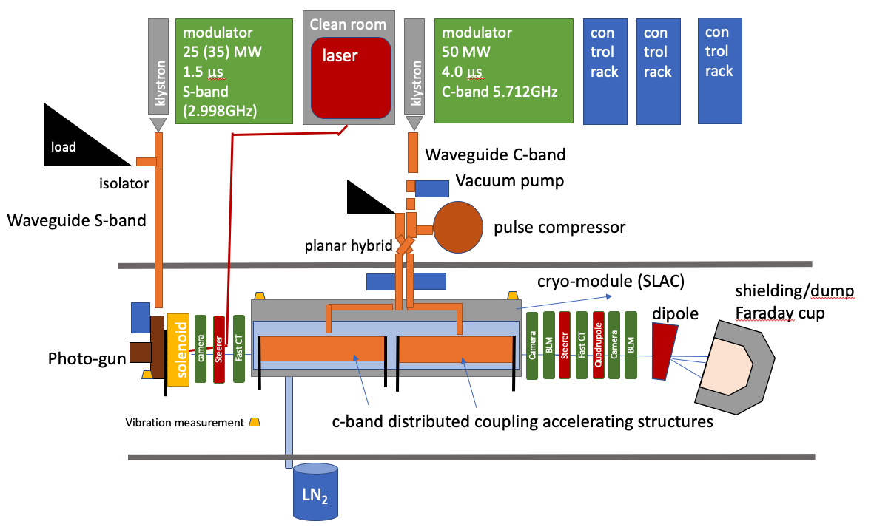
Cold project

Slide 14
Safety aspects of linac projects planning overview (first meeting)
1) Tunnel preparation in front of the existing linac:
Radiation level measurement during a standard injection (March 2025 restart, Friday 21 March) ➔ Done ➔ 1 moco sivert max linac ON
Define position of equipment (April 2025) (meeting with BIG in 2 weeks) ➔ Work done
Installation of a fence or lead door to inhibit LB1&2 radiation monitors (summer 2025) ) ➔ Done
Modification of PSS to include the fence door (October 2025) ) ➔ October 2025
Purchase and install of modern LB1&2 radiation monitors (October) ) ➔ Ordered
Upgrade of PSS to create a dedicated test zone (to be evaluate, end 2025) ) ➔ New zone created but not accessible with Linac ON
2) Linac refurbishment
Displacement of Modulator 3 (Summer 2025) ) ➔ In progress (shielding to be checked). SAT in Nov. To be declared ASN needed end 2025
Installation of a new Scandinova modulator at the place of Mod3 (Second half 2025, ASN authorization for klystron needed end 2025) ) ➔ SAT in Nov.
Installation in the tunnel and conditioning of the spare S band section (6 m long) (End 2025) ) ➔ install winter 2025, ready for cond beginning 2026
Assembly of the spare gun (second half 2025) ) ➔ In progress in the linac teststand End 2025 tested.
Installation of the available spare thermo-ionic gun (first half 2026), a beam dump and diagnostics. (To be confirmed) ) ➔ Confirmed second half 2026
beam at 125 MeV in the spare section (end of first half 2026) (To be confirmed, ASN for a new Linac begin 2026) ➔ Confirmed second half 2026. max energy135 MeV.. Need ASN authorization for a new linac.
Store the S band spare section in the tunnel (end 2026)
3) New Linac demo: COLD C3 operation linac demonstrator
Installation of the INFN photo gun and (5-6MeV) including the laser system (End2026, description to provide) ) ➔ 2028
Upgrade and Instillation of modulator 0 for the gun (Beginning 2027) ) ➔ Dedicated modulator ordered
Installation of C band section in place of the S band (2 cells of 1 m) (First half 2027) ) ➔ Confirmed
Installation of a new Scandinova modulator for section powering (First half 2027, ASN authorization for klystron, begin 2027) ) ➔ Confirmed
Rf conditioning of C band section (Mid 2027) ) ➔ Confirmed
Beam in the C band section at 150 MeV max (Beginning 2028, ASN for a new Linac begin 2027 ) ) ➔ Probably beginning 2029
4) Full energy linac injector preparation
Project specification and CDR (End 2026-mid 2027) ) ➔ in progress
300 to 500 MeV linac for injection into the Booster for full validation of the technology (To be confirmed, Medium Term Plan if demo successful) ) ➔ Project at 325 MeV to inject in the booster Confirmed for 2030 if all other phases are successful
Full energy linac including new infrastructure (To be endorsed by council, Long Term Plan)

Slide 15
Preparation meeting 2 September
Deliverable 2 :test of the spare cavity with beam at 135 MeV by end 2026 / mid 2027 latest
Pro: Section fully validated Linac + other staff training more efficient Anticipation of the beam test of COLD project
Check & confirm of safety with the measurement result at the condition of real beam (simulation vs measurement);
Test and validate diagnostics, controls, infrastructures, etc, and commissioning experience for COLD & future linac;
Strengthen the reason to have new recruitment for linac.
Provide beam with energy 135 MeV, test and beam condition to the spares.
Be ready for the any serious failure happened during the current linac operation.
Con: Delay the start of COLD project Available staff fully occupied by preparation and performing the test
Deliverable 3:conditioning of cryomodule C3 Pro and con of starting the test while the spare cavity is still in place
Pro: The 2 projects are independent in time The test of spare cavity could be finished correctly Linac + other staff can continue development and efficient training Spare cavity already in the tunnel in case of need for intervention
Check & validate of safety with C3 sections;
Test and validate all the relevant techniques, especially cryogenics/cryomodule of C3 section.
Validate beam operation, which is quite critical for the future full energy linac.
Provide higher beam current for possible injection integrating with the current linac.
Show the project COLD, with real beam operation, and a complete mastery of C3 technology.
Con: Less space available for C3 installation People still occupy by the spare cavity validation while C3 istallation and test Space (tunnel and Mod hall) more crowded More handling Facilities adaptation
Decision: Test to be done prior May 2027
Decision: No conditioning in // to test with beam of section 0

Slide 16
Conclusion meeting with safety
(Present: PC,PB, QQ ,PB,MD,SL,JLR)
1) The main topics of the discussion was the justification of the test of the spare section 0 with beam.
We need a strong justification in order to built a new linac
Part of the motivation of the test was already in the document provided, here recalled:
Deliverable 2 :test of the spare cavity with beam at 135 MeV by end 2026 / mid 2027 latest
Pro:
Section fully validated
Linac + other staff training more efficient
Anticipation of the beam test of COLD project
Check & confirm with the measurement result at the condition of real beam (simulation vs measurement);
Test and validate diagnostics, controls, infrastructures, etc, and commissioning experience for COLD & future linac;
Strengthen the reason to have new recruitment for linac.
Provide beam with energy 135 MeV, test and beam condition to the spares.
Be ready for the any serious failure happened during the current linac operation.
Con:
Could delay delay the start of COLD project
Available staff fully occupied by preparation and performing this test
==> The objective is not to create a new linac which could be used as a full spare linac but to provide spares fully tested for the existing linac.
==> If the section see beam it will become an activated equipment to be managed.
==> If the cavity spare is integrated in a new linac the RF conditioning may be delayed by the necessity to get the full ASNR authorization for this new Linac
==> shooting toward the entrance of the LINAC is not acceptable (or will be difficult to justify)
==> the ASRN authorization for a new Linac will need 6 month to one year after sending all documents
==> the ASRN authorization for a new Linac will need a full CDR for the project
==> the ASRN authorization for a new Linac will need the definition of the maximum energy and the maximum power.
==> radiation mapping needs the description of the equipment and the 3D drawing of building and earthing (at least profiles)
==> It seems not realistic to write the CDR, to perform the radiation mapping, to get the authorization, to built the Linac, to condition the section and to use the linac for at least a few month before dismounting it ==> all this before the start of the cold project (mid 2027)

Slide 17
Conclusion meeting with safety
2) RF conditioning of section zero
==> section will arrive end of the year and SAT with RF must be done ASAP.
==> No specific requirement from ASRN if considered as spare for the existing LINAC ...This should be confirmed by Paul/Patrick
==>Declaration to ASRN is needed if integrated in the new LINAC and will largely delay the SAT
==> Scandinova modulator 0 will be delivered in October and will be declared in the list of Xray sources (action Patrick, information already provided).
==> Most probably section 0 will never see beam (except if we do the test with beam). We hope not having big failures of the present sections prior the end of COLD phase 2.
3) Radiation mapping
3D profile of building and earth covering PINJ is needed for the simulation. A meeting took place between BIG/ISDD/ASD on Thursday 11 September.
ISDD (Brochard) is in charge to provide a 3D model of the building including the earth protection.
3D scanning of the external and internal of building should be performed.
4) The different deliverables of Cold project was reviewed
==> the creation of a new LINAC require a CDR, the radiation study and the full justification to be accepted by ASRN (6 months minimum required for ASNR response)
==> Justification of COLD project in view of a full energy linac injector seems acceptable
Cold is absolutely needed to validate the technology before launching a full energy linac project. This full energy injector is needed for the next generation storage ring. This test is important for the storage ring community. This long tern vision is shared and supported by the ESRF council. Budget for COLD is endorsed by ESRF management (phase 2 still to be e endorsed in term of budget)
==> Maximum energy and power must be clearly defined
Post meeting information from Simone: For the energies in the authorization please consider 180MeV (simulations 150, theory 167, with margin 180) and 350 MeV (300 in simulations, 327 in theory, 350 with margin).
==> the total COLD project should be presented to ASNR in details including Phase2 and the injection in the BOOSTER.
5) It was reminded during the meeting that one RF-unit per year will arrive in the next years. 2025 1st S-band RF-unit, 2026 2nd S-band RF-unit, 2027 C-band RF-unit. The information necessary for the authorization request has been sent to Safety Group on 9th September 2025.
A new meeting will be organized in one month (between 13 October and 21 October, prior the restart and prior the MAC, please give your availability) with the following topics:
final decision on the test of section 0 with beam (strong justification to be provided)
Status of 3D profile of buildings
Status of CDR for COLD

