Slide 1
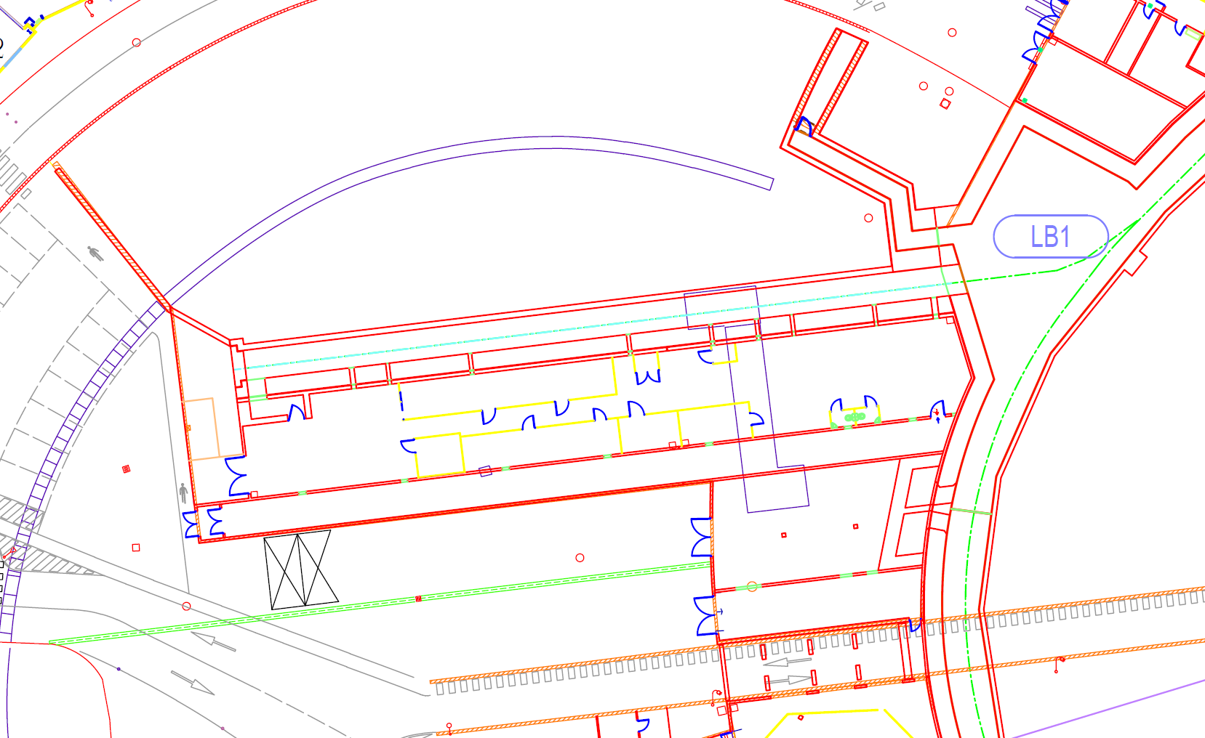
Phases of the Linac projects
WP06-operation: plan of installation
Linac refurbishment and Cold project phases
Safety issues
40.5 m
19.5 m
8 m
60 m
Gun
Bunch
Section1
Section1
Mod S 1
Mod S2
Mod S3
All X_ray sources must be declared to ASNR
Safety will ask for a single authorisation for linac refurbishment and for COLD projects and not phase by phase. To be done in the coming

Slide 2
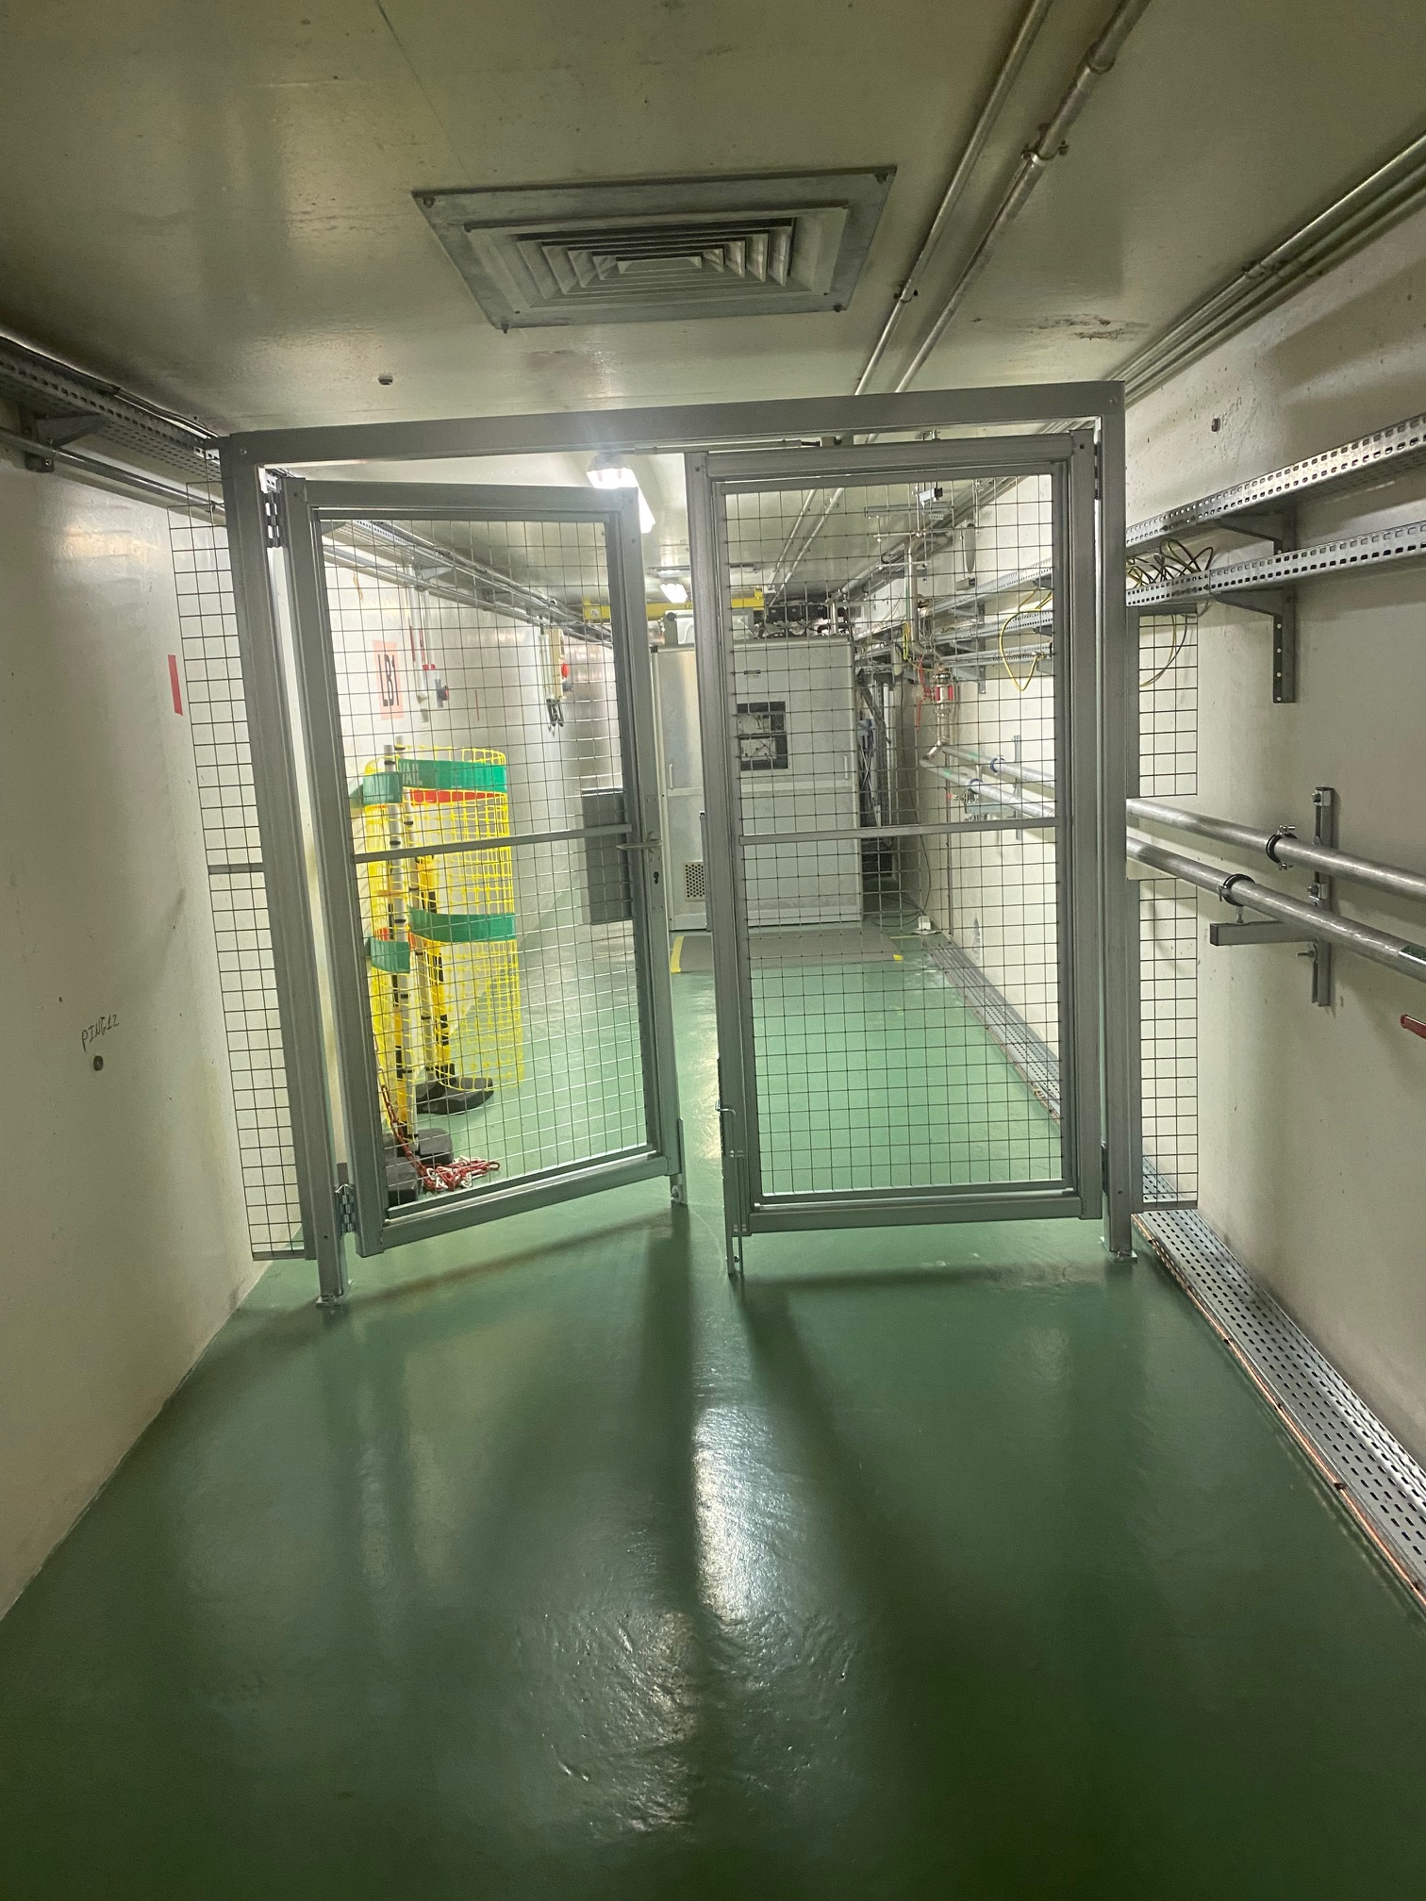
Phases of the Linac projects
Step 0
Present configuration
40.5 m
19.5 m
8 m
60 m
door
Gun
Bunch
Section1
Section1
Mod S 1
Mod S2
Mod S3
Status:
Operational
Objective: Injection in the booster
Door is installed
Door to be connected to PSS in October or winter shutdown
Modulator 3 disconnected from Linac

Slide 3
Phases of the Linac projects
Step 1
Project: Linac refurbishment
40.5 m
19.5 m
8 m
60 m
door
Section0
Gun
Bunch
Section1
Section1
Mod S3
Mod S 1
Mod S2
Mod S0
Objective: Validation of spare section with RF
RF Conditioning of spare section using Mod_S_3
SAT of Scandinova modulator Mod_S_0
Operational test of Scandinova modulator Mod_S_0
Status:
Procurement of modulator and spare section
Infrastructure mostly prepared
Linac entrance to be validated (how to and when)

Slide 4
Phases of the Linac projects
Step 2
Project: Linac refurbishment
40.5 m
19.5 m
8 m
60 m
door
Diag &Dump
Section0
Bunch
Gun
Gun
Bunch
Section1
Section1
Mod S3
Mod S 1
Mod S2
Mod S0
Gun
Status:
Design
Objective: Spare section validation with beam
Assembly of spare gun in teststand
Installation diag and beam dump
Installation of the assembled gun in tunnel
Beam at 135 MeV
➔ full operational spares for the present Linac

Slide 5
Phases of the Linac projects
Step 3
Project: COLD
40.5 m
19.5 m
8 m
60 m
door
C3_1
Diag &Dump
Section0
Bunch
Gun
Gun
Bunch
Section1
Section1
Mod C1
Mod S3
Mod S 1
Mod S2
Mod S3
Status:
Design and collaboration
Objective: SLAC C³ section validation with RF
SAT scandinova C_band modulator Mod_C_1
Installation SLAC C³ section in the tunnel
C3 cooling operationnal
RF conditioning C³ section

Slide 6
Phases of the Linac projects
Step 4
Project: COLD
40.5 m
19.5 m
8 m
60 m
door
Laser
Gun
C3_1
Diag &Dump
Section0
Bunch
Gun
Gun
Bunch
Section1
Section1
Mod Gun
Mod C1
Mod S3
Mod S 1
Mod S2
Mod S3
Status:
Design
Objective: SLAC C³ section validation with beam
Installation laser &Gun
Refurbishment diag and beam dump
Beam at 170 MeV

Slide 7
Phases of the Linac projects
Step 5
Project: COLD Phase 2
40.5 m
19.5 m
8 m
60 m
door
Laser
Gun
C3_1
C3_2
Diag &Dump
Gun
Bunch
Section1
Section1
Mod Gun
Mod C1
Mod C2
Mod S3
Mod S 1
Mod S2
Mod S3
Status:
Study
Objective: Preparation new linac as pre-injector
Installation second SLAC cryomodule
Installation second C band modulator Mod_C_2
Beam at 325 MeV

Slide 8
Phases of the Linac projects
Step 6
Project: COLD Phase 2
40.5 m
19.5 m
8 m
60 m
door
Laser
Gun
C3_1
C3_2
Diag &Dump
Gun
Bunch
Section1
Section1
Mod Gun
Mod C1
Mod C2
Mod S3
Mod S 1
Mod S2
Mod S3
Status:
Proposal
Objective: Injection in Booster
Transfer line
TL1 adaptation
Present linac kept as spare if possible

Slide 9
Master planning
Step 1 | year | Instrument added to the installation | project
Step 1 | 2025-second semester | Mod3 RF-unit displacement | Linac refurbishment
Step 1 | 2025-second semester | Mod0 S-band RF-unit (SAT) | Linac refurbishment
Step 1 | 2026-first semester | 6m section (RF Cond) | Linac refurbishment
Step 2 | 2025-second semester | Thermo-ionic gun assembly teststand | Linac refurbishment
Step 4 | 2026-second semester | Gun S-band RF-unit (SAT) | COLD
Step 2 | 2026-second semester | Thermoionic gun in tunnel | Linac refurbishment
Step 2 | 2026-second semester | Diag and beam dump in tunnel | Linac refurbishment
Step 2 | 2026-second semester | 135MeV Beam | Linac refurbishment
Step 3 | 2027-second semester | First C-band RF-unit | COLD
Step 3 | 2027-second semester | First C-band acc. Struct. | COLD
Step 4 | 2028-first semester | S-band photo-gun + laser | COLD
Step 4 | 2028-first semester | Diag and beam dump upgrade | COLD
Step 4 | 2029-first semester | 170MeV beam | COLD
Step 5 | 2030-first semester | Second C-band RF-unit and acc.struct | COLD phase 2
Step 5 | 2030-second semester | 325MeV beam | COLD phase 2
Step 6 | 2031-first semester | TL1upgrade and inject in booster | COLD phase 2

Slide 10
Safety aspects of linac projects planning overview
1) Tunnel preparation in front of the existing linac:
  Radiation level measurement during a standard injection (March 2025 restart, Friday 21 March) ➔ Done ➔ 1 moco sivert max linac ON
  Define position of equipment (April 2025) (meeting with BIG in 2 weeks) ➔ Work done
  Installation of a fence or lead door to inhibit LB1&2 radiation monitors (summer 2025) ) ➔ Done
  Modification of PSS to include the fence door (October 2025) ) ➔ October 2025
  Purchase and install of modern LB1&2 radiation monitors (October) ) ➔ Ordered
  Upgrade of PSS to create a dedicated test zone (to be evaluate, end 2025) ) ➔ New zone created but not accessible with Linac ON
2) Linac refurbishment
  Displacement of Modulator 3 (Summer 2025) ) ➔ In progress (shielding to be checked). SAT in Nov. To be declared ASN needed end 2025
  Installation of a new Scandinova modulator at the place of Mod3 (Second half 2025, ASN authorization for klystron needed end 2025) ) ➔ SAT in Nov.
  Installation in the tunnel and conditioning of the spare S band section (6 m long) (End 2025) ) ➔ install winter 2025, ready for cond beginning 2026
  Assembly of the spare gun (second half 2025) ) ➔ In progress in the linac teststand End 2025 tested.
  Installation of the available spare thermo-ionic gun (first half 2026), a beam dump and diagnostics. (To be confirmed) ) ➔ Confirmed second half 2026
  beam at 125 MeV in the spare section (end of first half 2026) (To be confirmed, ASN for a new Linac begin 2026) ➔ Confirmed second half 2026. max energy135 MeV.. Need ASN authorization for a new linac.
  Store the S band spare section in the tunnel (end 2026)
3) New Linac demo: COLD C3 operation linac demonstrator
  Installation of the INFN photo gun and (5-6MeV) including the laser system (End2026, description to provide) ) ➔ 2028
  Upgrade and Instillation of modulator 0 for the gun (Beginning 2027) ) ➔ Dedicated modulator ordered
  Installation of C band section in place of the S band (2 cells of 1 m) (First half 2027) ) ➔ Confirmed
  Installation of a new Scandinova modulator for section powering (First half 2027, ASN authorization for klystron, begin 2027) ) ➔ Confirmed
  Rf conditioning of C band section (Mid 2027) ) ➔ Confirmed
  Beam in the C band section at 150 MeV max (Beginning 2028, ASN for a new Linac begin 2027 ) ) ➔ Probably beginning 2029
4) Full energy linac injector preparation
  Project specification and CDR (End 2026-mid 2027) ) ➔ in progress
  300 to 500 MeV linac for injection into the Booster for full validation of the technology (To be confirmed, Medium Term Plan if demo successful) ) ➔ Project at 325 MeV to inject in the booster Confirmed for 2030 if all other phases are successful
  Full energy linac including new infrastructure (To be endorsed by council, Long Term Plan)

