Slide 1
S.Liuzzo on behalf of the COLD project team:
A.D’Elia, P.Borwiec, V.Serriere, M.Dubrulle, M.Morati, S.White, F. Ewald, N.Benoist, K.Scheidt, B.Roche, C.Benabderrahmane, G. Le Bec, R.Bourtenbourg, J.-L. Pons, D. Martin, B. Pelissier, L.Eybert, T.Brochard, C.Maccarrone, J.-L. Revol, B.Joly, Y.Gouez, H. Pedroso Marques, P.Colomp, A.Dely, Q.Qin
International collaborators
E.Nanni, A.Dhar, W.-H. Tan, G.Aymar (SLAC),
A.Latina (CERN),
D.Alesini, F.Cardelli, A.Giribono, C.Vaccarezza, G.Silvi (LNF),
M.Andorf, J.Maxson (Cornell),
P.Craievich, R.Zennaro (PSI)
Low energy, space charge dominated section of 6GeV Linac
Gun parameters vs emittance and bunch length

Slide 2
Summary table
Configuration | Gun | Solenoid | Energy | Length | Emittance | Bunch length
 |  |  |  | Target: | ~ 5 mm mrad | 0.6 ps
G-S-S | SPARC 120MV | 0.29 T |  | 4.3 m | 16 mm mrad | 1.6 ps
G-C-C | SPARC 120MV | 0.30 T |  | 4.3 m | 15 mm mrad | 1.7 ps
G-C-C | SPARC 160MV | 0.38 T |  | 4.3 m | 12.0 mm mrad | 1.0 ps
G-C-C | SPARC 250MV | 0.55 T |  | 4.3 m | 6.0 mm mrad | 0.5 ps
G-S(v.b.)-C-C | SPARC 120MV | 0.28 T |  | 6.0 m | 14.0 mm mrad | 1.2 ps
G-C-C | CLEAR 100MV | 0.32 T |  | 4.3 m | 17.7 mm mrad | 1.7 ps
G-C-C | CLEAR 120MV | 0.37 T | 160 MeV | 4.3 m | 10.5 mm mrad | 1.3 ps
G-S-S | CLEAR 120MV | 0.37 T | 162 MeV | 4.3 m | 7.6 mm mrad | 1.3 ps
G-S(v.b.)-S-S | CLEAR 120MV | 0.37 T | 170 MeV | 6.0 m | 7.6 mm mrad | 1.15ps
COLD
project
Common features:
700pC
Cu cathode
σ_{r} = 0.3 mm (uniform)
σ_{t} = 0.2 ps (gaussian)
E_{z} S band = 130.7MV/m
E_{z} C band = 135.0MV/m
May be with updated field maps, 1.3ps will be acceptable.
S-band structures produce lower emittance, and reach same final energy.
Increasing gun voltage seems more “efficient” then using velocity bunching.

Slide 3
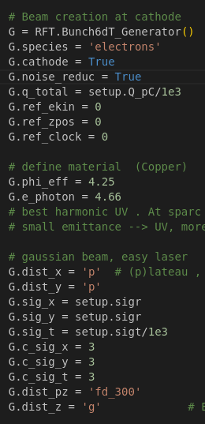
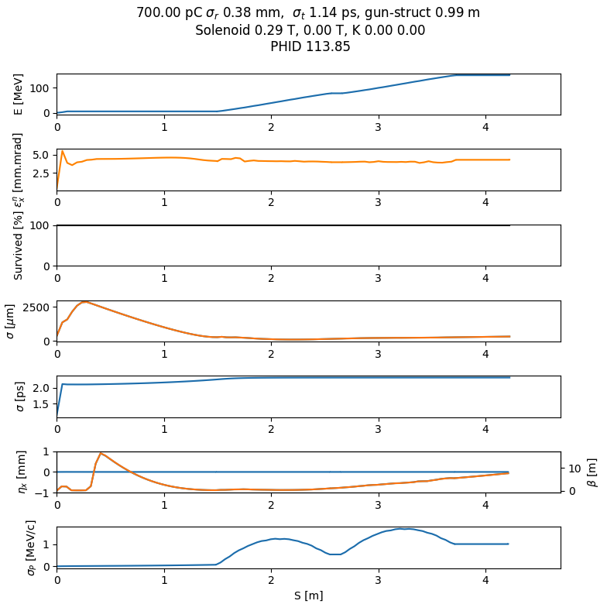
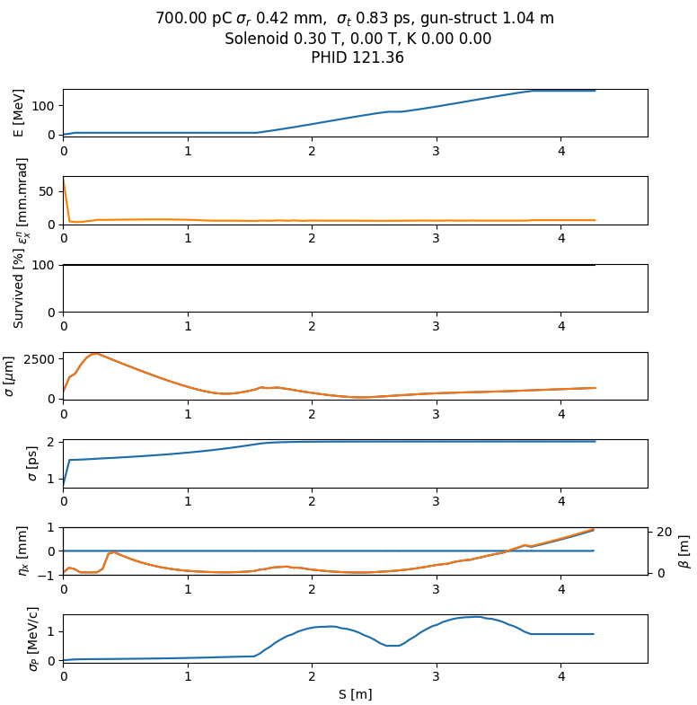
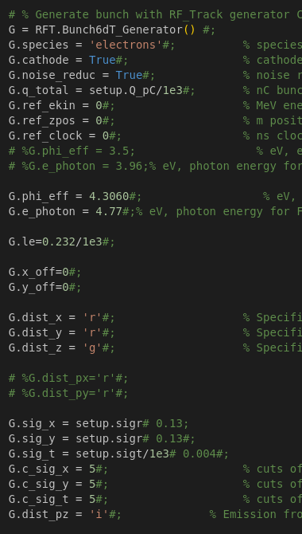
SwissFEL generator file for RF-Track from A.Latina (CERN)
'Bz': 0.29,
'DriftGunStruct': 0.98,
'PHID': 113.85,
'sigr': 0.375,
'sigt': 1.14
'Bz': 0.30,
'DriftGunStruct': 1.037,
'PHID': 121.36,
'sigr': 0.415,
'sigt': 0.825
4.3 mm.mrad
2.3 ps
6 mm.mrad
2.0 ps
SPARC-120MV-C-C
emit_4D from RF-Track, instead of 6D

Slide 4
Emittance and bunch length as a function of charge
charge | Emittance [mm mrad] | Bunch length [ps] | Bz [T] | Gun-struct [m] | σ_{r} [mm] | σ_{t} [ps] | PHI
700 pC | 5.4 | 1.6 | 0.287 | 0.95 | 0.507 | 0.10 | 101.5
500 pC | 4.0 | 1.35 | 0.297 | 0.95 | 0.492 | 0.10 | 108.0
200 pC | 1.9 (expected 0.35 ?) | 1.0 | 0.297 | 0.95 | 0.407 | 0.15 | 114.4
100 pC | 1.4 | 0.75 | 0.302 | 0.95 | 0.426 | 0.15 | 126.4
1 pC | 0.1 | 0.17 | 0.289 | 0.95 | 0.103 | 0.1 | 125.2
4D emittance: values more similar to G.Silvi (INFN) presentation from last meeting
For every current and Xopt optimization was run varying:
Solenoid field
Distance gun-structure (about 1m)
Gun phase
Laser spot size
Laser spot length
The target of optimization is:
small emittance,
short bunch length and
100% transfer.
Used as in a single objective Bayesian optimization to minimize:
emitt_x * bl + 10 * lost / total

Slide 5
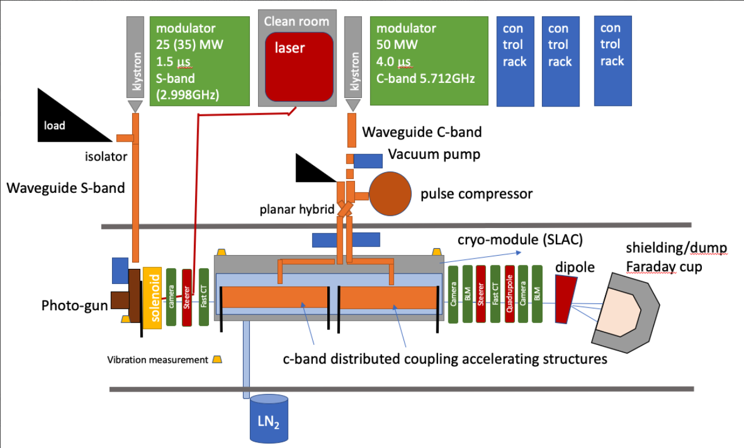
Next actions
Redaction of CDR (editable link): https://www.overleaf.com/7899755955tmcgtsjgcdkt#10571a
(just for the demonstrator, for the moment it is just a very rough draft starting from IPAC 2025 paper)
Redaction of mid/long term plan ( 6GeV linac and COLD demonstrator)
Complete table of requested information for infrastructure feasibility report.
Definition of layout, including diagnostics, magnets, dump, etc… for the first 2 project phases (RF only and with beam)
Error/Tuning/Tolerance studies
etc..

Slide 6
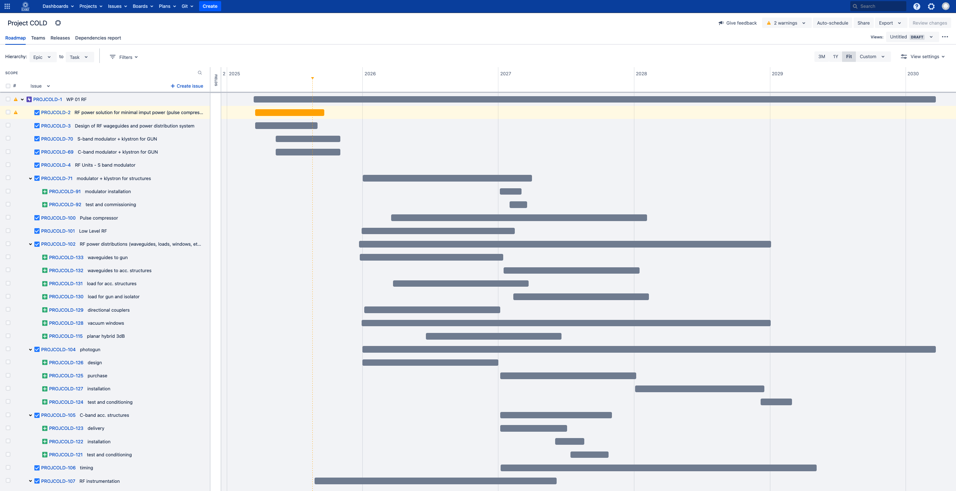
Internal ESRF Project follow up set up
Some modifications needed to be able to do RF tests in 2027

Slide 7

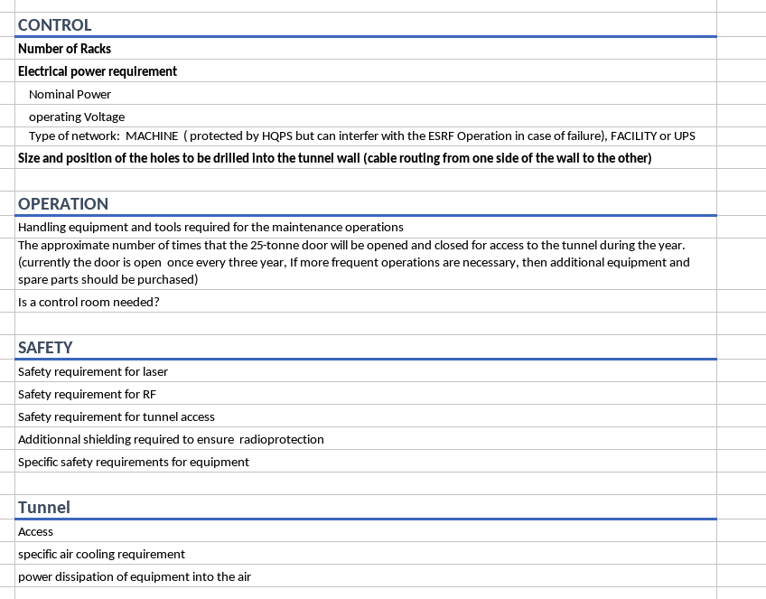
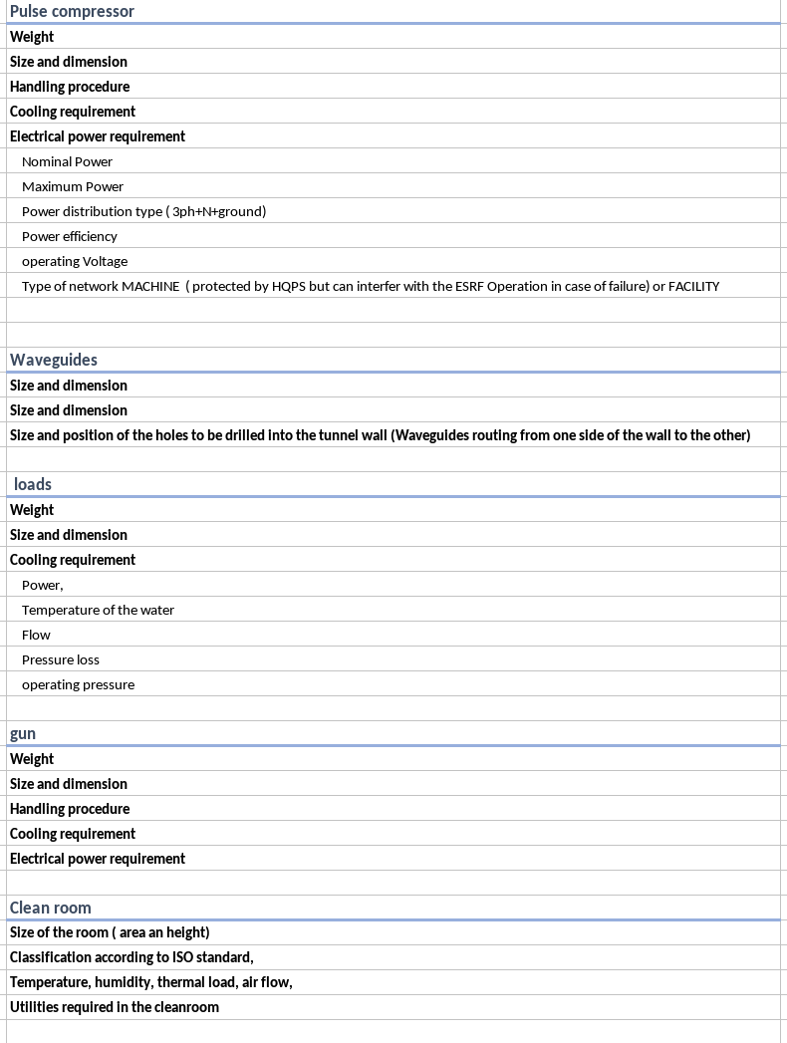
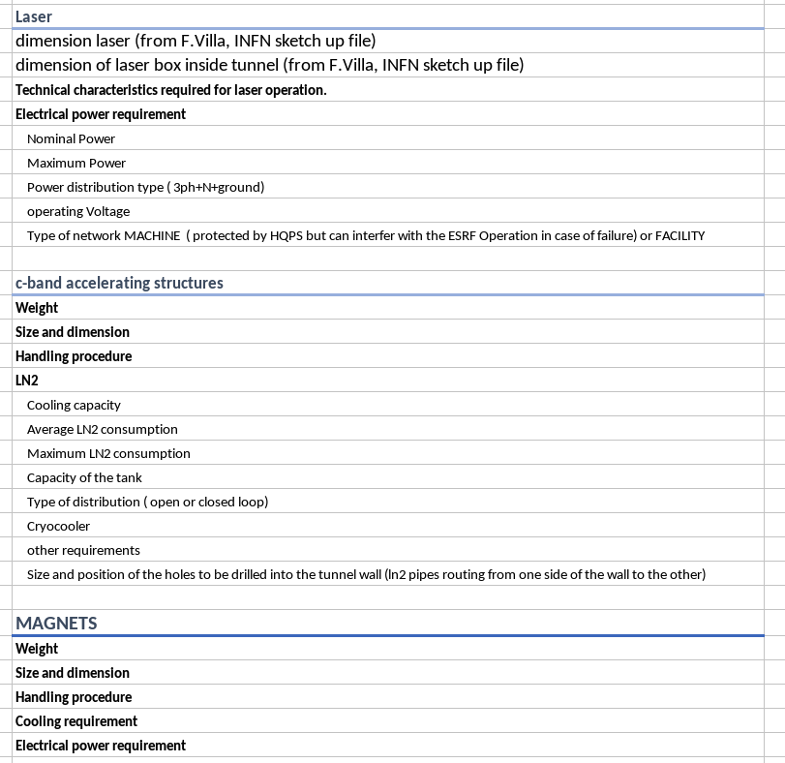
List of requested information for infrastructure feasibility report

