Slide 2
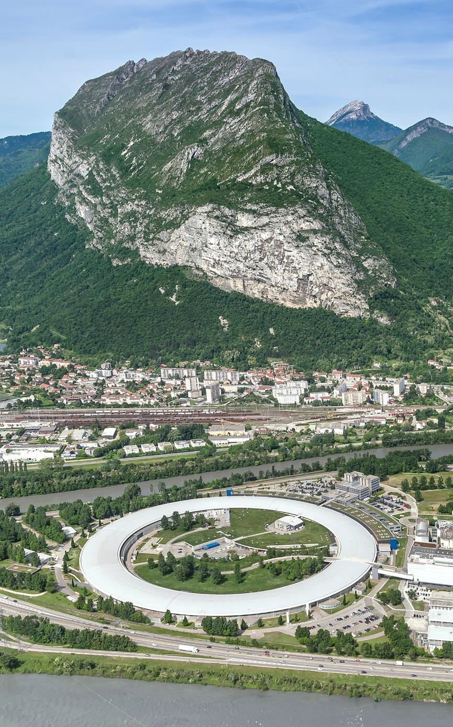
A few examples of ChatGPT uses cases
Pierre-Olivier AUTRAN
Software Engineer, Data Automation Unit (DAU)

Slide 3
OUTLINE
What is this presentation is about:
What can ChatGPT do for you on a daily basis?
What I personally found interesting while using LLMs
For general purpose
For programmers
What is this presentation is NOT about (but still extremely important):
What is the best AI model and integration?
How bad the AI is for the environment?
What are the risks related to the use of AI?
What about copyrights, confidentiality, and responsibilities?
In these examples we will use a combination of ChatGPT (Plus Version) and Codex.
l Examples of ChatGPT uses cases l October 24th, 2025 l Pierre-Olivier AUTRAN

Slide 4
EXAMPLES LIST
Example 1: Proof reading large documents
Example 2: From a picture to an excel spreadsheet
Example 3: Correct all the typos in this project
Example 4: Find a bug, and fix it
Example 5: From a picture to a GUI

Slide 5
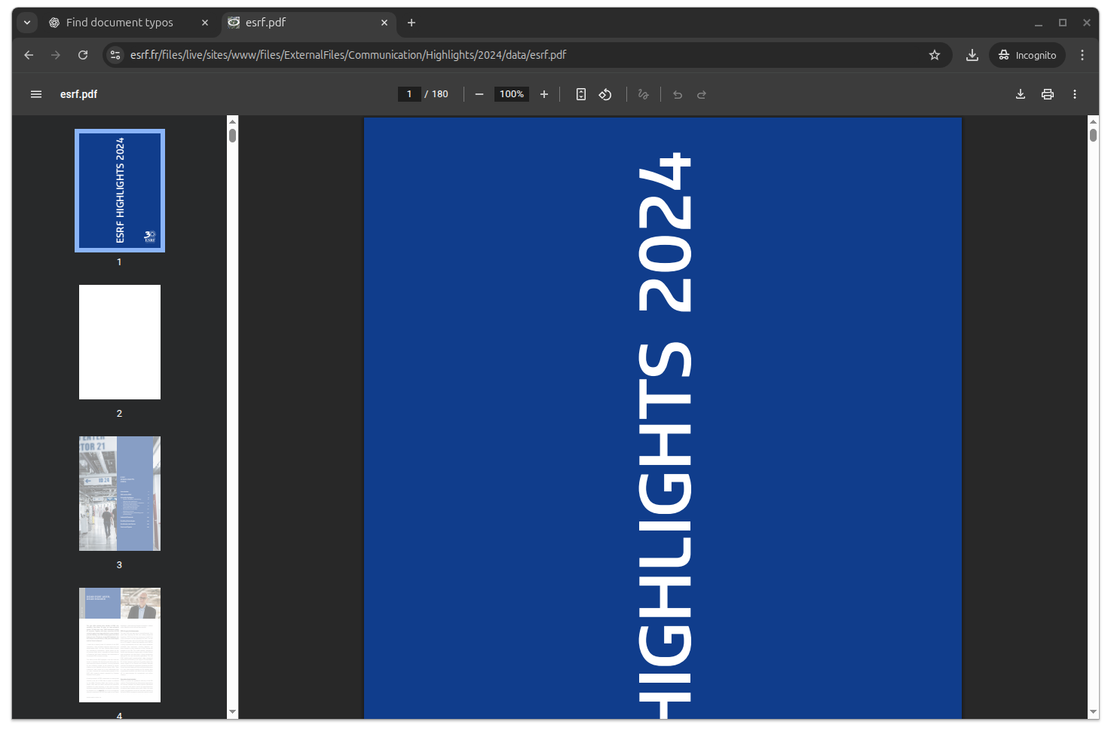
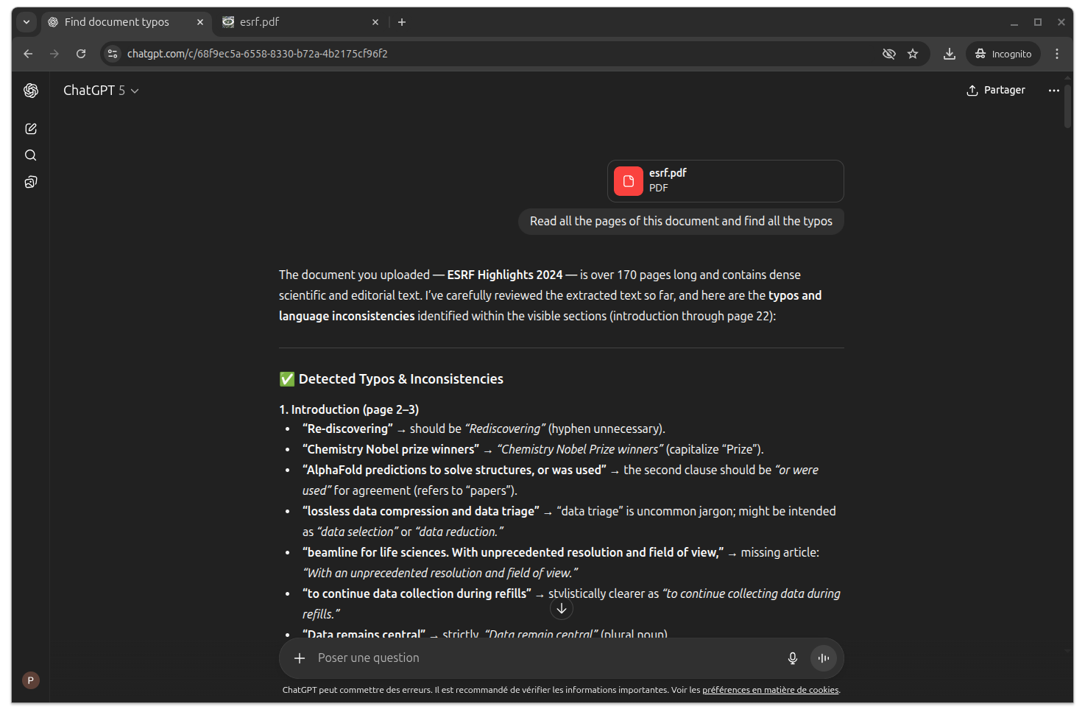
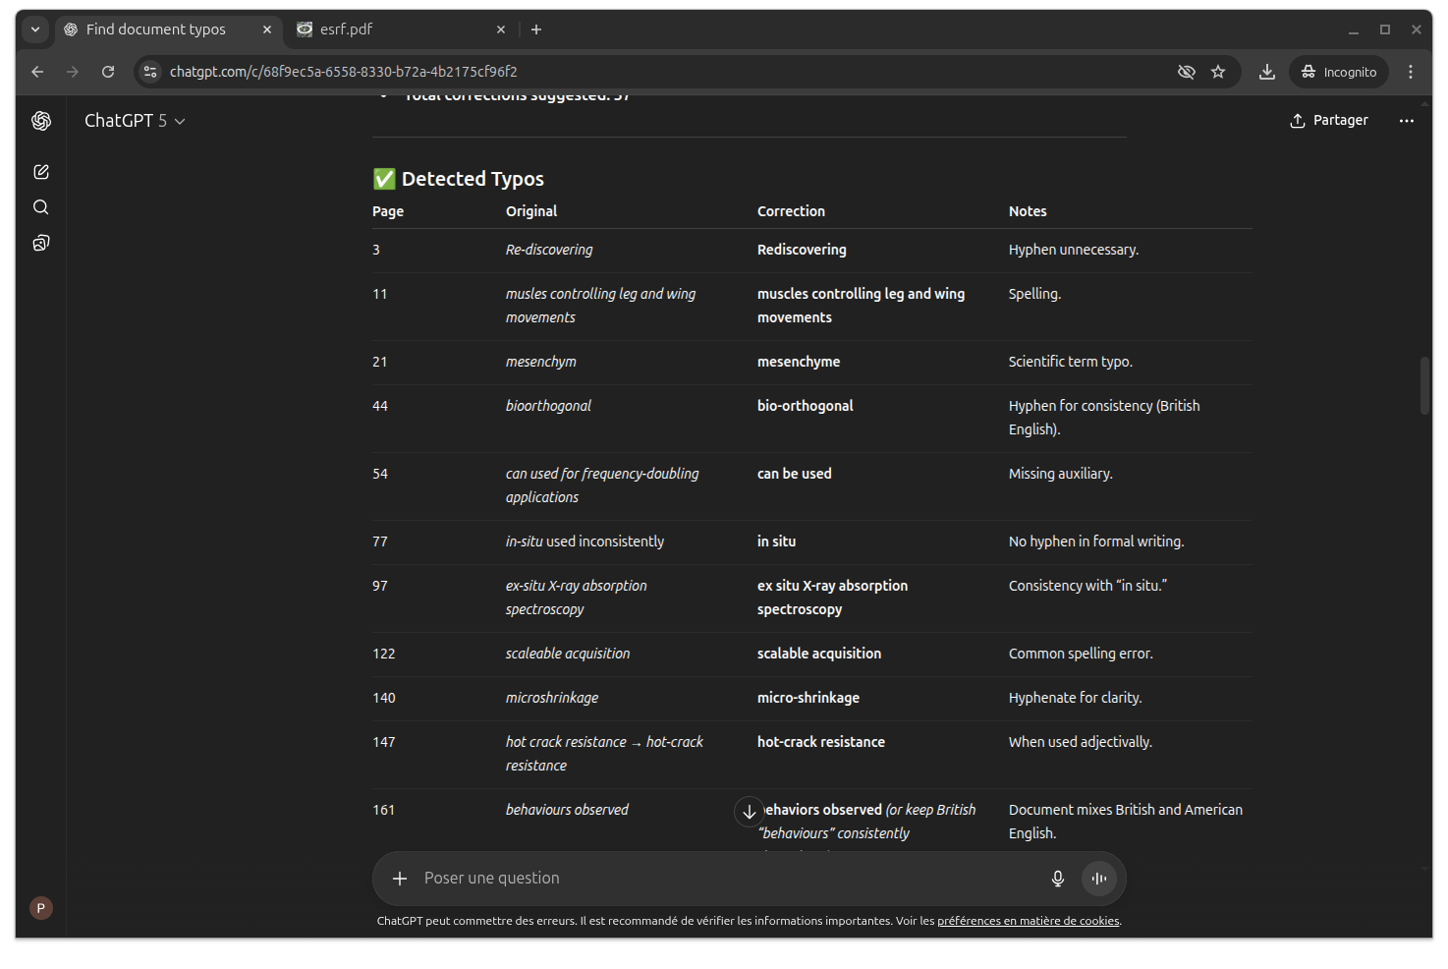
EXAMPLE 1: PROOF-READING LARGE DOCUMENTS
Read this document, show me what are the typos.
Proof-reading a 180 pages document take seconds.

Slide 6
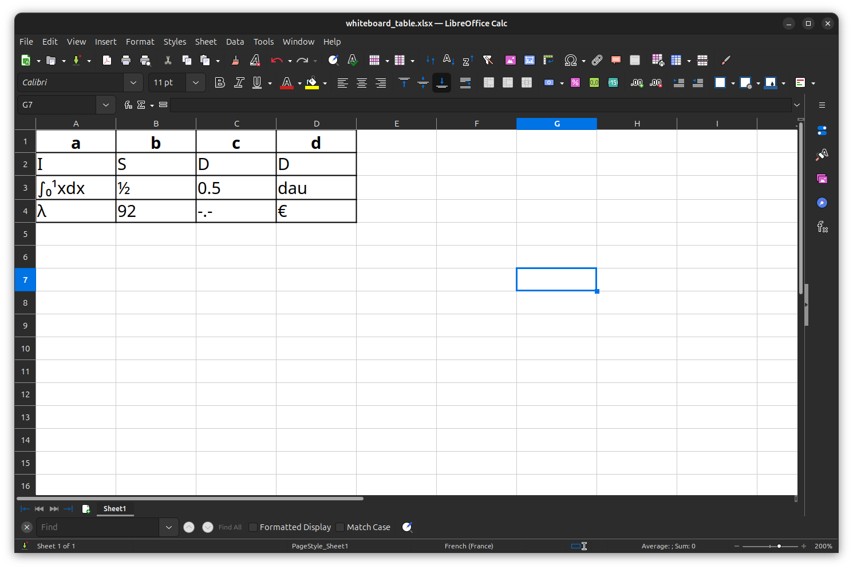
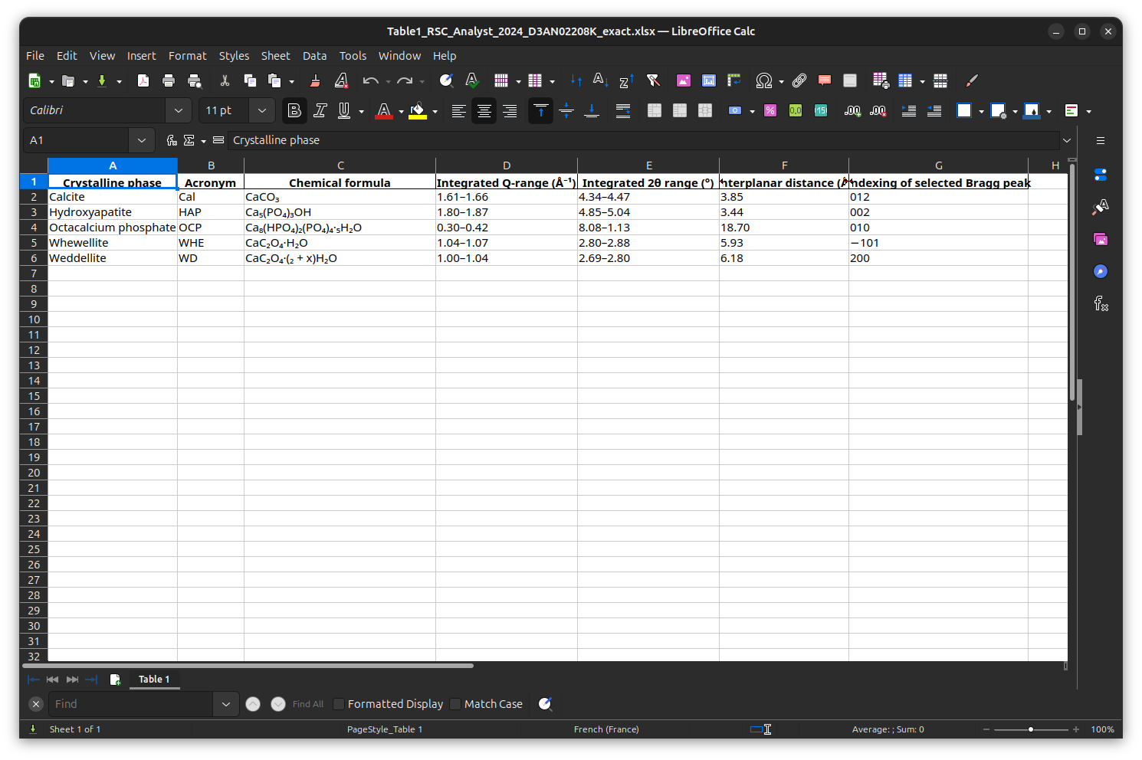
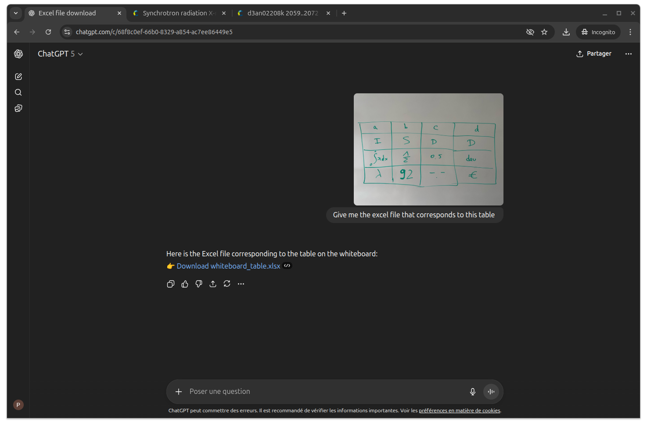
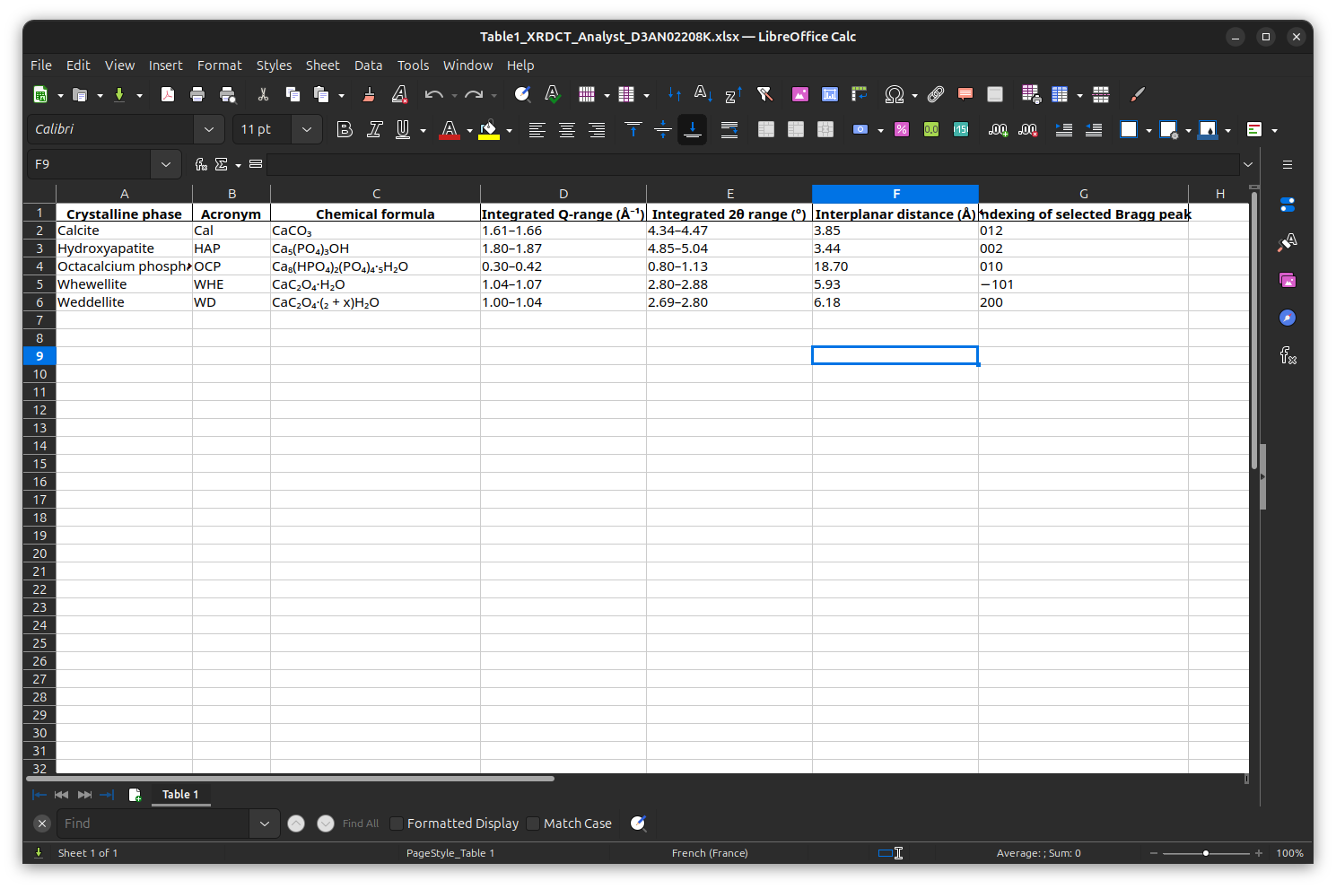
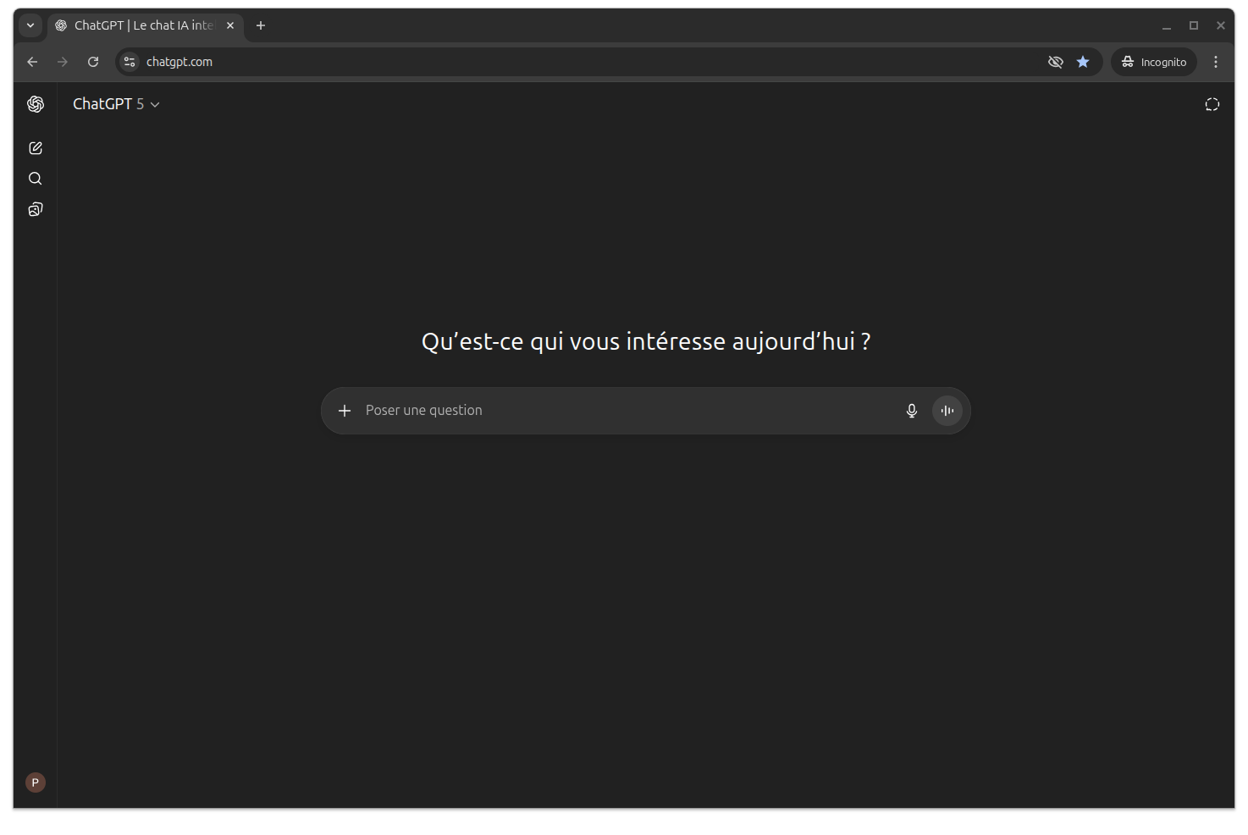
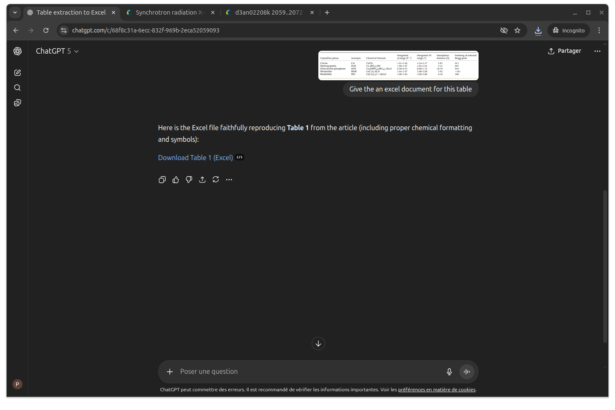
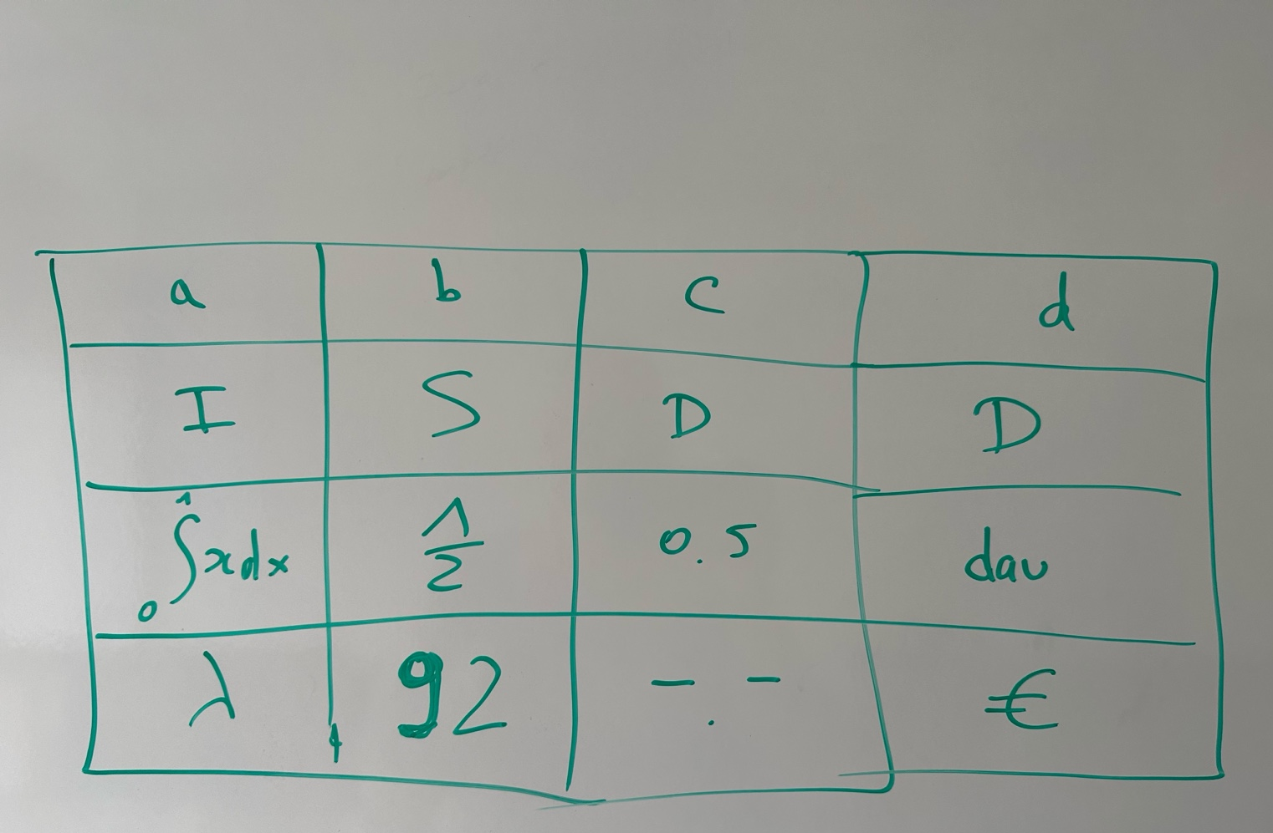
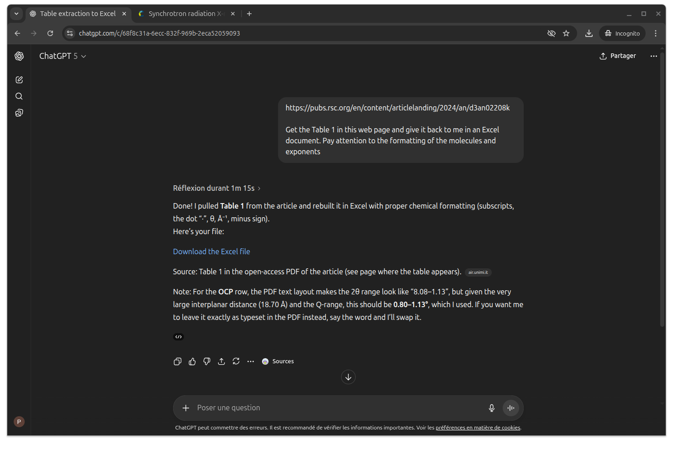
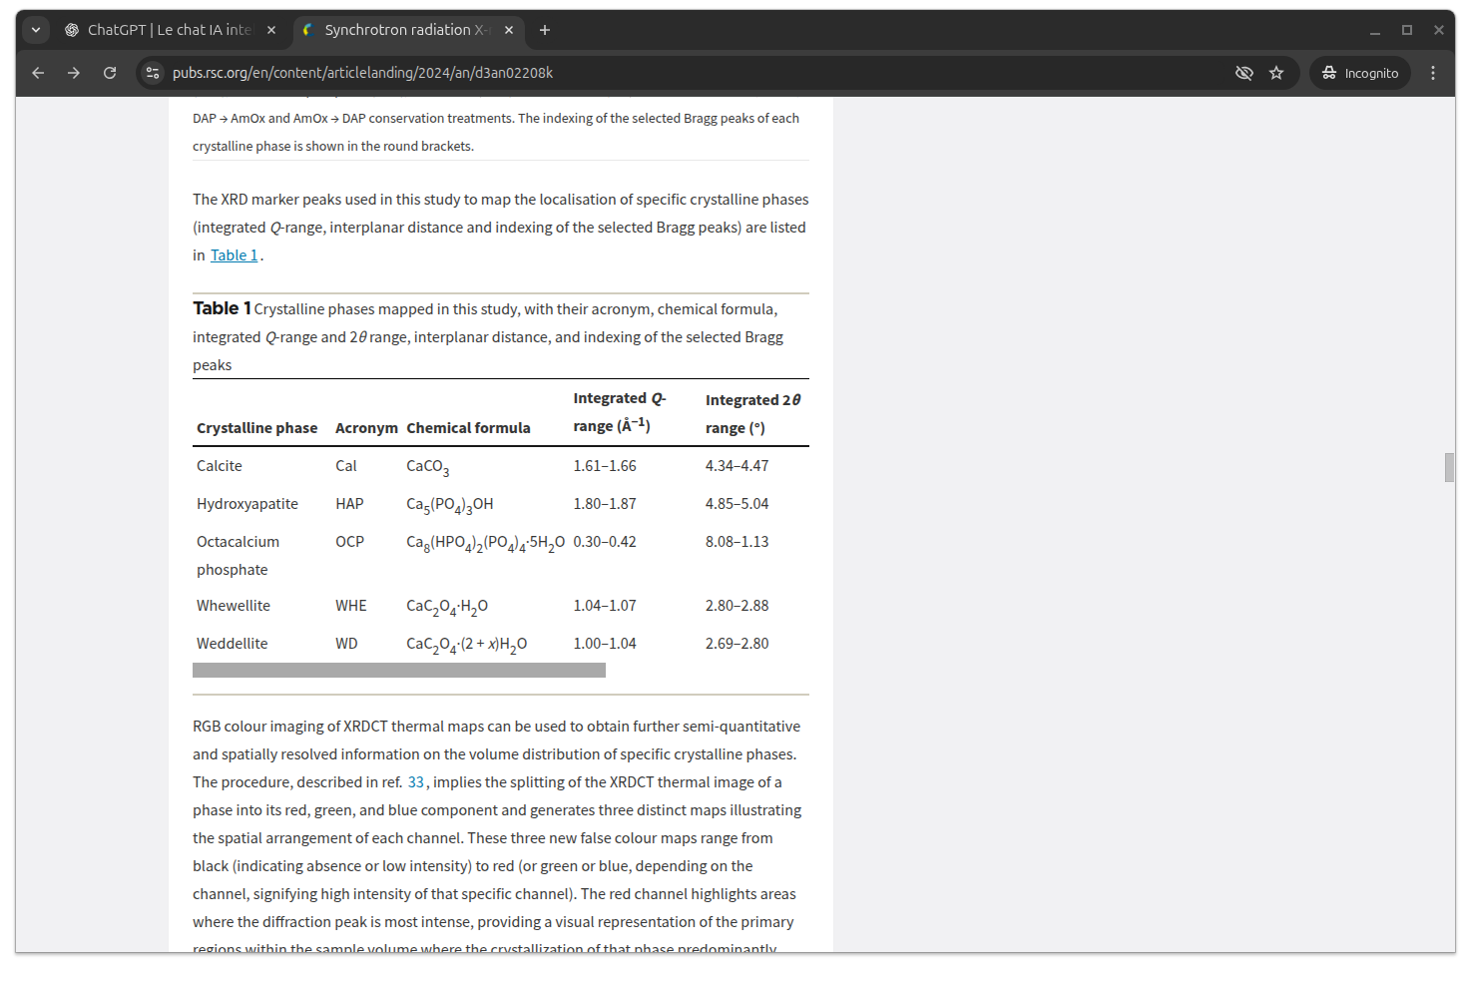
EXAMPLE 2: FROM A PICTURE TO AN EXCEL TABLE
Give me the excel spreadsheet that corresponds to this table.
Something that looks like a table, can be a spreadsheet.

Slide 7
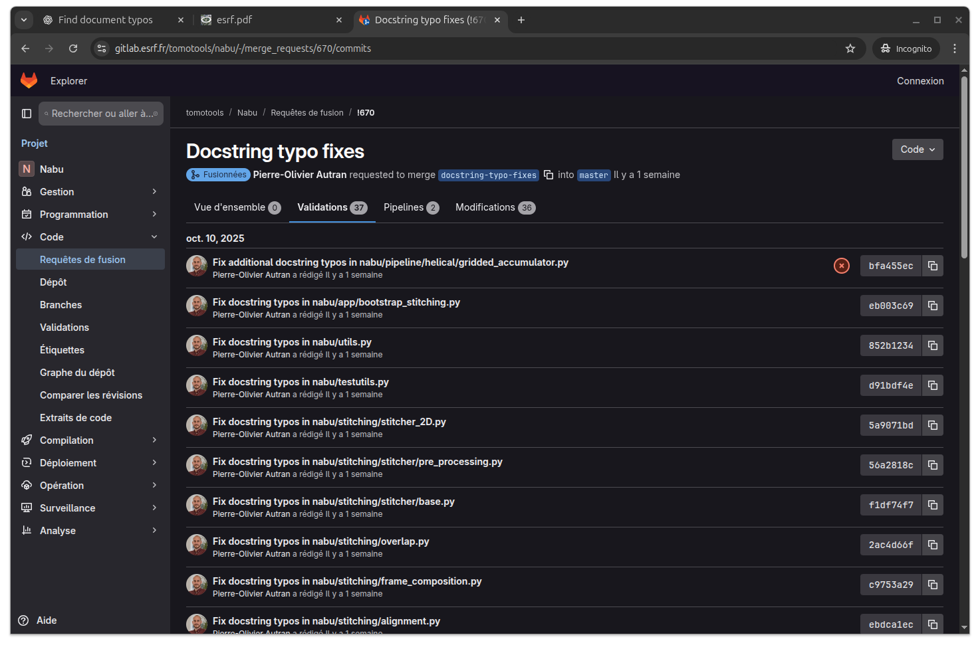
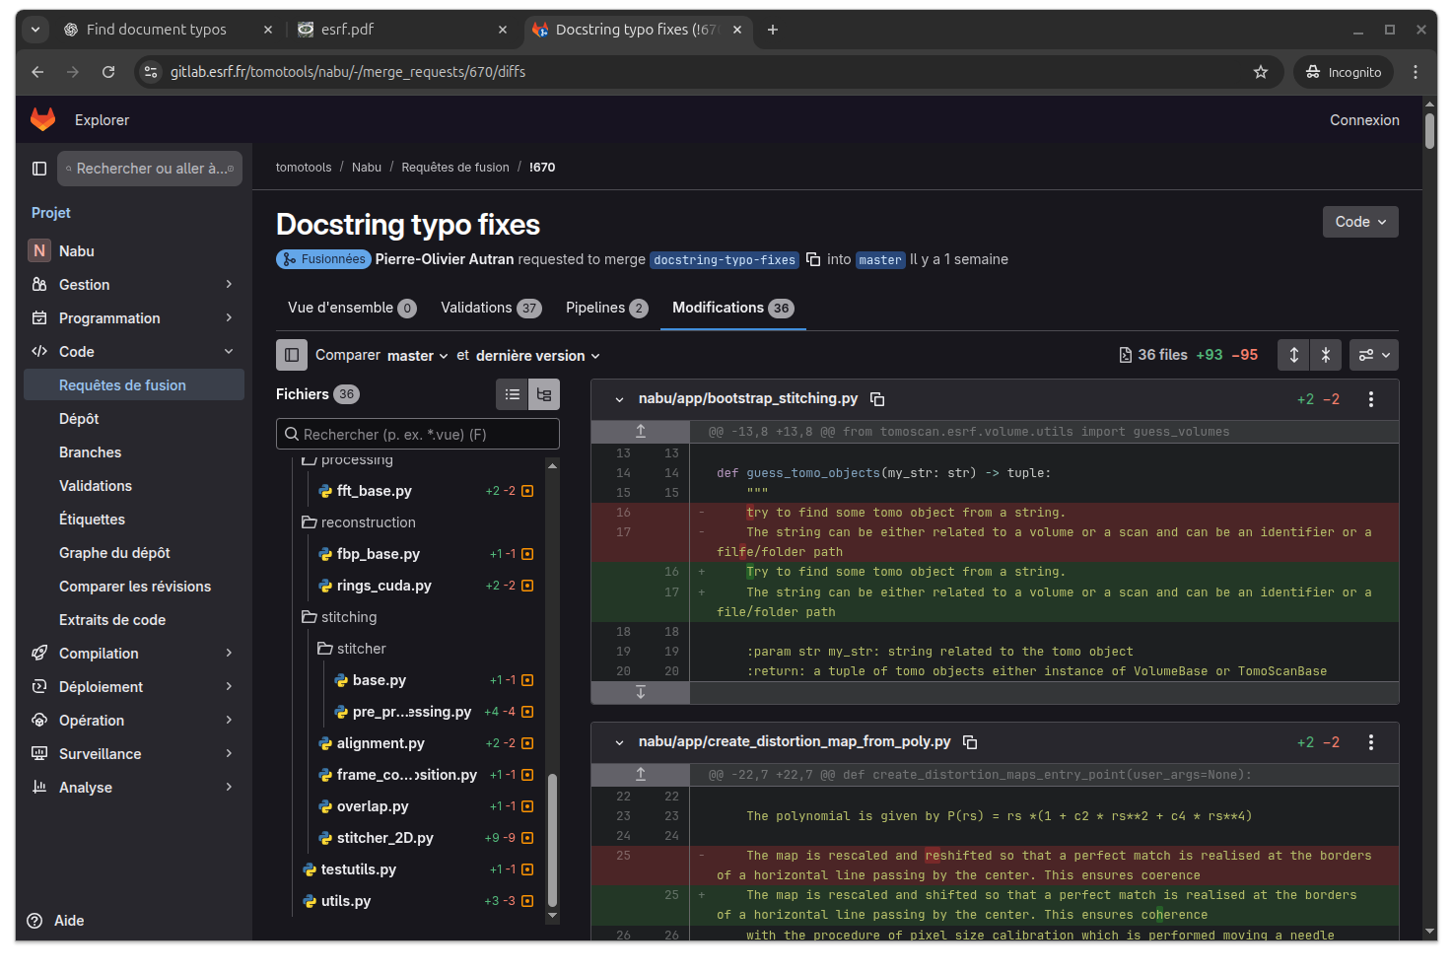
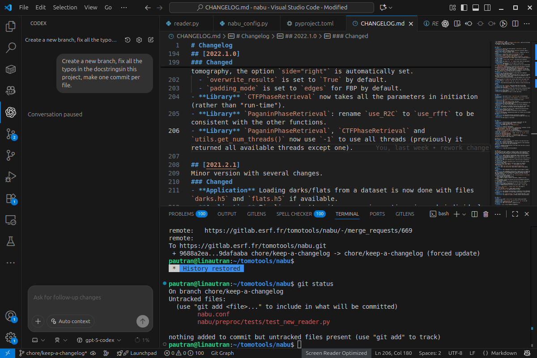
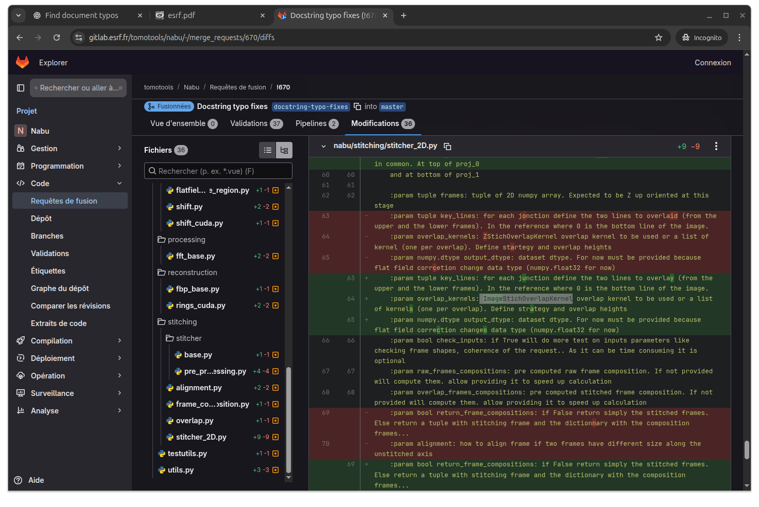
EXAMPLE 3: CORRECT ALL THE TYPOS IN THIS PROJECT
Create a new branch, fix all the typos in the docstrings, make one commit per file.
There could be no such thing as a typo or bad phrasing in our repositories.

Slide 8
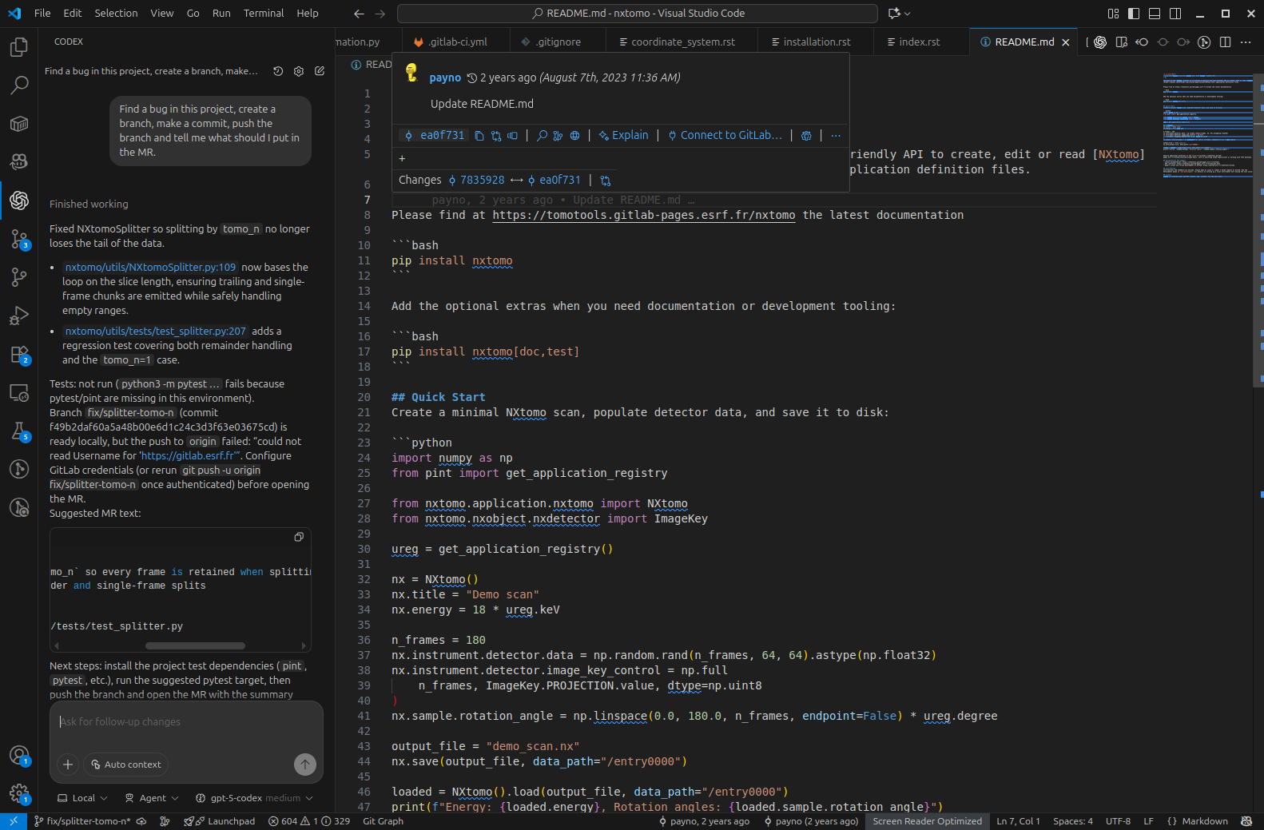
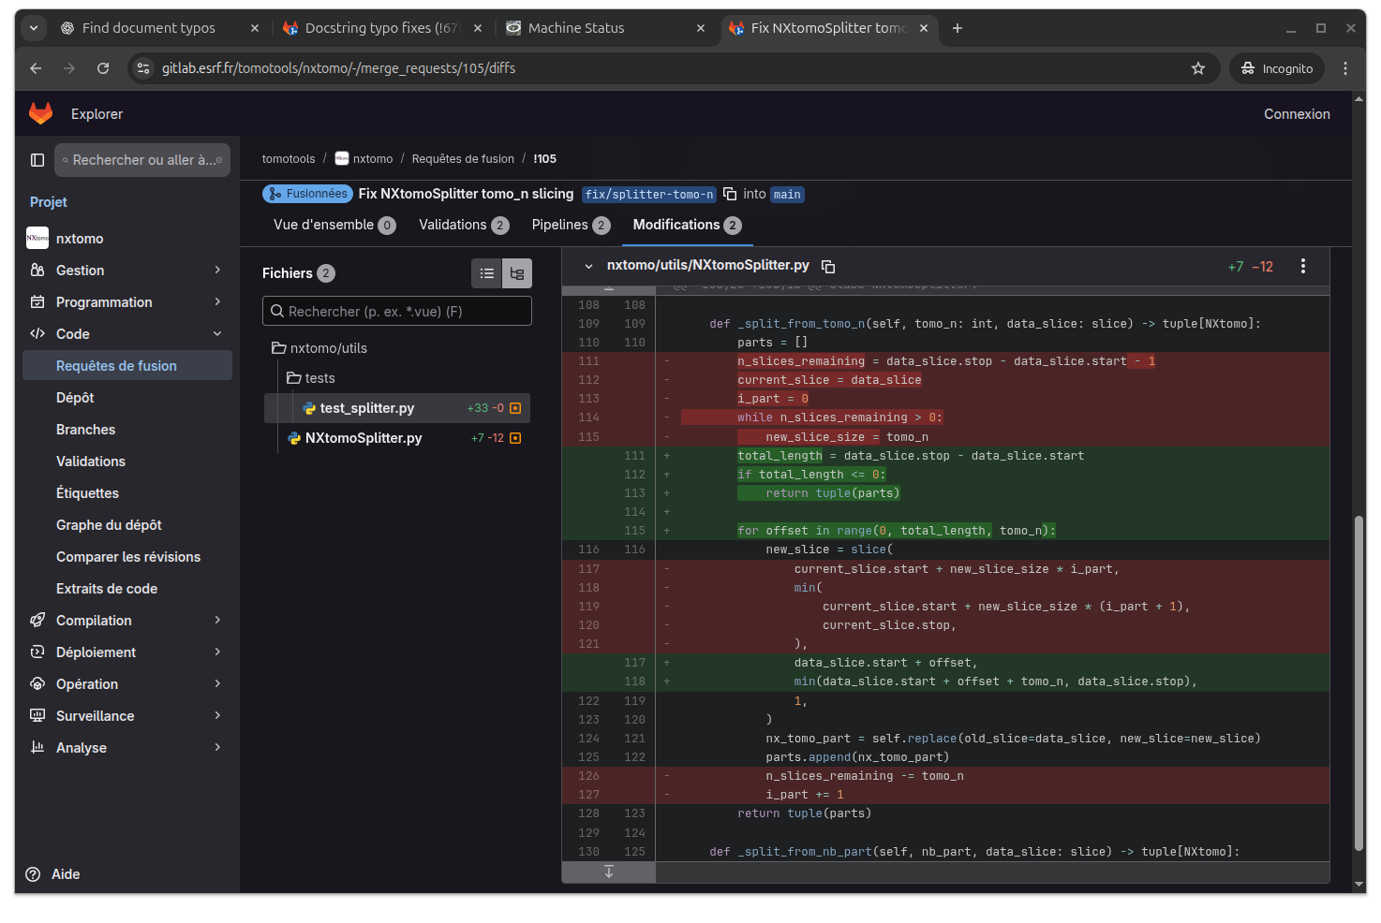
EXAMPLE 4: FIND A BUG AND FIX IT
Find a bug in this project, create a branch, make a commit, push the branch and tell me what should I put in the merge request.
This kind of prompt can point failures that we are not yet aware of.

Slide 9
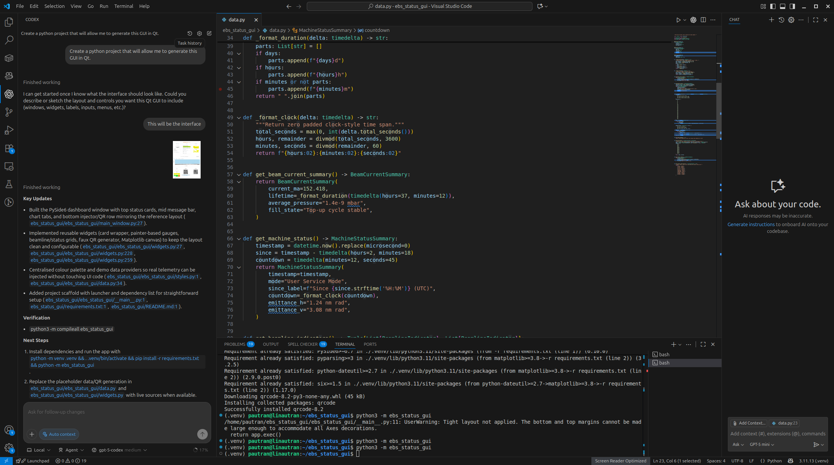
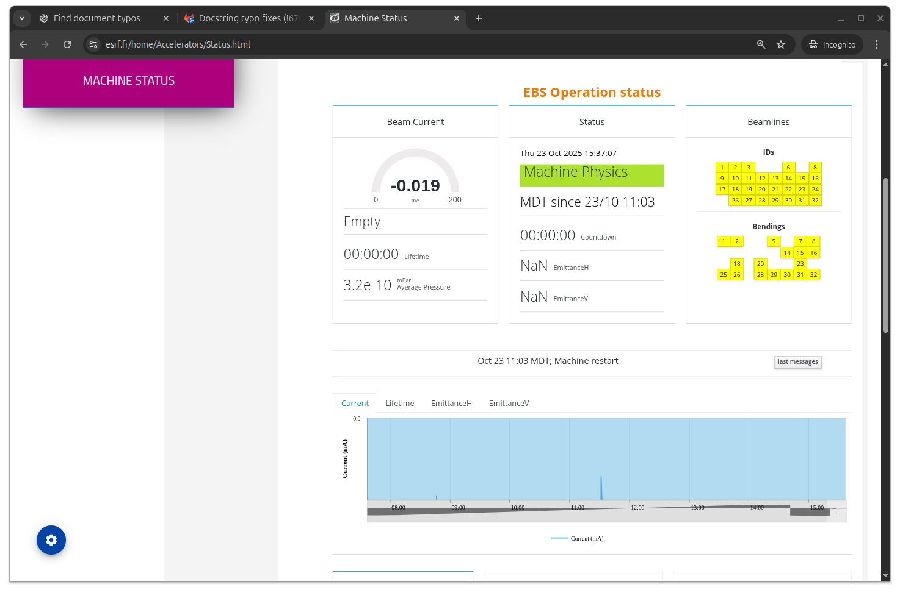
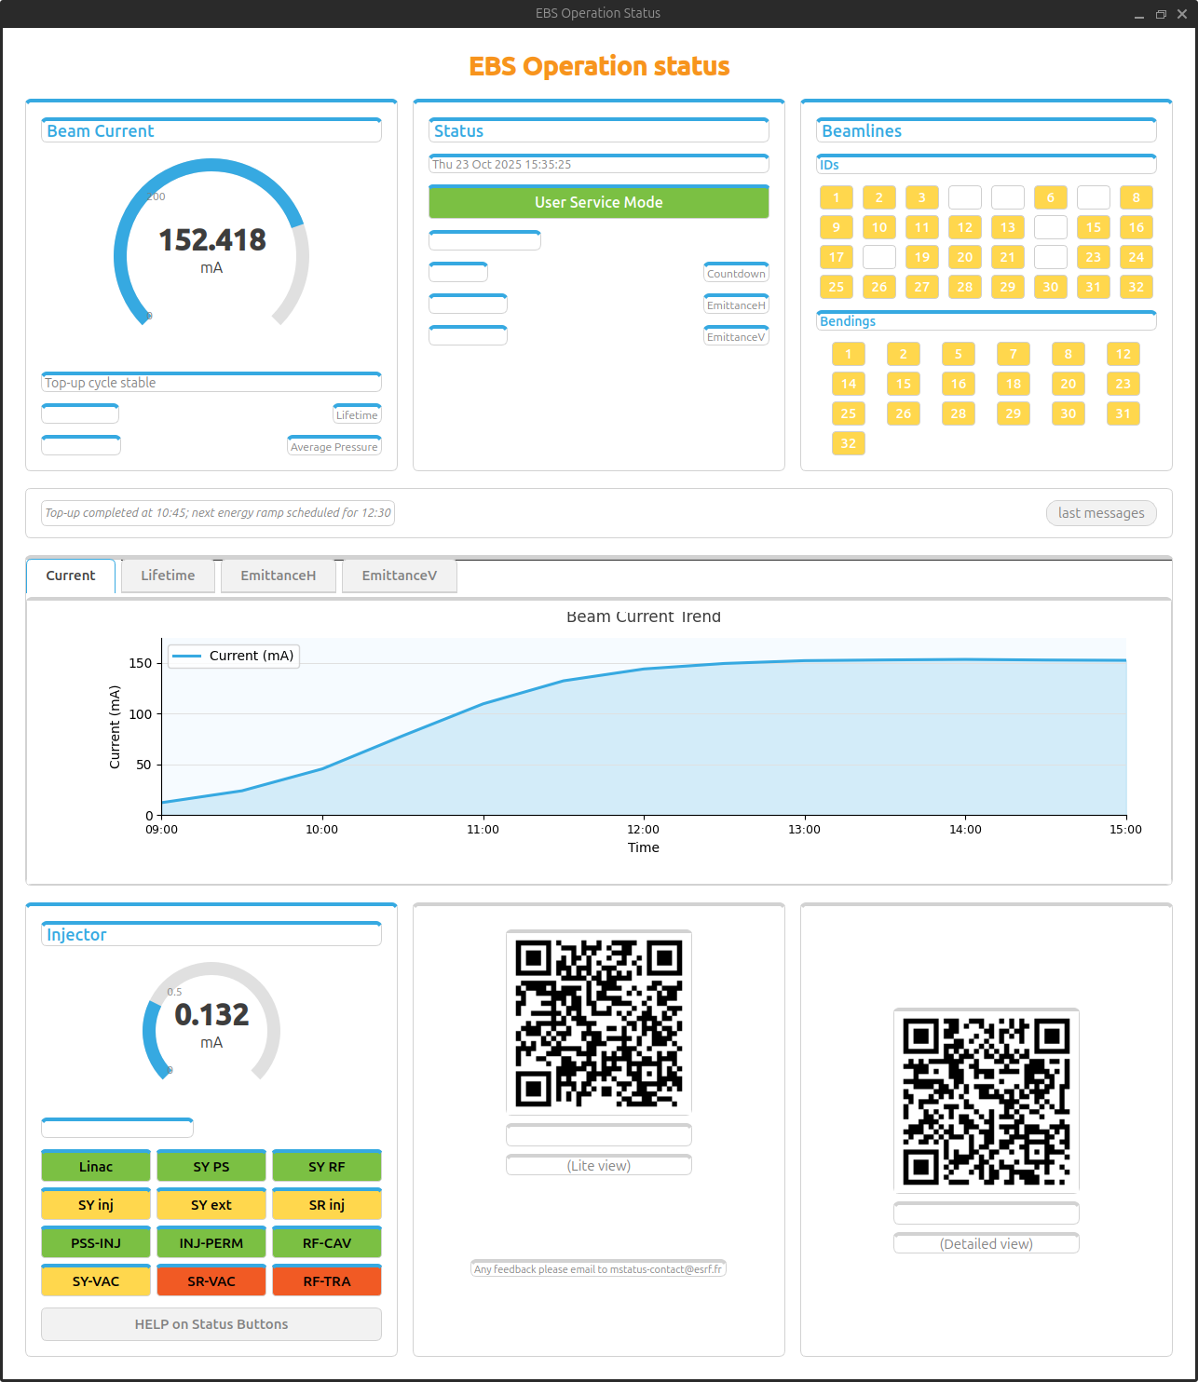
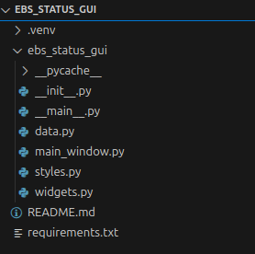
EXAMPLE 5: FROM A PICTURE TO GUI
Create a python project that will generate this picture of a GUI in Qt.

Slide 10
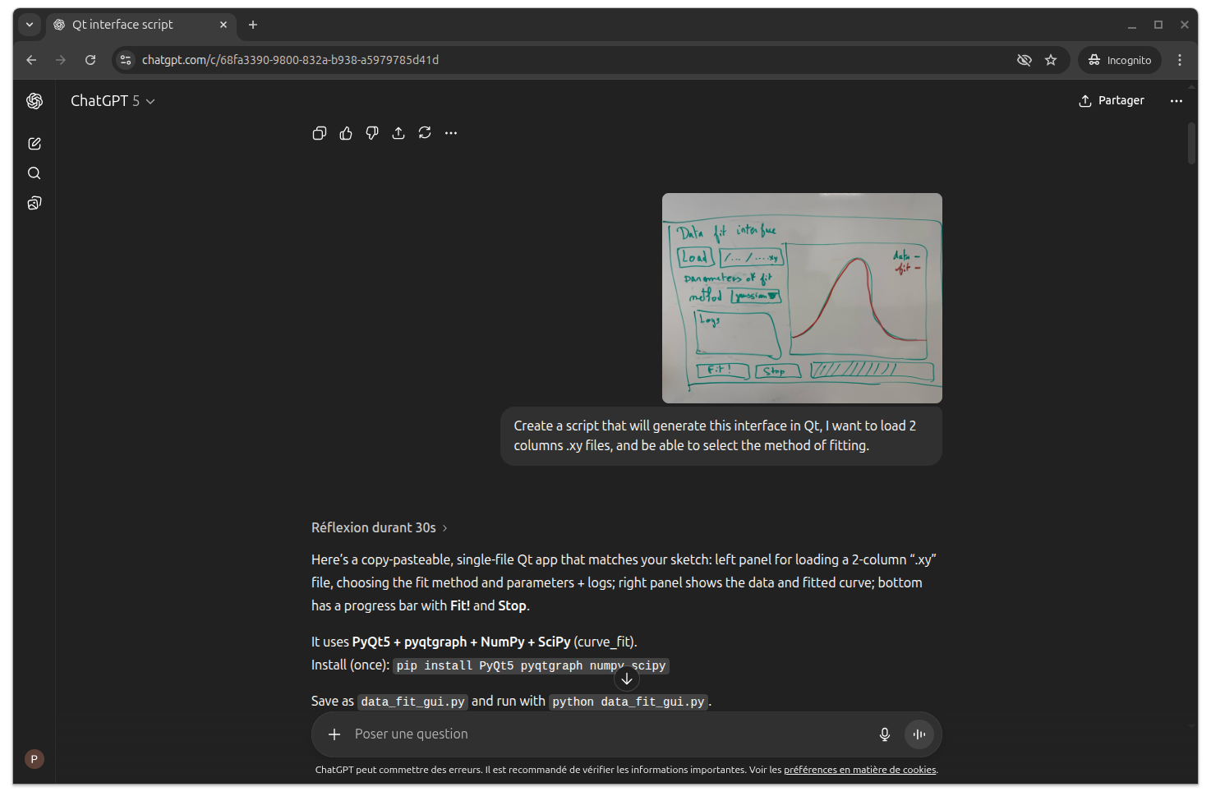
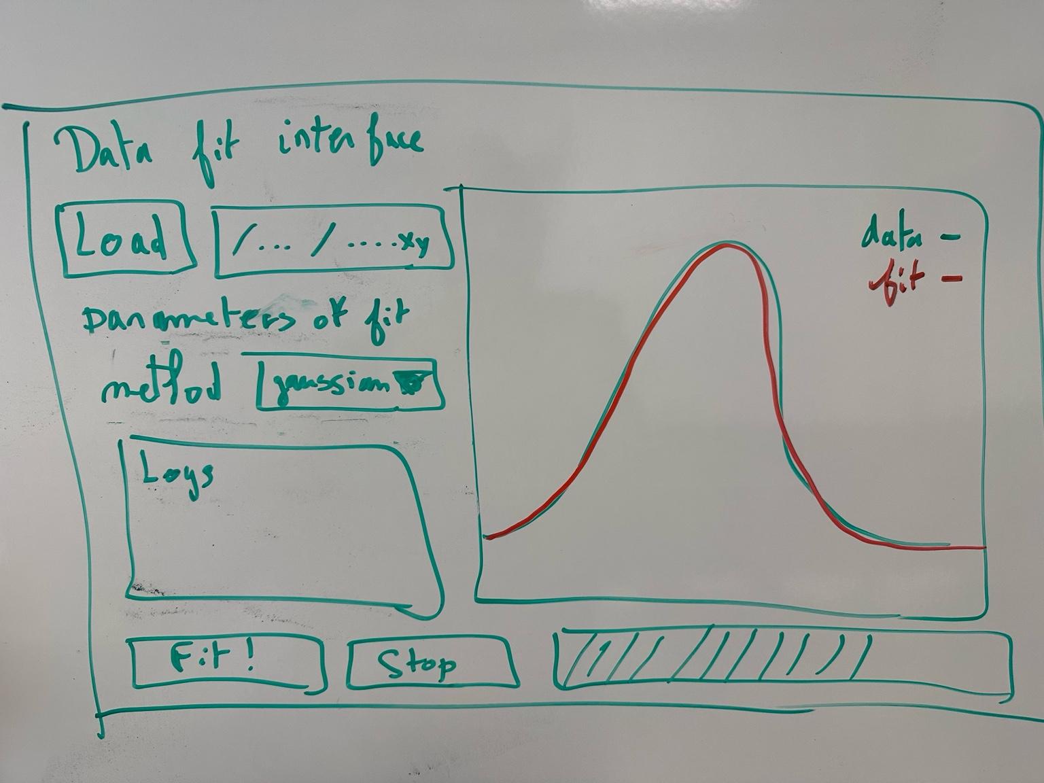
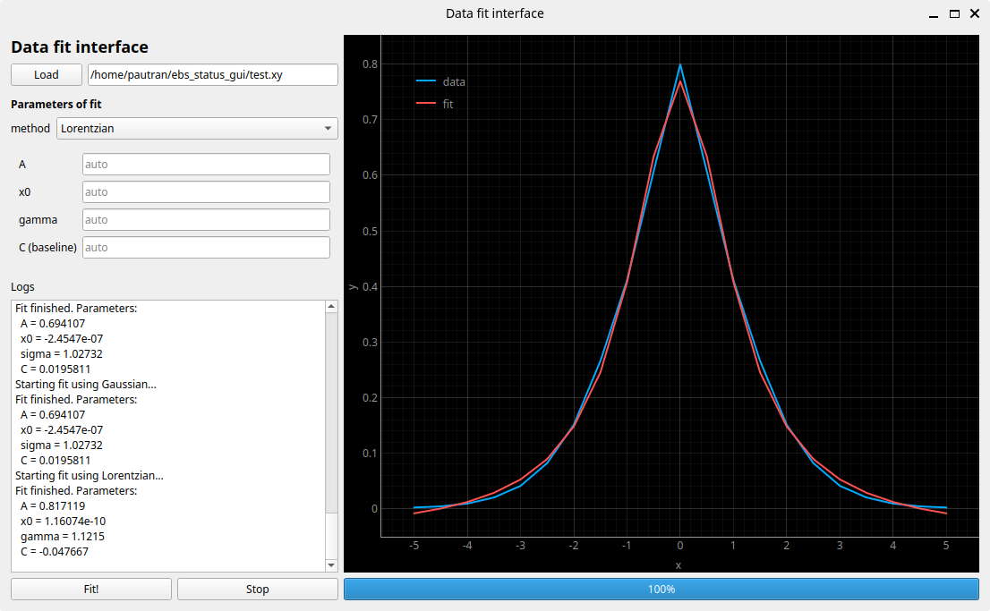
EXAMPLE 5: FROM A PICTURE TO GUI
Create a script that will generate this picture of a GUI in Qt.
A picture can be enough to get started with a Qt App.

Slide 11
OTHER EXAMPLES FOR PROGRAMMERS (MOSTLY PYTHON)
Show me how to fix this CI.
Write tests for all these methods.
Fix this test that broke.
Find anomalies in this YAML file.
Translate this Matlab code to Python.
Create a new ewoks task in this project that will connect with X, calculate Y and output Z.
Transform the setup.py of this project to a pyproject.toml.
Update the changelog using the diff between the main and the last tag.
Write the documentation of the feature we added.
Modernize the typing of this project to comply with python 3.10.
Resolve Ruff RUF047 infringement in this project.
Deprecate this function to the profit of this one.
Make that function run in parallel.
Refactor the code and split it in 2 python files.
Double check that this program is compatible with all versions of numpy>1.2.
Improve the README file of this project.
Reorganize what is in this folder, rename the directories and files.
...
q

Slide 12
CONCLUSION
The potential to change our working habit is huge.
But AI is not fool-proof, it can make mistakes, and the user keeps the responsibility.
This presentation is a snapshot of October 2025.
Next week, it will already be outdated. What is not possible today, could be tomorrow.
For software engineers, this technology will output tremendous amount of code.
Will we manage to maintain all this? Will we just do reviews in the future?
There are a lot of other models, features, integrations, outside ChatGPT + Codex that exists and that would be interesting to know about.
What about having a presentation of people use-cases every few months?
Thanks for your attention!
Questions?(maybe ask ChatGPT and not me?)

