Slide 2
Can A.I. help me at work?
Can A.I. do some real, useful work in an instrument?
A.I.: at work?
Manuel Sanchez del Rio
srio@esrf.eu
Advanced Analysis & Precision Unit, MEG/ISDD, ESRF
October 24th 2025

Slide 3

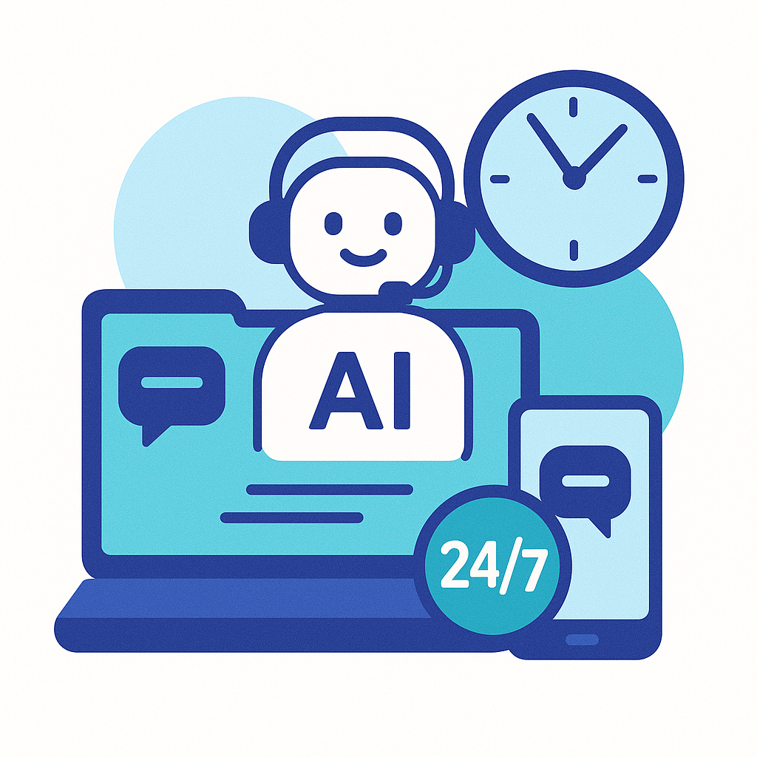

Outline
Introduction
Personal thoughts: use at work
1 Fun 2 Assistance (AI) 3 Working (ML)

Slide 4

Why I am here talking about this?
I am interested in A.I.
I gained some experience:
Using/testing LLM (Large Language Models) (chatGPT, DeepSeek, etc)
Looking at ML (Machine Learning) applications to the synchrotron world and science in general
Doing reviews (2 papers and 1 project)
Participate (and collaborate) in 2 projects related/proposing A.I.
I “tested” ML with our simulation work with some good results. https://doi.org/10.1107/S1600577524004958
I followed a “training” “PAISS Artificial Intelligence Summer School”
Our best contribution: “The Rap of the Thermal Load” (A summary of “Power transport and management in BL” by P.B. and M.S.R)

Slide 5
1 Fun 2 Assistance 3 Working (ML)

Slide 6
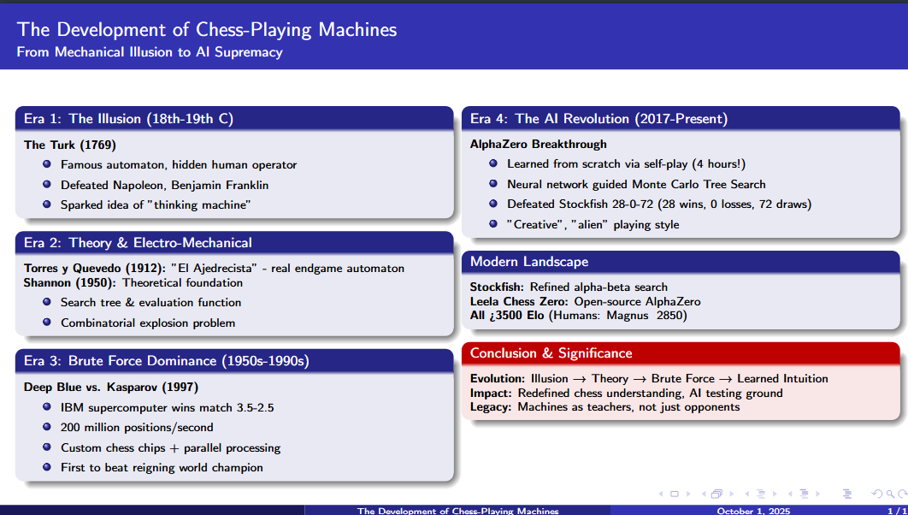

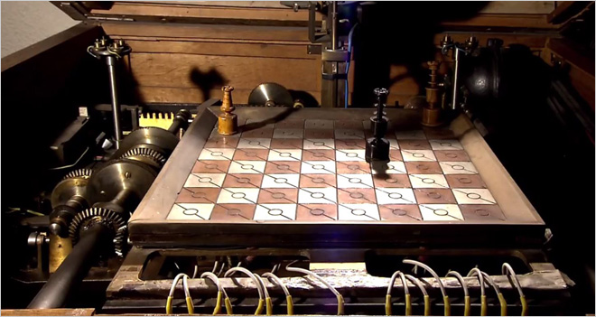
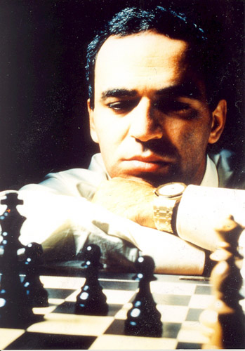

Fun (1 of 2): Chess
https://arxiv.org/abs/1712.01815
https://doi.org/10.1080/14786445008521796
Made with

Slide 7
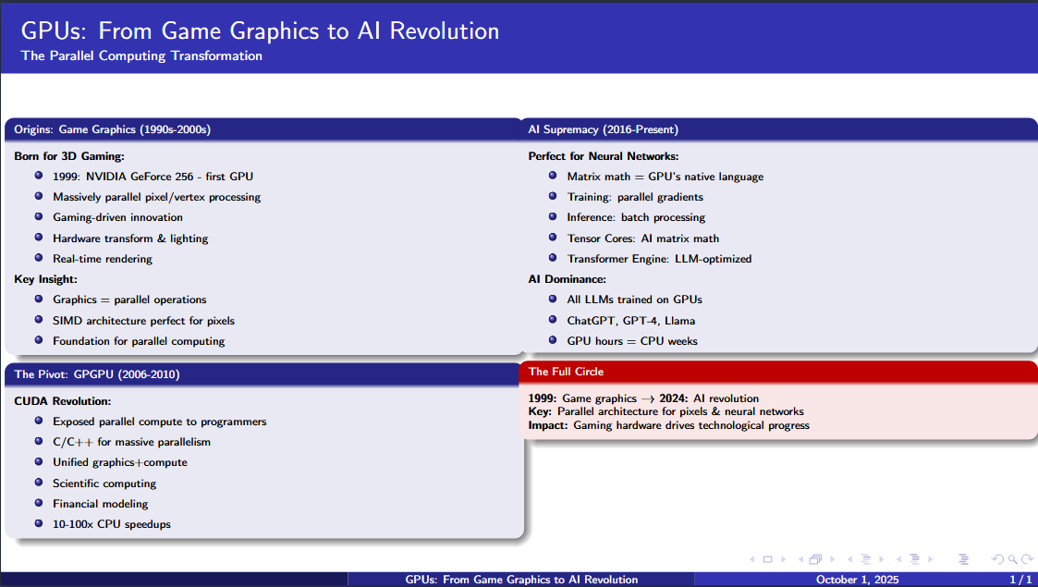


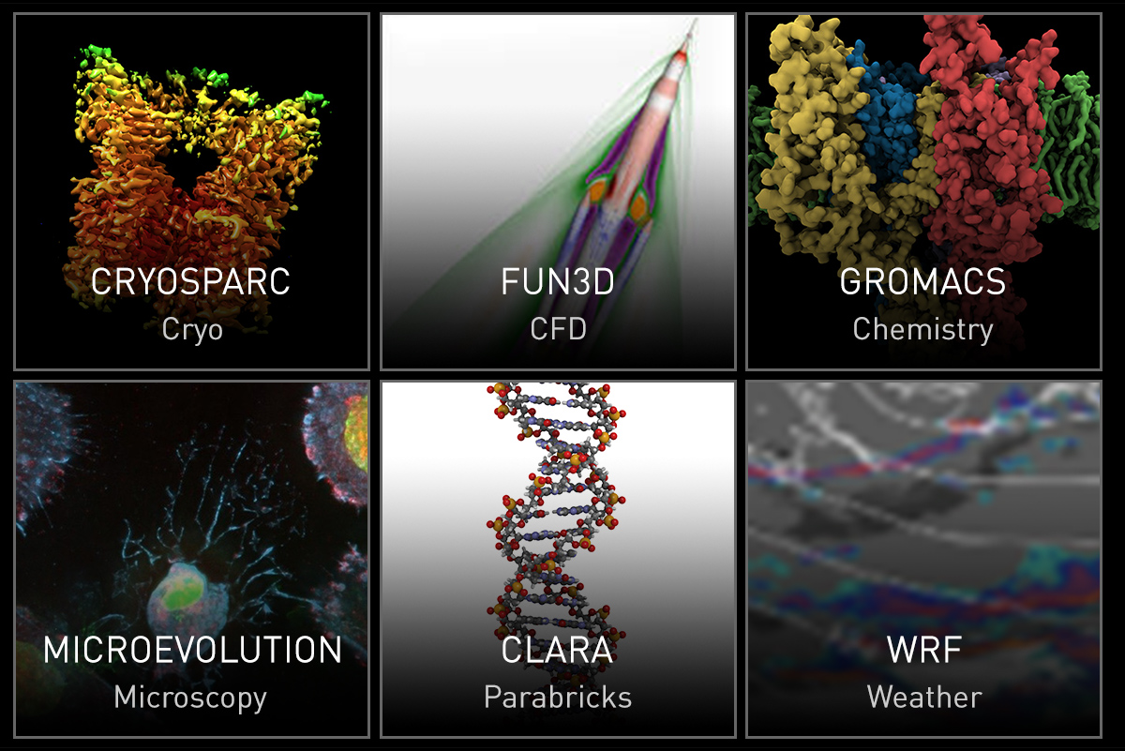
Fun (2 of 2): GPUs
Made with

Slide 8
1 Fun 2 Assistance 3 Working (ML)

Slide 9









Assistance: LLMs
https://chatgpt.com
https://gemini.google.com/
https://chat.deepseek.com/
https://chat.mistral.ai/
https://publicai.co/

Slide 10
Assistance: How LLMs Can Assist Your Work ?
Information & Knowledge:
Summarize long documents, reports, or papers. NOT GOOD FOR LONG DOCUMENTS
Explain complex concepts at different levels (expert vs. layperson). YES! BUT NOT SO COMPLEX
Compare and contrast methods, approaches, or technologies. DO NOT TRUST IT: YOU ARE THE EXPERT
Writing & Communication
Draft emails, reports, proposals, and presentations. VERY GOOD, BUT SPLIT YOUR TEXT IN SHORT PARTS
Reformat text for different audiences (executives, technical staff, students). YES
Translate between languages, or simplify jargon-heavy material. YES
Programming & Data Generate
code snippets in multiple languages. VERY GOOD! NICE TEMPLATES, DOCUMENTED. YOU TEST!!
Debug or refactor existing code. MAY BE, AFTER MANY MANY TRIALS. KEEP IT UNDER CONTROL!
Analyze data, automate repetitive calculations, create plots/visualizations. YES. TRANSLATE FILE FORMATS, ETC
Productivity & Workflow
Automate repetitive tasks (document formatting, file conversion, summarization). MAY BE
Brainstorm ideas, outline projects, or generate checklists. GOOD FOR LISTS, NOT RELIABLE FOR PROJECTS
Organize and restructure large volumes of information. ORGANIZE AT ITS WAY, MAY BE NOT YOUR WAY!
Problem-Solving
Suggest alternative approaches or methods to tackle a problem. YES, IN COMPUTING SUGGEST SEVERAL METHODS
Identify possible risks or weaknesses in a plan or workflow. ? BE CAREFUL WITH CONFIDENTIALITY!
Provide quick “second opinions” for decisions. ?
Learning & Training
Act as a personal tutor for new skills, tools, or concepts. NOT TUTOR, JUST A DOC PROVIDER. KEEP THE CONTROL!
Generate practice problems or simulations. YES, BUT IT MAKES ERROR. NEVER TRUST LLMs
Offer interactive Q&A for continuous learning. THAT I MAY NOT FOLLOW
🔑 Main idea: LLMs act as a universal assistant so professionals can spend more time on the thinking and less on the tedious.
LANGUAGE MODELS: THEY ARE VERY GOOD FOR BLA BLA.
NOT GOOD FOR IMAGES, SKETCHES, VIDEOS, ETC

Slide 11
Assistance: How to drive the LLM
Writing:
Help in document writing:
grammar corrections, style, refactoring
good for “introduction”
search for references?
format in latex/overleaf RTF? Powerpoint? File conversion?
Help to create “projects”
Summarize documents/PDFs.
Computing:
Replace the manual or instructions
Translate (e.g. matlab -> python, setup.py -> pyproject.toml)
Search algorithms and implementation (several options)
Accelerate pieces of code
Create templates
Scripts for applications
Web search:
Filters-out results
Mathematics:
Solve (college) exercises
Methodology:
Start a new chat for a new subject
Ask simple questions, to enter in the subject
Slowly, direct it to your main question/problem
Iterate many times, in order to get answers:
accurate (you must check!)
respond to what you asked (or wanted to ask)
Never trust it. Double-check everything
Tell it when there are mistakes

Slide 12
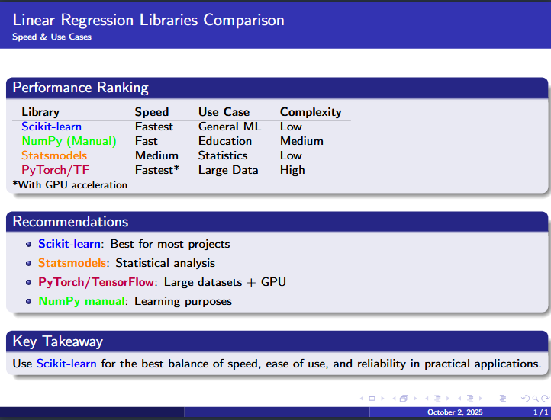

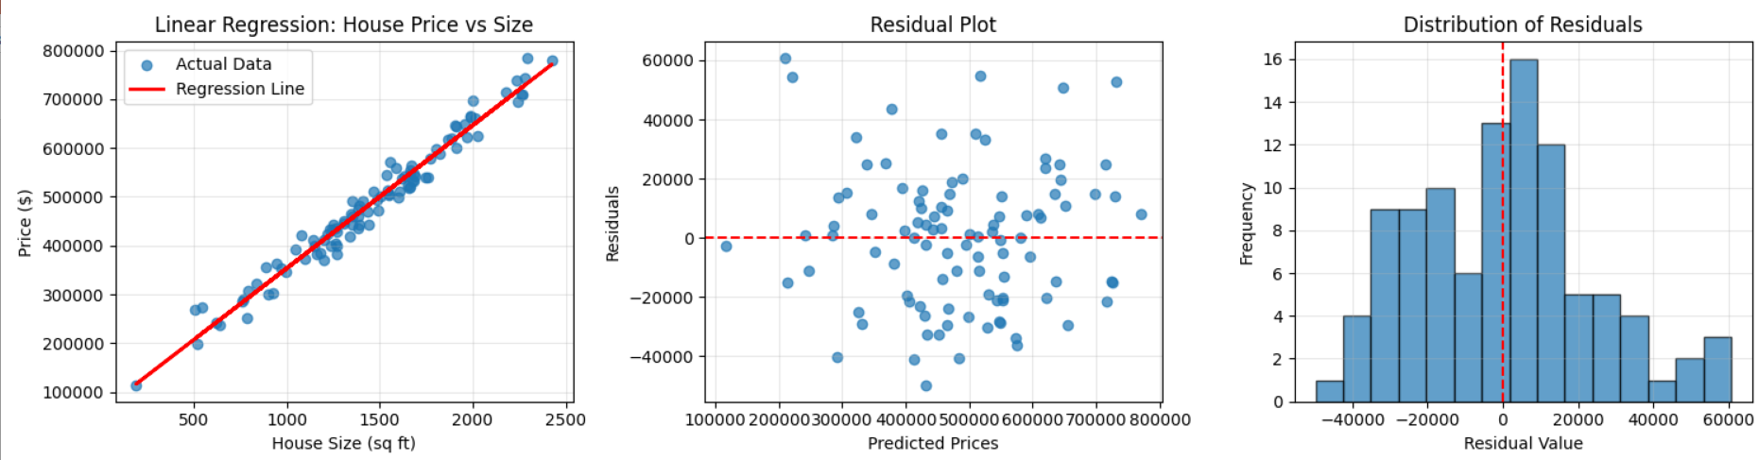
Assistance: Example 1: simple regression
https://chat.deepseek.com/share/nes26yzjcfq0568gll
what is linear regression?
Summarize the methodology in one slide
example in python using numpy
ModuleNotFoundError: No module named 'sklearn’ No problem! Here's the same example using only NumPy and Matplotlib, without scikit-learn:
Tens of millions of dollars spent: “Saying ‘Thank You’ to ChatGPT Is Costly. But Maybe It’s Worth the Price.”
which libraries can I use, and what is faster?
could you summarize in a single slide (in latex)
LaTeX Error: Unicode character ⚡ (U+26A1) ‪./apertus.tex, 75
Here's the corrected LaTeX code without Unicode characters:
expand_more Extra }, or forgotten \endgroup. ./apertus.tex, 81
Here's the corrected LaTeX code without the syntax error:

Slide 13
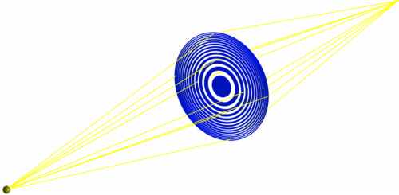
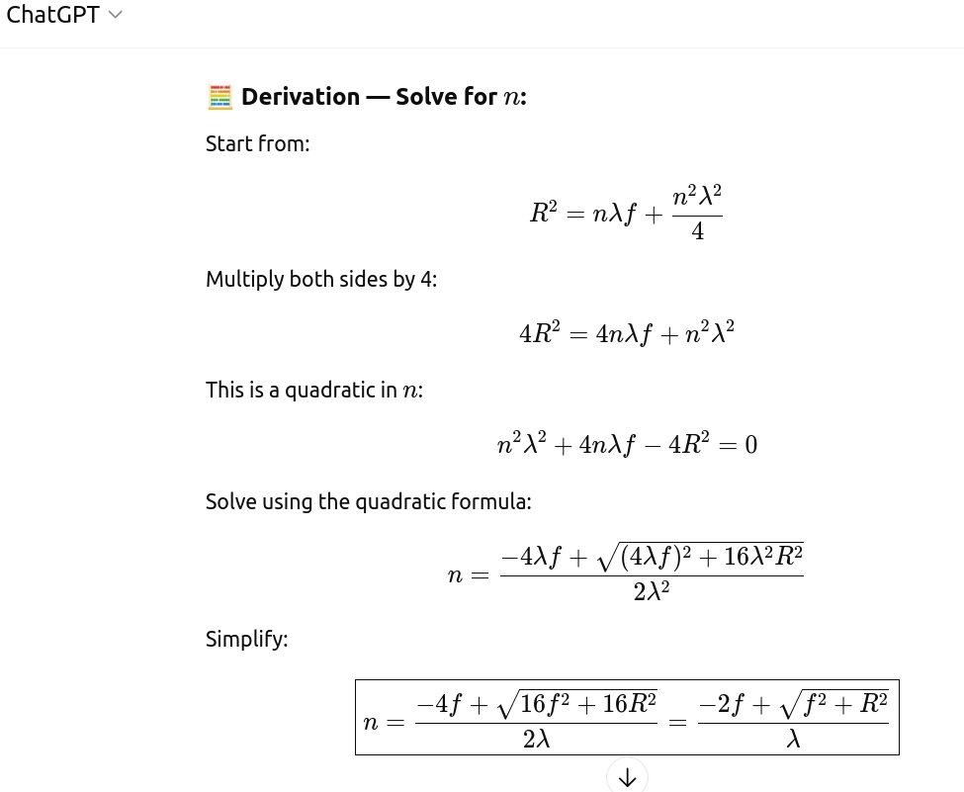
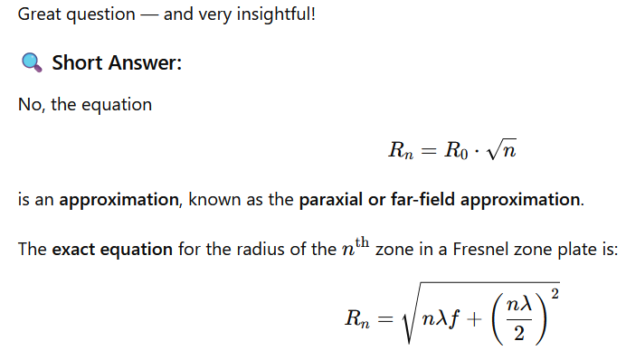
Assistance: Example 2: a simple technical/mathematical problem FZP
https://chatgpt.com/share/68de4673-aa0c-8008-ac11-9fdb8ceaff96
what is a fresnel zone plate?
what are the parameters that define a FZP
can I use R0 and Rn to fully define a FZP?
can you script calculation of R as a function of n?
if the equation of Rn exact?
What is the exact value for R0?
And the exact value for n?
How to get from here the approximated value?
compare for f=1m, lambda=1 A, R=1mm
This is negative, which makes no physical sense.Let’s pause here.
Wrong!

Slide 14
1 Fun 2 Assistance 3 Working (ML)

Slide 15
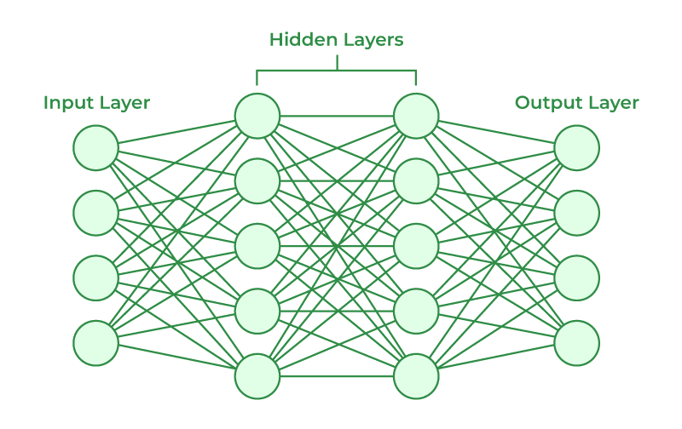
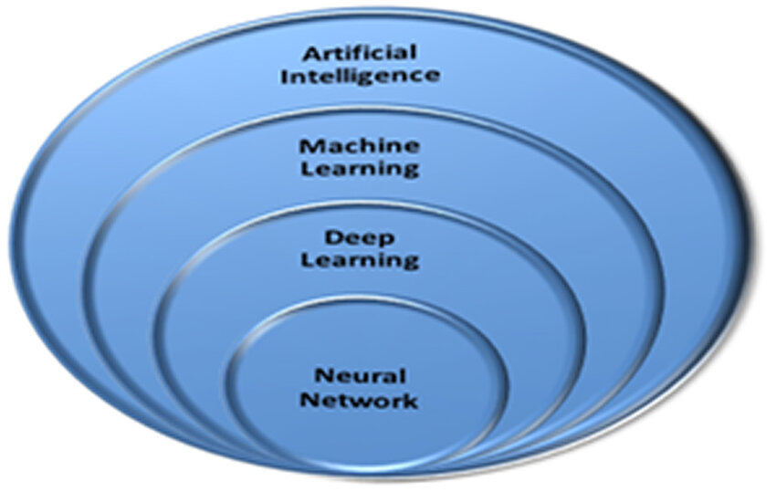
A.I. doing work ?
LLMs can HELP you (save your time) BUT YOU ARE THE BOSS and THE EXPERT: it makes mistakes that you must correct (or help it to correct) => SO, IT CANNOT DO ANYTHING THAT YOU CANNOT DO BY YOURSELF
Can we use A.I. as an agent to do some work, possibly integrated in an instrument, implement algorithms or make simulations?
A.I. is used everywhere, also in different fields of Synchrotron Radiation (I compiled a few references here P:\ISDD\Modelling Team\PAISS2025\SR_bibliography.pdf)
Accelerators
Beamline control and alignment
Data analysis and applications
LLM beamline/software assistants

Slide 16
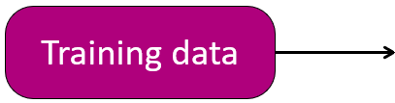
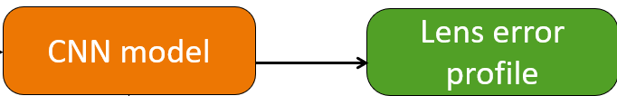
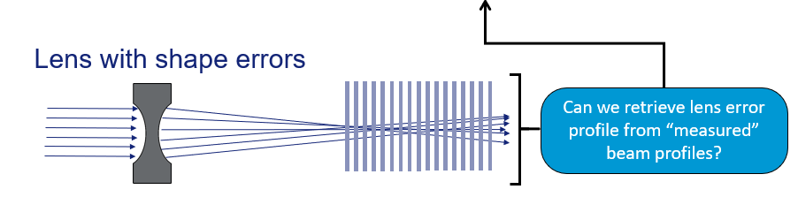
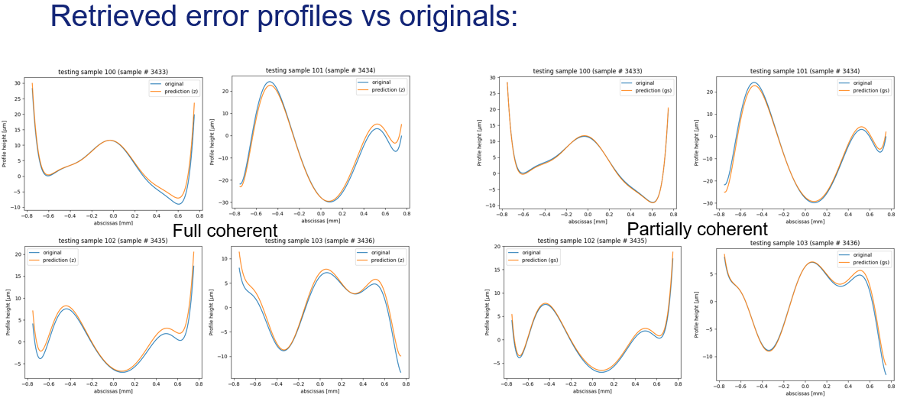
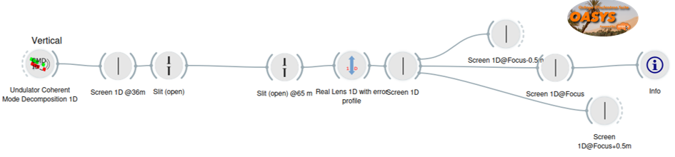
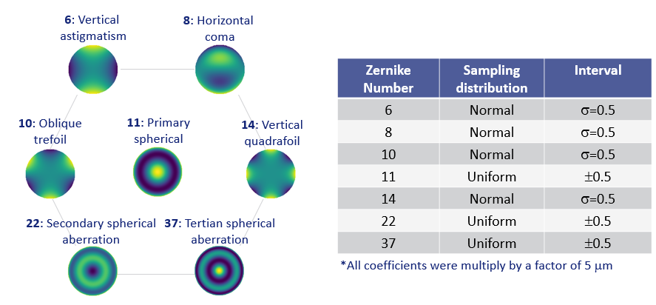
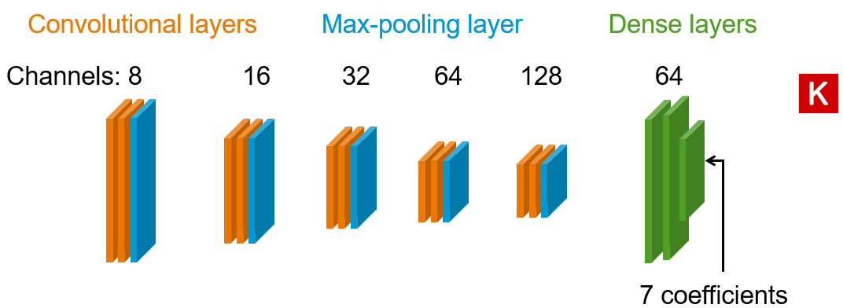
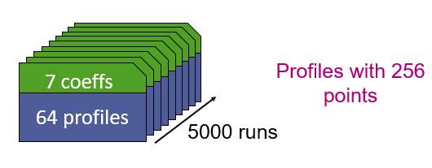
My test: X-ray lens figure errors retrieved by deep learning from several beam intensity images (MSR, R Celestre, J Reyes-Herrera) https://doi.org/10.1107/S1600577524004958

Slide 17
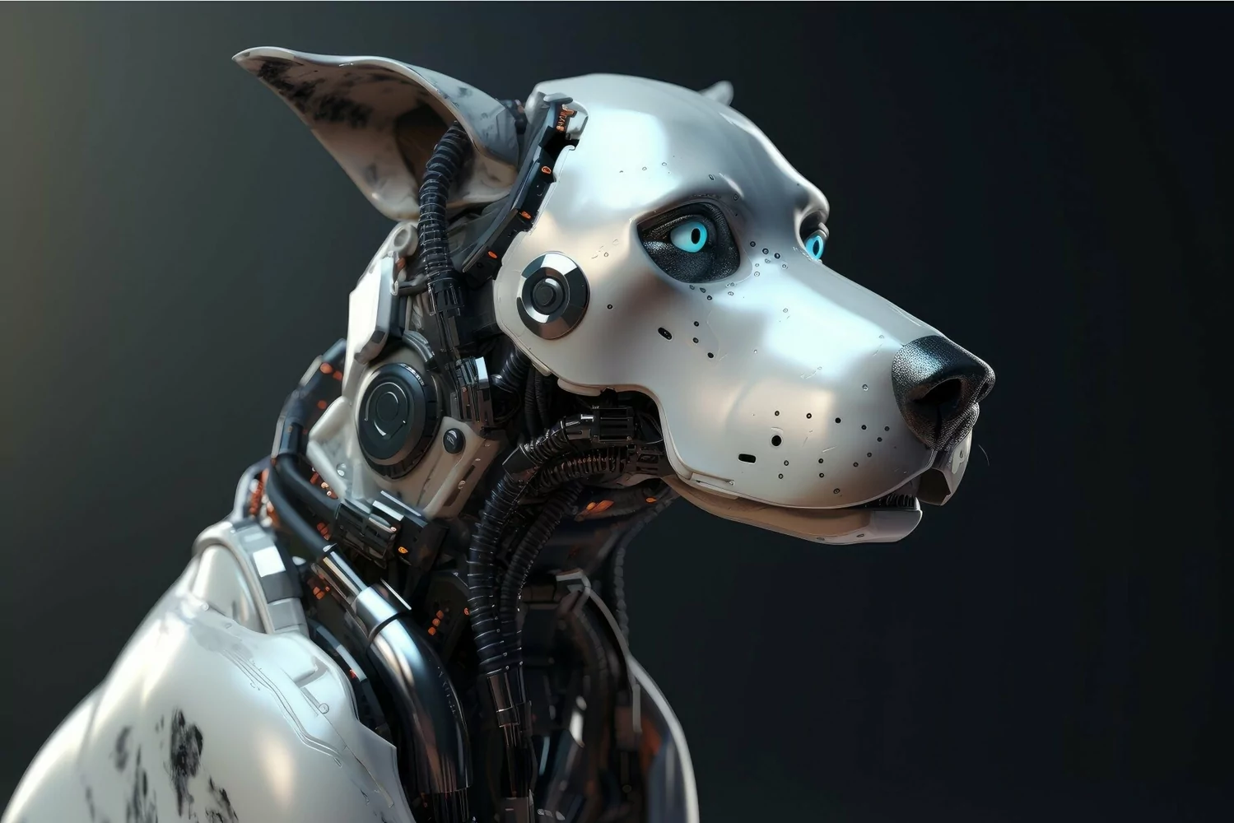
“Practical” consequences
Simulated data are inexpensive: big data can be created
Used for training NNs:
Solving the inverse problem
Create “fast simulators” (surrogate models)
Results may be used for in-situ characterization of X-ray lenses
Does it work with measured data?
Certainly yes, but… it could need some model adjustments or fine-tuning
ID11 watchdog: Defend monochromators against users
Continuous monitoring (encoders and switches) and the ability to intervene (close shutter) when something goes wrong (user mistake, risk for the mono).
Would the “logic” require a calculation?
May a complex calculation be accurately replaced by a surrogate model?

Slide 18
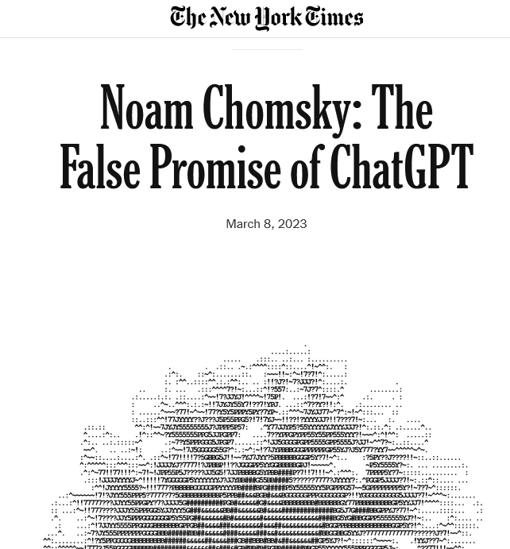

Can A.I. be creative? (e.g. can it produce art?)
Naively, Yes
Reasonably, No
But… errors, or stupidities…
can be profitable?
So next time you see that light so bright, Know there's science keepin’ it tight. Beamline flow, yeah, we keep it supreme, Runnin’ experiments, livin’ the dream. 🚀🎤🔥
The Synchrotron's Light
In Grenoble’s valley, where the keen minds meet, A giant ring of might and precision turns, Where electrons race with velocity fleet, And out of circling speed, bright brilliance burns.
A light beyond all lights, an X-ray beam, That cuts through matter’s most entangled schemes, Reveals the cell, the protein, and the dream, And fills the researcher’s waking hours with themes.
From ancient scrolls that Vesuvius concealed, To virus forms that plagued the human lung, Your rays make visible what was concealed,
In every spectrum, every wavelength, strung.
So shine on, vast machine of human grace, That we may see the world’s uncharted face.
However useful these programs may be in some narrow domains (they can be helpful in computer programming, for example, or in suggesting rhymes for light verse), we know from the science of linguistics and the philosophy of knowledge that they differ profoundly from how humans reason and use language. These differences place significant limitations on what these programs can do, encoding them with ineradicable defects.
Now, A.I. hallucinations are reinvigorating the creative side of science. They speed the process by which scientists and inventors dream up new ideas and test them to see if reality concurs. It’s the scientific method — only supercharged. What once took years can now be done in days, hours and minutes. In some cases, the accelerated cycles of inquiry help scientists open new frontiers. “We’re exploring,” said James J. Collins, an M.I.T. professor who recently praised hallucinations for speeding his research into novel antibiotics. “We’re asking the models to come up with completely new molecules.”

Slide 19
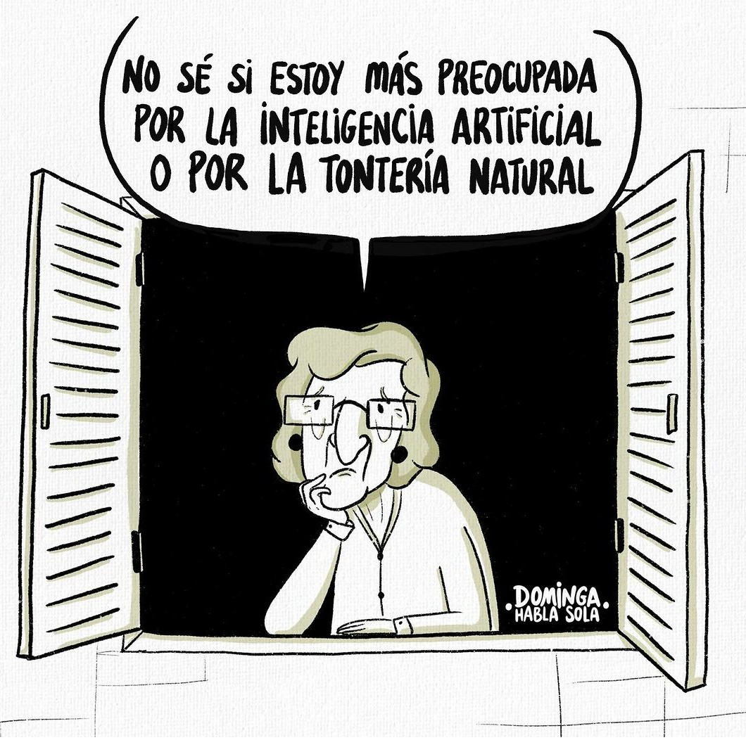
I DON'T KNOW IF I'M MORE WORRIED ABOUT ARTIFICIAL INTELLIGENCE OR ABOUT NATURAL STUPIDITY
Thank you!

