Slide 1
News from the XOG: recent achievements & challenges
Multilayers
Refractive lenses
Crystals
Crystal analysers
Metrology
‘Routine’ manufacture/test
Developments
  Wavefront preservation
  Optics reconditioning
  Optical systems new/improved capabilities
Ray Barrett (XOG leader)
B. Argoud, P. Bras, J. Cave, J-P. Guigay, S. Laboure, C. Lapras, T. Manning, C. Morawe, F. Perrin, B. Picut, T. Roth, T. Sieg-Letessier, R. Verbeni, A.Vivo

Slide 2
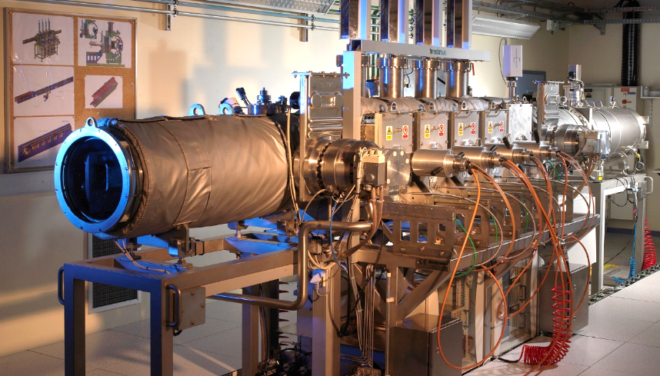
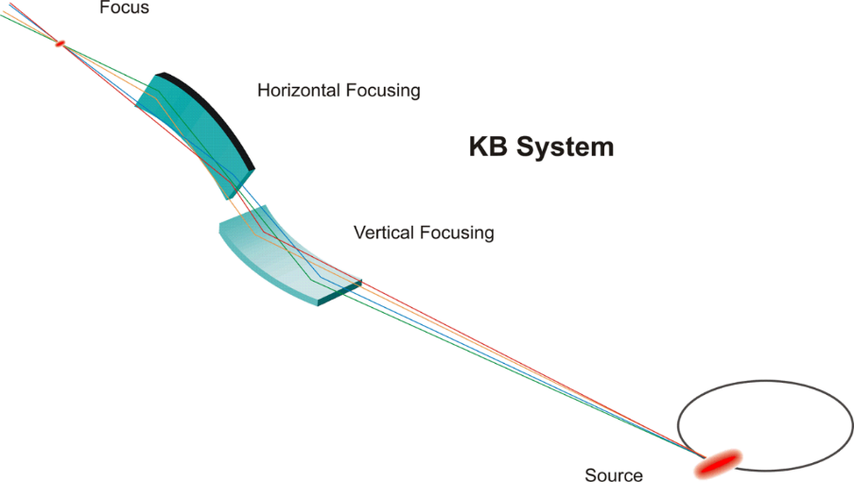
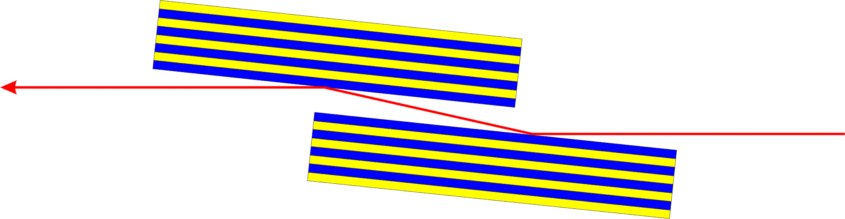
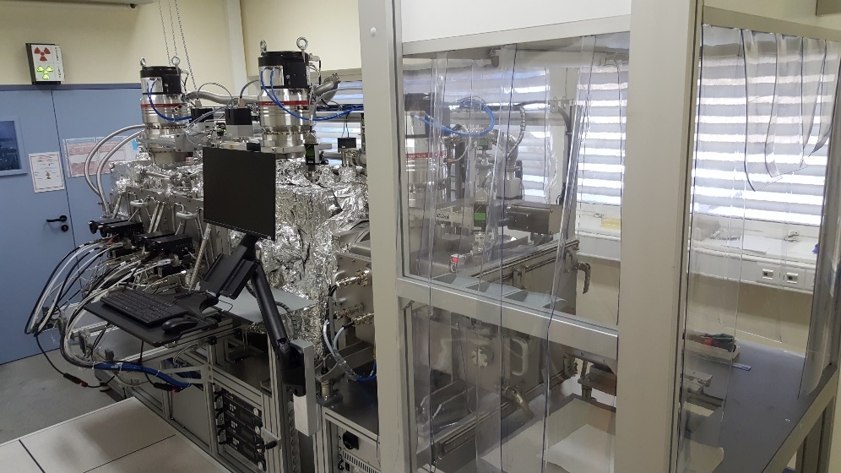


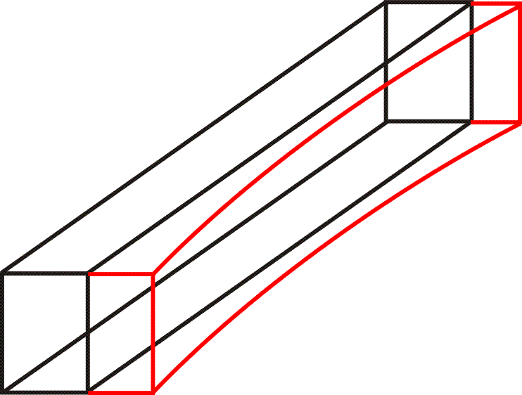
Multilayer Lab (ML): Introduction
- 2 magnetron sputter deposition systems
Graded MLs for monochromators and KB focusing mirrors
Dynamic deposition technique
Large ML Coating System – LMCS (2007): up to 1 m long optics
Particle flux
Substrate
Mask
Sputter Target
Compact ML Coating System - CMCS (2021): up to 0.3 m long optics

Slide 3
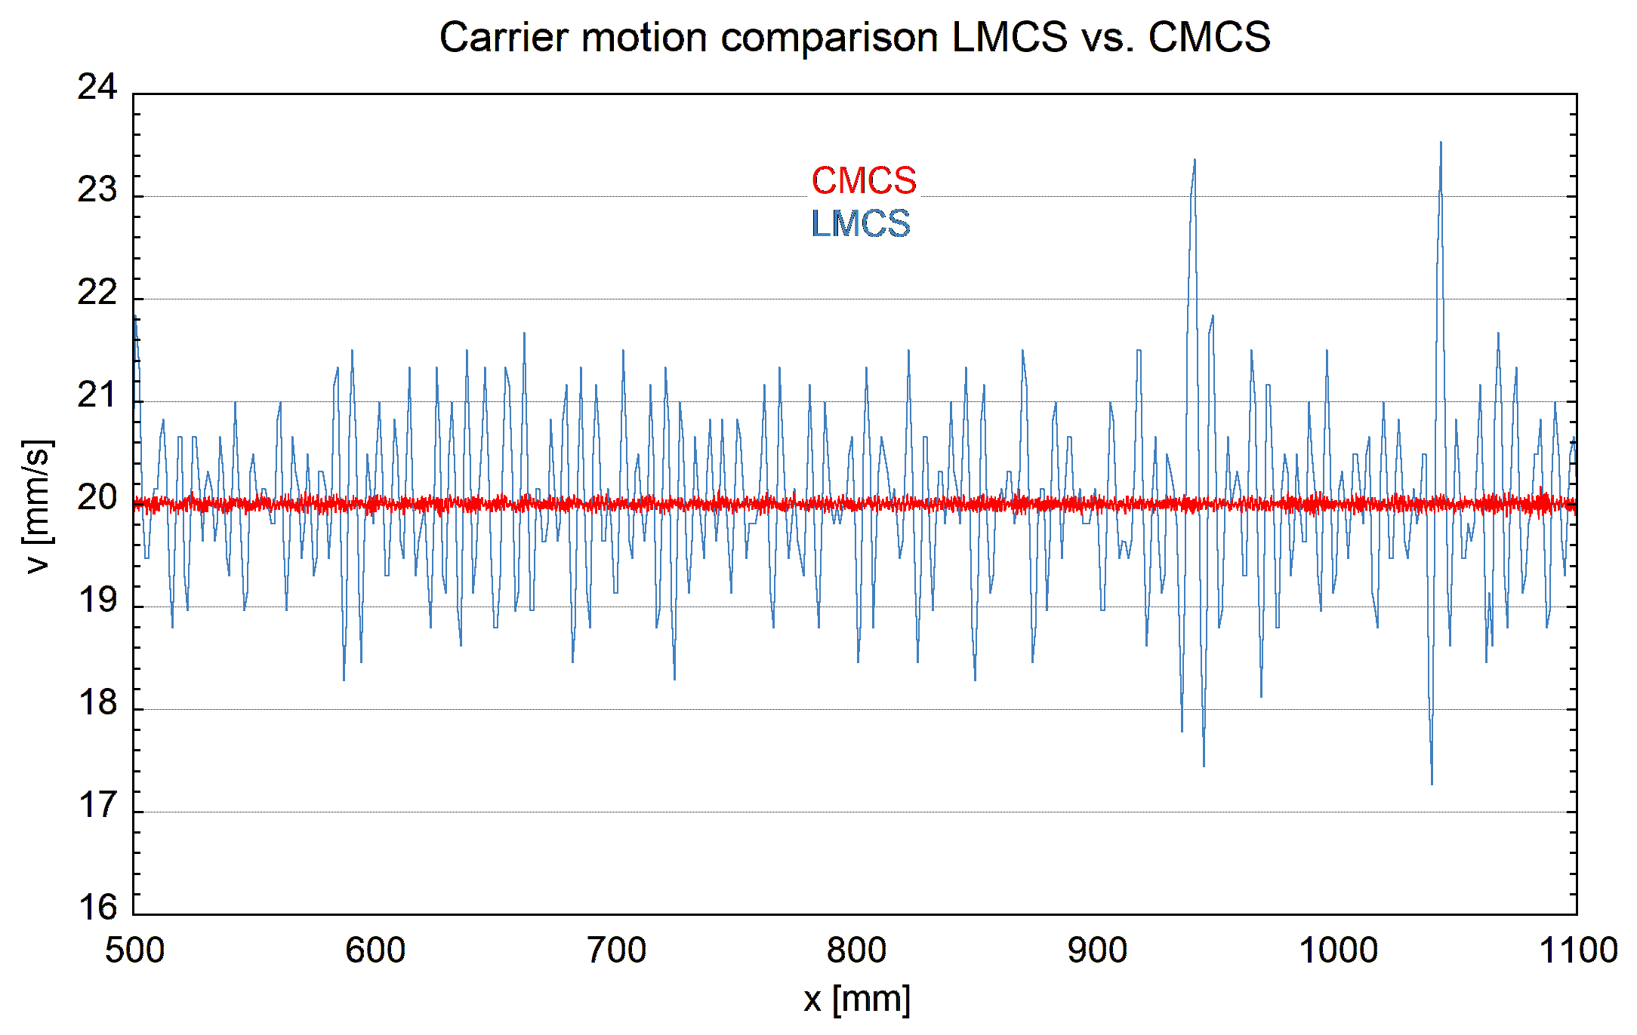
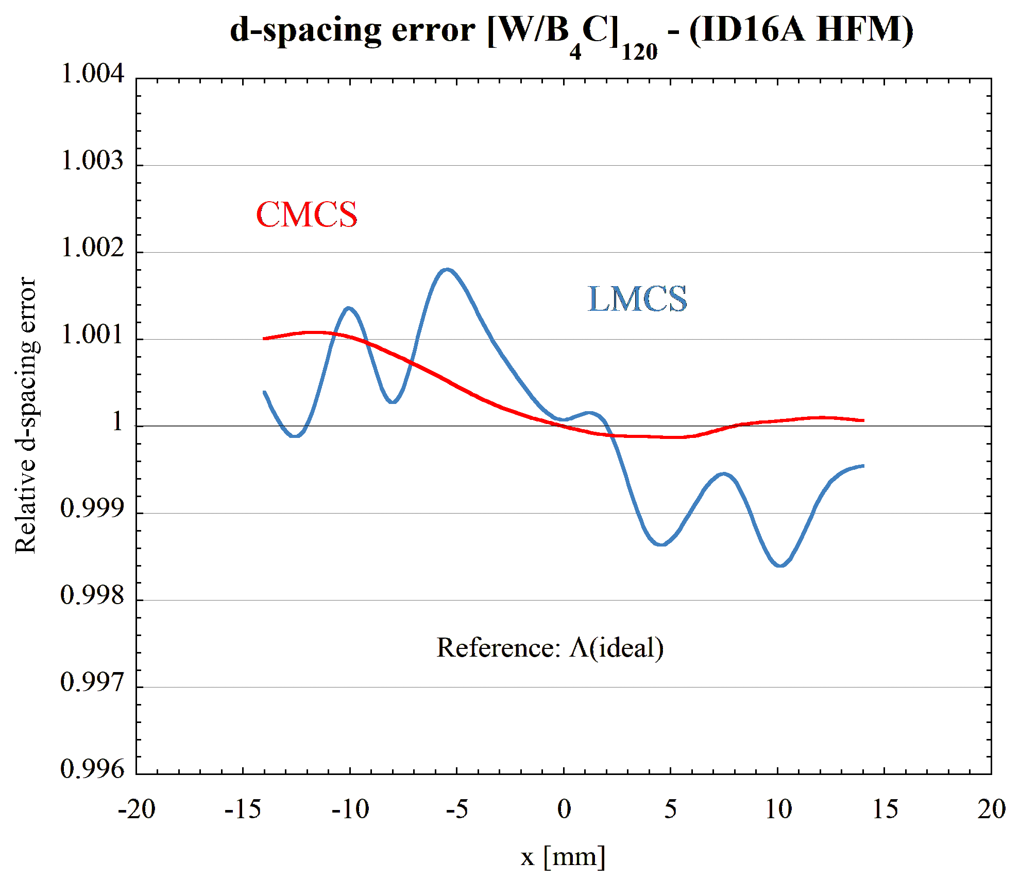
XOG ML Lab: Main achievements
- Nano KB coating for ID16A using CMCS
- Smoother carrier motion during deposition
- Improved graded d-spacing control compared to LMCS: dΛ/Λ ≈ ±0.1%

Slide 4
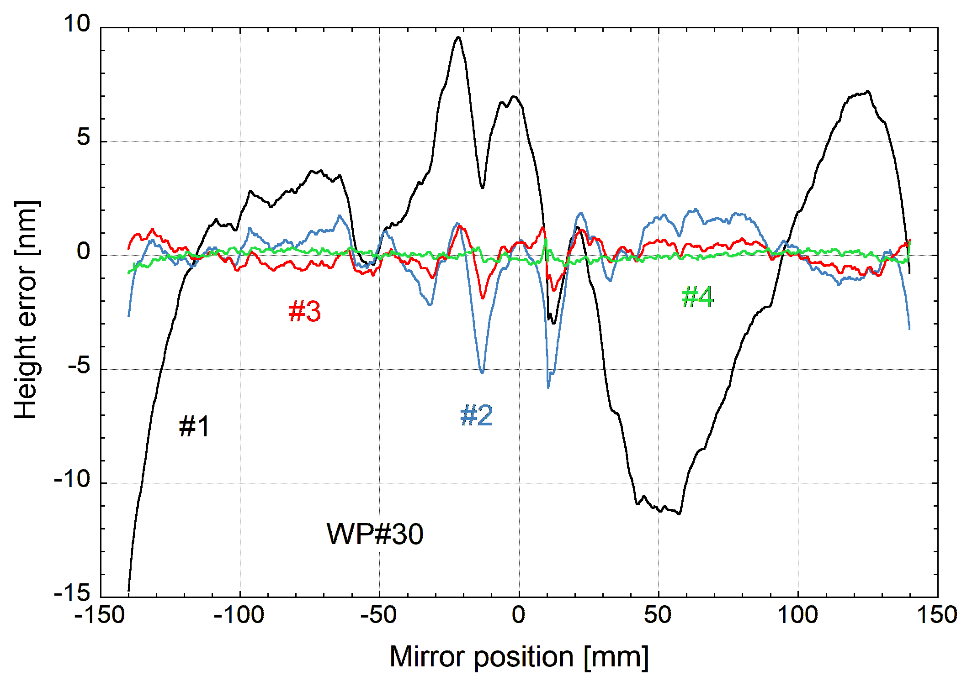
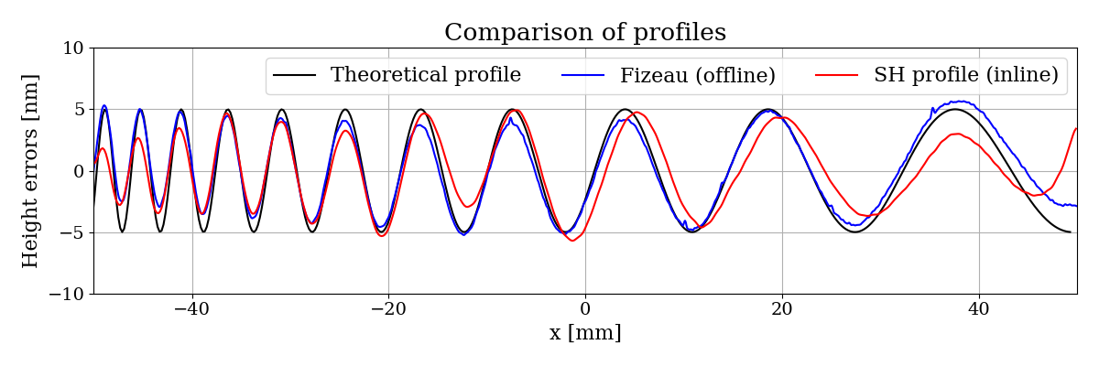
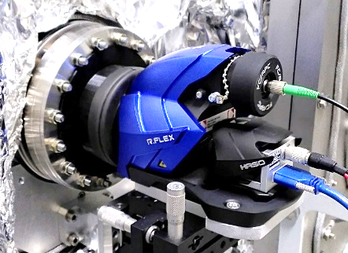
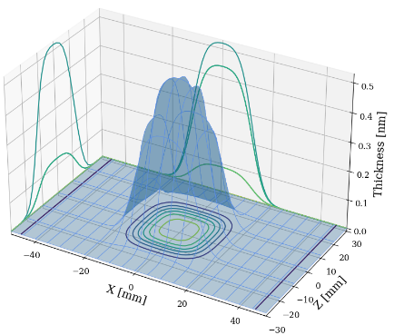
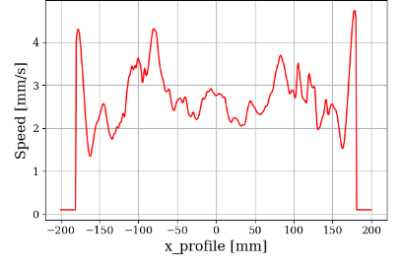
XOG ML Lab: Challenges
- Advanced mirror surface figure correction using differential deposition (DD)
- DD with in-situ metrology tools for faster convergence
Shack-Hartmann
wave front sensor
differential deposition
- DD in 2 dimensions using deep learning
INPUT
COMPUTATION
OUTPUT
2D static profile
Targeted thickness profile (2D)
Deep learning (neural network)
Slit shape
Slit
Speed profile
Static flux profile (2D)
Speed profile

Slide 5
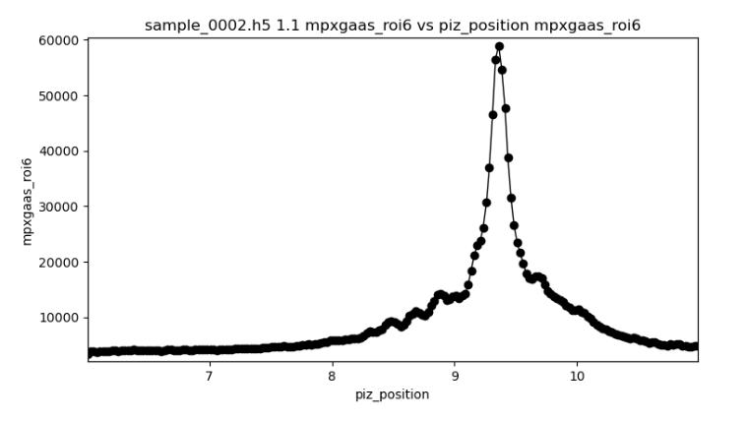
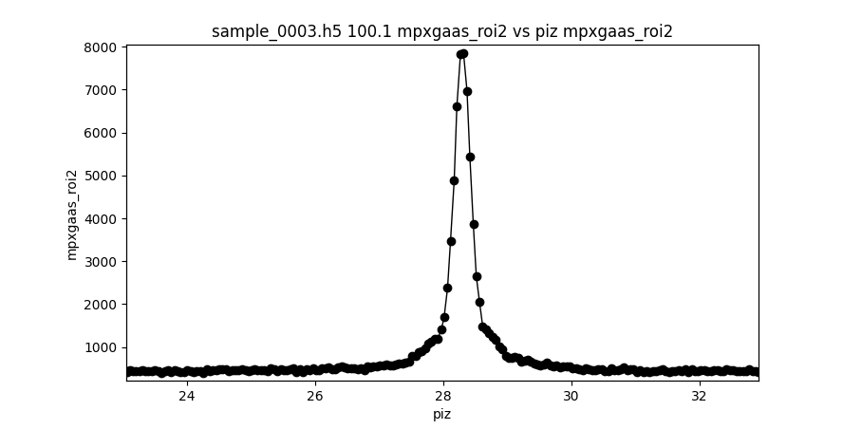
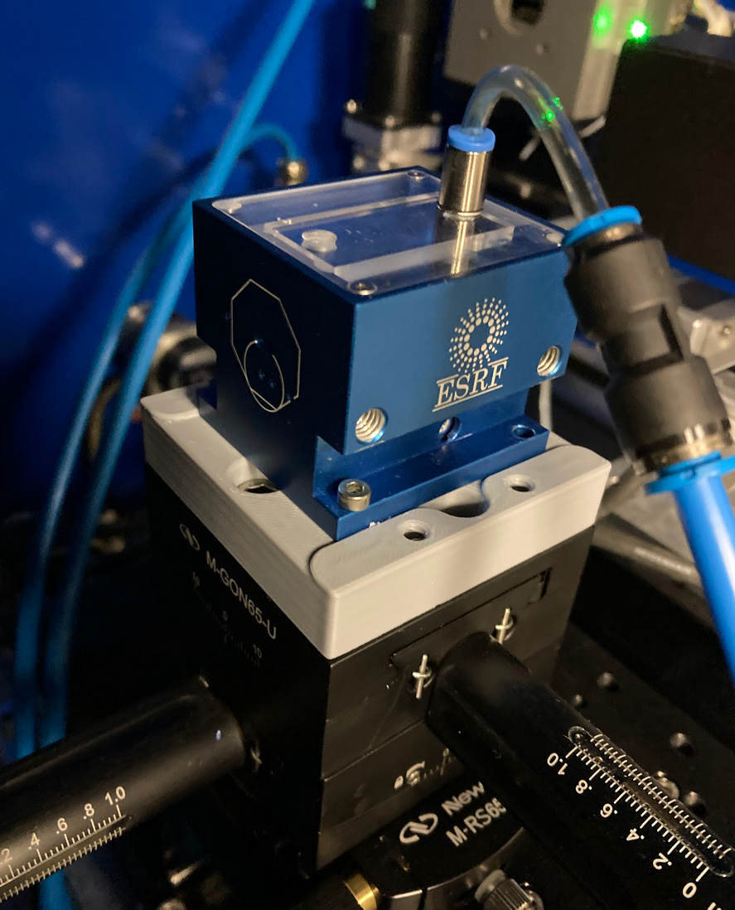
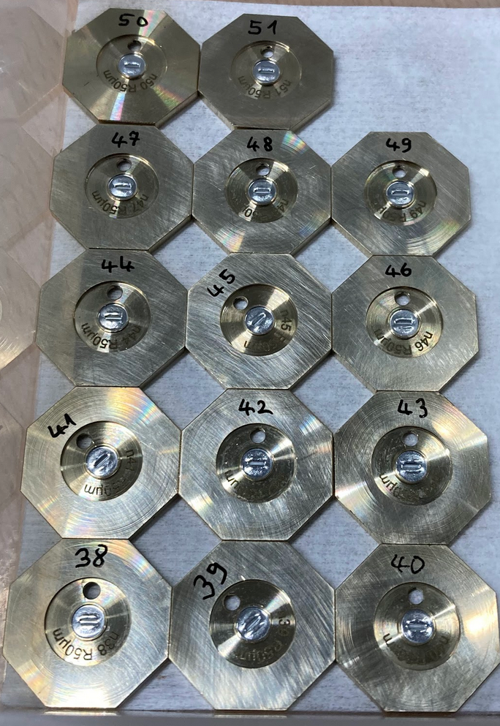
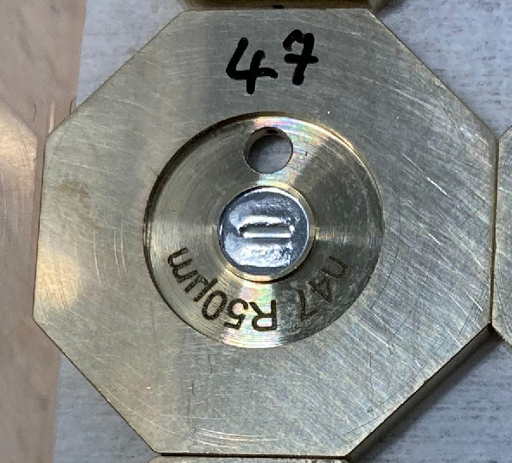
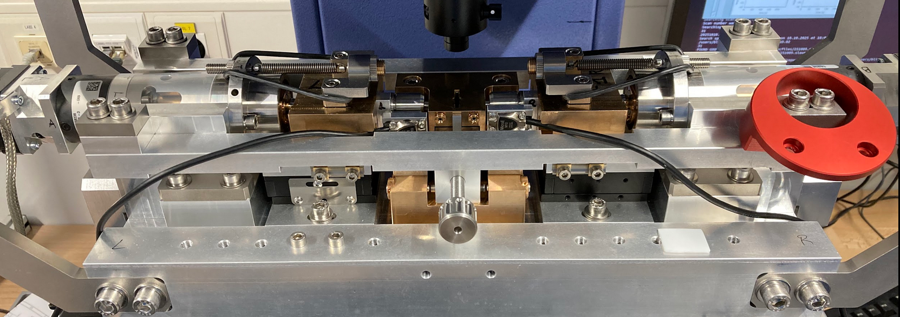
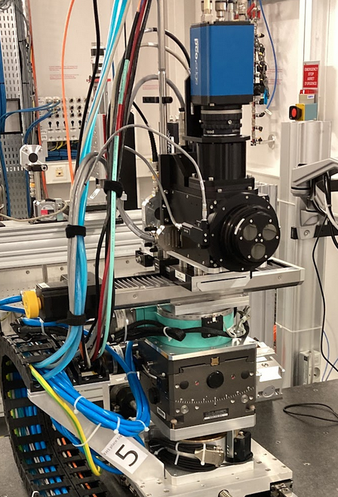
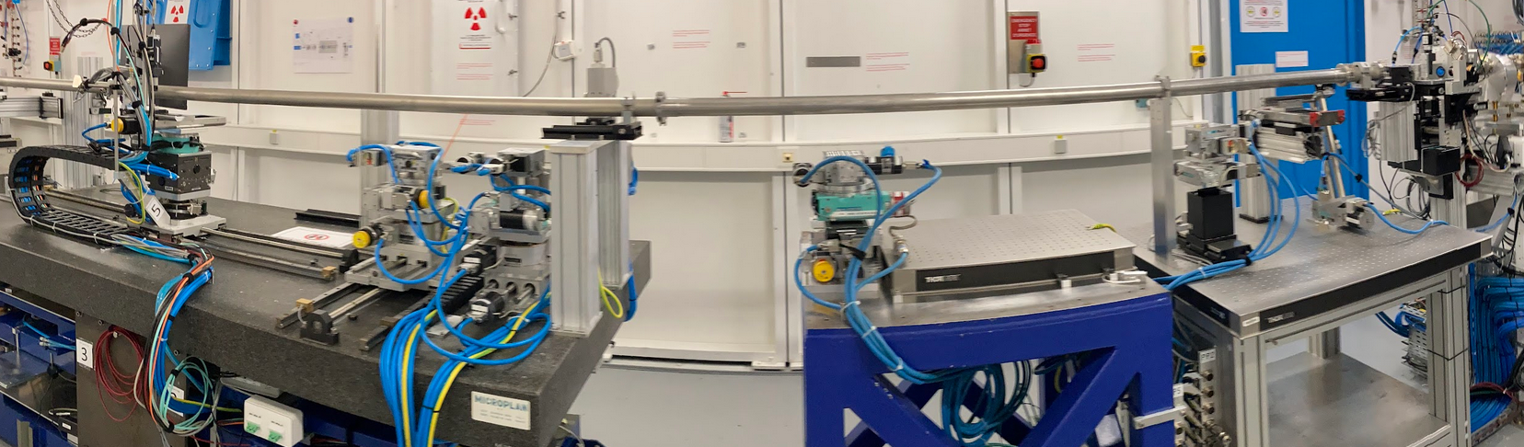
CRLs: Main Achievements
ISDD lenses
operating on
ID01 @ 20keV
manufacture of 2D Al lenses:
N=173 R=30um to ID11
N=70 R=30um to ID01
N=24 R=30um to ID06-LVP
Aluminium
Beryllium
significantly
reduced tails
280nm beam
FWHM
start of 1D Al lens manufacture:
First lens pressed in January ’25
Total pressed: 51 so far
1D lens press
operating on BM05
ID06-EH1
operational

Slide 6

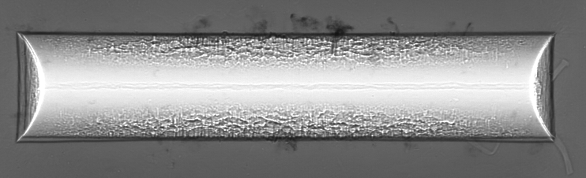
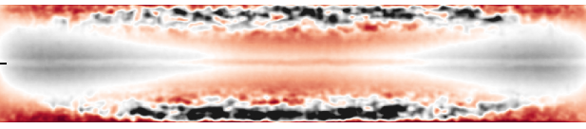
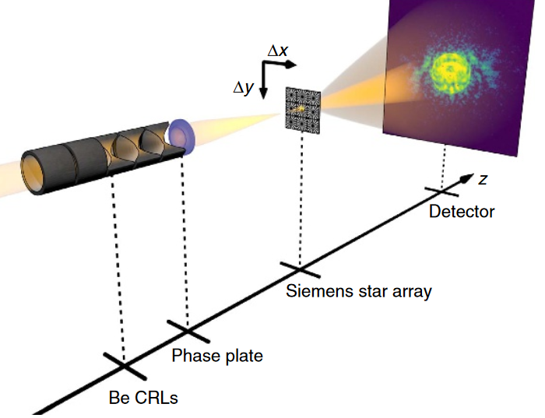
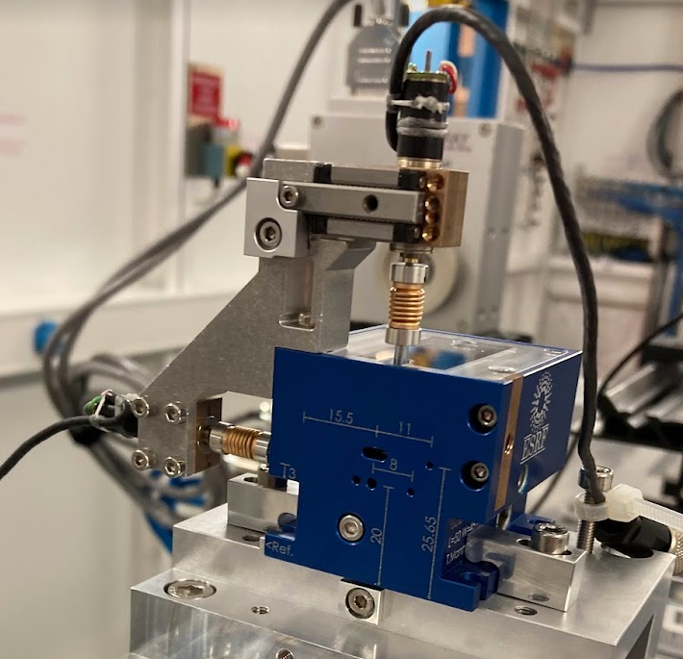
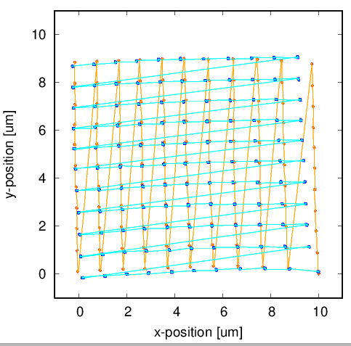
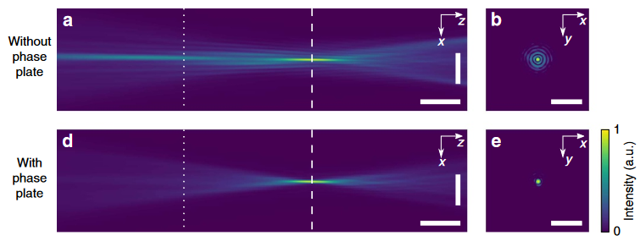
CRLs: Challenges
Delivery of R=30µm & R=200µm 2D Al lenses to beamlines
Delivery of R=50µm 1D Al lenses to beamlines
shape fidelity, punch aging
height error [µm]
Phase correction optics
R. Celestre re-joining XOG for these efforts

Slide 7
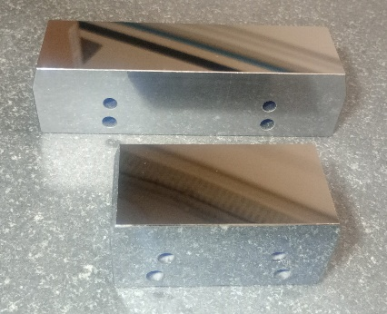
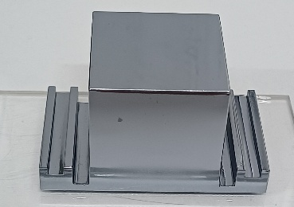
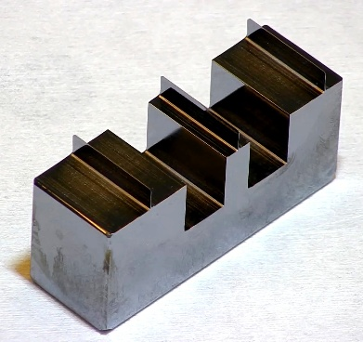
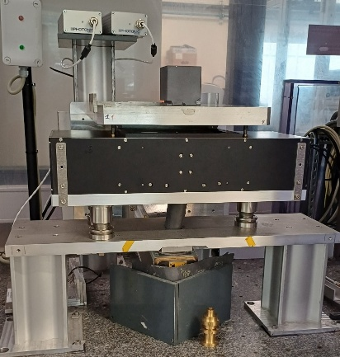
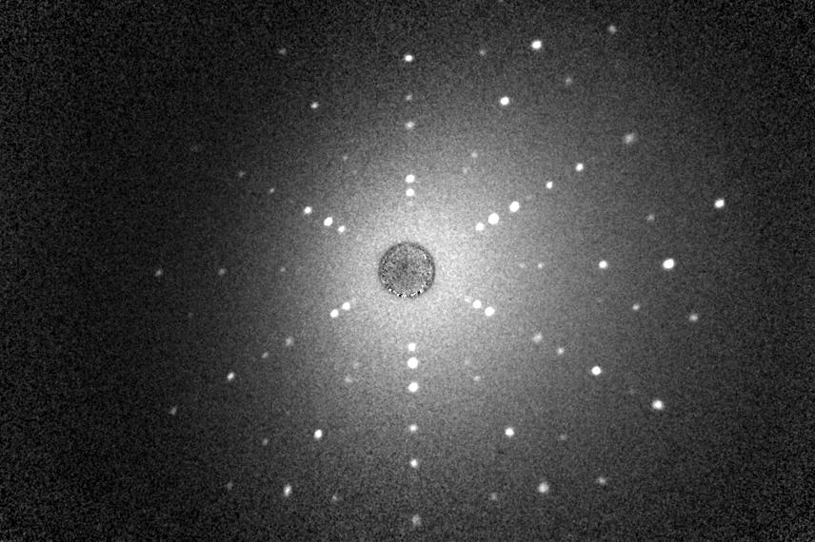
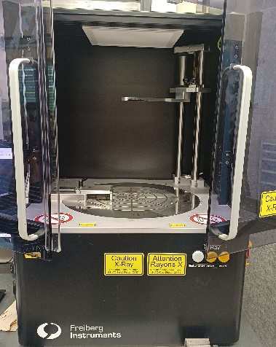
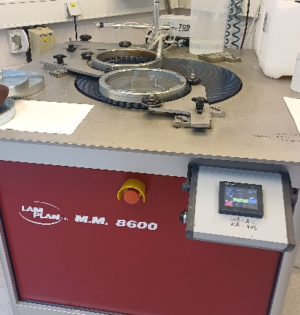
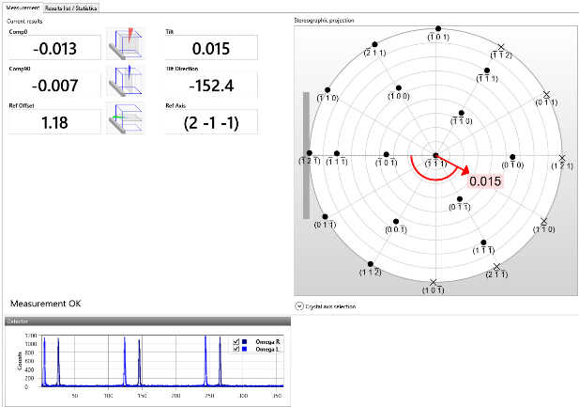
Crystal Lab: Achievements
DCM monochromator crystals
Bonse-Hart LLL-type interferometer crystal
ID28 Backscattering
2025 production
12 x monochromator crystals for the new DCMs of ID16B/ID26 beamlines
2 x backscattering monochromators for ID28 beamline
4 x monochromator crystals for CRG’s and external companies
2025 developments
New X-ray Laue Camera for crystal orientation
DDCOM commissioning: precise asymmetry angles ~0.001 degrees
Second LamPlan polishing machine
New X-ray Laue camera
Laue picture Si(111)
40 s exposure
Second LAMPLAN
Polishing machine
DDCOM machine
Precise asymmetry angle measurements

Slide 8
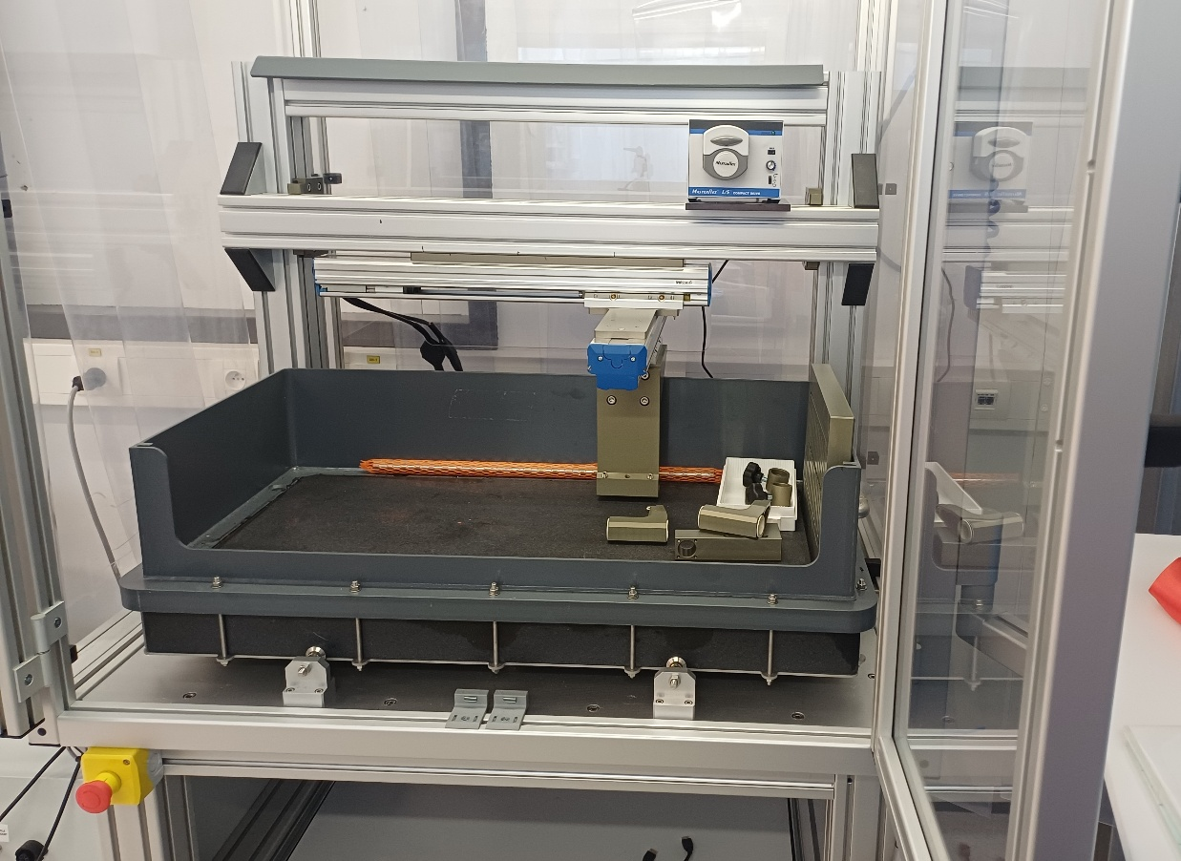
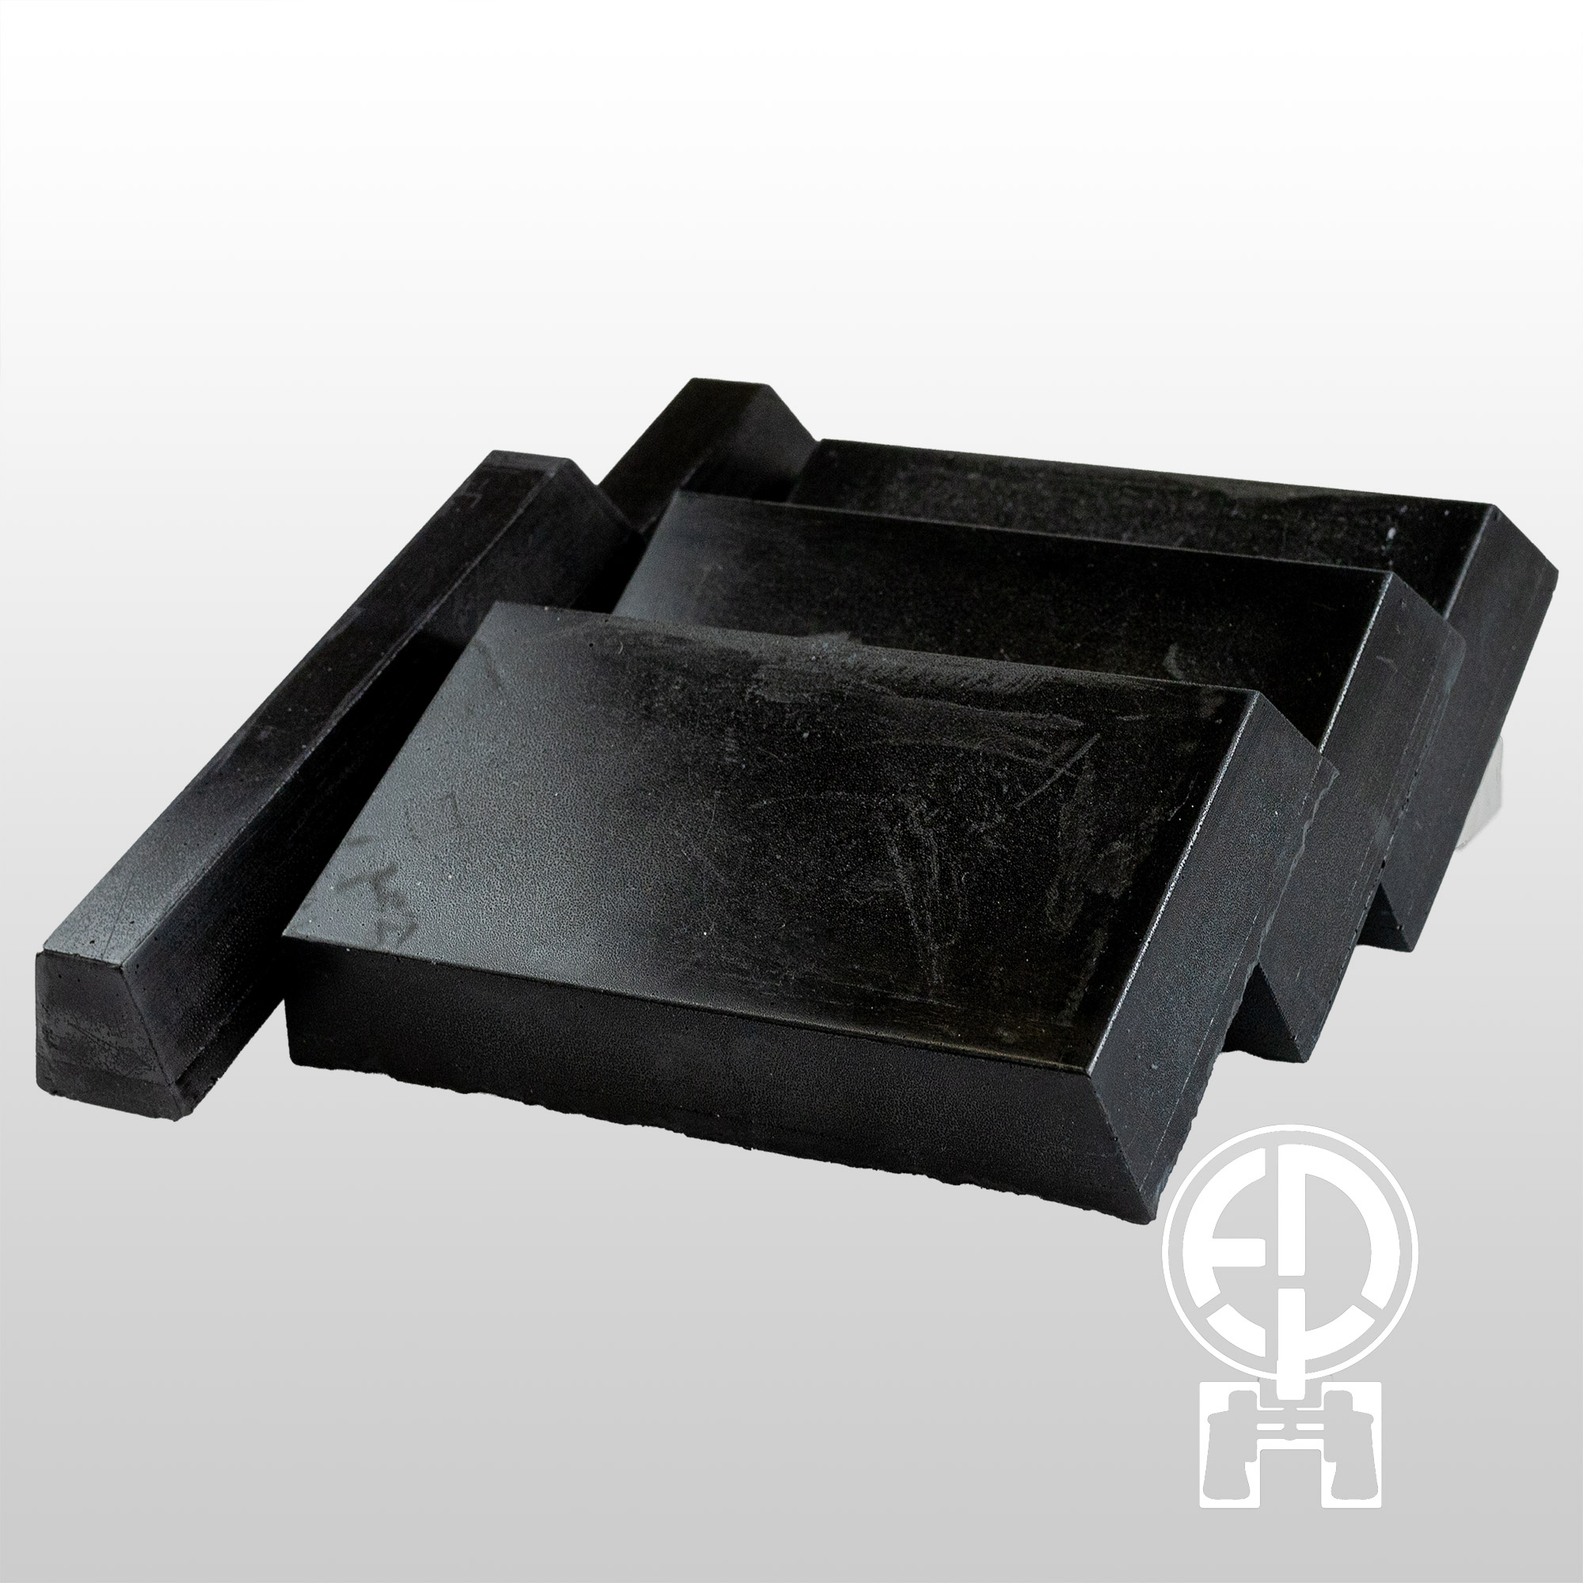
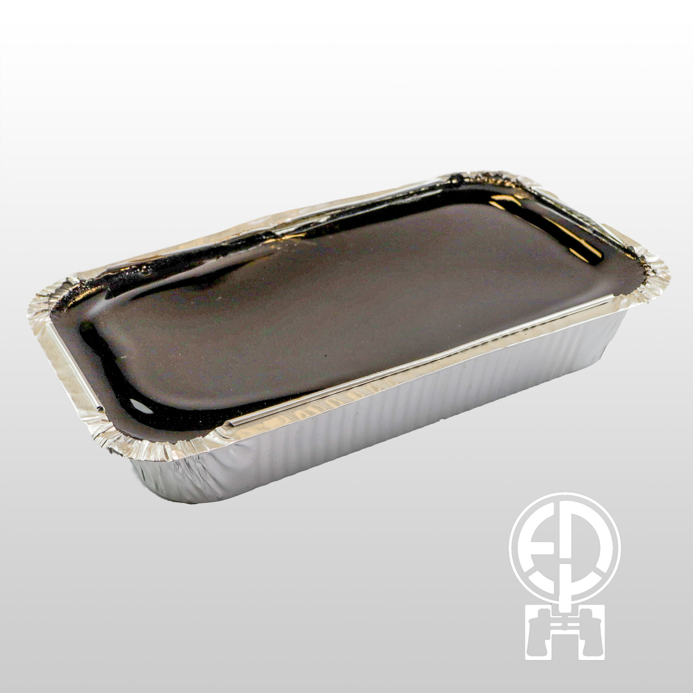
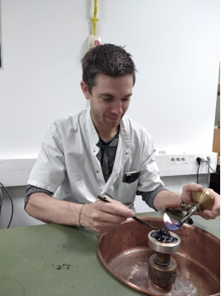
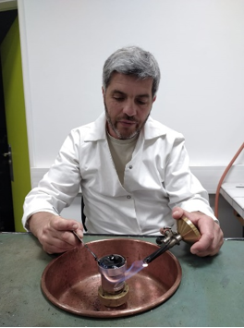
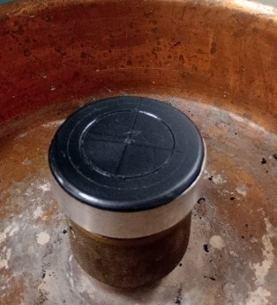
Crystal Lab: Challenges
Future perspectives:
Improving the planarity and roughness of the polished crystals
Implementation of pitch* polishing
* pitch = mixture of rosin and bitumen
(rosin = distillate of wood resin)
New inhouse designed X-Y polishing machine dedicated
to pitch polishing
Pitch polishing plate
pieplow-brandt.de
B. Argoud and B. Picut during “pitch polishing” training in Paris

Slide 9
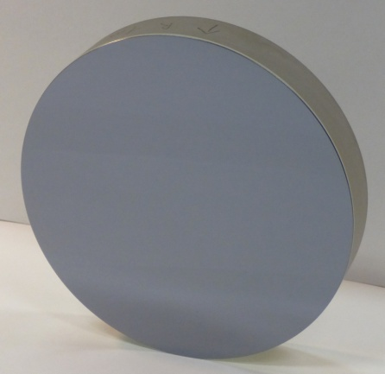
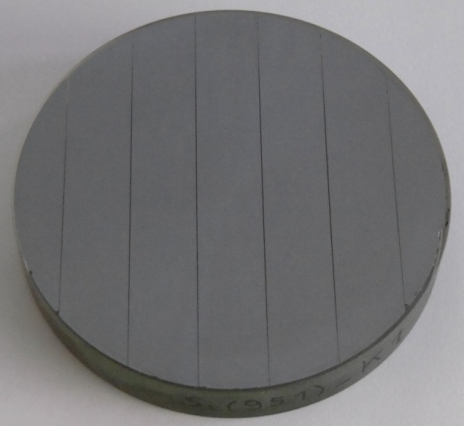
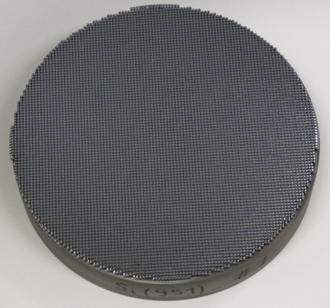
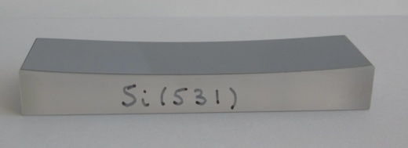

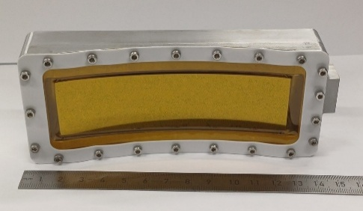
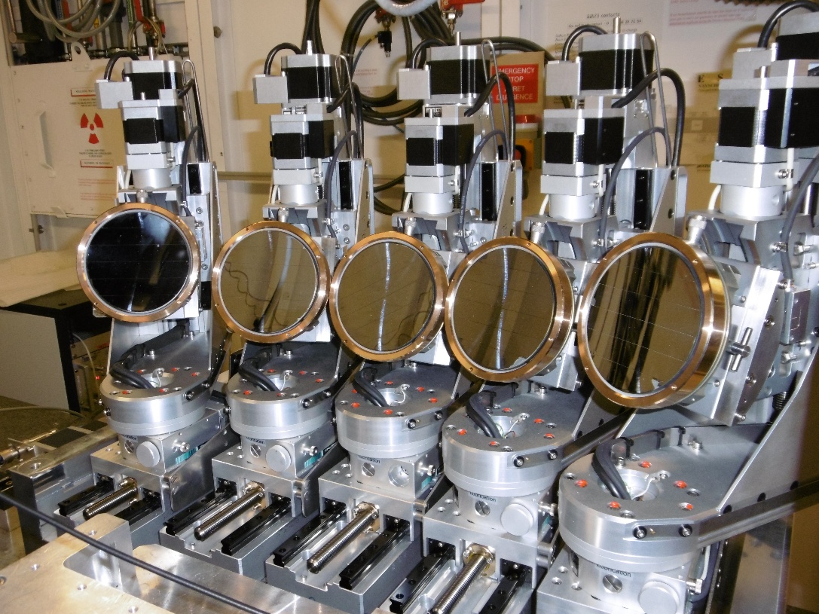
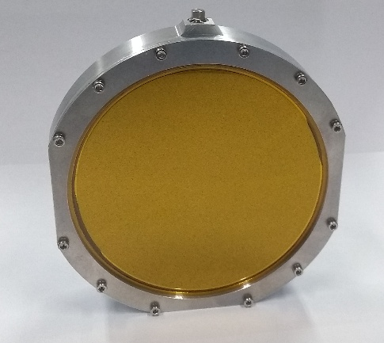
Crystal Analyser Lab: Achievements
2025 Production:
25 x bent, bent-striped and diced spherical analysers
16 x cylindrical Von Hámos analysers
5 x vacuum clamped cells (spherical/cylindrical)
~50% for external clients
Improvements/developments
  Cylindrical VCC
  Spin-coating technique
Bent
Bent-striped
Diced
Von Hámos
VCC Cylindrical
Typical ESRF 5-crystal spectrometer
VCC Spherical

Slide 10
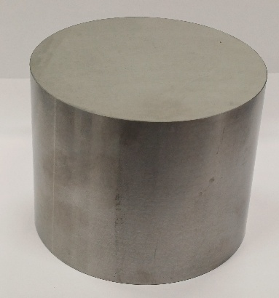
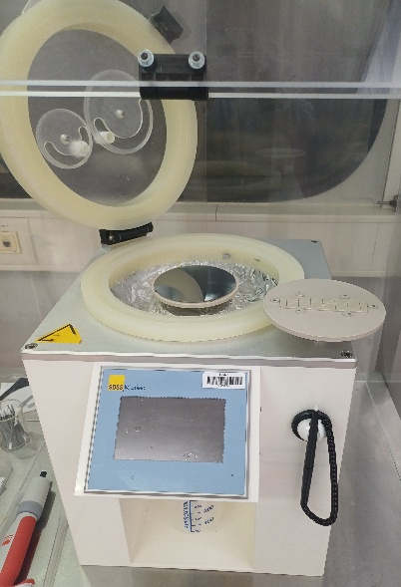
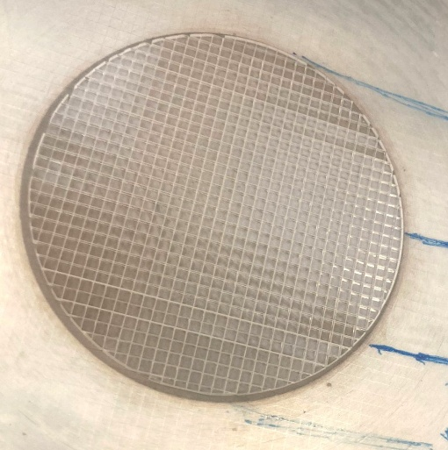

Crystal Analyser Lab: Challenges
Ge ingots very important for analyser manufacture
Major suppliers in China (control 80-85% of world production). Export controls implemented in 2023-24. Export bans to US - very difficult to purchase.
Price increased by 4X in one year.
Challenges for the next years
Find alternative Ge ingot suppliers
Improvement of bonding of Ge analyser crystals
  epoxy gluing
Production of quartz and lithium niobate spherical/cylindrical analyser crystals
Find new suppliers of double-side polished wafers
Spin-coating machine:
Epoxy gluing of spherical/cylindrical analyser for Ge/quartz and LiNbO3
Improvement of the spinning parameters.
More adapted Epoxy glue
Diced LiNbO3 wafer – Ø65 mm
Double-side polished Si wafers
Alpyx very slow delivery
Very difficult to find suppliers for ‘non-standard’ reflections
Dicing LiNbO3 →appears to be under control.
Dicing quartz wafer still very hard → few analysers in the world
Siltronix
Alpyx

Slide 11





Metrology Lab: Achievements
Measurement of Sub-nanometer deformation induced by support
JTEC mirror (PSI): 270 mm x 40 mm(w) x 50 mm (t)
  Top view
  Optical surface Shape error
  Optical surface
  244 mm x 20 mm
  0.7
  Optical surface
  nm
Mirror support allowing various sphere position
  -0.7
Face Up/Face down measurement capability successfully implemented on Fizeau interferometer
Folding mirror
LEAPS-Innov Superflat prototype mirror: 600 mm x 60mm x 60 mm
Fizeau
Face side
500 mm x 20mm
  8
Face side
  nm
Mirror facing up
Face Up
  -8
LTP scanning speed successfully increased to 100 mm/sec

Slide 12






Metrology Lab: Challenges
Before bonding
ID16B
Nano KB
Metrology
Improve gluing process for ID16B nano-KB
Improve mirror support for acceptance tests
Reduce low spatial frequency measurement errors (LTP/ Fizeau) –air turbulence
Improve micro-stitching interferometry for longer mirrors (currently <150 mm)
    new micro-interferometer arriving in 2026
ID21 HF
ID21 VF
After O2 plasma exposure
HF
VF
Mirror refurbishment
strip off coatings and recover original Si surface
remove contamination after X-ray exposure
metrology for 2D differential deposition aimed to improve mirror figure errors
Mirror implementation
Reduce or compensate mirror mounting deformations (FEA as for gravity : ID32 – ID29 …) by polishing or differential deposition ??

Slide 13

Thank you!

