Slide 1
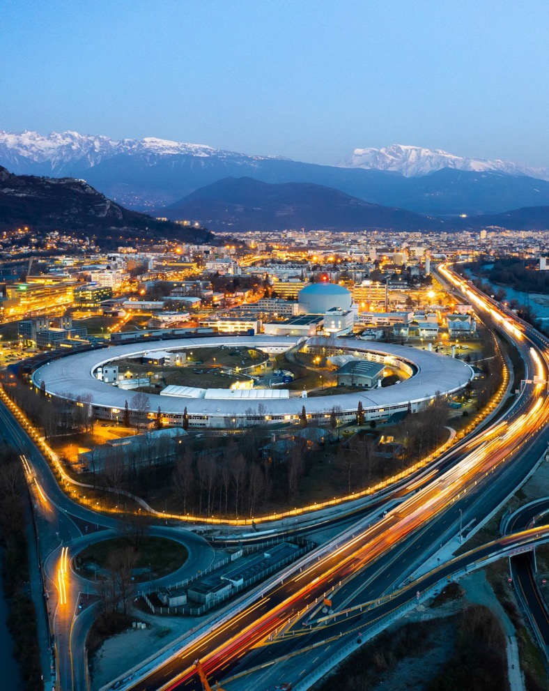

Software Group
ISDD Away Day – Oct 2025

Slide 2
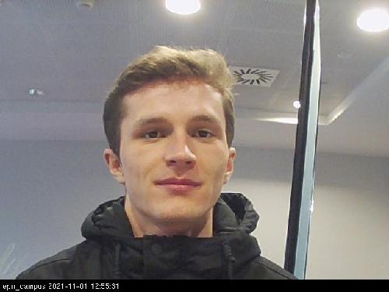
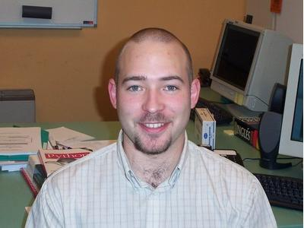
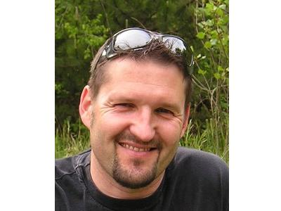
New paths
Mael Gaonach
Matias Guijarro
Holger Witsch (preparing retirement)
ISDD Away Day – 24 Oct 2025 - SWG

Slide 3
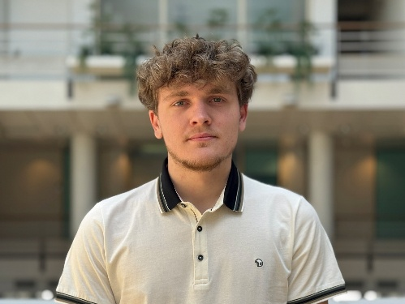
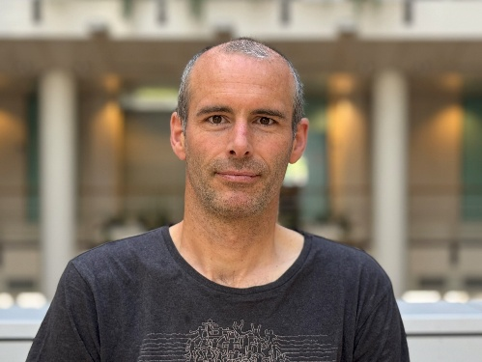
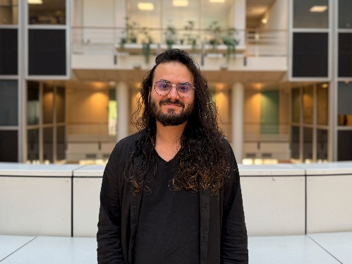
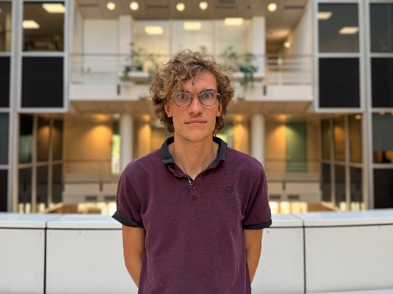
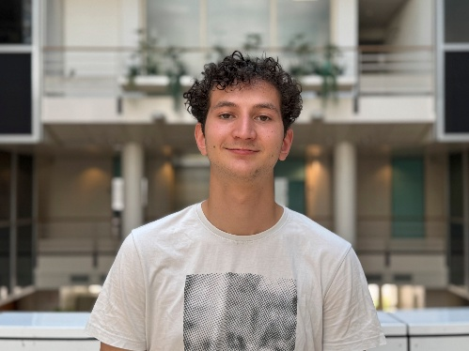
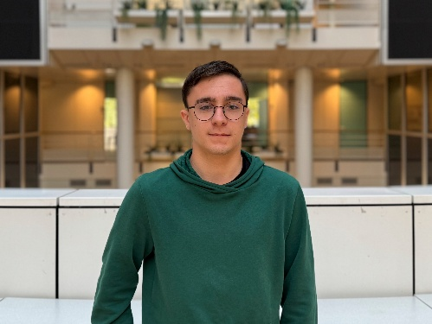
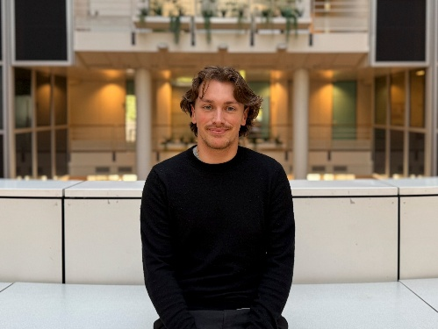
New FAces
Newcomers
Theo Rozier (ACU) Ignacio Vergara (ACU) Simon Delcamp (DAU) Maxence Ruyer (DAU)
Sandwich course students
Eliot Michel Fabio Brambilla Mathis Loussert

Slide 4
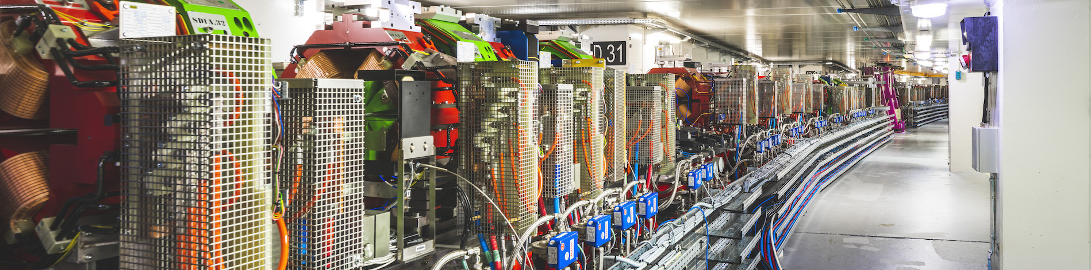
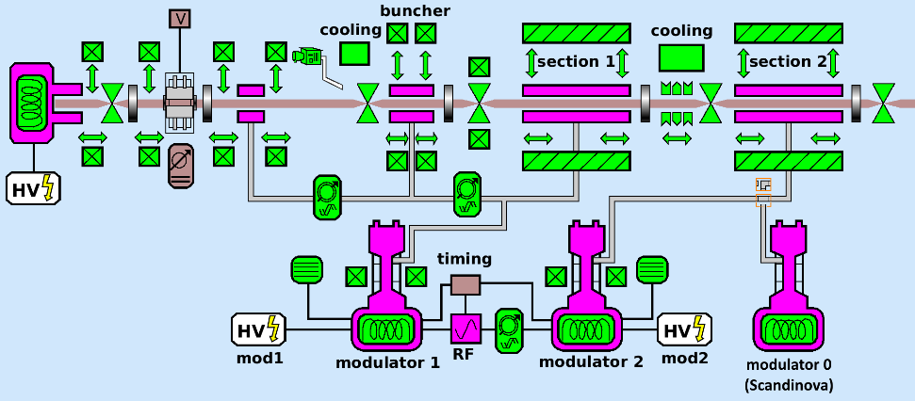
Accelerator Control System
> 150 graphical applications
Distributed Control System
178 computers;
348 different servers;
2870 servers/instances;
23425 controlled devices.
HDB++
~9 TB;
86 archivers;
17901 Archived attributes.

Slide 5

AcCelerator control system
Accelerator control - Highlights 2025
New projects / developments
Linac refurbishment, modulators
HQPS monitoring
RIPS update
Undulators & IcePAP
PyAML
Fighting Obsolesence
DeviceMaster SLs
new vacuum gauges
TL2 correctors Power Supplies
Long term
Tango 10 – telemetry
GUI alternative - Taurus

Slide 6
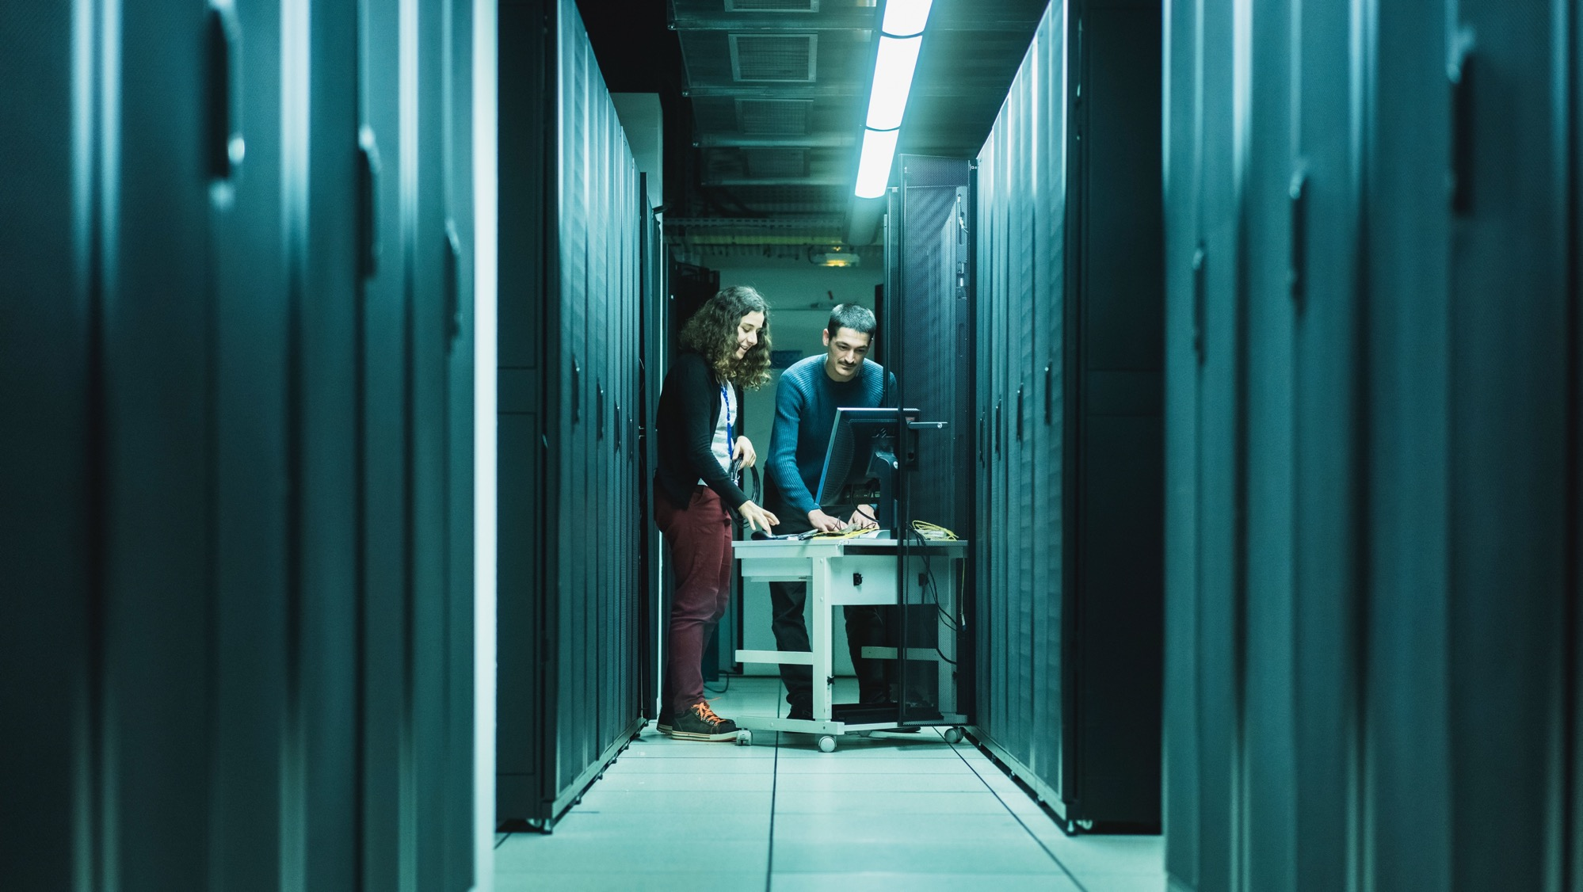
DATA STRATEGY

Slide 7


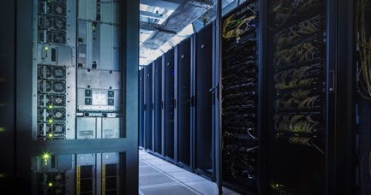
EBS StRATEGIC PILARS
Beamline & Accelerator upgrades
Enabling technologies
Training the next generations
New access modes for academia & new services for industry
HUB
Engagement towards
a sustainable development
Data Strategy Implementation Plan
ISDD Away Day – 24 Oct 2025 - SWG
Notes:
One of them was the « data strategy implemtation plan » And that is what I am going to talk about

Slide 8
Data Strategy Implementation Plan
DSIP = framework program to support the post-EBS data deluge
From 2021, funding planned until 2031
All IT Groups: EXP/ADA, ISDD/SWG and TID/ITS
Key objectives:
High-throughput and big data adaptation:
  Acquisition (Lima2, BLISS)
  Storage, network, computing infrastructures and software
Data usability: Ensure that every user leave the ESRF with a data set that is ready for use
  Processing and automatic data analysis (Lima2, EWOKS, ADA)
Data quality: The quality of the data sets shall be confirmed at time of experiment.
Reusability (FAIR)
  DRAC
Cybersecurity: Mitigate cybersecurity risk level to protect data and operations.
Carbon footprint control
Cost effectiveness

Slide 9
Data Strategy Implementation Plan
DSIP = framework program to support the post-EBS data deluge
From 2021, funding planned until 2031
All IT Groups: EXP/ADA, ISDD/SWG and TID/ITS
Key objectives:
High-throughput and big data adaptation:
  Acquisition (Lima2, BLISS)
  Storage, network, computing infrastructures and software
Data usability: Ensure that every user leave the ESRF with a data set that is ready for use
  Processing and automatic data analysis (Lima2, EWOKS, ADA)
Data quality: The quality of the data sets shall be confirmed at time of experiment.
Reusability (FAIR)
  DRAC, metadata collection, ESRFET ontologies
Cybersecurity: Mitigate cybersecurity risk level to protect data and operations.
Carbon footprint control
Cost effectiveness

Slide 10
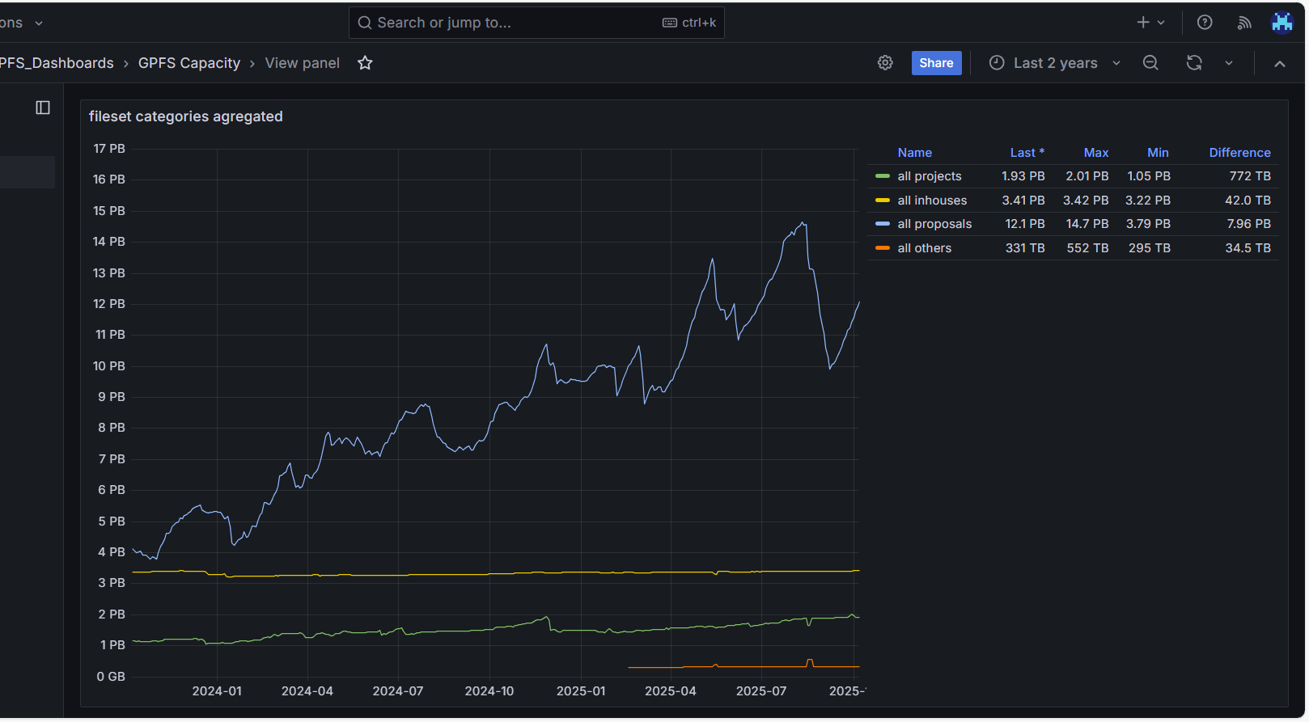
Storage for acquisition and processing (theoretically 90 days staging)
23PB July 2025

Slide 11
DATA STRATEGY: data-centric approach
50 Petabytes
SOFTWARE COMPONENTS
of data archived since 2015 at ESRF
1.5 PB
downloaded in 2024
500 TB
BLISS
LIMA2
produced in a single experiment
Detector control and data acquisition.
Advanced features (lossless compression, data triage).
1 billion datasets
Beamline control – data collection.
ORCHESTRATION
blissdata
STRATEGY
Parallel and scalable detector acquisition
Advanced synchronization and flexible acquisition schemes
DRAC
EWOKS
Advanced data catalog for Open Science
Data Policy – FAIR data.
ESRF Workflow System (EWOKS)
Data processing online / offline.
Efficient tools and processing workflow automation
Collection and curation of metadata - data FAIRness
Other non-software components (IT infrastructure + remote access…)
ISDD Away Day – 24 Oct 2025 - SWG
Notes:
What is the problem to solve? The handling of bigger and faster dectors and the management of the data they produced. Already with current data volumes we observe that the time leading from experiment to publication has slowed down. The users dependent more and more on beamline scientists to digest those volumes of data and produce scientific results. Automation of processing whenever possible is mandatory.
Other than the IT resources, the software components of the strategy are shown here:
LIMA2 for the control and detector data acquisition
BLISS for the experimental sequences and instrumentation control
EWOKS as the data processing automation component
DRAC is our solution addressing the data management and other aspects such as our data policy

Slide 12
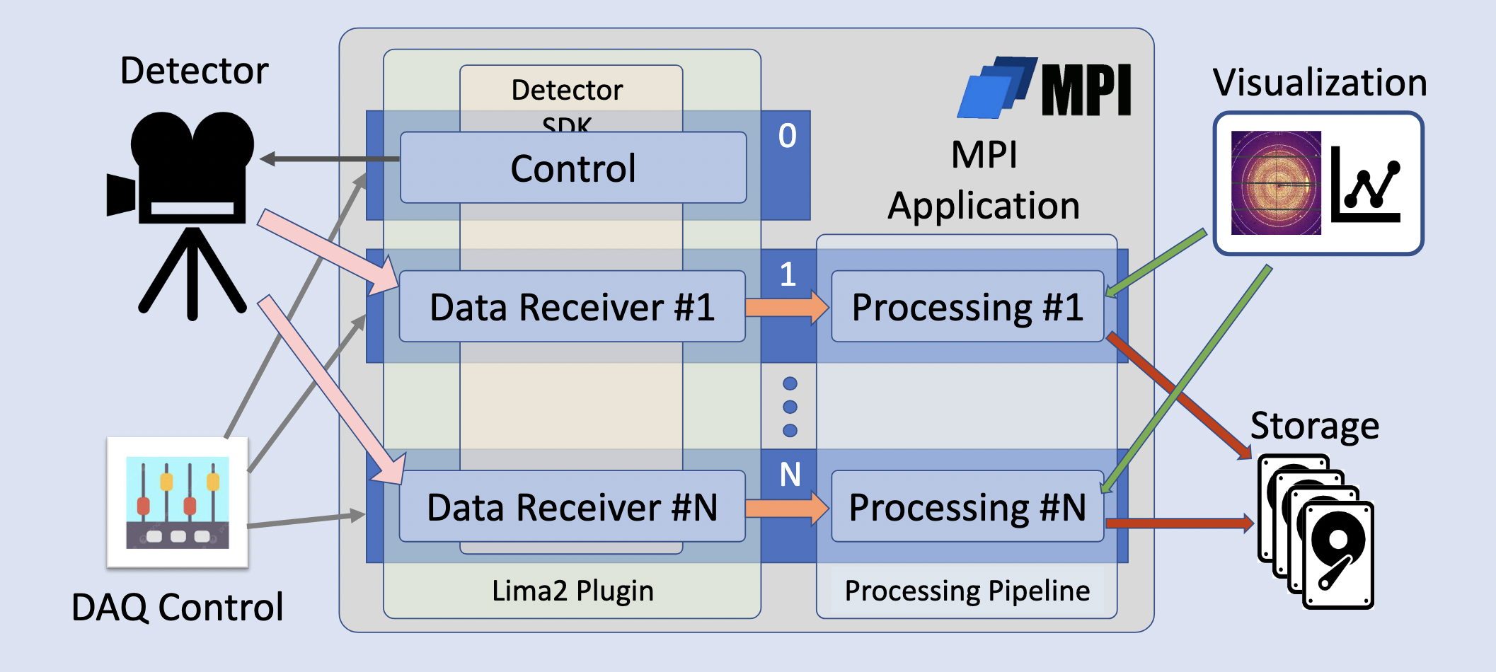
DETECTOR DATA ACQUISITION
LIMA2 Key Features
Parallel and Scalable : One system controller, one or more data receivers ;
Low-latency feedback to experiment ;
Feature extraction and advanced data reduction.
Dectris Pilatus4 (ID15A)
Managed with 2 PCs at full rate (4kHz)
16 data receivers on 2 computers
Sustained acquisition for 5min: 1.2 million frames/1.4TB
Compression rate obtained slightly over 3 (1.2MB/frame)
Each PC digested a flow of 2.4GB/sec → 4.8GB/sec in total
On-going: consolidate developments / including processing with PyFAI
LIMA(1) reminder
Started in 2007. 162 devices – 16 unique models
Notes:
The “upgrade” of LIMA is LIMA2 – (there was a dedicated presentation this morning by Samuel Debionne – I hope you could enjoy it)
LIMA2 keys are parallelization and scalability.
Other that the acquisition it offers an advanced data reduction component. If LIMA already offers basic processing such as ROI, Binning, flatfield corrections. LIMA2 aims for powerful data reduction. For example: azimuthal integration of all frames, peakfinding…
To soustain high frame rates and these processing we chose a multi-receiver architecture. (read ID29 box)

Slide 13
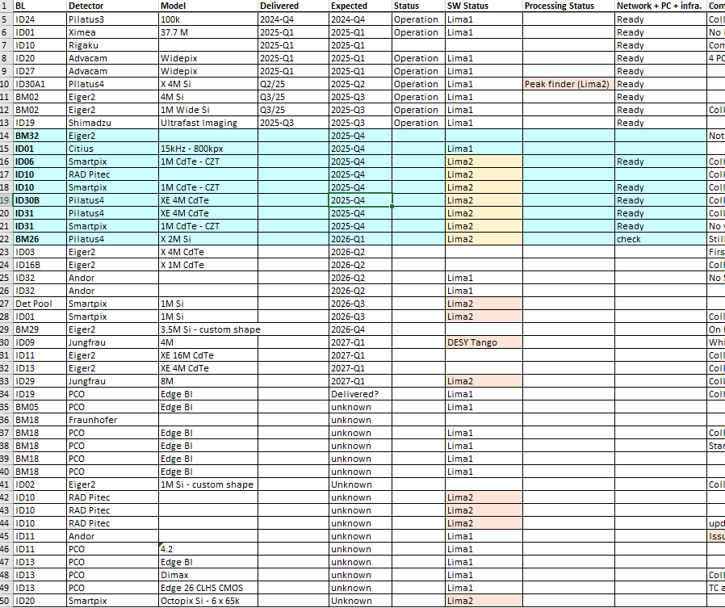
DETECTOR SOFTWARE
Delivery Planning
2024-Q4 to 2027-Q1 (as of Oct.25)
49 detectors (2D) in planning:
12 already delivered and installed
37 planned (at various stages)
Lima2 for 23 of them (estimated)
5 unique models – undetermined processing plug-ins
ISDD Away Day – 24 Oct 2025 - SWG

Slide 14

DETECTOR SOFTWARE
Detector Software in 2025
Intense Lima2 core development
Installation of first Pilatus4 detectors (ID15A, ID30A1) and imminent new arrivals
Lima2 Processing plugins
Citius (Lima)
MOSCA (1D) – V2 – xpress4 and xgla models

Slide 15
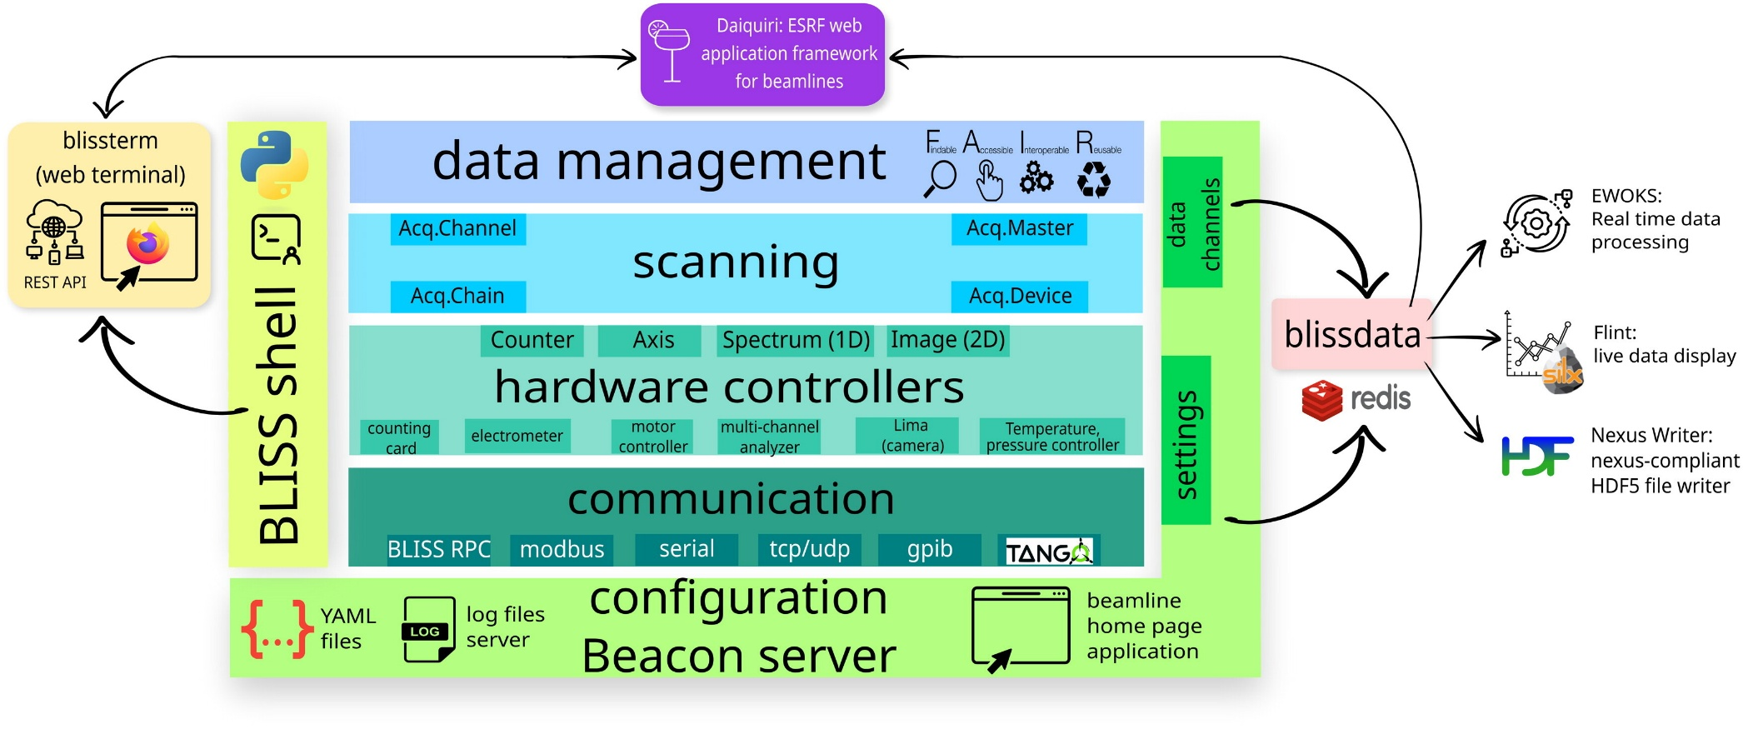
BLISS
BLISS – Data acquisition & sequencer
Integrates access to most BL hardware;
Both python command line and REST-API ;
Sequencer: Step and continuous scans; scripts ;
Decoupes data acq. and handling through Blissdata ;
Allows automated data processing with EWOKS ;
Ingests datasets in data catalog.
ISDD Away Day – 24 Oct 2025 - SWG
Notes:
Then, we have BLISS.
BLISS was developed and deployed along the EBS. It is our data acquisition sequencer.
BLISS is the interface to experimental sequences, either through CLI or through graphical applications that connect through a rest-api to BLISS. There is project not described here for web graphical applications, Daiquiri.
BLISS command line is a pure python interface. Between many other features, BLISS is the component in charge of scanning (fast scanning included) and user scripts. BLISS through the scans builds the correlation between data. It publishes scan info and metadata as datasets to our data catalog. It delegates the handling of the data produced to the following component: blissdata

Slide 16
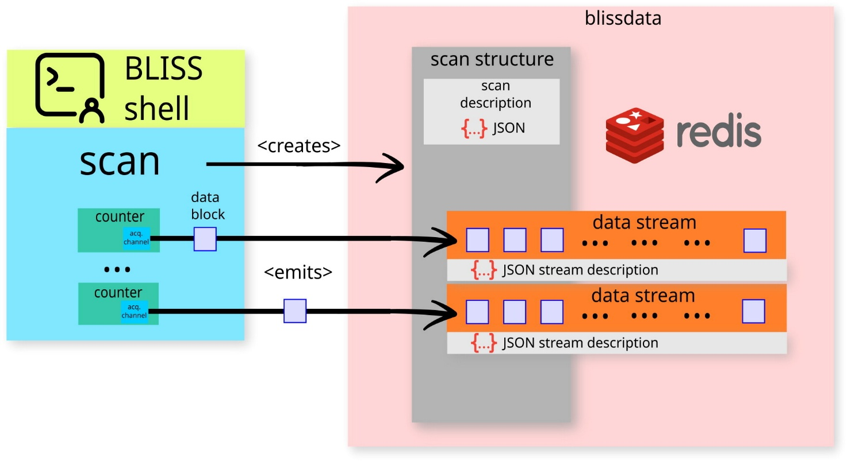
Blissdata
Blissdata (in a nutshell)
In-memory storage & distributed db ( REDIS ) ;
Collects Data and metadata ;
Transparent access for online and offline;
NexusWriter to write data to disk (implements standard data format)
De-couples producers: BLISS, Lima/Lima2 refs, and consumers: Daiquiri (GUI) , EWOKS (processing), Flint (visualization)
Independent of BLISS – interest by ESRF partners
ISDD Away Day – 24 Oct 2025 - SWG
Notes:
Blissdata is an in-memory database based on Redis.
When BLISS starts a scan it creates a new scan instance in Blissdata, fills with metadata and assigns Redis data streams to it. Then the streams are fed with counter data through the scan. In the case of LIMA and LIMA2 those streams are only references to LIMA or to the files in disk created by LIMA.
Scans data and metadata are then buffered in blissdata and accessible as far as memory allows. Data consumers (such as automatic processing or visualization) can obtain all data from blissdata. This mechanism decouples producers (BLISS, LIMA) from consumers.
To store data in its final HDF5 files, a special consumer, NexusWriter, is continuously scanning for new data.
This component is an orchestrator and can be included with other controls systems. It has been successfully tested with Sardana (ALBA) and with bluesky at DESY.

Slide 17
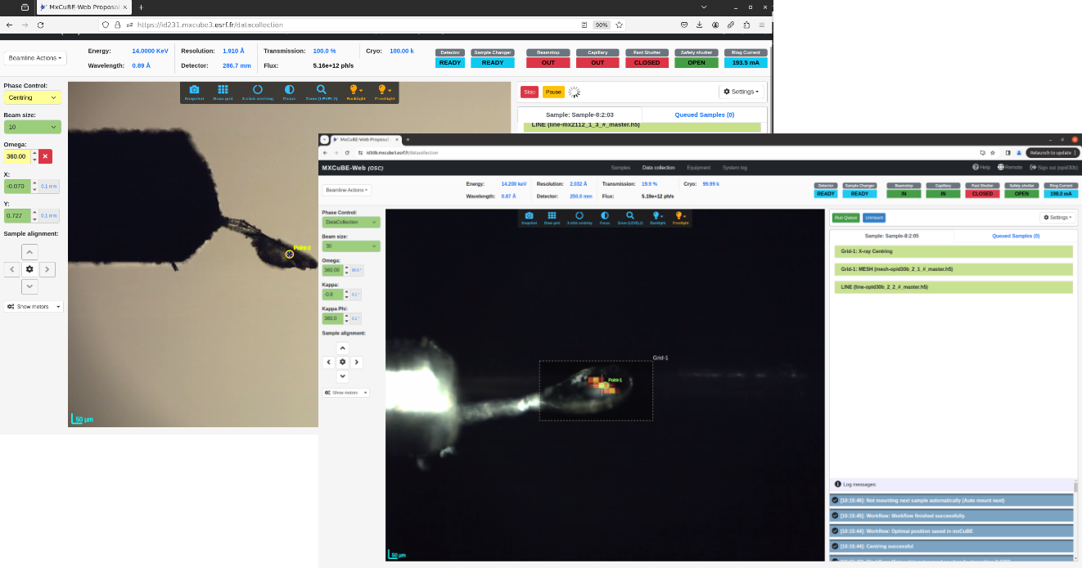
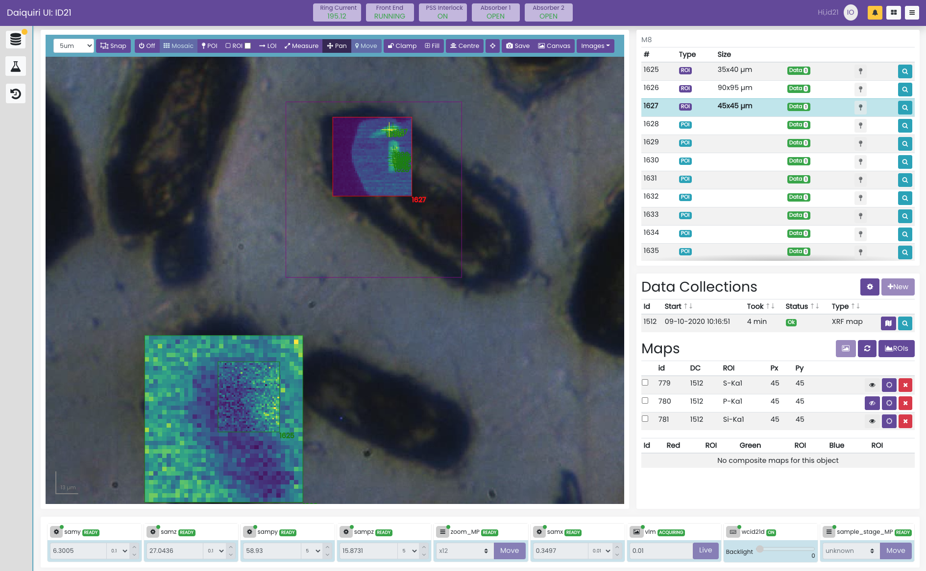
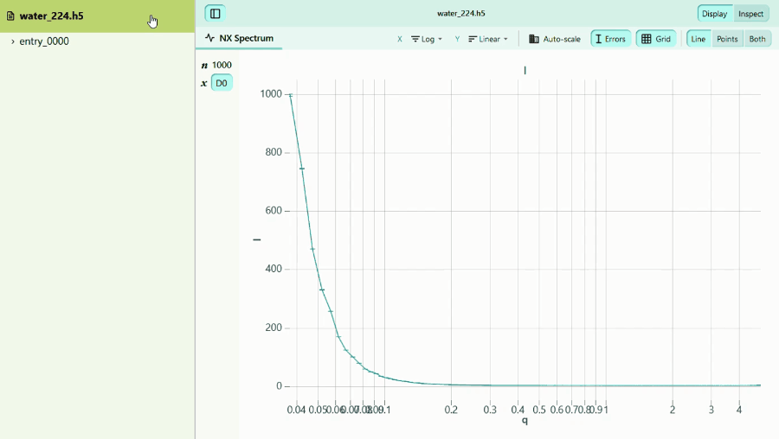
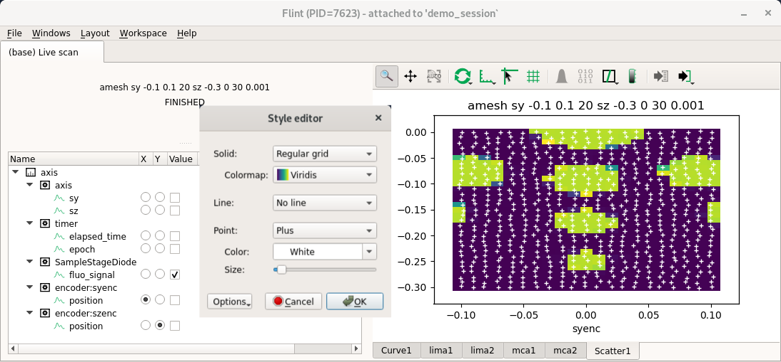
Data visualization

Slide 18

Bliss
Highlights 2025
Version 2.2
rest-API
Lima2 client
Version 2.3 (imminent)
Lima2 conductor client
Blissdata – hdf5 (and blisswriter)
Notes:
Blissdata is an in-memory database based on Redis.
When BLISS starts a scan it creates a new scan instance in Blissdata, fills with metadata and assigns Redis data streams to it. Then the streams are fed with counter data through the scan. In the case of LIMA and LIMA2 those streams are only references to LIMA or to the files in disk created by LIMA.
Scans data and metadata are then buffered in blissdata and accessible as far as memory allows. Data consumers (such as automatic processing or visualization) can obtain all data from blissdata. This mechanism decouples producers (BLISS, LIMA) from consumers.
To store data in its final HDF5 files, a special consumer, NexusWriter, is continuously scanning for new data.
This component is an orchestrator and can be included with other controls systems. It has been successfully tested with Sardana (ALBA) and with bluesky at DESY.

Slide 19
Bliss
Highlights 2025
BLISS conversion
bliss conversión for ID12, ID20, ID32, BM20, BM25 and BM30. Ongoing ID16A, ID16B
All ESRF beamlines have BLISS installed (last conversions ongoing)
Instrumentation
DCM
Mono-undulator sync / undulator trajectories with IcePAP
Maestrio
Sample stages (ID15A, BM18…)
Various scanning features and hardware support
ISDD Away Day – 24 Oct 2025 - SWG
Notes:
Blissdata is an in-memory database based on Redis.
When BLISS starts a scan it creates a new scan instance in Blissdata, fills with metadata and assigns Redis data streams to it. Then the streams are fed with counter data through the scan. In the case of LIMA and LIMA2 those streams are only references to LIMA or to the files in disk created by LIMA.
Scans data and metadata are then buffered in blissdata and accessible as far as memory allows. Data consumers (such as automatic processing or visualization) can obtain all data from blissdata. This mechanism decouples producers (BLISS, LIMA) from consumers.
To store data in its final HDF5 files, a special consumer, NexusWriter, is continuously scanning for new data.
This component is an orchestrator and can be included with other controls systems. It has been successfully tested with Sardana (ALBA) and with bluesky at DESY.

Slide 20

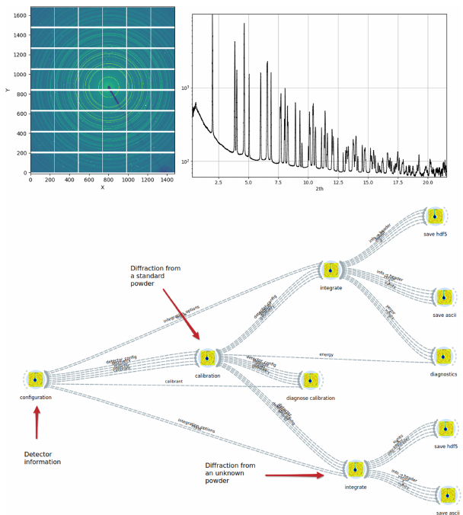
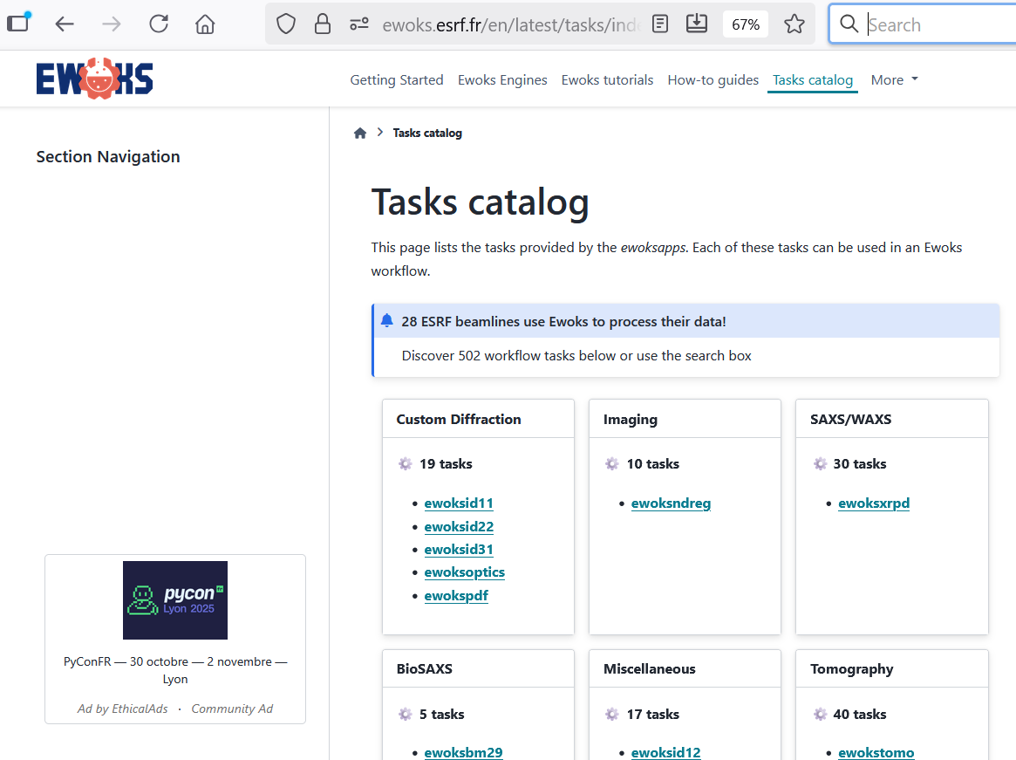
Ewoks: an Extensible WOrKflow System
Extensive data processing workflow system
Execution
  Meta workflow system
  Online and offline – full processing or small tasks
  Consumes Blissdata for online processing
  Leverage parallelism / GPU usage when needed
Tasks
  Graphical workflow editor
  Catalog of tasks
EBS higher flux & coherence
10 to 100 increase in data flow
ISDD Away Day – 24 Oct 2025 - SWG
Notes:
EWOKS is the component in charge of data processing automation
Description
Meta workflow system (can execute orange, dusk or other workflows)
Can leverage computing resources as needed: parallelism, GPU….
Can be triggered offline or online during experiments (by consuming from blissdata)
Enables users to make informed decisions during experiments and take pre-processed data home.
FAIR compliance:
Workflows are reproducible and traceable via executable documents containing all necessary input parameters.
Future inclusion of dependencies will make workflows installable on any computer.
It includes a catalog of more than 500 processing to choose from and connect between them (or obviously you can write your own task)

Slide 21
Bliss
Data processing 2025
Countless data automation and workflow improvements for:
single-crystal diffraction, online 2D azimuthal integration, fast-EXAFS data reduction, BioSAXS, XRF fitting, 3DXRD, SSX, SIXES and XAS
Darfix overhaul for cluster use
Workflows for SSX data accumulation and indexing
Tomography experiments, online slice reconstruction with visualization in Flint and many other workflow improvements.
User-driven software (ID10) for GISAXS/GIWAXS integrates data acquisition, processing, real-time visualization, and uploads results to the ESRF data portal
ID energy calculations from attenuators
ISDD Away Day – 24 Oct 2025 - SWG

Slide 22

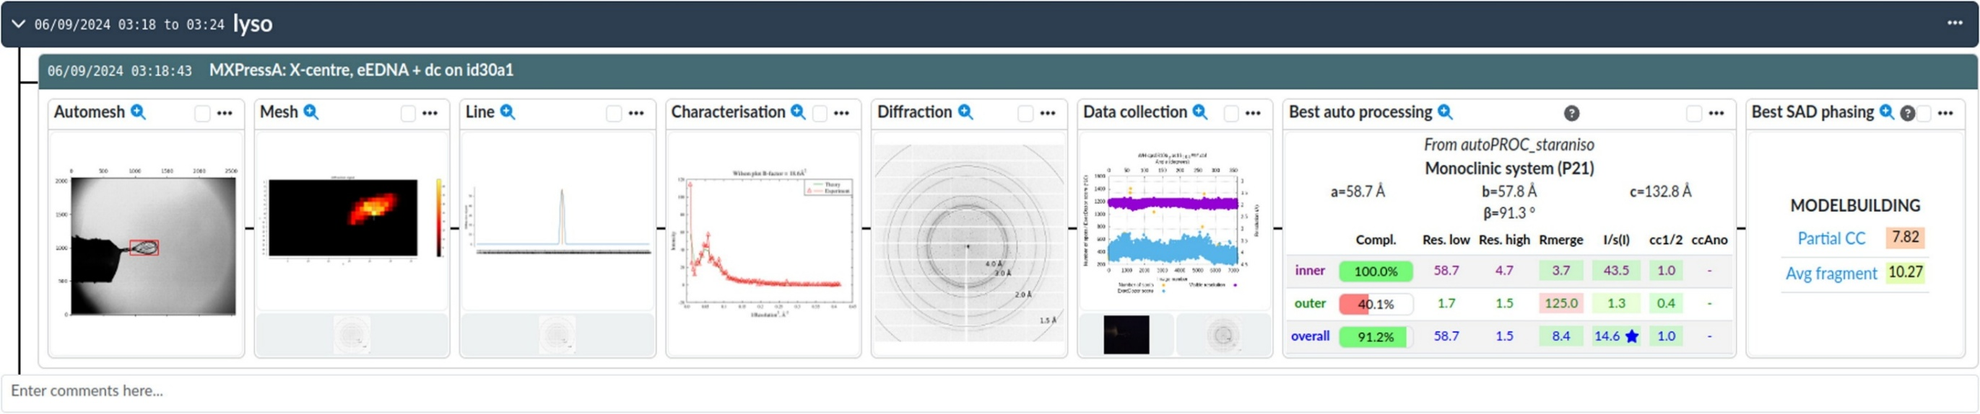
DRAC: Data Repository for Advancing Open sCience
Data / Metadata catalog (based on iCat)
Data Policy (V2 - for both raw and processed data)
FAIR data
Data Portal
=
MORE:
Ingestion from BLISS or EWOKS through ActiveMQ
User interface to archiving / access / download data
DOI generation – DOI minting
E-logbook (correlating various information from user session)
Display plugins for specific techniques
ISDD Away Day – 24 Oct 2025 - SWG

Slide 23
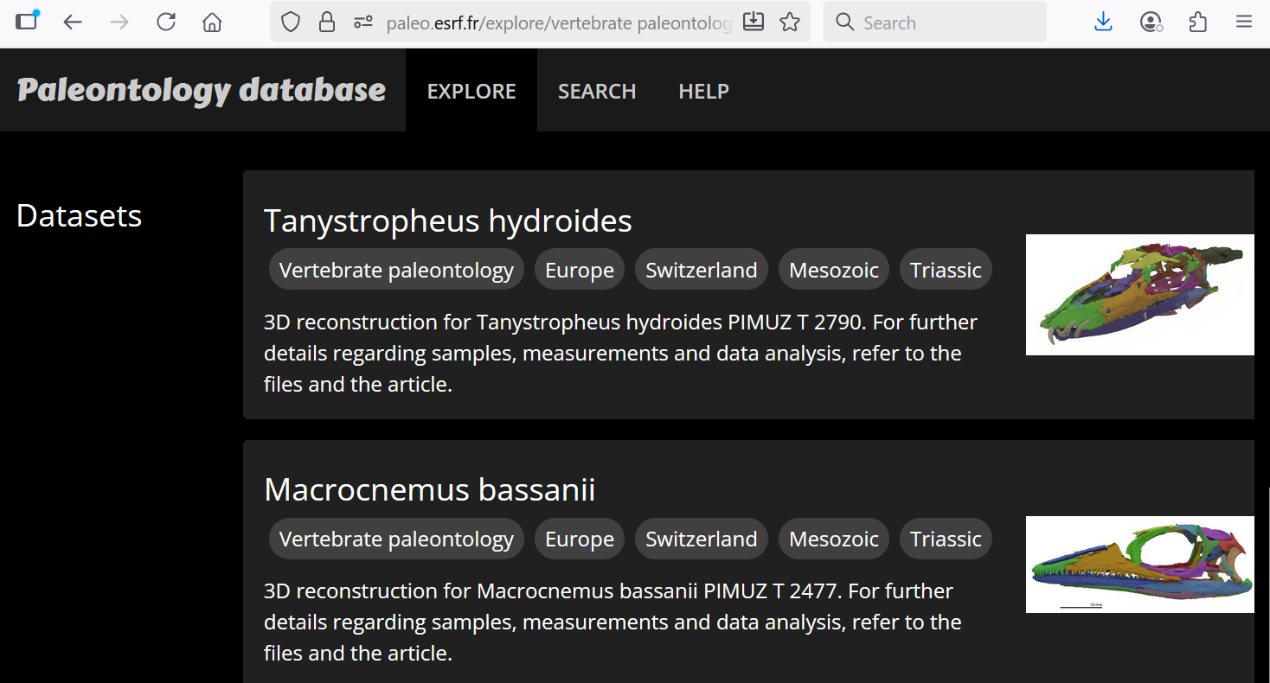
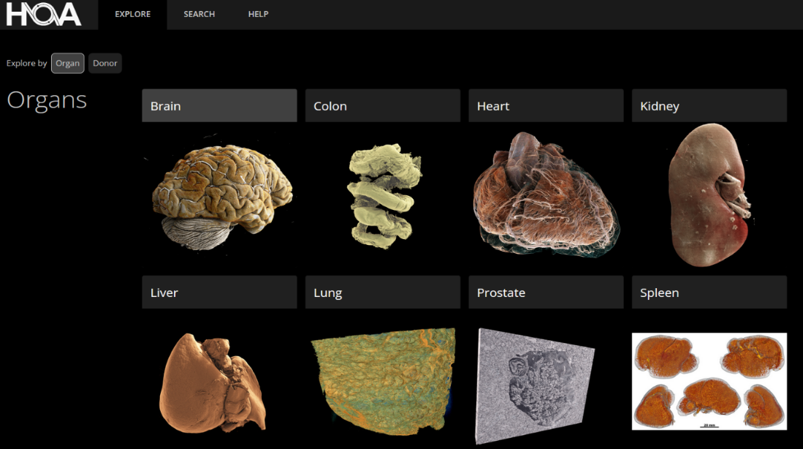


Domain specific data portals
https://human-organ-atlas.esrf.eu/
177 datasets on the open-access database
with 721 downloads since 2021
28 publications from users
+ 8 publications from open data
https://paleo.esrf.eu/ hosts FAIR data from X-ray Computed Tomography experiments since 2011
Of 399 articles published:
  342 direct publications
  57 linked to open data (16% of all Paleo publications
ISDD Away Day – 24 Oct 2025 - SWG

Slide 24
Bliss
Data management 2025
DRAC
DRAC ready to replace ISPyB
Unified sample tracking
Online reprocessing with EWOKS
MX collection strategies prior to experiment
Dedicated domain portals include ESRFET ontologies
Improvements for technique plug-ins (Tomography), dedicated domain portals and DOI handling
Notes:
Blissdata is an in-memory database based on Redis.
When BLISS starts a scan it creates a new scan instance in Blissdata, fills with metadata and assigns Redis data streams to it. Then the streams are fed with counter data through the scan. In the case of LIMA and LIMA2 those streams are only references to LIMA or to the files in disk created by LIMA.
Scans data and metadata are then buffered in blissdata and accessible as far as memory allows. Data consumers (such as automatic processing or visualization) can obtain all data from blissdata. This mechanism decouples producers (BLISS, LIMA) from consumers.
To store data in its final HDF5 files, a special consumer, NexusWriter, is continuously scanning for new data.
This component is an orchestrator and can be included with other controls systems. It has been successfully tested with Sardana (ALBA) and with bluesky at DESY.

Slide 25
RESULTS / status
LIMA2 under active development
4 detectors in operation with LIMA2
Many detectors in queue
LIMA2
Installed at all beamlines
3 last conversion ongoing
LIMA2
Deployed to 37 beamlines
Standardization of pipelines
500+ tasks in catalog. more being developed
LIMA2
Available for all beamline / all users
Raw and processed data
Domain portals
LIMA2
DRAC

Slide 26


SOFTWARE Collaborations - 2025
Partners
MoU for FAIR data signed;
Exchanges for adoption of:
  Daiquiri (DESY, Soleil)
  Blissdata (ALBA, DESY, MaxIV)
  BLISS, EWOKS
DRAC installations at ALBA and EMBL-HH
Developer meeting on Taurus (ALBA, ESRF, Soleil)
SIG on Experiment Control in LEAPS roadmap
Established collaborations
Tango (preparation of new contract)
MXCuBE and ISPyB (two workshops)
EU projects
Initial publication of metadata on NOMAD (AddMorePower)
Associating samples with generic metadata; Cultural heritage portal (SHARE project)
Activities for the build-up of PaNOSC Node (PaNOSC).

Slide 27
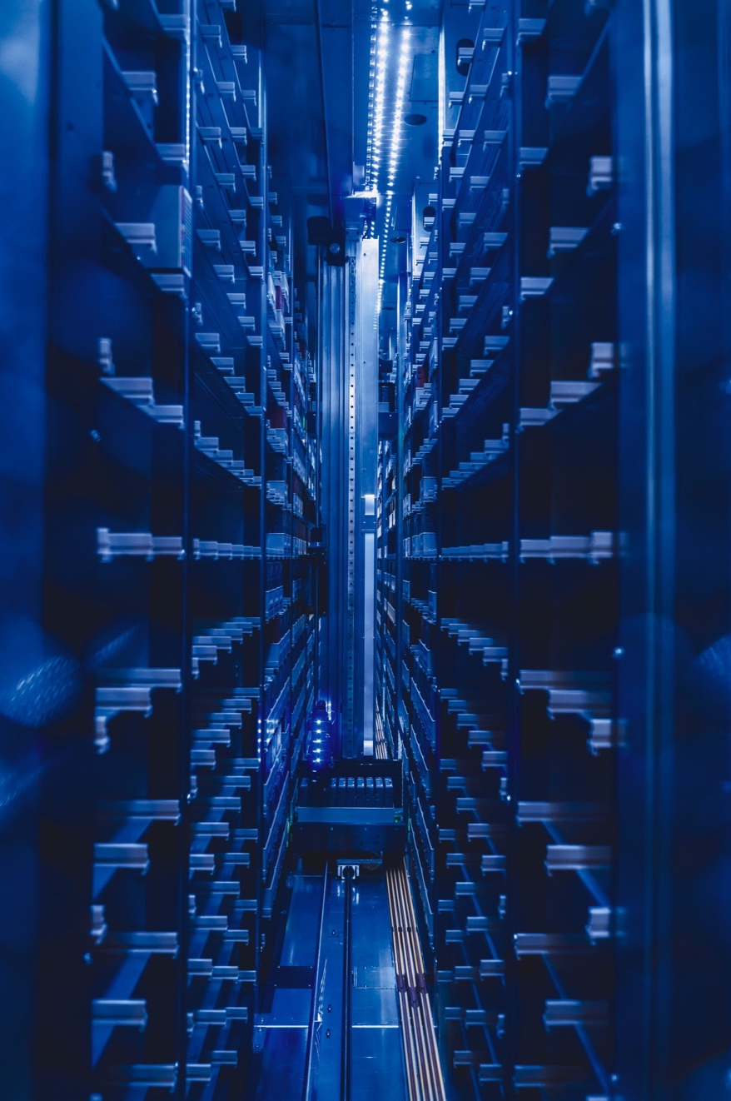
FUTURE PERSPECTIVES
Data sharing
Blissdata
HDF5
New data models
AI tools
Ontologies
Domain
portals
Domain portals

Slide 28


On behalf of the ESRF Software Group
THANK YOU FOR YOUR ATTENTION

