Slide 1

ISDD DAY – MEG CHALLENGES
MEG Challenges — Presentation Outline
- Machine Projects Portfolio and technical challenges
- Beamline Projects Portfolio and technical challenges
- Staff challenges and conclusion

Slide 2
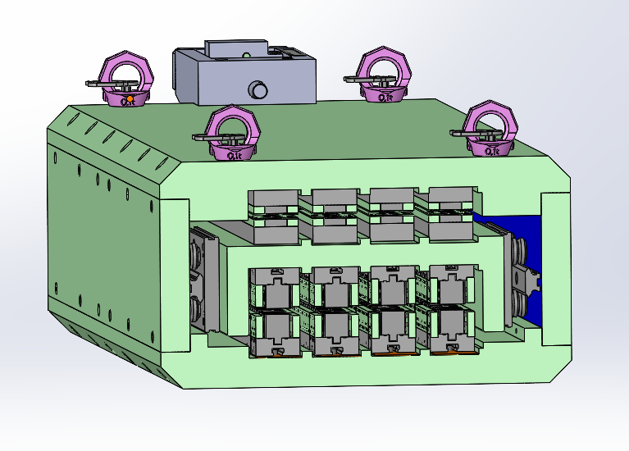
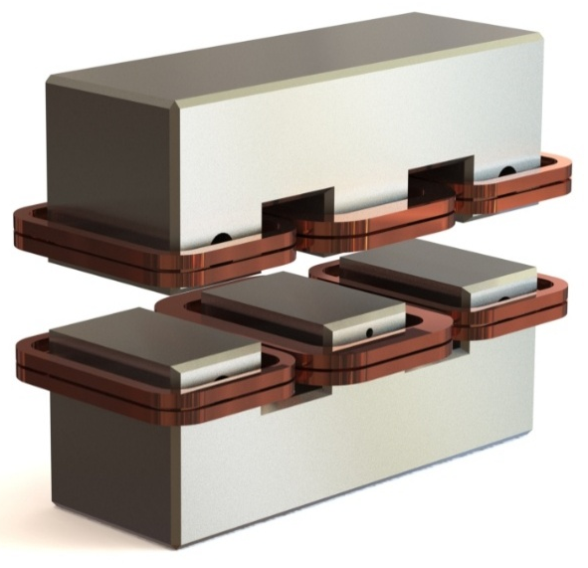
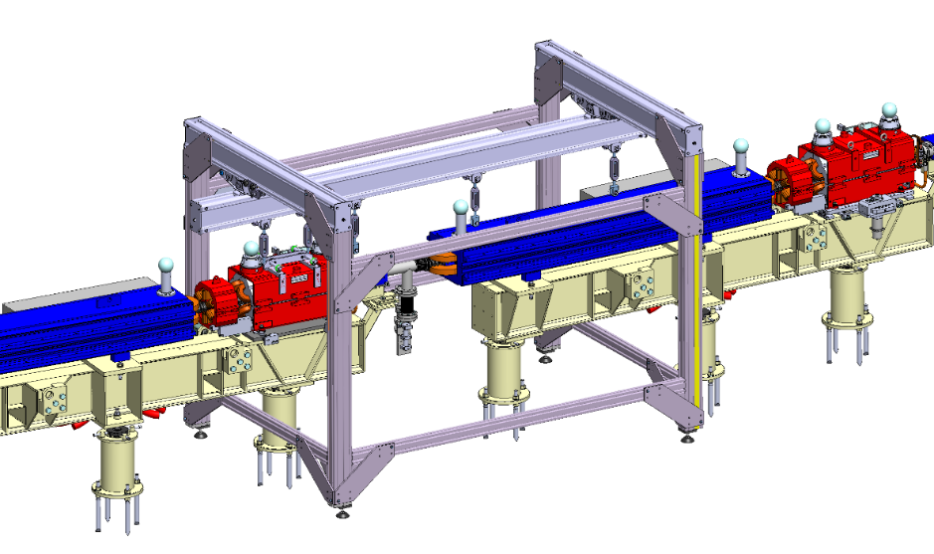

Machine Projects Portfolio and technical challenges
IDM projects
New generation of revolver
in vacuum undulator
HTS source for BM18
Booster upgrade
EBS machine
ASD projects
$$e^{−}$$
Challenges : T=65K/HTS coil in vacuum design
Challenges : manufacture follow up and installation of 18 quadrupoles
Short period/magnetic compensation
Challenges = dimensions/new design
Courtesy B. Ogier

Slide 3
Machine Projects Portfolio and technical CHALLENGES challenges
Injection upgrade
IDM projects
New generation of revolver
in vacuum undulator
HTS source for BM18
Booster upgrade
EBS machine
ASD projects

Slide 4
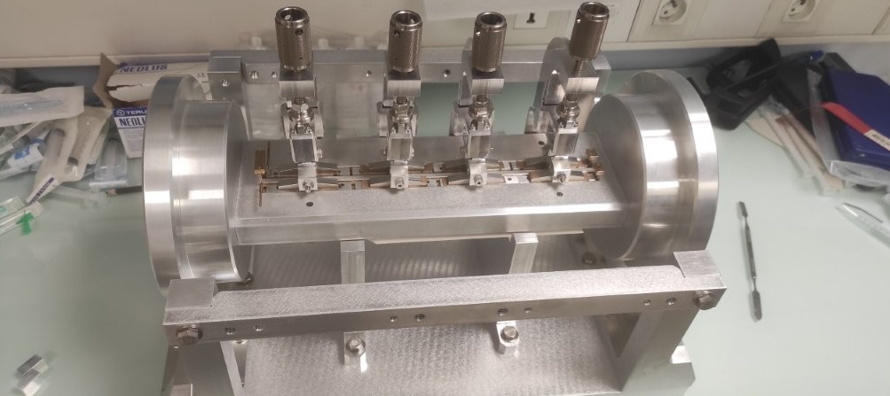
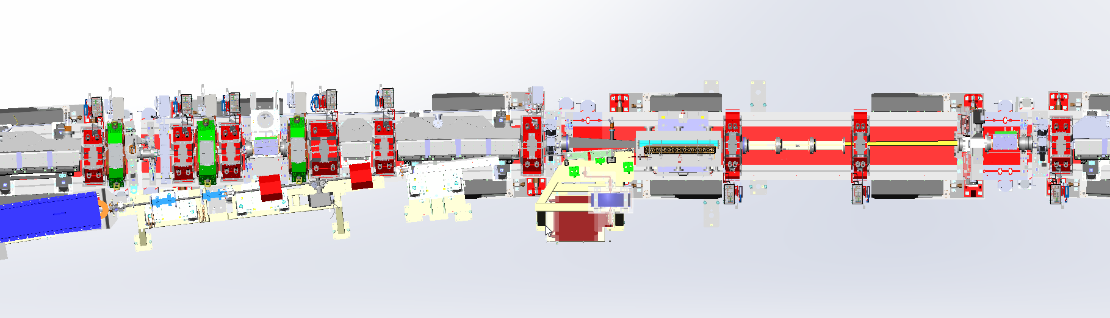
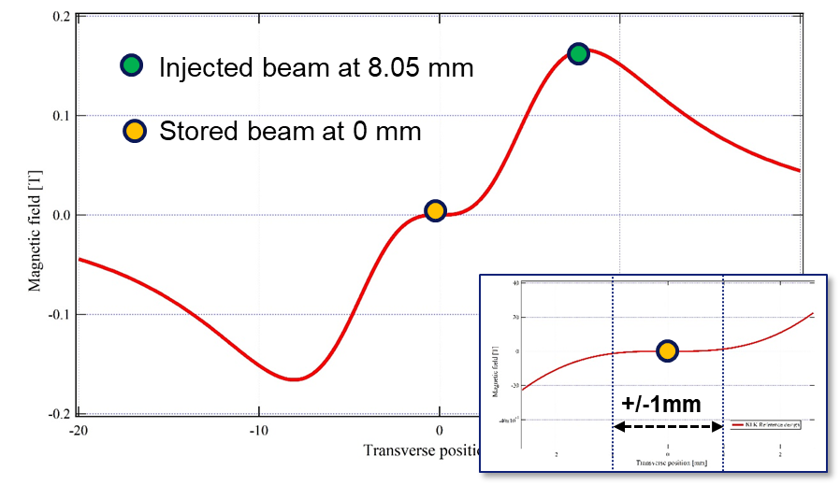
Machine Projects Portfolio and technical CHALLENGES
Fully transparent off-axis injection is possible using non-linear kicker (NLK) injection:
Operating at MAXIV and SIRIUS: demonstrated method
Zero field and gradient seen by stored beam
Requires a full re-design of injection straight and end of TL2
NLK design and maintaining high efficiency challenging
D. Baboulin/T. Brochard
Challenges = full re-design of injection and end of TL2 + NLK design
Courtesy = T. Brochard

Slide 5
Machine Projects Portfolio and technical CHALLENGES challenges
Injection upgrade
IDM projects
New generation of revolver
in vacuum undulator
HTS source for BM18
Booster upgrade
EBS machine
ASD projects
COLD project

Slide 6
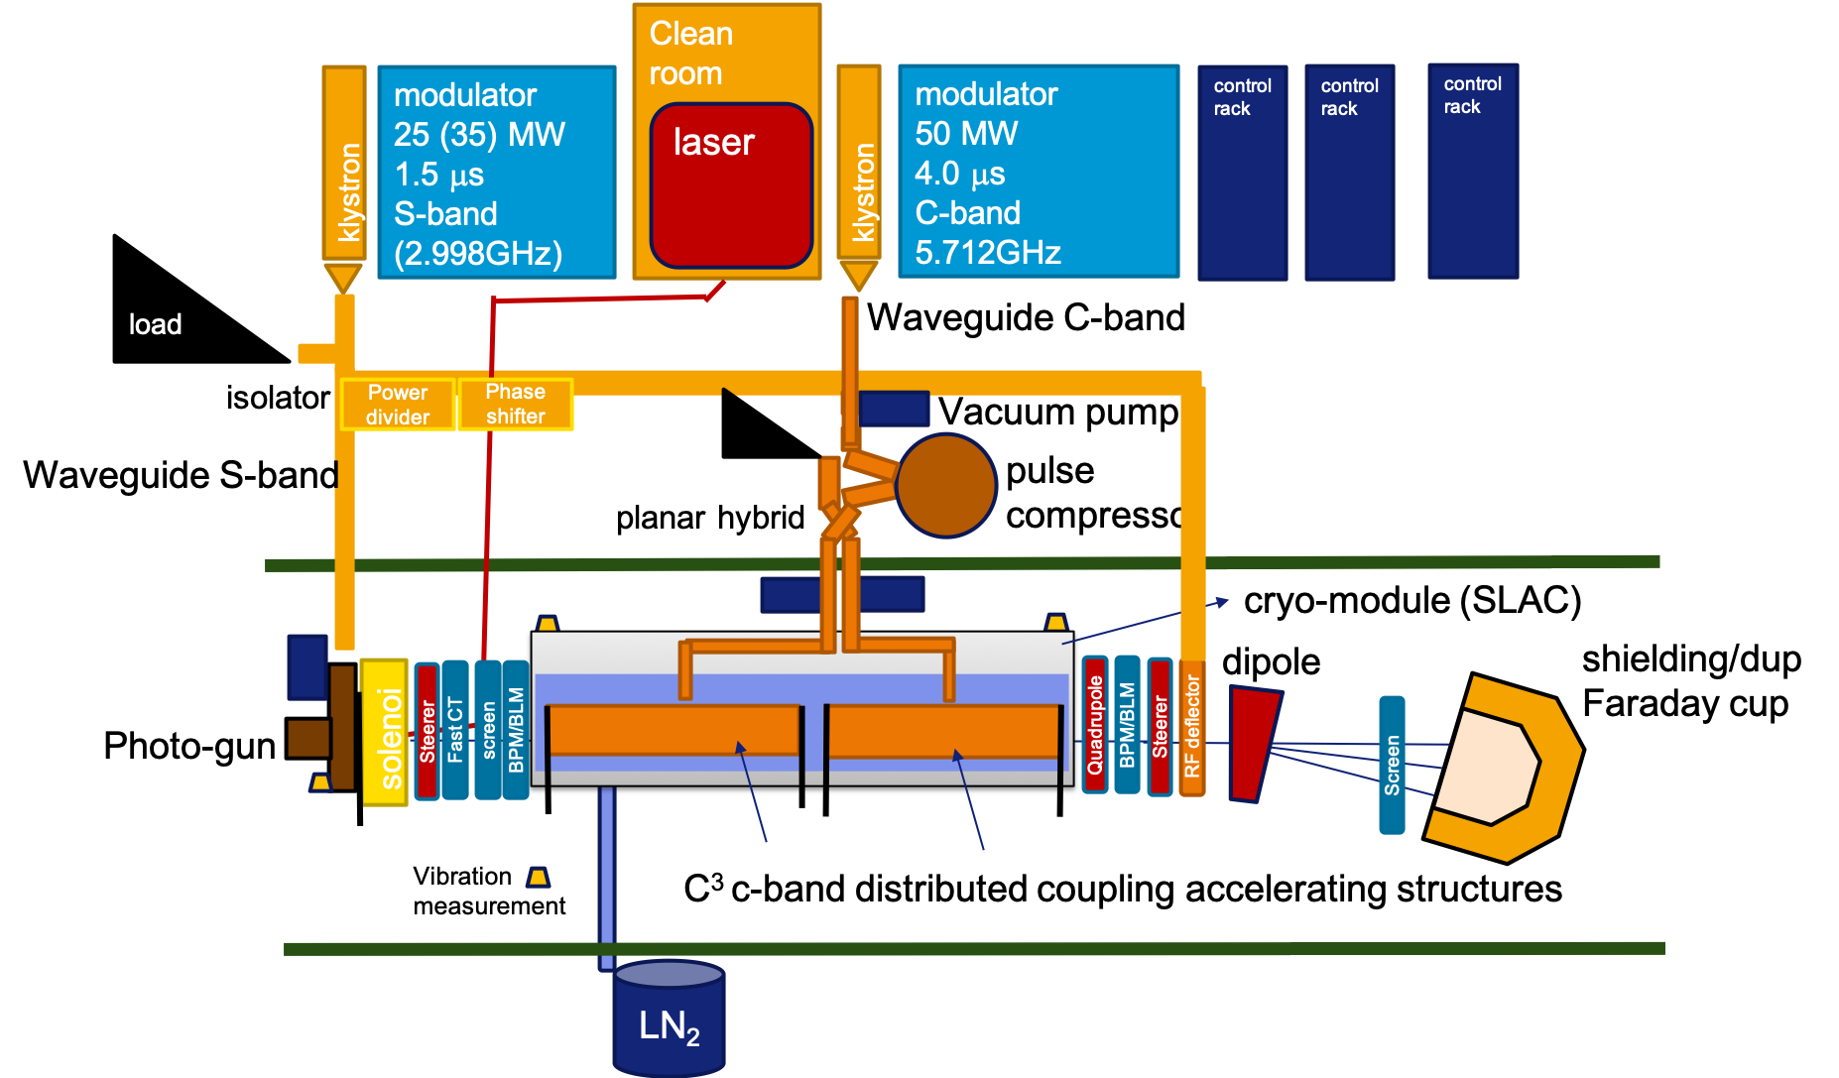
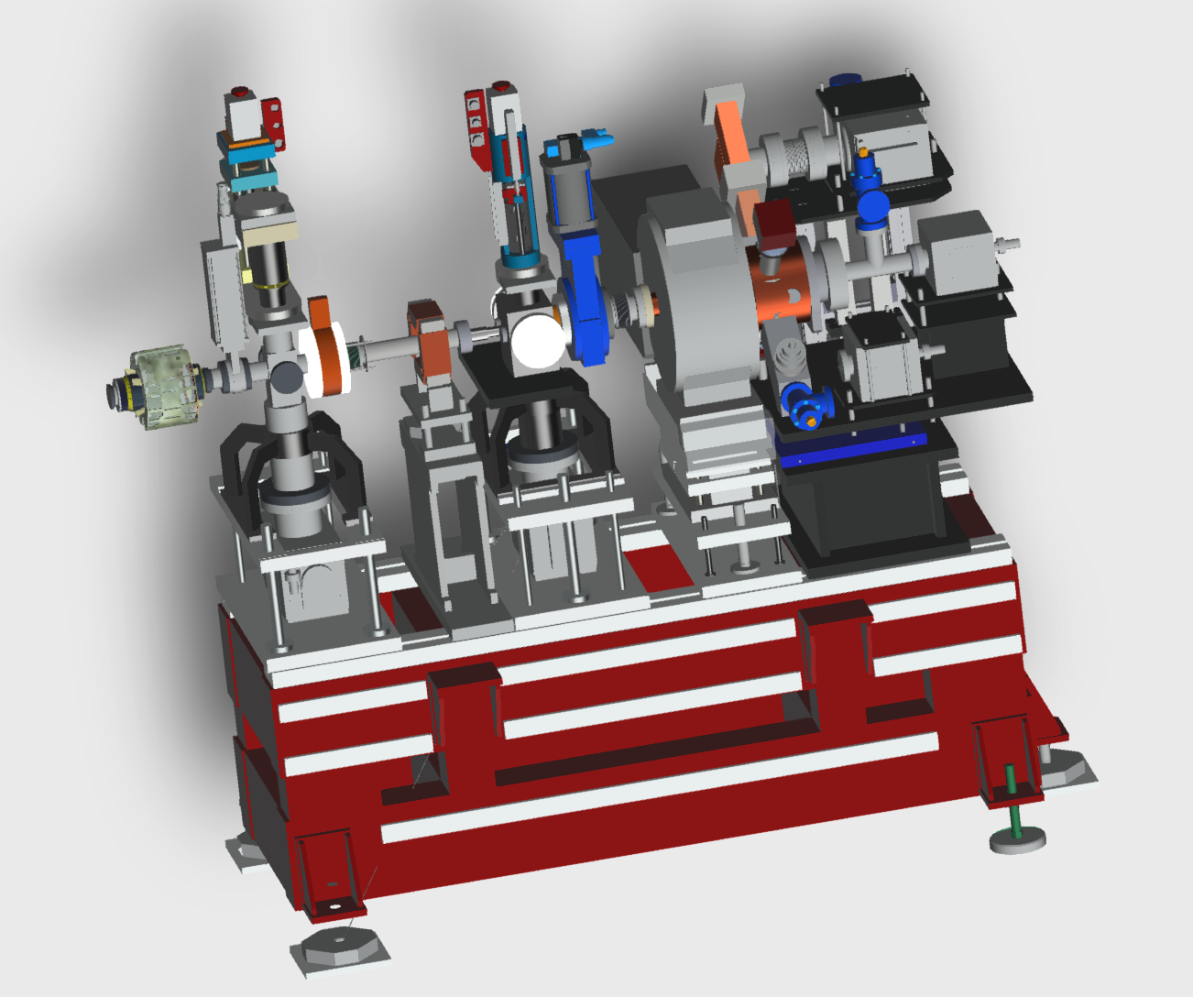
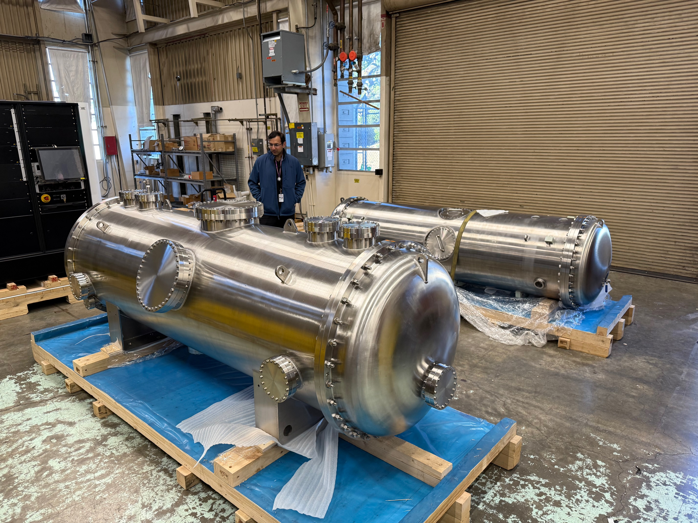
Machine Projects Portfolio and technical CHALLENGES
COLD
C^{2 cold copper}
Operation
Linac
Demonstrator
A demonstrator to prove
high gradient cryogenic accelerating structures
for users facility grade operation
at low repetition rate.
The pre-injector of a new 6GeV linac.
Courtesy = S. Liuzzo et al.
Challenges = collect 3D model of components from SLAC/INFN –
Participate to the design of missing parts
Integrate them in the existing building while maintaining current linac operations (maintenance)
=> Provide the necessary data and inputs to perform radiation calculations for ASNR validation

Slide 7
Machine Projects Portfolio and technical CHALLENGEShallenges
Injection upgrade
IDM projects
New generation of revolver
in vacuum undulator
HTS source for BM18
Booster upgrade
EBS machine
ASD projects
COLD project
= Linac upgrade
FE UPGRADE

Slide 8
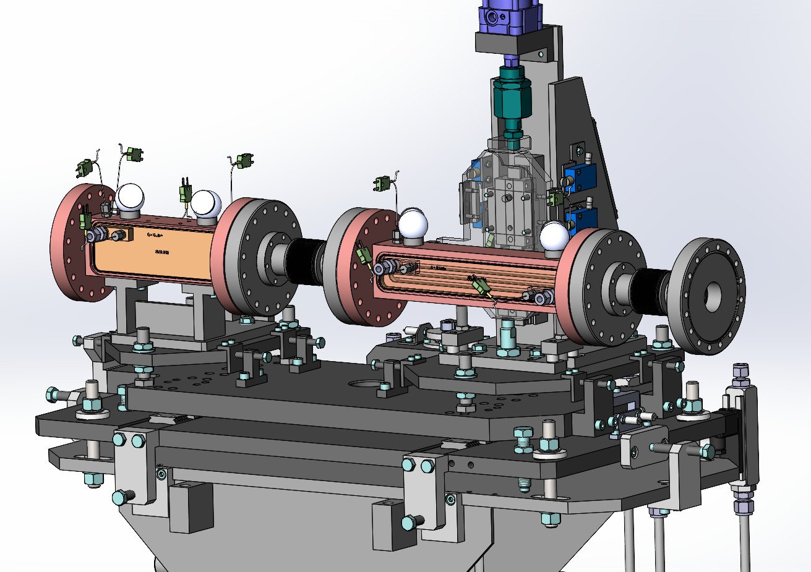
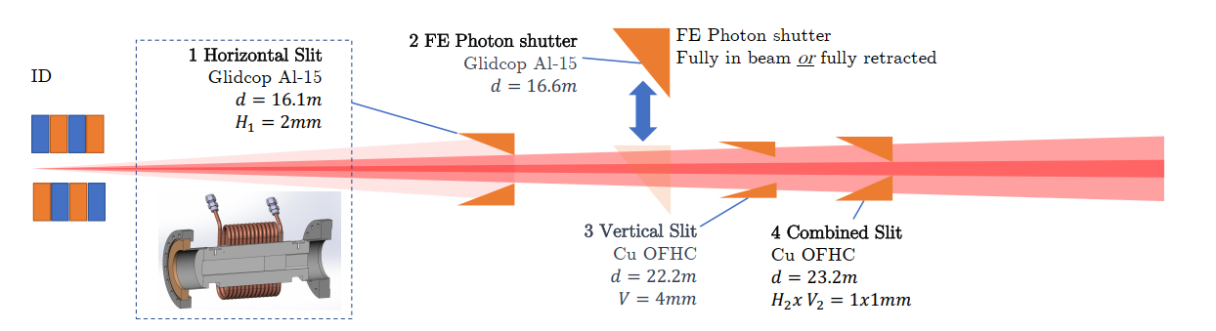
FE UPGRADE
=> More power on FE components (slits, shutter)
Insertion device
Gap
Total Power
Power Density (in
Comment
(length)
(mm)
(kW)
16.1m)
(W/mm2)
CPMU16.4 (2m)
5.0 mm
12.9
1545
Installed and used on ID03
CPMU16.4 (2m)
4.0 mm
20.1
1947
ID03
-
4mm (“mini
-
beta”)
CPMU20.5 (4m)
5.5 mm
29.6
2716
Plan for double CPMU ID20/ID14
Courtesy P. Brumund

Slide 9
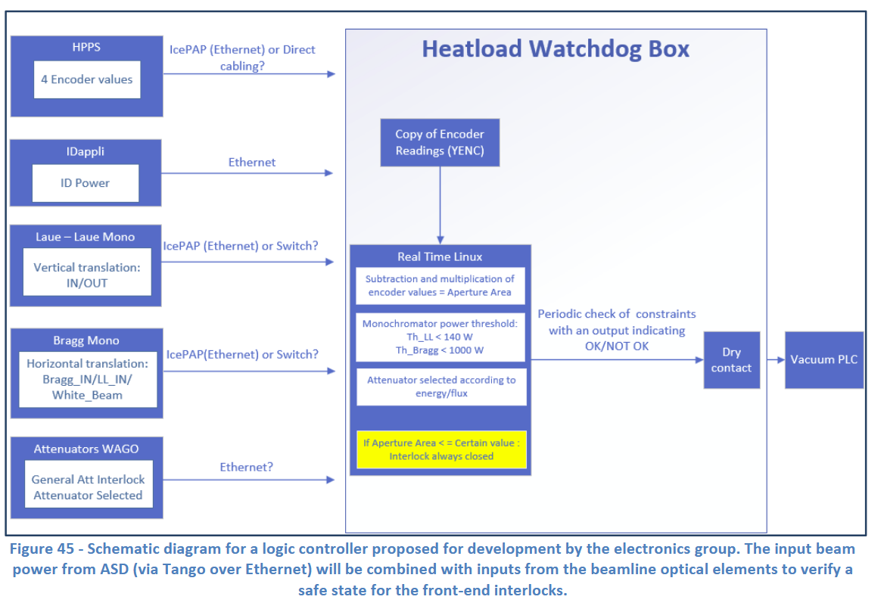

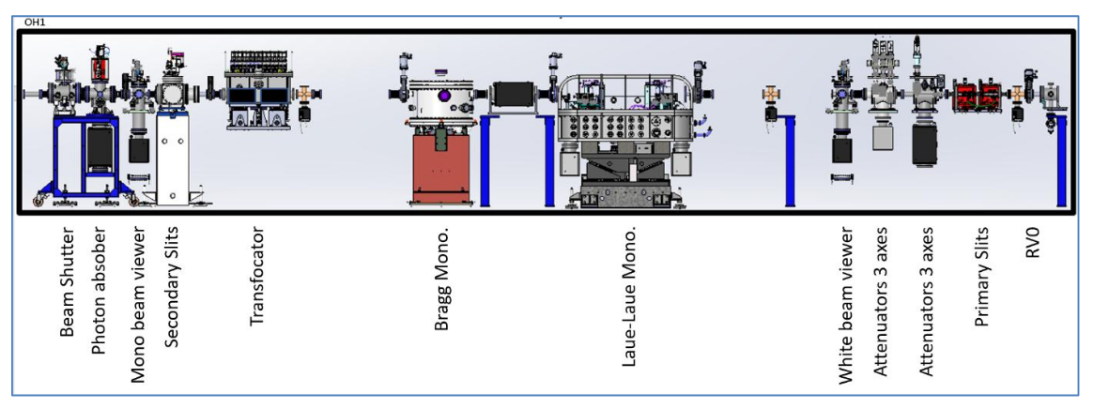
BEAMLINE Projects Portfolio and technical CHALLENGEShallenges
ID11 - TDR
BEAMLINES
Courtesy = Joachim Leonardon
Challenges manage beam power = Source = 2*CPMU – 18 and 20,5 using the entire beam > 2KW
=> Precise knowledge of power beam from the source to the sample, as well as the limits of each equipment
=> Re-design safety component such as photon absorber and use watch dog for other components

Slide 10
BEAMLINE Projects Portfolio and technical CHALLENGEShallenges
ID18 - TDR
ID11 - TDR
BEAMLINES

Slide 11
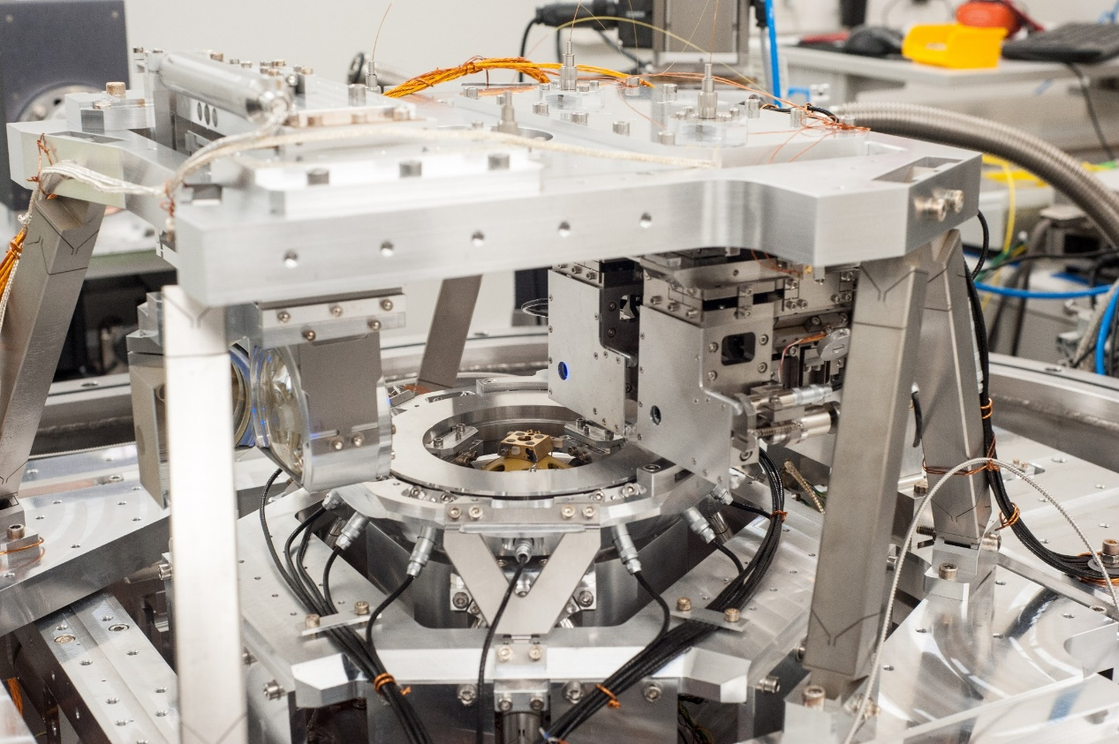
BEAMLINE Projects Portfolio and technical CHALLENGES - ID18hallenges
ID16A → ID18 end station specifications
 | ID16A | ID18
Scanning range | 50 µm | 1 mm
Speed | 5 µm/s | 500 µm/s
volume | 10⁻⁵ mm³ | 10 mm³
Resolution | 10 nm | 10 nm
KB focalization
25 nm beam sizes
=> Real-time controller is necessary
Dynamic modeling is crucial (eg Simulink) to assist design
Determination of transfer function
Evaluation of perturbation effect (vibration …)
Evaluation of final performance
Increased bandwidth will require new actuators
voice coil and direct drive, maglev actuator ?
higher servo bandwidth + higher disturbance rejection and better tracking performance
Sample holder
Courtesy F. villar
Challenges = probably not related to the heat load and optical equipment, but rather to the nano end stations design

Slide 12
BEAMLINE Projects Portfolio and technical CHALLENGEShallenges
ID18 - TDR
ID11 - TDR
BEAMLINES
ID10 - COH

Slide 13
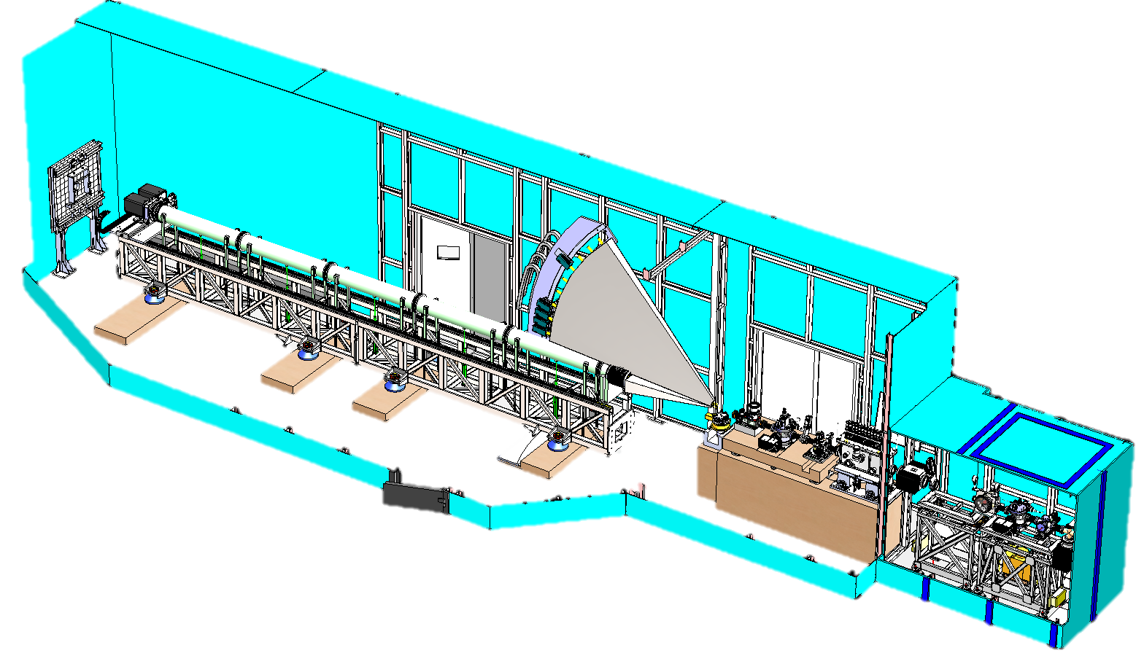
BEAMLINE Projects Portfolio and technical CHALLENGEShallenges
MEG engineering : 80 days
MEG Drafting : 40 days
MEG PAMU : 30 days
Ressources in 2025
SAXS
2 detectors from 3 to 7m
From 0 to 5º
WAXS
4 Detectors @ 3m
From 5 to 45º
END STATION
- Ovens/peltier
Sample of few Kg
µm resolution
- Ptychography
10mm membranes
20nm resolution
Courtesy = Carole Clavel
Technical challenges :
Extractable vacuum tube for SAXS detector
WAXS detectors positioning (@3m on a large angular range)
WAXS very large vacuum chamber
Ptychography end-station (20nm resolution & sample position measurement)
Windowless and in-vacuum from source to sample
Total budget ~1.5M €
OPTICAL COMPONENTS

Slide 14
BEAMLINE Projects Portfolio and technical CHALLENGEShallenges
ID18 - TDR
ID11 - TDR
BEAMLINES
ID10 - COH
DCMs

Slide 15
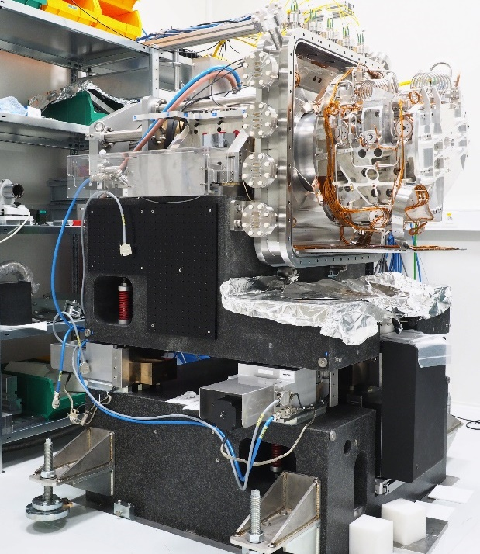
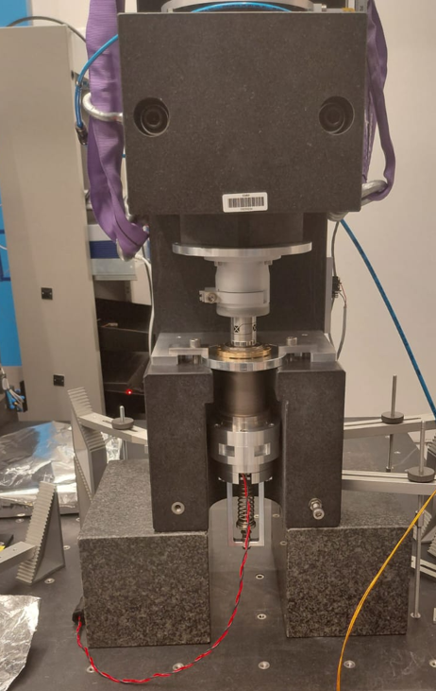
BEAMLINE Projects Portfolio and technical CHALLENGEShallenges
Technical challenges =
Operation and maintenance (3*DCMs)
production (2*DCMs)
study of a non standard for ID20(1*DCM)
Procurement of high quality components
Development of new actuators / voice coil

Slide 16
STAFF CHALLENGES and CONCLUSION
1 – Many technical challenges are good for maintaining motivation and improving staff skills
2 - The current workload is not aligned with MEG team’s capacity

Slide 17
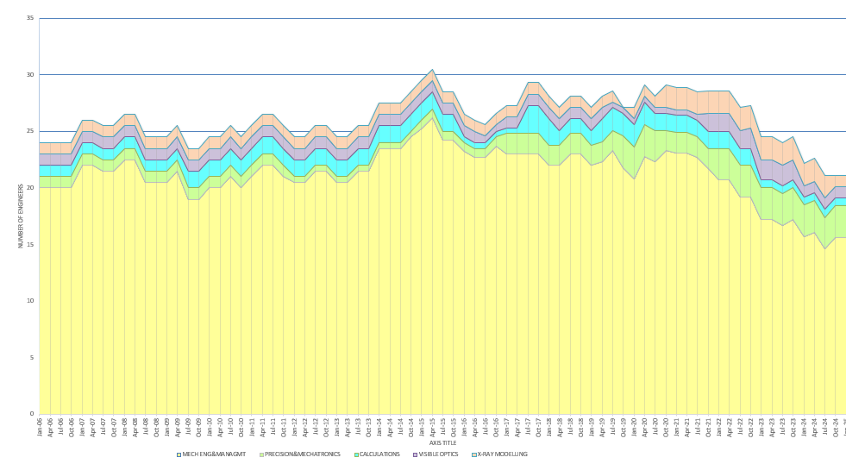
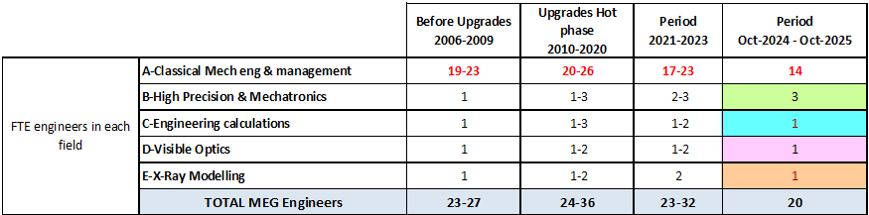
STAFF CHALLENGES and CONCLUSIONS
EBS upgrade
3 COD
5

Slide 18
STAFF CHALLENGES and CONCLUSION
1 – Many technical challenges are good for maintaining motivation and improving staff skills
2 - The current workload is not aligned with MEG team’s capacity
Impact on our medium-term development capacity
Impact on staff motivation
3 - This year we identify critical skills and obtain one position for a calculation engineer, one position in anticipation of retirement for beam transport modelling engineer and for a measurement technician for mechatronic system.
- Recruitment of one PhD student to help with dynamic modeling and Maglev actuator development (ID18 nano tomo end-station).

Slide 19
ISDD DAY – MEG CHALLENGES
Thank you for your attention

Slide 20
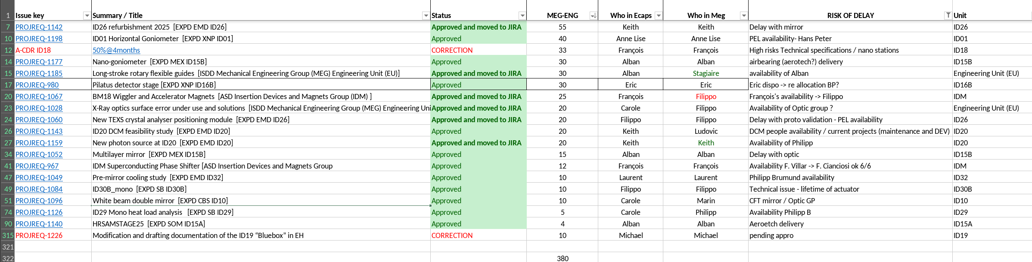
Jira project 2025 = 1500 days
Jira project 2026 = 2000 days
MEG capacity = 1900 days

Slide 21
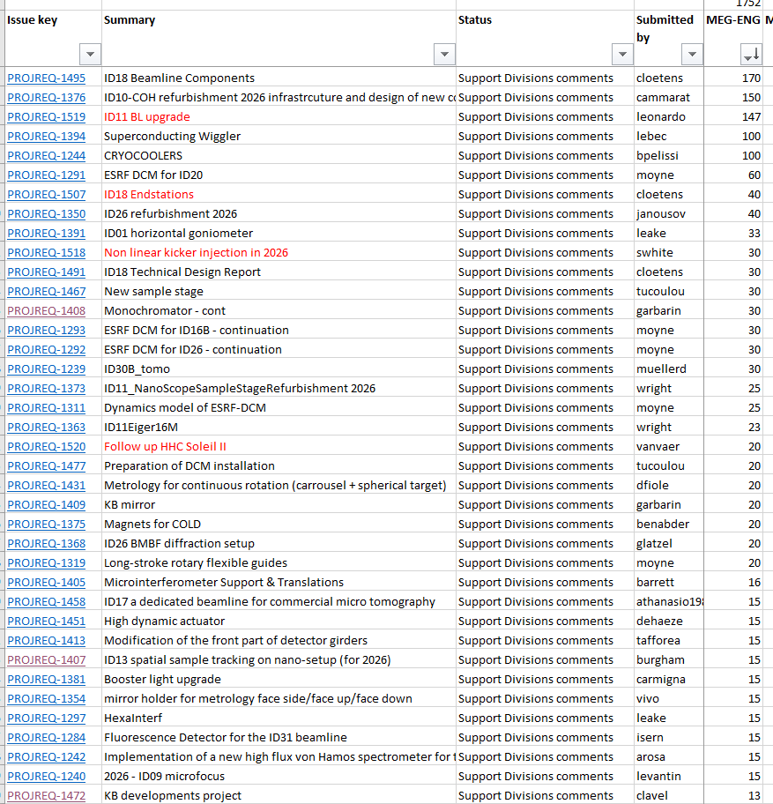

Slide 22
