Slide 1
NEWS
Detector & Electronics Group
Instrumentation Services and Development Division
24 October 2025

Slide 2
News
OUTLINE
The ISDD Detector and Electronics Group
Staff recruitment
Labs and Test Facility
Instrument Pool
Projects and Activities
Notes:
2

Slide 3
The ISDD Detector & Electronics Group
Two main areas of responsibility:
Hardware infrastructure for instrument control
X-ray detectors
ISDD Detector & Electronics Group
ISDD Detector & Electronics Group
Detector Unit
Electronics Unit
Detector Unit
Electronics Unit
Electronics operation and services
Detector Engineering Team
Mechanical Engineering
Detector Engineering Team
Electronics Operation and Services
Analog and control electronics
Detector Technical Support
Analog and Control Electronics
Mechatronics Team
Detector Technical Support
FPGA and digital electronics
FPGA and Digital Electronics
Instrumentation Software Services
Instrumentation Software Services

Slide 4
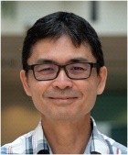
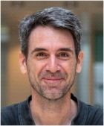
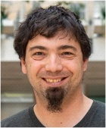

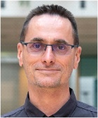
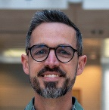
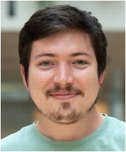
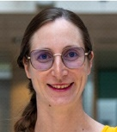
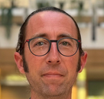
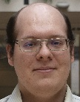
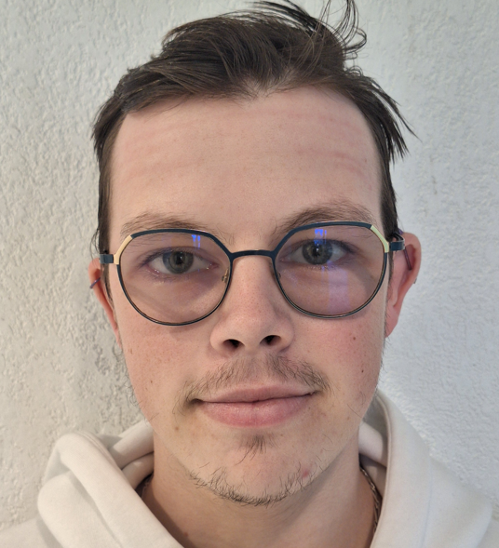
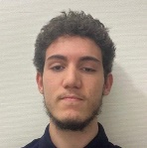
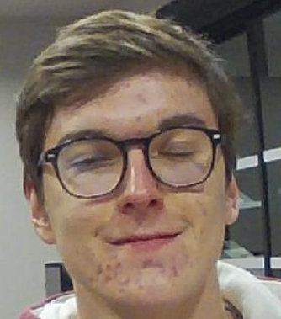
D&E Group STAFF – New group leader C. Risacher – start 1st Nov.
Analog and Control Electronics
FPGA and Digital Electronics
Ricardo Hino
José María
Clement
Tetiana Pridii
Damien Scortani
Jinna Benaboura
?
Nordin Aranzabal
Laurent Siron
?
Electronics Operation and Services
Instrumentation Software Services
Marcos
López Marrero
Kader Amraoui
Steven Chazalette
Marine Girot
Pierrick Got
Alessandro Pasini
Manuel Perez
Rattana Biv
Bruno Martin
?
Pablo Fajardo
Detector Technical Support Team
Cédric Cohen
Nahel Belgherze
Elia Chinchio
Christophe Jarnias
Eric Mathieu
Julien Mathieu
Benoit Martinet
Gregory Prost-Dumont
Chouaib Meraihia
Detector Engineering Team
Paolo Busca
Emmanuel Collet
Marin Collonge
Paul Antoine
Douissard
Kristof Pauwels
Marie Ruat
Menyhert Kocsis
retired
Thierry Martin
Marie Ruat

Slide 5

STAFF / recruitment
On-going recruitment
Two electronics engineers
One instrumentation software engineer
We are facing difficulties to hire Technicians and Engineers
Competitive market: Strong competition from technological and industrial companies.
Talent Shortage: High demand for skilled electronics professionals exceeds current supply.
Rapid Technological Evolution: Continuous advances in technologies require constant upskilling, narrowing the pool of qualified candidates.
Geographical Constraints: Difficulty attracting talent to certain locations or facilities.
Long Recruitment Cycles: Finding qualified candidates takes significant time and resources.

Slide 6

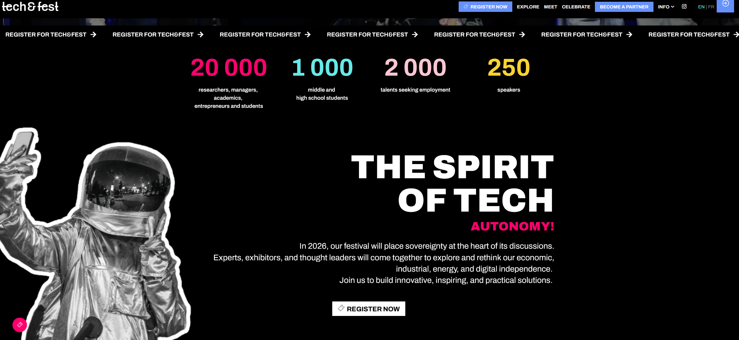
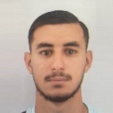
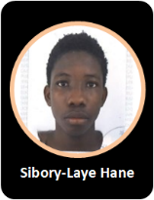
Our actions for Recruitment
Participating in various forum (such as IUT, Tech Fest, Hello Handicap)
Contacting schools
LinkedIn
Success story with recruitment of sandwich course students of previous years
Julien MATHIEU: DUnit
Benoit ARGOUD: XOG
Nahel BELGHERZE: DUnit
Benjamin REYNIER: EUnit but resign
Antonin BROQUET: EUnit but resign in 2025
but
In 2025, none of three technician sandwich course students expressed interest in joining ESRF
Leila Niongui
Gessem Jemili
Sibory-Laye Hane

Slide 7
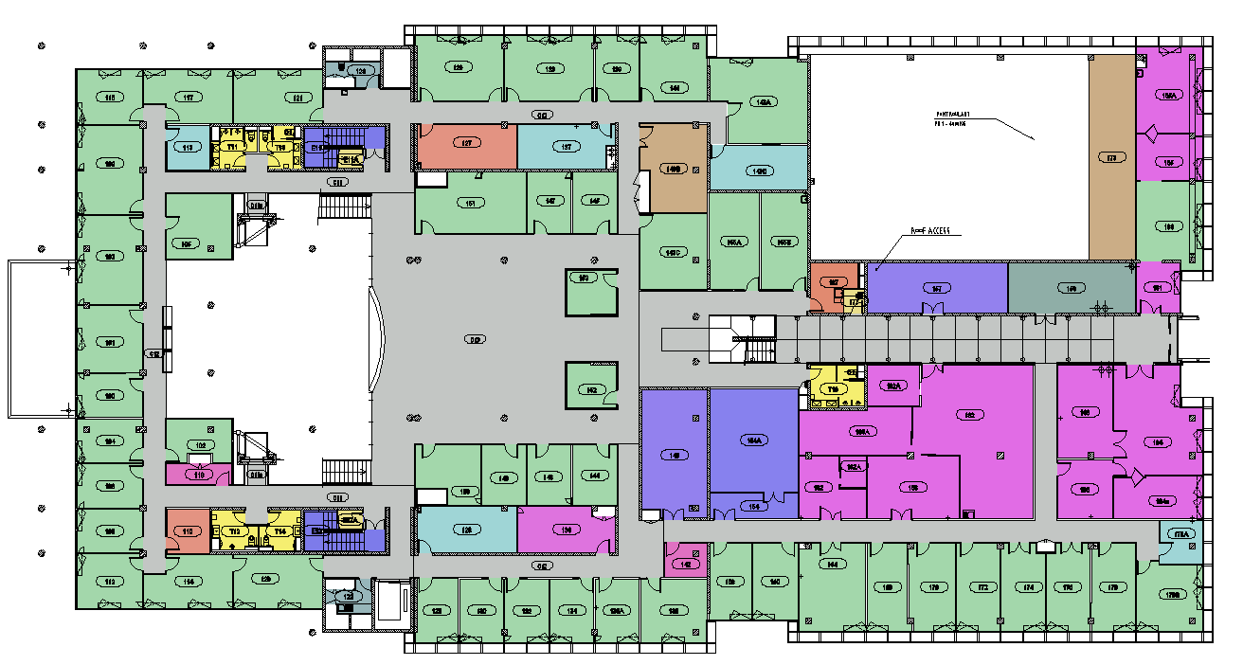
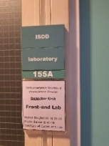
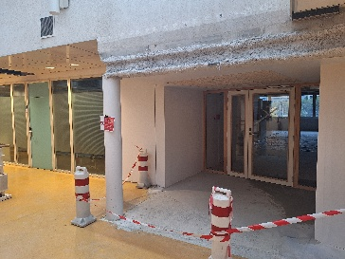
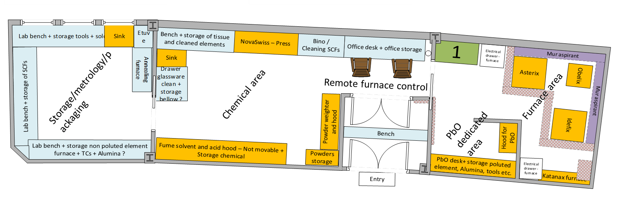
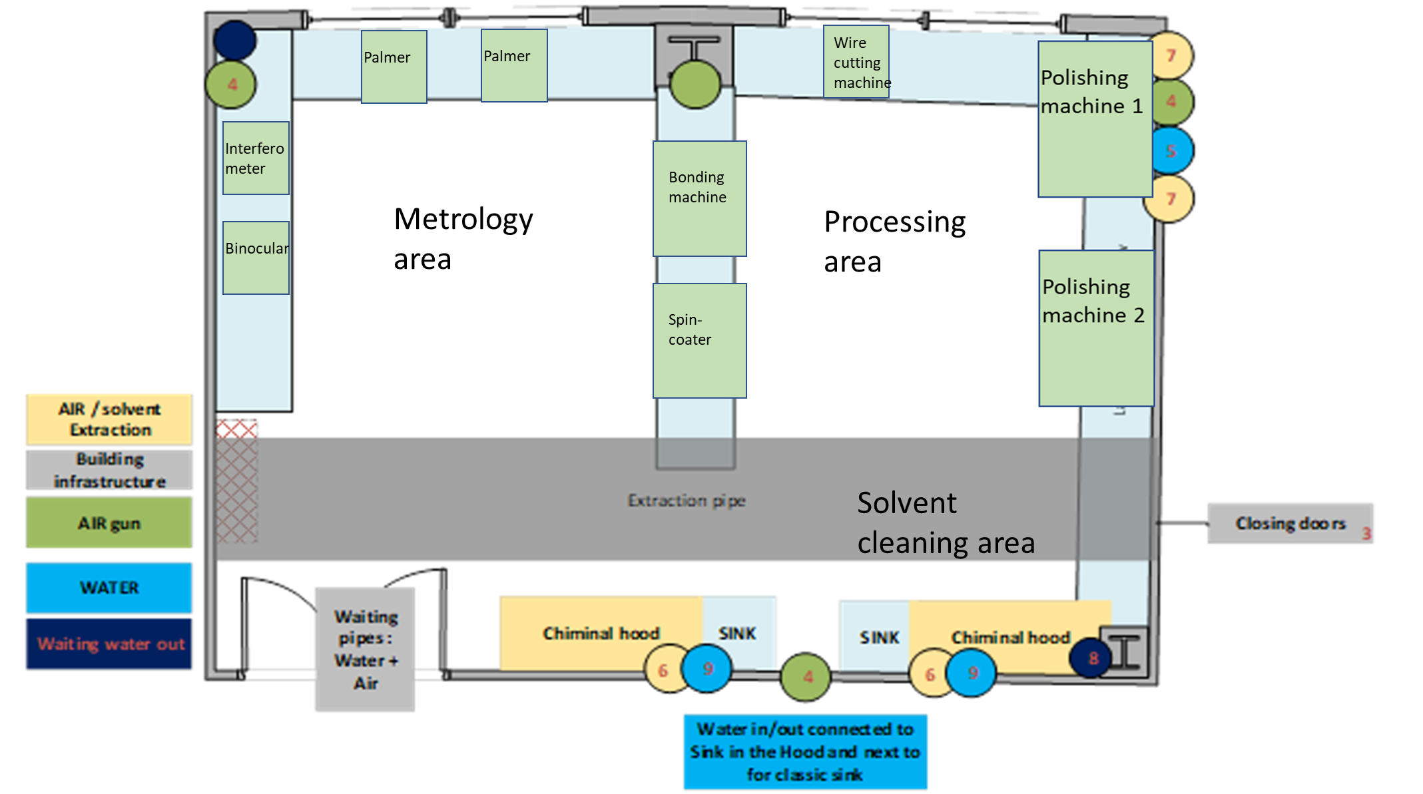
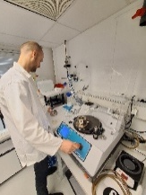
LABS and test facility
DEG laboratories
Reorganization
Transfer of Front-End Labs CB161 to CB155A
Access to BM05/EH1 and ID06-EH1
New project for 2026 : LPE and Polishing Lab
Refurbishment:
LOB-0-09

Slide 8
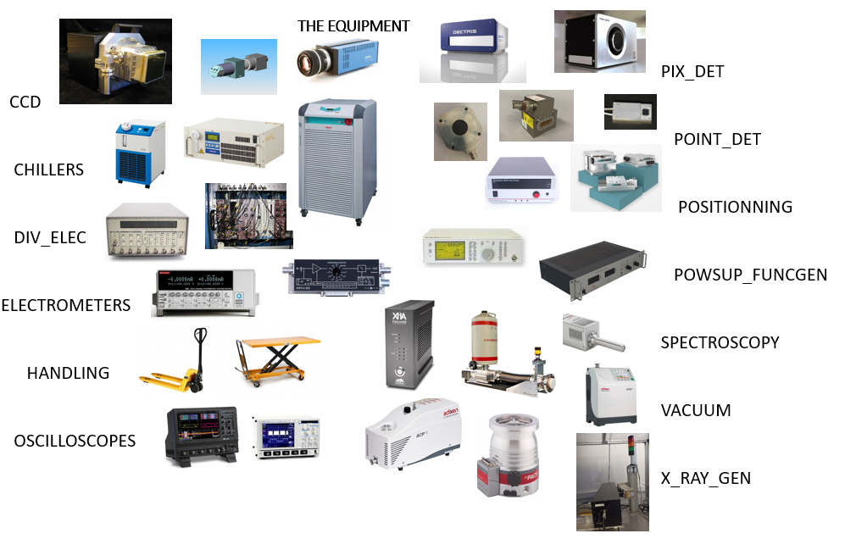
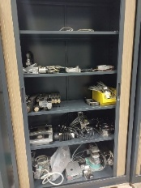
Instrument pool
Loans
Managing spare components
Services
Radioactive sources for detector testing
Ionization chambers gas filling
HP Ge Detectors LN2 refill (3 times a week)
Chillers’ issues
Aging equipment
Equipment coming from Exp. Div.
From (7) 2.1 to 1.1 FTE (E. Chinchio 100% and B. Martinet 10%)
ADVICE TO USER ON EQUIPMENT SELECTION
LOAN CREATION
TEST OF EQUIPMENT BEFORE LOAN
EQUIPMENT INSTALLATION ON BEAMLINE
TEST OF EQUIPMENT AFTER LOAN
Menyhert Kocsis
retired

Slide 9
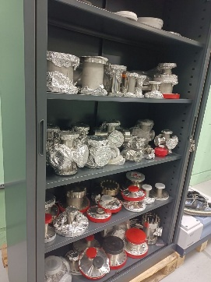
Instrument pool
Investment in new equipment (FalconX)
Transfer Exp. Div. equipment to Instrument Pool data base
Transfer equipment to technical expert (i.e. Vacuum)
Operational adjustment
Opening hours
LN2 refilling, only provided for essential energy dispersive detectors
Support and Expertise
Continue to ensure the availability of spare components
Provide expertise on X-ray detectors and electronics instrumentation
Address request to the relevant technical groups

Slide 10
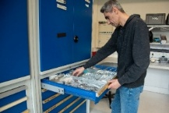
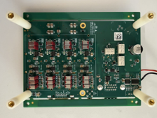
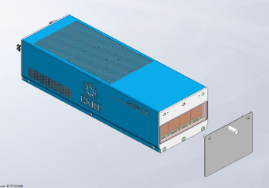
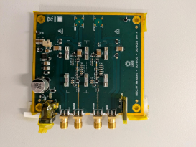
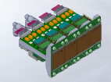
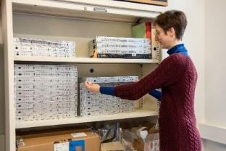
Main Projects - Activities in 2025
Services
Operation activities (cabling, technical assistance,…)
CFTs
2 CDRs, 2 TDRs
Dectris detectors (10+1)
Service contracts with Dectris
DCM
Development
GASP
MAESTRIO
RESYST
ICEPAP
CITIUS
XIDER
HORNET
LEAPS WP2 Ge
Production
Electrometer heads
Beam monitors
XBIC amplifiers
SMARTPIX (6 BLs)
Scintillators
CITY

Slide 11
New “challenging” projects
ID18 Nano-Tomography
Control of high-precision equipment
Imaging cameras for indirect detection : commercial + in-house custom development
Hybrid pixel detector : high energy, uniform response, no gap
Energy dispersive detector : commercial + custom design
ID11 Refurbishment
Watch-dog to preserve optics and detectors from radiation damage (based on new generic digital platform)
Production
ICEPAP (obsolescence, supplier, …)

Slide 12
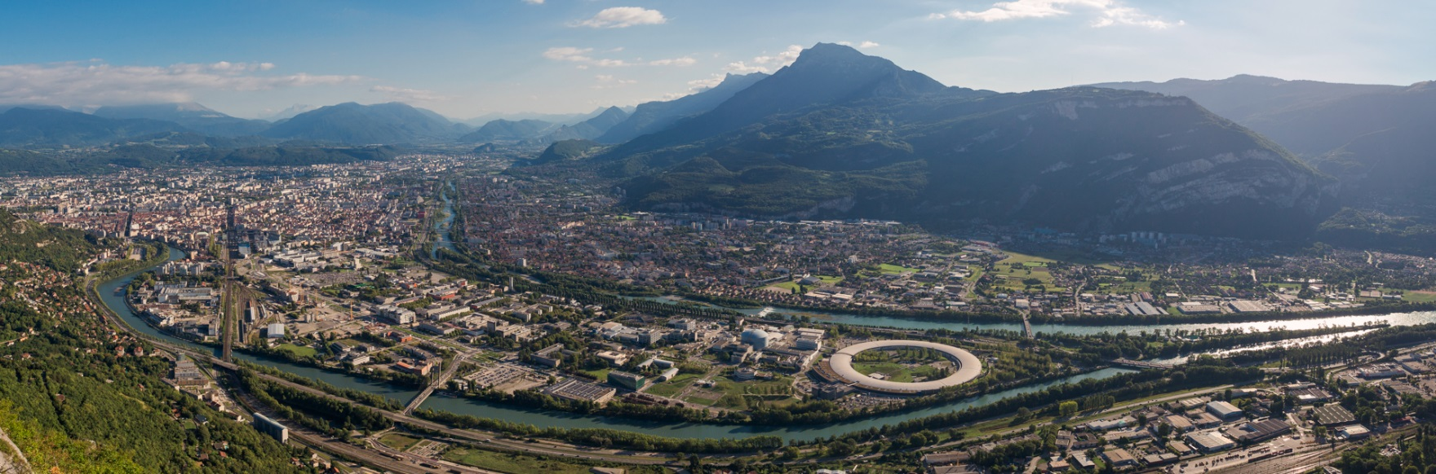
THANK YOU FOR YOUR ATTENTION

Slide 13
Instrument pool

Slide 14
Instrument pool
40%
36%
24%

Slide 15
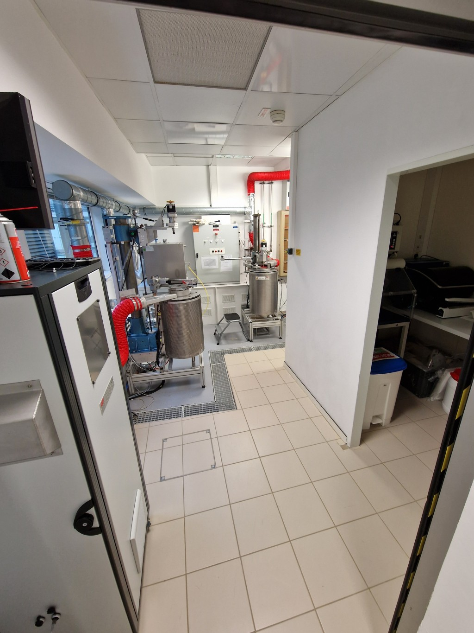
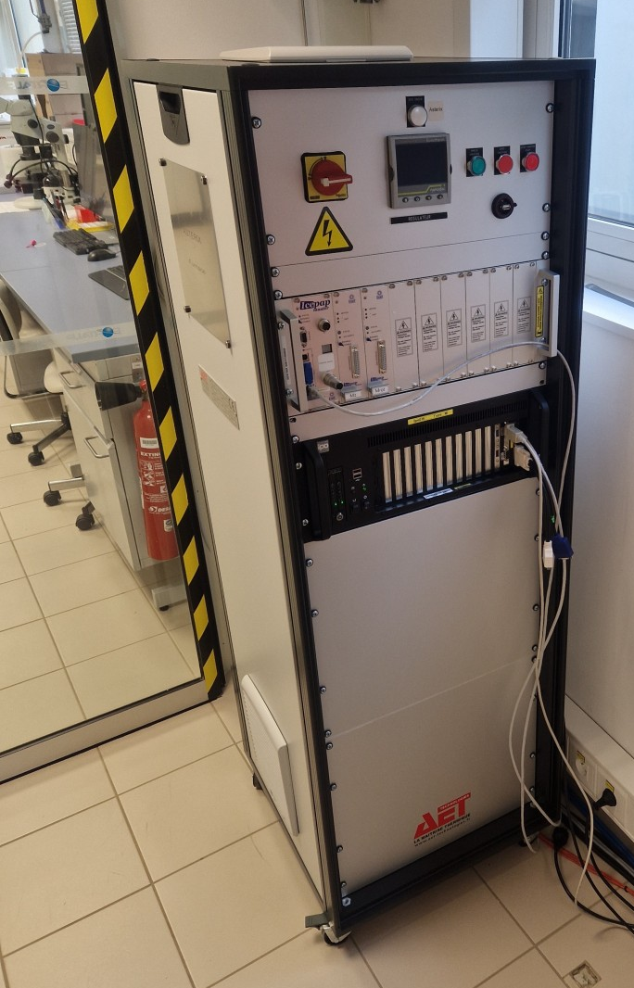
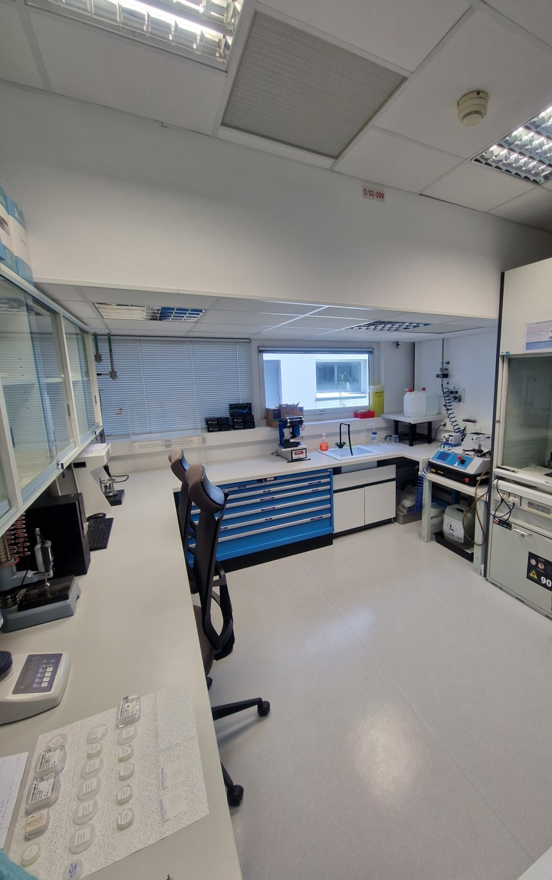
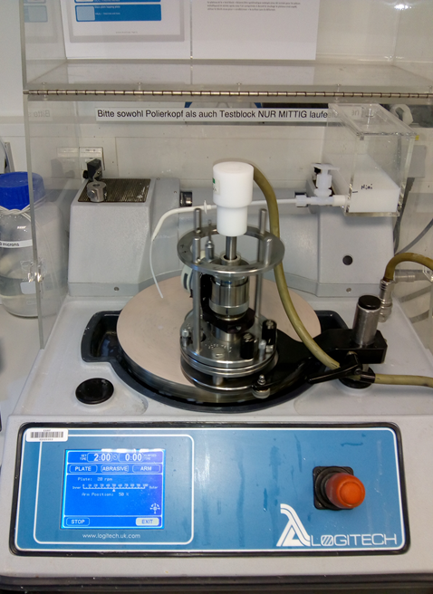
LPE Growth & polishing laboratories
LPE facility: 2 inhouse (DU/EU/BCU) LPE furnaces operating with IcePAPs and Spec (soon Bliss)
Polishing lab: polishing/cutting of scintillators
40 m² laboratory
Preparation raw powders
Chemistry (cleaning, etc.)
2 LPE furnaces
1 glass fusion furnace
2 muffle furnaces
Presses
Thorough process:
Furnace maintenance
Preparation of powder and furnaces (3-5 days)
LPE cycles (~4 weeks duration)
Cleaning steps
Processing (cutting/polishing)
Characterization (XRD, luminescence, optical quality,…)
Goal:
Processing LPE scintillators
Processing special requests (e.g. thin freestanding film)
Know-how on the processing
Example of realizations:
50µm freestanding 1” LYSO:Ce
Layers <20µm on substrates
Polishing of glass, silicon, vitreous carbon, micropore arrays
20m² laboratory
1 polishing machine
1 wire cutting machine
Chemistry (cleaning)
Metrology tools (palmers etc)

