Slide 1
2nd COLD Meeting: RF Activity Report
A. D’Elia

Slide 2
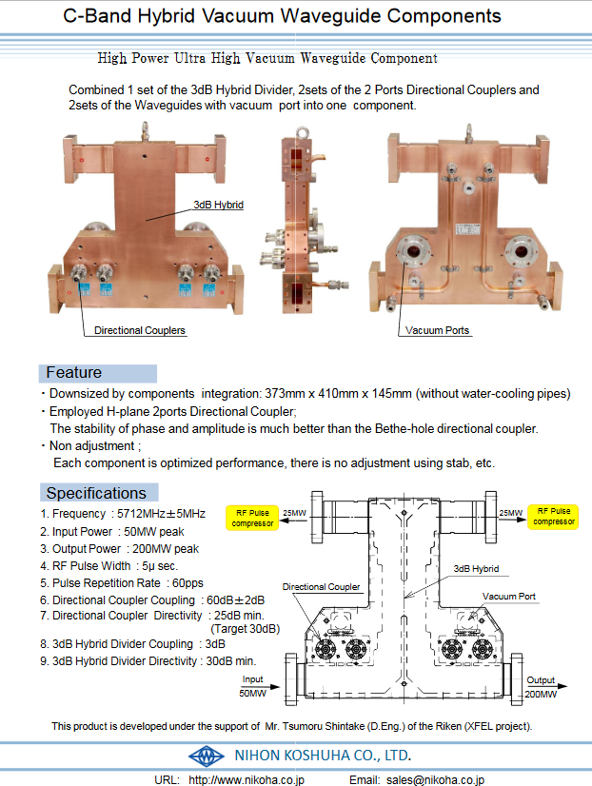
Preliminary Layout
50 MW
4 μs, 4-10Hz
C-band**
** Only 25MW needed for COLD
load
Modulators SAT
35 MW
4.5μs, 4Hz
S-band*
* EU S-Band=2.998GHz.
According to INFN: only 20-25MW/1.5μs needed.
Modulators SAT
WG switch
load
load
Vacuum Valve
Vacuum Valve
Planar hybrid
WG switch?
Vacuum?
BOC
BOC
load
RF Window?
Isolator under SF6
DC
DC
RF Window
WG Switches not mandatory
Ph.
Shift.
DC
Atten
Atten
WALL
pen
IP
valve
C3 1m struct
C3 1m struct
GUN
C3 1m struct

Slide 3
Market survey: preliminary outcome
Addition from Pawel: we need to consider also arc detection system
I contacted MEGA, TSC and SPINNER for a preliminary survey for rough estimation of the prices and, more important to identify who can provide for what. Here below the first outcome.
TSC suggested DESY Type Flanges
EU S-Band: 2.998GHz – All Under Vacuum
Components | Company | Price | Spec
Waveguides
Straight | MEGA, TSC, SPINNER |  | 40MW peak, 4.5μs, Rep. Rate=10Hz
Elbow | MEGA, TSC, SPINNER |  | 40MW peak, 4.5μs, Rep. Rate=10Hz
Switch | Needed? |  | 40MW peak, 4.5μs, Rep. Rate=10Hz
Load | ? (However same as INFN) |  | 40MW peak, 4.5μs, Rep. Rate=10Hz
Isolator | SPINNER? (However same as INFN) |  | 40MW peak, 4.5μs, Rep. Rate=10Hz – SF6
Directional Couplers | MEGA, TSC, SPINNER |  | -
NEW: RF Window | SPINNER can provide, MEGA and TSC not contacted yet
C-Band: 5.712GHz – All Under Vacuum
Components | Company | Price | Spec
Waveguides
Straight | MEGA, TSC |  | 60MW peak, 4μs, Rep. Rate=10Hz
Elbow | MEGA, TSC |  | 60MW peak, 4μs, Rep. Rate=10Hz
Switch | NIHON KOSHUA (tbc with PSI), but needed? |  | 60MW peak, 4μs, Rep. Rate=10Hz
Load | ? (However same as PSI) |  | 60MW peak, 4μs, Rep. Rate=10Hz
Planar Hybrid | NIHON KOSHUA (tbc with PSI) |  | 140MW (?) peak, 4μs, Rep. Rate=10Hz
Directional Couplers | TSC (probably), MEGA (?) |  | -

Slide 4
Services
CEM (grounding): needs to be separated? What about separation w.r.t. present LINAC?
ELEC:
S-Band
1 klystron+Modulator: 35MW x 6μs (max) x 10Hz (that should be the same as for LINAC Refurbishment)
C-Band
1 klystron+Modulator: 50MW x 4μs (nominal, max?) x 10Hz
Laser? Asked FRASCATI??
Magnets?
Water Cooling:
Klystron and Modulators:
S-Band from SCANDINOVA: 60-65 l/min x klystron + 10 l/min x solenoid (that should be the same as for LINAC Refurbishment);
C-Band from SCANDINOVA: 70-80 l/min x klystron + 11 l/min x solenoid ;
Gun: 100-200W to be dissipated with high temperature stability <0.1°C (Frascati use a dedicated chiller system);
BOC: from PSI “[Each BOC] needs a dedicate heater and a dedicate variable valve, both are controlled by a feedback loop which stabilize the BOC temperature to 0.002 °C rms. Probably you do not need the same stability (for a test stand 0.1°C is enough) but you still need to have the possibility to warm up the cooling water. Our cooling water temperature range is 35 +- 7 °C. I suggest to use a commercial device for cooling/heating (for some installations with moderate water flow and where we do not need stability we use products from Regloplas at PSI) with this solution you do not need a variable valve.”
LOADS:
S-Band ISOLATOR: 100-200W to be dissipated, temperature stability of about 1°C;
C-Band: ??;
For specific WG’s: Hybrid and Directional Couplers (for thermal stability*). Isolator? To be asked to SPINNER, apparently the only one, so far, able to provide for such a component.
LASER? Asked FRASCATI?
Magnets?
* Needs temperature control loop?

Slide 5
Ongoing CFT(s)
So far we started the procedure to procure the S-BAND RF Unit for the GUN: not possible to go for a direct contract although same specifications of LINAC Refurbishment Unit (CFT done at the end of last year).
Main Objectives:
Purchase same RF Unit such as the one for the LINAC Refurbishment (w/o C-Band Option);
Purchase on the COLD Budget of this year 2025;
FAT in 9-12 months with Option of delaying SAT until LINAC Refurbishment Activity is over (max June 2027).
Status:
Created a Commercial Consultation for CFT-3572;
Writing technical specification: small modification of those for CFT-3461 (thanks a lot to Marc and Mathieu for the specs!!!);
According to David Flood this is the scheduling to realistically place the order for the end of the year (November 2025?):
Mid-July: dispatch to the supplier;
Mid-July (at the latest): Technical specification + PBPF (Price Breakdown Pro-Forma);
End of August: end date for supplier to answer;
End of August: evaluation grid.

