Slide 1
SHARE: Synchrotron x-ray analysis of Heritage Accessible to and Reusable by Everyone
Marine Cotte – Principal Investigator (ESRF)
On behalf of Simon Delcamp, Marjolaine Bodin, Andy Götz (ESRF)

Slide 2
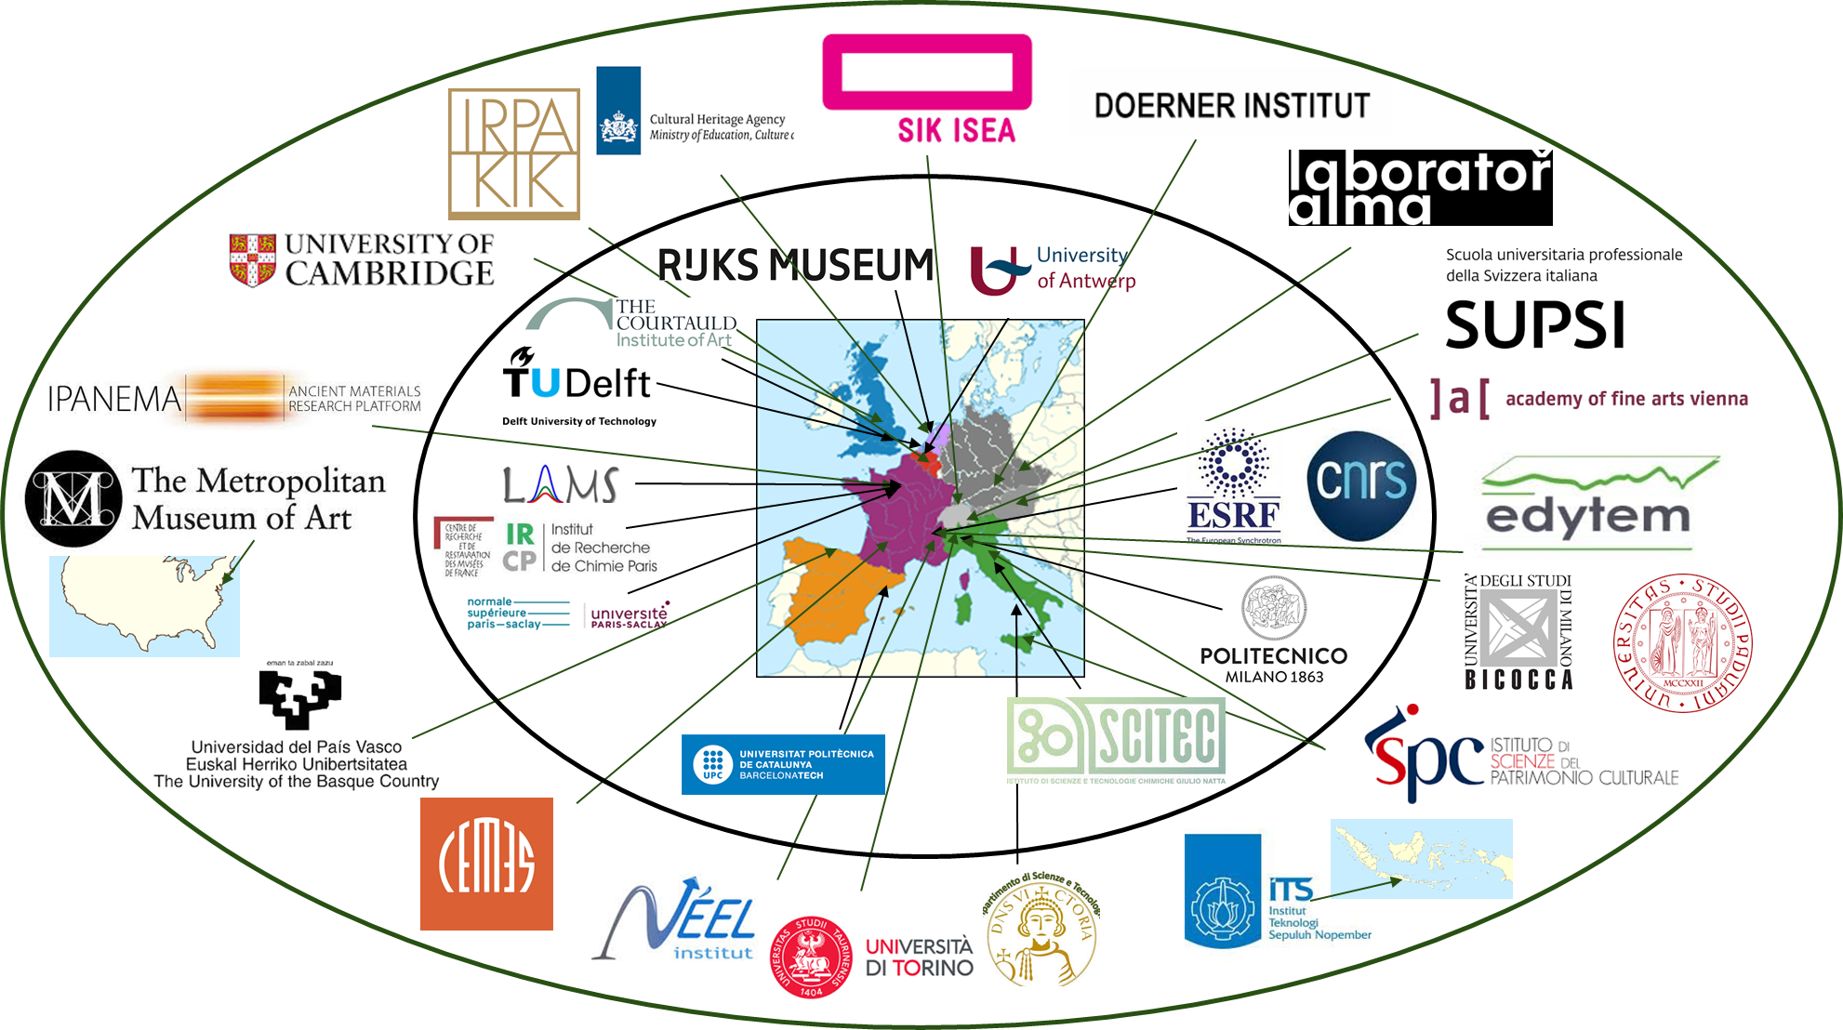
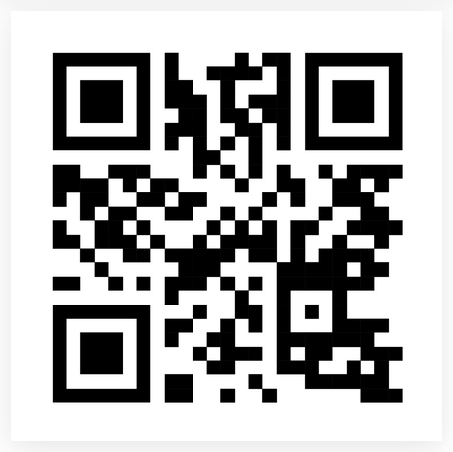
The ESRF “historical materials BAG”: regular, facilitated and collective access to 2 diffraction beamlines
Started in 2020
130 partners over 13 countries
Already > 1800 samples scanned,
with stable instrumental configurations
Data acquired on cultural and natural heritage is as precious as is our heritage:
let’s preserve it and share it!

Slide 3
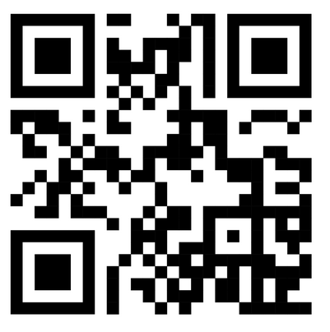


SHARE: Synchrotron X-ray analysis of Heritage Accessible to and Reusable by Everyone
Raw X-ray diffraction data
Info about the sample/ object
Database to search and find data and metadata
Info about the instruments and about data acquisition and processing
New knowledge about our heritage!
Software + interface to populate and utilize this database

Slide 4
PaNOSC Mentoring of OSCARS projects
PaNOSC OSCARS can provide expertise and guidance for the PaNOSC outcomes (cf. https://leaps-wg3.desy.de/outcomes.html ) :
  AAI - user authentication and authorisation i.e. login identity
  Data Catalogues – SciCat and Icat and other catalogues
  Data Portals – Domain specific portals + generic portals
  Metadata – NeXus, Sample and ontologies
  Notebooks – Jupyter notebooks
  PaN Search – searching for PaN data via the data.esrf.fr and other portals
  Software – developing, versioning, packaging and deploying software
  Training – training material platform
  VISA VRE – virtual research environment

Slide 5
PaNOSC Mentoring of OSCARS projects
PaNOSC OSCARS Partners have identified the following overlap between the PaNOSC OSCARS projects and the PaNOSC outcomes:
 | AI- SCOPE | AMBCAT | CDIF-4- XAS | CODEMETASOFT | Findable | HEFTIE | HiMAGNETOS | MatScat Net | Mc-REDD | mTess-X | OSPARK | PaN- Finder | SHARE | VISA
AAI | Y | Y |  |  | Y | Y | Y | Y |  | Y |  |  | Y | Y
Data Catalogues | Y | Y |  |  |  |  | Y | Y |  |  |  | Y | Y
Data Portals | Y | Y |  |  |  |  |  | Y |  |  |  |  | Y
Metadata | Y | Y | Y | Y | Y | Y | Y | Y | Y |  |  | Y | Y
Notebooks | Y |  |  |  |  | Y | Y | Y |  |  |  |  | Y | Y
PaN Search | Y | Y |  |  | Y |  | Y | Y | Y |  |  | Y | Y
Software | Y |  |  | Y |  | Y | Y |  | Y | Y |  |  | Y | Y
Training | Y | Y |  | Y |  | Y | Y | Y | Y | Y | Y |  | Y | Y
VISA VRE | Y |  |  |  |  | Y |  | Y |  |  |  |  | Y | Y

Slide 6
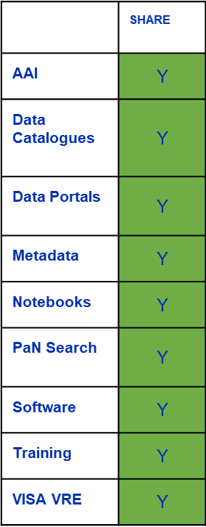
PANOSC outcomes that we already managed to adopt
  Authentication and Authorisation infrastructure (AAI) –already implemented by the ESRF data portal. SHARE uses the ESRF AAI which will be adapted to EOSC AAI.
  Data Catalogues – all data and metadata are/ will be stored in the ESRF data catalogue
  Data Portals – SHARE is reusing the PaNOSC domain portal software to build a domain specific portal for Cultural Heritage
  Metadata – raw data use NeXus definitions + PaNET techniques. New Sample metadata is being defined for CH, it may link to International Generic Sample Numbers (IGSN).
  Notebooks: now replaced by Workflows (EWOKS)

Slide 7
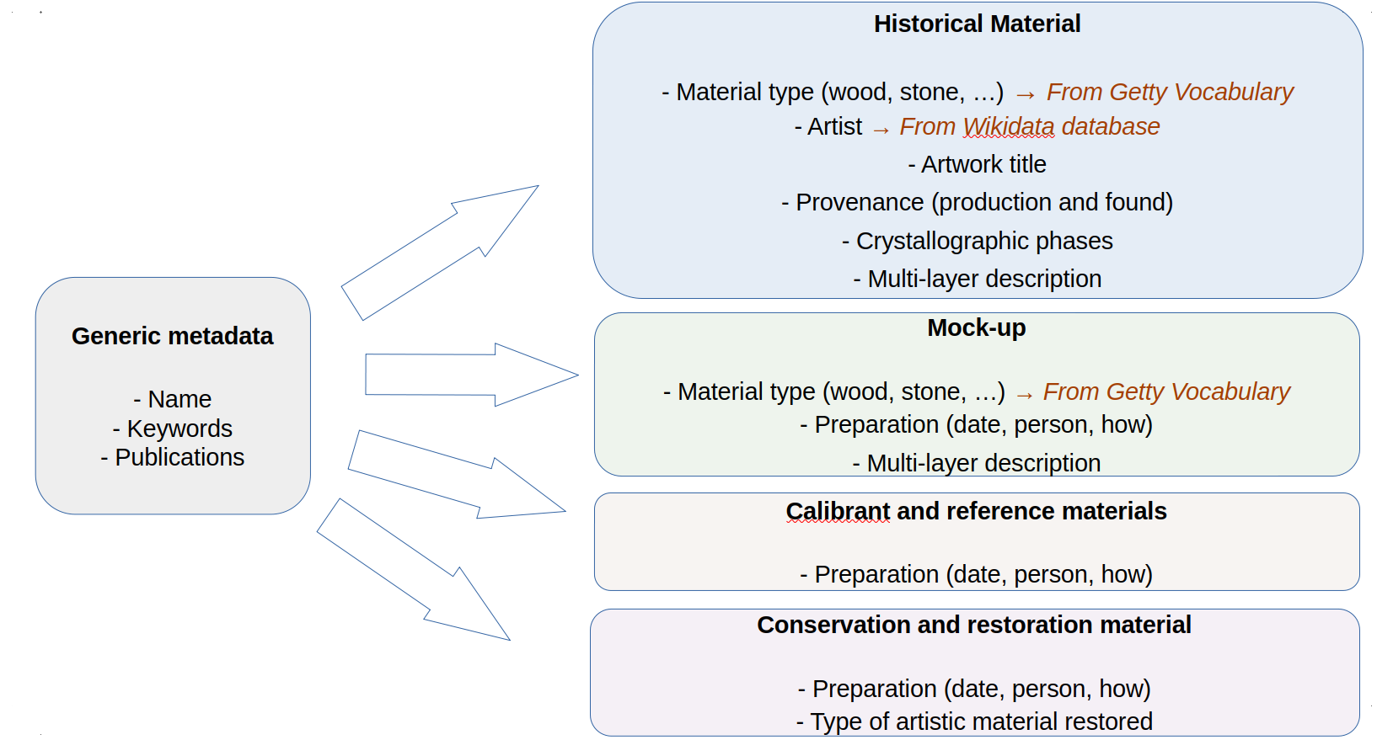
Metadata: Four categories of metadata to describe samples

Slide 8
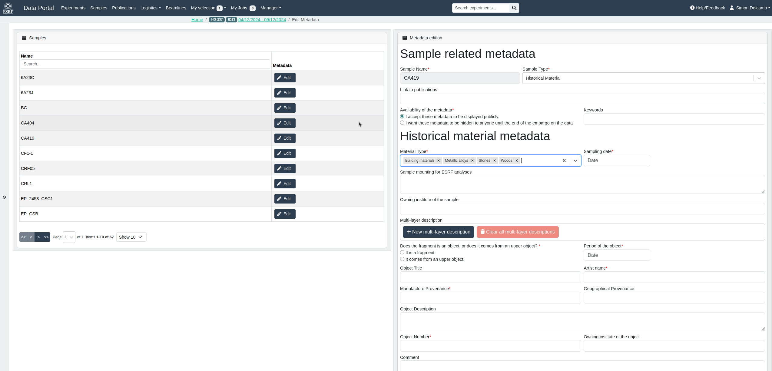
WIP : Metadata editing form

Slide 9
PaNOSC outcomes where we need help/ not started yet
  PaN Search – need to ensure the CH data are found through typical user searches
  Software – will use packaging for EWOKS and distribute SW via Cern VM-File System (CVFMS)
  Training – need help integrating training on PaN training platform (pan-training.eu)
  VISA VRE – need help to create customised VISA-VMs for CH data processing

Slide 10
Contribution to Photon & Neutron Research Infrastructures
  By providing a tool for the Cultural Heritage community (first users, but after embargo anyone) for finding and reanalyzing data from CH experiments.
  Define, gather and manage rich Sample metadata via the data portal before, during and after experiments
  Define, gather and manage beamline metadata describing how data has been collected and processed
  By developing tools to search into this data and metadata and re-use it

Slide 11
Strategies on sustainability of the project results
  Sustainability of the software solutions and data + metadata will be the responsibility of the ESRF after the end of the project. The project is being developed together with ESRF data managers using ESRF compliant solutions.
  ESRF heritage users will be the first beneficiaries of the SHARE tools. This will certainly encourage them to use tools systematically, and possibly to develop similar approach in their respective laboratories
Notes:
How will you encourage users to adopt your solutions? Are there any partnerships, funding plans, or integration efforts that will help sustain the outcomes beyond the project’s duration?

Slide 12
Acknowledgment of the team
ESRF colleagues:
Simon Delcamp,
Marjolaine Bodin, Georgina Robertson, Andy Götz, Stuart Fisher,
Edgar Gutierrez-Fernandez, Clément Holé
Manfred Burghammer, Catherine Dejoie
Historical Materials BAG coordinators:
Victor Gonzalez (ENS Paris Saclay)
Frederik Vanmeert (Rijksmuseum)
Letizia Monico (CNR, Perugia)
BAG partners in particular the working group of beta-testers of the tools

