Slide 1
VISA: User experience enhancement

Slide 2
Desired support from the PaNOSC cluster for your project.
VISA is a remote data analysis services in a web browser with access to scientific data and scientific software.
VISA was developed for the PaNOSC European project
VISA is already adopted at ILL, ESRF and DESY and is under evaluation in other institutes
MoU for VISA collaboration between ALBA, DESY, ESRF, ESS, EuXFEL, HZDR, ILL, MAX IV, PSI and SOLEIL

Slide 3
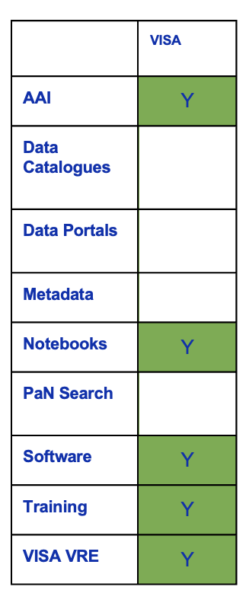
Desired support from the PaNOSC cluster for your project.
The PaNOSC outcomes identified for VISA project:
  AAI - user authentication and authorisation i.e. login identity
  Notebooks – Jupyter notebooks
  Software – developing, versioning, packaging and deploying software
  Training – training material platform
  VISA VRE – virtual research environment

Slide 4
Desired support from the PaNOSC cluster for your project.
Some PaNOSC outcomes could help us:
  AAI: discussion about MyAccessID in EOSC Node Project
  Public CVMFS with PaN Software

