Slide 1



HiMagnetOS
High Magnetic field Open Science
Nicolas Bruyant

Slide 2
PaNOSC Mentoring of OSCARS projects
PaNOSC OSCARS can provide expertise and guidance for the PaNOSC outcomes (cf. https://leaps-wg3.desy.de/outcomes.html ) :
  AAI - user authentication and authorisation i.e. login identity
  Data Catalogues – SciCat and Icat and other catalogues
  Data Portals – Domain specific portals + generic portals
  Metadata – NeXus, Sample and ontologies
  Notebooks – Jupyter notebooks
  PaN Search – searching for PaN data via the data.esrf.fr and other portals
  Software – developing, versioning, packaging and deploying software
  Training – training material platform
  VISA VRE – virtual research environment

Slide 3
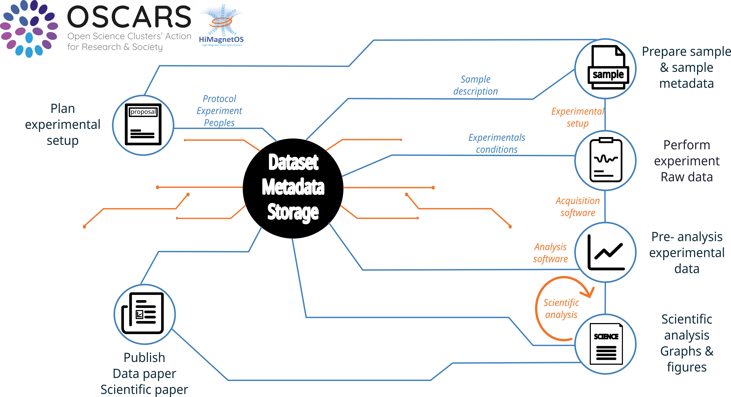
CHALLENGE ADDRESSED

Slide 4
PaNOSC Mentoring of OSCARS projects
Identified overlap between HiMagnetOS and PaNOSC outcomes:
 | HiMAGNETOS | Current stage | Priority | Adoption ?
AAI | Y | Planned End 2026 | 2 | People to be hired for both data and proposals user authentication
Data Catalogues | Y | 2027 ? | 3 | Catalogue of experiment’s outcomes ?
Software Catalogue | Y | Started | 1
Data Portals | N | Planned 2026 | 3 | Integrated in EMFL proposal’s submission portal
Metadata | Y | Started | 1 | Nexus format evaluation
Notebooks | Y | Planned end 2025 | 2
PaN Search | Y |  | ? | No clear idea, need a data portal first ?
Software | Y | Started | 1 | Yes: Software quality outcomes
Training | Y | Planned 2027 | 3
VISA VRE | N

Slide 5
What is already done ?
Software catalog of High magnetic field experiment
Open Data repository : https://entrepot.recherche.data.gouv.fr/dataverse/lncmi
Proposal submission and rating:
https://emfl.eu/SelCom/login.php
  Minimal metadata

Slide 6
Desired support from the PaNOSC cluster for your project.
PANOSC outcomes planned to adopt Software and metadata
User authentication and authorisation
  EduGain, EduTEAMS ?
  Umbrella ?
  ORCID, EOSC ?
Metadata :
Jupyter notebook in EOSC
Software quality

Slide 7
Desired support from the PaNOSC cluster for your project.
PANOSC outcomes planned to adopt Software and metadata
User authentication and authorisation
Metadata :
  HiMagnetOS peoples’s training needed on NeXus format
  Technical choices review
  PIDINst, FAIRMat proposal for sample metadata
Jupyter notebook in EOSC
Software quality

Slide 8
Desired support from the PaNOSC cluster for your project.
PANOSC outcomes planned to adopt Software and metadata
User authentication and authorisation
Metadata :
Jupyter notebook in EOSC
Software quality
  Forge choice: Gitlab
  Packaging and distribution
  Codemeta ?

Slide 9
Desired support from the PaNOSC cluster for your project.
PANOSC outcomes to be evaluated
    Training :
      Safety training : online platform
      Data analysis
      FAIR experimentals datas and publication
    Data portal
    Data catalogs
→ Tess Portal ?

Slide 10
Contribution to Photon & Neutron Research Infrastructures
PaN community challenges
  High magnetic Field: measurement after PaN sample characterization
    Sample metada preservation
    Linking and citing PaN scientific outcome
  Plused magnetic Field at PaN Facility: Bigger than OSCAR
    Long term work of F. Duc:
      ESRF, ILL : as magnet provider
      EuroXFEL, Luli, RAL LLNL SwissFEL as user
    Nexus Format extended to high magnetic fields
  Proposal submission already operational

Slide 11
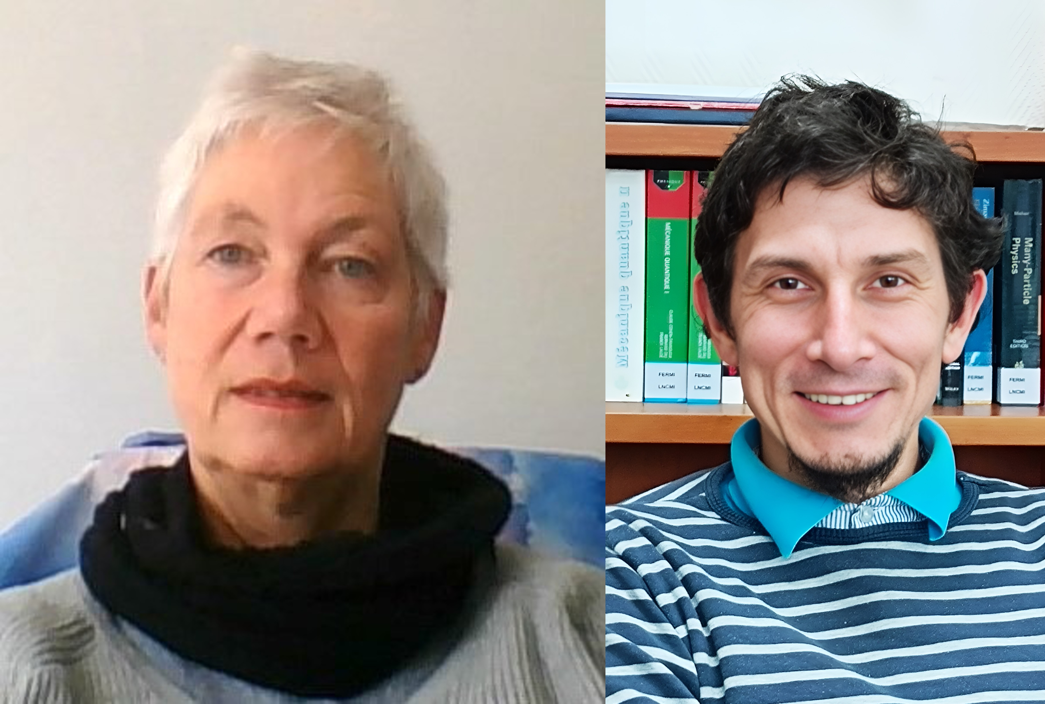
TEAM
Nicolas Bruyant : LNCMI Toulouse User support
Open sourcing software
Christiane Warth : LNCMI Grenoble Planning
Metadata and proposals link
Sébastien Buisson & Stéphane Levignac: IT support & architecture
2 short term position:
- Sofware open sourcing and Nexus : Guillaume Le Goc, started in april 2025
- Repository creation and metadata link : starting in october 2025

Slide 12





Strategies on sustainability of the project results.
Ask EMFL support to deploy at European scale
  EMFL days and User’s meetings 2026
  EMFL spring school 2026
H2025 EOSC call : EMFL is Looking for partners
Notes:
How will you encourage users to adopt your solutions? Are there any partnerships, funding plans, or integration efforts that will help sustain the outcomes beyond the project’s duration?

