Slide 1





CDIF-4-XAS: Describing X-Ray Spectroscopy Data for Cross-Domain Use
Funded Project
Principal Investigator: S. Hodson, Codata
Project team members: A. Gregory; M. Heikkurinen; L. Liborio; P. Austin; A. Nieva de la Hidalga; H. Görzig; R. Krahl; M. Kubin
Implemented by

Slide 2
CHALLENGE ADDRESSED
Related to (meta)data obtained from X-ray Absorption Spectroscopy (XAS) experiments.
Over time, scientific communities, research facilities and software developers have created different formats and applications to store XAS data and describe it with metadata. This resulted in the data not being easily integrated or interoperable.
XAS experiments are performed all over the world, and reusing XAS data from different sources—whether for further research, AI training, or the reproduction and replication of results—can be challenging. Or simply impossible.

Slide 3
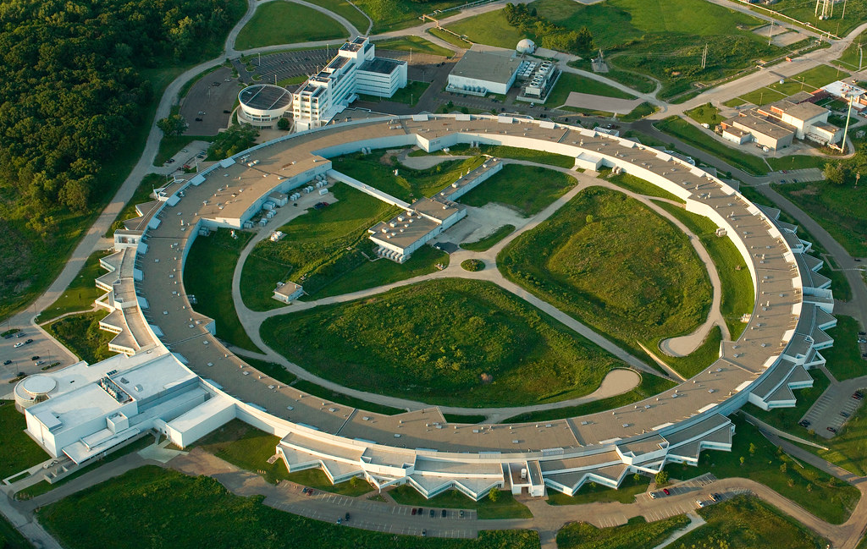
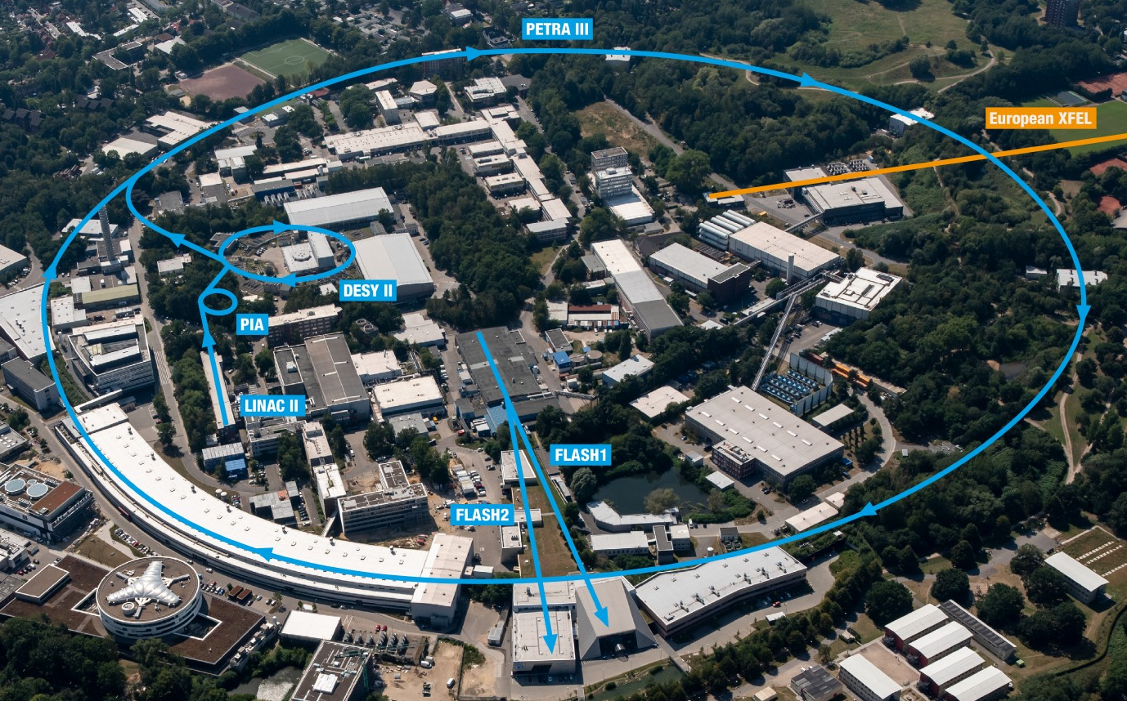
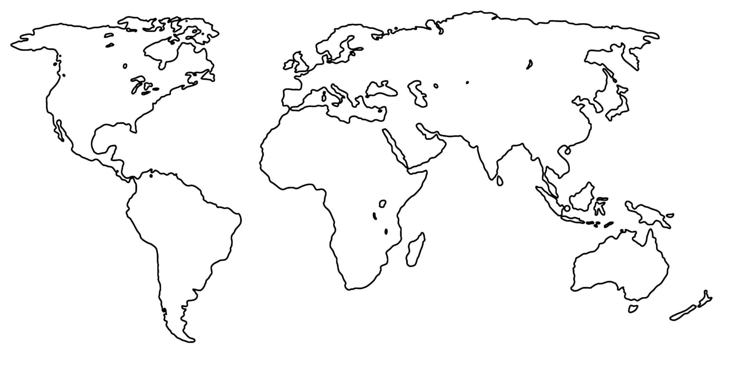
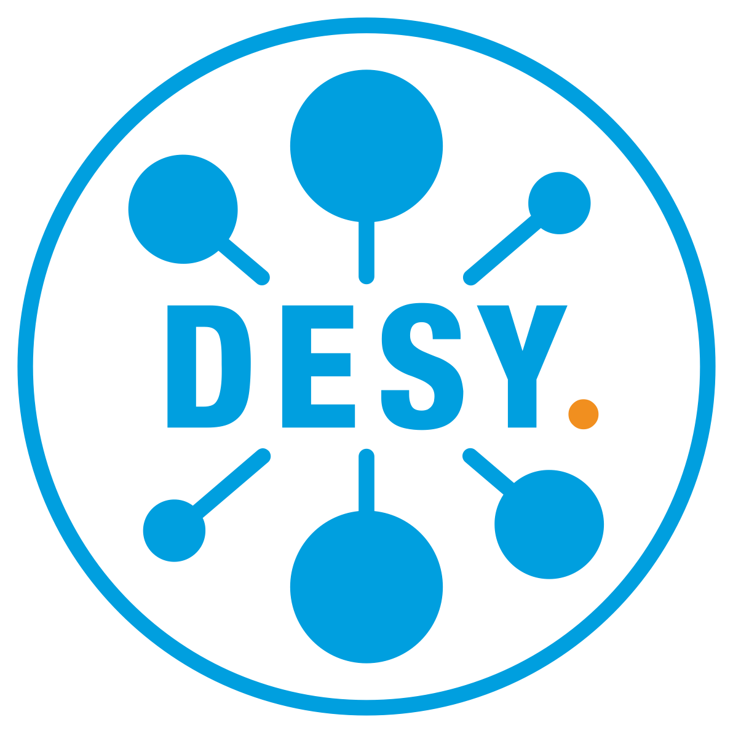

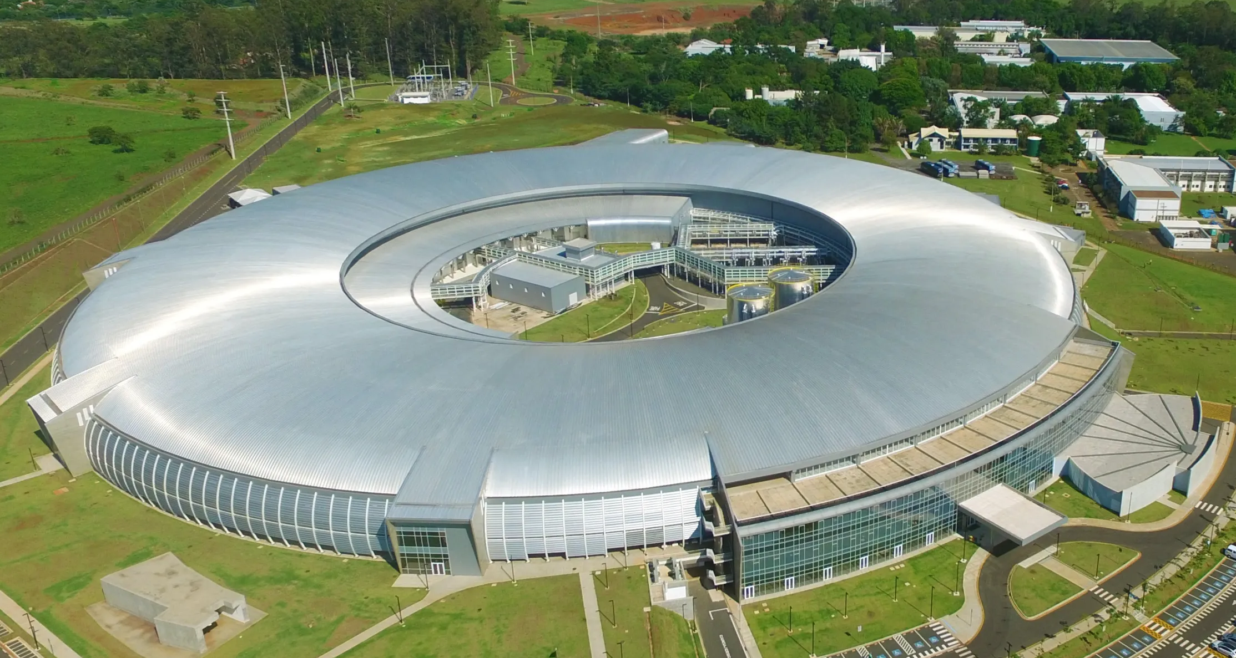
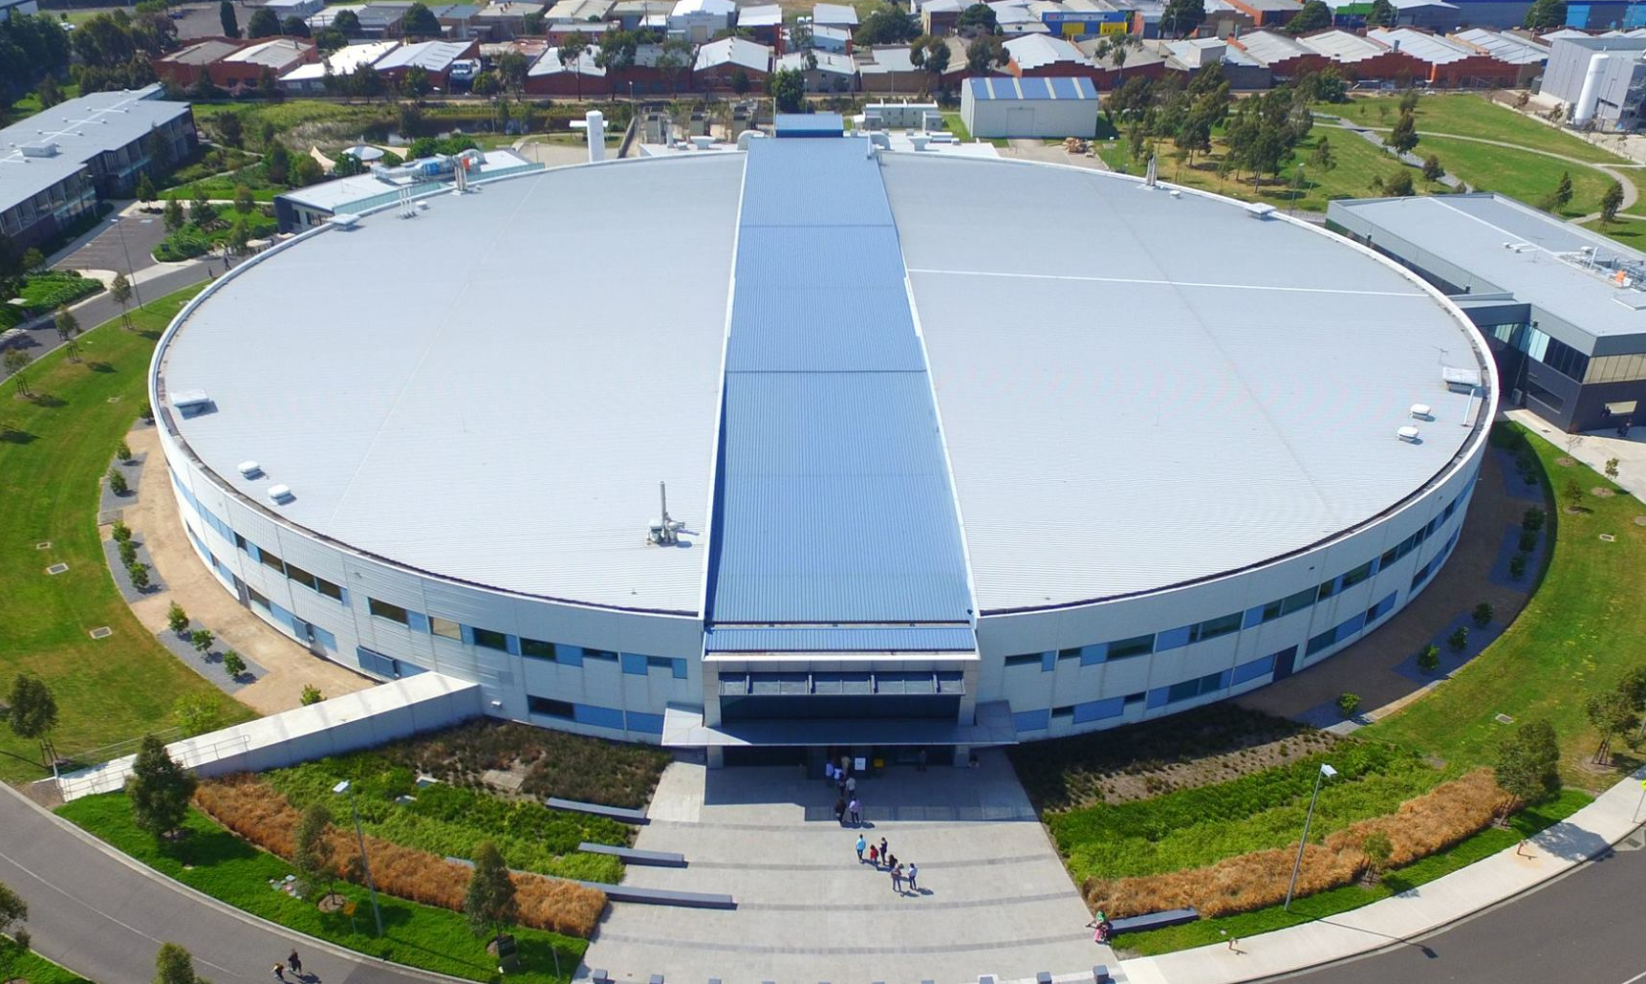


CHALLENGE ADDRESSED
CDIF-4-XAS
Hamburg
Germany
Chicago, U.S.A
Improving the transfer, interoperability and reusability of X-ray spectroscopy data and metadata.
Enabling new science through combining X-ray spectroscopy data at scale across infrastructures.
Brazilian Synchrotron Light Laboratory.
Campinas, Brazil.
Australian Synchrotron.
Clayton, Australia.

Slide 4
WHAT ARE WE DOING TO TACKLE THE CHALLENGE?
We want to develop a metadata framework aligned the Cross-Domain Interoperability Framework (CDIF) to tackle this problem.
The CDIF will serve as the scaffold for preserving the relevant metadata needed to map the published results to their supporting XAS data, which may be available in various formats.
The CDIF does this by establishing domain-agnostic standards to support data sharing across institutional and disciplinary boundaries.
Through CDIF-4-XAS, metadata and provenance for XAS data are standardised, enhancing the integration of XAS datasets. This promotes data reuse across different research domains, making XAS data more accessible, valuable and interoperable.

Slide 5
PaNOSC Mentoring of OSCARS projects
PaNOSC OSCARS can provide expertise and guidance for the PaNOSC outcomes (cf. https://leaps-wg3.desy.de/outcomes.html ) :
  AAI - user authentication and authorisation i.e. login identity
  Data Catalogues – SciCat and Icat and other catalogues
  Data Portals – Domain specific portals + generic portals
  Metadata – NeXus, Sample and ontologies
  Notebooks – Jupyter notebooks
  PaN Search – searching for PaN data via the data.esrf.fr and other portals
  Software – developing, versioning, packaging and deploying software
  Training – training material platform
  VISA VRE – virtual research environment

Slide 6
PaNOSC Mentoring of OSCARS projects
PaNOSC OSCARS Partners have identified the following overlap between the PaNOSC OSCARS projects and the PaNOSC outcomes:
 | AI- SCOPE | AMBCAT | CDIF-4- XAS | CODEMETASOFT | Findable | HEFTIE | HiMAGNETOS | MatScat Net | Mc-REDD | mTess-X | OSPARK | PaN- Finder | SHARE | VISA
AAI | Y | Y |  |  | Y | Y | Y | Y |  | Y |  |  | Y | Y
Data Catalogues | Y | Y | Y Search API? |  |  |  | Y | Y |  |  |  | Y | Y
Data Portals | Y | Y | Y Connect Galaxy to these? |  |  |  |  | Y |  |  |  |  | Y
Metadata | Y | Y | Y | Y | Y | Y | Y | Y | Y |  |  | Y | Y
Notebooks | Y |  |  |  |  | Y | Y | Y |  |  |  |  | Y | Y
PaN Search | Y | Y |  |  | Y |  | Y | Y | Y |  |  | Y | Y
Software | Y |  |  | Y |  | Y | Y |  | Y | Y |  |  | Y | Y
Training | Y | Y |  | Y |  | Y | Y | Y | Y | Y | Y |  | Y | Y
VISA VRE | Y |  |  |  |  | Y |  | Y |  |  |  |  | Y | Y

Slide 7
Desired support from the PaNOSC cluster for your project.
Are the dependencies on the PaNOSC outcomes identified in the previous slide correct?
We think some things are missing. We are interpreting the PaNOSC outcomes in a broad sense.
We plan to implement the CDIF-4-XAS in our XAS Galaxy tools. We anticipate that this specific implementation may further benefit its users if we connect Galaxy with metadata catalogues and data bases.
We think that a common search API (product provided by PaNOSC) could potentially be used for implementing a cross-facility search API, which is something that we would like to use to search data/metadata from different facilities.

Slide 8
Desired support from the PaNOSC cluster for your project.
Please elaborate, which PANOSC outcomes have you managed to adopt?
Reviewed over 50 x-ray facilities around the world to learn about the current practices, standards, vocabularies, ontologies, schemas, and data formats used in the generation, curation, and publishing of X-Ray Absorption Spectroscopy (XAS) data and metadata.
Landscape analysis published here: https://doi.org/10.5281/zenodo.14920226
We use the NeXuS and PaNET ontologies. However, despite the community standardisation efforts, there are several facility-scale databases and schemas, but there is no common schema for XAS (meta)data and no defined ontology.

Slide 9

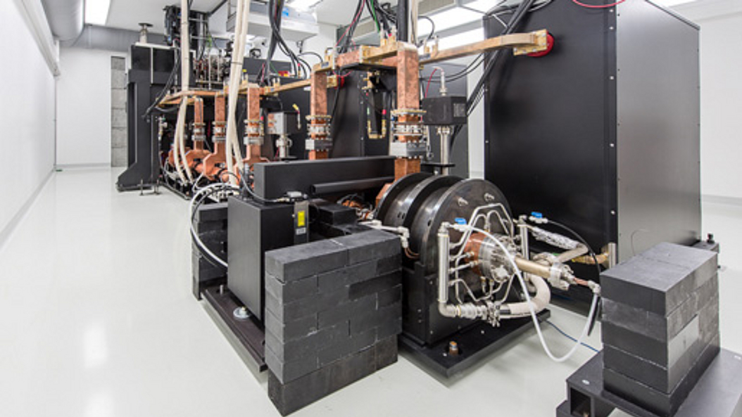

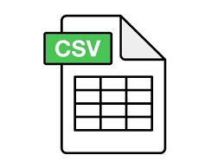
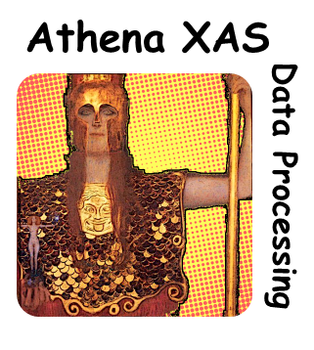
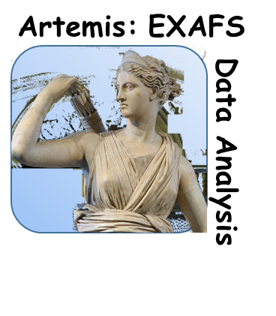

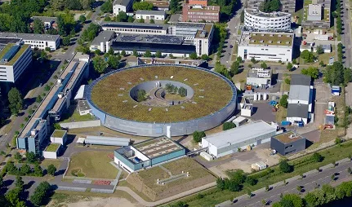







Desired support from the PaNOSC cluster for your project.
Landscape Analysis: Sources of Variability
Device dependent
Database dependent
Software dependent

Slide 10
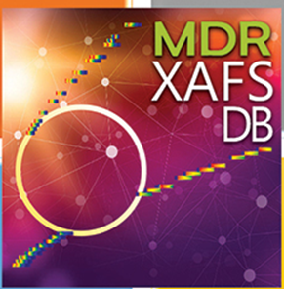
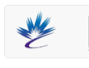
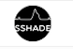
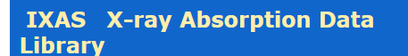
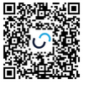
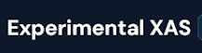
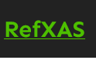
Desired support from the PaNOSC cluster for your project.
PaNOSC outcomes: Data Bases and Data Catalogs?
Database | Data Schema | Use of Schema | Output | Metadata
MDR XAFS DB | Public | Guide data curation/ingestion | Text 9809 | External
CLS DB | Not public | NA | XDI | In file
SSHADE/FAME | Public | Guide data curation/ingestion | Text | In file and external
XASLIB | Public (Simple) | Guide data curation/ingestion | XDI | In file
LISA DB | Public (Simple) | NA | XDI | In file
EX-XAS | Not public | NA | NA
RefXAS | Public | Guide data curation/ingestion | Text | In file and external
Notes:
Published XAS data varies widely. While specialised databases have guidelines on required formats and metadata, data published in institutional and public repositories vary widely

Slide 11
Desired support from the PaNOSC cluster for your project.
PaNOSC outcomes: Data Formats? NeXUS?
All databases support at least an export format which is text based and that can be mapped and used in current processing software.
Few databases reports providing data in complex formats such as Nexus (or HDF5).
Combining data as provided by the different databases is complicated, since the formats vary. Depending on the origin, special processes may be needed to parse and transform the data.

Slide 12
Desired support from the PaNOSC cluster for your project.
Please discuss the PaNOSC outcomes do you need help in:
Continuous collaboration in the community to improve metadata standards.
Would it be possible to have more experimental XAS data/metadata openly accessible? Cross facility search.
We think that a common search API (product provided by PaNOSC) could potentially be used for implementing a cross-facility search API, which is something that we would like to use to search data/metadata from different facilities.
What is the status of the common search API produced by PaNOSC?

Slide 13
Contribution to Photon & Neutron Research Infrastructures
Describe how your project’s developments contribute to the needs and challenges of the photon and neutron community.
Improving the transfer, interoperability and reusability of X-ray spectroscopy data and metadata, So that we can enable new science through combining X-ray spectroscopy data at scale across infrastructures.
We want to develop a metadata framework aligned the Cross-Domain Interoperability Framework (CDIF) to tackle this problem.
The CDIF will serve as the scaffold for preserving the relevant metadata needed to map the published results to their supporting XAS data, which may be available in various formats. The CDIF does this by establishing domain-agnostic standards to support data sharing across institutional and disciplinary boundaries.
Through CDIF-4-XAS, metadata and provenance for XAS data are standardised, enhancing the integration of XAS datasets. This promotes data reuse across different research domains, making XAS data more accessible, valuable and interoperable.

Slide 14
Strategies on sustainability of the project results.
How will you encourage users to adopt your solutions? Are there any partnerships, funding plans, or integration efforts that will help sustain the outcomes beyond the project’s duration?
We delivered a landscape analysis of standards, ontologies, data formats and practices within the XAS community, which is a useful benchmark of the present status of these issues in the community.
The CDIF profile will facilitate integration with a set of Galaxy software tools that we have developed, as part of the EU's EuroScienceGateway project, for processing XAS data. Galaxy is a web-based workflow management platform, and our tools are available to the XAS community.
CDIF framework adoption is the main outcome, which should encourage using standard frameworks and formats in other XAS tools.
Through CDIF-4-XAS, metadata and provenance for XAS data are standardised, enhancing the integration of XAS datasets. This promotes data reuse across different research domains, making XAS data more accessible, valuable and interoperable.
Notes:
How will you encourage users to adopt your solutions? Are there any partnerships, funding plans, or integration efforts that will help sustain the outcomes beyond the project’s duration?

Slide 15
TEAM
Who is doing it?
CODATA, the Committee on Data of the International Science Council, France.
    Simon Hodson (PI), Arofan Gregory, Matti Heikkurinen
Rutherford Appleton Laboratory, STFC, UKRI, UK.
Leandro Liborio, Patrick Austin
School of Computer Science and Informatics, Cardiff University, Wales, UK.
Abraham Nieva De La Hidalga
Helmholtz-Zentrum Berlin für Materialien und Energie GmbH, HZB, Germany.
  Heike Görzig, Rolf Krahl
Helmholtz Metadata Collaboration (HMC) Hub Matter, Germany.
Markus Kubin

