Slide 1



AI-SCOPE: AI-Driven Enhancement of Surface Scattering Data for Open Science Platforms Across Europe
Presenter: Frieda Sorgenfrei, University of Graz, Austria
Implemented by

Slide 2
Overview
Functional AI tools
We have functional AI tools for the analysis of XRR and GIXD data
Challenge of test and training data
Mainly work with synthetic data and our own experimental data
Mentoring support to integrate our tools
Opportunity to address the challenges in the integration of our tools in the existing infrastructure

Slide 3
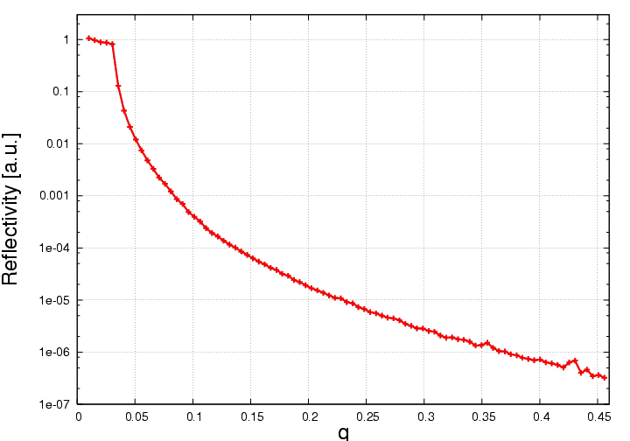
Objective of the project
What problems are we going to solve?
X-ray data overwhelms users
→ experimental mistakes, sub-optimal planning, selective data analysis
Limited metadata (electronic lab book, sample description)
Low submission rates to FAIR and open databases

Slide 4
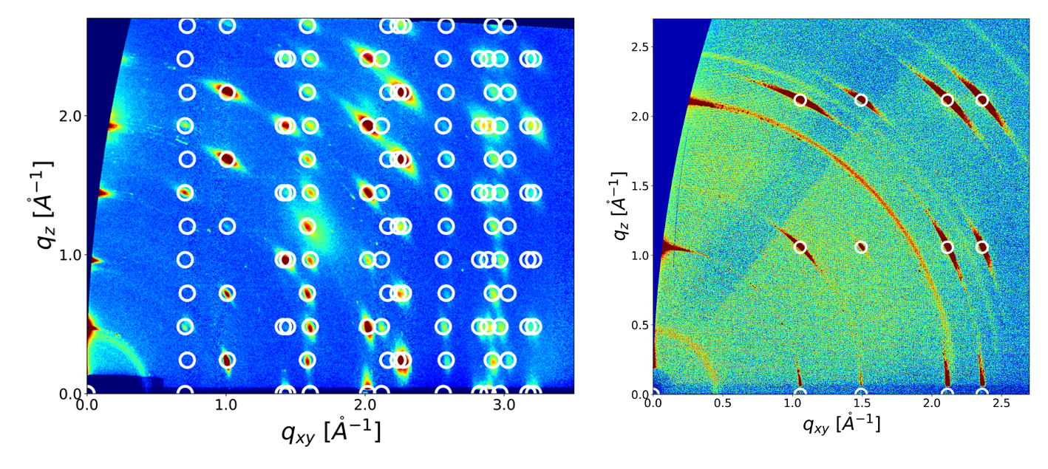
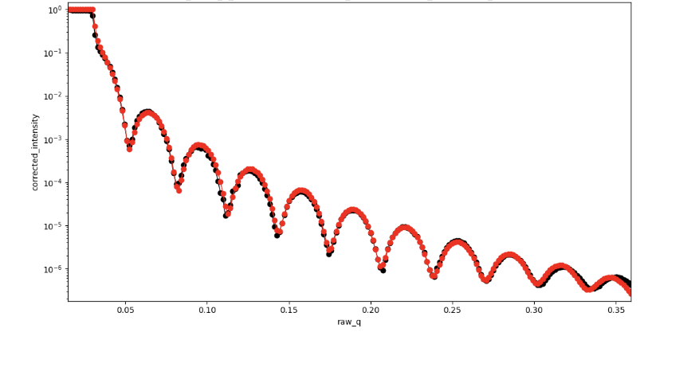
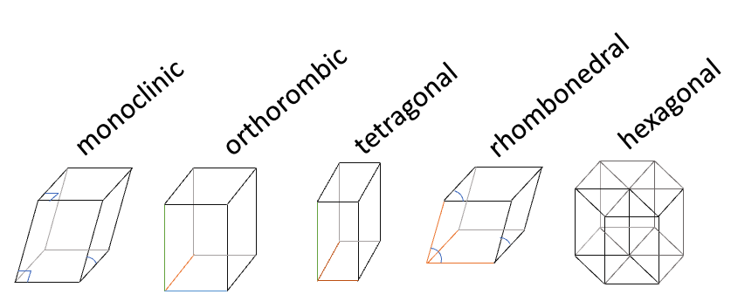
Objective of the project
What are we planning to do to solve the problem?
AI Copilot: Development of an AI-tool for rapid analysis of X-ray scattering data
Use this AI for live annotation of datasets to create FAIR and open data
→ “Raw data” includes structural models (Orsopy: “.ort”, Crystals “.cif”)
Establishing a curated database of surface scattering data
X-ray reflectometry (black)
=> AI live fit (red)
AI analyses Bragg reflections
=> crystal structure
Functional Tools: https://github.com/schreiber-lab/reflectorch
Local version for the analysis of GIXD (manuscript under preparation)

Slide 5
Functional tools for XRR and GIXD
https://github.com/schreiber-lab/reflectorch
Local version for the analysis of GIXD (manuscript under preparation)

Slide 6
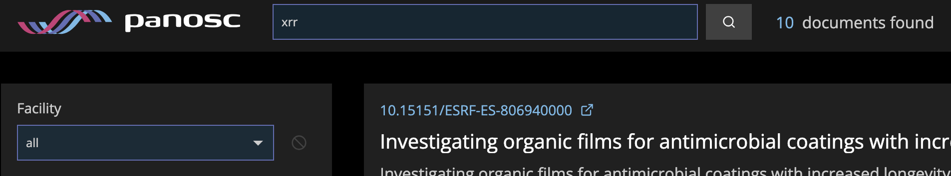
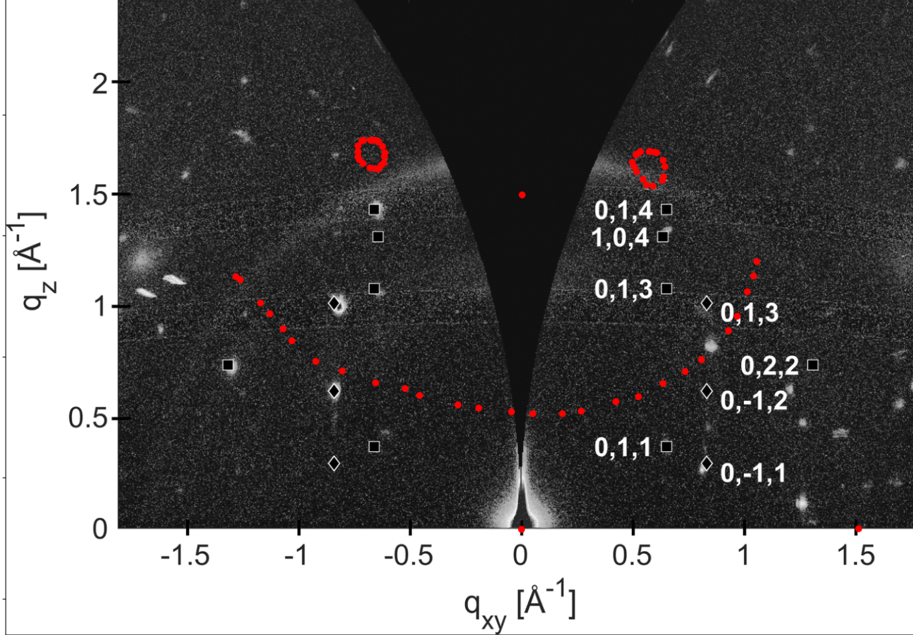
Challenge to find training and test data
XRR
Rely on synthetic and our own data
GIXD
Rely on synthetic data and extraction from literature

Slide 7
PaNOSC Mentoring of OSCARS projects
PaNOSC OSCARS can provide expertise and guidance for the PaNOSC outcomes (cf. https://leaps-wg3.desy.de/outcomes.html ) :
  AAI - user authentication and authorisation i.e. login identity
  Data Catalogues – SciCat and Icat and other catalogues
  Data Portals – Domain specific portals + generic portals
  Metadata – NeXus, Sample and ontologies
  Notebooks – Jupyter notebooks
  PaN Search – searching for PaN data via the data.esrf.fr and other portals
  Software – developing, versioning, packaging and deploying software
  Training – training material platform
  VISA VRE – virtual research environment

Slide 8
Contributions to PaNOSC OSCARS outcomes
 | AI- SCOPE
AAI | Y
Data Catalogues | Y
Data Portals | Y
Metadata | Y
Notebooks | Y
PaN Search | Y
Software | Y
Training | Y
VISA VRE | Y
We overlap with all marked PaNOSC OSCARS outcomes
Contribute to most, open questions for others
Challenges
Struggling with the goal and functionalities of some of the points

Slide 9
Contributions to PaNOSC OSCARS outcomes
Our contribution
Generate more meta data in an automatic manner
Annotate and upload 100k XRR und GIXD data sets
 | AI- SCOPE
AAI | Y
Data Catalogues | Y
Data Portals | Y
Metadata | Y
Notebooks | Y
PaN Search | Y
Software | Y
Training | Y
VISA VRE | Y
Challenges
Identify interface where we contribute, people, contacts
Requirements, and specification etc., API?
Can we upload old or lab data?
How can we integrate our programms at the beamlines
How can we save the meta data with the raw data

Slide 10
Contributions to PaNOSC OSCARS outcomes
Our contribution
Software for automated analysis and annotation of x-ray scattering data
Example pipelines as Jupyter notebooks
 | AI- SCOPE
AAI | Y
Data Catalogues | Y
Data Portals | Y
Metadata | Y
Notebooks | Y
PaN Search | Y
Software | Y
Training | Y
VISA VRE | Y
Challenge
Assistance in packaging and deploying at synchrotrons

Slide 11
Contributions to PaNOSC OSCARS outcomes
Our contribution
Use as login (data & meta data deposition), no direct contribution
 | AI- SCOPE
AAI | Y
Data Catalogues | Y
Data Portals | Y
Metadata | Y
Notebooks | Y
PaN Search | Y
Software | Y
Training | Y
VISA VRE | Y
Challenges
AAI for lab data?
How can I access data after embargo?
Open access for everyone?

Slide 12
Contributions to PaNOSC OSCARS outcomes
Our contribution
AI-tools for automated analysis and annotation of data of x-ray scattering data
 | AI- SCOPE
AAI | Y
Data Catalogues | Y
Data Portals | Y
Metadata | Y
Notebooks | Y
PaN Search | Y
Software | Y
Training | Y
VISA VRE | Y
Challenges
What is the idea, intention behind it?

Slide 13
Contributions to PaNOSC OSCARS outcomes
 | AI- SCOPE
AAI | Y
Data Catalogues | Y
Data Portals | Y
Metadata | Y
Notebooks | Y
PaN Search | Y
Software | Y
Training | Y
VISA VRE | Y
Our contribution
Is to most PaNOSC OSCARS outcomes
?
?
Challenges
Unsure how we can contribute to the marked ones
?

Slide 14
Contribution to Photon & Neutron Research Infrastructures
  Provide automated live data analysis during the measurement, allows for adaption during data collection
  Generate meta data, improves x-ray scattering data towards FAIR principles
  Enhances data accessibility and usability
  Establishing a curated database of surface scattering data

Slide 15
Strategies on sustainability of the project results.
  Integrate software directly at beamlines
  Provides useful additional live info to user, possible to adapt experiment
  Streamline process to provide data with rich meta data as FAIR and open
Notes:
How will you encourage users to adopt your solutions? Are there any partnerships, funding plans, or integration efforts that will help sustain the outcomes beyond the project’s duration?

Slide 16
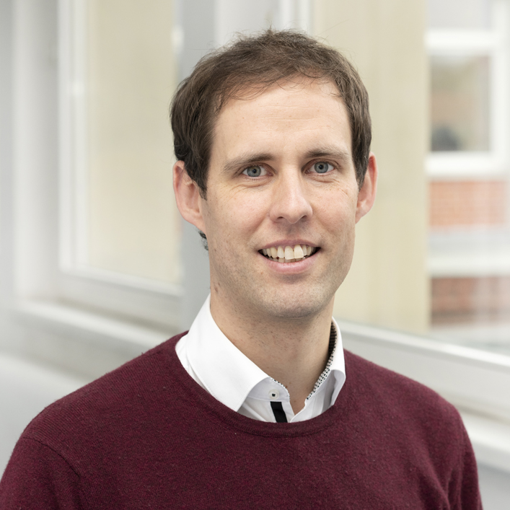

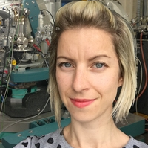
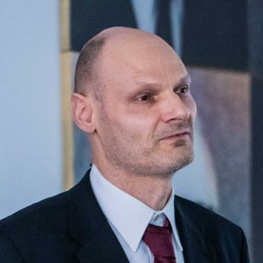

Team
Stefan Kowarik
Frieda Sorgenfrei
Nada Mrkyvkova
Frank Schreiber
Alexander Hinderhofer

Slide 18
Desired support from the PaNOSC cluster for your project.
Are the dependencies on the PaNOSC outcomes identified in the previous slide correct? Please confirm.

Slide 19
Desired support from the PaNOSC cluster for your project.
Please elaborate, which PANOSC outcomes have you managed to adopt?

Slide 20
Desired support from the PaNOSC cluster for your project.
Please discuss the PaNOSC outcomes do you need help in:
  Competence #1
  Competence #2
  Competence #3

