Slide 1
S.Liuzzo on behalf of the COLD project team:
A.D’Elia, P.Borwiec, V.Serriere, M.Dubrulle, M.Morati, S.White, F. Ewald, N.Benoist, K.Scheidt, B.Roche, C.Benabderrahmane, G. Le Bec, R.Bourtenbourg, J.-L. Pons, D. Martin, B. Pelissier, L.Eybert, T.Brochard, C.Maccarrone, J.-L. Revol, B.Joly, Y.Gouez, H. Pedroso Marques, P.Colomp, A.Dely, Q.Qin
Collaborators: E.Nanni, A.Dhar, W.-H. Tan (SLAC), A.Latina (CERN), D.Alesini, F.Cardelli, A.Giribono (LNF), M.Andorf, J.Maxson (Cornell), P.Craievich, R.Zennaro (PSI)
COLD
(Cool copper Operation Linac Demonstrator)
16 May 2025 Update
WP tasks update
WP01 update
WP02 Laser requirement
WP04 JIRA set up, Drawings
WP11 Simulations
Financial aspects
Collaboration agreements

Slide 2
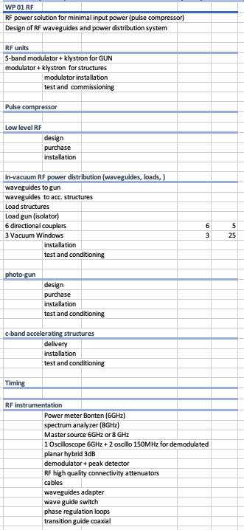
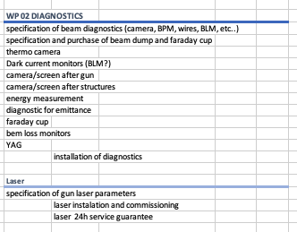
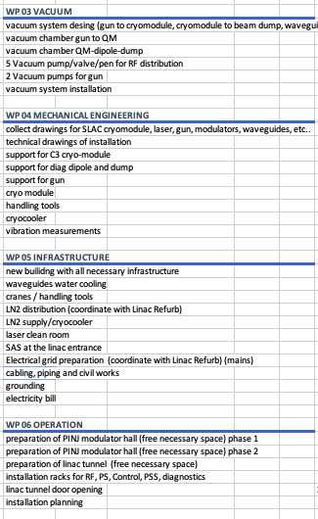
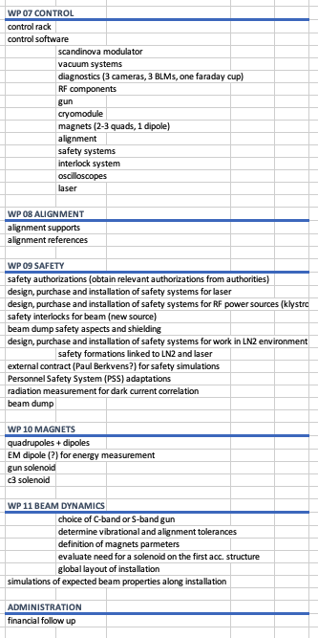
WP tasks update
Task: Vibration measurements
from WP02 DIAG to WP04 MEG
Task: Beam dump
from WP02 DIAG to WP09 SAFETY

Slide 3
WP01 RF
See presentation by A.D’Elia
Pulse compression studies → possibility to reduce number of modulators → large savings (~15MEuros)
Updated RF waveguides with input from INFN-LNF, SLAC, PSI
Soon to start process to procur S-band modulator for gun compatible with present linac.
Inquiry with companies for RF units and waveguide components
etc ..

Slide 4
WP02 Diagnostics
F.Ewald
Photocathode material | Cu
Quantum efficiency QE for electron emission from Cu: | ~1 x 10⁻⁴
Electron beam properties and RF-gun material define the laser parameters:
Photoemission energy for Cu-cathode | 4.53 -5.1 eV (different sources…)
Requires a laser wavelength in the UV region: | < 243 nm – 274 nm, e.g. 266 nm (3rd harmonics of Ti:Sa)
Electron bunch charge (wished): | 1 nC
à Laser pulse energy (4.3 eV * 1 nC/QE) | ~ 50 uJ
Electron bunch length: | < 1 ps (?)
Repetition rate: | 4Hz… 10 Hz
Focal spot size/shape of laser on photo cathode | Will have (which/how much) influence on emittance?
Longitudinal pulse profile? | Simple Gaussian possible?
Operational requirements:
Stability | High reliability and as much as possible maintenance free
Phase locking to RF
Initial set of Laser parameter
In contact with experts and will review with INFN experts
Meeting after 5th of June to detail necessary diagnostic.

Slide 5
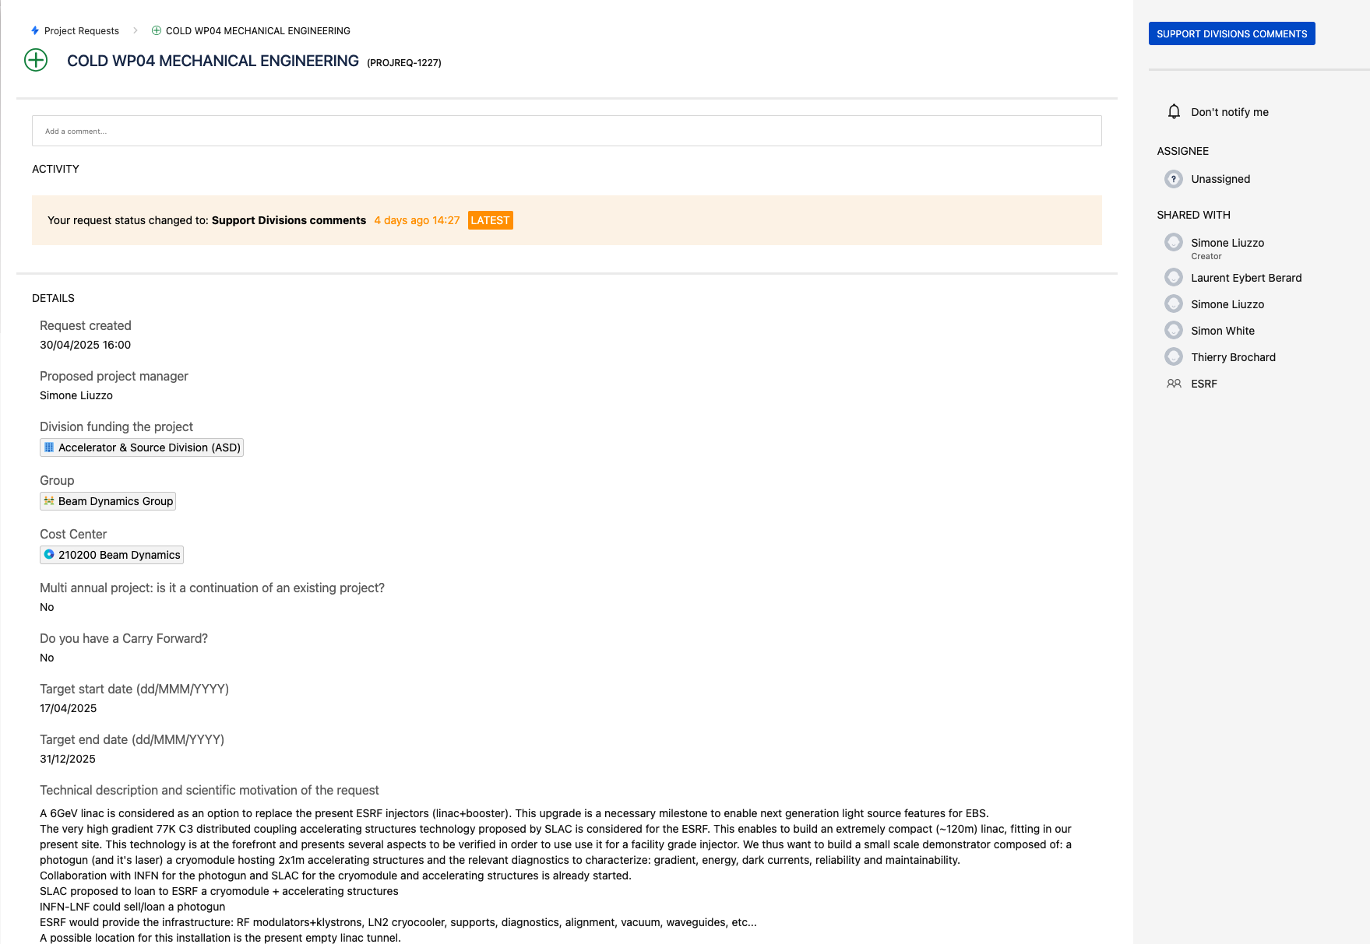
WP04 Mechanical Engineering
Project request submitted with the help of V.Scibetta

Slide 6
WP 11
Andrea Latina (CERN) provided software.
Meeting with Frascati 19th May
Objectives: Simulate space charge dominated linac section 0-200MeV (COLD)
1. S-band gun - diagnostics, drifts, valves - 2x C-band accelerating structures
2. S-band gun - diagnostics, drifts, valves - 4x C-band accelerating structures
Tune injector parameters for high charge
Work constantly delayed by other issues.

Slide 7
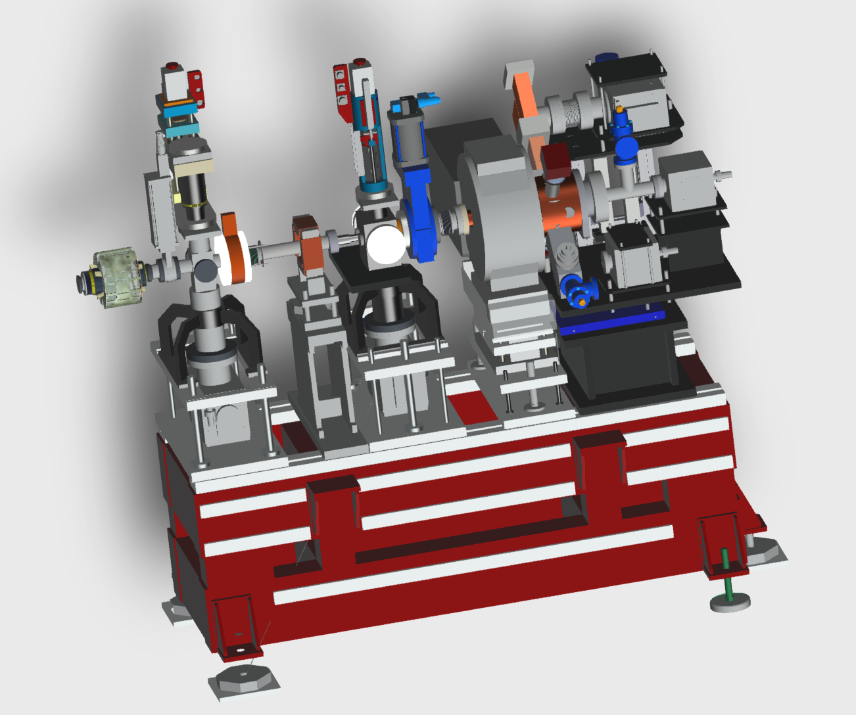
DRAWINGS
INFN-LNF SPARC GUN
C-band waveguides from SLAC nitrogen coffin stand

Slide 8
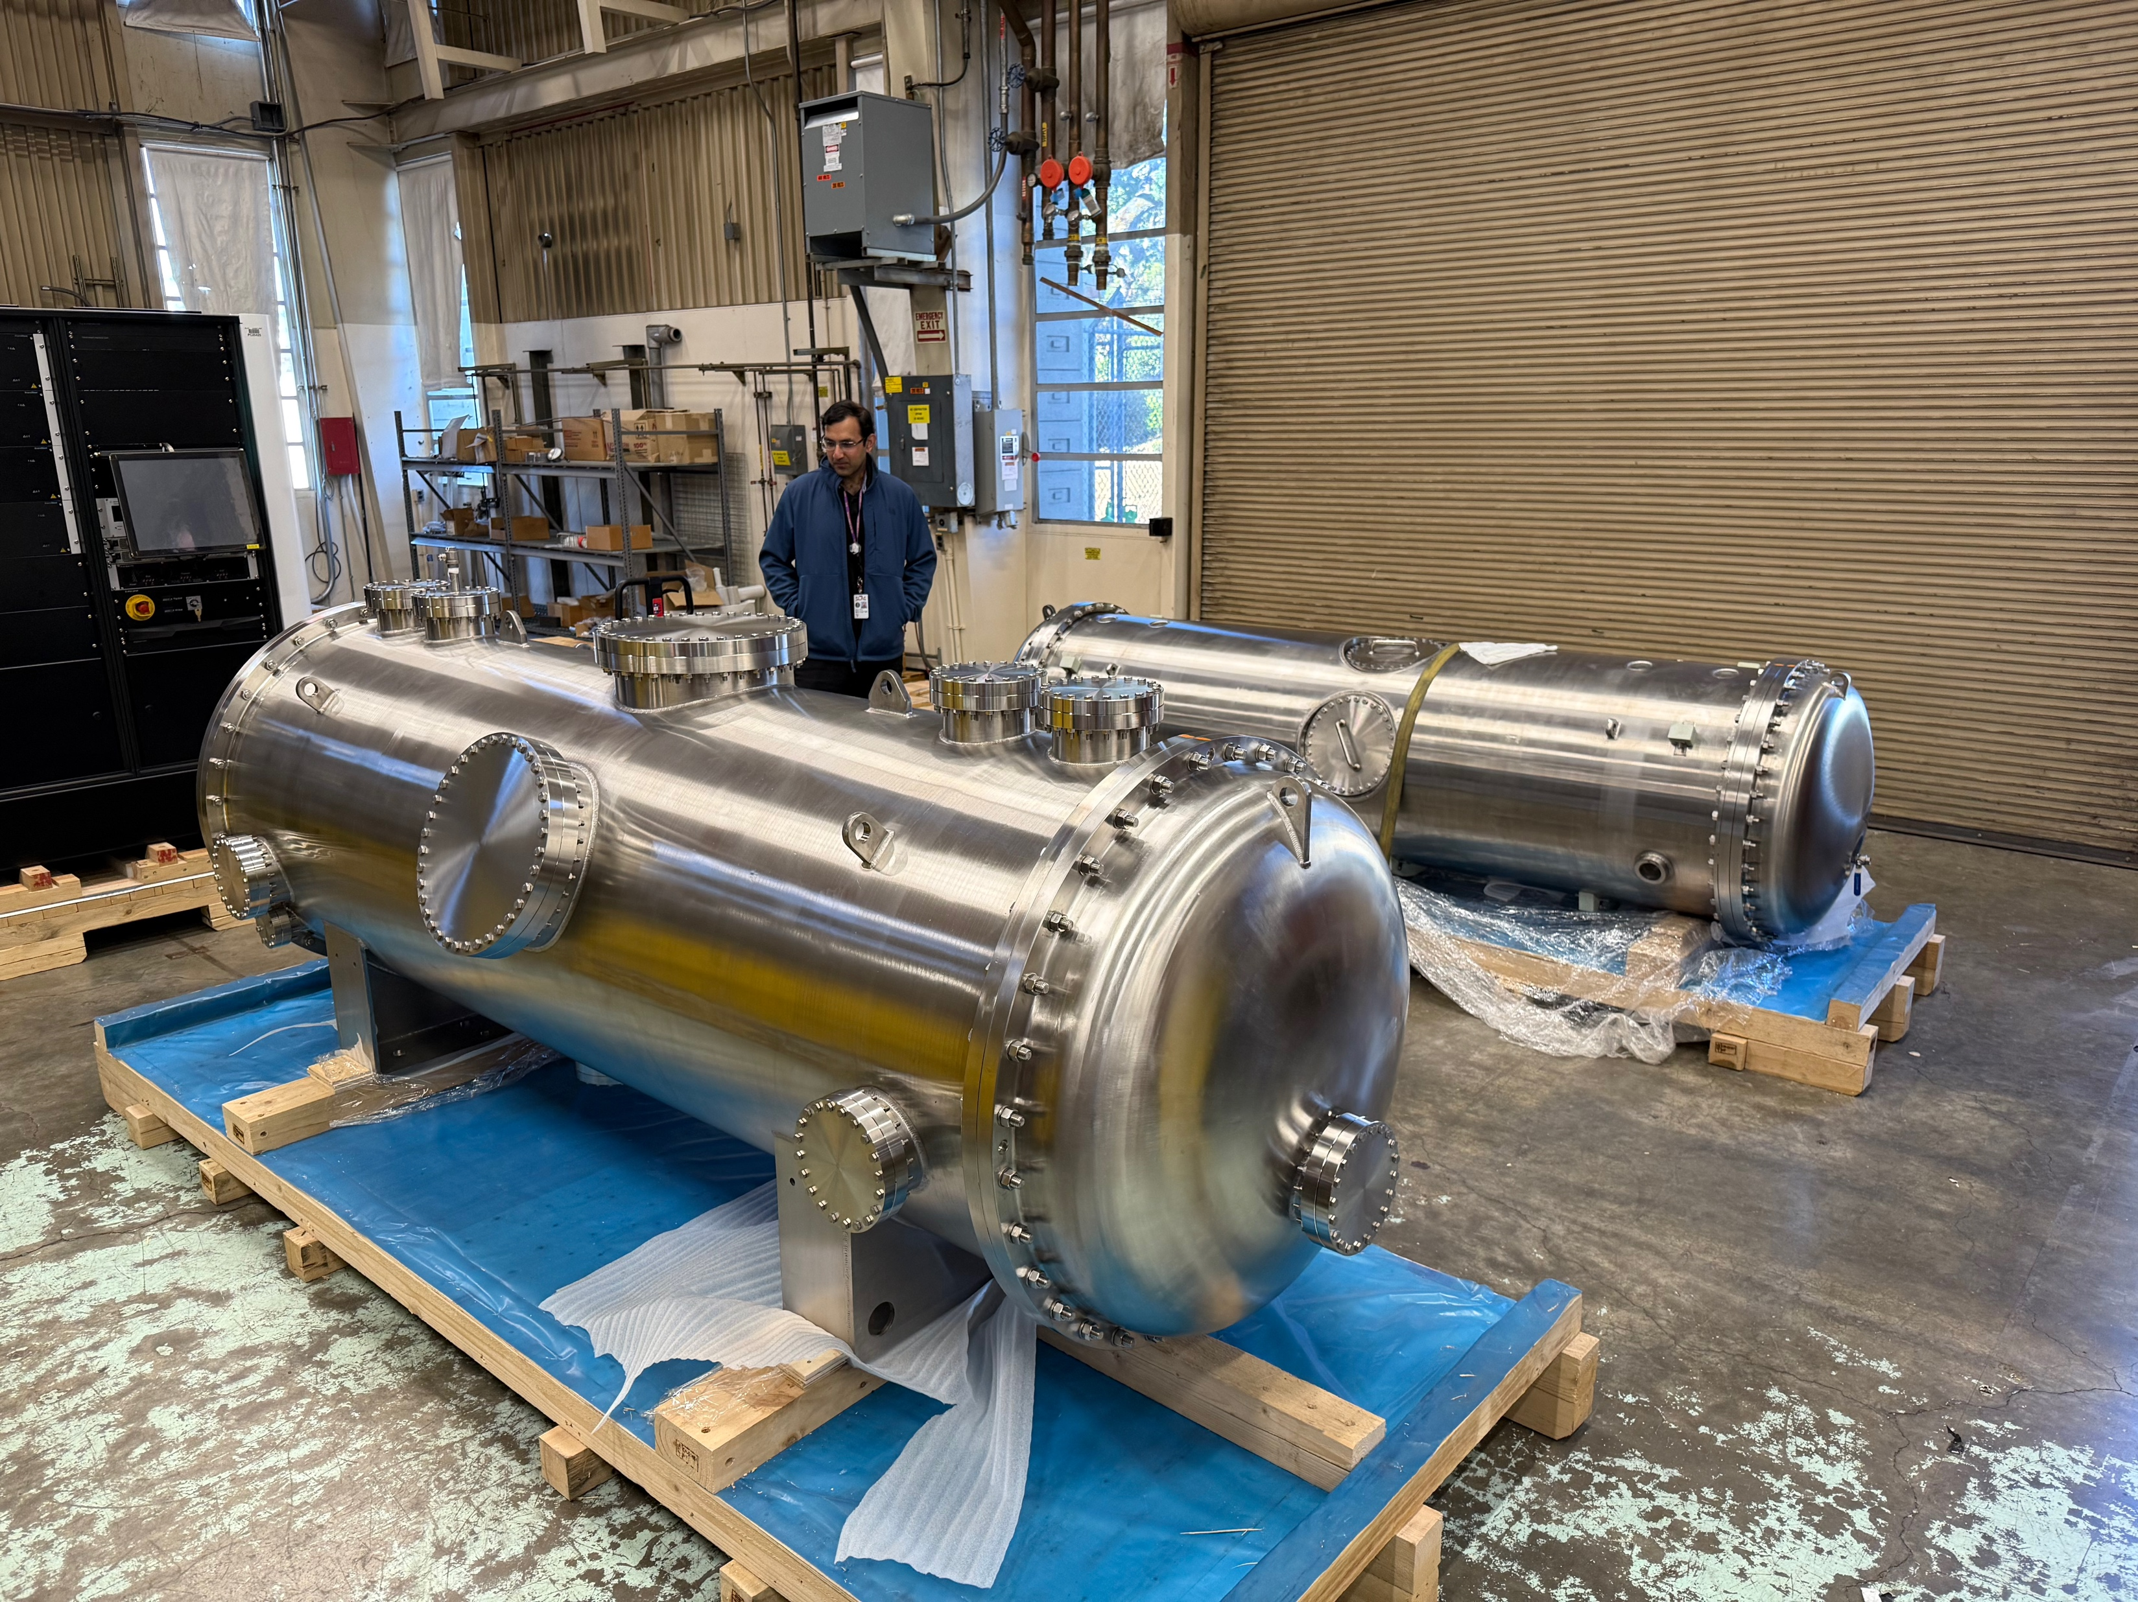
Meeting 5th May
quarter cryomodule at SLAC
good crane for loading it.
insertion of inner vassel in the outher the most tricky.
design to load and remove the raft in the structure
raft design, movers to avoid interference, cryogenic feeds to avoid interefernce to cryostat.
Individual regulation of cryostat or common feed to be decided for full linac.
how to insert and remove raft from cryostat is an important detail.
RF feeds to be designed, thorugh a flange that is sealed. layout for diagnostic on cryomodule not fully clear.
Next MEETING 13th June:
SLAC will present
RAFT design and installation
(MEG + ALGE will attend)
inside
outside

Slide 9
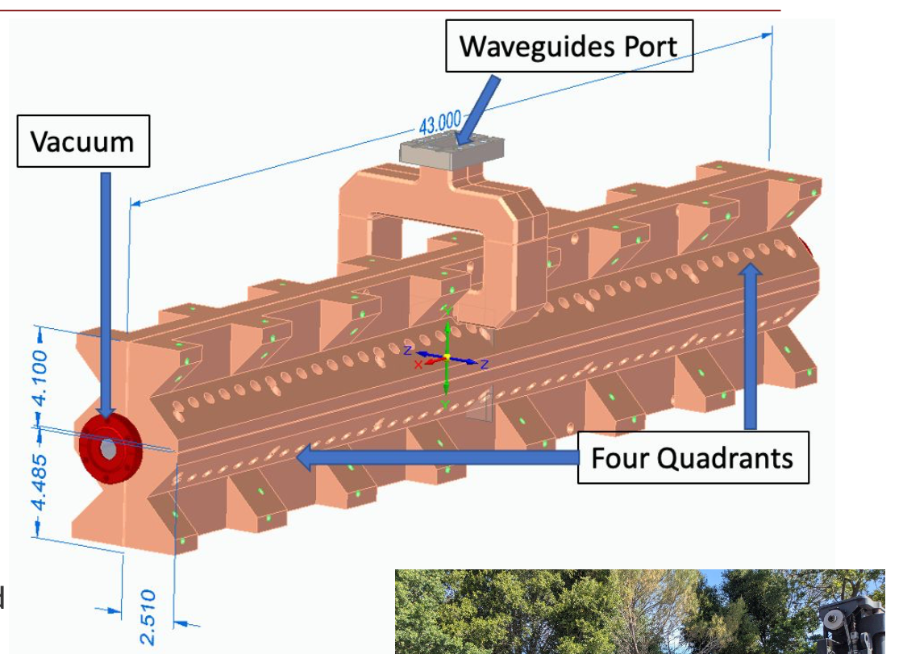
SLAC report on C3 activity
right quality of copper needed. ordered and on site. working model to minimize collection of gas, manifolds on top and bottom. More rounds of review. In the next strucutres need very good alignment and flatness of flat surfaces inner referenced to outer.
High quality fixture holds the structure in place.
NIKHEF colleagues, going to SLAC in June. resonant approach to alignment. small laser source with no lens. projected into a mask and the diffraction is projected in bare CCD, no lenses. software to reconstruct point source/mask and ccd. can be used for long or short range alignment. nm scale fluctuations. only ccd is complicated in cryoenvironemnt.
E.Nanni presentation

Slide 10
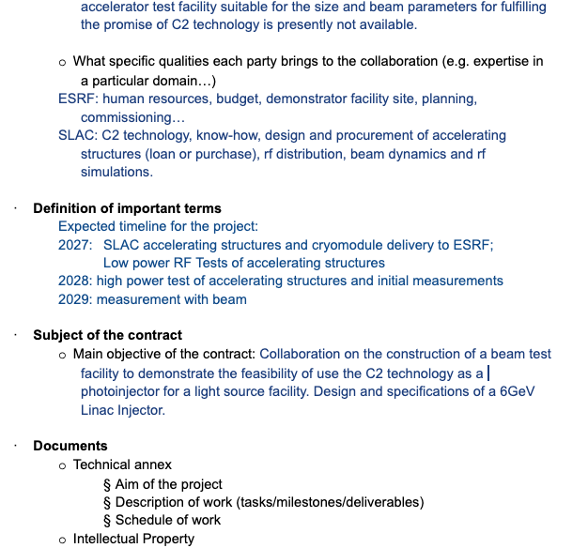
MoU
NO progress from ESRF
Strategy:
Modify MoU to add rough dates (align with SLAC plans) OK
Send new document to Legal Office+ expected dates for first draft to share with SLAC. OK
Wait few days for a reply. If no reply, SLAC may propose a first version. (However this agreement should come from ESRF)
ADDED

Slide 11
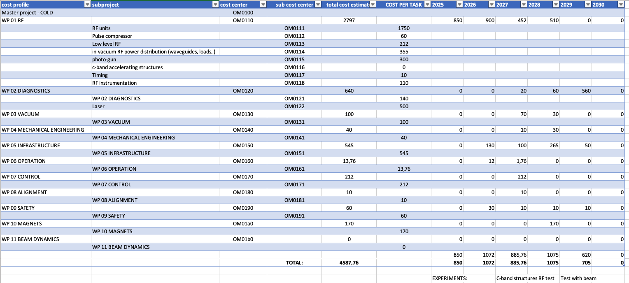
Financial profile and project codes
Soon to start procurement process

Slide 12
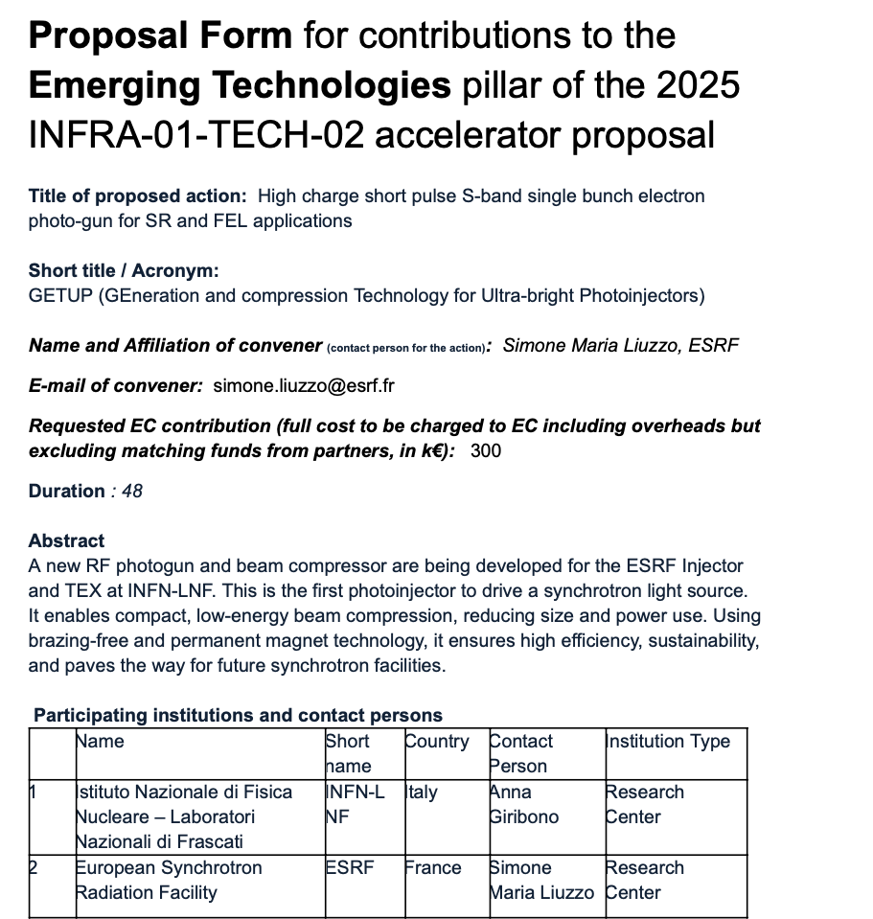
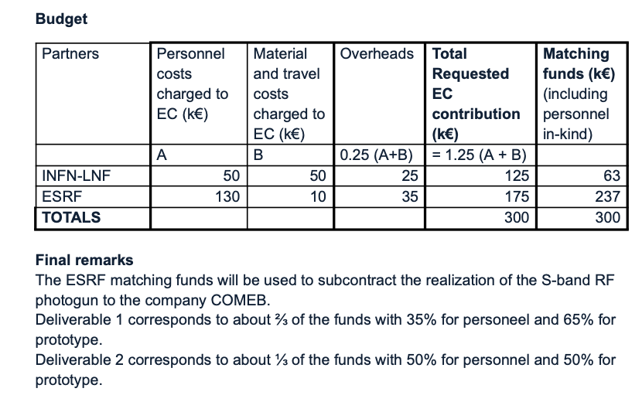
Ifast2 activity proposal submitted
Photogun
+ wiggler
for high charge (ESRF) short pulse (INFN and ESRF)

Slide 13
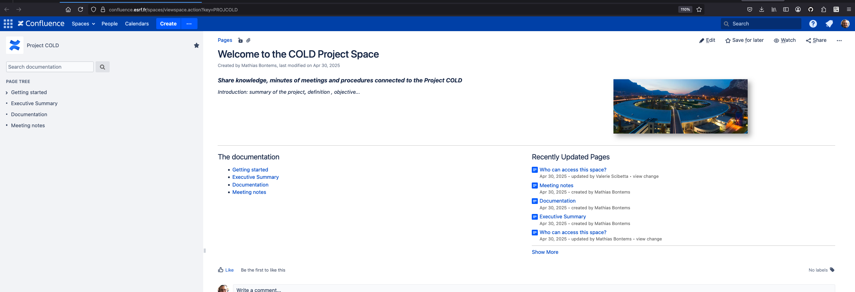
COLD confluence page
https://confluence.esrf.fr/spaces/viewspace.action?key=PROJCOLD

Slide 14
COLd project phases
2025 S-band RF-unit for gun
2026 2x C-band RF-unit for Cryomodules
diagnostics for Linac refurbishment
2027 RF test of C-band structures + dark currents, Laser
2028 photogun, diagnostics
2029 beam measurements
2030 + 2xC-band accelerating structures for pulse compression studies
2031(?) TL1bis, COLD as ~300-350MeV alternate operation injector for ESRF.
SECTION 0
COLD PROJECT PRESENT OBJECTIVE BUDGET AND PLANNING END HERE
To booster
INJECTION IN PRESENT LINAC IS NOT CONSIDERED ANYMORE (Inj.Up.meeting 12th May 2025)

Slide 15
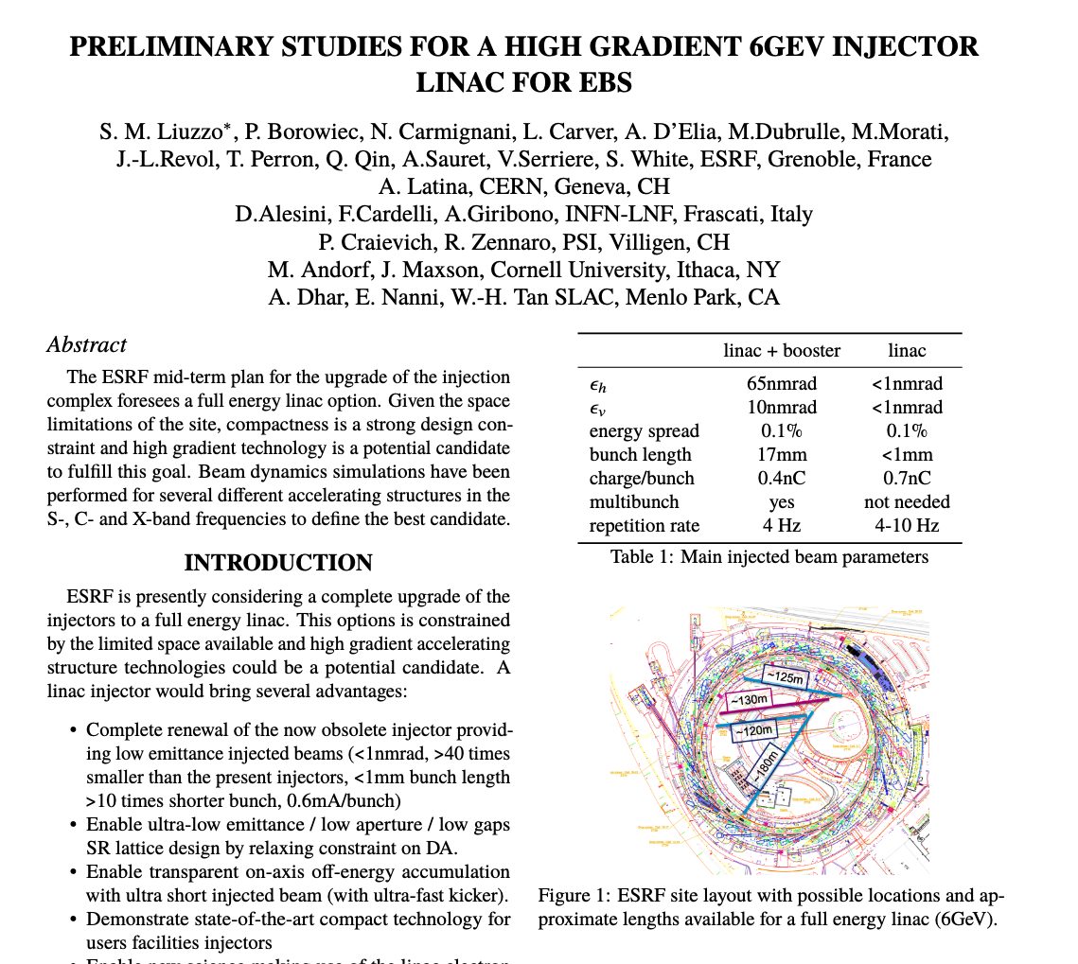
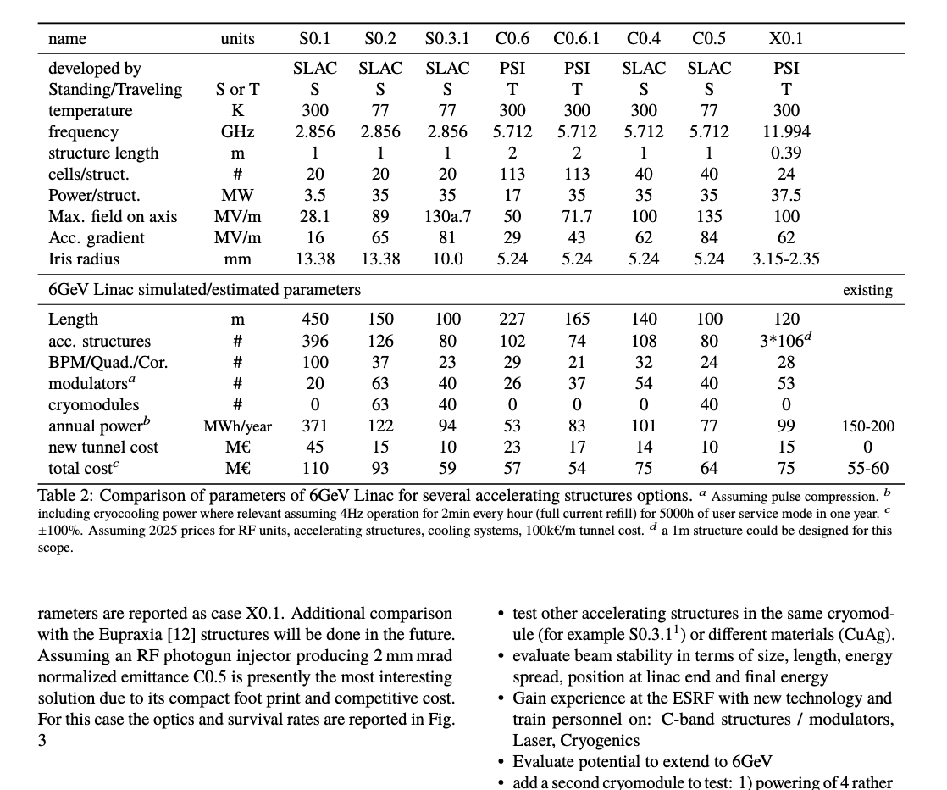
Ipac 2025 paper
Final review in progress.

Slide 16
Next meetings/deadlines
19th May INFN remote meeting for WP11 beam dynamics simulations
5th - 13th June (TBD) : Diagnostics specification meeting
13th June 2025 10.30 2nd COLD update meeting
13th June 17.05 ESRF 6GeV Linac meeting with SLAC, INFN, Cornell, PSI, CERN
23-25 June: INFN-LNF visit for beam dynamics simulations

