Slide 1
1st COLD Meeting: RF Activity Report
A. D’Elia

Slide 2
Contents
Pulse Compression Studies:
  Benchmark with SLAC results;
  PSI-BOC pulse compressor studies;
Klystron needs
Layout update
Where we are

Slide 3
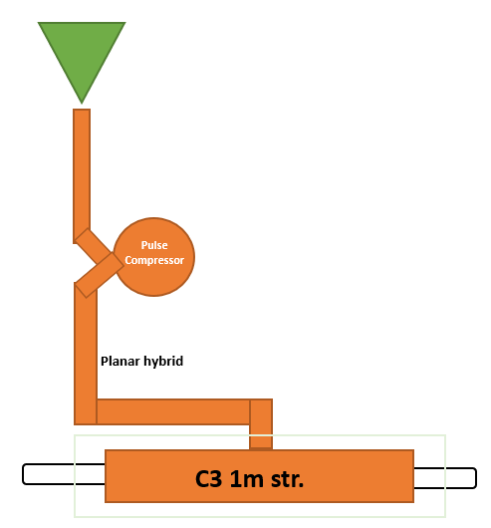
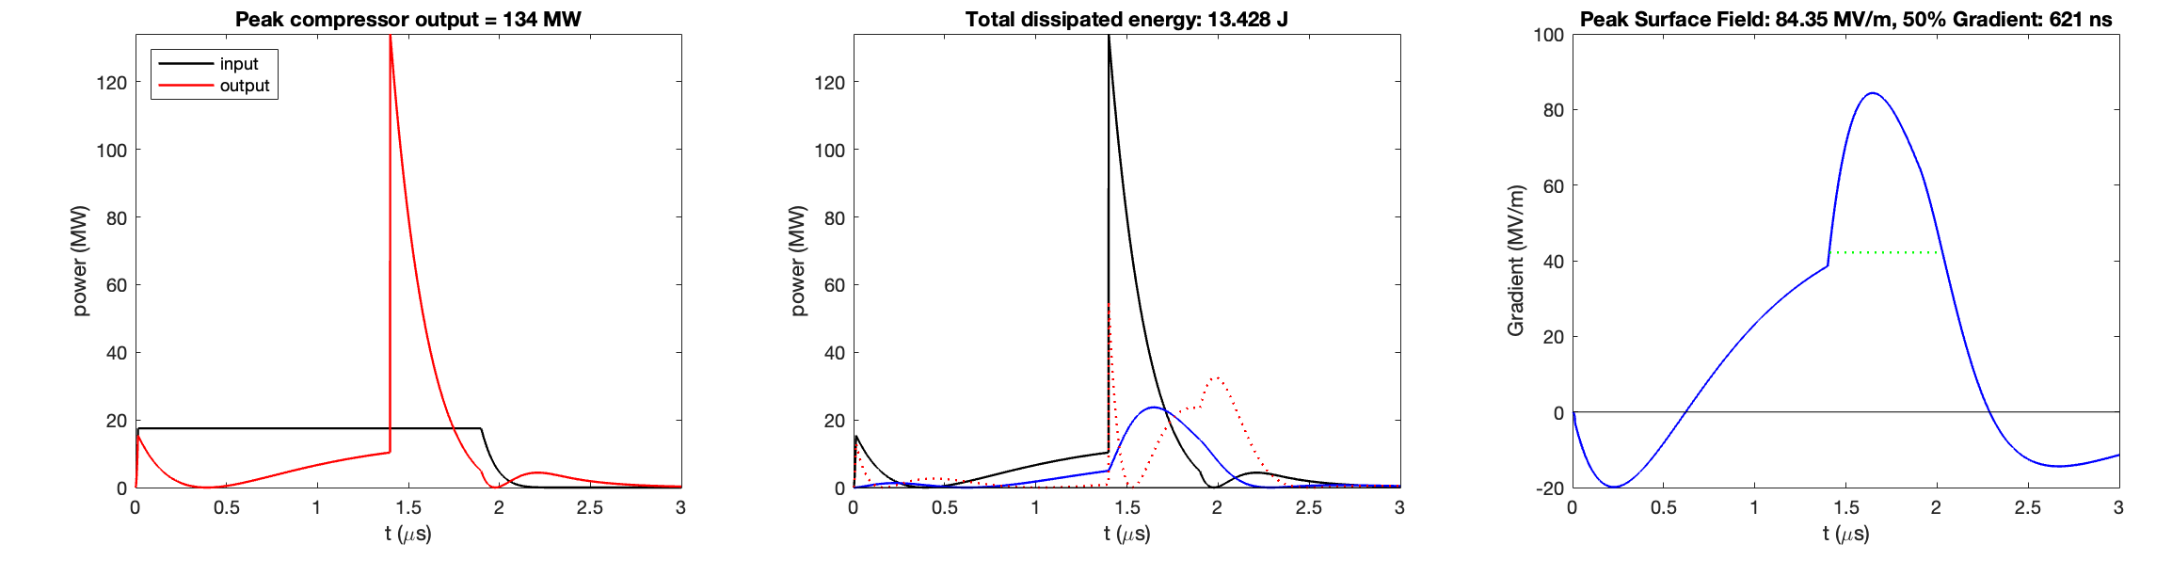
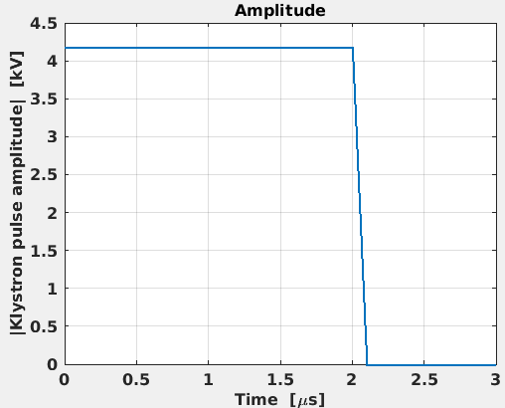
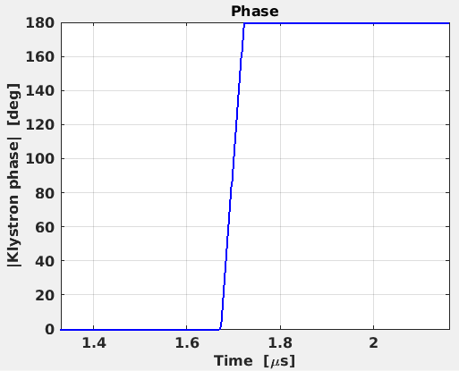
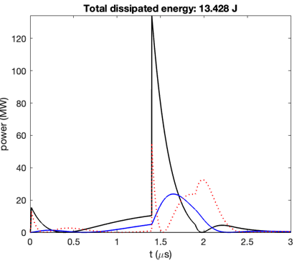
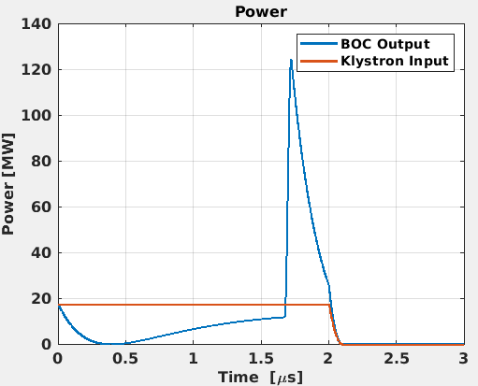
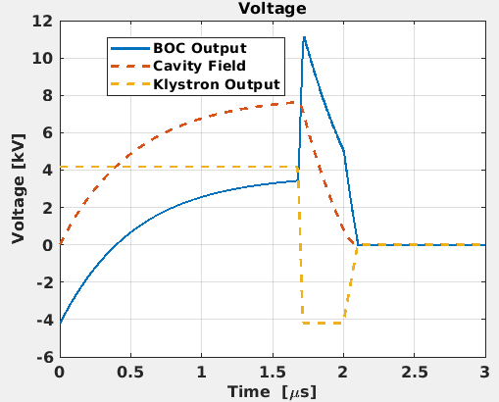
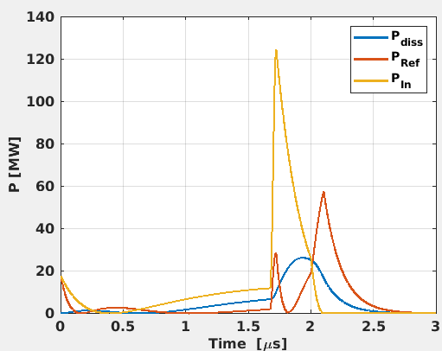
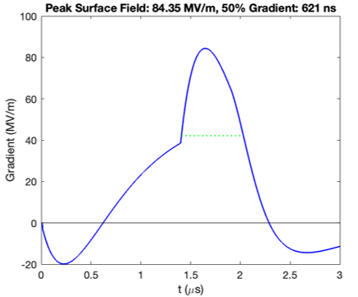
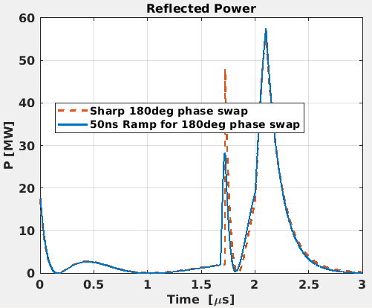
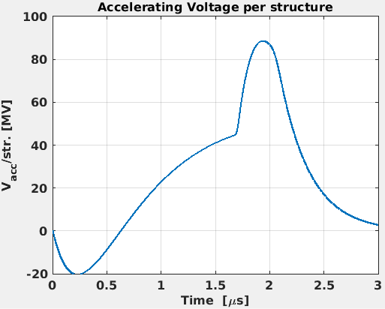
Benchmark with SLAC results
NB: SLAC does not consider a finite phase ramp
Freq. (GHz) | 5.712 | W/O P.C.
Pin (MW) | 17.5 | 26.2***
Pulse length (μs) | 2 | 1.65***
Pulse Compressor
β | 20 | -
Q0 | 200000 | -
Acc. Structure
β | 3.5 | 1
Q0 | 22500* | 20700*
Rsh** (Mohm/m) | 300 | 300
SLAC
Phase ramp=180°/50ns
SLAC
Pulse length=2μs
* In the original table I see 20700, SLAC confirmed they observe some variation from structure to structure, however final results do not change significantly.
** LINAC-Ohm (R_{sh}=V²/P), TTF included.
*** C-Band klystron, 50MW/1.5-2μs are available (100Hz rep. rate).
Total Diss En=14.644 J
SLAC
NB: Pulse Compressor Output Power is sensitive to the speed of the phase ramp
1/3 less power with a Pulse Compressor

Slide 4
34 C-Band BOC and 4 XBOC structures produced and operational: w/o any operational problem so far!!
Courtesy of R. Zennaro, PSI

Slide 5
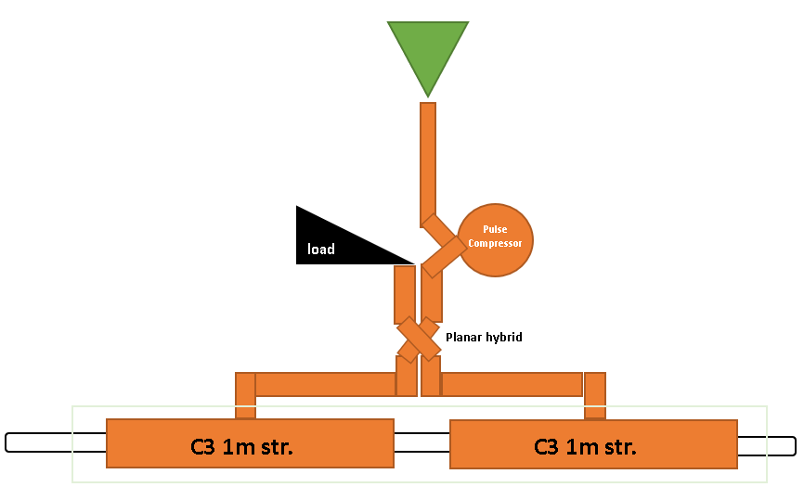
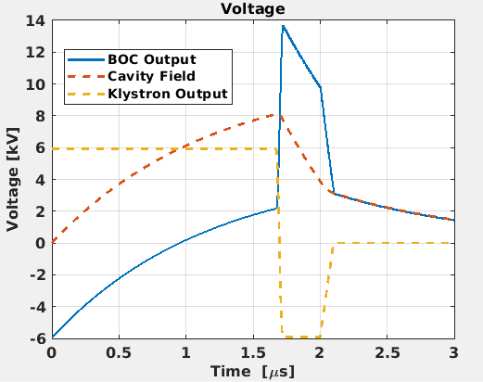
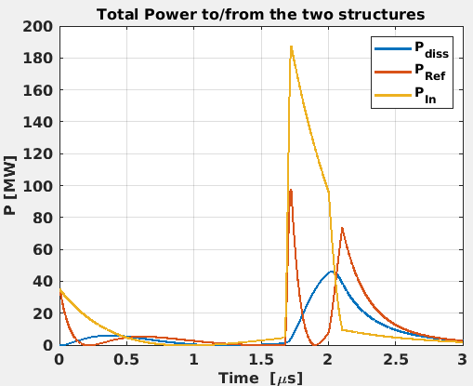
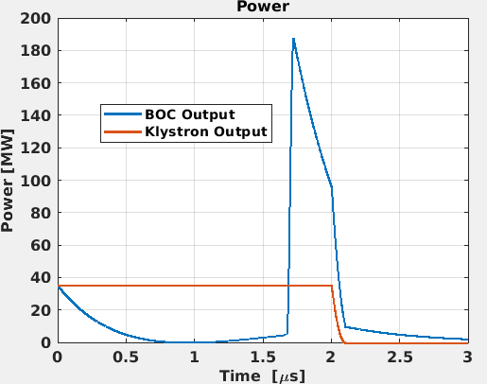
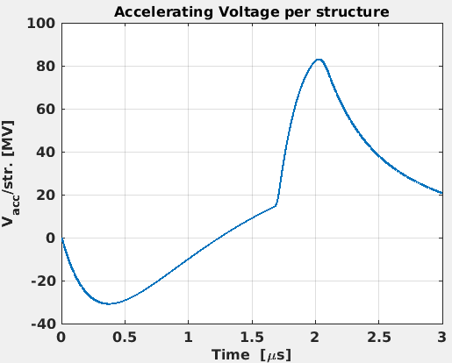
“Real” PSI-BOC parameters
Freq. (GHz) | 5.712
Pin (MW) | 35
Pulse length (μs) | 2
BOC
β | 9.4
Q0 | 220000
Acc. Structure
β | 3.5
Q0 | 22500
Rsh (Mohm/m) | 300
(PSI-BOC)
A 35MW/2μs klystron + PSI BOC works. NB: no margins, the final power from the klystron, should also include:
RF losses in the waveguide (~20%);
Always a 10% margin from Max power that the klystron can deliver.

Slide 6
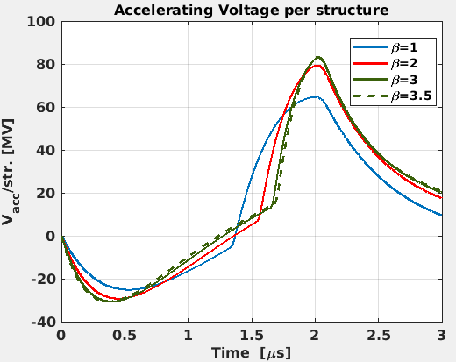
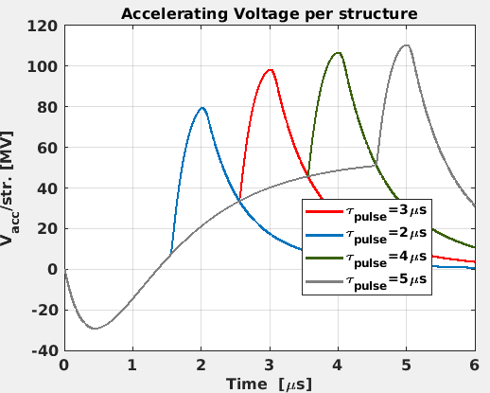
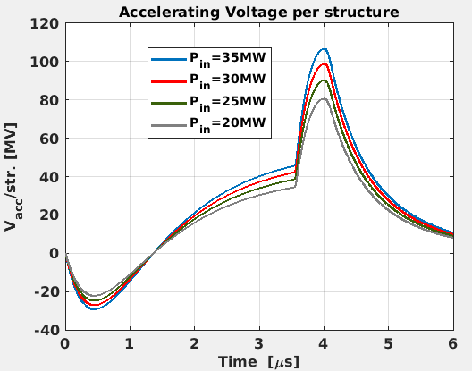
Studies with “real” PSI-BOC parameters
Freq. (GHz) | 5.712
Pin (MW) | 20-35
Pulse length (μs) | 2-5
BOC
β | 9.4
Q0 | 220000
Acc. Structure
β | 1-3.5
Q0 | 22500
Rsh (Mohm/m) | 300
P_{in}=35MW
Pulse length=2μs
P_{in} =35MW
β=2
β structure variation
Pulse length variation
We are not considering any margin on the klystron input power.
P_{klys} variation
Pulse length=4μs
β=2

Slide 7
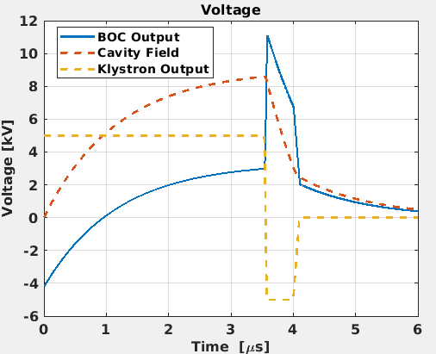
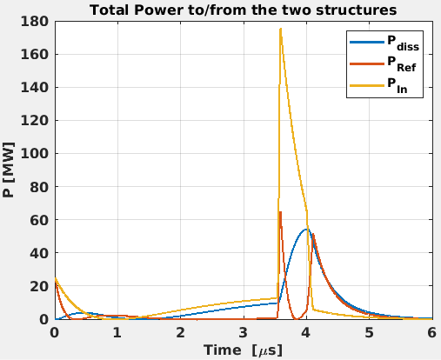
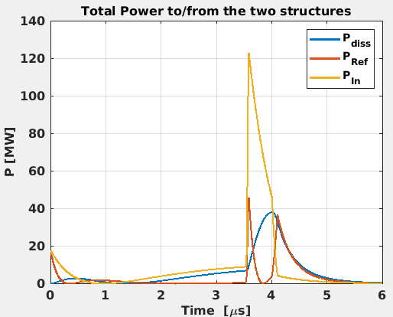
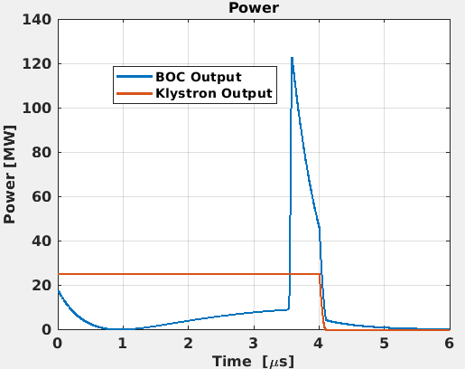
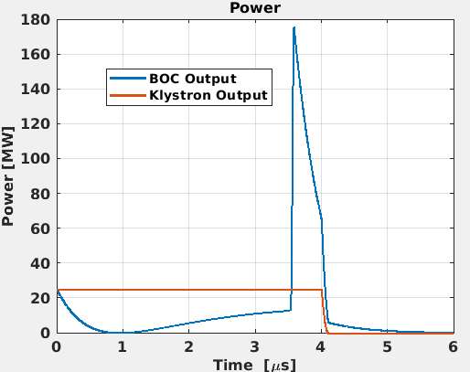
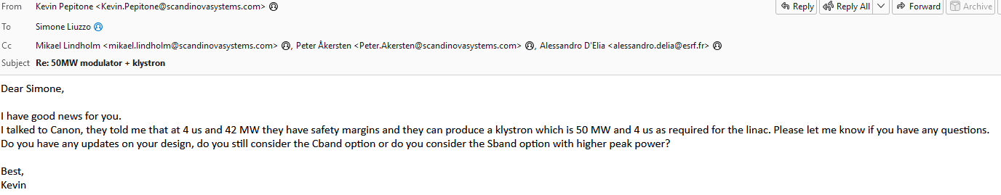
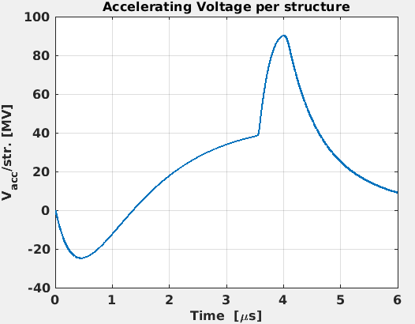
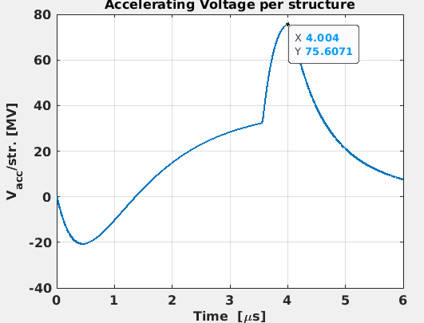
Can we reduce the number of klystrons?
Freq. (GHz) | 5.712
Pin (MW) | 25
Pulse length (μs) | 4
BOC
β | 9.4
Q0 | 220000
Acc. Structure
β | 2
Q0 | 22500
Rsh (Mohm/m) | 300
No Power reduction
-30% in power applied at the output of the BOC
No Power reduction
(PSI-BOC)
We applied a 30% of power reduction at the output of the BOC to take into account WG losses and some klystron power margin.
No Power reduction
Can we use a 50MW klystron, 4μs pulse length to feed 2 cryomodules (4 x C3 structures)?

Slide 8
Overall Layout
50 MW
4 μs, 4-10Hz
C-band**
** Only 25MW needed for COLD
load
Modulators SAT
35 MW
4.5μs, 4Hz
S-band*
* EU S-Band=2.998GHz.
According to INFN: only 20-25MW/1.5μs needed.
DC
?
Modulators SAT
WG switch
load
DC
Vacuum Valve
?
WG switch
load
BOC
Vacuum Valve
Vacuum Valve
DC
load
Vacuum Valve
Planar hybrid
Isolator
DC
DC
DC
Ph.
Shift.
PINJ Entrance Door? ➔
Atten
Atten
WALL
pen
IP
valve
C3 1m struct
C3 1m struct
GUN
C3 1m struct

Slide 9
S-Band section
Outcome from last Injectors upgrade: New Linac Meeting (5th May 2025):
No issues to use a 35MW/4,5μs to feed a GUN needing only <25MW/1,5μs (PSI+SLAC+SCANDINOVA);
Better replacing RF windows with vacuum valves (SLAC);
Preliminary spec for RF loads correct: Max Power+~10% Margin (PSI);
To be addressed in the near future: what about temperature stability if “everything” outside the tunnel? (PSI+SLAC).
Outcome from last Meeting with SCANDINOVA (15th May 2025):
Isolator doesn’t exist in vacuum but only in SF6➔ To be asked to INFN-LNF who developed also a system using a BOC to reduce the power…
They can provide for integrated directional coupler in the klystron and reflected power interlock system;
They may provide for material for SAT if necessary;
They can offer guarantee extension of 1 year for ~5% on the final price;
They can help with LLRF (can suggest dedicated Companies/Institutes) if necessary.
35 MW
4.5μs, 4Hz
S-band*
* EU S-Band=2.998GHz.
According to INFN: only 20-25MW/1.5μs needed.
load
Modulators SAT
DC
?
WG switch
load
Vacuum Valve or RF Window?
Vacuum Valve?
Isolator
DC
RF Window?
pen
IP
valve
GUN

Slide 10
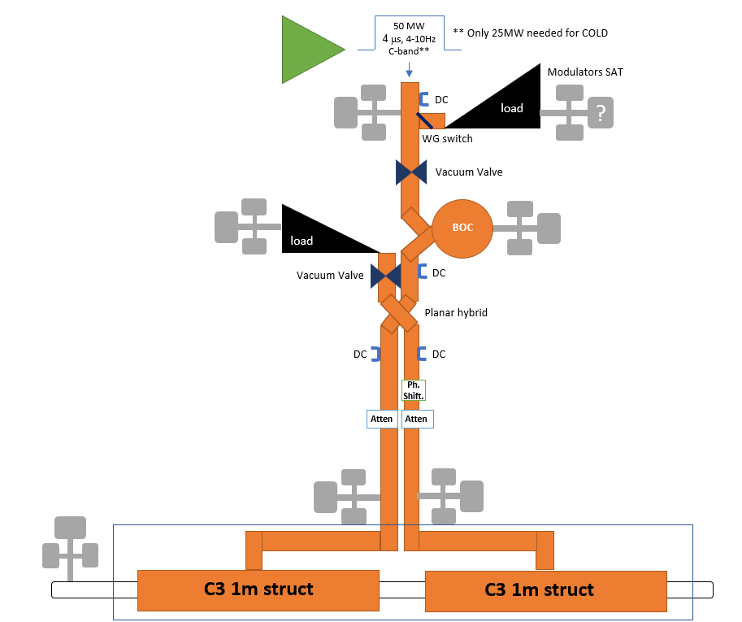
C-Band Section
Outcome from last Injectors upgrade: New Linac Meeting (5th May 2025):
No issues to use a 50MW/4μs for COLD (PSI+SLAC+SCANDINOVA);
Better replacing RF windows with vacuum valves (SLAC);
Preliminary spec for RF loads correct: for COLD we calculate 50MW Max reflected power from the 2 structures ➔ 2 identical RF loads for SAT and Ref. Power (50MW+10% Margin) (PSI);
PSI has C-Band switches and can suggest a Company which can provide for;
To be addressed in the near future: what about temperature stability if “everything” outside the tunnel? (PSI+SLAC)
Outcome from last Meeting with SCANDINOVA (15th May 2025):
They can provide for integrated directional coupler in the klystron and reflected power interlock system;
What about the required flatness for the full 4μs pulse? They can provide +/-1.5%. However using a pulse compressor this should not be a problem. Of course tbc.
They may provide for material for SAT if necessary;
They can offer guarantee extension of 1 year for ~5% on the final price;
They can help with LLRF (can suggest dedicated Companies/Institutes) if necessary.

Slide 11
Market survey: preliminary outcome
Last minute addition from Pawel: we need to consider also arc detector system
I contacted MEGA, TSC and SPINNER for a preliminary survey for rough estimation of the prices and, more important to identify who can provide for what. Here below the first outcome.
C-Band: 5.712GHz – All Under Vacuum
Components | Company | Price | Spec
Waveguides
Straight | MEGA, TSC |  | 60MW peak, 4μs, Rep. Rate=10Hz
Elbow | MEGA, TSC |  | 60MW peak, 4μs, Rep. Rate=10Hz
Switch | NIHON KOSHUA (tbc with PSI) |  | 60MW peak, 4μs, Rep. Rate=10Hz
Load | ? (However same as PSI) |  | 60MW peak, 4μs, Rep. Rate=10Hz
Planar Hybrid | NIHON KOSHUA (tbc with PSI) |  | 140MW (?) peak, 4μs, Rep. Rate=10Hz
Directional Couplers | TSC (probably), MEGA (?) |  | -
EU S-Band: 2.998GHz – All Under Vacuum
Components | Company | Price | Spec
Waveguides
Straight | MEGA, TSC, SPINNER |  | 40MW peak, 4.5μs, Rep. Rate=10Hz
Elbow | MEGA, TSC, SPINNER |  | 40MW peak, 4.5μs, Rep. Rate=10Hz
Switch | ? |  | 40MW peak, 4.5μs, Rep. Rate=10Hz
Load | ? (However same as INFN) |  | 40MW peak, 4.5μs, Rep. Rate=10Hz
Isolator | SPINNER? (However same as INFN) |  | 40MW peak, 4.5μs, Rep. Rate=10Hz
Directional Couplers | MEGA, TSC, SPINNER |  | -
TSC suggested DESY Type Flanges

Slide 12
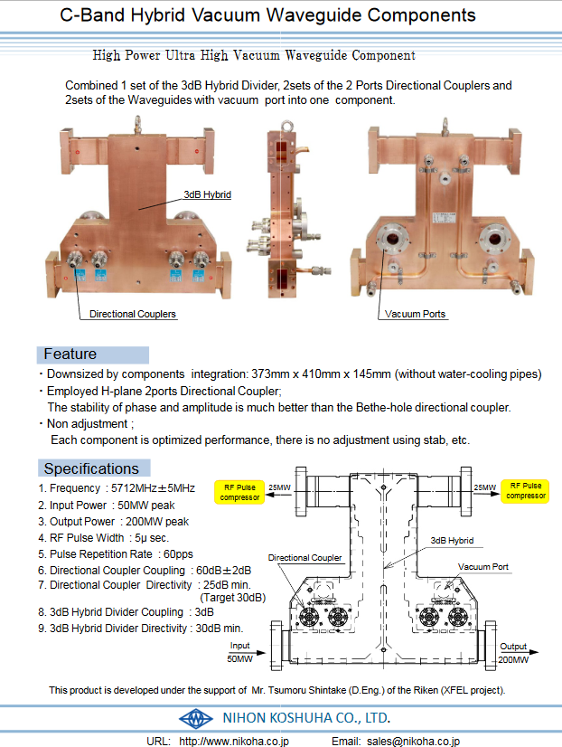
Overall Layout 2
50 MW
4 μs, 4-10Hz
C-band**
** Only 25MW needed for COLD
load
Modulators SAT
35 MW
4.5μs, 4Hz
S-band*
* EU S-Band=2.998GHz.
According to INFN: only 20-25MW/1.5μs needed.
?
Modulators SAT
WG switch
load
load
Vacuum Valve
Vacuum Valve
?
Planar hybrid
WG switch
Vacuum Valve or RF Window?
BOC
BOC
load
Vacuum Valve?
Isolator
DC
DC
In case the planar Hybrid can’t manage BOC Peak Power output
DC
RF Window?
Ph.
Shift.
Atten
Atten
WALL
pen
IP
valve
C3 1m struct
C3 1m struct
GUN
C3 1m struct

Slide 13
Services
CEM (grounding): needs to be separated? What about separation w.r.t. present LINAC?
ELEC:
S-Band
1 klystron+Modulator: same as for LINAC Refurbishment
C-Band
1 klystron+Modulator: SCANDINOVA will send us an estimation
Laser? Asked FRASCATI??
Magnets?
Water Cooling:
Klystron and Modulators:
  S-Band: same as for LINAC Refurbishment (flow rate~120 l/min?);
  C-Band:
    According to PSI, considering their system working at 50MW/3μs/100Hz (15kW) ➔ 100l/min per channel; for 50MW/4μs/10Hz (2kW) ➔ 15l/min;
    According to SCANDINOVA, CANON always asks the klystron working at the nominal flow for the highest possible nominal power ➔ ~100l/min per channel (klystron will be basically the same as PSI): SCANDINOVA will send us an estimation;
Gun: asked FRASCATI??
BOC: from PSI “[Each BOC] needs a dedicate heater and a dedicate variable valve, both are controlled by a feedback loop which stabilize the BOC temperature to 0.002 °C rms. Probably you do not need the same stability (for a test stand 0.1°C is enough) but you still need to have the possibility to warm up the cooling water. Our cooling water temperature range is 35 +- 7 °C. I suggest to use a commercial device for cooling/heating (for some installations with moderate water flow and where we do not need stability we use products from Regloplas at PSI) with this solution you do not need a variable valve.”
LOADS: to be asked to PSI/FRASCATI/SLAC;
For specific WG’s: Hybrid and Directional Couplers (for thermal stability*). Isolator?
LASER? Asked FRASCATI?
Magnets?
* Needs temperature control loop?

