Slide 1
Simus done to know if focussing is needed in the new section.
Conditions: 2 coils, buncher at 0.75from gun buncher coil at 0.006T, acceleration section considered as drifts, not powered. Low charge (no space charge included)
<number>
9/13/22

Slide 2
Focussing coils
Accelerating structure
Actual Lay out
Gun exit
Optional coils
Buncher
section
0
130
476
825
130
1440
130
2860
3355
Optimised
885
0
130
300
520
750
1065
1950
9/13/22
<number>

Slide 3
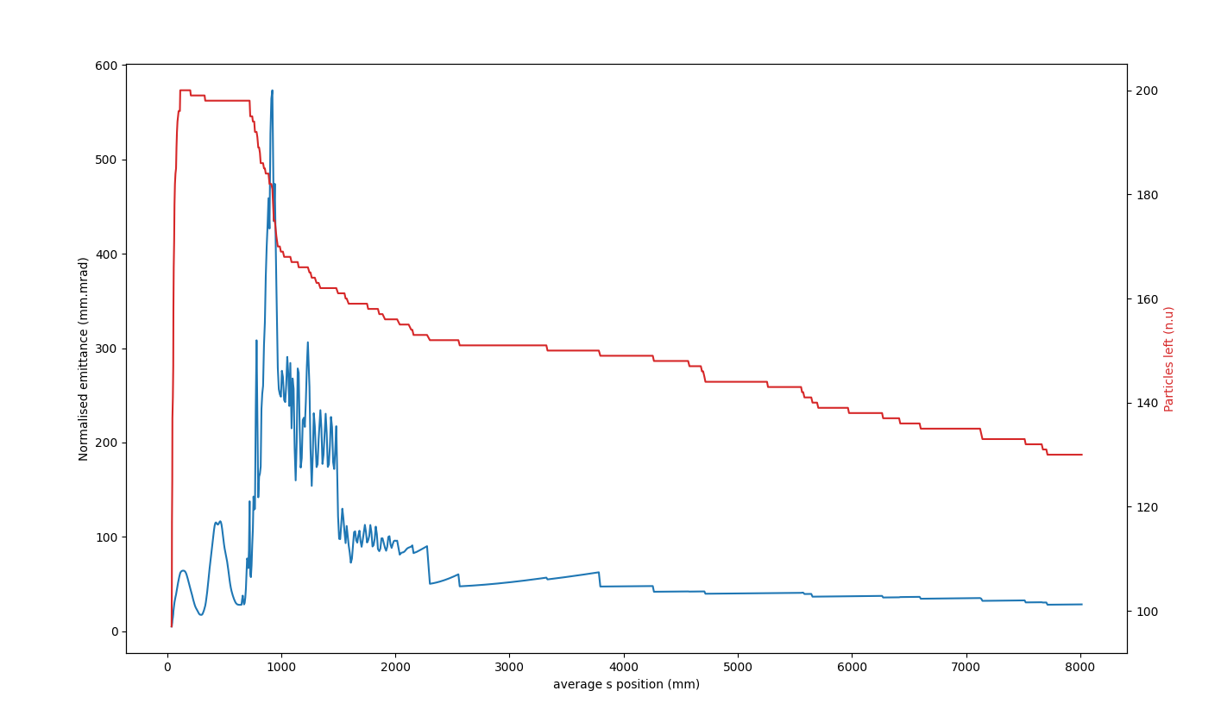
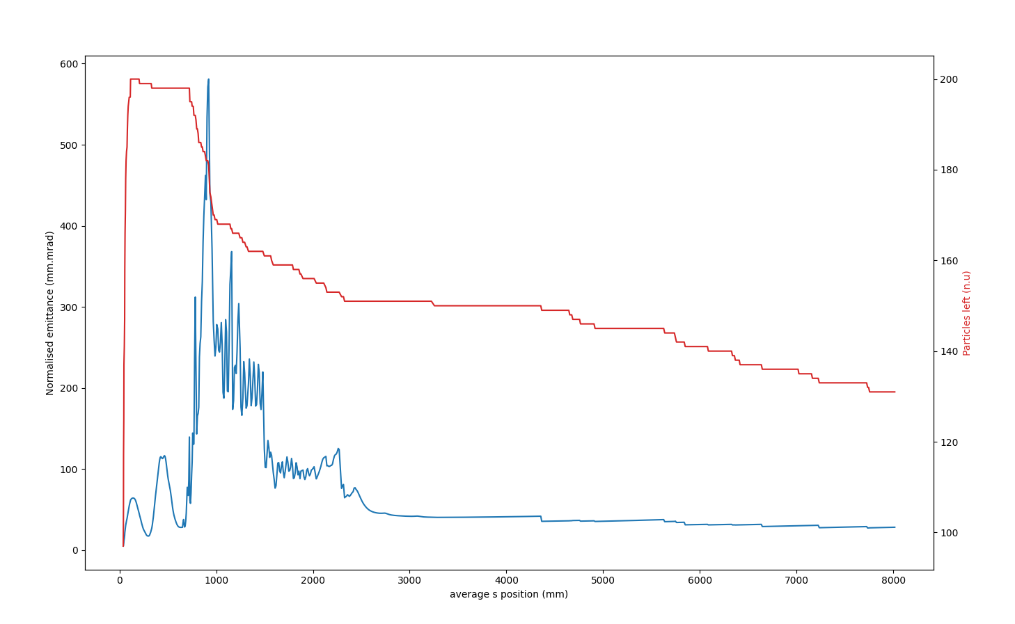
Emittance Comparison
2 coils at 0
1 coils at 0.1T
<number>
9/13/22

Slide 4
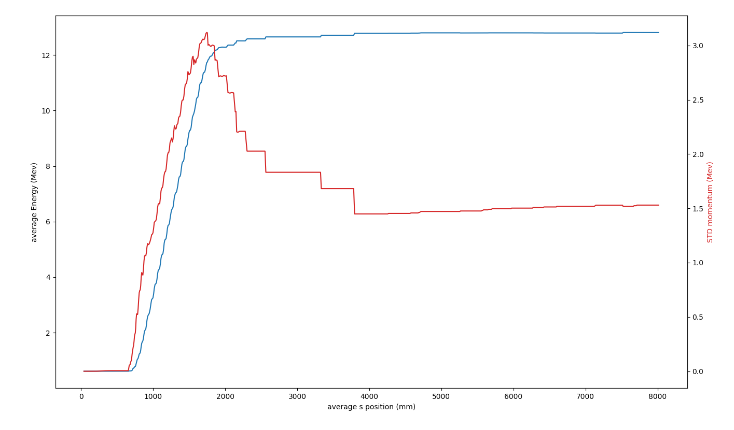
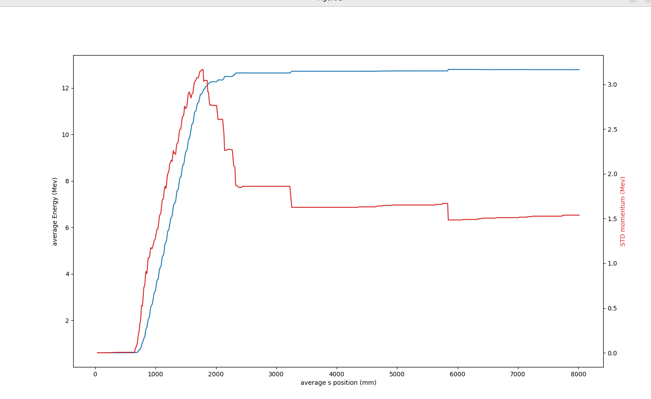
comparaison energy
2 coils at 0
1 coils at 0.1T
<number>
9/13/22

Slide 5
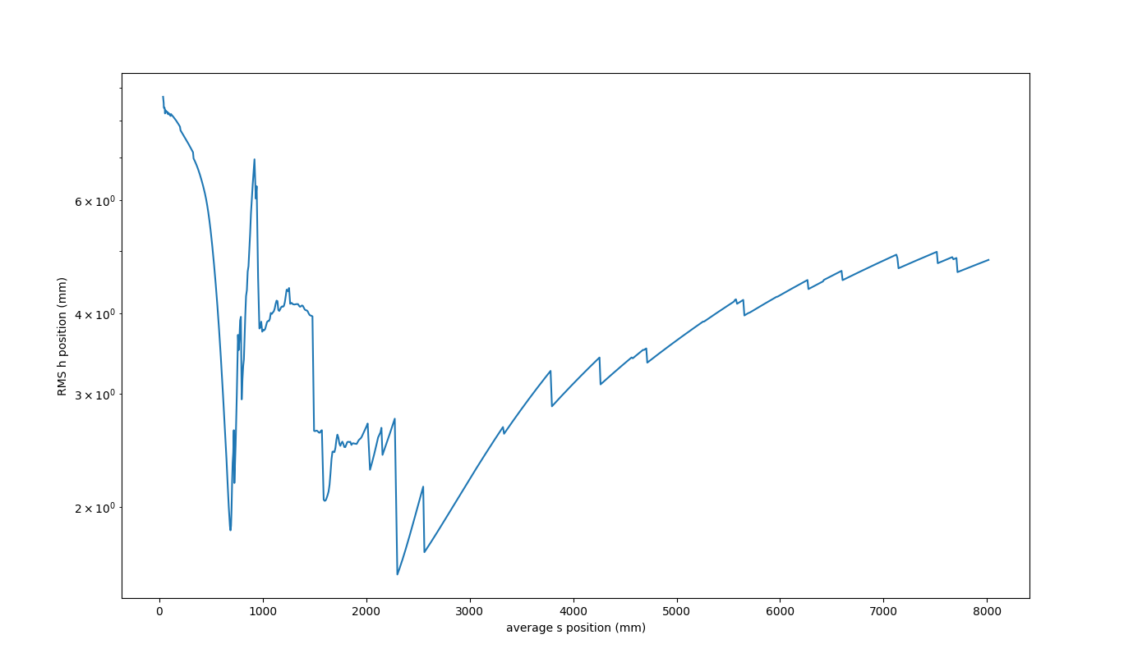
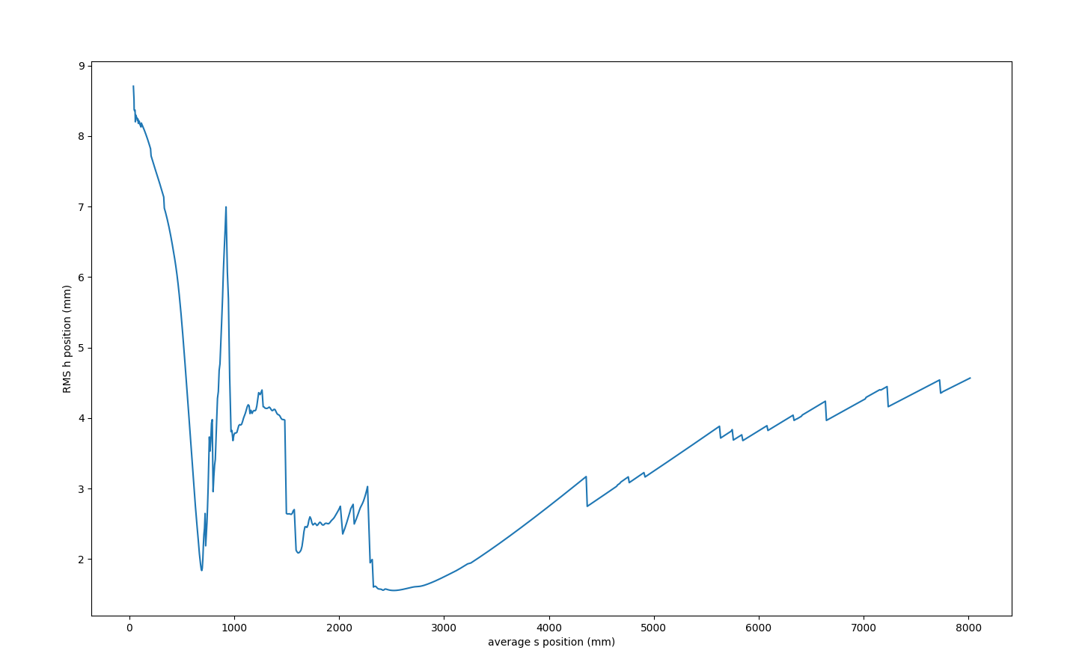
Comparaison taille
2 coils at 0
1 coils at 0.1T
<number>
9/13/22

Slide 6
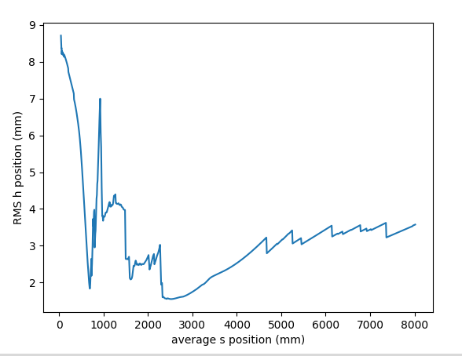
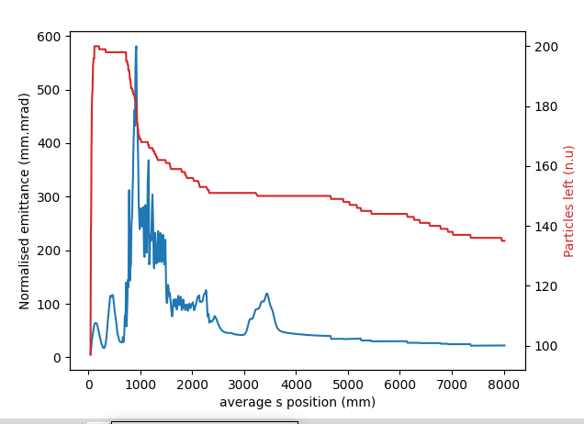
2 coils at 0.1
<number>
9/13/22

Slide 7
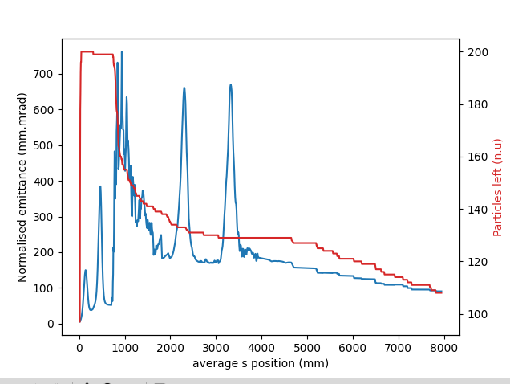
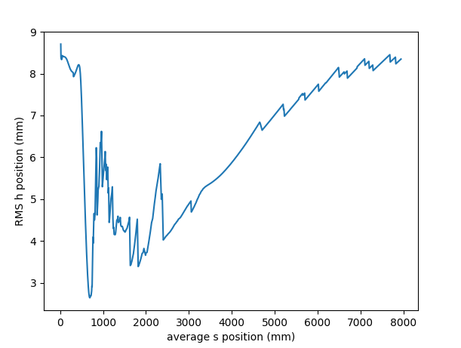
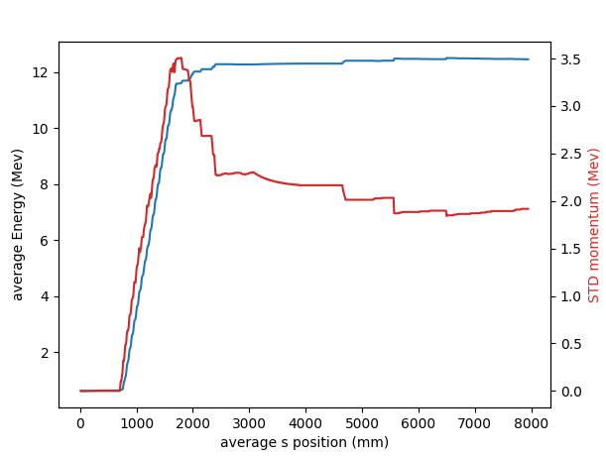
1.3nc bunch with space charge 20mm rms 5mm.mrad
2coils on at 0.1T
<number>
9/13/22

Slide 8
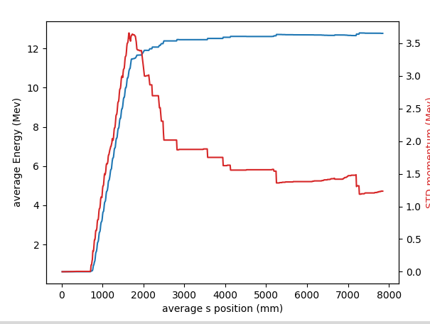
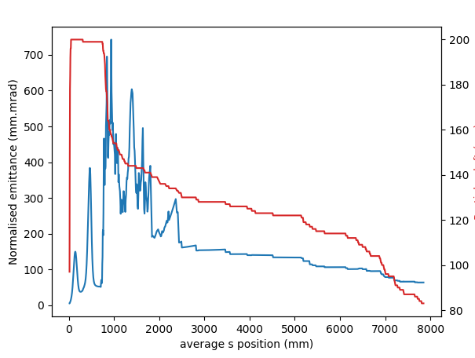
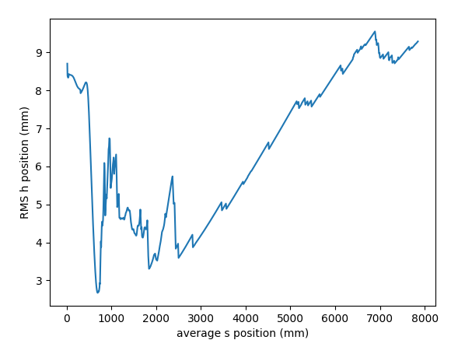
1.3nc bunch with space charge 20mm rms 5mm.mrad no coils.
No foc
<number>
9/13/22

Slide 9
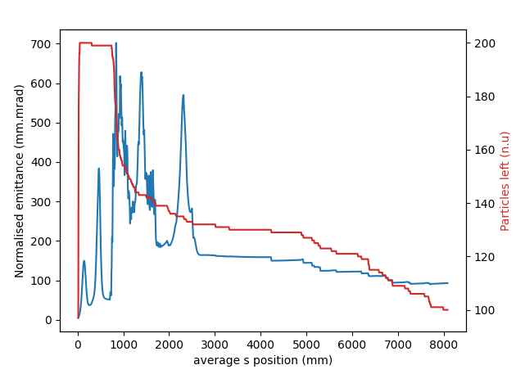
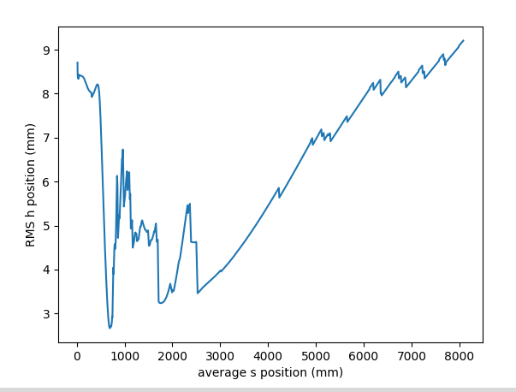
Comme ci dessus + 1 modul de foc
<number>
9/13/22

Slide 10
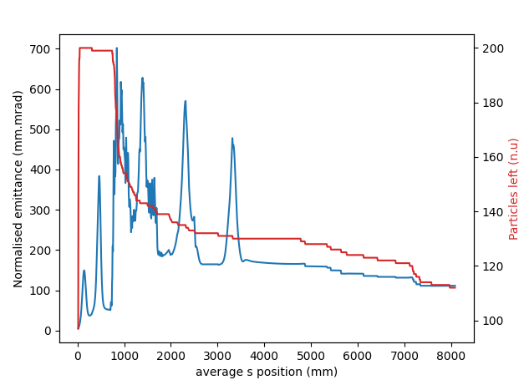
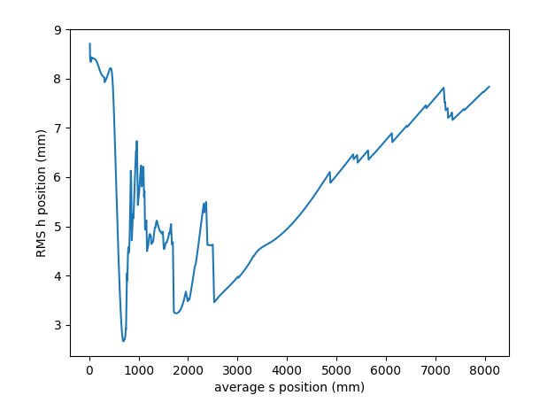
+ 2 modules de foc.
<number>
9/13/22

Slide 11
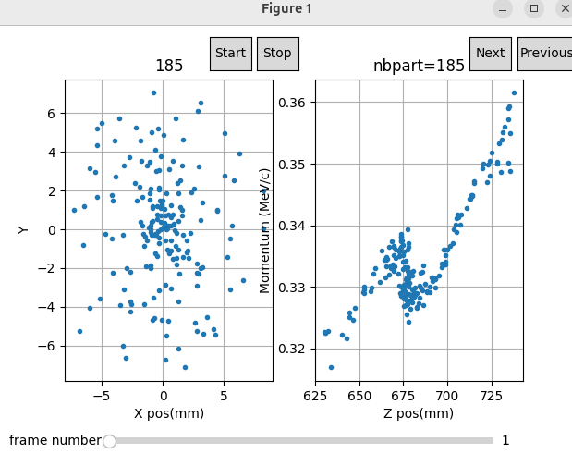
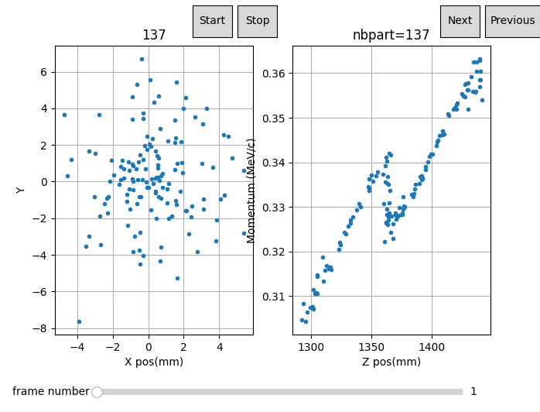
Bunch 20mm, 1.3nc 5mm mrad
Beam distrib at buncher entrance.
New
<number>
9/13/22

Slide 12
Section as drift
With focussing: transmission enhanced by ~20%. (beam size at 8m goes from 8mm to 9.5 rms. For dense bunches.
If no space charge,the effect of the focussing is limitted. size 5 to 4mm, transmission + 4%.
Emittance and Energy spread are same.
If the section is powered, there is no significant difference between the with / without even for the high charge case.
<number>
9/13/22

Slide 13
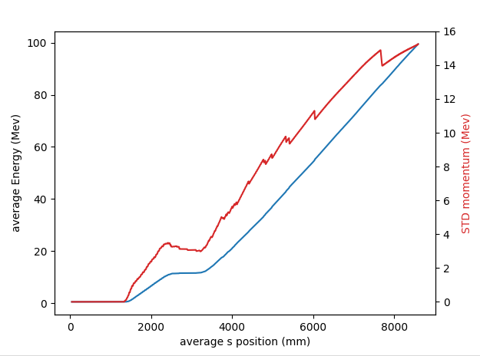
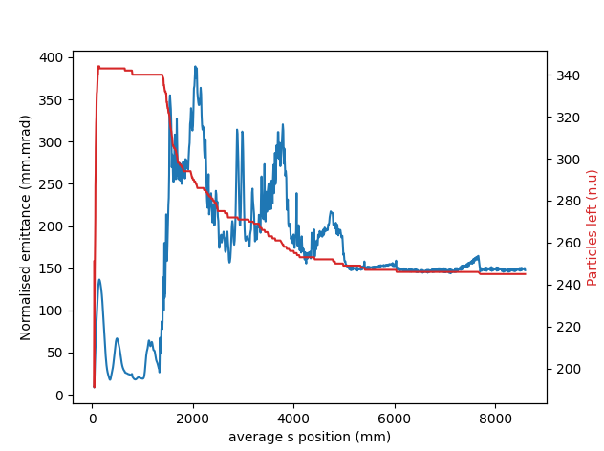
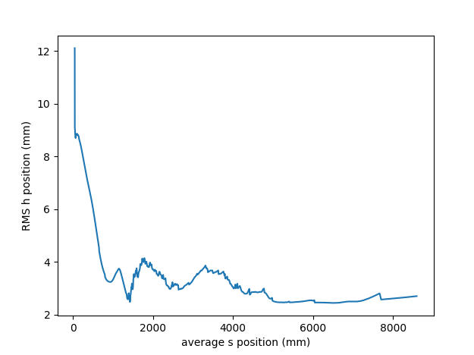
Full linac simulation to compare original set up of 1.4m and 4 coils between gun and buncher
with reduced drift between gun and buncher (2 coils, 750mm)
four coils, dist to buncher 1.4m (present layout), emith=10mm mrad charge 1nc. Bunch length 50mm rms
<number>
9/13/22

Slide 14
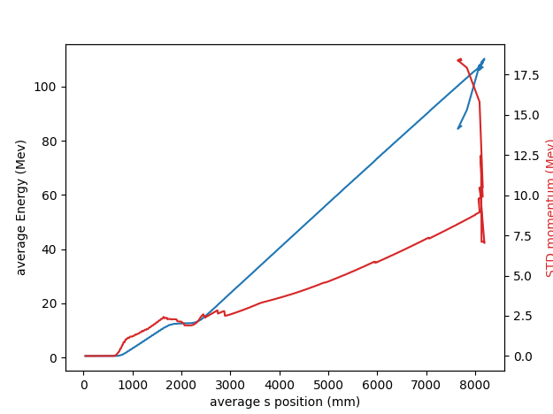
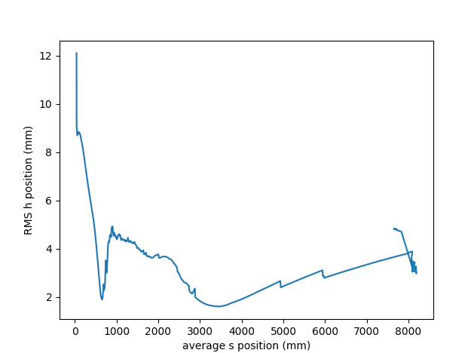
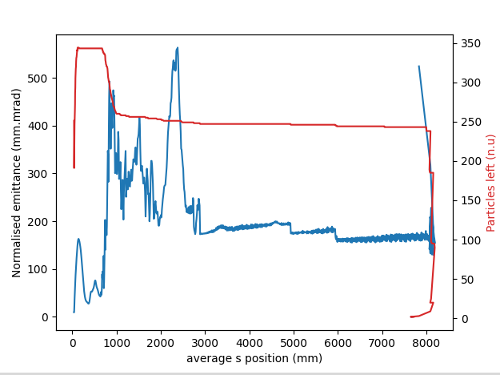
Same as above for optimised layout.
Emittance and transmission are similar, but energy spread is divided by two (7.5Mev compare to 15) in the short gun case.
<number>
9/13/22

Slide 15
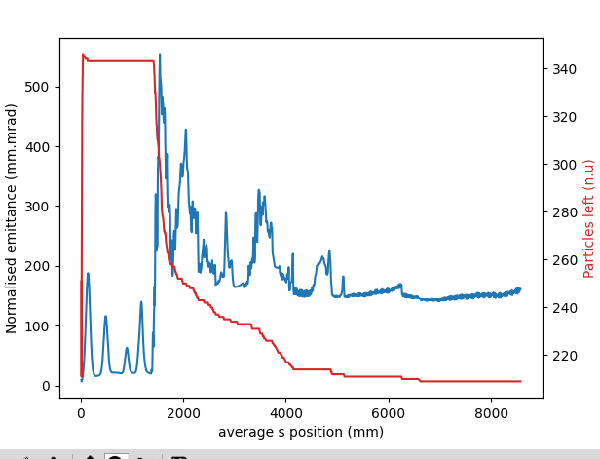
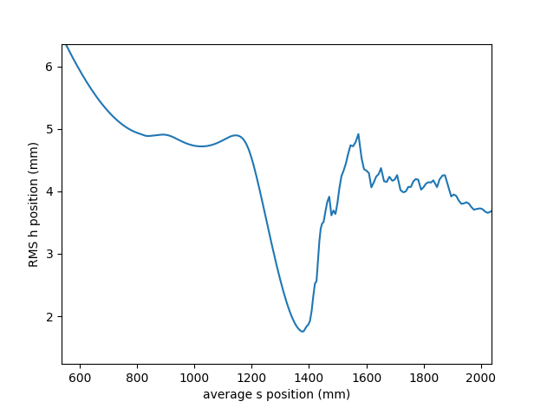
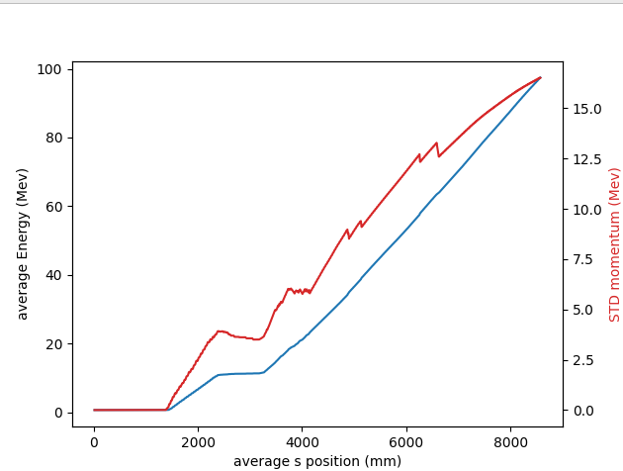
four coils, dist to buncher 1.4m (Badta), emit 10mm mrad charge 1nc. Bunch length 20mm rms
<number>
9/13/22

Slide 16
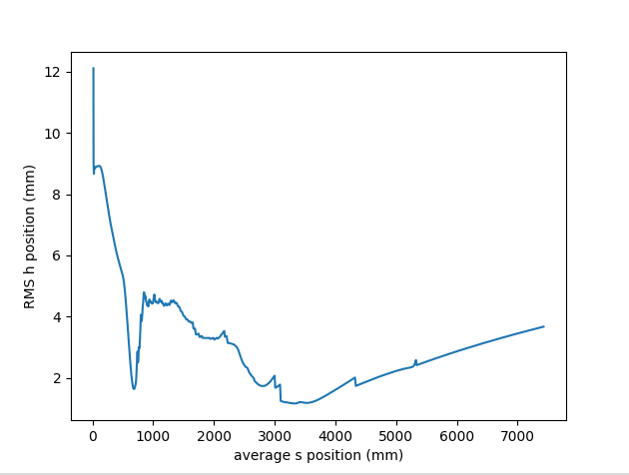
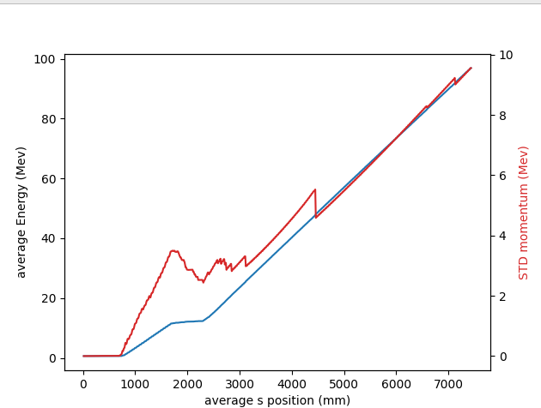
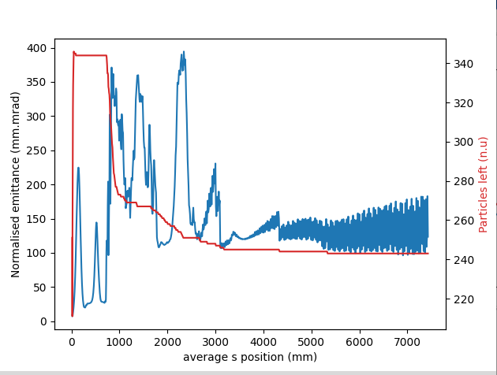
four coils, dist to buncher 1.4m (pesent layout), emit 10mm mrad charge 1nc. Bunch length 20mm rms
Same conclusion with better transmission (+10%).
<number>
9/13/22

