Slide 1
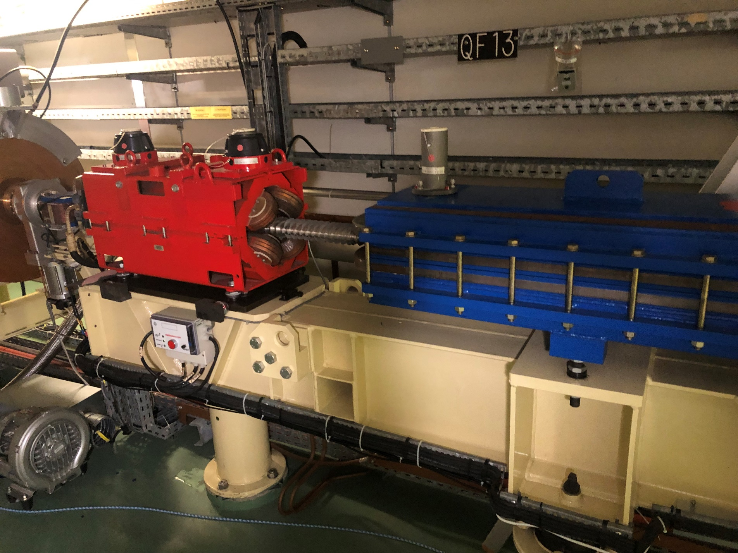
QUAD QF13

Slide 2
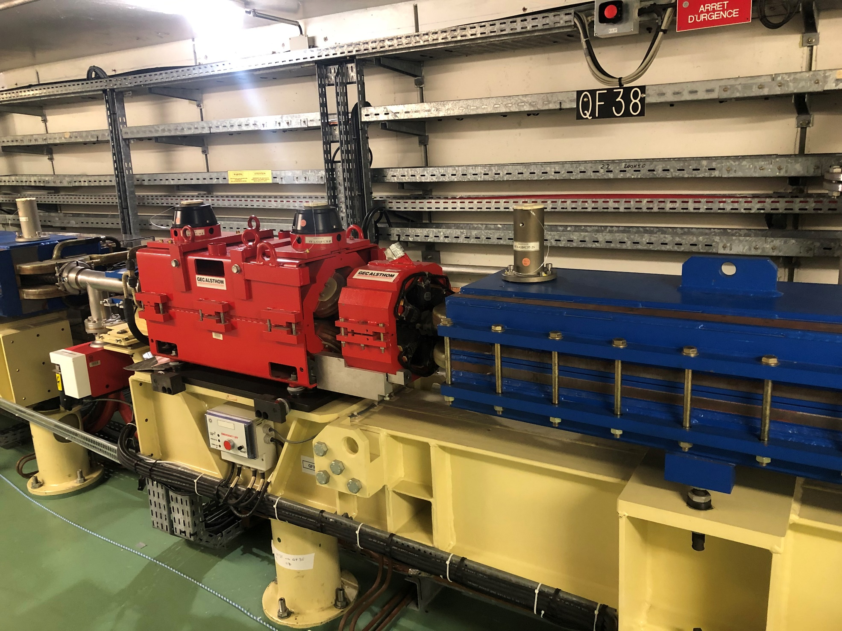
QUAD QF38

Slide 3
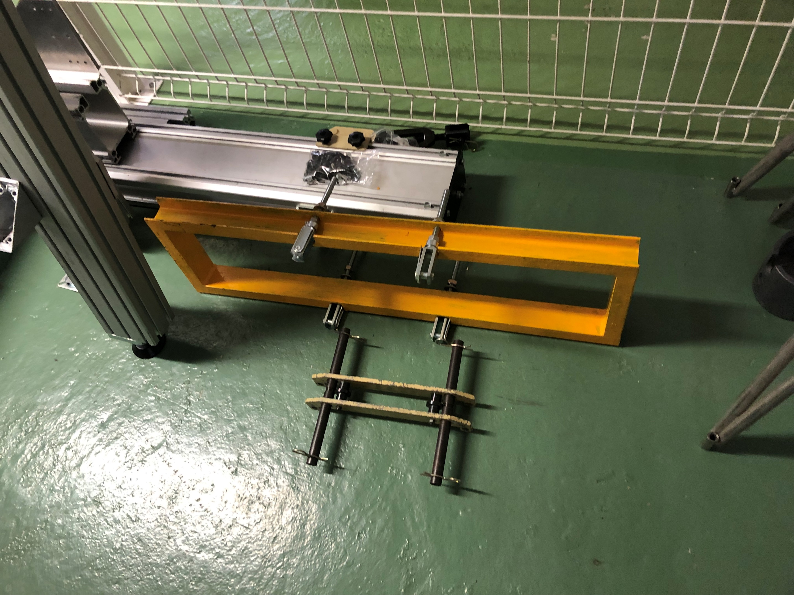
GANTRY and TOOLS in BOOSTER TUNNEL

Slide 4
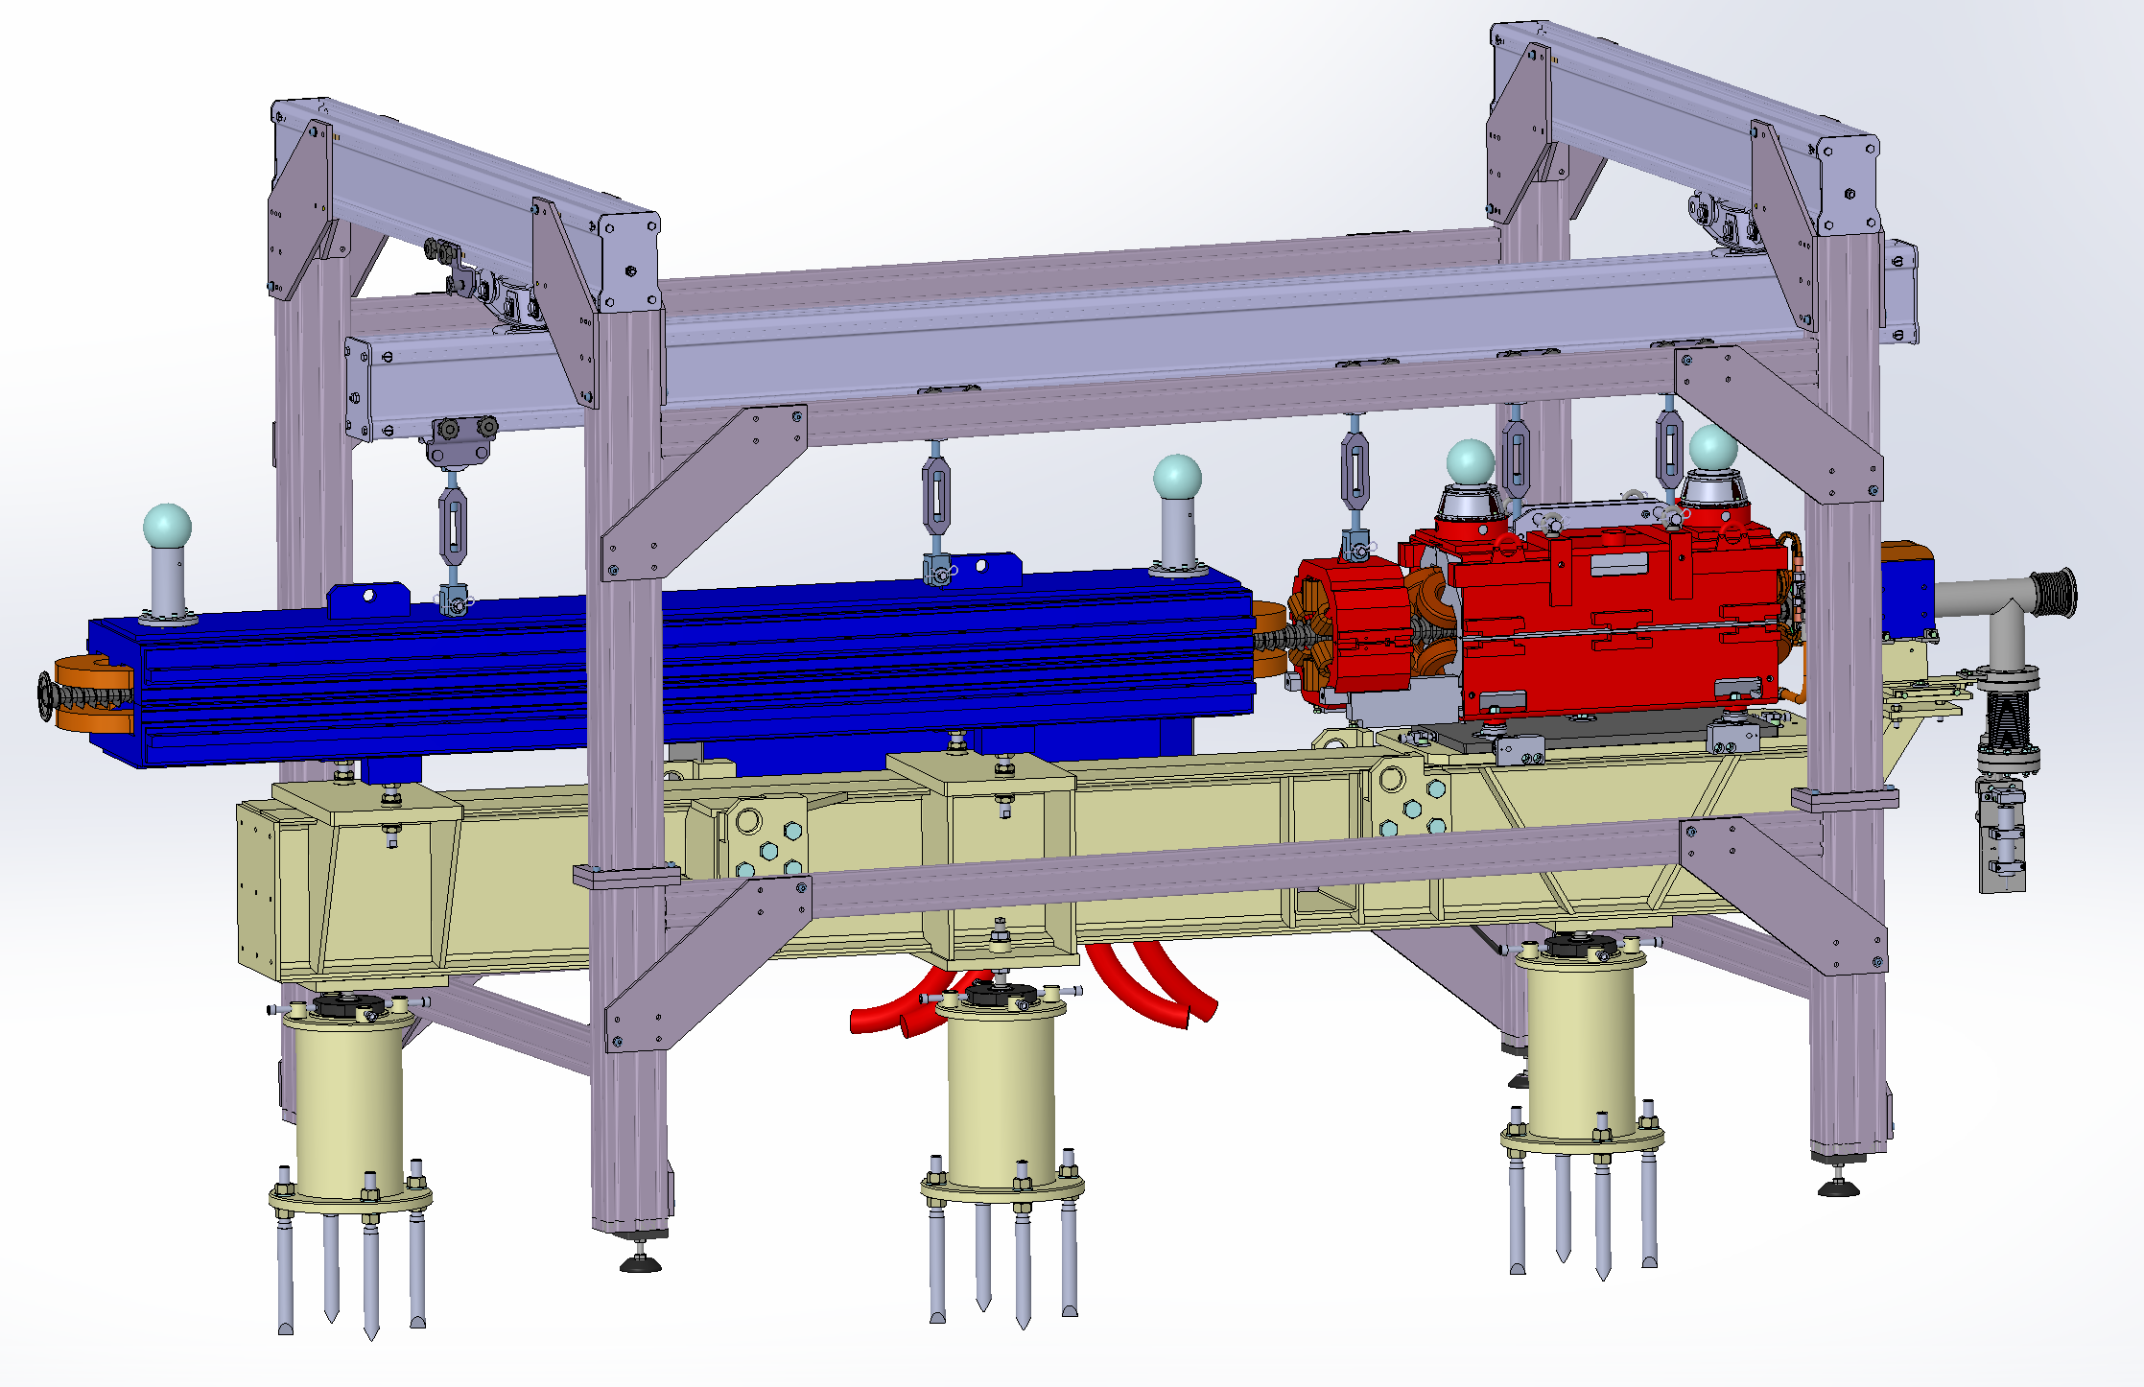
SUMMER SHUTDOWN
Installation of the gantry
disassembly of electrical connections and fluids
tensioning the sextupole (no need to dismantle it)
Installing the tool and remove the upper part of the quadrupole

Slide 5
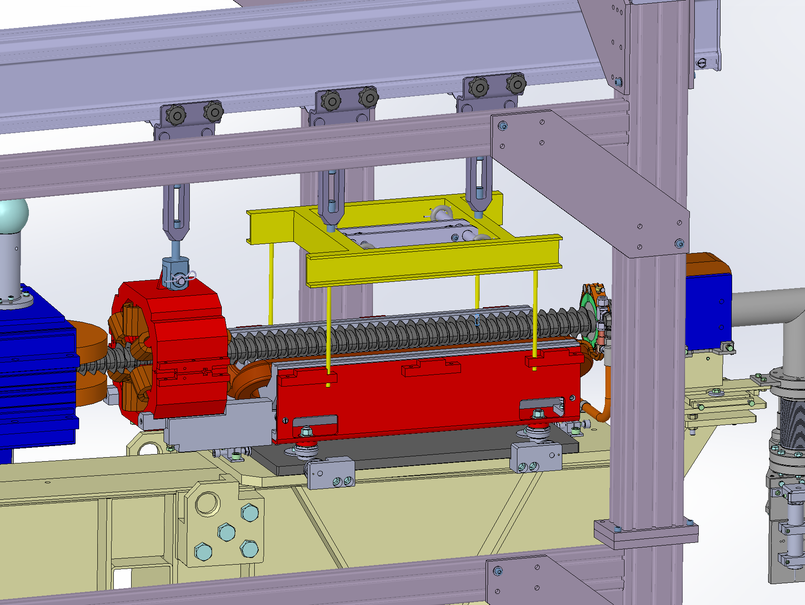
tension the bottom of the quadrupole
with new tools (yellow frame)
Unscrews support of sextupole

Slide 6
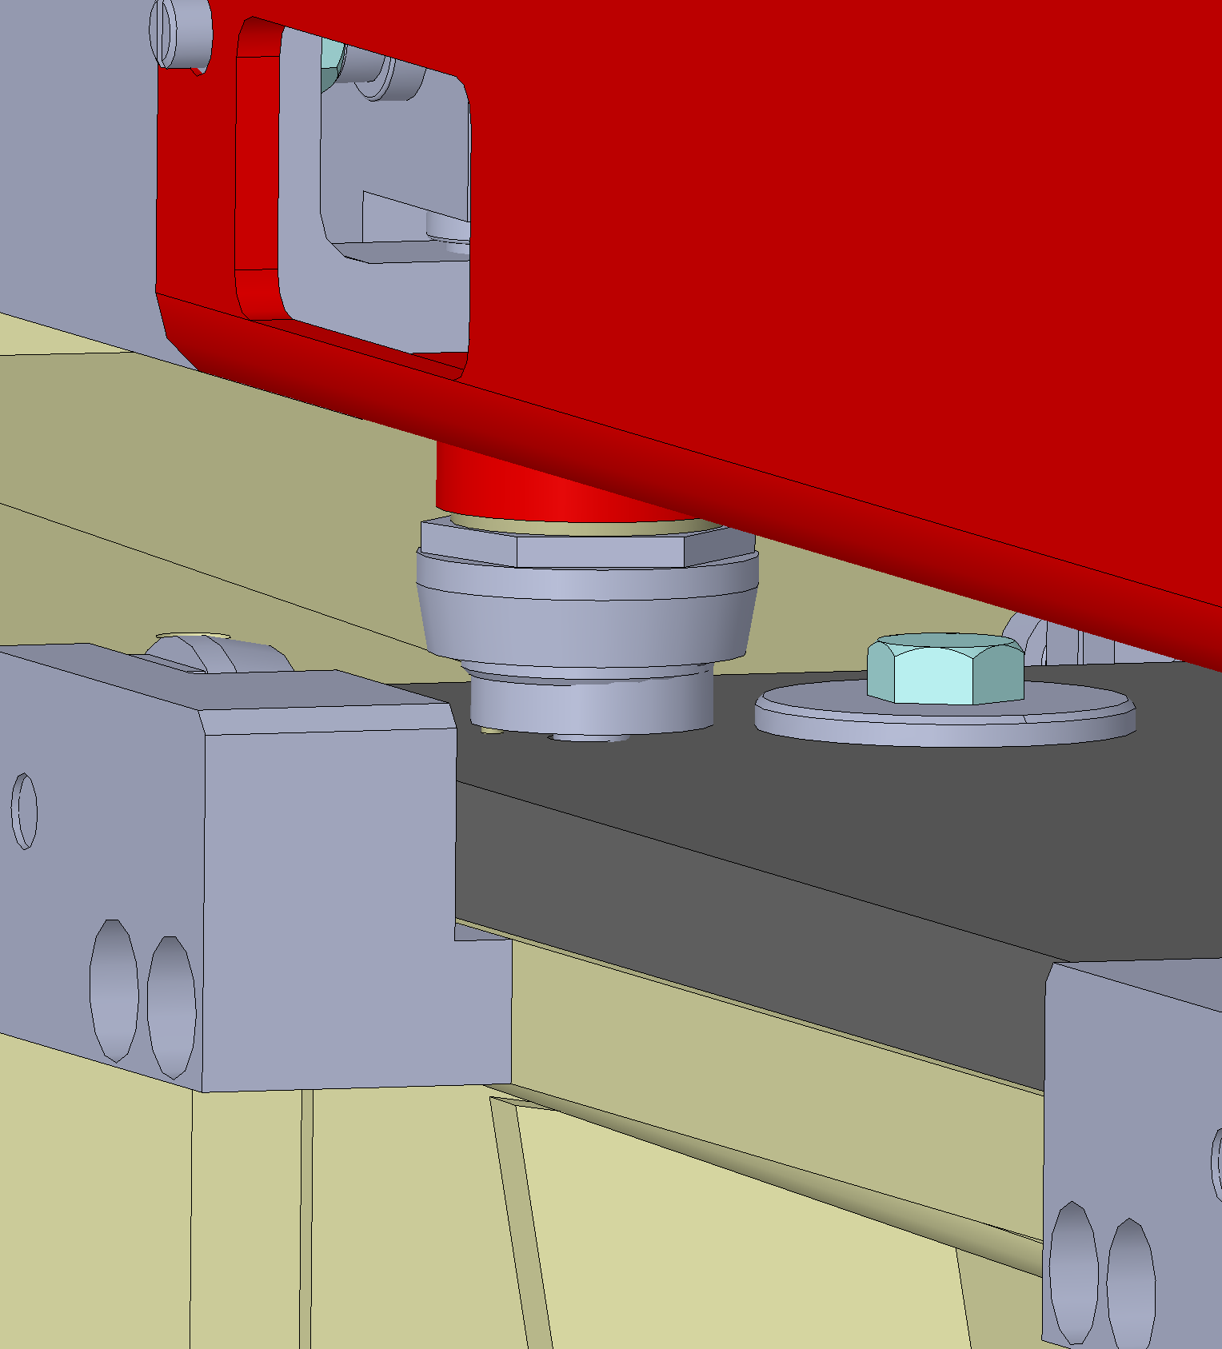
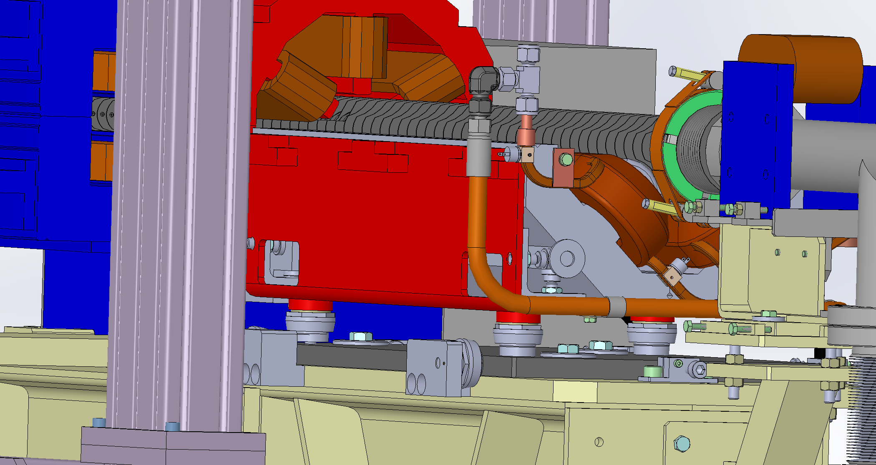
cutting the 3 screws with a saber saw

Slide 7
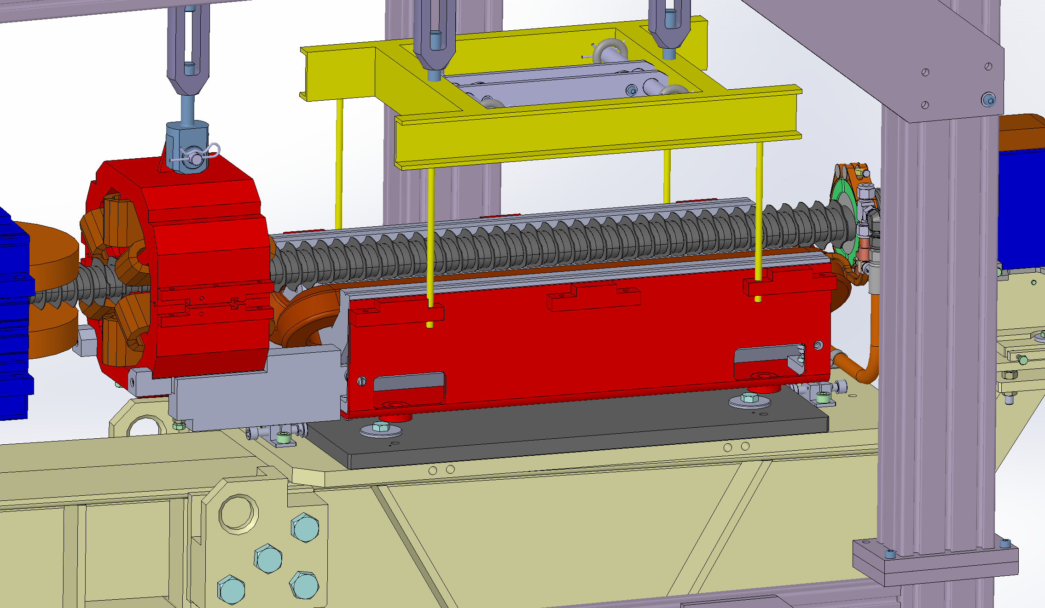
remove the transverse and vertical adjustments
Remove the plate

Slide 8
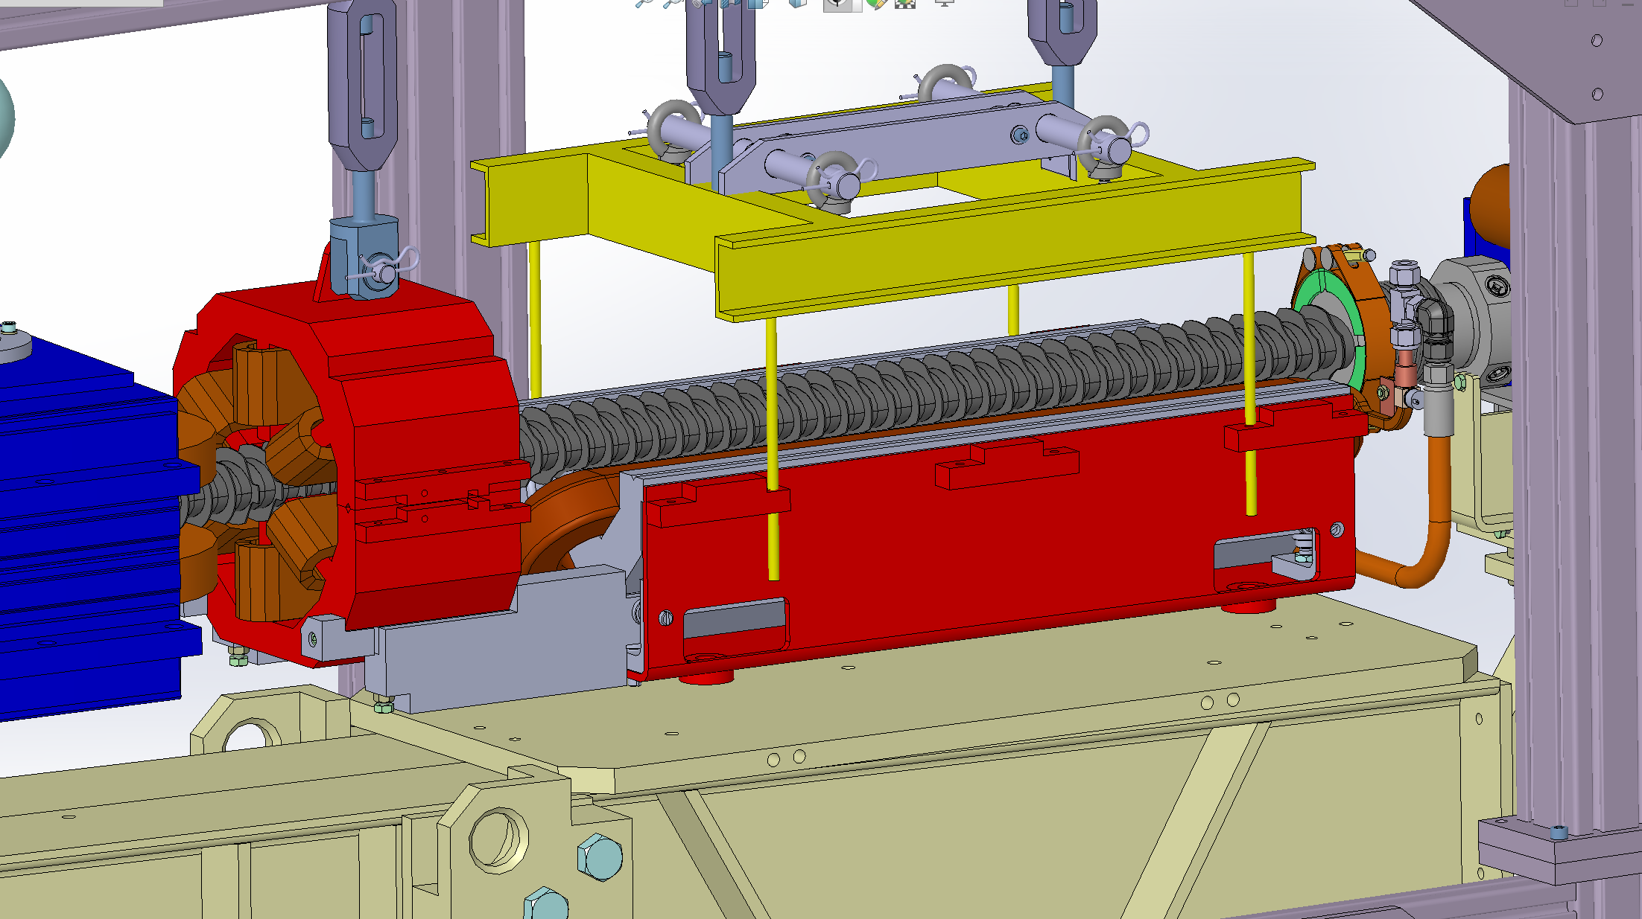
go down and put the quadrupole on the girder

Slide 9
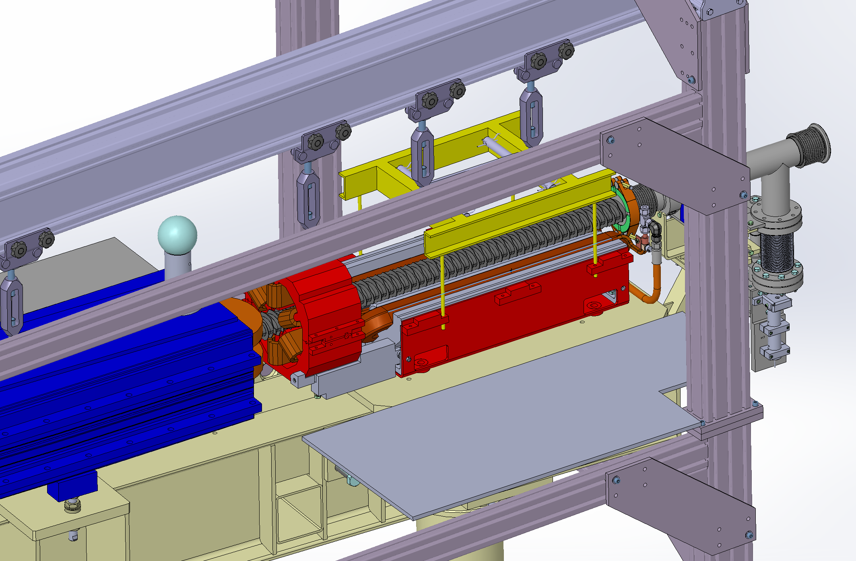
installing a table fixed on the girder

Slide 10
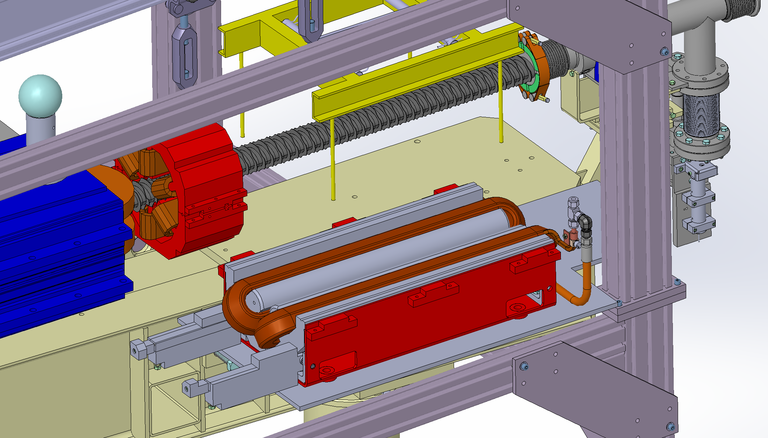
remove the lower part of the quadrupole
remove the 2 supports of the sextupole

Slide 11
install the lower part of the quadrupole spare on the plate
install the 2 supports sextupole

Slide 12
installing the lower part of the quadrupole under the tool
lift the lower part of the quadrupole

Slide 13
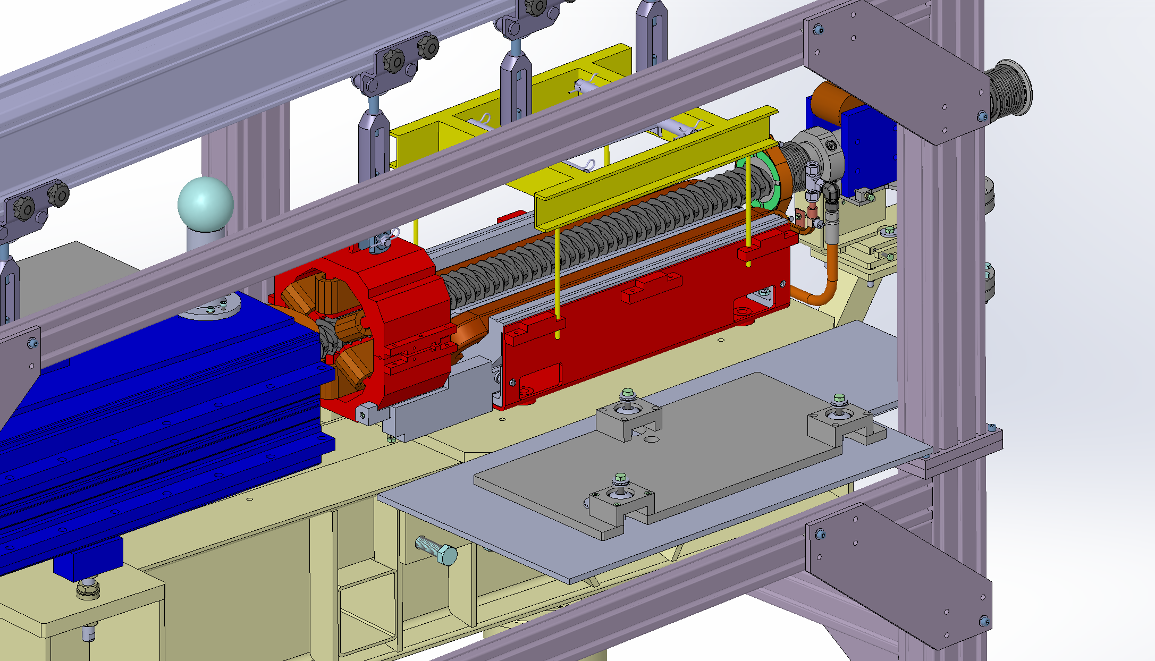
installing a new type of support (same design that for motorizations)

Slide 14
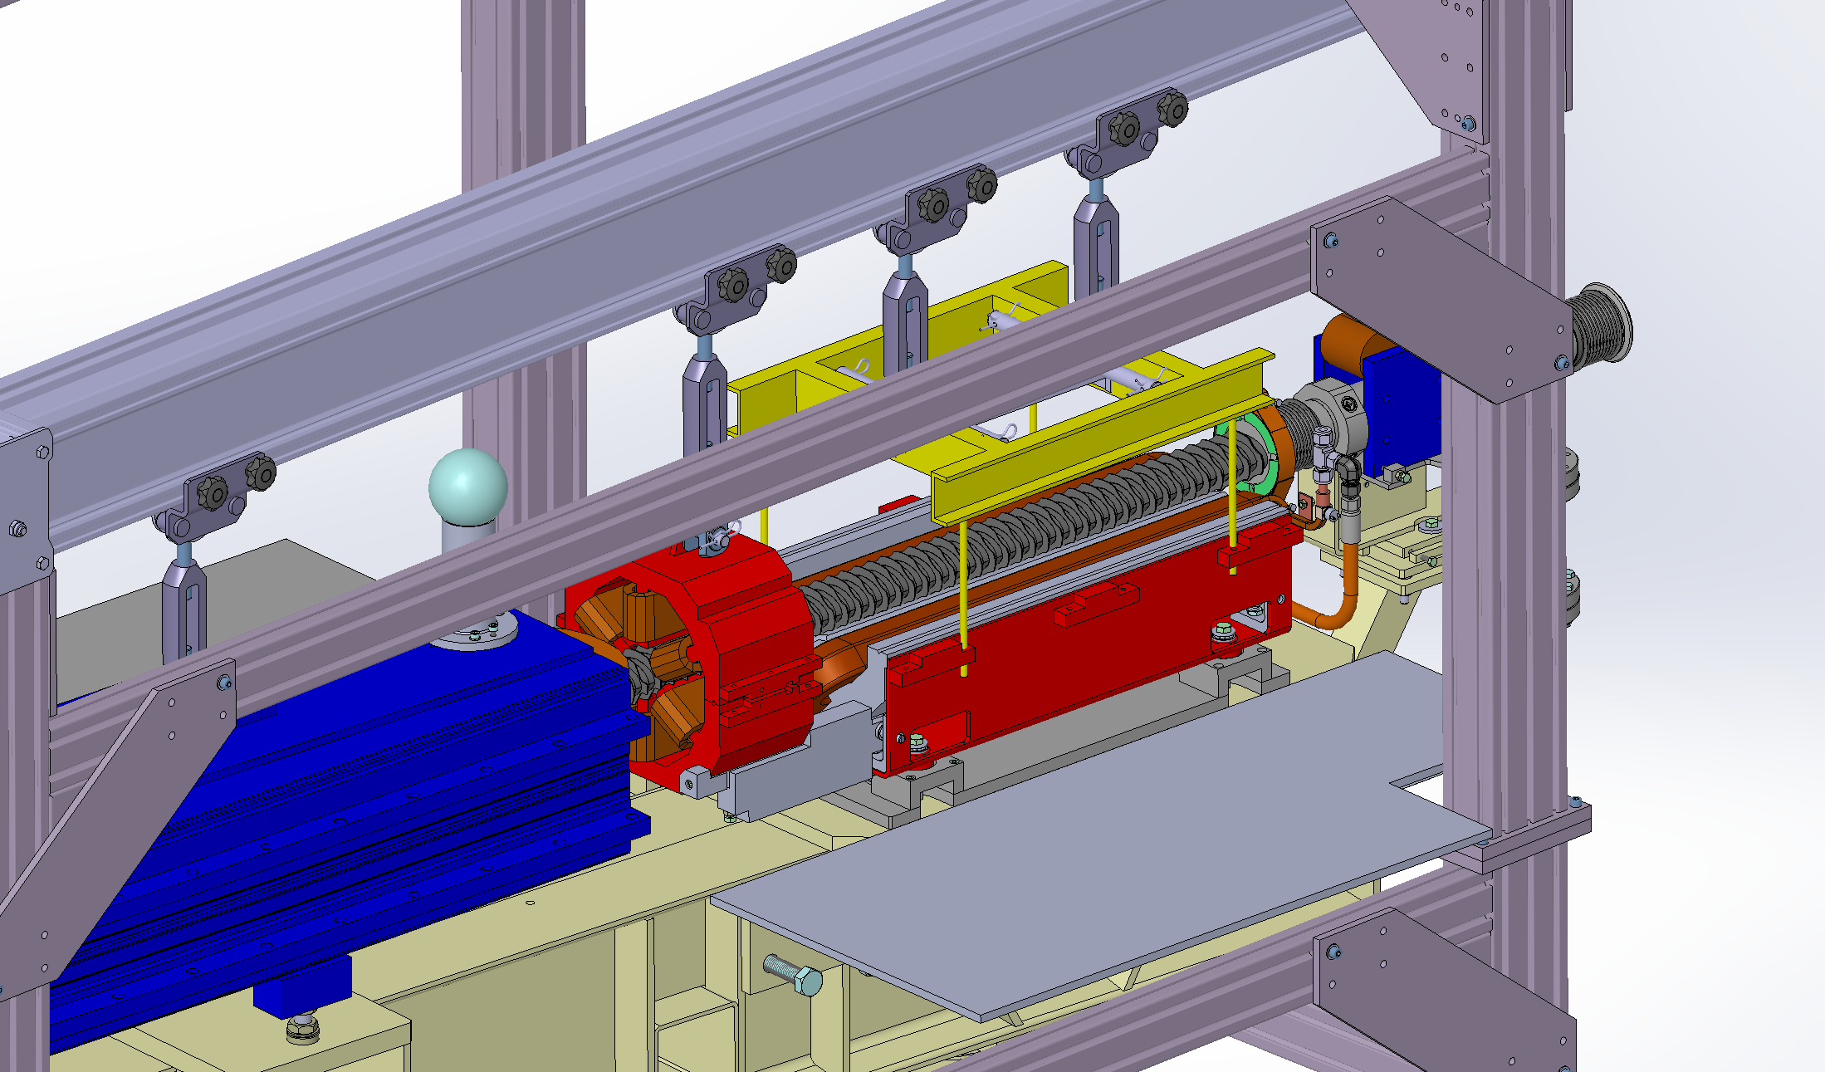
fixing the new support with quadrupole (right height)

Slide 15
Installing the tools and installing the upper part of the quadrupole
Connect electrical connections and fluids
Remove gantry and support
check the position of the quad with the ALGE team

Slide 16
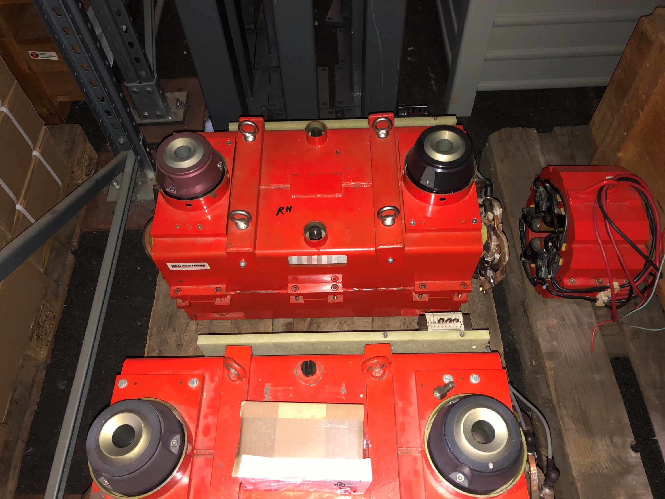
SPARES quadrupoles
RIGHT
RIGHT

Slide 17
QUESTIONS
Nicolas propose QF13 & QF38 (left) for installing spares
Actually 2 right spares
Difficulty in reversing connections, possible or not (Chams) ? (cables length)
No problem for installing gantry
Normally not necessary to break the vacuum (experience of the 12 vertical and horizontal motorizations)
1 vacuum chambers spares 83.41.0001
a team of 3 people N. Benoist,B. Ogier , N, Carmignani (experience of the 12 vertical and horizontal motorizations)
+ 1 people of ID (F. Bidault - refurbishment of the 2 spares)
check the position of the quad with the ALGE team before ?
check the position of the quad with the ALGE team after

