Slide 1
Booster light upgrade
24th March 2025
Nicola Carmignani

Slide 2
outline
Error simulations
Extraction
Timeline of the project
Preliminary design of the magnets (Chamseddine)

Slide 3
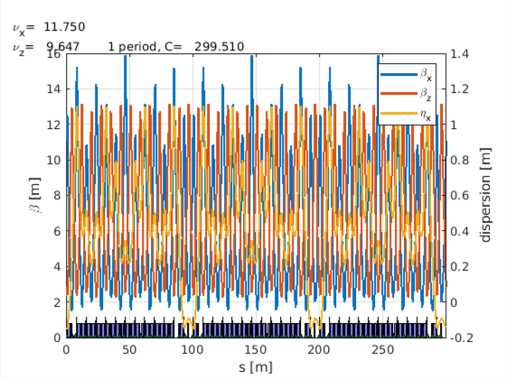
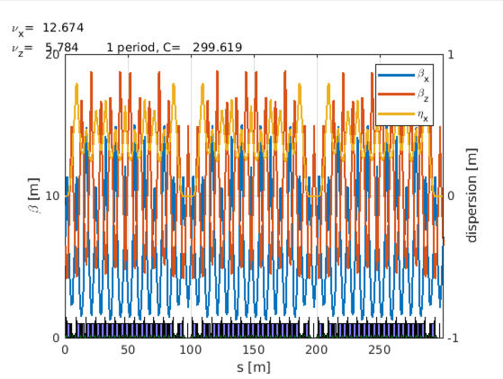
light upgrade of the booster
The number of quadrupole families will be increased from 2 to 5 to reduce the horizontal emittance and the bunch length.
The three additional families have 6 QF each, so we need to have 21 new magnets (one spare per family).
39 QD, 21 QF,
6 QF1, 6 QF2, 6 QF3
ε_{x} = 59.6 nm
BL = 19.9 mm
Present lattice
2 quad families
39 QD, 39 QF
ε_{x} = 83.1 nm
BL = 22.6 mm
New lattice
5 quad families

Slide 4
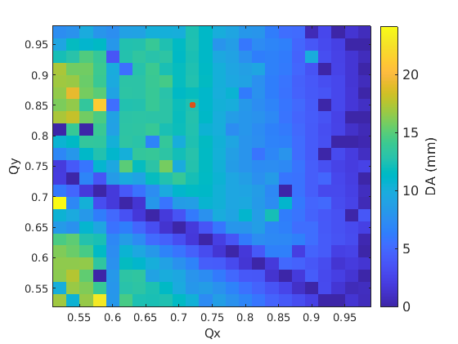
Tune scan old lattice and new lattice
DA Present lattice
DA New lattice
The dynamic aperture of the present lattice is larger (20-25 mm instead of about 12-14 mm). In the new lattice, we can see a resonance line where DA is zero: Qx+2Qy.
We have to be more careful choosing the tunes in the new lattice to avoid the resonance.

Slide 5
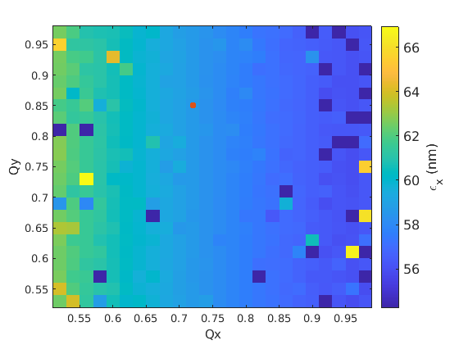
New lattice Tune scan
With the nominal tunes of Q_{x} = 12.72 and Q_{y} = 5.85, the horizontal emittance is
ε_{x} = 58.6 nm.
In the present lattice, ε_{x} is about 85 nm.
Emittance
Dynamic aperture

Slide 6
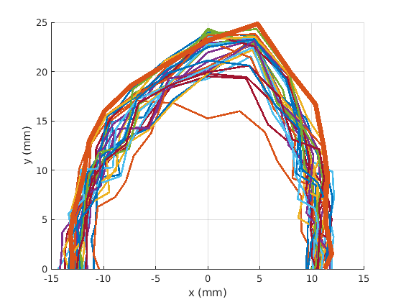
Effect of random errors
Random errors (misalignments and quadrupole gradient errors) added on the new lattice without and with orbit correction
No orbit correction
With orbit correction

Slide 7
Effect of Systematic errors on Emittance
A systematic shift of the 18 quadrupoles is added (± 3%) to see the effect on emittance and bunch length.
No random errors added here.

Slide 8
Effect of Systematic errors on Dynamic aperture
A systematic shift of the 18 quadrupoles is added (± 3%) to see the effect on the horizontal dynamic aperture. Error bar is std of 3 error seeds.
At +2 % of systematic error, the machine gets instable when random errors are added.

Slide 9
Extraction
Blue line is a closed bump with B1, B2 and B3 of 20 mm.
The red is the trajectory with KE at its maximum current (1 mrad angle).
With the new lattice, the displacement at SE1 is 9.2 mm instead of 9.9 mm.
A stronger KE would be beneficial, but extraction with 10 % lower KE is possible with the present lattice.

Slide 10
Timeline of the project
Beam dynamics simulations: now to March 2025
Design of new magnets: March-April 2025
Magnets drawings: may 2025
Launch of CFT: June 2025
Measure the 2 spare magnets: July-August 2025
Exchange 2 quadrupoles of the booster with the 2 spares: August 2025 shutdown
Measurement of the 2 quadrupoles from the booster: September 2025
Signature of the contract, with precise gradients defined: September 2025
Measurement of first prototype: September 2026
Launch of series production: October 2026
Measurement of 20 more quadrupoles: June-July 2027
Installation: August shutdown 2027

Slide 11
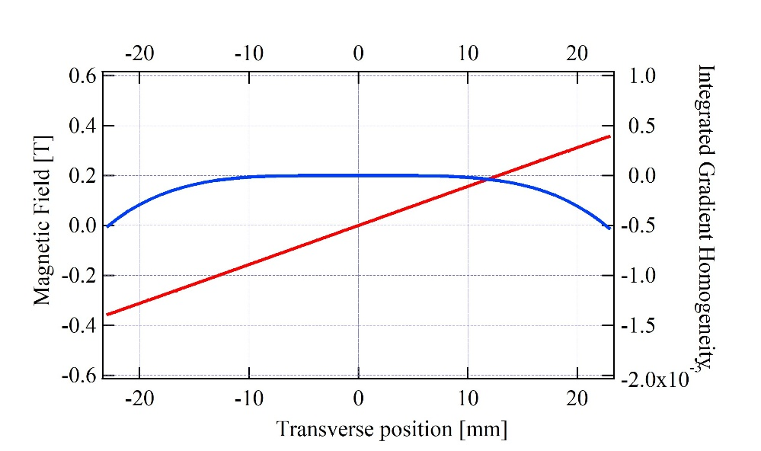
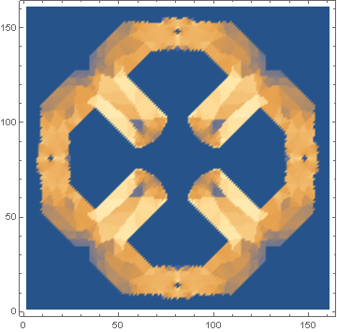
Injection upgrade magnets (Chamseddine)
Magnet | Length (mm) | Int. G (T)
QFs | 600 | 9.751
QF1 | 575 | 9.367
QF2 | 550 | 8.982
QF3 | 500 | 8.214
Radia
Gradient G = 15 T/m
GFR at 23 mm
Bore = 60 mm
Coil with 12 turns
Current = 481 A
Electric Steel lamination

