Slide 1
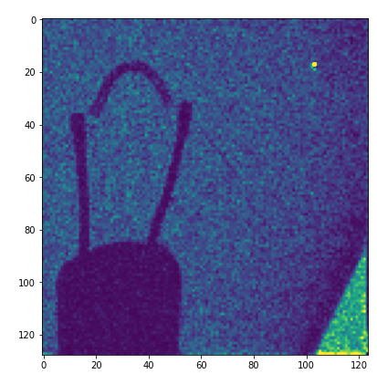
Characterizing electron-collecting CdTe for use in a 77 ns burst-rate imager
Lena Franklin
September 21, 2023
Lightbulb filament radiograph with e- CdTe detector
Notes:
Look at other speakers too
Slide discussing depolarization

Slide 2
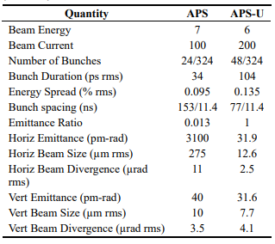
Motivation: APS Upgrade
Advanced Photon Source (APS) at Argonne National Lab upgrading
Reduced emittance, increased brightness
154 ns to 77 ns bunch spacing
Once per bunch imaging requires new detectors
Faster time-resolved experiments
Applications: protein dynamics, materials science (shock physics, crack propagation), etc.
R. Hettel, "Status of the APS-U Project." 12th Int. Particle Acc. Conf. (2021).
Notes:
Upgrades
Time resolved studies

Slide 3
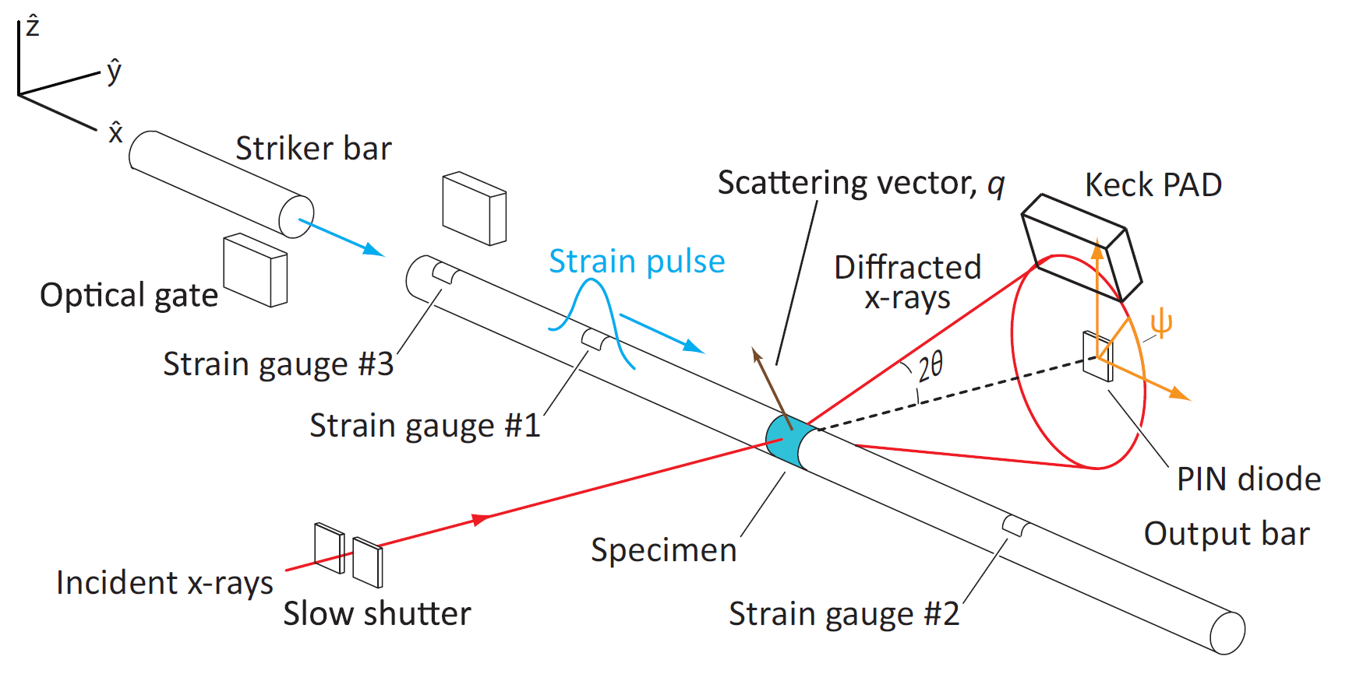
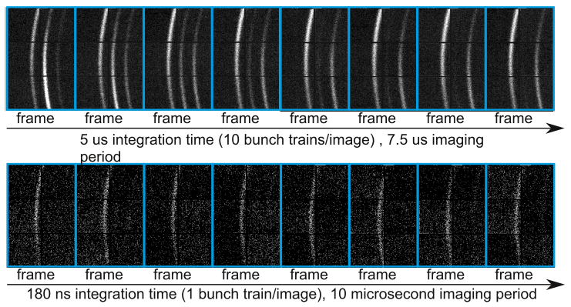
Single Bunch Imaging
Single bunch imaging example: diffraction patterns of metals under high strain rates
Husted et al, Rev. Sci. Intrum. (2018)

Slide 4
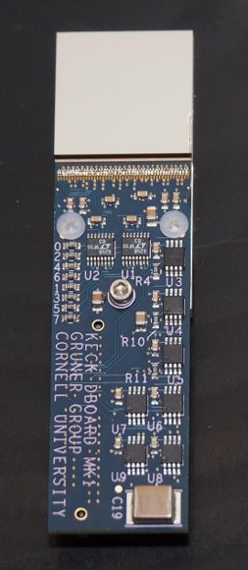
Detector Goals
Goal: 77 ns burst x-ray imaging at 40 keV
Fast electronics under development
High-Z sensor material with fast charge collection
Simulations suggest 750 µm e- CdTe is fast enough
This talk: real-world sensor properties tested using pulsed laser and single x-ray bunches
Notes:
40+ keV
Detector requirements
Material and simulations
Talk summary

Slide 5
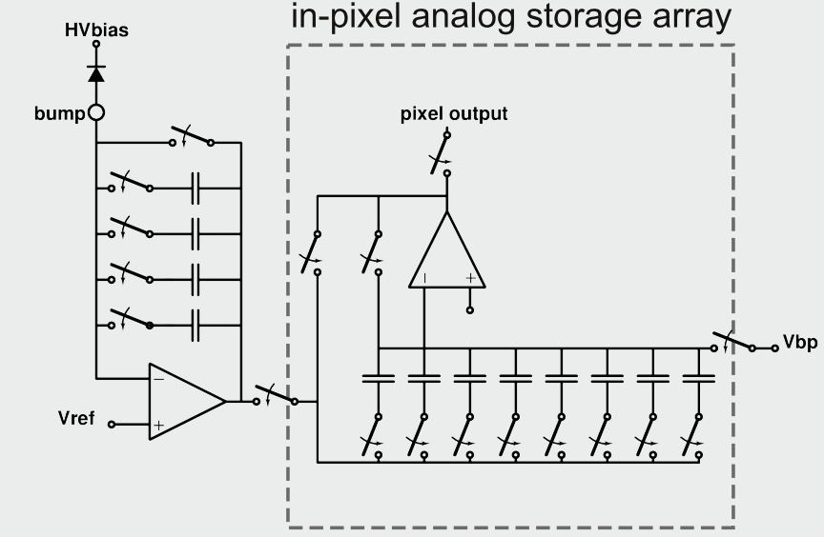
Testing on Keck Pad Platform
Sensor: 750 µm e- Schottky CdTe from Acrorad
ASIC: Keck PAD – 8 frame burst imager, 128x128 150 µm pixels
ASIC designed for 154 ns imaging
Pixel ASIC
Integration capacitors
X-rays
Pixel array detector (PAD):
Semiconductor sensor bonded pixel-by-pixel to custom readout ASIC
Modified from [4]
Storage capacitors
From [3]
Notes:
Group developed many ASICs, one is KECK
KECK history and specs
detail on circuits: charge integration amplifier, selectable gain, etc.
New electronics

Slide 6
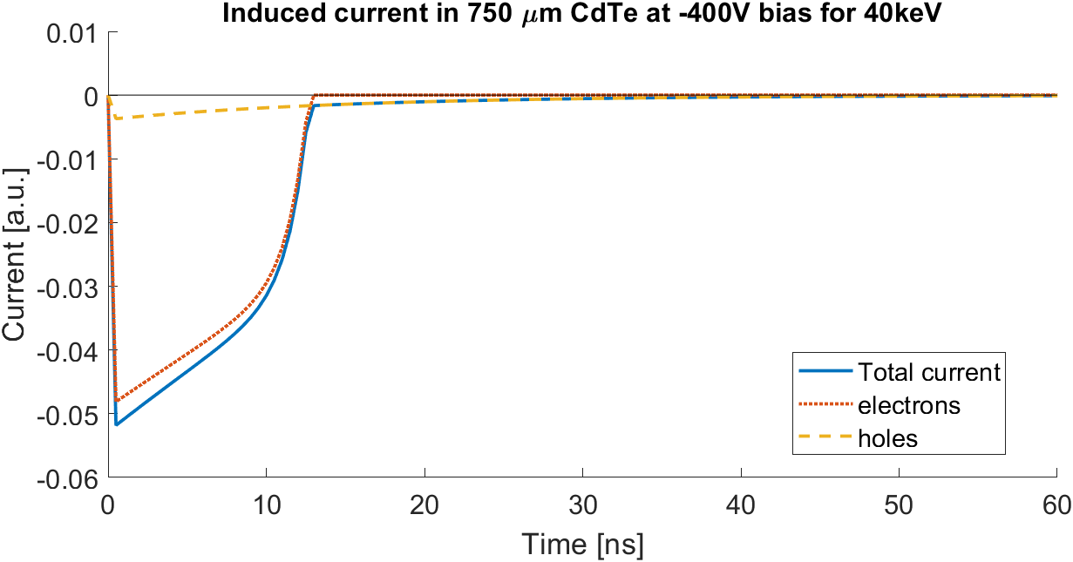
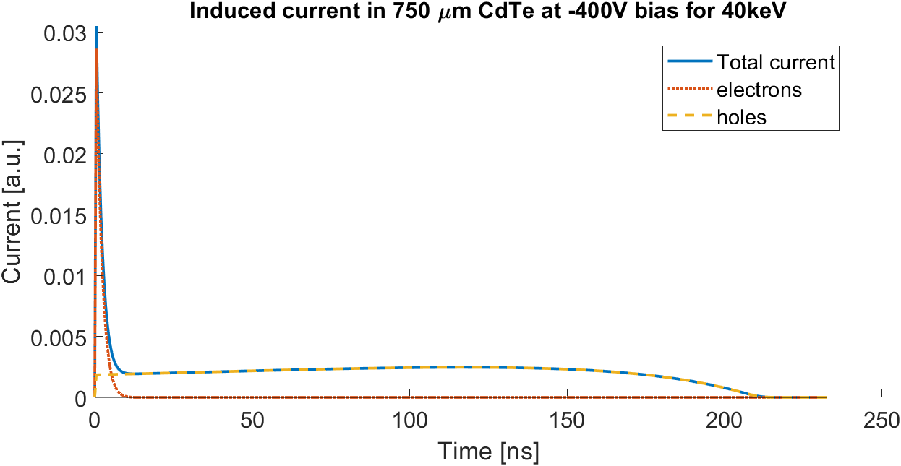
Detector Speed and Induced Current
Electron collecting simulation
Current pulse < 50 ns
Detector speed limited by the duration of the current pulse
Goal: 90% of induced current in 35 ns
x-rays
Lower energies are faster in e- CdTe
x-rays
h+
h+
40 keV
Hole collecting simulation
Current pulse > 200 ns
e-
150 keV
e-
ASIC side
1/e length 40 keV = 90 µm
750 µm CdTe used due to availability
Notes:
Can do two plots, one with both e and h to show differences
Mention that the total integral of the current needs to happen in ~35ns, could be helpful to show the integral
integrate + electronics in 77ns
35 ns for integration, 90% CC
Induced current due to holes + electrons, comment on speeds
Lower energies better in CdTe

Slide 7
Measuring Induced Current
Detector triggered with variable delay from photon pulse
Integration window is "scanned" through induced current pulse
Current Pulse
Integration window
X-Ray Burst, Laser pulse, etc.
window 1
window 2
window 3
Notes:
Need to understand induced current – but it happens faster than 100ns integration time
Soln: many images at different phases, can back out characteristics of the current

Slide 8
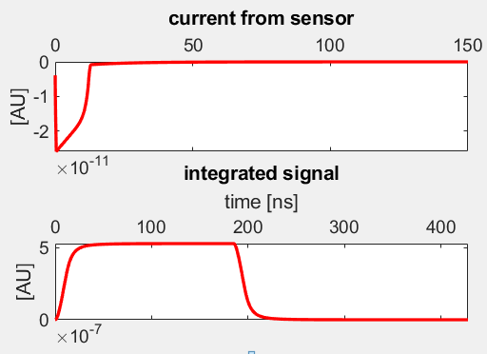
Measuring Detector Speed
Simulation e- CdTe
40 keV photons, -400V bias, 200ns integration
Result compared with MATLAB simulations
Simulates induced current and integration process w/detector electronics
Charge collection time from rise/fall times of the curve
Simulation of the induced current (top) and the result of scanning an integration window through
Notes:
What this integrated curve looks like in practice
2 ways to study – rise/fall times, will look mostly at fall times in this prez
Compare with a simulation, describe

Slide 9
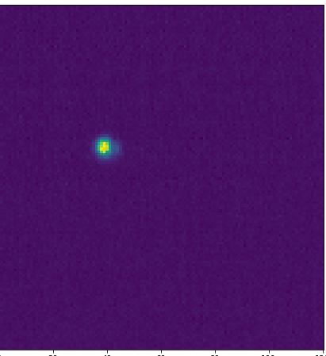
Extracting Mobilities using Pulsed Optical Laser
Partially reflective mirror
Laser & variable attenuation
Detector
Phase between laser pulse and beginning of integration measured on oscilloscope
Delay generator
Fast photodiode
Pulsed femtosecond laser generates e/h pairs in the sensor
Optical frequencies equated to x-ray energies by matching attenuation lengths
Extreme attenuation lengths used to study charge carrier mobilities
515 nm: conversion near top of sensor, can extract electron mobility
1030 nm: uniform conversion, can extract hole mobility from tail. Slowest case for detector behavior.
Integration is triggered by previous pulse + a variable phase delay
Oscilloscope
Integration region >> sensor thickness
Notes:
Early testing w/ optical laser – goal was to find electron hole mobilities
We need pulsed source for testing
Optical frequencies induce e/h pairs
Optical to x ray
In this test we use femtosecond laser (Explain setup)
Integration region >> thickness!
515 vs 1030nm

Slide 10
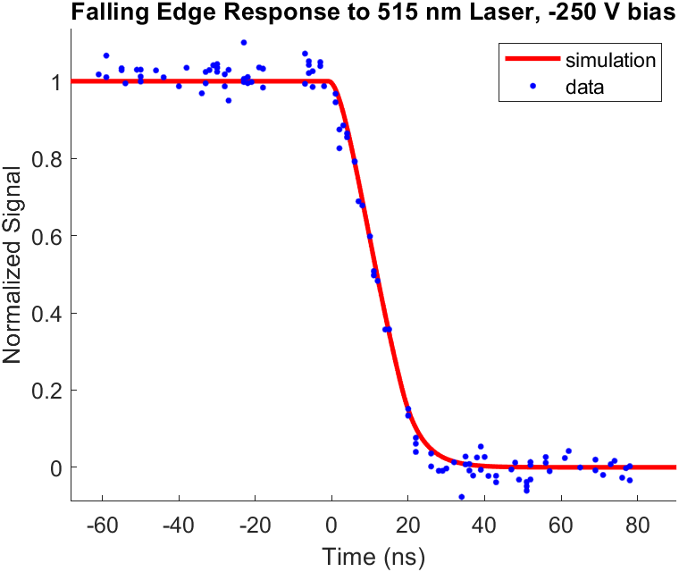
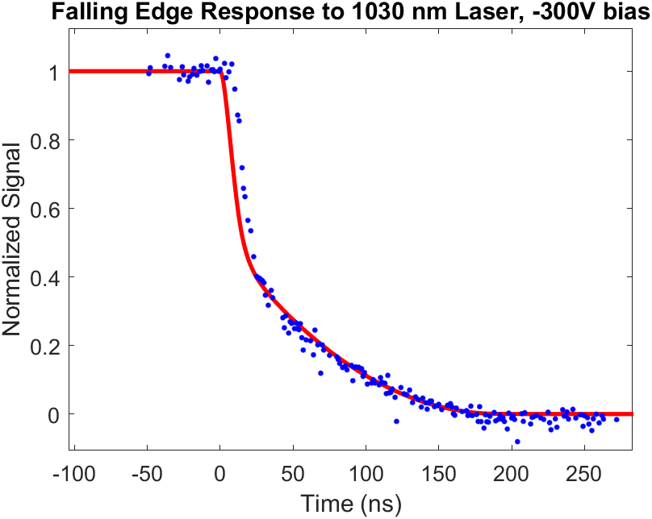
Carrier Mobilities
The measured electron and hole mobilities agree within uncertainties to expected values for CdTe (see [5]).
Photons convert at the top of the sensor, signal is due to electrons. Electron mobility of 990 ± 100 cm²/(V⋅s) at 0C.
Other sources report 850-1100 cm²/(V⋅s) for CdTe.
Only holes contribute to the tail past ~35ns. Hole mobility around 100 ± 15 cm²/(V⋅s) at 0 C. Other sources report 80-110 cm²/(V⋅s) for CdTe.
Notes:
515, 1030
1030 is worst case
Goal: appx value
Agree with expected, supports simulation

Slide 11
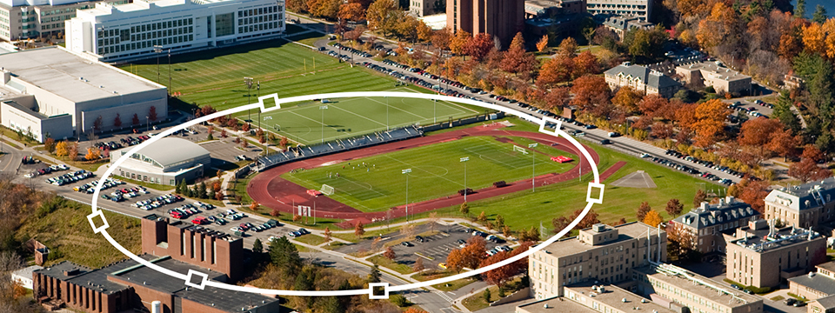
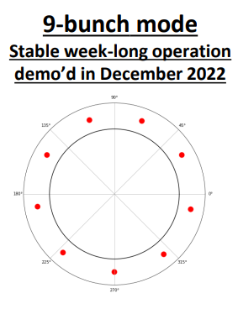
Single bunch x-ray testing
X-ray testing at Cornell High Energy Synchrotron Source (CHESS)
Primary energy ~29.2 keV, attenuated beam used to study higher energy behavior
Periodic signal – e.g. synchrotron ring clock
Oscilloscope
Frame timing information
Delay generator for hardware triggering
KECK Pad
HW trigger
Bunch spacing ~280 ns
Bunch length ~83 ps
Notes:
X rays important b/c fluorescence
CHESS @ cornell
Bunch spacing and triggering scheme
Energies used, sharing time

Slide 12
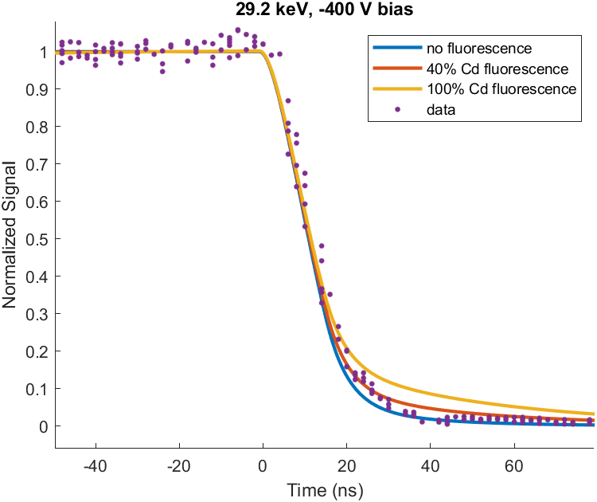
29.2 keV Testing
Scattered Photons
Detector
Main Beam
Aluminum Scatterer
Scattered beam isolates 29.2 keV
e- CdTe requires <35 ns for 90% charge collection at 29.2 keV, –400V bias
X-ray fluorescence slows charge collection
Cd K-α edge at 26.7 keV
29 keV photons convert at 1/e = 72 um
23 keV fluorescent photons create holes deeper in the detector, 1/e = 120 um
Notes:
Fluorescent photons have > atten length than primary
Scattered
X-ray fluorescence is bad
At 29.2, Cd fluoresces
Resolution, speed
Plot, effects of adding fluorescence
Still achieves timing requirements

Slide 13
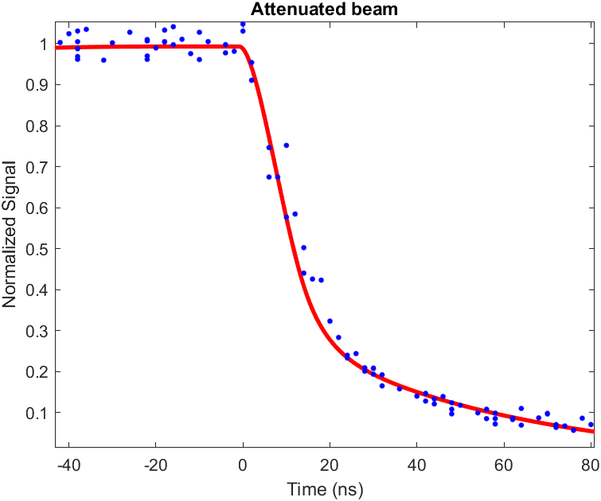
Higher Energy Testing
Attenuated beam, mostly harmonics
Main Beam
Primary 29.2 +
Harmonics
5 mm steel
29.2 keV trans. ~10⁻¹⁶
Detector
29.2 keV attenuated out of main beam, higher harmonics are used to study higher energy behavior
83% of signal occurs in 35 ns, 90%+ should be possible at 40 keV
Approximately
67% N=2→58.4 keV
20% N=3→87.6 keV
13% N=4→116.8 keV
Beam composition estimated from scattered photons
Notes:
Beam composition estimated from spectra of scattered photons.
Labels on axes bigger, title B (for all plots), include voltage (go through whole presentation)
See if I can get a spectrum to show on slide
Attenuated out 29.2 keV
Used scatter to determine the beam composition
At these energies, 83% in 35 ns
At lower energy (faster behavior), 90% is possible
CONCLUSION: 750um CdTe is fast enough

Slide 14
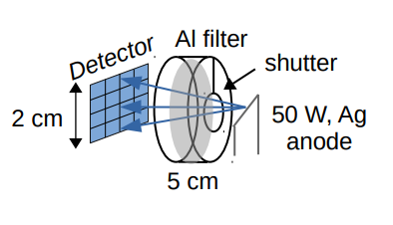
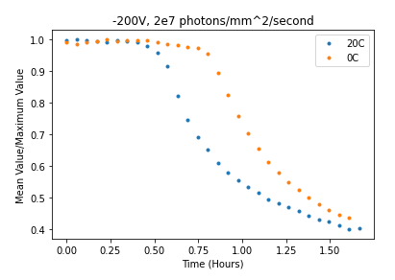
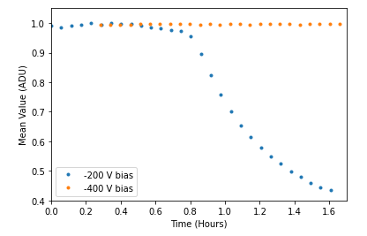
Sensor Polarization
Dosing leads to decreased sensitivity and uniformity
X-ray source: Al filtered Ag x-ray tube
Results similar to h+ CdTe (see [6]), polarization is slowed by
Lower temperatures
Higher bias voltages
Polarization and Temperature at –200 V
Polarization and Bias at 0 C
Normalized Average Signal
Normalized Average Signal
~1.3x10¹¹ photons/mm² dose in 1.5 hours
Notes:
Cite hole collecting paper
Also need to understand polarization
Define
Also when biased for a long time
Setup (ag tube ect), flood illumination
Describe plots
Reference prev CdTe results, best operating conditions

Slide 15
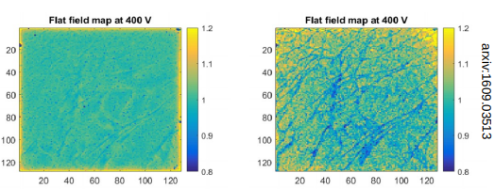
Polarization Flood Images (Preliminary Result)
From [6]
Previous results:
h+ CdTe
h+ CdTe exhibited a network of lines after polarization
e- CdTe exhibits a line network and prominent bright spots with large signal amplitude
More work needed to understand this
h+ and e- from different batches, different Schottky barriers, taken at different times
Detector before and after ~3x10¹¹ photons/mm² at -200V
e- CdTe
Detector before and after ~1.3x10¹¹ photons/mm² at -200V
Notes:
Can look at them in grayscale, can check Julian’s folder for data (people and data)
Explain how average charge collected decreases with dosing, but in bright points local
What metals specifically? Check Acrorad literature, (Indium and Al?)
Preliminary results
These are examples of a flood illuminated image before and after dosing
In h+ CdTe the polarized image shows a network of lines
In e- CdTe the polarized image also shows a network of lines, but much more prominent are spots with high signal. These bright spots begin to appear before significant changes in the normalized average signal is visible.

Slide 16
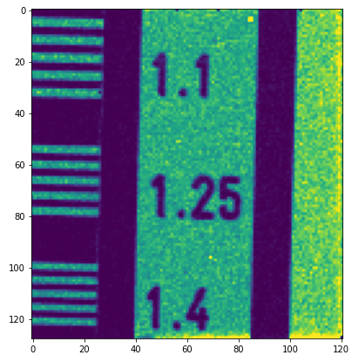
Radiographs
Raw images - no flatfield correction
Object placed ~2 cm before detector
A line-pair mask
(numbers refer to # line pairs per mm)
Lightbulb filament
Notes:
Raw images w/ no flatfield correction
Some radiographs to give a qualitative indication that the sensor is able to be used for imaging
# lp per mm

Slide 17
Conclusions
More work needed to understand polarization differences from h+ CdTe
750 µm e- CdTe is fast enough for 77 ns imaging at 40 keV
Acknowledgements
We thank the Department of Energy, the National Nuclear Security Administration (NNSA) and Argonne National Laboratory for their support.

Slide 18
References
[1] R. Hettel, "Status of the APS-U Project." 12th Int. Particle Acc. Conf. (2021).
[2] Husted et al, "Time-resolved x-ray diffraction techniques for bulk polycrystalline materials under dynamic loading." Rev. Sci. Intrum. (2018)
[3] K. Shanks, "Development of photon-integrating area detectors for x-ray science." (Presentation, 2020)
[4] Kate Shanks "Detectors for high-speed imaging and diffraction at the Cornell High Energy Synchrotron Source." (Presentation, 2021)
[5] Suzuki et al, "Carrier Transport Properties of HPB CdZnTe and THM CdTe : Cl." IEEE Transactions on Nuclear Science. (2002)
[6] Becker et al, "Characterization of CdTe Sensors with Schottky Contacts Coupled to Charge-Integrating Pixel Array Detectors for X-Ray Science." JINST. (2016)

