Slide 1
High-Z Sensor Development at DECTRIS
Pietro ZAMBON
20.08.2023
dectris.com

Slide 2
Table of contents
01
CdTe
02
GaAs:Cr
03
CZT
04
Perovskite
All results obained in COUNTING MODE

Slide 3
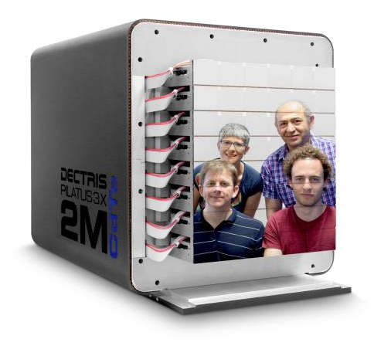
CdTe
Generalities
Commercially available, reliable supplier (Acrorad, JP)
Large sensor area up to 4 cm x 4 cm
Ohmic contacts, 750 um and 1000 um sensor thickness
75 um, 100 um and 150 um pixel size
Electron collection
I_{leak} 2-3 uA/cm²
Settling time ~15-20 min at bias ON

Slide 4
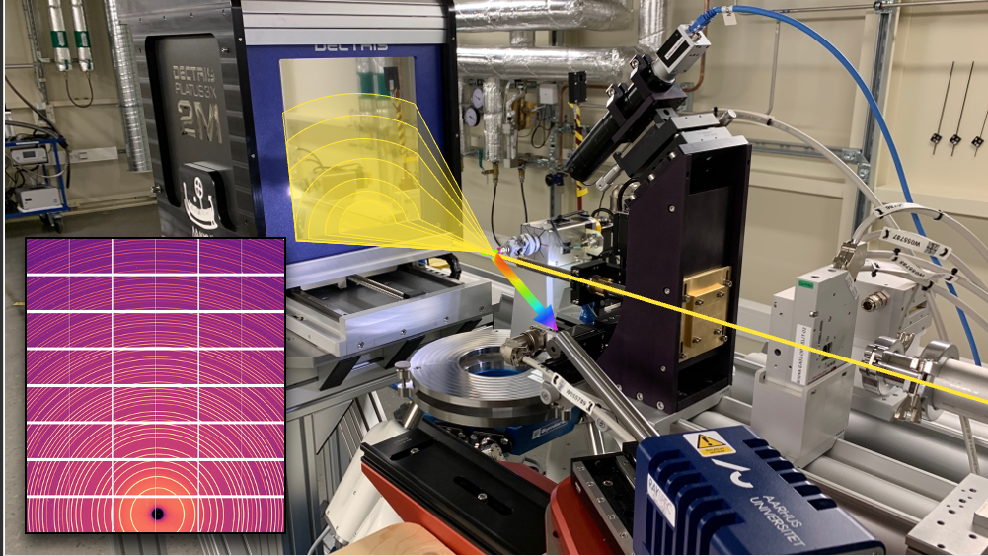
PILATUS3 CdTe 2M @ DanMAX beamline, MAX IV
Beam energy 15-35 keV
Powder X-ray diffraction

Slide 5
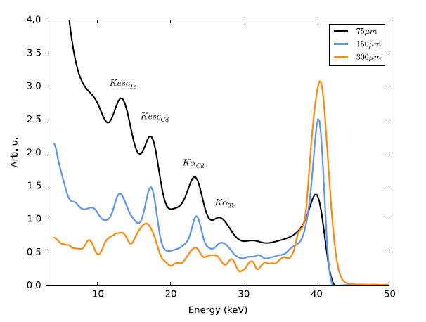
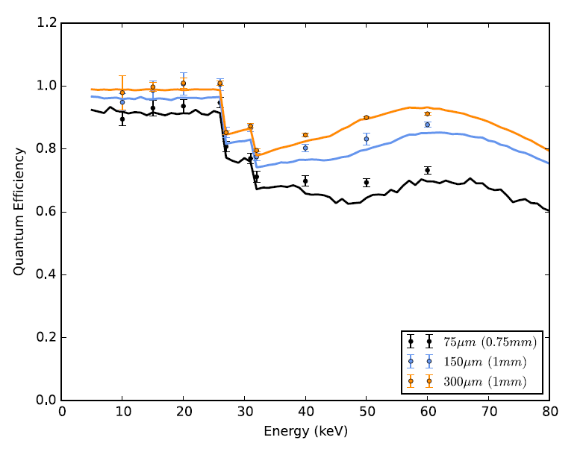
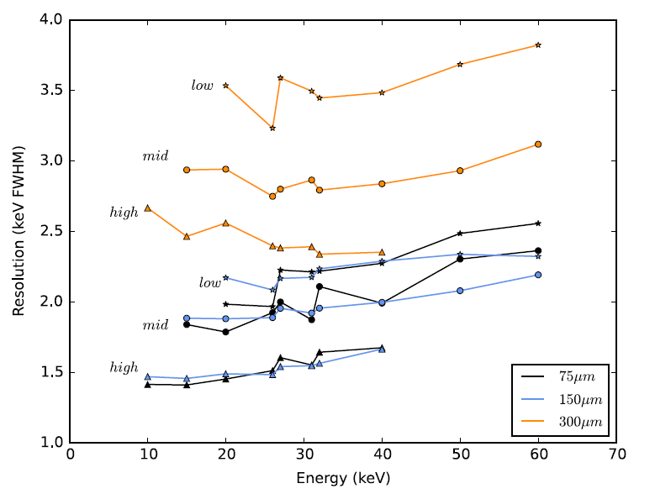
Spectral properties
X-ray 40 keV
Element | K_{edge} | K_{α1} | K_{α2} | K_{β1}
Cd | 26.73 | 23.17 | 22.99 | 26.09
Te | 31.82 | 27.47 | 27.20 | 30.99
Refs:
Zambon, et al., Spectral response characterization of CdTe sensors of different pixel size, NIM A 892 (2018).
Zambon, et al., A fitting model of the pixel response to monochromatic X-rays in photon counting detectors, NIM A 905 (2018).

Slide 6
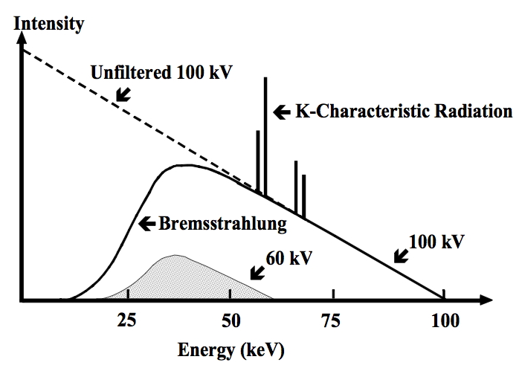
High-energy calibration
1.
Spectrum = derivative of Vcmp-scan = ramp function convoluted with a Gaussian (noise).
Ideal
Measured
spectrum
end-point
Spectrum’ = step function convoluted with a Gaussian
2.
spectrum’
Direct X-ray tube beam given by Bremsstrahlung radiation. It decreases linearly to the cut-off point.
For the Duane-Hunt law it corresponds to the tube kVp.
Spectrum’’ = delta function convoluted with a Gaussian = Gaussian.
3.
spectrum’’
4.
The peak is the calibration point
Ref:
Zambon, et al., A wide energy range calibration algorithm for X-ray photon counting pixel detectors using high-Z sensor material, NIM A 925 (2019).

Slide 7
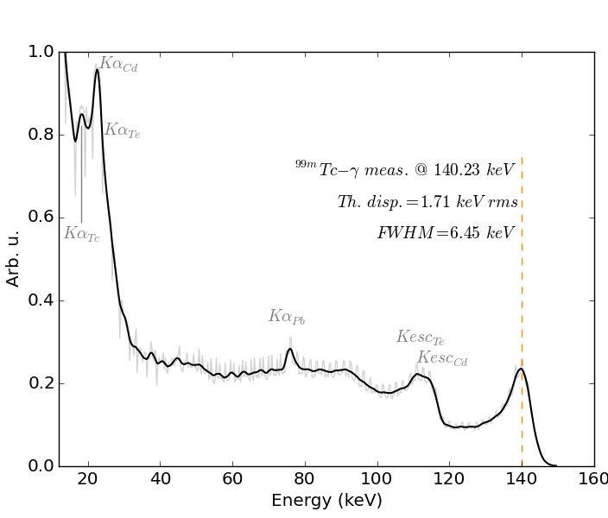
Beyond X-ray fluorescence: ^{99m}Tc spectrum
Setup
Tc source
1 mm CdTe 150 µm pixel size Calibration range: 25 – 140 keV
Pb shielding
1 cm
Flat-field Image at E_{th}=120 keV
ACCURACY: ± 0.5 keV (< 1%) → global threshold calibration works!
PRECISION: Pixel-to-pixel threshold dispersion ~1.7 keV
Notes:
γ = 140.5 keV (98%) + 142.6 keV (1.4%)

Slide 8
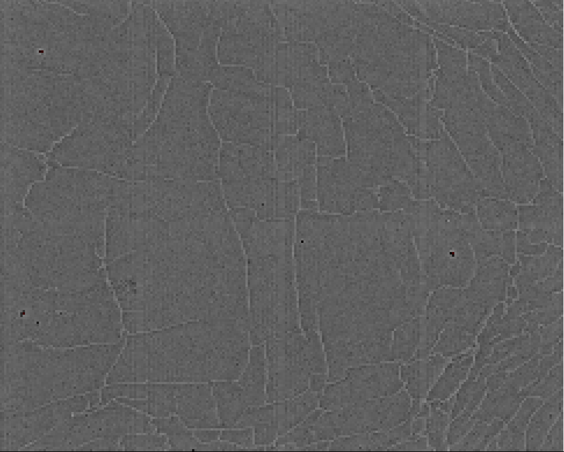
Pilatus3 flat-field (Ag, 50% threshold)
Very small number of defects and/or bad pixels
Excellent dicing edge quality
Ling 2013
Network of lines i.e. local charge build-up with distorting effects on charge transport.
dark+bright line, constant average counts
depends on growing process
enhanced by time (h) and irradiation
mitigated by high Vbias
erased (almost completely) by detector reset

Slide 9
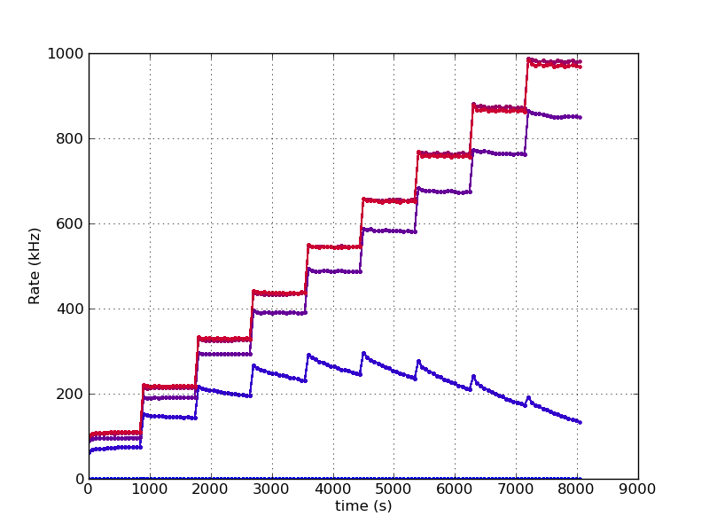
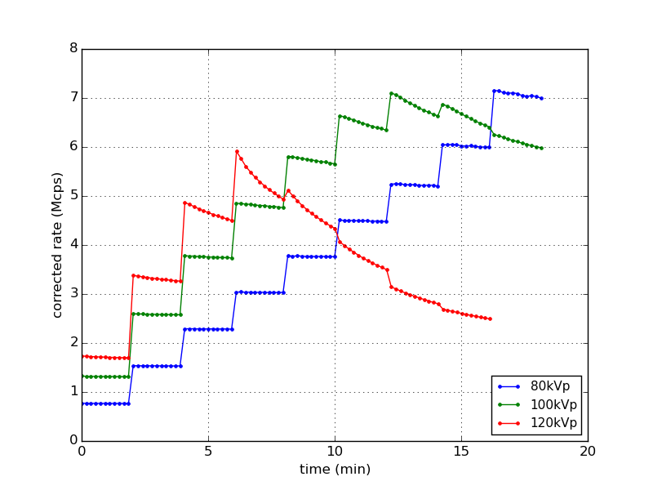
Polarization example in CdTe
Measurement of the count rate vs. bias voltage, tube voltage, tube current, time (and temperature)
direct beam 60 kVp, tube current increased every 15 min
bias -500 V, tube current increased every 2 min
-500V
-400V
-300V
-200V
-100V
Count rate degradation with increasing time, flux, energy and for decreasing temperature (not shown). Uniform degradation over the irradiated area.

Slide 10
GaAs:Cr
Generalities
Cr-compensation process firstly developed at Tomsk University, now available also at Dectris.
Reached a good manufacturing level, still room for optimizations
Polarization and grains seem to be related with GaAs starting material (doping, stresses...) and the Cr diffusion
6’’ wafer LEC, 4’’ wafer VGF
Large sensor area up to 8 cm x 4 cm
Ohmic contacts, sensor thickness from ~250 um to 1 mm
Electron collection
I_{leak} min. ~5 uA/cm²
No settling time at bias ON

Slide 11
Example of flat field image
Full sensor 8 cm x 4 cm, 500 um-thick 75 um pixel size
LEC
VGF
1 cm
Sensor edges (2 pixels size)
Grainy structure lead up to a factor 3 difference in count rate. Strongly dependent on the starting material

Slide 12
X-ray tube 28 kVp with Al filter, E_{th} = 8 keV
LEC material, Flat-field corrected, gaps interpolated.
1 cm

Slide 13
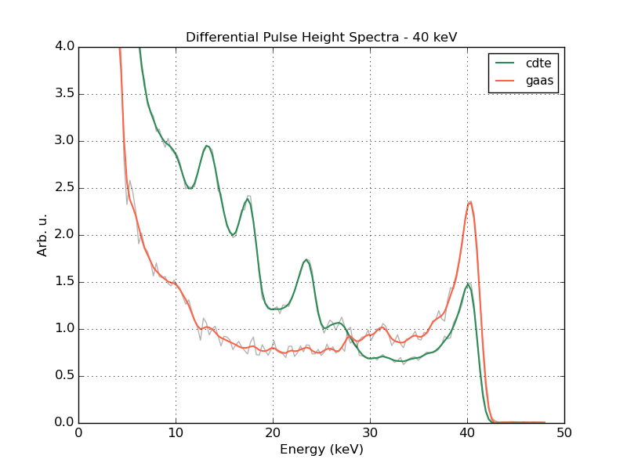
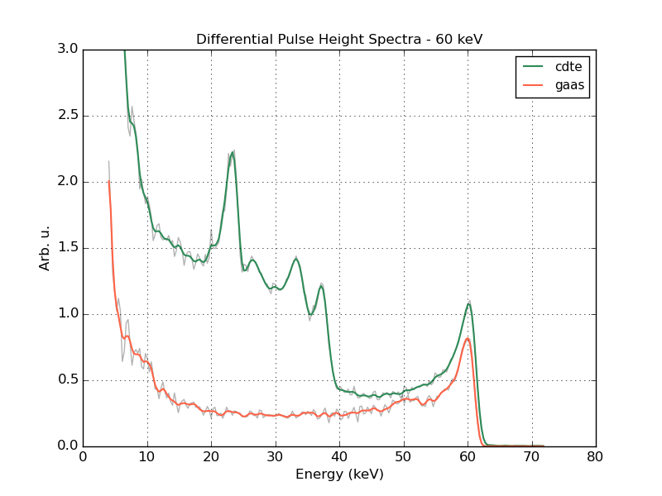
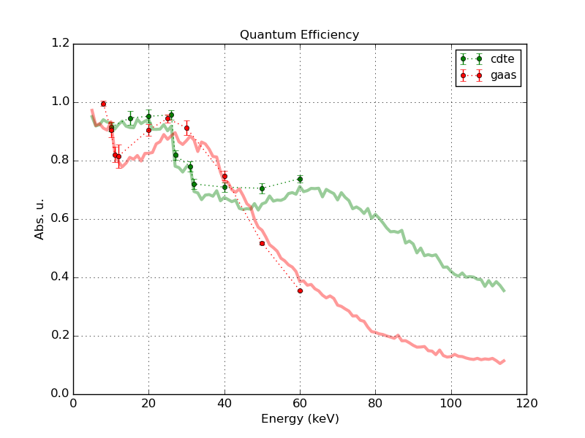
Spectra comparison GaAs/CdTe
$$QE≝\frac{\# counted photons at 50\% threhsold }{\# impinging photons}$$
X-ray 40 keV
X-ray 60 keV
E₀-Te_{Kα}
Cd_{Kα}
E₀-Cd_{Kα}
E₀
Ga_{Kα}
Te_{Kα}
E₀-Te_{Kα}
As_{Kα}
Cd_{Kα}
Te_{Kα}
E₀-Cd_{Kα}
E₀
E₀-Ga_{Kα}
Ga_{Kα}
E₀-As_{Kα}
As_{Kα}
E₀-Ga_{Kα}
E₀-As_{Kα}
normalized to the QE
normalized to the QE
GaAs shows less fluorescence yield
Comparable energy resolution
Element | K_{edge} | K_{α1} | range (μm)
Ga | 10.39 | 9.25 | ~40
As | 11.88 | 10.54 | ~15

Slide 14
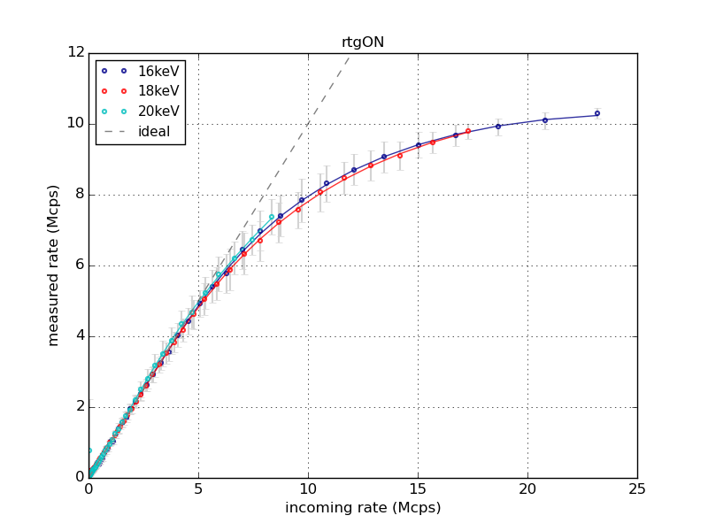
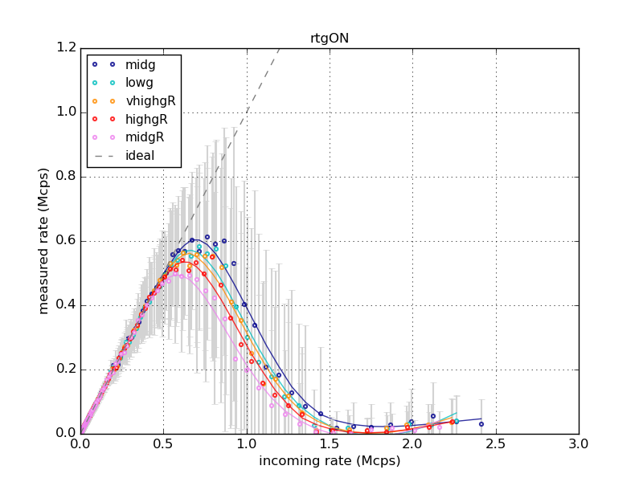
Count rate capabilities
GaAs sensor: 75 μm pixel, 500 μm thickness, room temperature
X-rays up to 20 keV
X-rays 55 keV
Strong polarization for increasing energies!

Slide 15
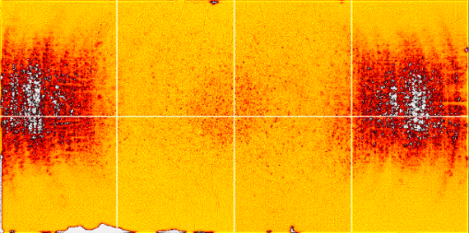
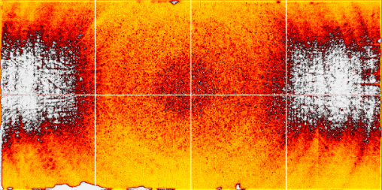
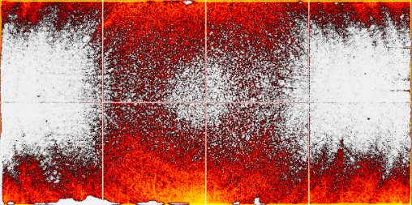
Example of polarization behavior
Direct X-ray tube beam 60 kVp, threshold 17 keV
Low rate
Good
Bad
MAX observed count rate: 0.6-1.5 Mcts/s/pix
i.e. 105-266 Mcts/s/mm²
1 cm
Increasing tube current

Slide 16
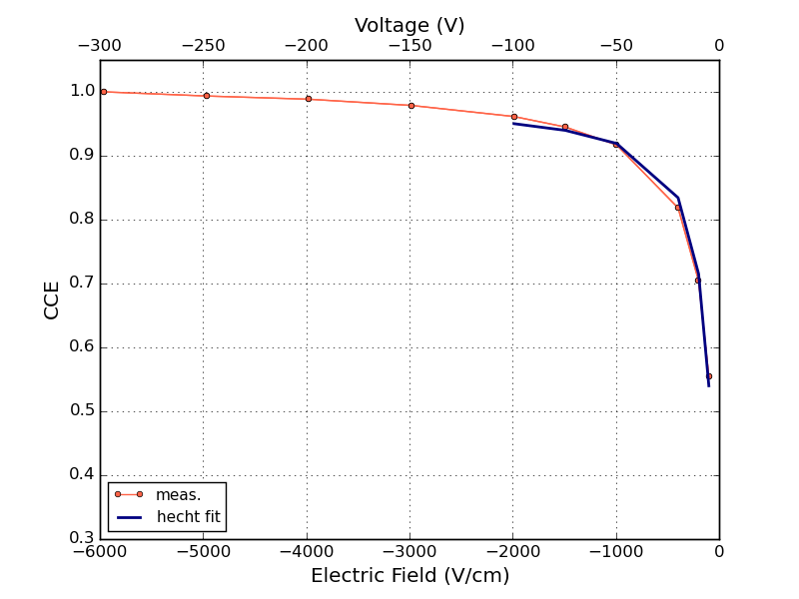
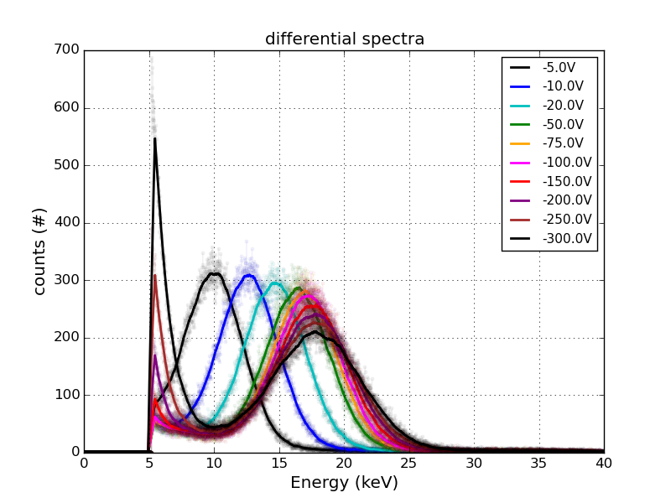
Charge collection efficiency (CCE) measurements
Tomsk GaAs (diode), dedicated setup at Dectris. Mo X-ray fluorescence spectra (17.48 keV), range ~30 um
Hecht equation only electrons
$$CCE= \frac{μ_{e}τ_{e}V_{b}}{d^{2}} \left(1−e^{−\frac{d^{2}}{μ_{e}τ_{e}V_{b}}}\right)$$
µτ_{e} = 3.74·10⁻⁴ cm²V
Hecht equation electrons + holes:
$$CCE= \frac{μ_{e}τ_{e}V_{b}}{d^{2}}\left[1−e^{−\frac{d\left(d−z\right)}{μ_{e}τ_{e}V_{b}}}\right]+\frac{μ_{h}τ_{h}V_{b}}{d^{2}}\left[1−e^{−\frac{dz}{μ_{h}τ_{h}V_{b}}}\right]$$
µτ_{e} = 3.83·10⁻⁴ cm²V
µτ_{h} = 1.69·10⁻⁶ cm²V

Slide 17
CCE results summary
Assuming
µ_{e} = 1500 cm²/V/s
µ_{h} = 100 cm²/V/s
sample | µτ_{e} (cm² V) | τ_{e} (ns) | µτ_{h} (cm² V) | τ_{h} (ns)
ArN276_G555715_1_N13 | 4.21 · 10⁻⁴ | 280 | 8.72 · 10⁻⁶ | 87
ArN204_614378_12_N2 | 1.51 · 10⁻⁴ | 100 | 5.29 · 10⁻⁶ | 53
Ag4669A | 2.37 · 10⁻⁴ | 158 | 4.06 · 10⁻⁶ | 40
Ag4668C | 3.02 · 10⁻⁴ | 201 | 4.86 · 10⁻⁶ | 48
Ag4669D | 2.26 · 10⁻⁴ | 150 | 3.61 · 10⁻⁶ | 36
Holes lifetimes consistent with Ilahi, Doping effects on minority carrier parameters in bulk GaAs, Phys. B 652 (2023)
And used in Zambon, Simulation of polarization dynamics in semi-insulating, Cr-compensated GaAs pixelated sensors under high x-ray fluxes, AIP Adv. 11 (2021)

Slide 18
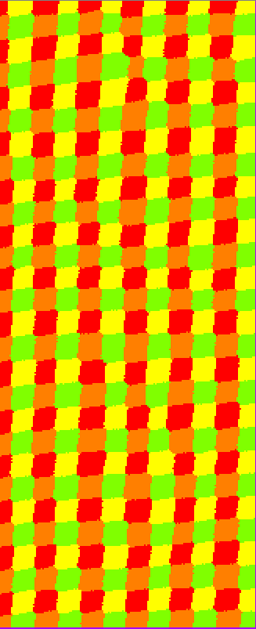
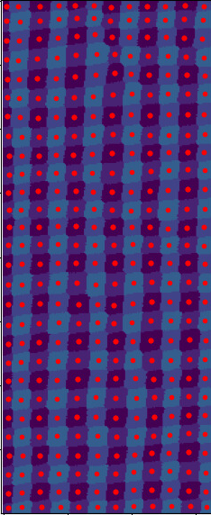
Geometrical distortion due to the grainy structure
Direct X-ray tube 23 kVp
Eth = 10 keV
Pixel size 75 um
Pinhole scan
5 um step

Slide 19
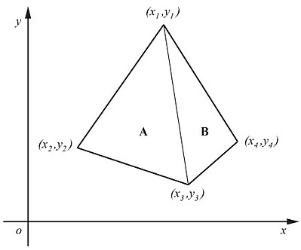
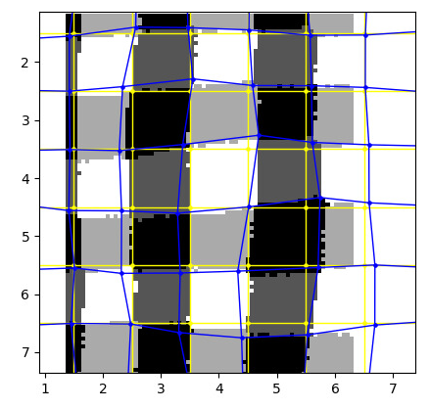
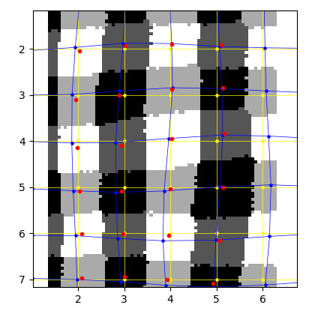
Is a correction possible?
Goal:
On the basis of a flat-field illumination only, infer the geometrical distortion assuming pixels as irregular quadrilaterals.
The area of the quadrilaterals corresponds to the number of counts in that pixel → compute optimal coordinates of the vertices (non-linear, huge).
Ideal boundaries
Ideal centroids
Reconstructed boundaries
Measured centroids
Reconstructed centroids

Slide 20
CZT
Generalities
Commercially available (Redlen)?
Typically sensor area 2 cm x 2 cm
Ohmic contacts, 1-2 mm sensor thickness
75 um, 100 um and 150 um pixel size
Electron collection
I_{leak} 1-2 uA/cm²
No settling time at bias ON
“High Flux” type → very resitent towards polarization

Slide 21
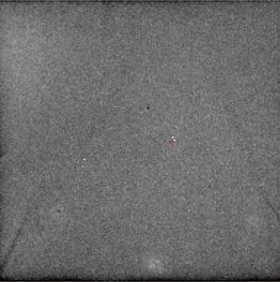
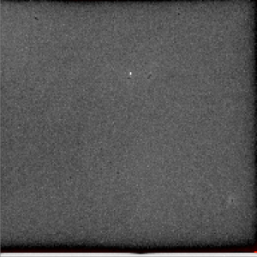
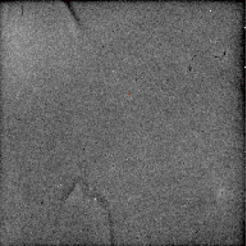
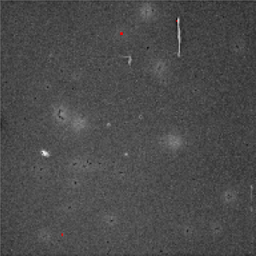
Examples of flat field images (X-ray fluorescence)
1 cm
Reached very good response uniformity
Sometimes defects can be found (bulk, surface)
Dicing edges not always excellent: no visible damages but bad pixel response

Slide 22
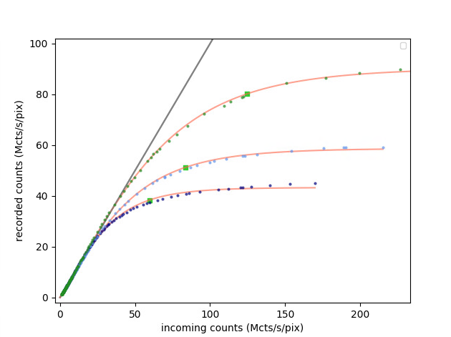
Count rate w/ KITE ASIC, non-paralyzable (retrigger enabled)
Electrons 300 keV – Retrigger ON
Threshold (keV) | Cutoff at slope 0.2
7 | 60.6 Mcts/s/pix
17.5 | 84.0 Mcts/s/pix
43 | 126.1 Mcts/s/pix
43 keV
17 keV
7 keV
Ref:
Zambon, et al., KITE: High frame rate, high count rate pixelated electron counting ASIC for 4D STEM applications featuring high-Z sensor, NIM A 1048 (2023)

Slide 23
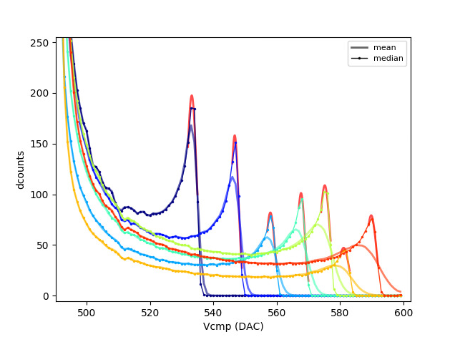
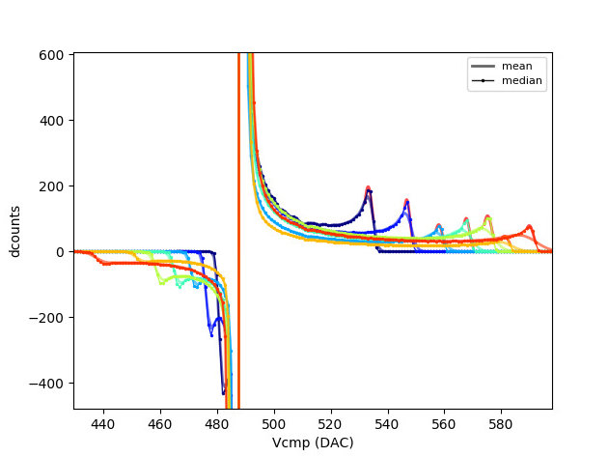
Spectra (electrons) and bipolar signals w/ KITE ASIC
Bipolar signals are induced in neighboring pixels (Ramo’s theorem)
The fast shaping time of the front-end electronics (< 10 ns FWHM) makes them measurable
60 keV
80 keV
120 keV
140 keV
100 keV
200 keV
160 keV
Negative peaks

Slide 24
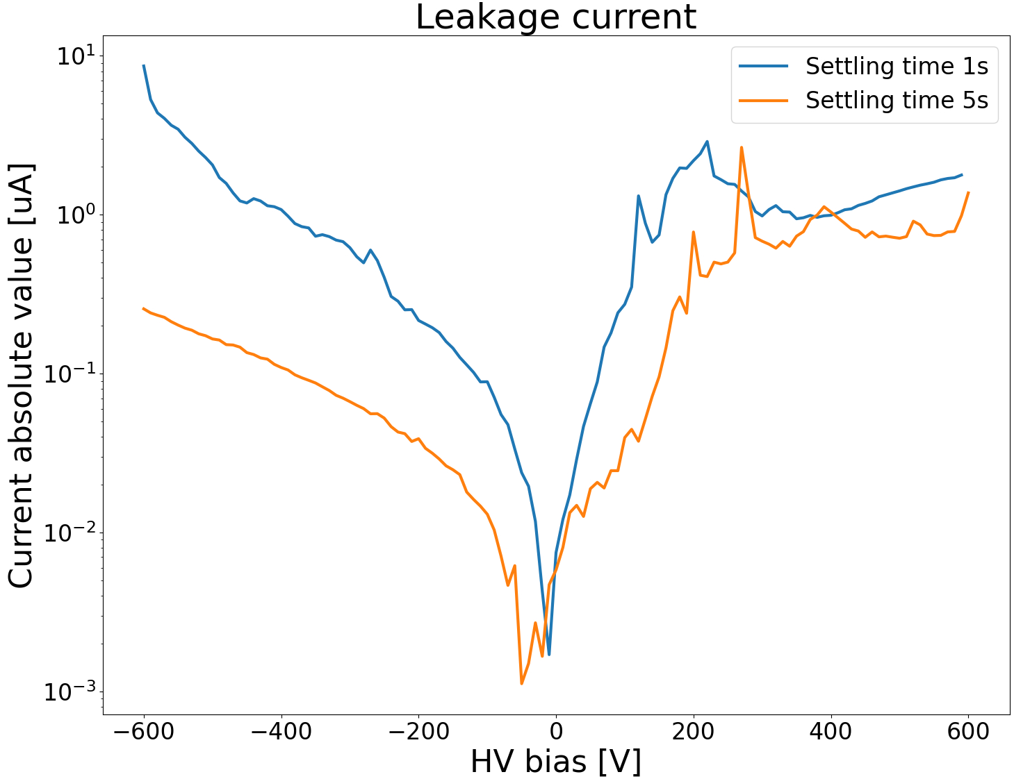
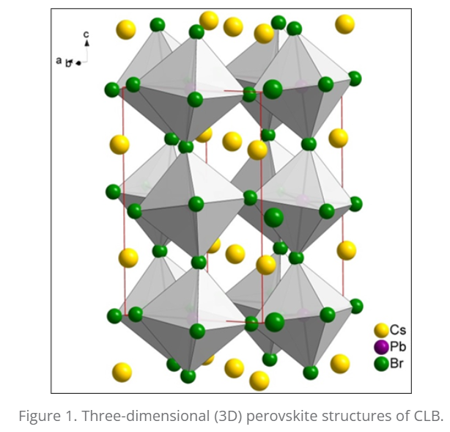
PEROVSKITE
PRELIMINARY
Generalities
Sample sensors from Actinia https://actiniadetectors.com/
Inorganic Pb-based (CLB) Perovskite: CdPbBr3 development since 2000s, bandgap ~2.3 eV (-> low leakage current)
Sample area ~1 cm x ~1 cm, 150 um pixel size

Slide 25
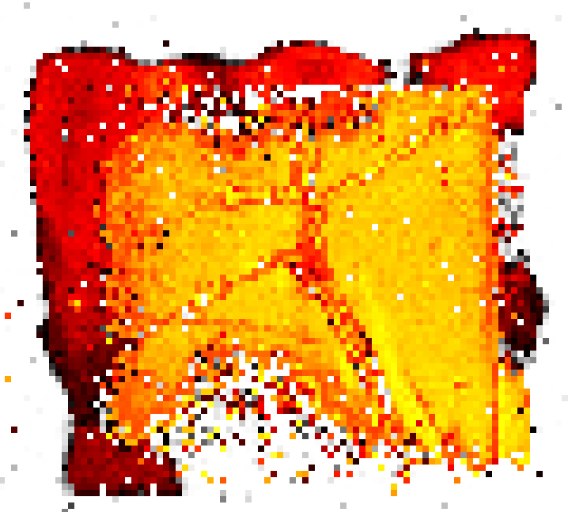
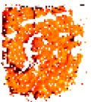
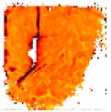
X-ray illumination
First images with Mo fluorescence (~17.5 keV) with both high voltage polarities
First batch Dec 2022
Second batch Aug 2023
V_{bias} +600 V
HOLE collection mode
V_{bias} -600 V ELECTRON collection mode
0 counts
1 cm

Slide 26
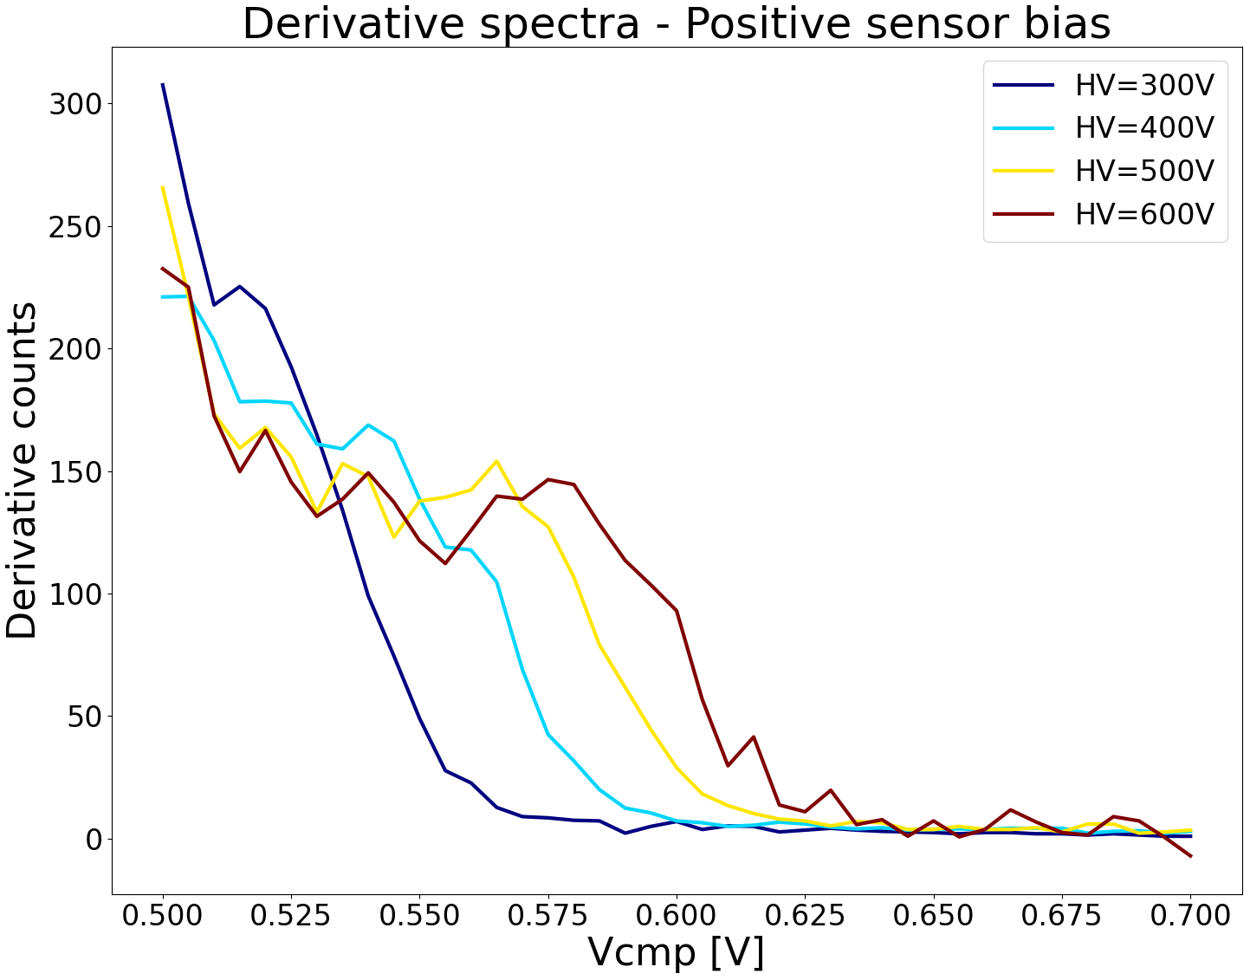
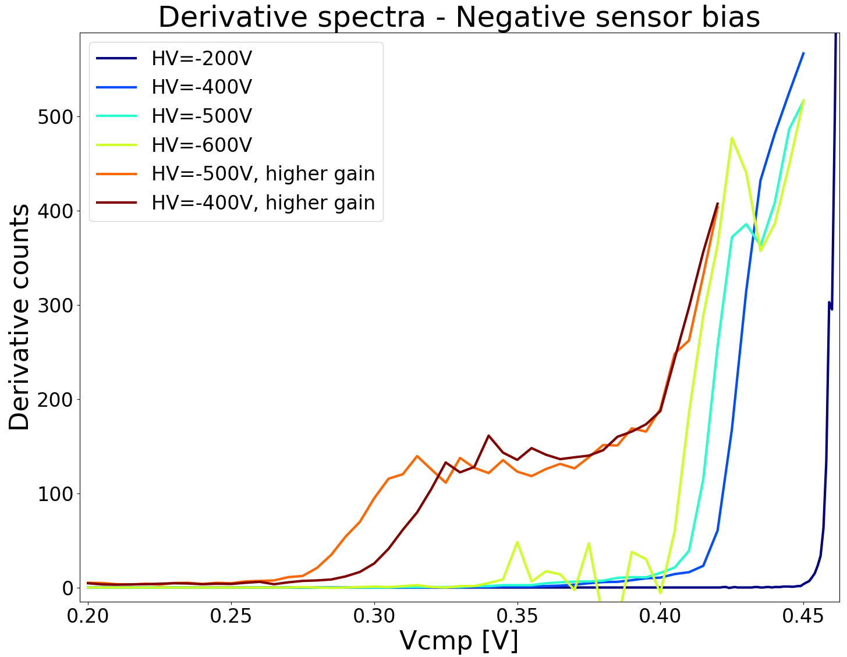
Mo Fluorescence spectra
Hole collection mode
Electron collection mode

Slide 27
Conclusion
High-Z sensor development is an open research topic at DECTRIS since 10+ years
Characterizing/ed CdTe, GaAs, CZT, Perovskite in photon/electron counting mode
Capable of manufacturing GaAs:Cr sensors
A universal high-Z sensor does not exists. The application matters!
Aknowledment
V. Radicci, S. Fernandez Perez, G. Montemurro, M. Rissi, A. Jensen, A. Gonzalez Taboada, T. Sakhelashvili.

Slide 28
Thank you for your attention!
DECTRIS Ltd.
5405 Baden-Dättwil
Switzerland
www.dectris.com

