Slide 1



High-Z Pixel Array Detectors
(HiZPAD)
Organising committee: Marie Ruat (ESRF), Dominic Greiffenberg (PSI), Matt Veale (STFC)
With the help of Stephanie Jack & Heinz Graafsma from DESY

Slide 2


























Welcome

Slide 3



HiZPAD: An Introduction
EU FP7: European Light Sources Activities - Synchrotrons and Free Electron Lasers
Joint Research Activity: High-Z Pixel Array Detectors (HiZPAD)
Started 2009 – Ended 2011
Established a strong EU community of early careers researchers in High-Z sensors
https://www.esrf.fr/UsersAndScience/Publications/Highlights/2011/et/et3

Slide 4
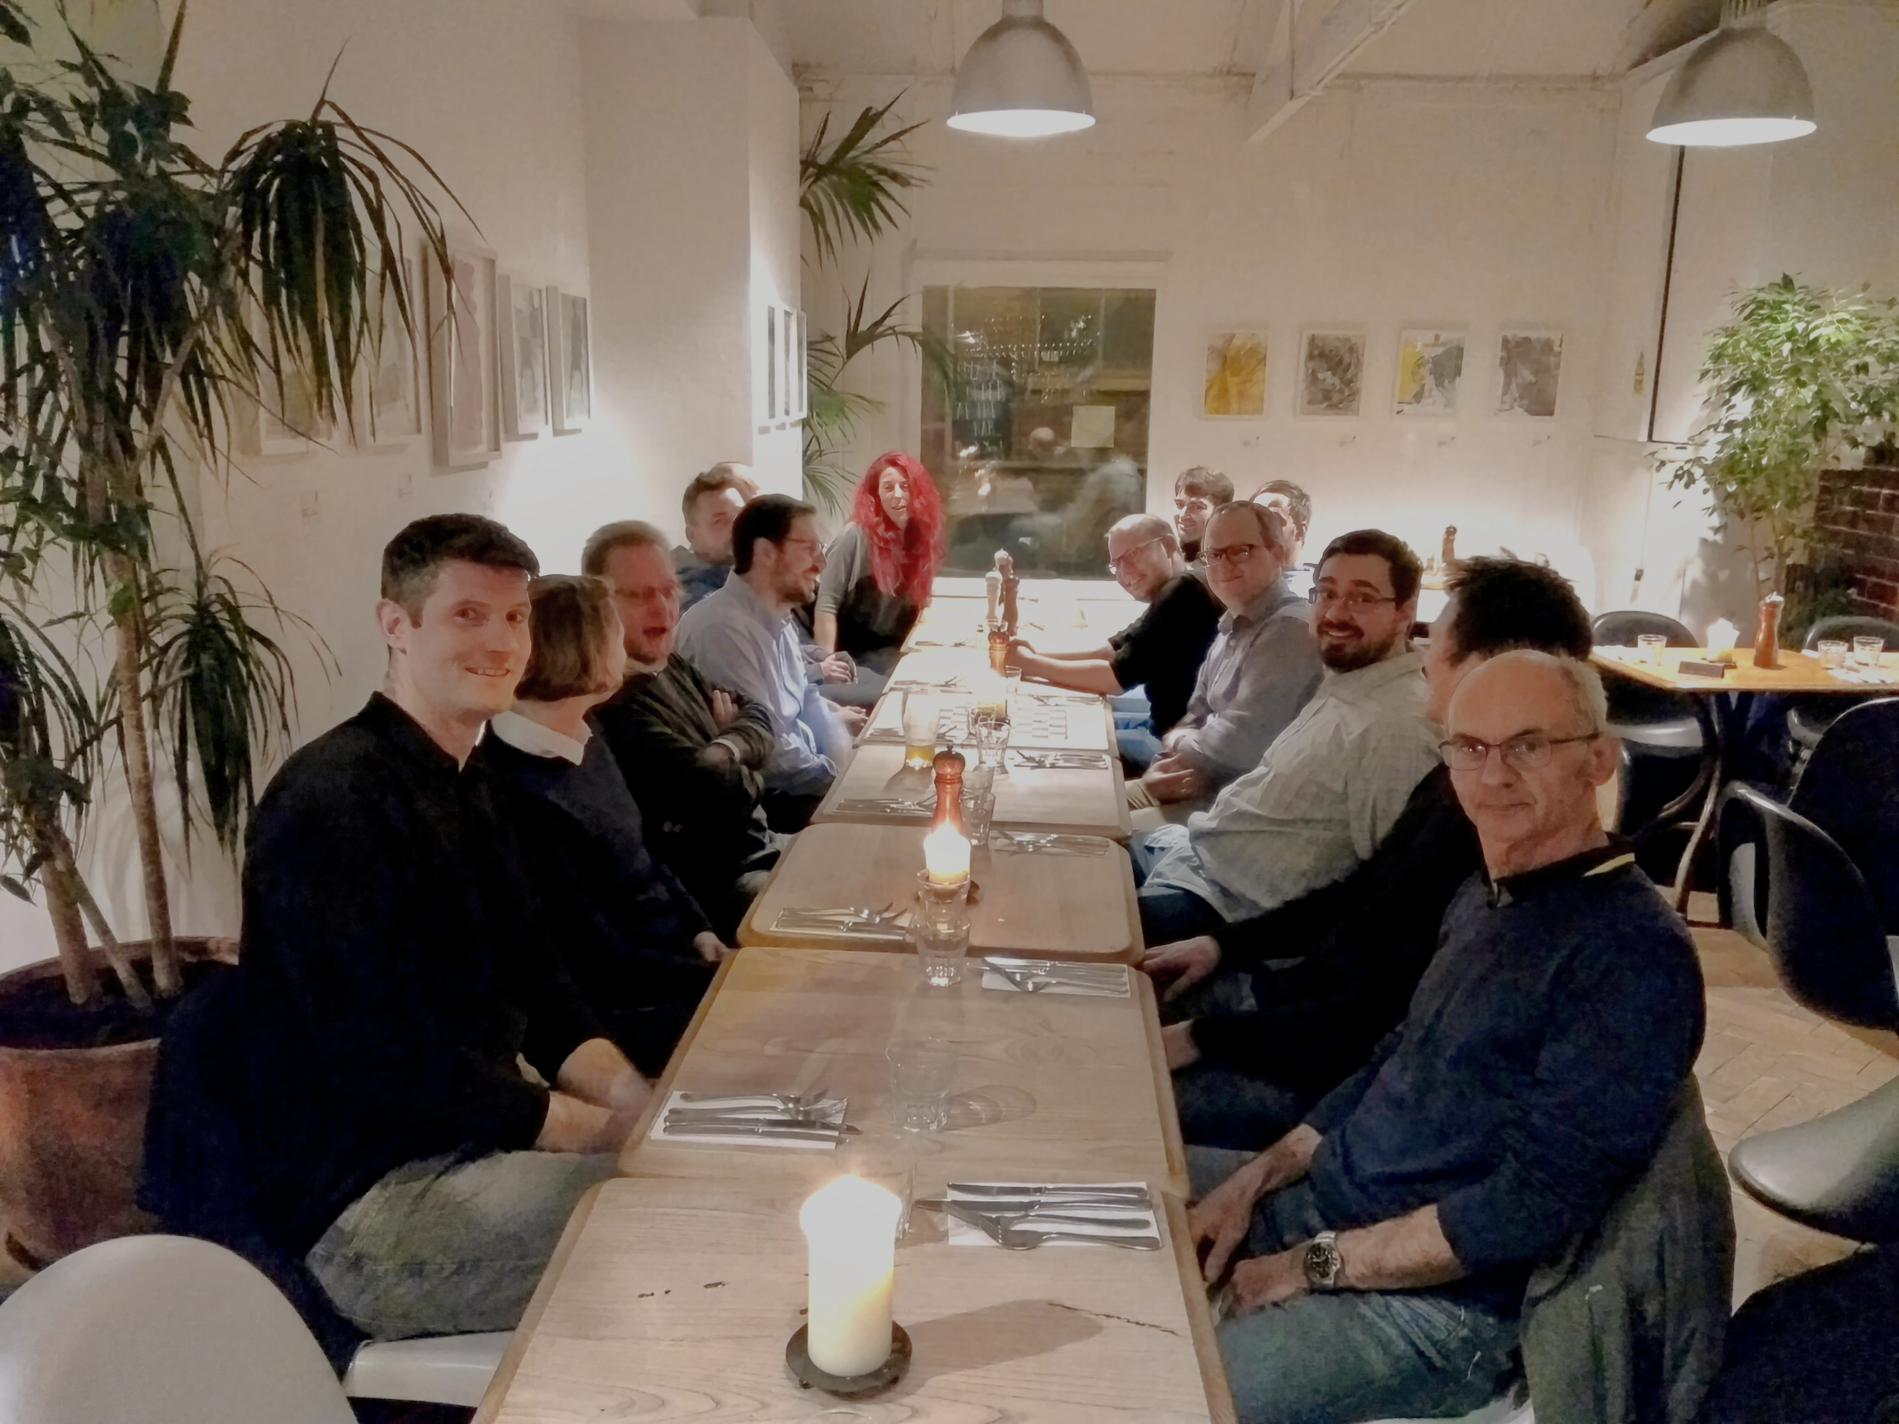
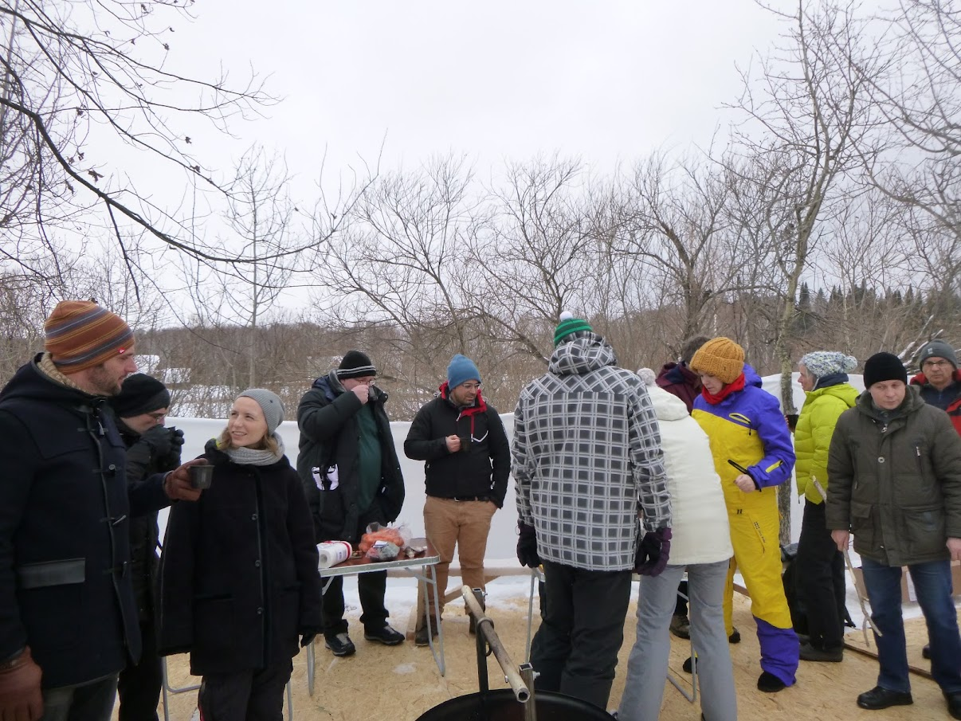
HiZPAD: The Next Generation
HiZPAD was a valued network of researchers
ESRF / PSI / STFC established informal network
In-person meetings 2013 / 2017 / 2019
COVID: Virtual Webinars
2023+: 1 in-person per year + webinars
Oxford, UK: 2019
Tomsk, RU: 2017

Slide 5

Primary goals
Collaboration, Cooperation & Careers

Slide 6

Primary goal
Collaboration & Cooperation

Slide 7


HiZPAD: September 2023 – Day 1

Slide 8
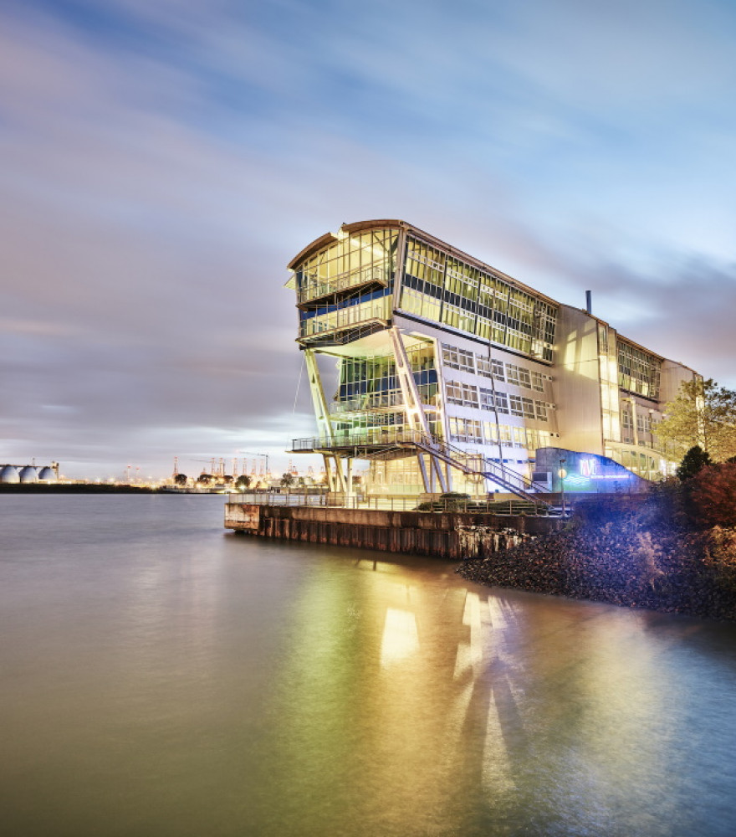
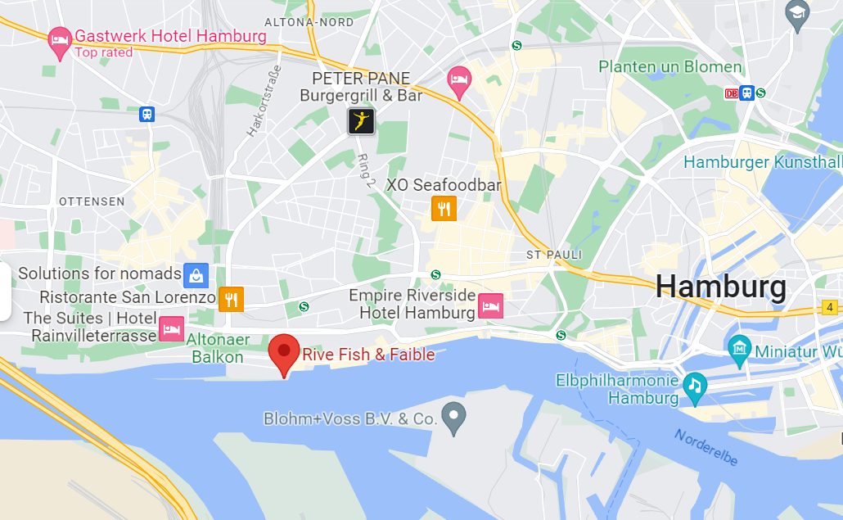
In Person – Workshop Dinner*
Rive Fish & Faible, Van-der-Smissen-Straße 1, 22767 Hamburg
Seated by
19:00
*Funding provided by the UK International Strategic Partnership Fund

Slide 9
HiZPAD: September 2023 – Day 2

Slide 10
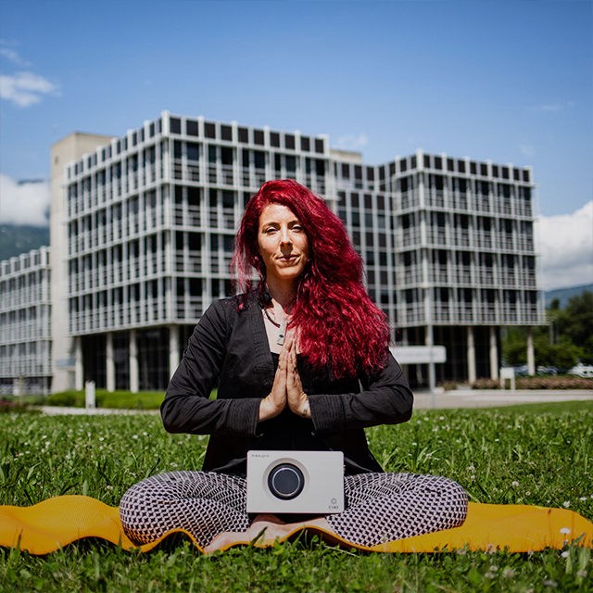
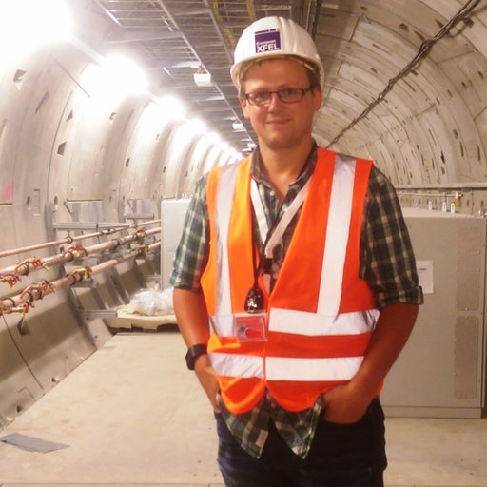
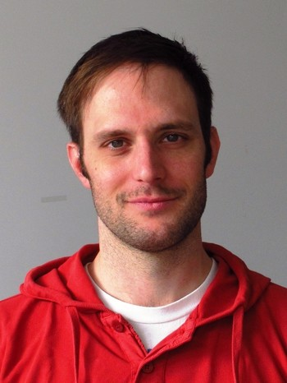
The HiZPAD Team
Marie Ruat
Matt Veale
ESRF, FR
STFC, UK
Any problems please let us know!
Please upload talks to Indico!
Dominic Greiffenberg
PSI, CH

Slide 11
Let’s know each other
Name tags are available on the coffee tables
Please bring them back to the organisers at the end!

