Slide 1
Machine Learning for the Real-Time Analysis of X-ray Spectroscopic Data
Federico Zecchi, Marius Retegan, Pieter Glatzel
H2020 ENGAGE conference
This work is partly funded by the European Union’s Horizon 2020 Research and Innovation Programme under the Marie Sklodowska-Curie COFUND scheme with grant agreement No. 101034267.

Slide 2
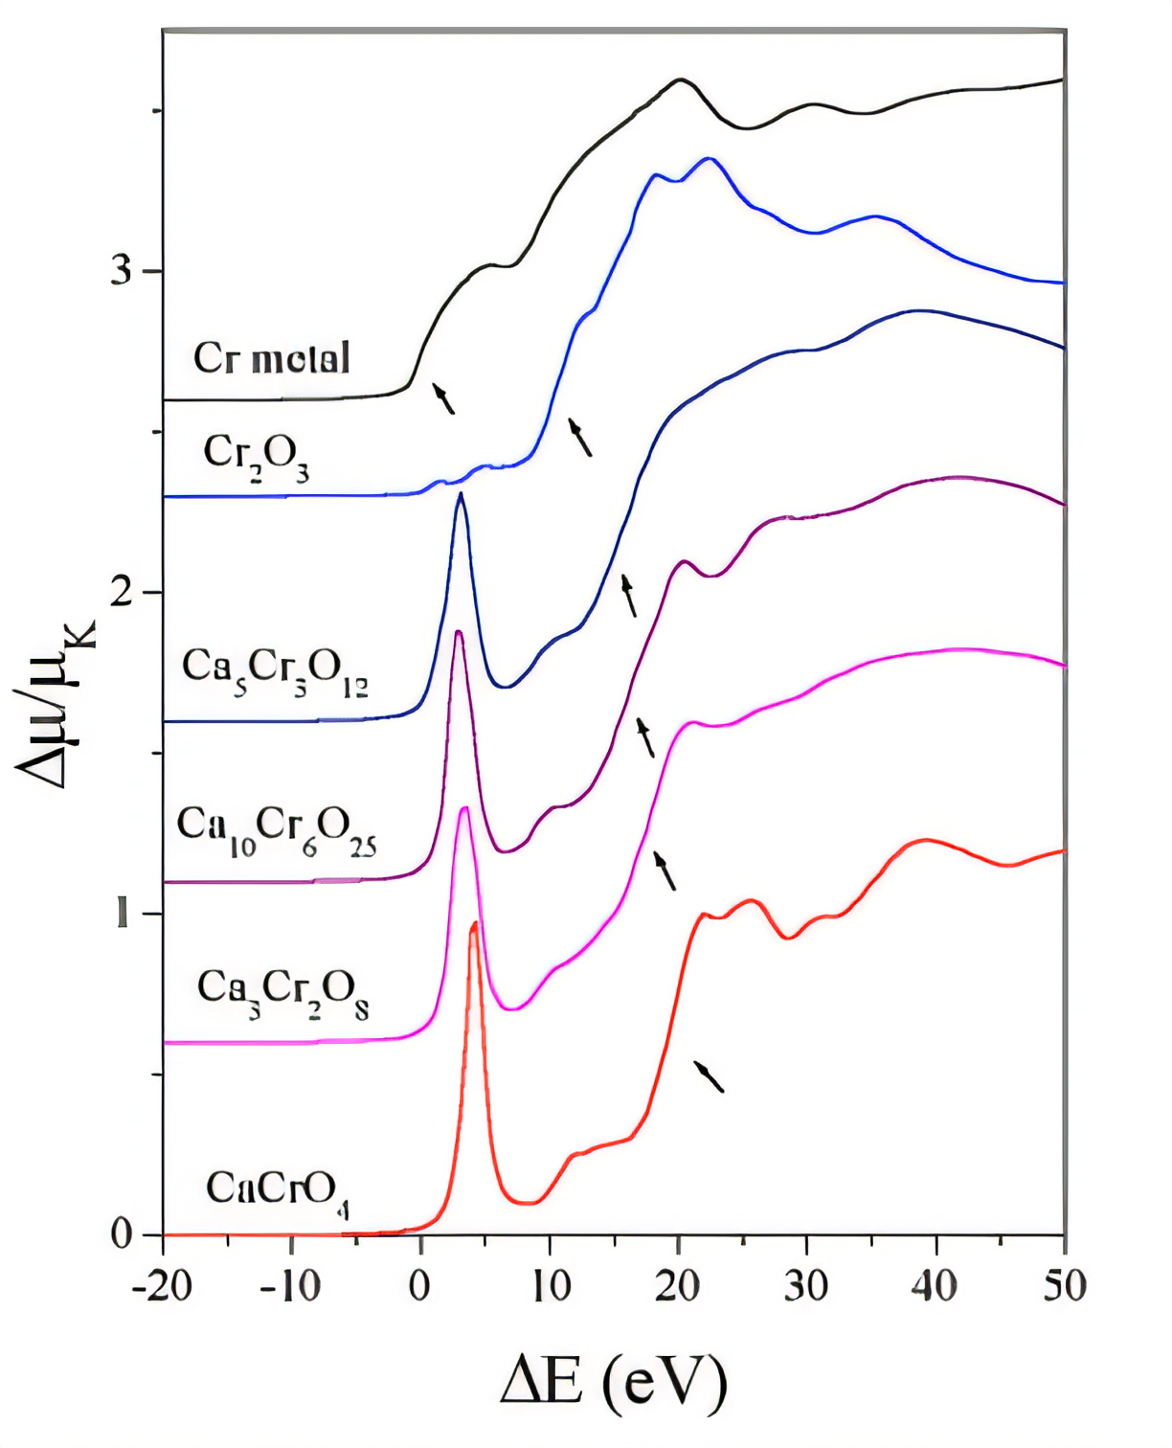
MOTIVATIONS FOR USING ML IN XAS DATA ANALYSIS
Domain Expertise
Spectra Comparison
Time-Consuming
Large Datasets
Synchrotron Datasets
Manual Analysis
Increasing Difficulty
Delays
Machine Learning
Maximize information
No Prior Knowledge Needed
Faster Analysis
ML Automation
Data Acquisition
Efficiency Boost
Beamline Operations

Slide 3
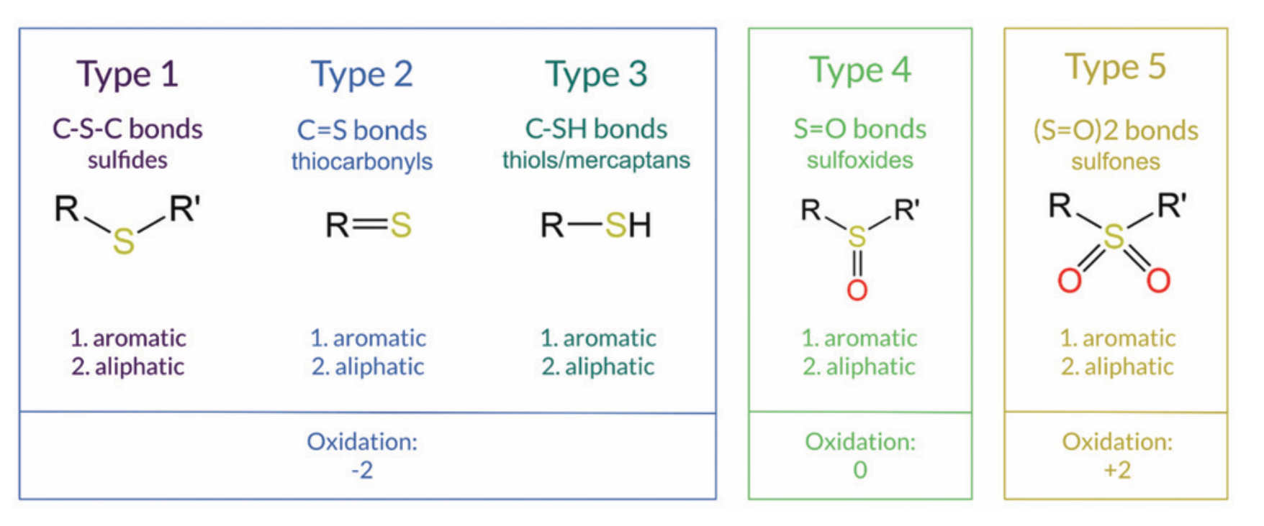
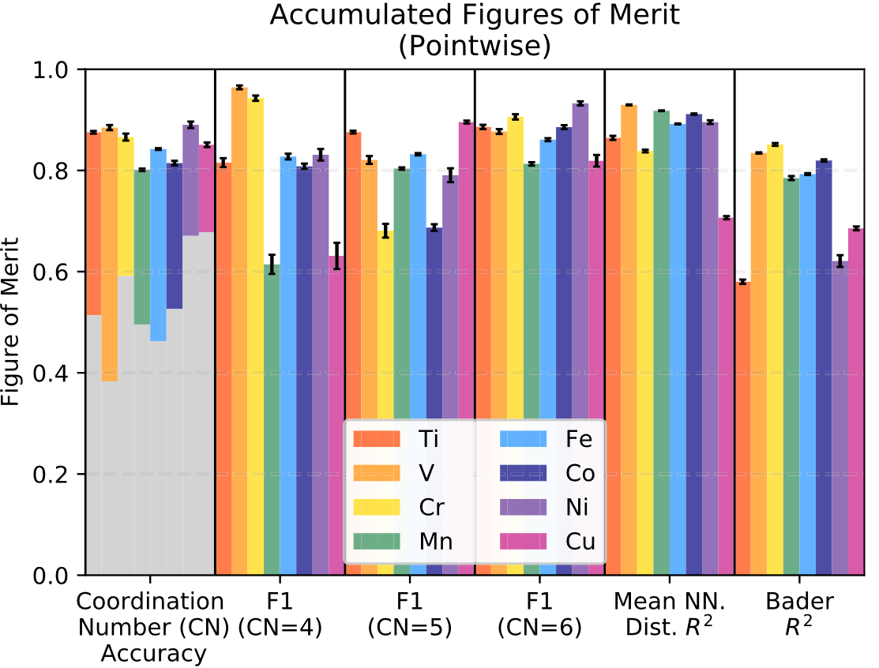
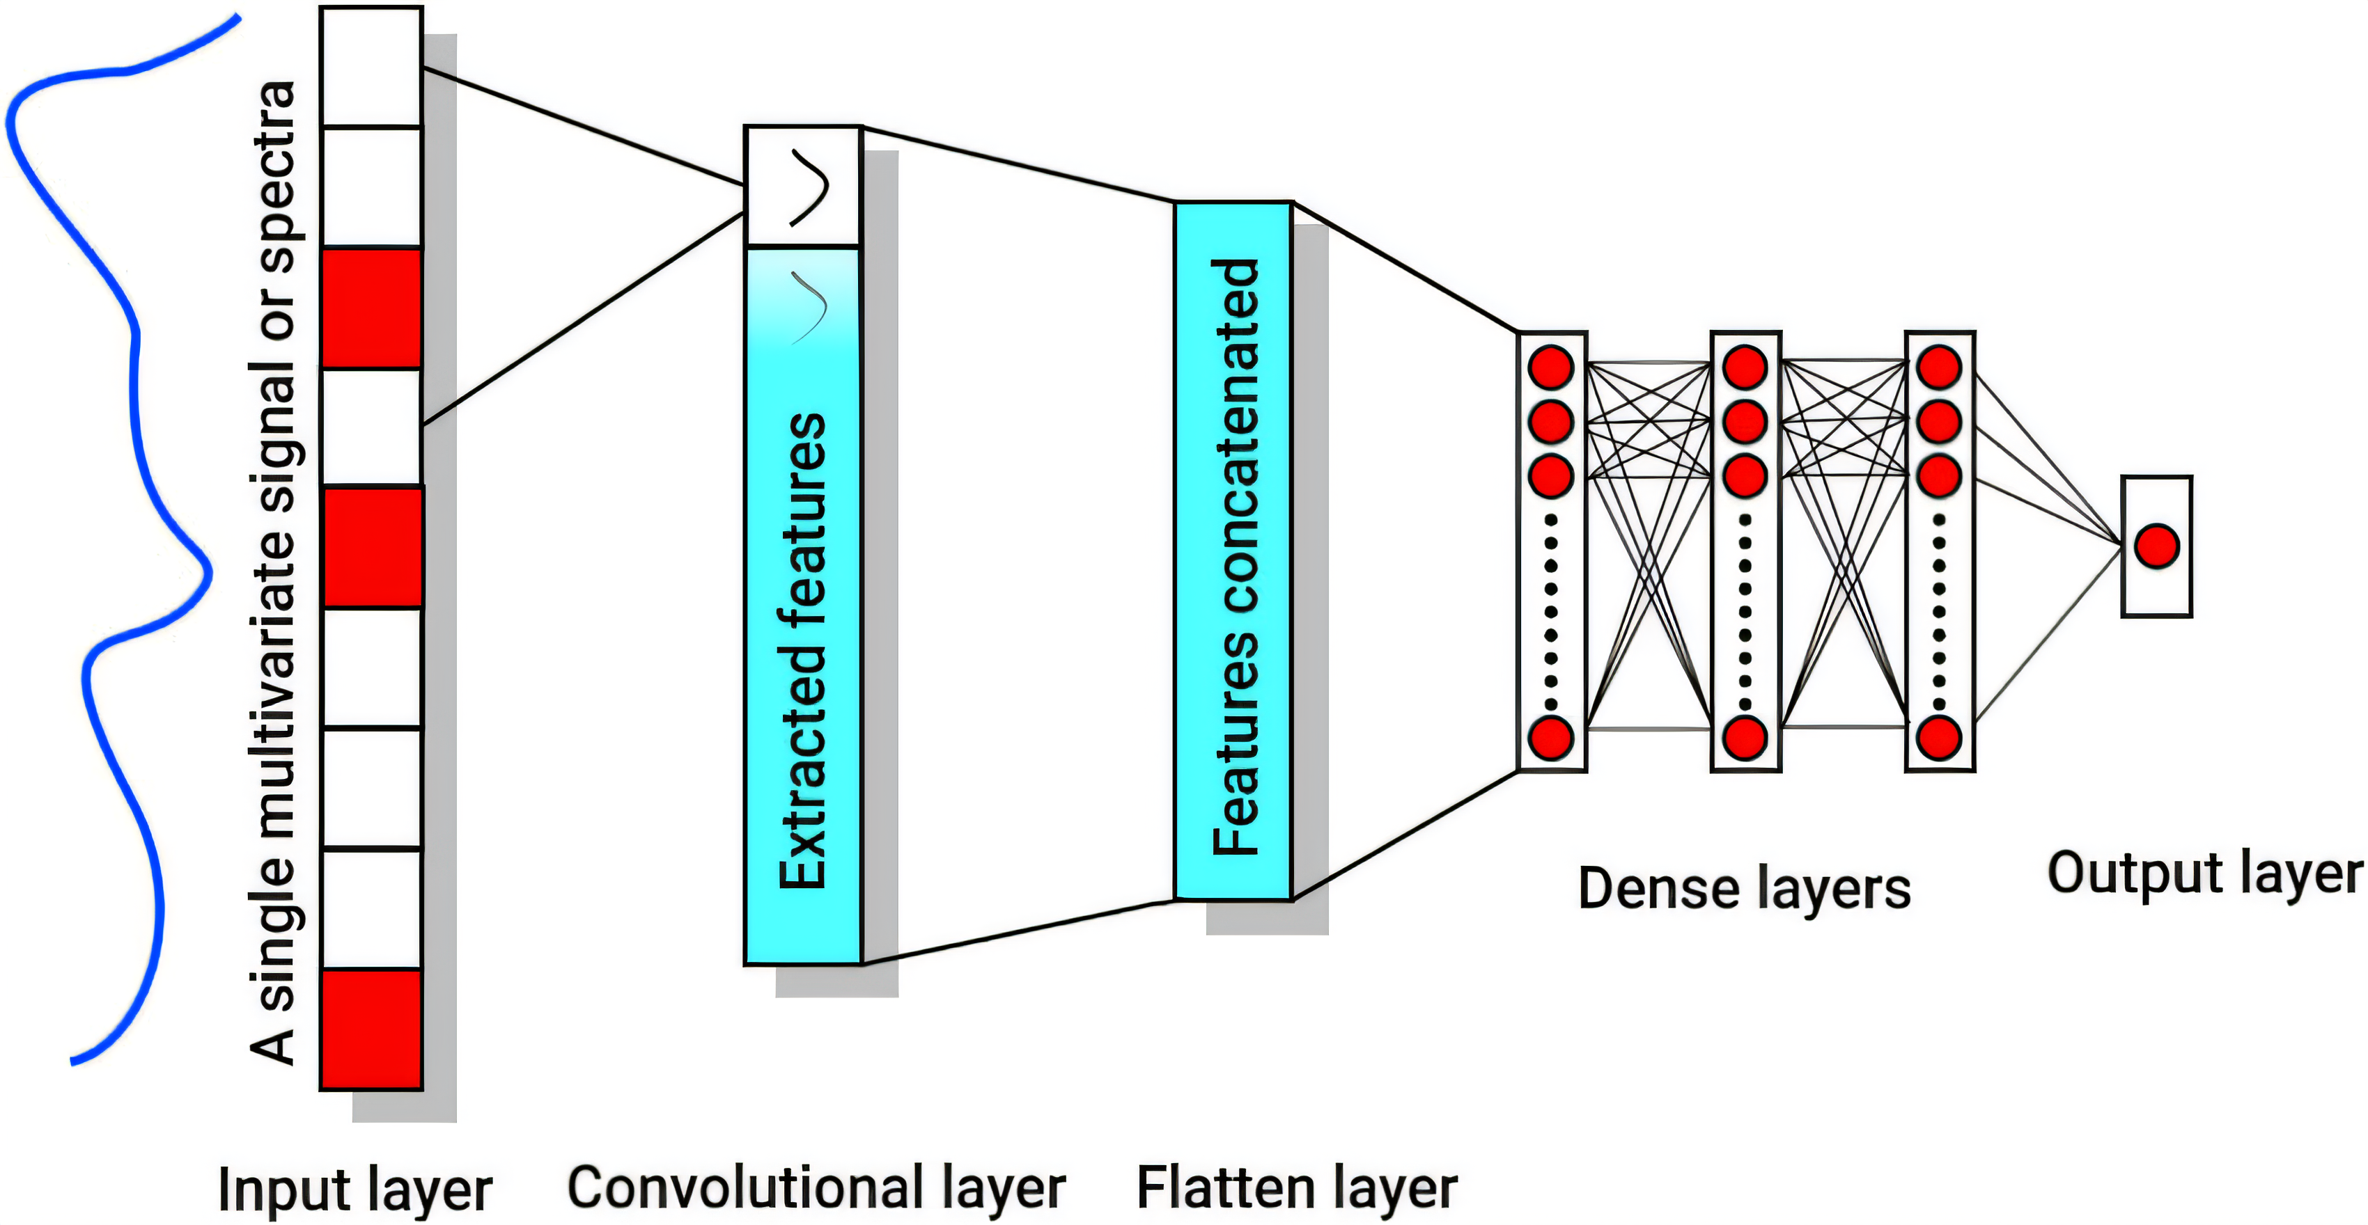
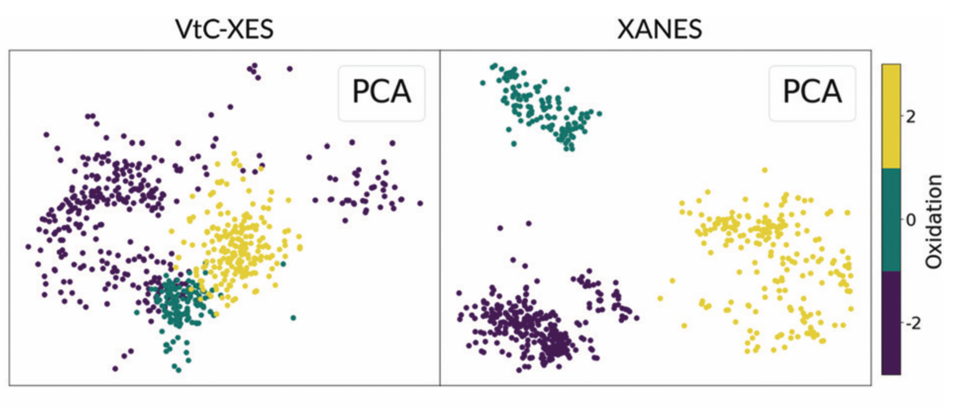
OVERVIEW OF ML MODELS COMPLEXITY FOR SPECTROSCOPY DATA ANALYSIS
PCA
Typically used for data pre-processing, dimensionality reduction.
Random Forest
Combines decisions from multiple predictors to improve accuracy.
Convolutional Neural Networks
Deep learning model for capturing spatial hierarchies. Often used in image analysis for feature extraction.
Mishra et al., Chemometrics and Intelligent Laboratory Systems 212, 104287 (2021).
Tetef et al., Chem. Phys. Phys. Chem. 23, 23586 (2021).
Torrisi et al., npj Comput Mater 6, 109 (2020).

Slide 4
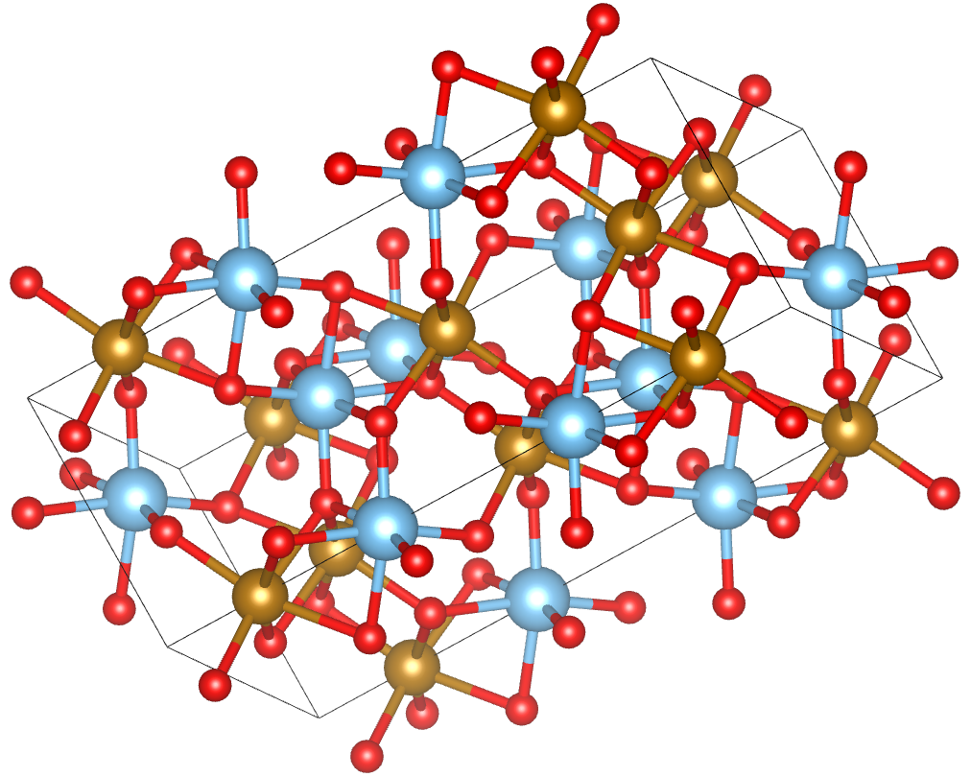
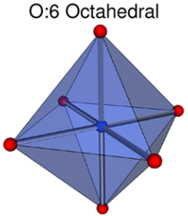
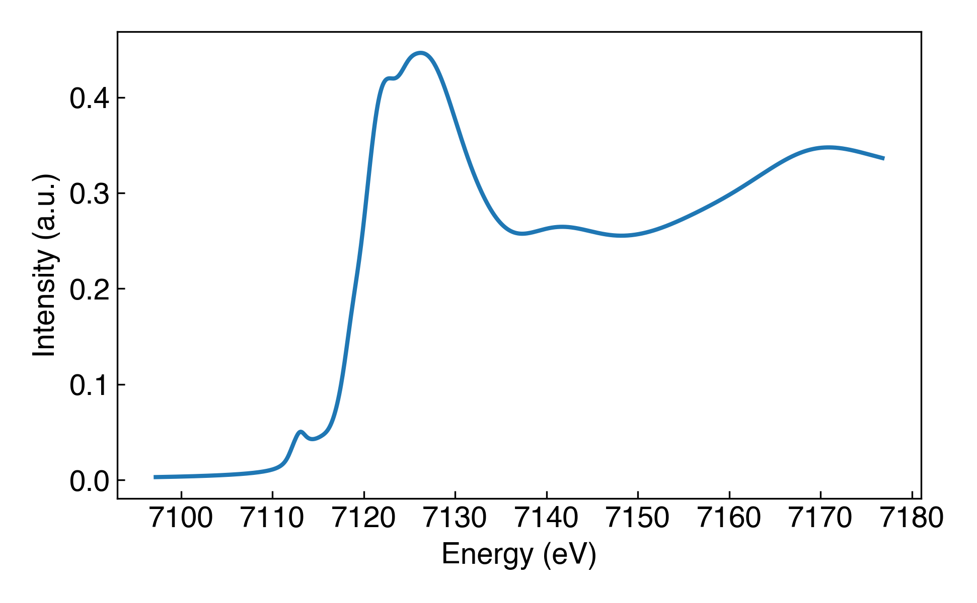
DATASET AND MODEL TRAINING
Spectrum
calculation
Coordination environment determination
Fe K-edge spectrum
Joly et al., J. Phys. Condens. Matter 21, 345501 (2009).
Waroquiers et al., Acta Crystallogr B Struct Sci Cryst Eng Mater 76, 683-695 (2020).
Spectral
database
Training
Random Forest Classifier

Slide 5
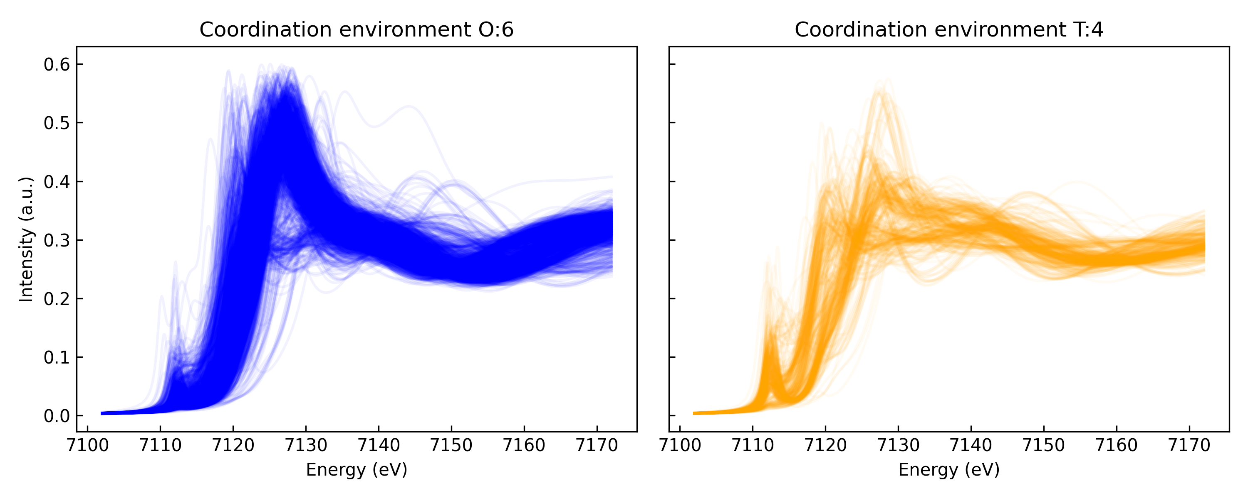
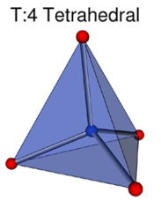
CALCULATED SPECTRA FOR OCTAHEDRAL AND TETRAHEDRAL ENVIRONMENTS
2689 spectra: 69% O:6, 31% T:4.

Slide 6
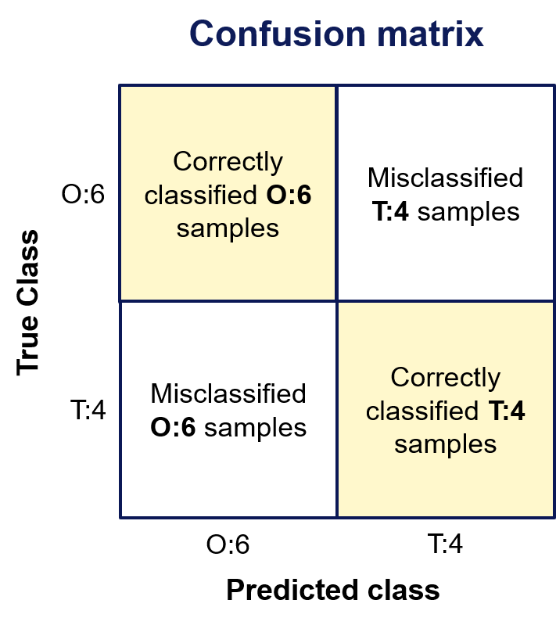
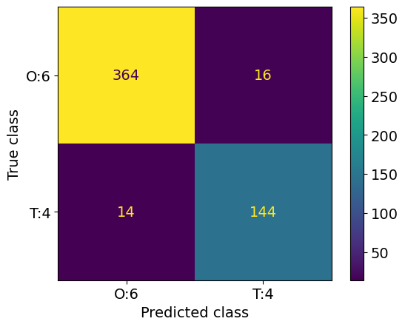
CLASSIFICATION RESULTS ON TEST SET
$$\text{Accuracy}\text{ (\%) }\text{= }\frac{\text{Number} \text{of} \text{Correctly} \text{Classified} \text{Samples} }{\text{Total} \text{Number} \text{of} \text{Samples}} × \text{100\%}$$
Dataset was split in train (80% of data) and test (20% of data) sets.
Accuracy: 92.7±0.6%

Slide 7
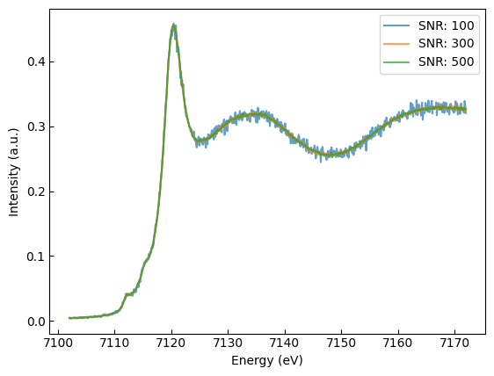
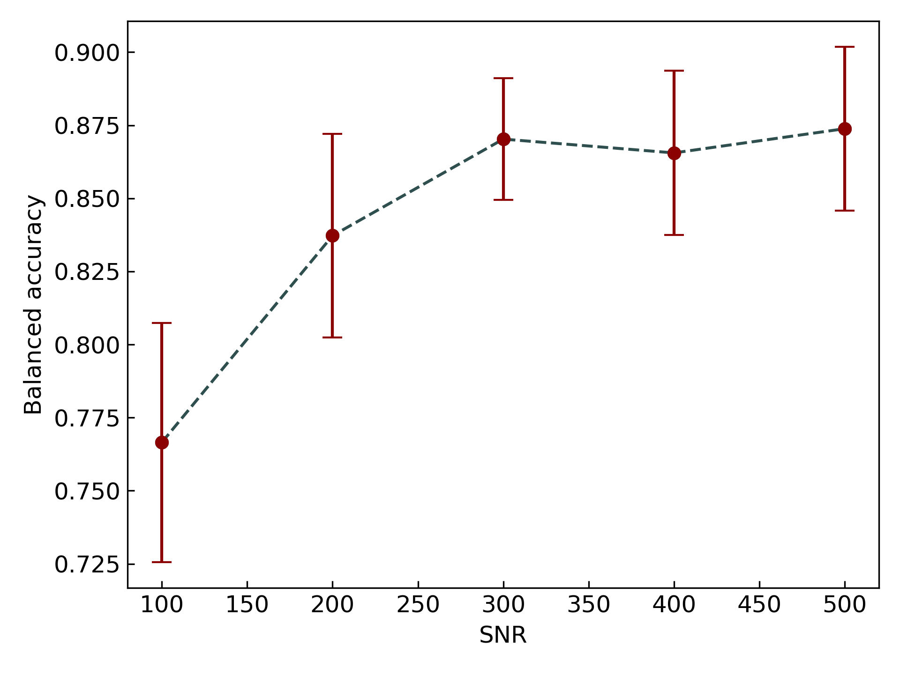
TEST SET PERTURBATION: NOISE
Photons counting statistic follows a Poisson distribution.
$$p\left(N\right)=e^{−rτ}\frac{rτ^{N}}{N!}$$
r: arrival rate; $τ:$time interval; N: number of counts
Signal-to-noise ratio definition for shot noise:
$$SNR= \frac{N}{σ}= \frac{N}{\sqrt{N}}=\sqrt{N}$$
Metrics for different noise values

Slide 8
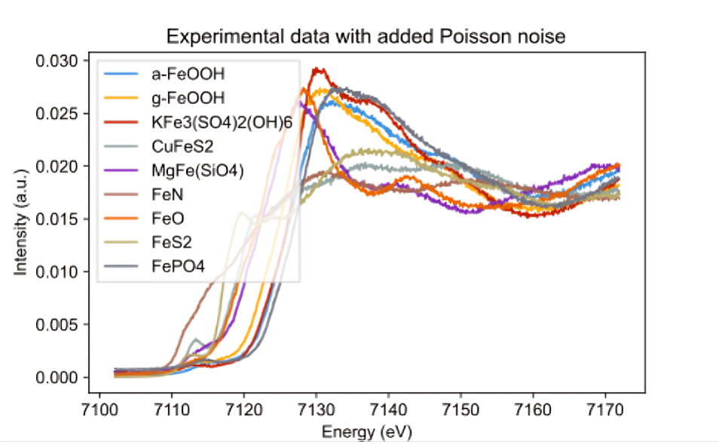
CLASSIFICATION OF EXPERIMENTAL DATA
Compound | CE | Full spectrum | Descriptors
α-FeOOH (Goethite) | O:6 | ✅ | ✅
ɣ-FeOOH (Lepidocrocite) | O:6 | ✅ | ✅
KFe₃(SO₄)₂(OH)₆ (Jarosite) | O:6 | ✅ | ✅
CuFeS₂ (Chalcopyrite) | T:4 | ✅ | ✅
MgFe(SiO₄) (Olivine) | O:6 | ✅ | ✅
FeN | T:4 | ✅ | ❌
FeO | O:6 | ✅ | ✅
FeS₂ | O:6 | ✅ | ✅
FePO₄ | T:4 | ❌ | ✅
Data collected at ID26 of ESRF

Slide 9
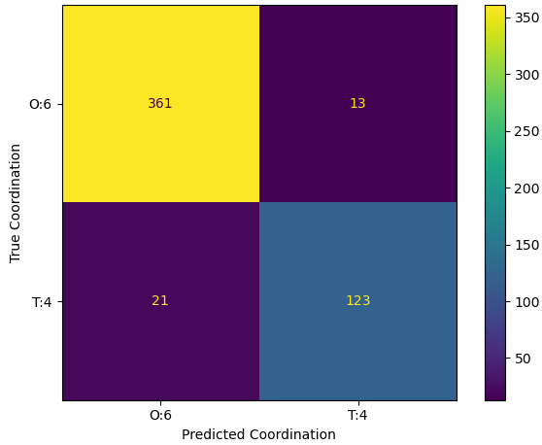
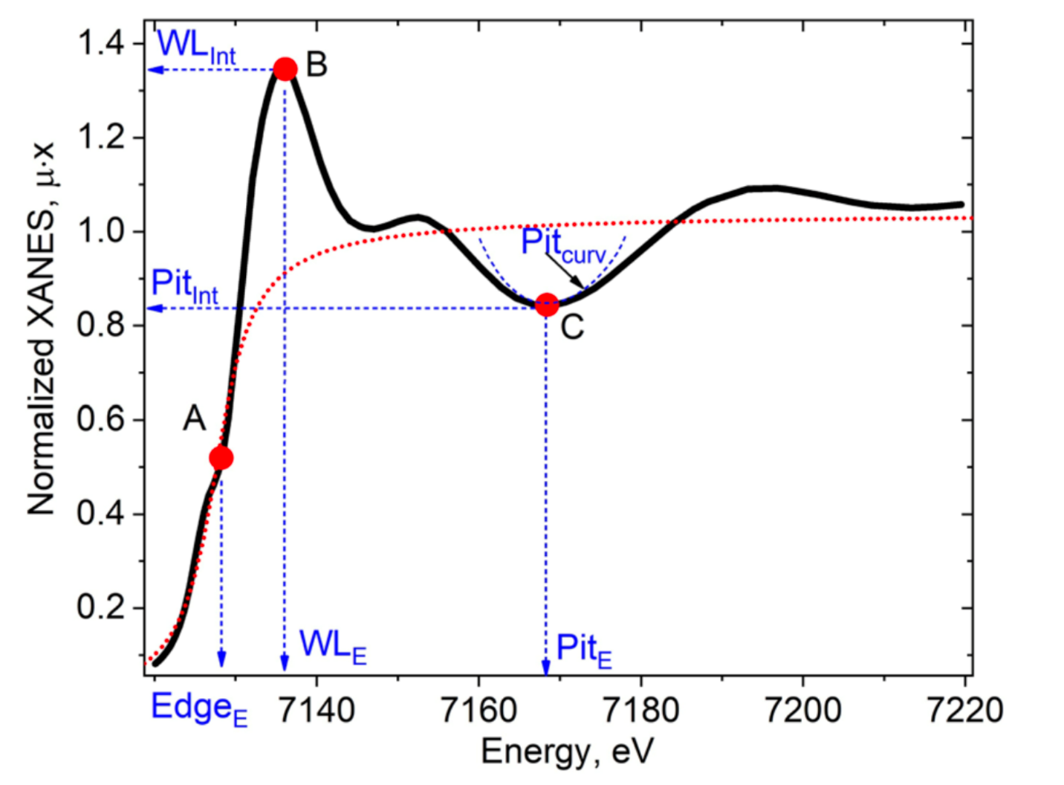
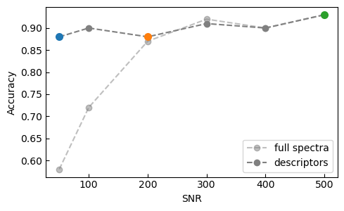
SPECTRAL DESCRIPTORS
Accuracy: 93.0±0.5%
Guda et al., Npj Comput. Mater. 7, 203 (2021).
Dimensionality reduction improves model efficiency, reduces overfitting, and enhances interpretability.
Edge Position (${Edge}_{E}$)
Edge Slope (${Edge}_{curv}$)
White Line Position (${WL}_{int}$)
First Pit Energy (${Pit}_{E}$)

Slide 10
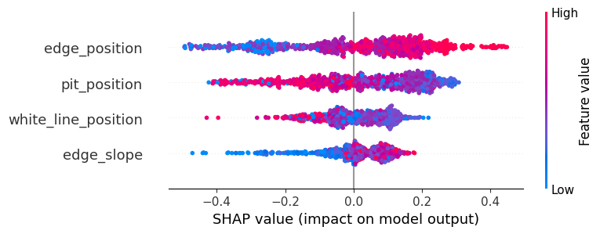
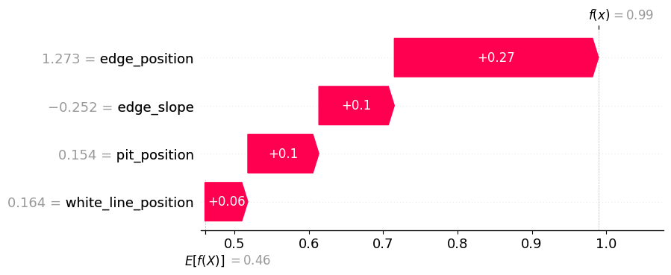
SHAPLEY VALUES FOR MODEL INTERPRETATION
Complex ML models improve prediction accuracy but reduce interpretability.
SHAP values clarify feature importance by showing their impact on model predictions.
arXiv:1705.07874
T:4
O:6
Waterfall plots illustrate how the prediction for a specific instance deviates from the average prediction across the entire dataset.
f(x): probability of classifying O:6 coordination.

Slide 11
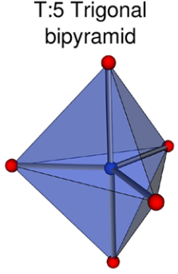
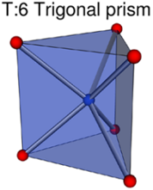
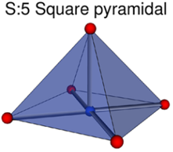
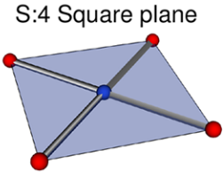
COMPLETE DATASET: BEYOND BINARY CLASSIFICATION
1856 spectra (59%)
833 spectra (26%)
153 spectra (5%)
106 spectra (3%)
104 spectra (3%)
98 spectra (3%)

Slide 12
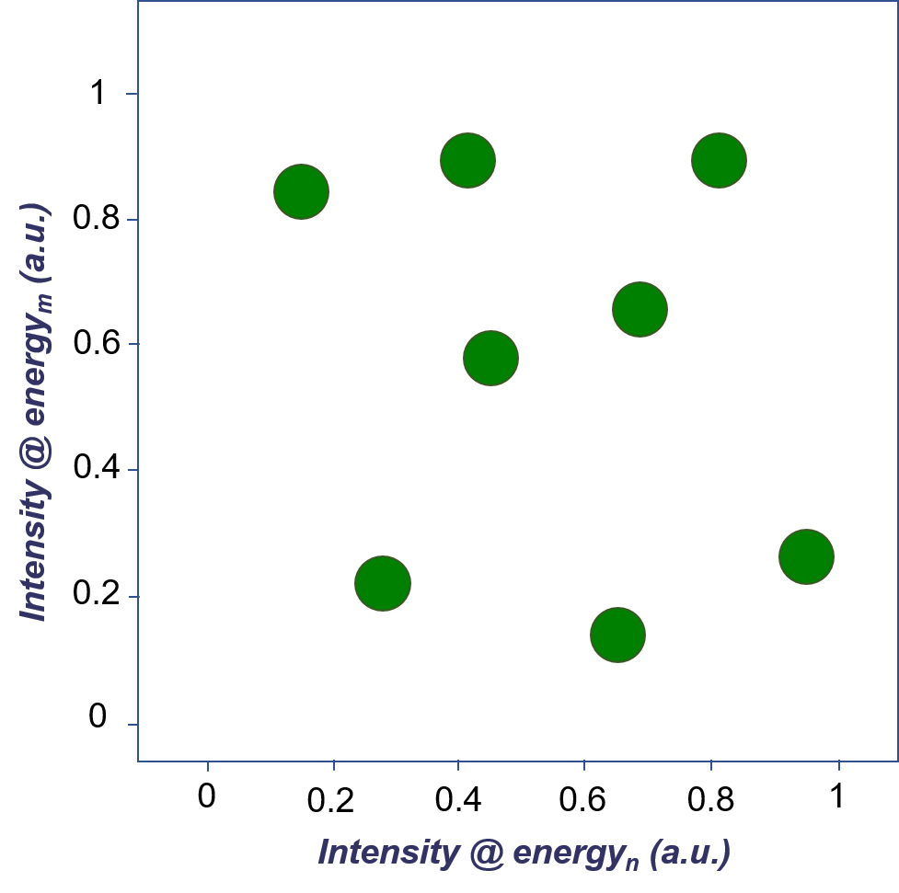
SYNTHETIC MINORITY OVERSAMPLING TECHNIQUE
Oversampling techniques are one way to solve class imbalances issues.
Chawla et al., J. Artif. Intell. Res. 16, 321–357, 2002.

Slide 13
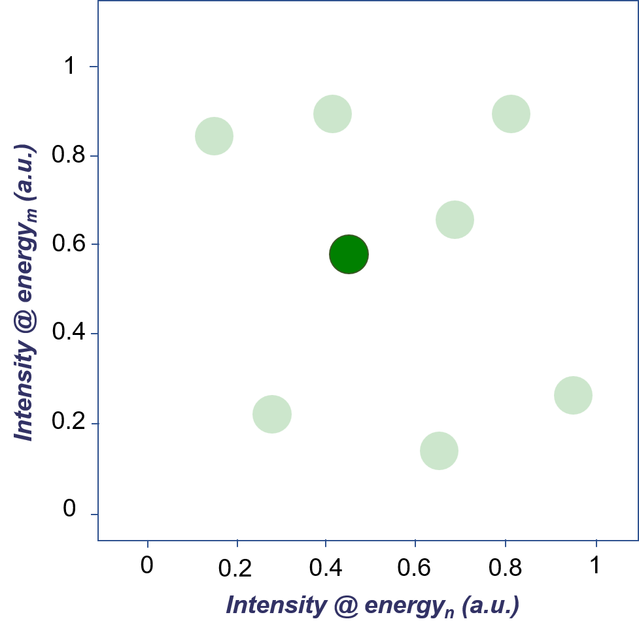
SYNTHETIC MINORITY OVERSAMPLING TECHNIQUE
Oversampling techniques are one way to solve class imbalances issues.
SMOTE algorithm:
Randomly select a minority class sample.
Chawla et al., J. Artif. Intell. Res. 16, 321–357, 2002.

Slide 14
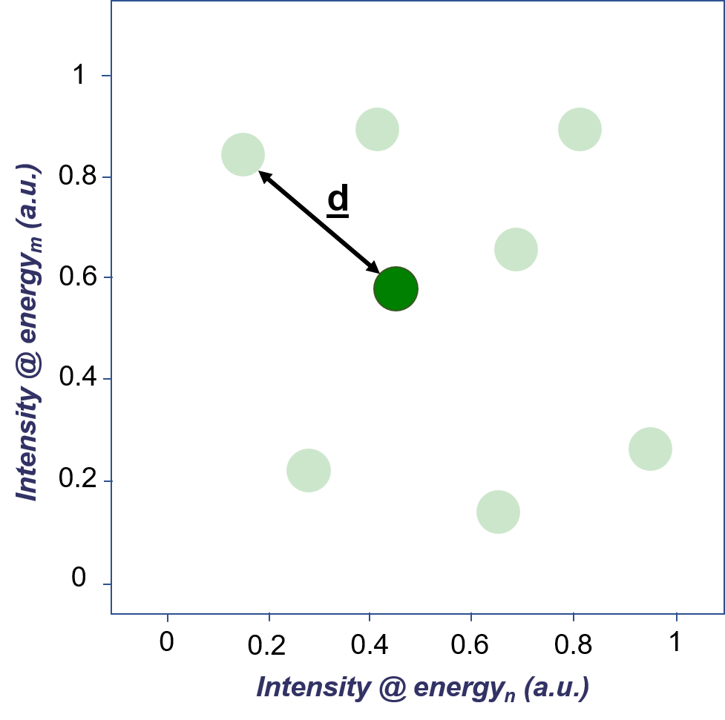
SYNTHETIC MINORITY OVERSAMPLING TECHNIQUE
Oversampling techniques are one way to solve class imbalances issues.
SMOTE algorithm:
Randomly select a minority class sample.
Choose one sample among the k nearest neighbors, then compute the difference between the feature values.
Chawla et al., J. Artif. Intell. Res. 16, 321–357, 2002.

Slide 15
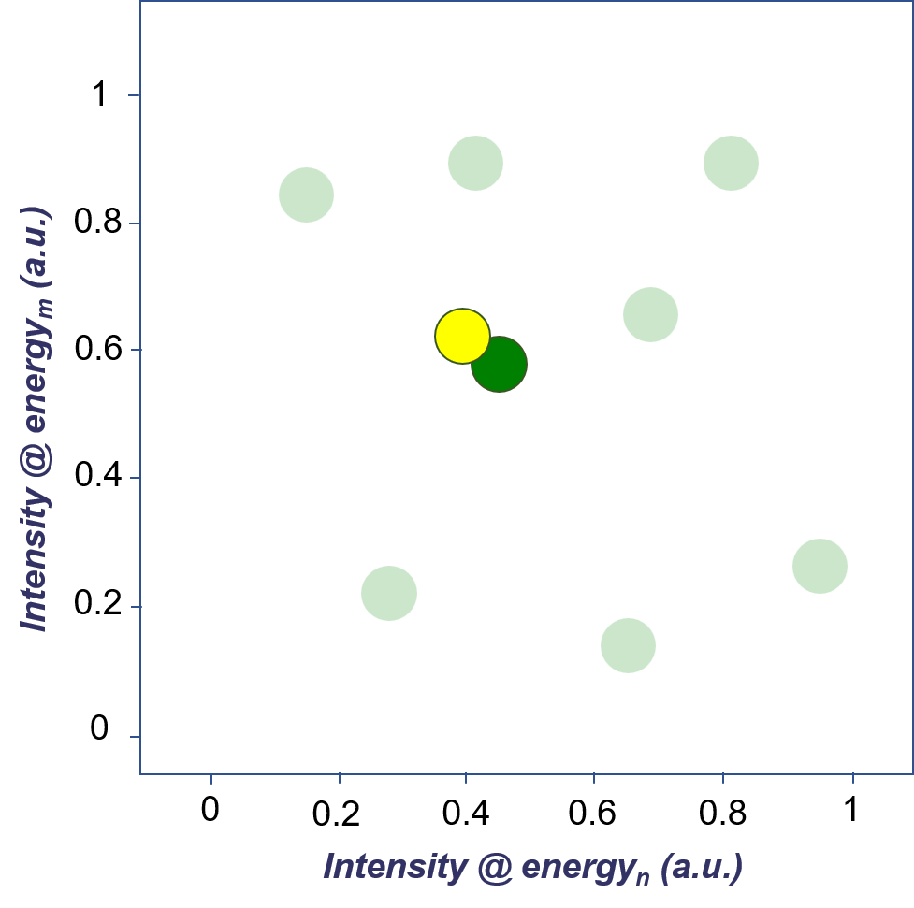
SYNTHETIC MINORITY OVERSAMPLING TECHNIQUE
Oversampling techniques are one way to solve class imbalances issues.
SMOTE algorithm:
Randomly select a minority class sample.
Choose one sample among the k nearest neighbors, then compute the difference between the feature values.
Multiply the difference by a random number between [0,1], then add it to the chosen sample’s features.
Chawla et al., J. Artif. Intell. Res. 16, 321–357, 2002.

Slide 16
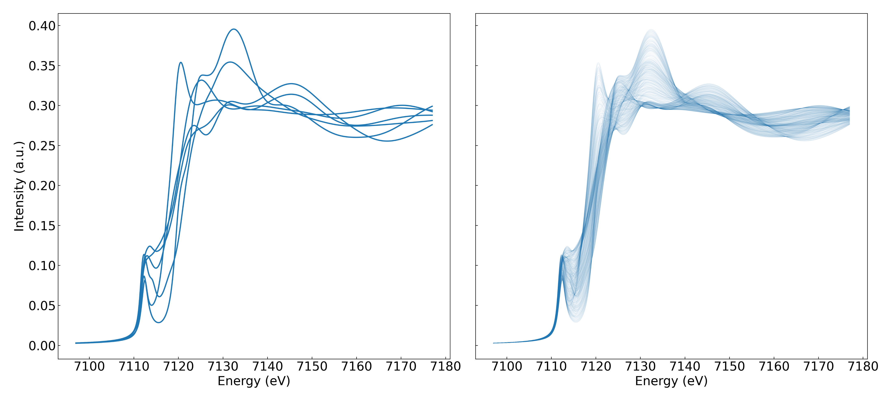
SYNTHETIC MINORITY OVERSAMPLING TECHNIQUE
SMOTE

Slide 17
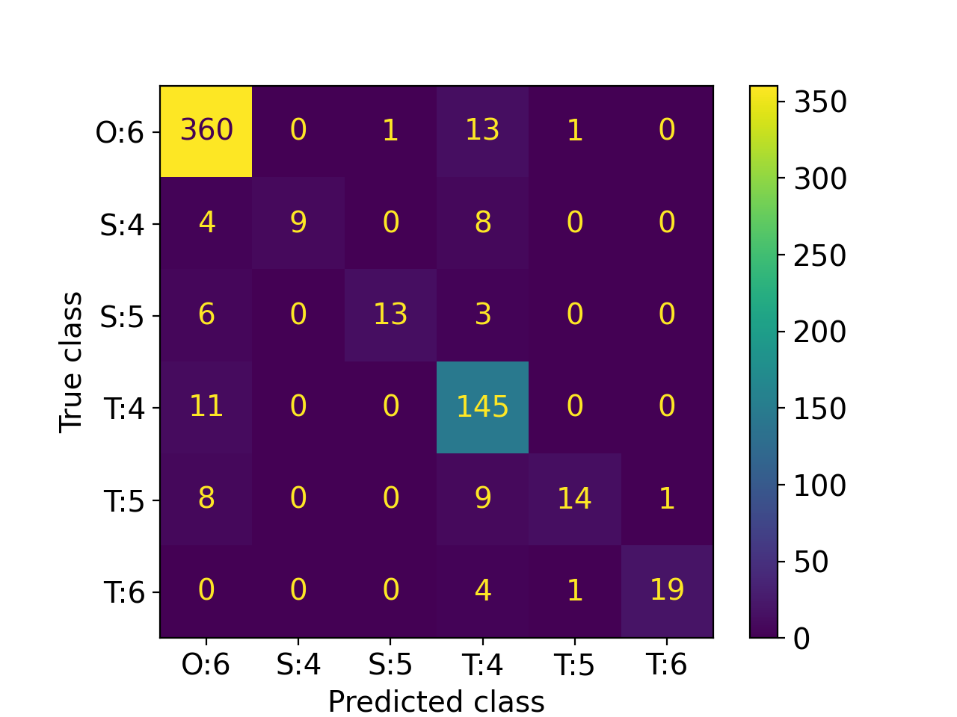
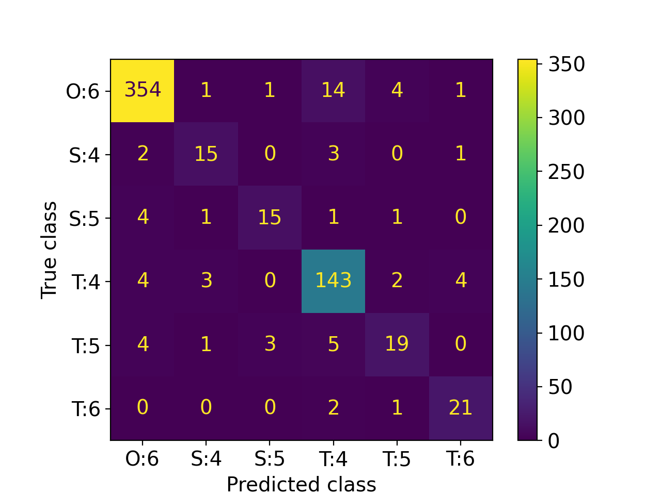
MULTICLASSIFICATION
Class imbalances can be solved using oversampling techniques,
like Synthetic Minority Over-sampling Technique (SMOTE).
Chawla et al., J. Artif. Intell. Res. 16, 321–357 (2002).
No oversampling - Accuracy = 70%
SMOTE - Accuracy = 79%
Only the training set is oversampled, the test set is fixed in size.

Slide 18
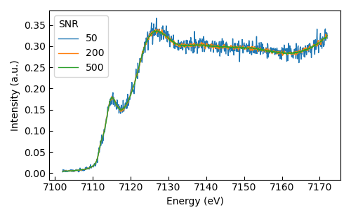
CONCLUSIONS
In the case of severely underrepresented classes, oversampling techniques such as SMOTE can help improve the metrics of the model.
The Random Forest algorithm is reliable for classifying materials’ properties from calculated data.
It is robust against shot noise, energy shifts, self-absorption.
Dimensionality reductions reduces overfitting, and enhances model interpretability.

Slide 19
Thank you for your attention!
”Enabling the next generation of computational physicists and engineers”
This work is partly funded by the European Union’s Horizon 2020 Research and Innovation Programme under the Marie Sklodowska-Curie COFUND scheme with grant agreement No. 101034267.

Slide 20
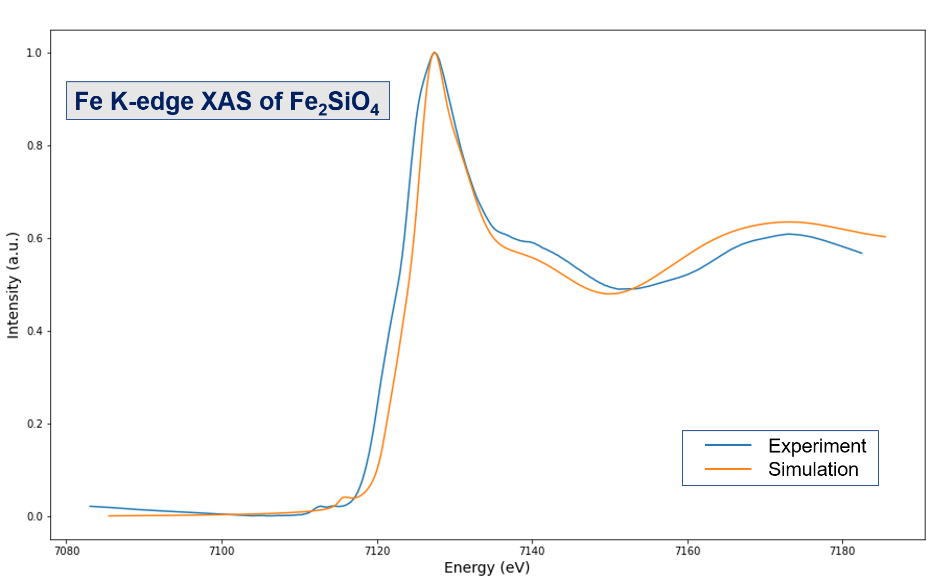
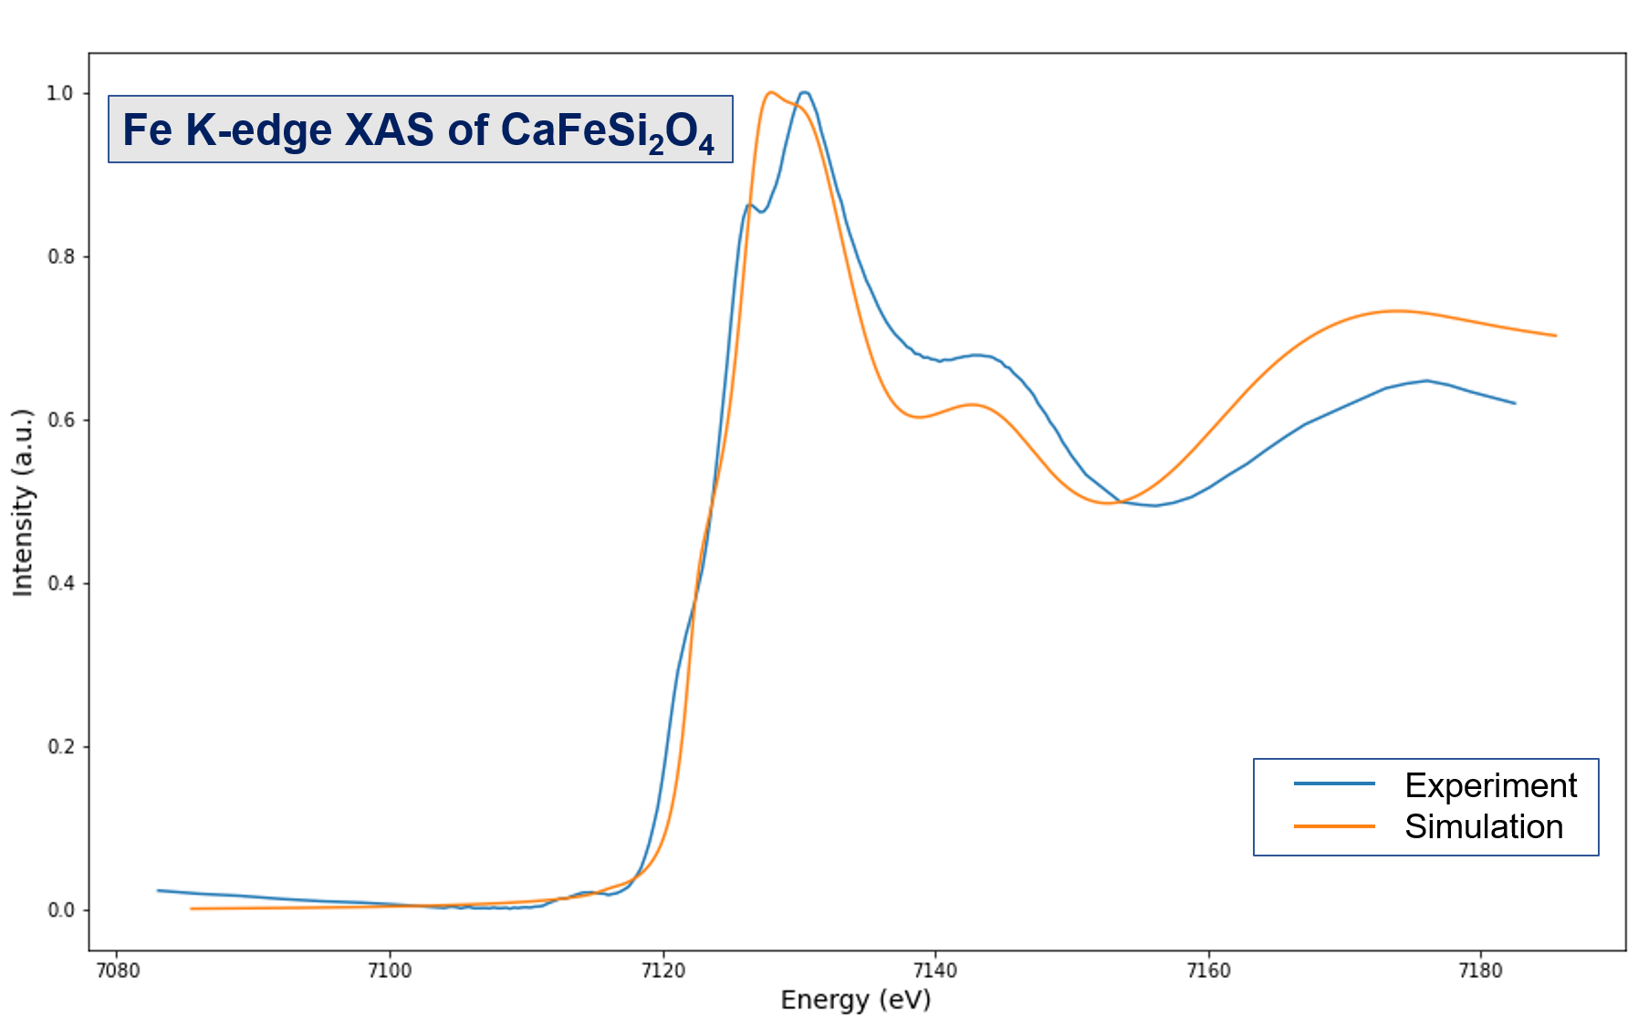
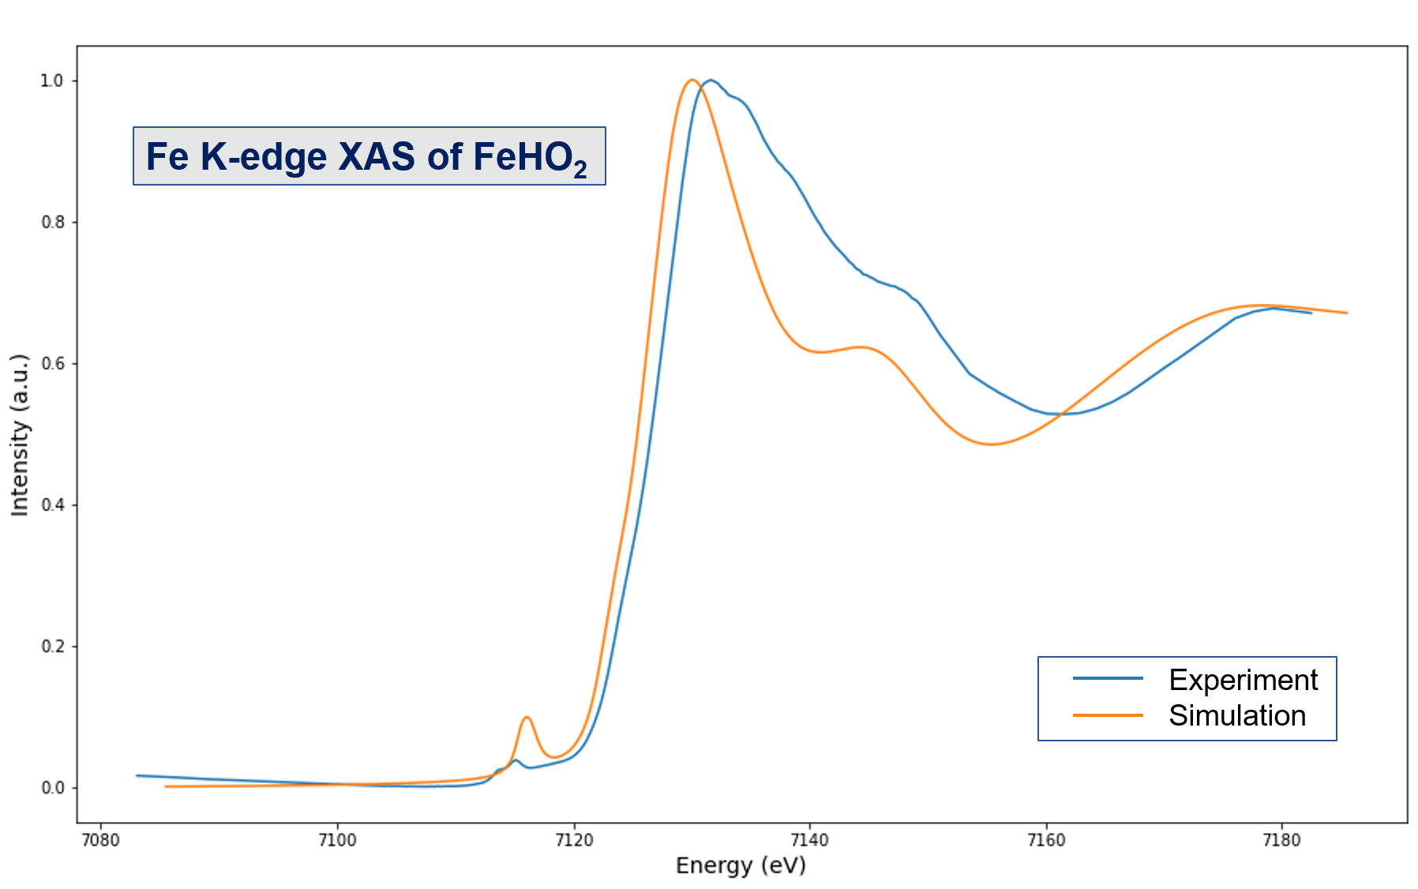
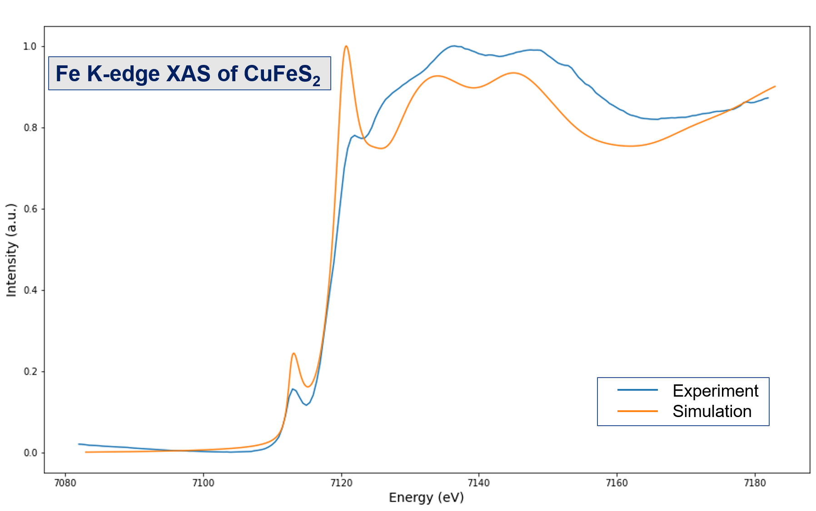
FDMNES vs EXPERIMENT

