Slide 1
Automation of X-ray Fluorescence Experiments at Synchrotrons Using AI
Rodion Shishkov :: ESRF – ID16A :: June 20 , 2025
rodion.shishkov@esrf.fr

Slide 2
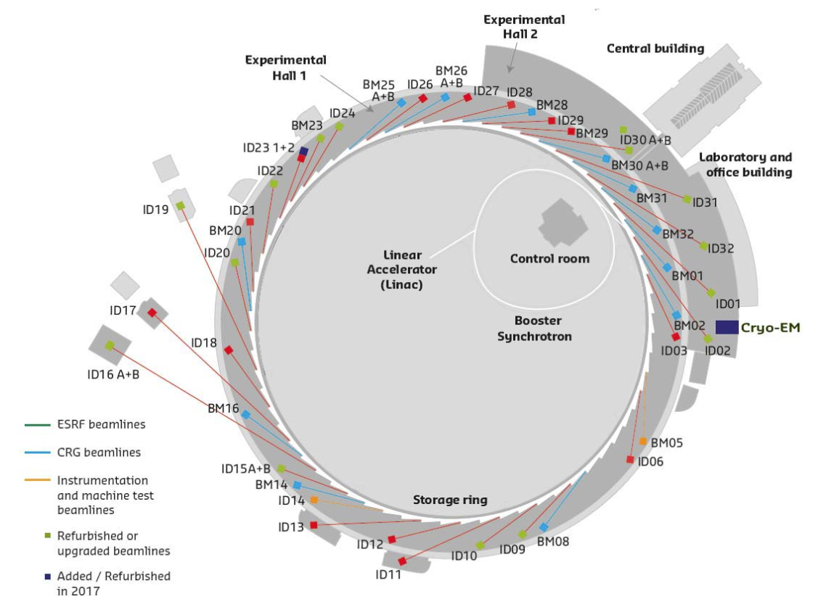
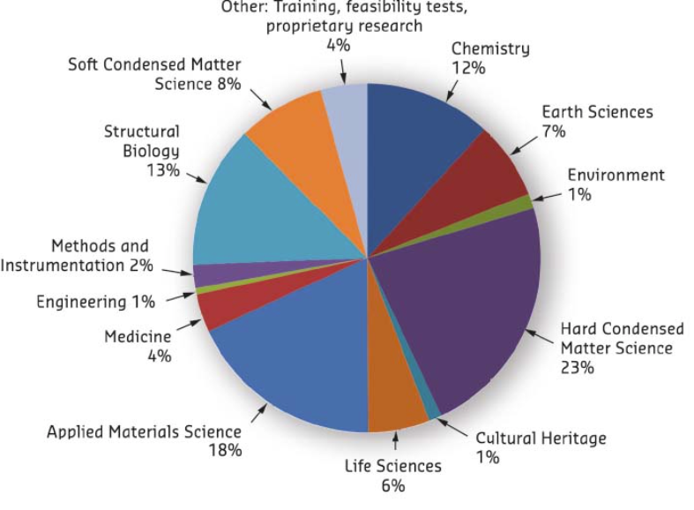
Synchrotron – users facilities
Experimental hall of ESRF
~44 beamlines in total.
Shifts delivered for experiments, March to July 2017
Notes:
Motivation for my project
Many beamlines, various scientific disciplines

Slide 3
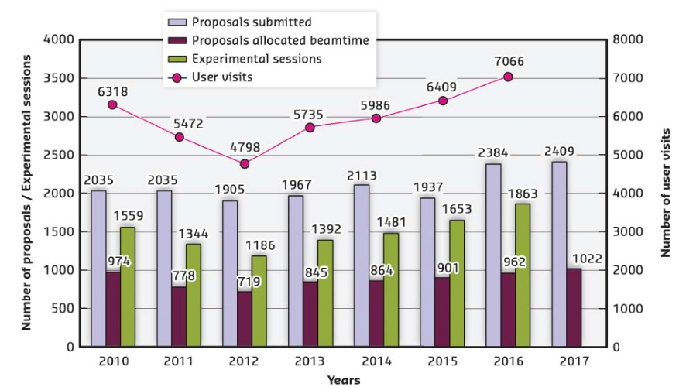
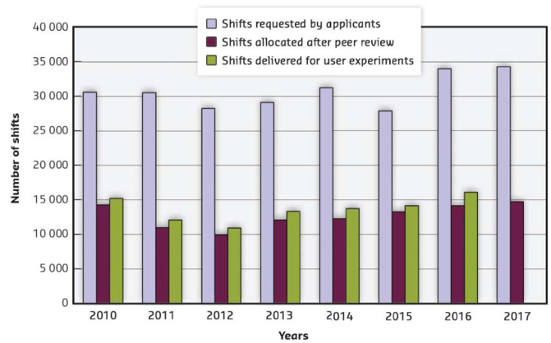
Beamtime at high demand
Number of applications for beamtime, experimental sessions and users visits
Amount of beamtime requested, allocated and delivered
High demand: The number of experiment proposals at synchrotron facilities continues to rise each year.
Limited access: Only a fraction of submitted proposals receive beamtime, and even accepted projects are often allocated significantly less time than requested.
Efficiency is critical: Maximizing experimental efficiency is essential—not only because time is limited and valuable, but because higher data throughput often leads to stronger scientific outcomes.
Notes:
Beamtime – is at high demand, number of submitted proposal growing, the amount of delivered beamtime is smaller than requested time
To keep up with the demand, it is necessary to constantly improve efficiency by developing more efficient methods and employing autmotization

Slide 4
Objectives of my thesis project
Explore potential of AI for the automation of experiments at ID16A beamline
Develop NN-based pipeline for sample pre-characterization, adaptive sample scanning, and data treatment
Increase beamline efficiency by improving data quality and acquisition time via AI
Minimize involvement of an operator during an experiment to reduce human error
Notes:
In this context, in my thesis, I study potential of AI for automation of experiments at ID16A. In particular…., which should increase and minimize

Slide 5
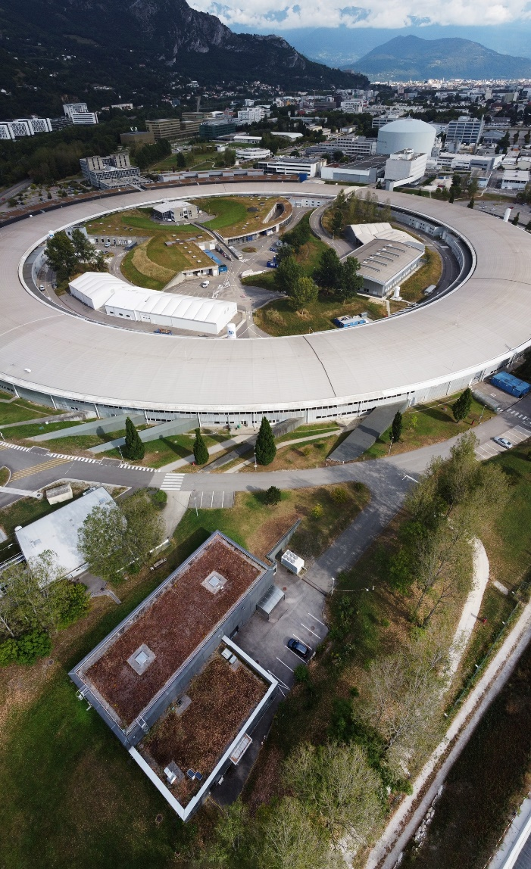
Id16a x-ray nano-probe beamline
My focus is XRF
ID16A

Slide 6
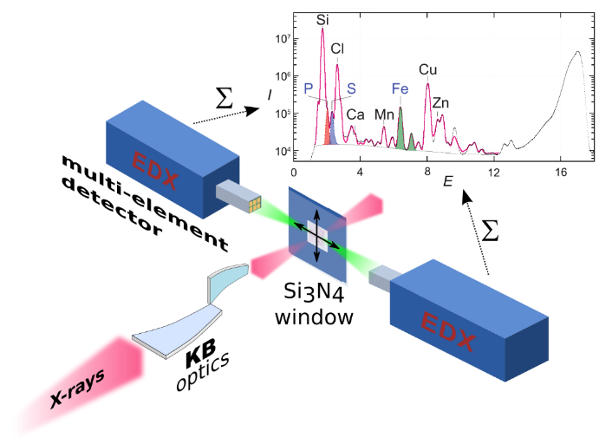
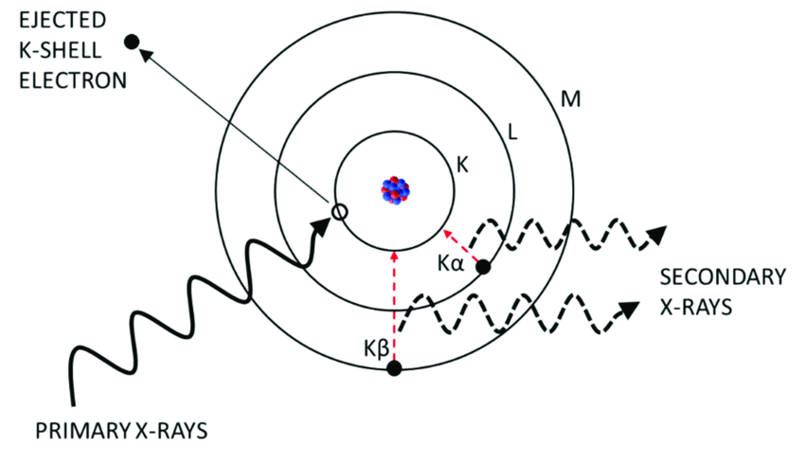
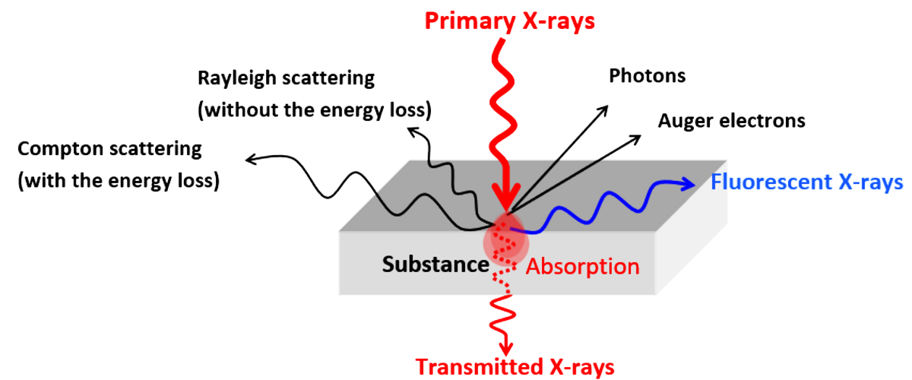
X-ray fluorescence imaging
Scanning technique → relies on the focus size and motors precision;
Access to multiple elements simultaneously;
Detection in an energy range from Al-Kα X-ray emission line (1.48 keV) to the excitation energy (17.1 or 33.6 keV);
Quantification through fixed experiment geometry & calibration standard.
Notes:
All is familiar with concept of XRF phenomenon. At our lab, we use 2 discrete excitation energies. XRF imaging – raster. We can achieve very high res. The scanning is performed by moving sample via sample stage equipped with precision motors.

Slide 7
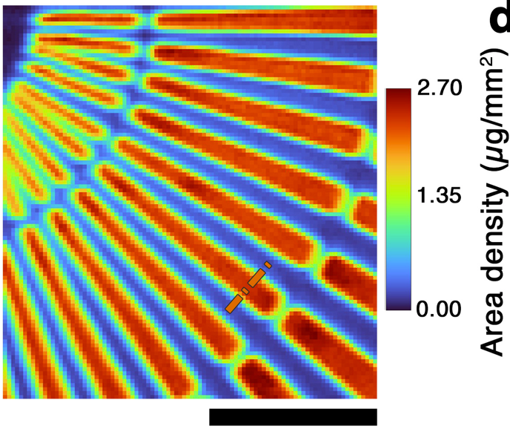
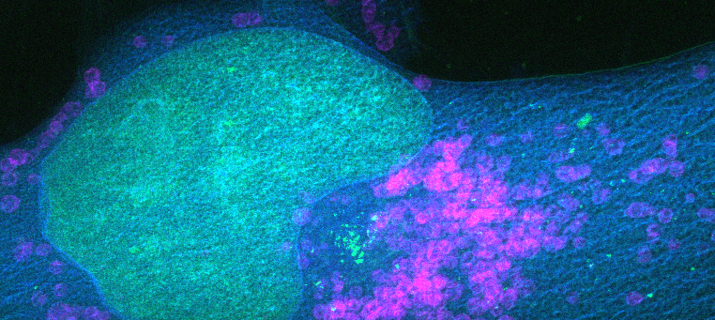
Examples of xrf imaging
K Zn Ir
5 um
2 um
XRF Image of human cancer cell obtained at ID16A | Resolution ~90nm resolution
Image of Siemens Star (Au)
Resolution ~50nm
Notes:
Here is some example of XRF images. Siemens. Enable quantitative and qualitive analysis. Pixel values – elemental concentration at a given point

Slide 8
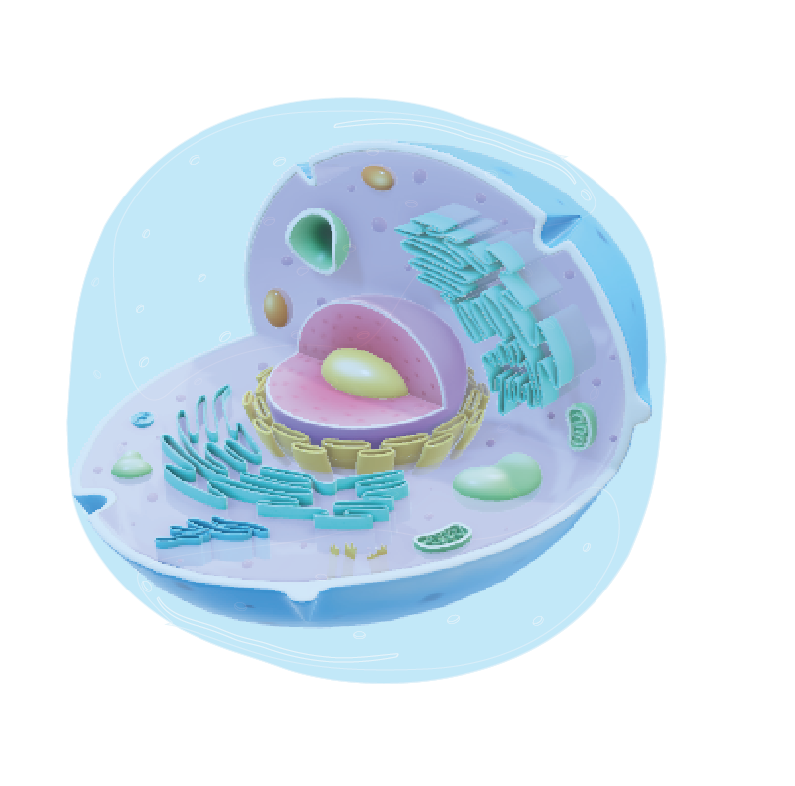
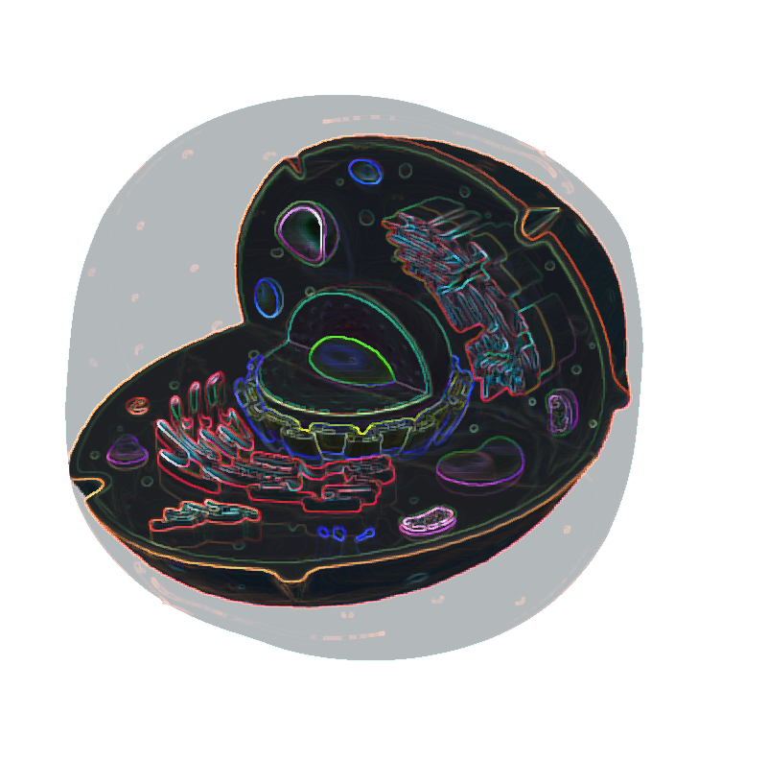
Applications of xrf at id16a
XRF for Drug development and cancer research
treatment
?
toxicity
effect
modification
nanomaterials
Notes:
At our lab, XRF is used for many disciplines such as material and battery science, environmental science and more often for biology and medicine such as cancer and drug research. This studies focus on effect of novel drugs and compounds on the live cells to better understand their mechanics and interaction.

Slide 9
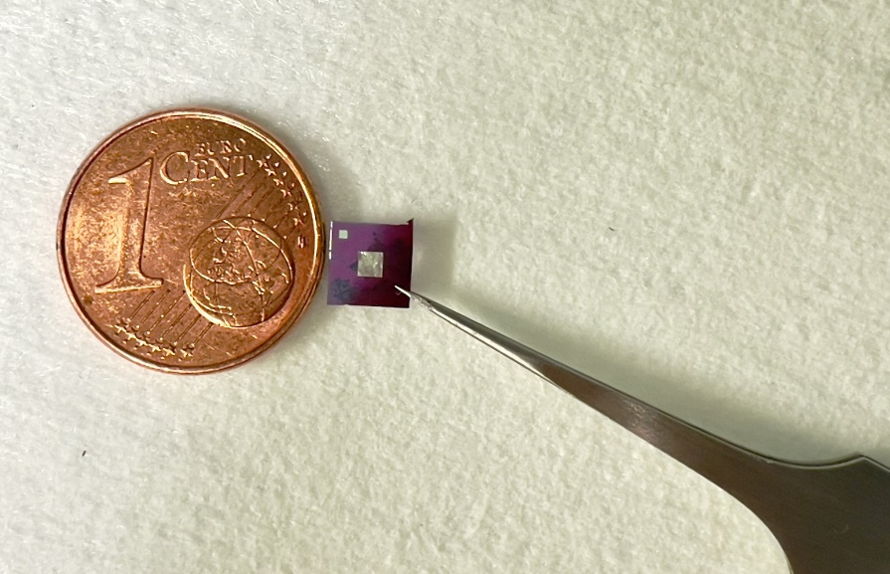
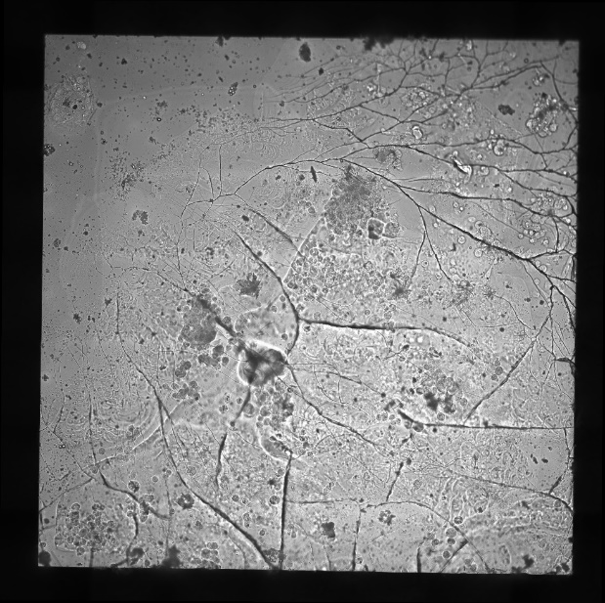
Live cell samples
treatment
?
Approx. 10 nano-XRF scans per beamtime
Multiple beamtimes → statistical significance
toxicity
effect
modification
nanomaterials
Dr. Karpov et al. (manuscript submitted)
1500 µm
On the membrane ca. 1000 cells of different morphology, stages of growth, etc.
No problem with statistics!
Notes:
we scan 10 cells. But this studies want statistically significant data.
So they ask for more beamtimes to get more data.However, our samples already contains thousands of cells. We just scan them all.

Slide 10
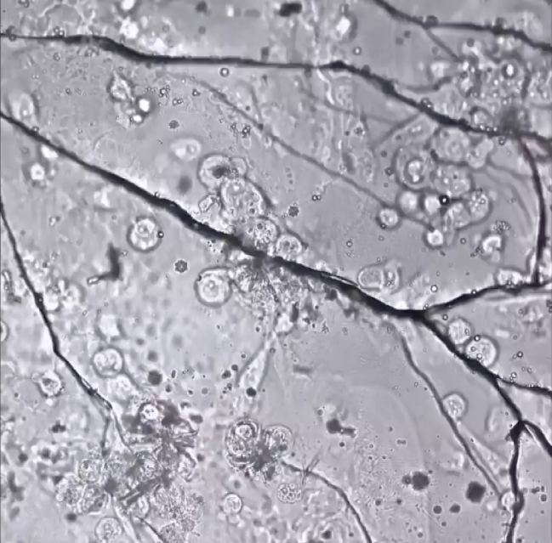
Live cells on a membrane
Bright-field cryo-microscopy
Beamline-integrated microscope field of view
XRF scan range
400 µm
40 µm
1500 µm
Notes:
Trade-off (precision vs speed). View of a sample during experiment. And overview of a scan with maximum motor range of 40x40um. The sample is on stage with coarse motors to navigate and precision motors with limited range used for scanning.

Slide 11
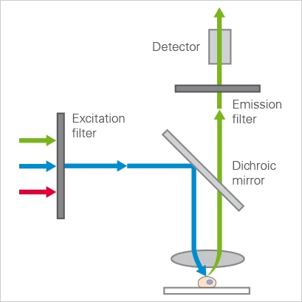
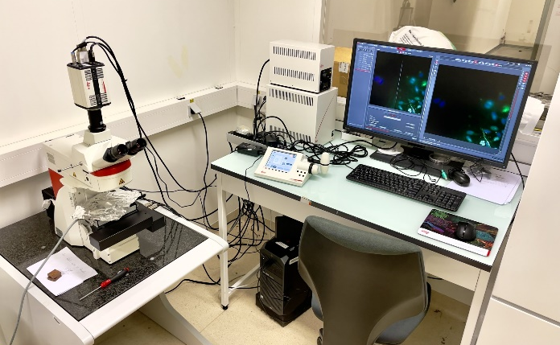
Optical fluo-Imaging
Bright-field cryo-microscopy
Optical fluorescence microscopy
Image courtesy ibidi
Leica Thunder cryo-CLEM @ ID16A
Notes:
So since we cannot scan the entire sample, we must be selective and efficient when collecting data. To aid selection of cells for XRF scanning we use CLEM. Clem allows dying specific organelles of cells which allows selection of interesting cells, morphologically, location, type etc.

Slide 12
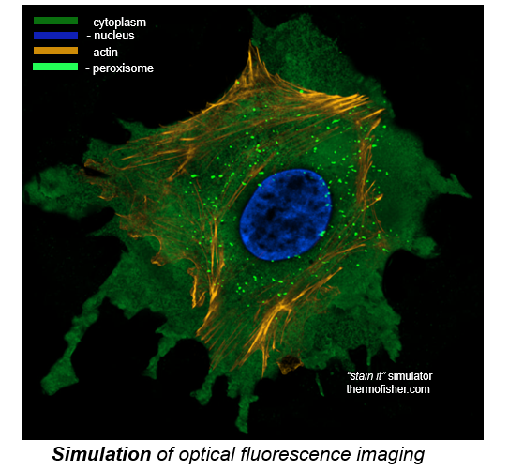
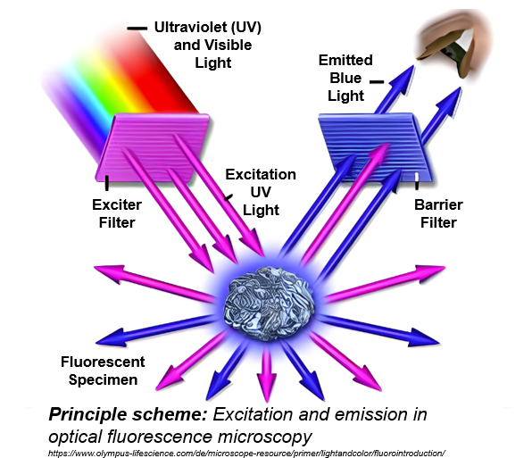
Optical fluorescence dyes
Notes:
Example of use of optical fluo dyes (show previous image)

Slide 13
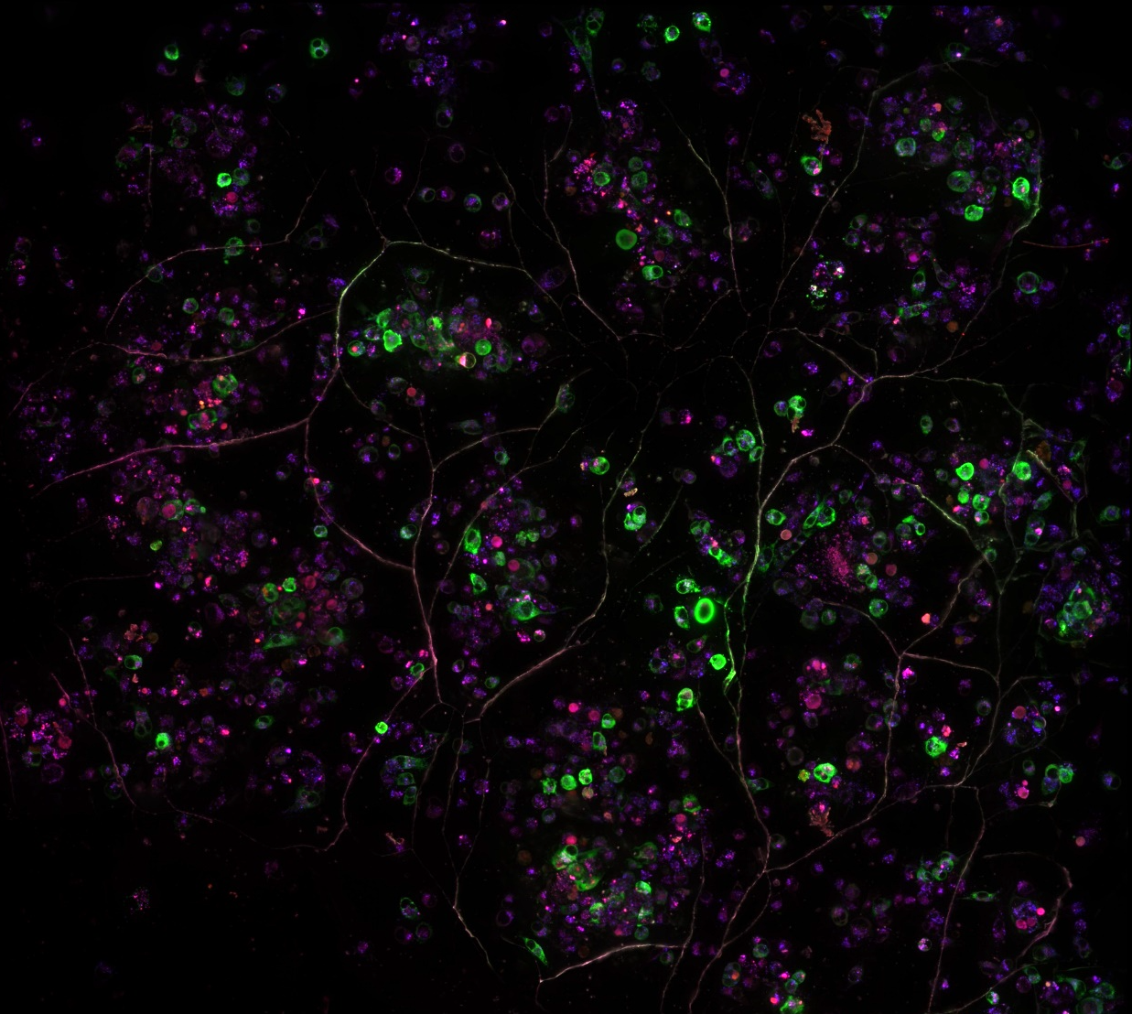
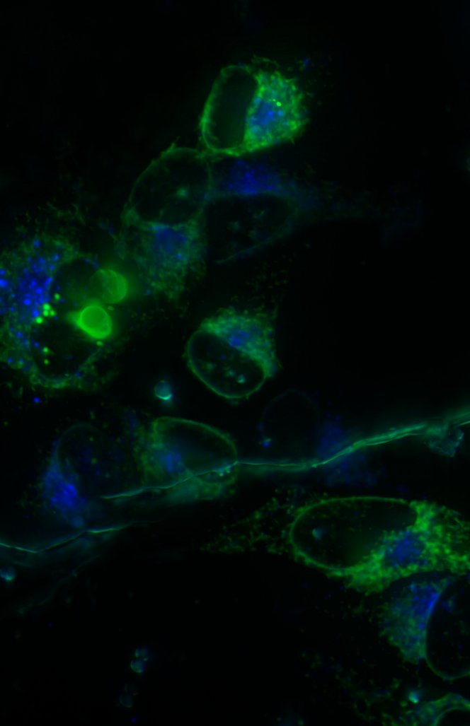
Clem fluo-imaging
endosome 🛃
lysosome 🗑
reticulum
🚛 🚛 🚛 🚛 🚛
10µm
100µm
30µm
Notes:
Here you can see the image of a sample obtained with our clem miscrope. Here they used a bunch of dyes to highlight different cell compartment.

Slide 14
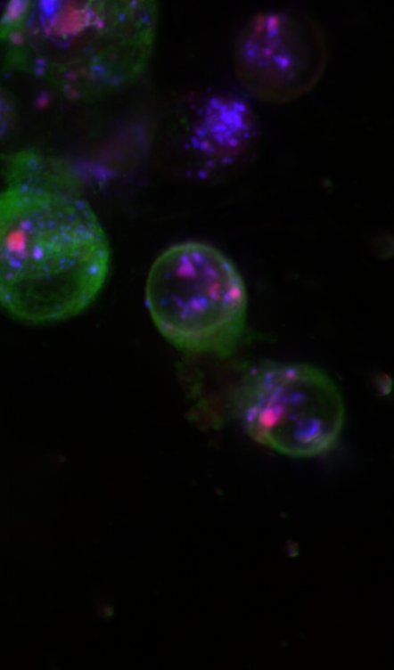
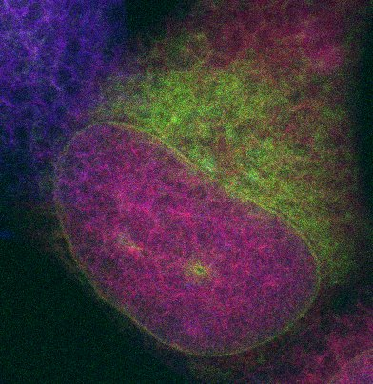
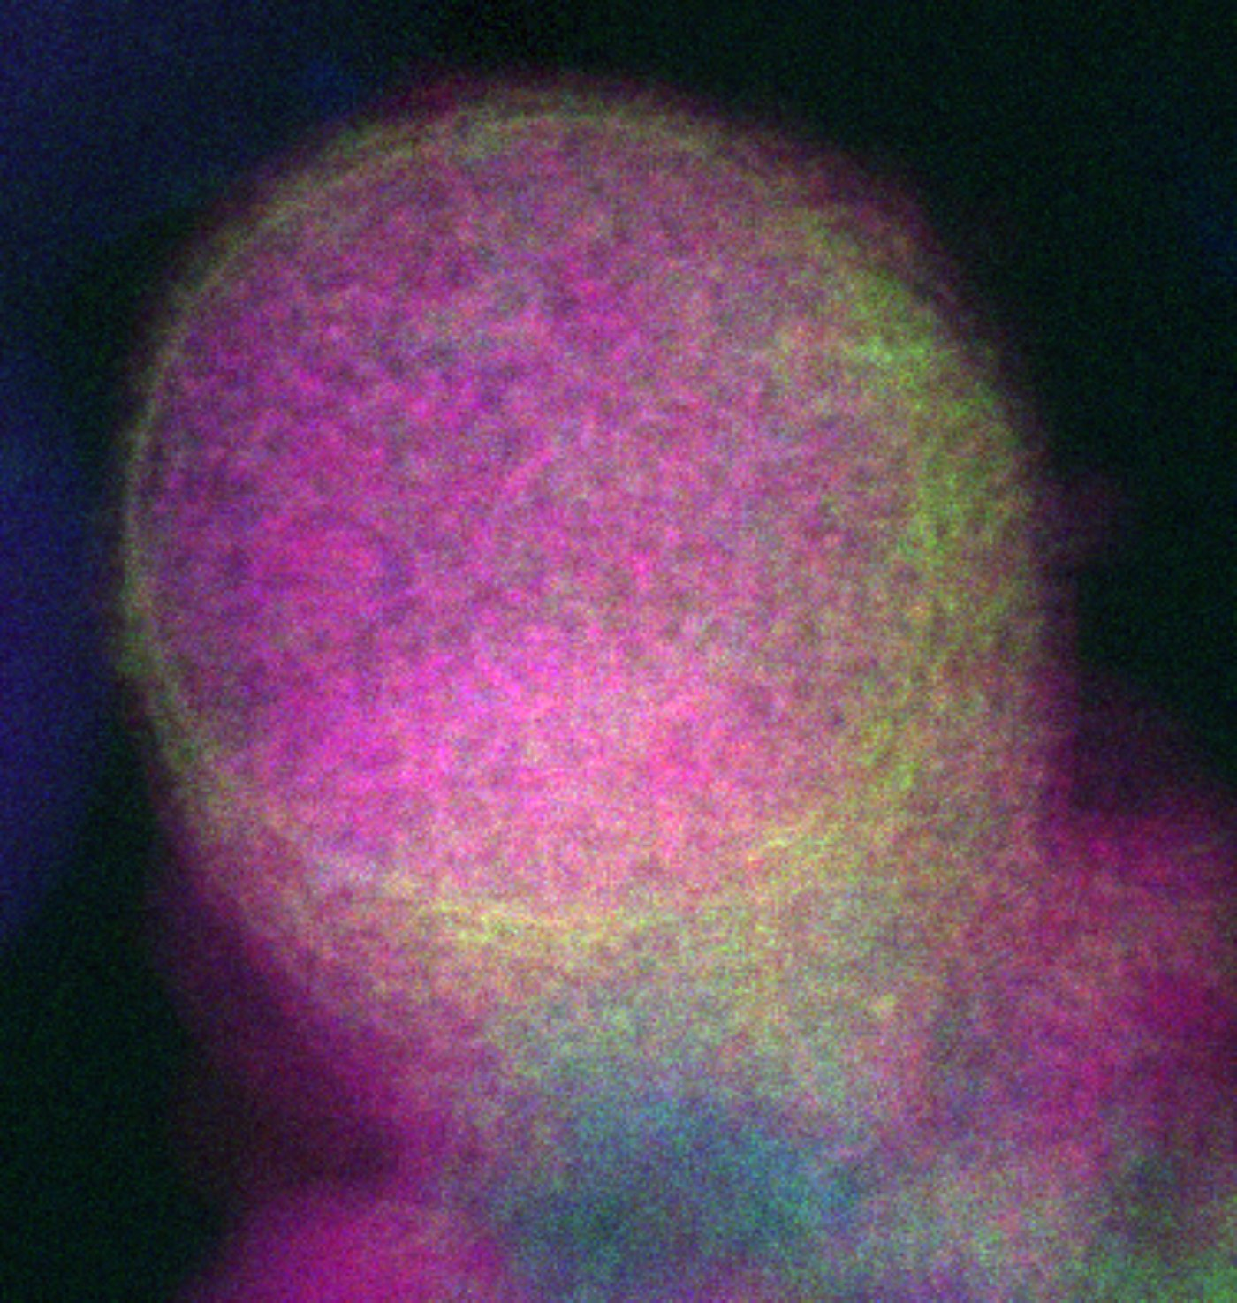
X-ray fluorescence imaging
optical
fluorescence
XRF
K
Os
Zn
10µm
Osmium
nucleus
Osmium
XRF
endosome 🛃
lysosome 🗑
reticulum
🚛 🚛 🚛 🚛 🚛
30µm
K
Os
Zn
10µm
Osmium
Notes:
And here some example of cell image on CLEM miscopy and resulting XRF. So we basically use the dark images of our sample to find best cells and during the experiment an operator must map cells on dark images to bright field miscroscope.

Slide 15
Segmentation of clem images
Notes:
So, there is a lot of involvement of an operator and manual work required to perform this exp in standard setup. Instead, we decided to try doing that for an operator via help of AI. Since we have all this images of a sample before the experiment, we can process them

Slide 16
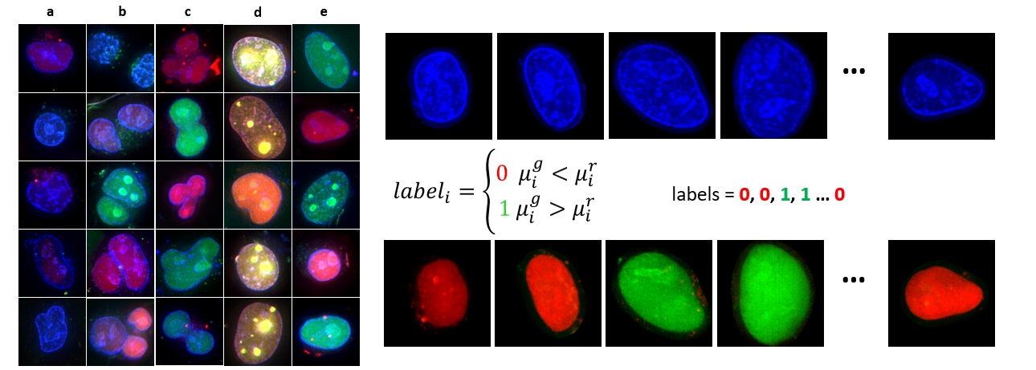
Cell cycle classification
Automatic Labeling and Filtering
Example of filtered nucleus crops: a) colorless cells, b) cells that are too close to one another, c) abnormal shapes, d) yellow cells correspond to transition phase between G1 and S, e) cells that passed all filtering criteria
Training and Inference
Notes:
Next, since dyes are expansive but they carry important information, we also tried to remove them from the equation. There is a blue dye which is always used in optical fluo imaging, it is inexpensive and easy to apply. And it carries information about nucleus content.

Slide 17
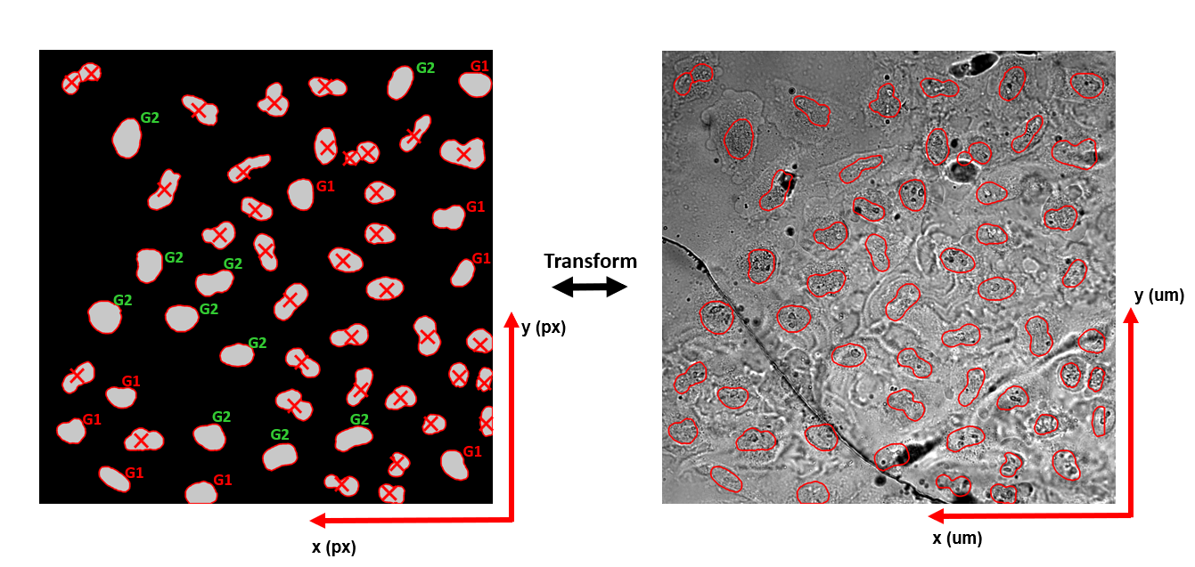
Pixel coordinates transformation
Classification of cell phase (age)
Beamline microscope view
Notes:
All previous stuff done before exp. Now, we get to experiment. We have applied two networks one to segment, another one to identify the phase, and a bank of filters to filter out strange cells. Our task is not to predict all cells and all their params but to find cells that we are confident in since our sample contains thousands of them and at best we can maybe a few hundreds.

Slide 18
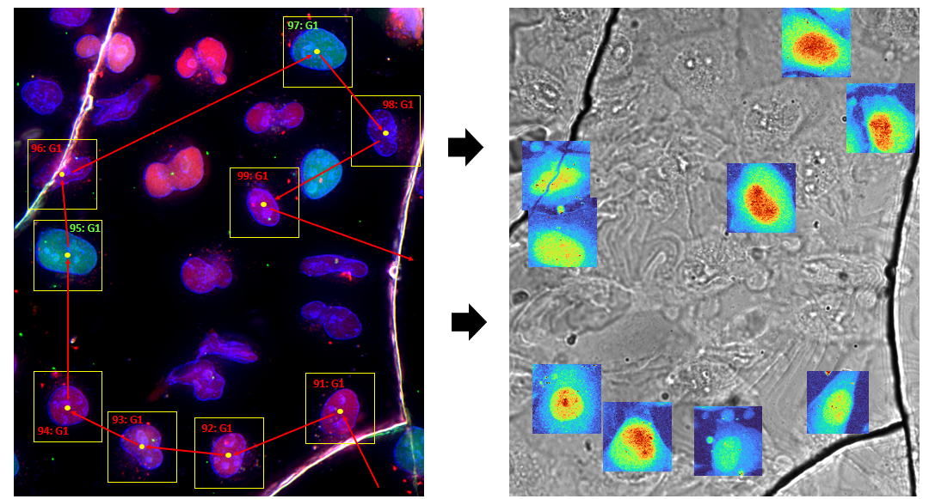
Automatic xrf pre-scanning
A
B
A – Planning and optimizing the scanning trajectory for preselected cells after filtering. B – Brightfield image of a sample captured by the beamline microscope with overlaid XRF pre-scans, as seen by the beamline operator during the experiment. The XRF maps shown correspond to zinc (Zn) traces
Notes:
Here is how automatic scanning with mapped coordinates look like. First we plan scanning trajectory and scanning boxes, then we perform PRESCANNING at low res. But what is low for us is how for others. Next, we collect hundersds of pre-scans

Slide 19
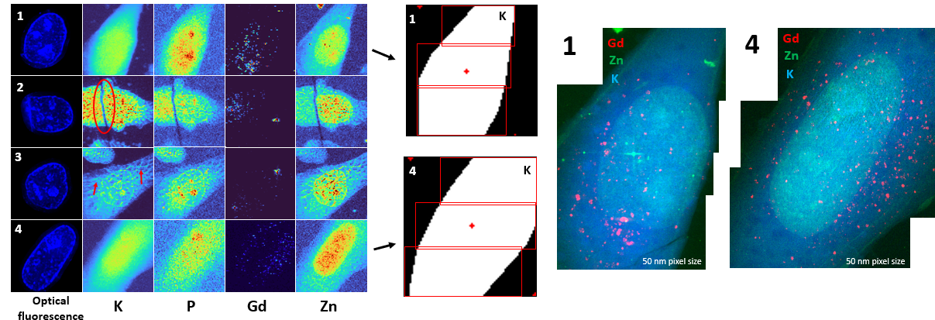
PRE-SCANS EVALUATION AND HIGH-RES SCANNING
A
B
C
A – Example of supervised evaluation of automatically acquired pre-scans. Note that row 2 revealed an ice crack that ruptured the cell membrane, while row 3 shows signs of unwanted cell dehydration.
B – Segmentation of Potassium XRF maps and further high-resolution scan formulation.
C – Corresponding high-resolution XRF maps
Notes:
We there are being collected, we process them automatically to get the fit. The fits are then inspected by a specialist to identify a few for high res scanning. Pre scan (5-10 mins) high res (5-10h). To further speed up scanning in high res, we segment

Slide 20
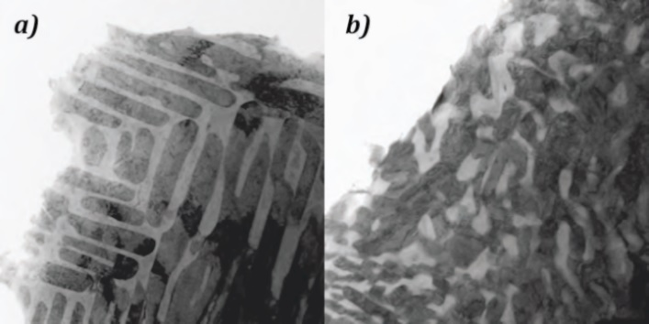
Treatment of xrf data - motivation
Achieving finer spatial resolution requires denser, point-by-point scanning => (longer acquisition and increased radiation dose)
Longer acquisitions raise operational costs for laboratory instruments and constrain throughput at synchrotrons
Achieving high resolution and sensitivity under fast, low-dose conditions therefore remains highly desirable for XRF
Radiation damage
https://cams.llnl.gov/cams-competencies/radiation-damage-materials-modification
Promising solution – Improve
Signal to Noise Ration via computational methods

Slide 21
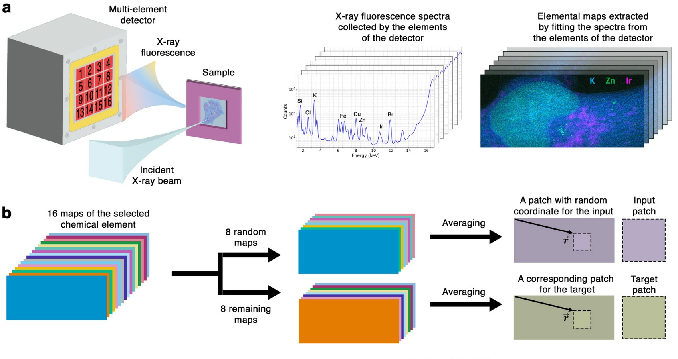
Overview of the proposed pipeline for denoising XRF data
(a) XRF data acquisition and fitting.
(b) Generation of a single training pair.
Notes:
Normally, all data is collapsed to improve statistics but we instead leverage from redundancy of the data offered by multi element detector

Slide 22
Overview of the proposed pipeline for denoising XRF data
(c) Training of a U-Net using the Noise2Noise approach.
(d) Inference with the trained U-Net

Slide 23
Results siemens star
Denoising results for the Siemens star sample. The scale bars in (a–c) represent 1 um. (a) Weighted sum image of the low-photon-count data (Au). (b) Denoised version of (a) using the proposed approach. (c) High-photon-count reference image. (d) Line profile comparison extracted from the corresponding regions indicated by green, blue, and orange lines in (a–c).

Slide 24
Results cell sample
Denoising results for the human cancer cell sample. (a–c) Overlaid elemental maps of K, Zn, and Ir from: (a) 10 ms dwell time image, (b) denoised 10 ms image, and (c) 50 ms reference image. (d–f), (g–i), and (j–l) show cropped views of K, Zn, and Ir, respectively, from the same region highlighted in (a–c)

Slide 25
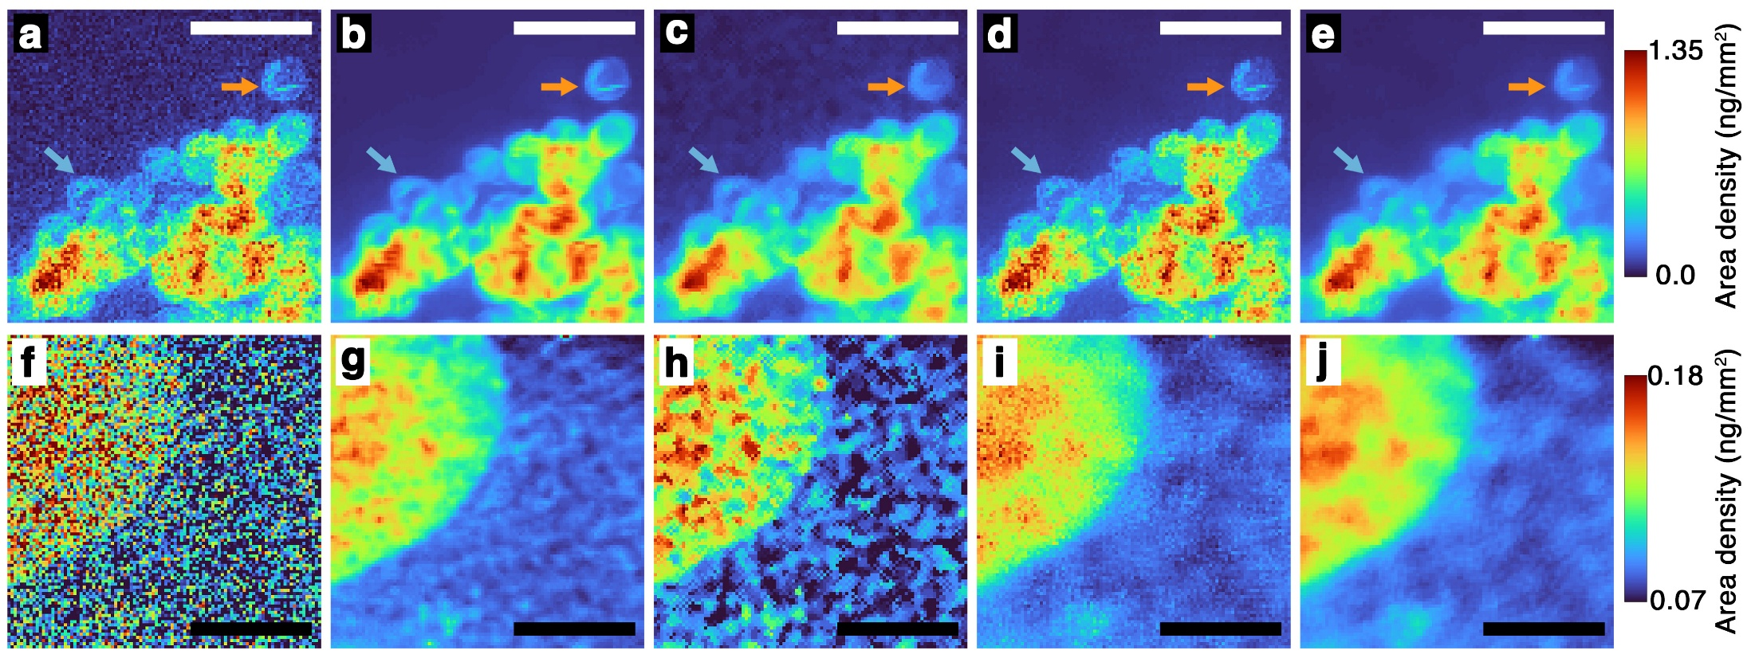
Comparison with other denoising methods
Comparison of denoising performance between the proposed approach (b, g), spatial median filtering (c, h), non-local means (NLM) (d, i), total variation (TV) regularization (e, j), and the untreated 10 ms weighted sum images (a, f). Denoising was performed on the full-size 10 ms weighted sum images, and the panels display zoomed-in views of the central region: Ir maps in (a–e) and Zn maps in (f–j).

Slide 26
acknowledgments
Thanks for your attention!
This work is partly funded by the European Union’s Horizon 2020 Research and Innovation Programme under the Marie Sklodowska-Curie COFUND scheme with grant agreement No. 101034267
Special thanks to Peter Cloetens, Sylvain Bohic, and Dmitry Karpov for their great help!

