Slide 1
Deep Learning for 3D Synchrotron X-ray Tomography Data
Date: 18, June 2025
H2020 ENGAGE CONFERENCE
Project Title:
PhD Student:
Syed Muhammad Haider Shah
The Cyprus Institute (CYI)
Department of Computation-Based Science & Technology Research Center (CASTORC)
Synchrotron-light for Experimental Science and Applications in the Middle-East (SESAME)
ID10 – BEATS
Name of Supervisor(s):
Associate professor: Dr. Mihalis Nicolaou
Scientific Director: Dr. Andrea Lausi
Research Assistant: Dr. Gianluca Lori
Associate Professor: Dr. Giannis Koutsou

Slide 2
Background:
Synchrotron X-ray Computed Tomography (SXCT) is an advanced imaging technique that uses powerful X-rays generated by a synchrotron. It allows to capture high-resolution, 3D images of materials, including biological tissues like bone.
Scan very quickly (ideal for in-situ or real-time experiments),
Provide detailed images of internal structures without cutting the sample,
Use tunable and intense X-ray beams, which improve image contrast and clarity.

Slide 3
Problem:
SXCT offers unique opportunities for scanning biological mineralized specimens but can lead to damage and alteration of the tissue.
For use cases such as cultural heritage and archaeological specimen imaging, or biomechanical studies where the mechanical properties of the tissue are investigated, radiation damage is inadmissible and must be avoided.
Radiation damage is inadmissible and must be avoided.

Slide 4
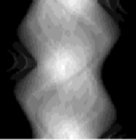
GOAL:
Propagation-based phase contrast imaging​
Monochromatic beam scans​
Sparse view CT ​
Sparse sinogram enhancement with ML​

Slide 5
Project Divided Into Three Sections:
Dataset Acquisition
Sparse View Reconstruction
Utilizing AI-based tools to obtain Artifacts-free scans

Slide 6
SECTION 1: DATASET ACQUISITION

Slide 7
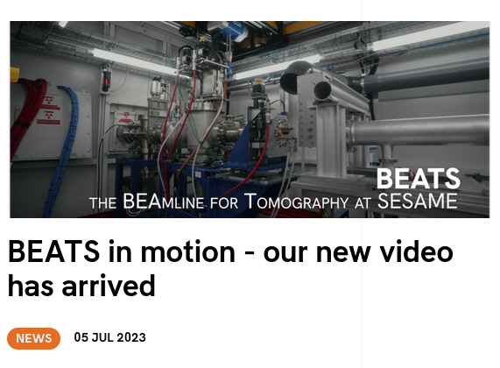
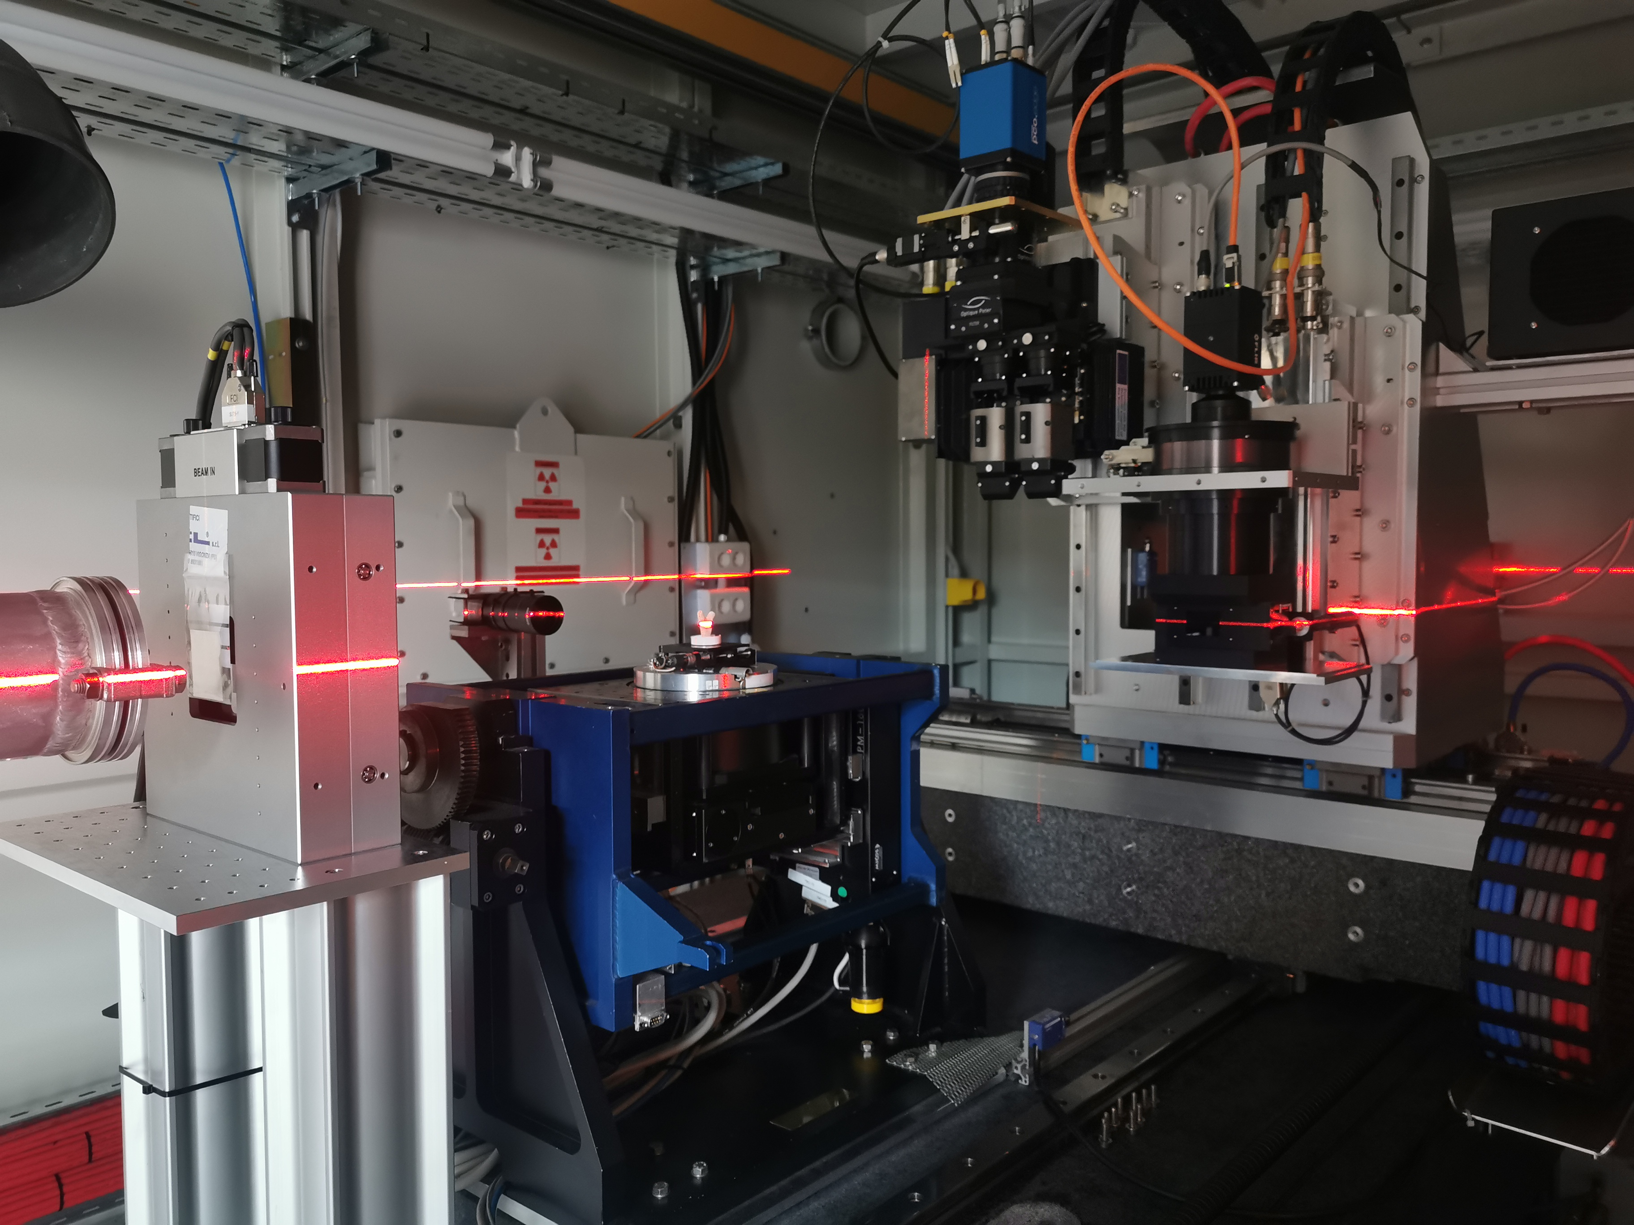
detector
(ESRF)
Sample stage
www.beats-sesame.eu
Funded by the EU’s H2020
framework programme under
grant agreement n°822535
Notes:
A long list of Observers worldwide is one of the strong pillars of SESAME
BEATS is one of the examples of support by SESAME's Observers. It was a EU Horizon 2020 project to design, build and commission a beamline for X-ray tomography at SESAME
The project started in 2018
2018-2021 were dedicated to beamline design, procurement, and user community building
The beamline was installed and commissioned between 2022 and 2023, and inaugurated in June 2023
Since February 2024, BEATS is fully commissioned and open to users

Slide 8
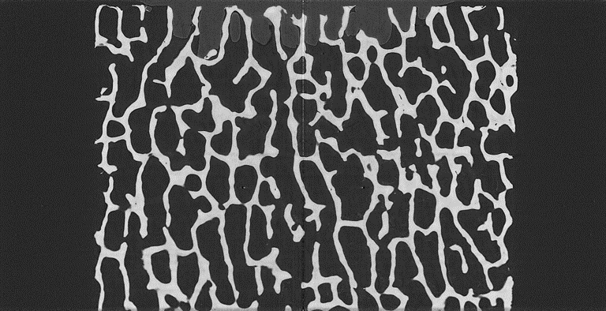
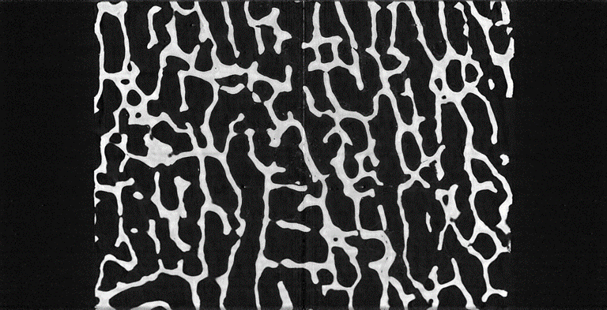
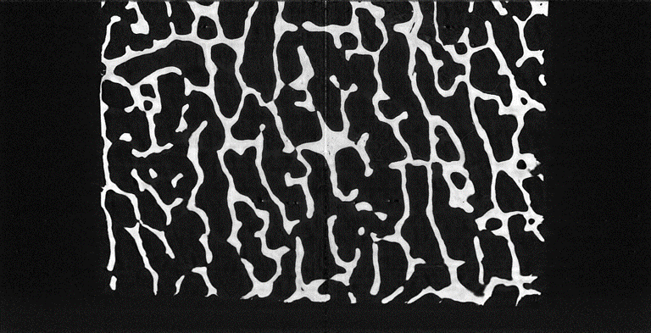
Dataset Acquisition:
Bovine trabecular bone; Tutoplast Cancellous Block
Specimens dimensions 10 mm × 10 mm × 20 mm.
Voxel Size: 6.5 µm.
X-ray Energy: 35 keV.
Monochromatic X-ray (with DMM; avoid beam hardening)
Exposure Time: 0.022 seconds for each projection while scanning.
Total projections taken is 4001.
Rotation angle used for this data in 180 degrees.
Image Size: 2535 × 2535 × 1300 (×3).
Total no. slices: approximately 1000×3×2 = 6000
Scan 1
Scan 2
2 cm
Scan 3
1 cm

Slide 9
SECTION 2: SPARSE RECONSTRUCTION

Slide 10
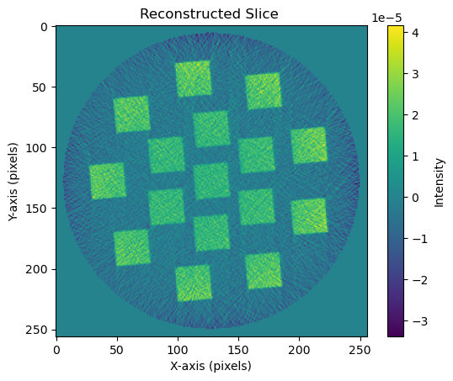
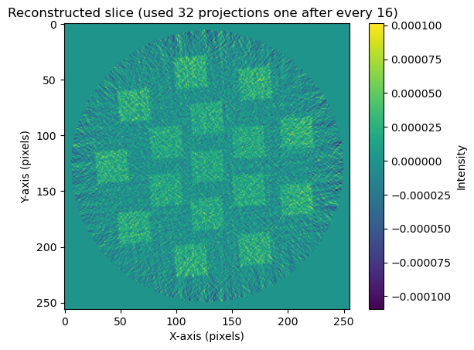
ANALYTICAL METHOD: Sparse-View CT
Filtered Back Projection
It assumes uniformly spaced and complete projections.
When projections are sparse, FBP introduces severe streak artifacts due to insufficient angular sampling.
inverse Fourier Transform:
$$p_{filtered}\left(s,θ\right)=ℱ_{s}^{−1}{p′}_{filtered}(w,θ)$$
Back projection:
$$f\left(x,y\right)=\int_{0}^{π}{p_{filtered}\left(xcosθ+ysinθ+θ\right)dθ}$$

Slide 11
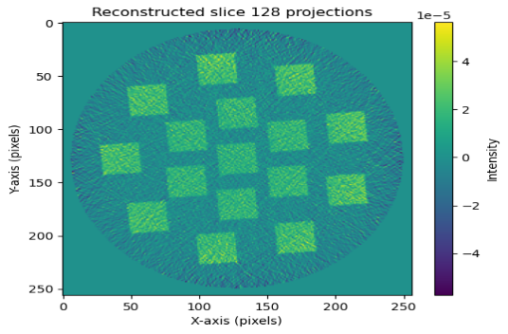
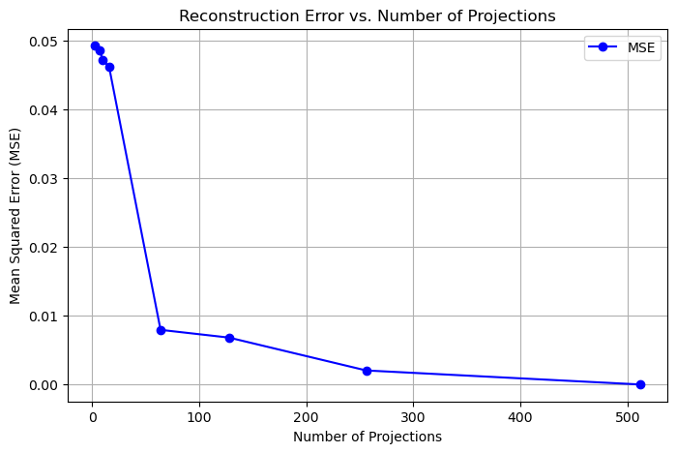
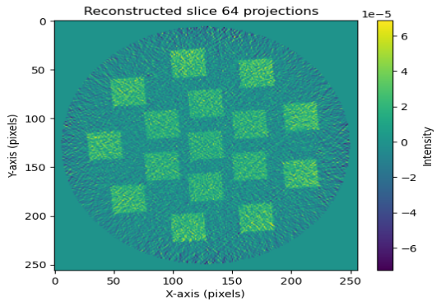
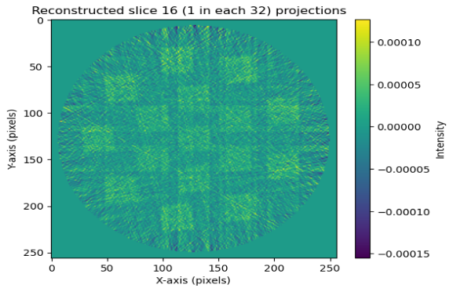
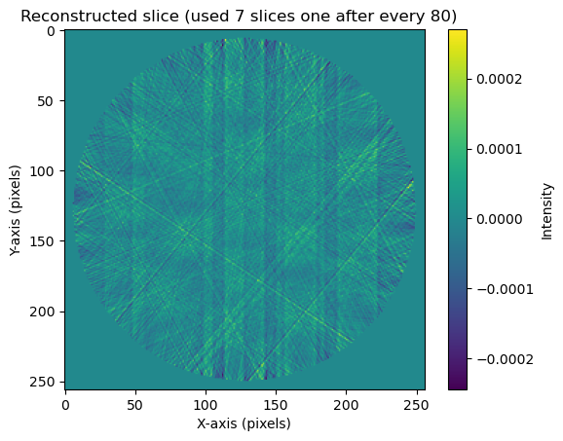
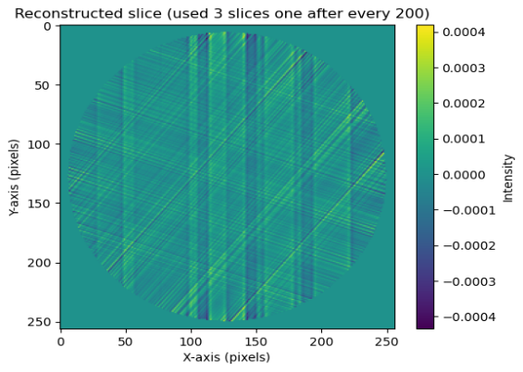
ANALYTICAL METHOD: Performance Evaluations
Number of projections | Mean Square Error (MSE)
512 | 0.00000
256 | 0.00204
128 | 0.00682
64 | 0.00794
16 | 0.04614
10 | 0.04725
7 | 0.04856
3 | 0.04926

Slide 12
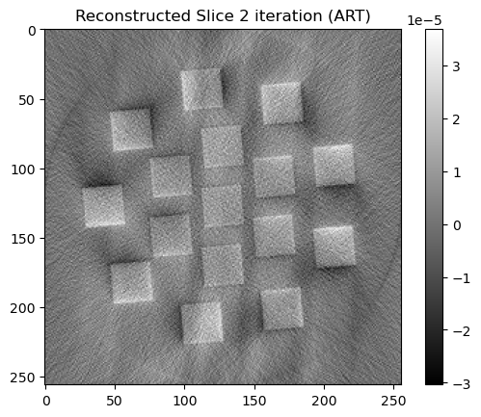
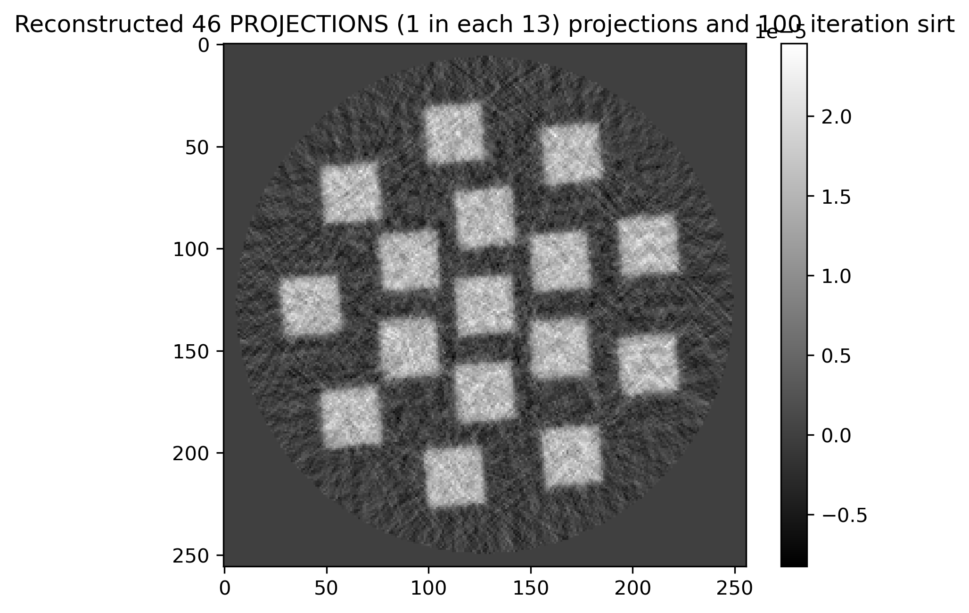
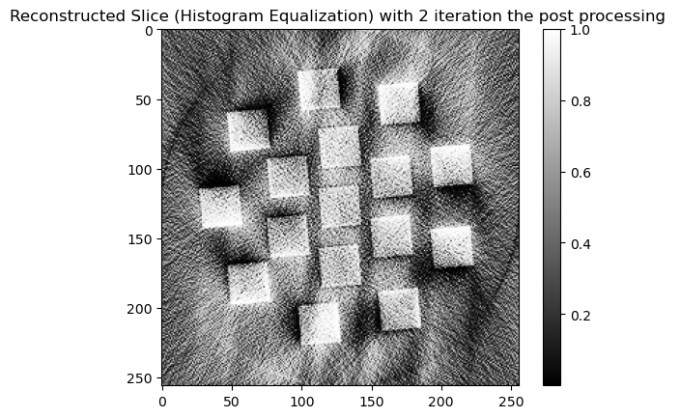
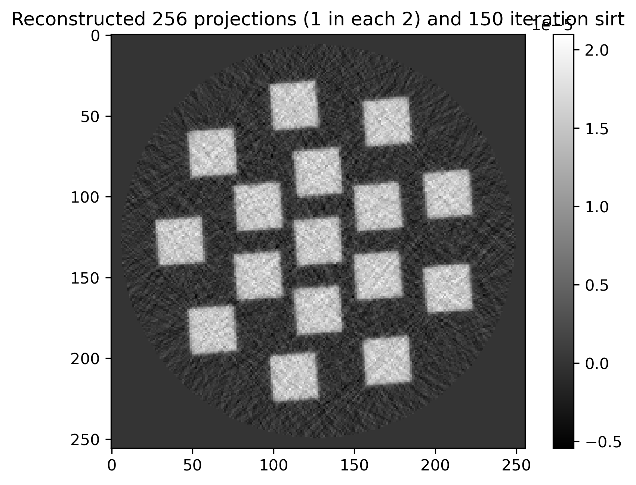
ITERATIVE METHOD: Sparse-View CT
ART AND SIRT METHOD:
Reconstruction Technique is an iterative algorithm that reconstructs an image from its projections by solving a system of linear equations.
ART Update Step:
$$x^{(k+1)}=x^{k}+λ\frac{b_{i}−\left\langle a_{i},x^{(k)}\right\rangle }{{\left\|a_{i}\right\|}^{2}}$$
$$x^{(k+1)}=x^{(k)}+λ.CA^{T}R(b−Ax^{k})$$
Algabric Reconstruction Method
Simulatanious Reconstruction Method​
ART Without TV Regularizer:
$$\min_{x}{ \left\|Ax−y\right\|+ }λG(x)$$

Slide 13
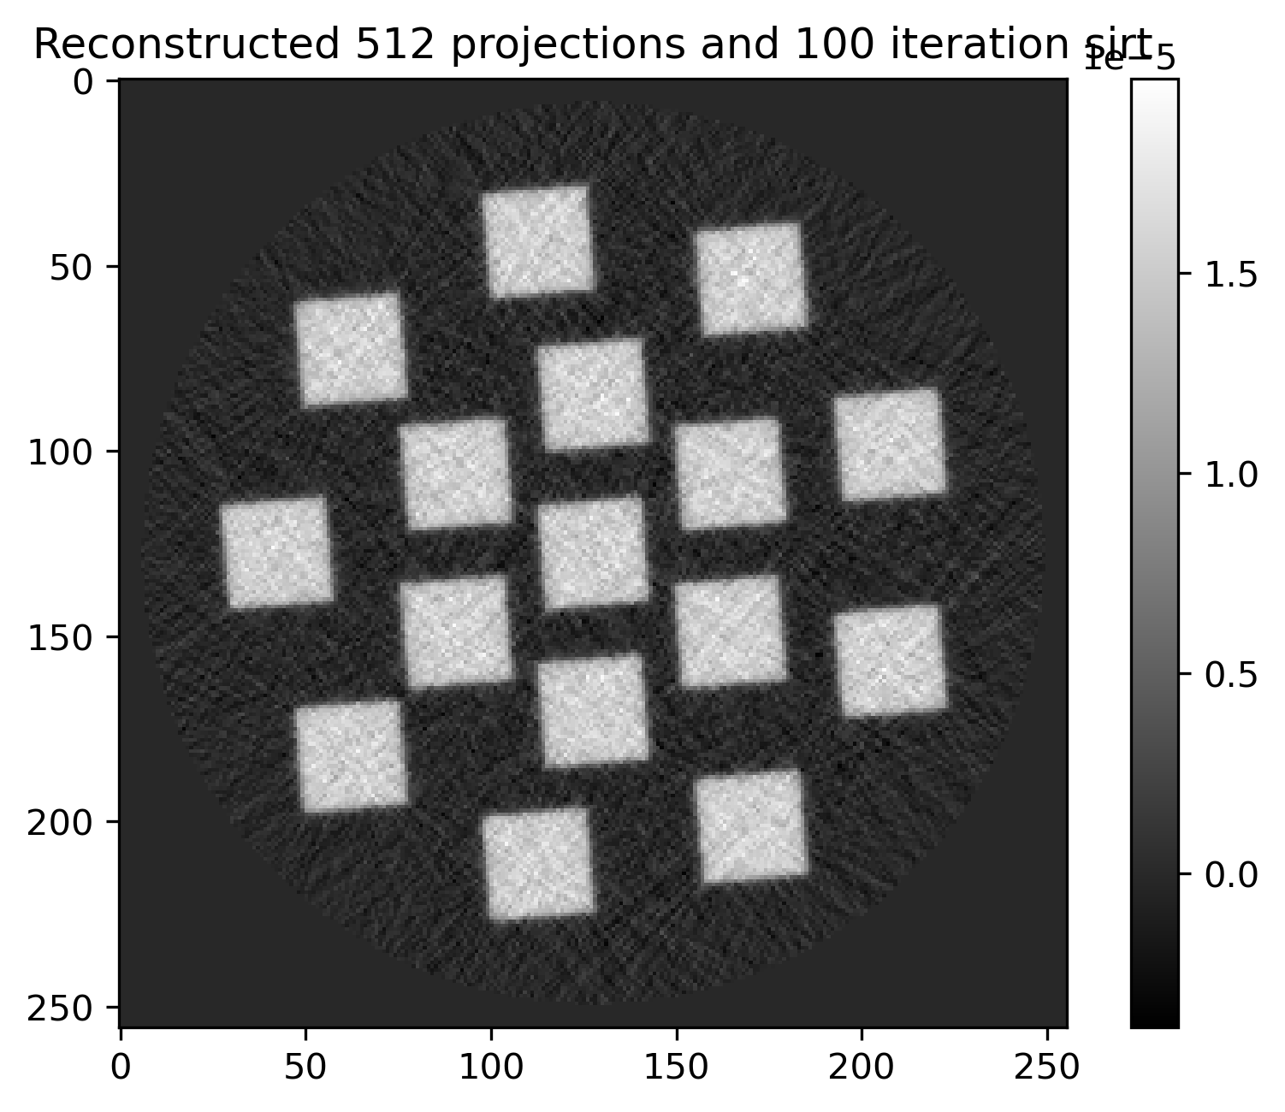
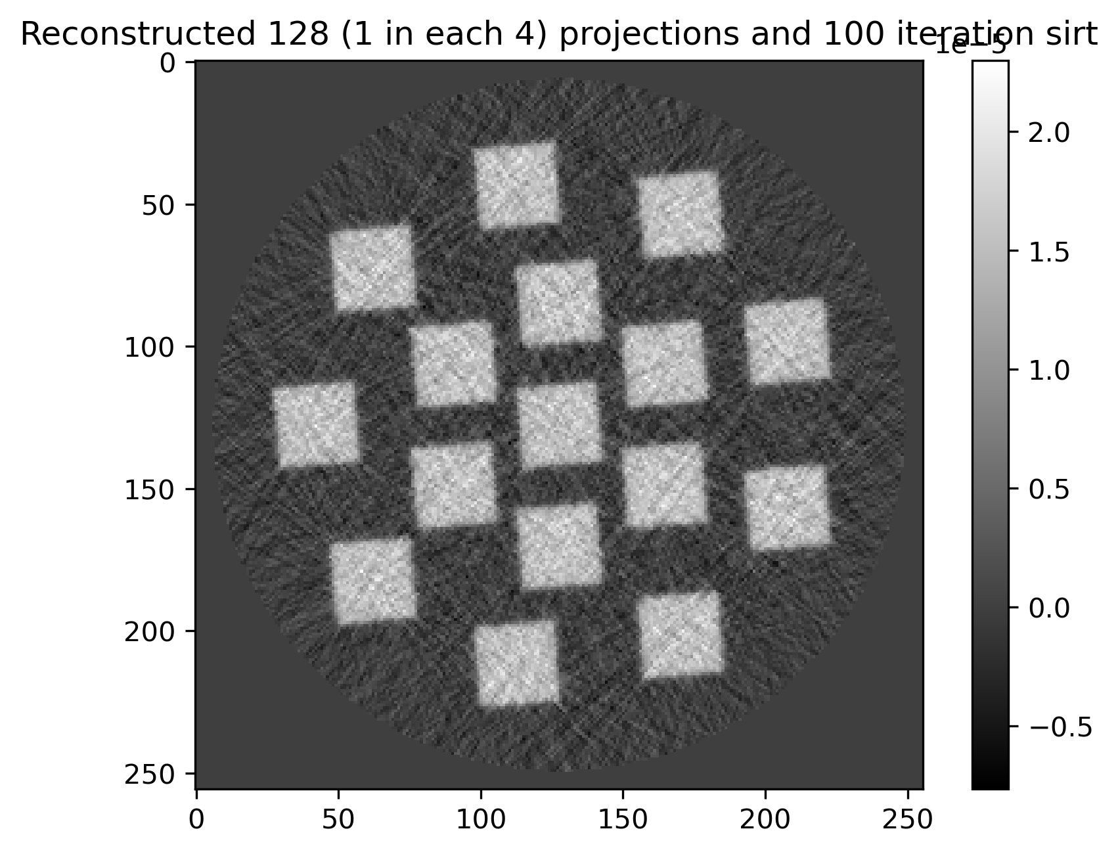
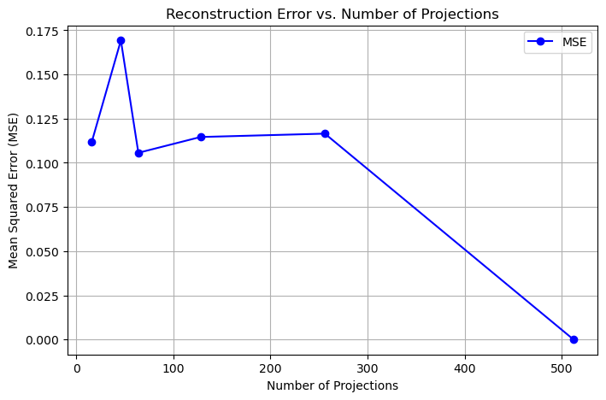
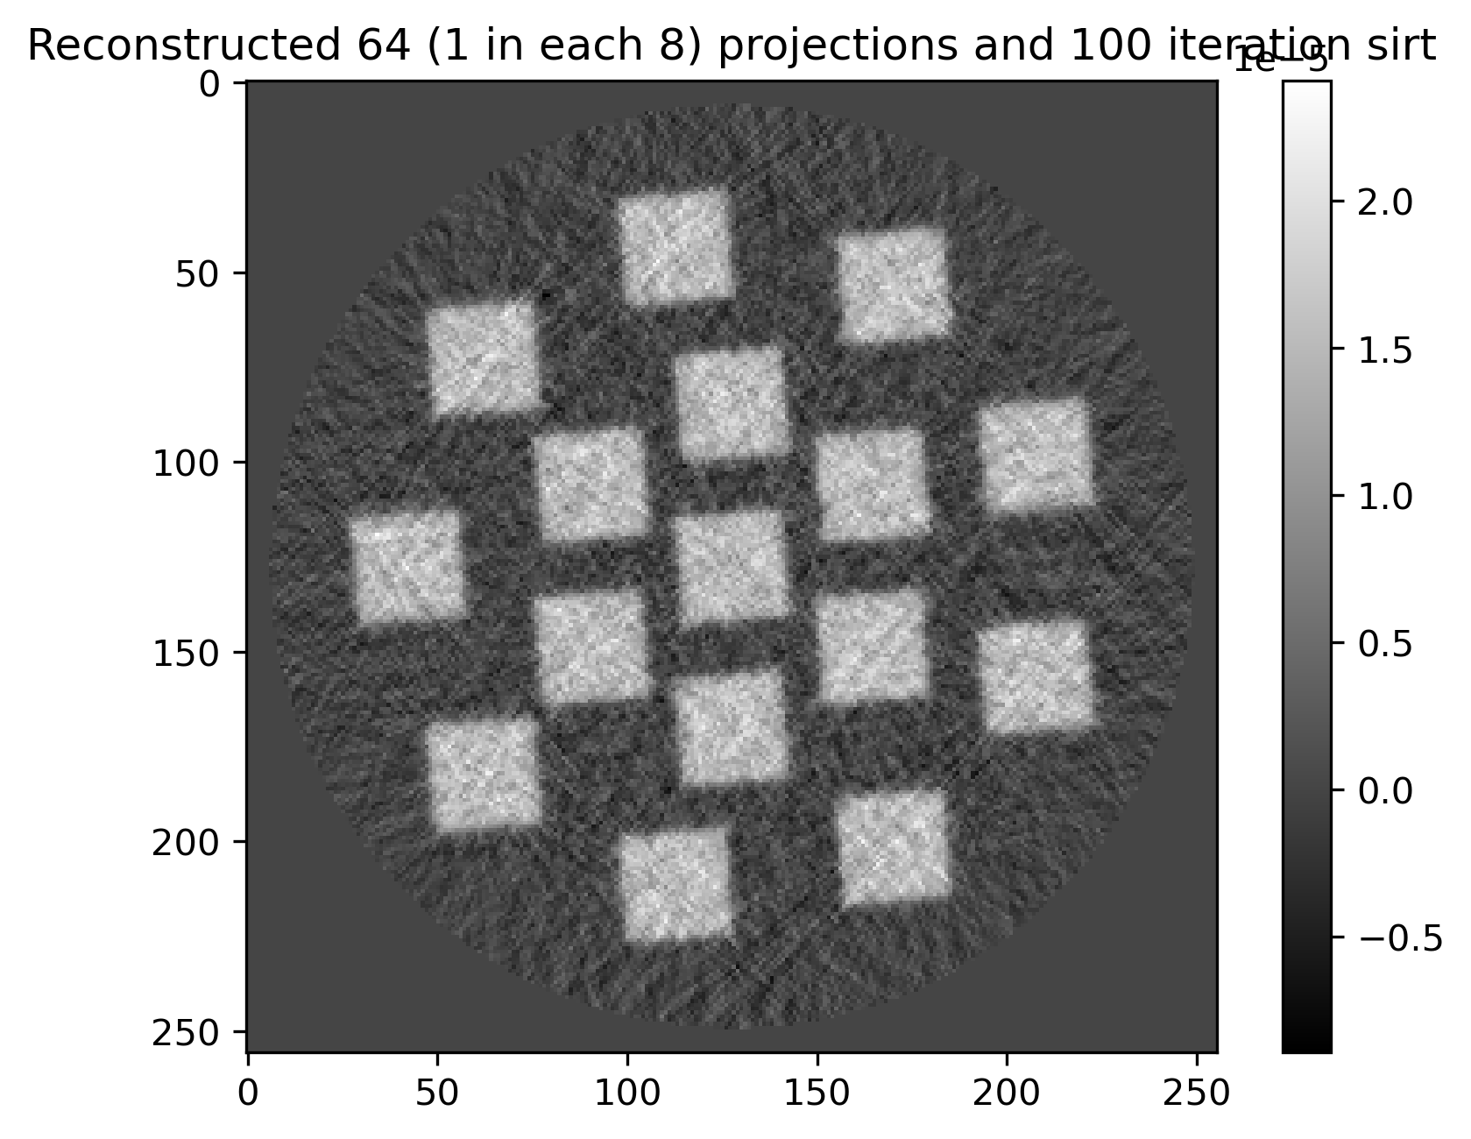
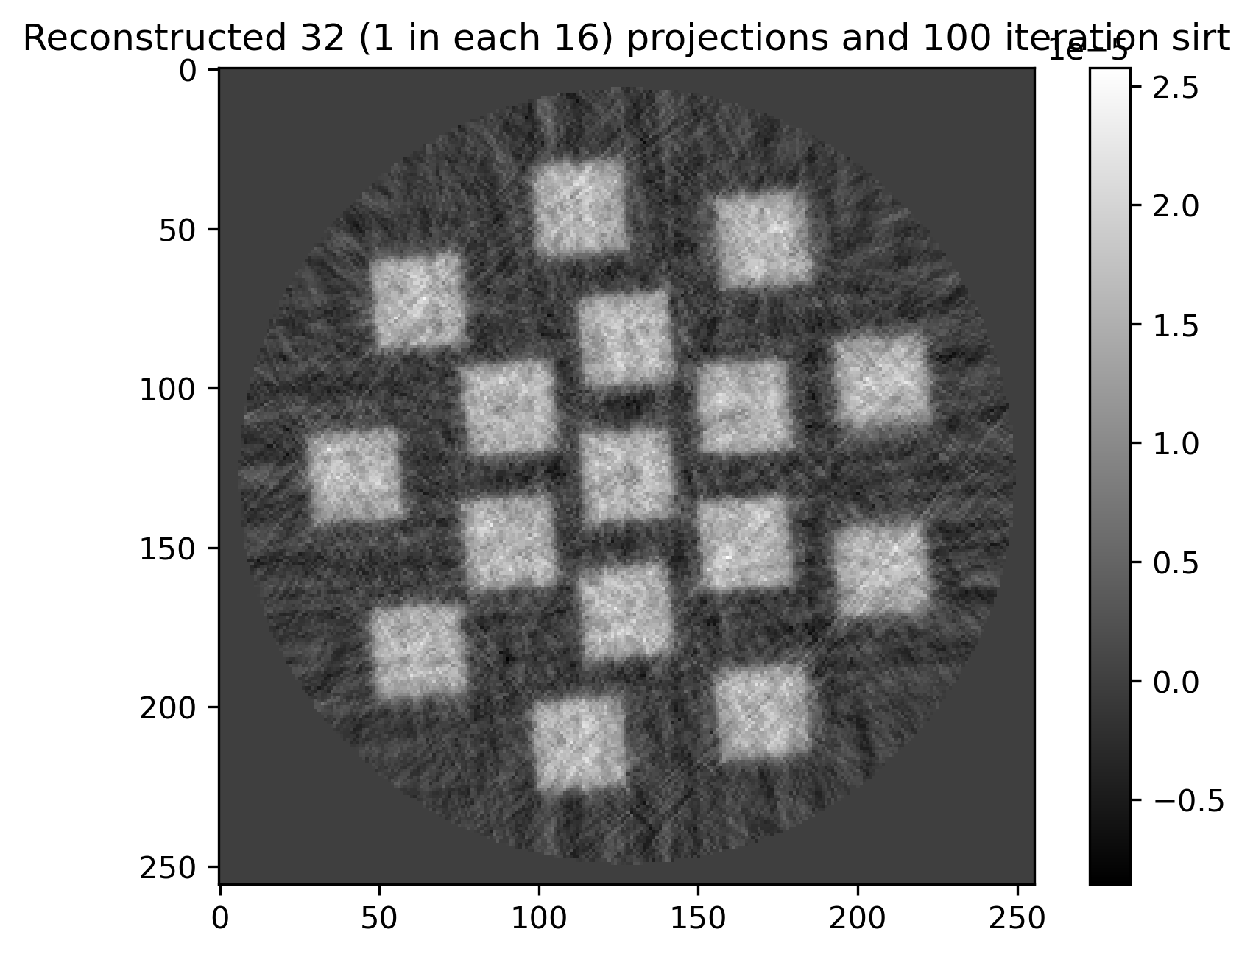
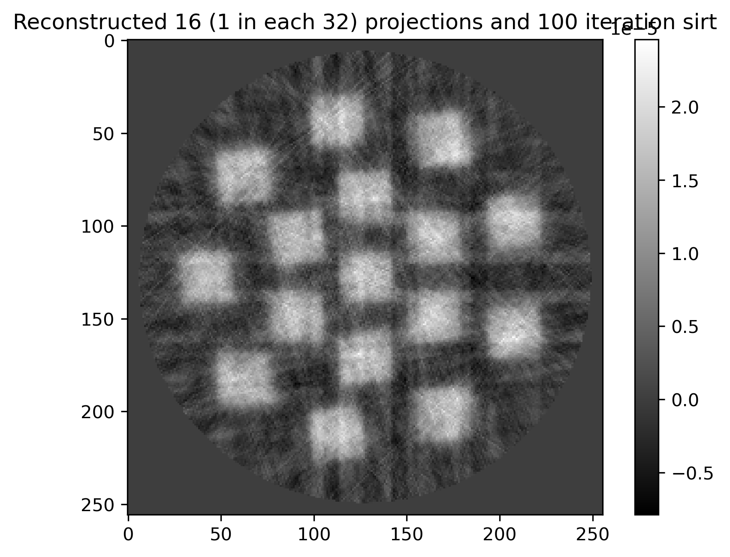
ITERATIVE METHOD: Sparse-View CT
Iterative method Performance evaluation
512 Projections
256 Projections
128 Projections
64 Projections
32 Projections
16 Projections

Slide 14
SECTION 3: Utilizing AI-based tools to obtain high- resolution scans

Slide 15
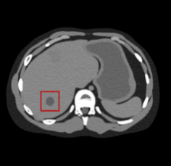
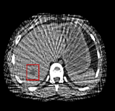
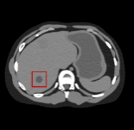
BACKGROUND: Deep Learning CT Reconstruction
First: Iterative Reconstruction
Second: Image processing
CNN
ART, SIRT, SART
CNN
$$Y=AX$$
$${}_{x}^{min}{{\left\|Ax−b\right\|}^{2}+λR(x)}$$
Require large training datasets and may fail to generalize across different scanning conditions
Second: End-to-end reconstruction network
Hey! Diffusion model generate realistic and detailed images even from very sparse or noisy input data.
CNN
End-to-end CNN reconstruction for sparse-view CT directly learns the mapping from undersampled data.

Slide 16
Mixed-Scale Dense Convolutional Neural Network
Mixed-Scale Dense (MS-D) CNN is a deep learning architecture designed to efficiently capture both fine and large-scale features in images without increasing network depth.
Dilation is a technique that increases the spacing between elements of the kernel.
$$g_{ij}\left(z_{i−1}\right)=\sum_{k=0}^{c_{i−1}}{D_{h_{ijk},s_{ij}}z_{i−1}^{k}}$$
increase the receptive field of the convolutional kernel without increasing the number of parameters .
Mixed-Scale Convolutions: Instead of using a fixed kernel size (e.g., only 3×3), MS-D CNN applies multiple kernel sizes (e.g., 3×3, 5×5, 7×7) within the same layer. Each channel inside the same layer gets its own dilation rate.
$$D_{h,s} and sεℕ^{+}$$
Dense Connections:
mixed-scale DCNN use all feature maps from previous layers, including the input image, are used to compute the output of a layer
$z_{i}^{j}=σ(g_{ij}\left({\{z}_{0},……z_{i−1}\}\right)+b_{ij})$
$$g_{ij}\left({\{z}_{0},……z_{i−1}\}\right)=\sum_{l=0}^{i−1}{\sum_{k=0}^{c_{i−1}}{D_{h_{ijk},s_{ij}}.}z_{i−1}^{k}}$$

Slide 17
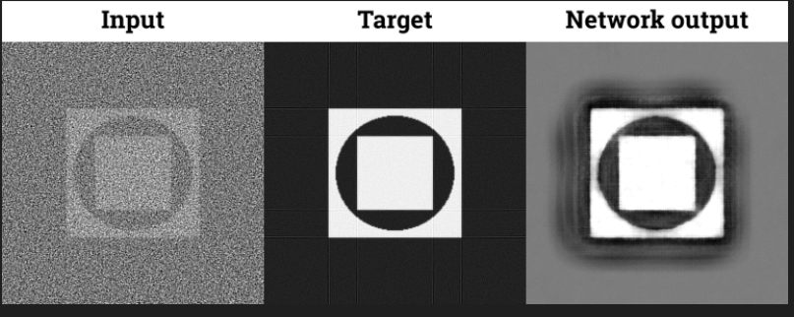
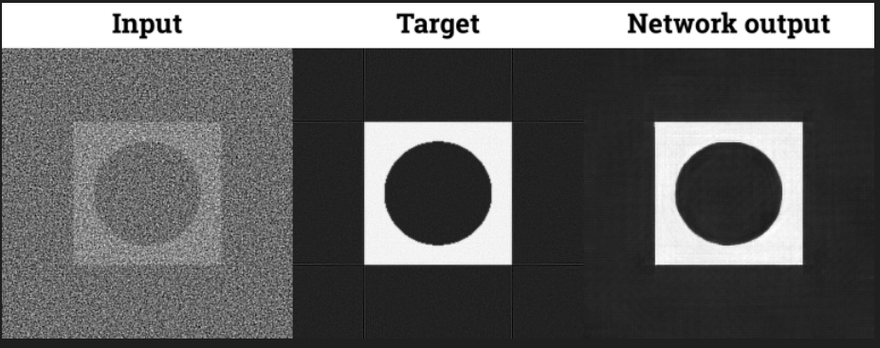
First Deep learning method: Msd-CNN Training
Training of MSD-CNN on toy dataset
MSD Results on generated data:
Shows improvement over the input but still lacks sharpness, indicating that the model needs more training.
Not yet fully learned fine details.
Significant Improvement :
After 3 hours of training on the cluster, the network output closely matches the target, with sharper edges and better structure recovery.

Slide 18
Testing Results: Applied trained msd-CNN on my dataset
.
The input image reconstructed
Using 10 projections (FBP).
Custom Dataset Processing: Successfully applied MSDNet to my own dataset for image reconstruction/denoising.
Improved Image Quality: The network effectively enhances details and reduces noise in the reconstructed images.
Training Success: After sufficient training, the output closely resembles the target, demonstrating MSDNet’s capability on real data.
The input image reconstructed
Using 32 projections (FBP).

Slide 19
SOME RESULTS DONE WITH ACTUAL DATASET

Slide 20
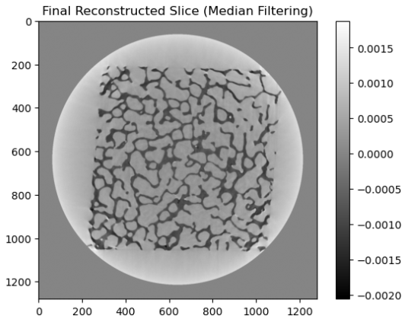
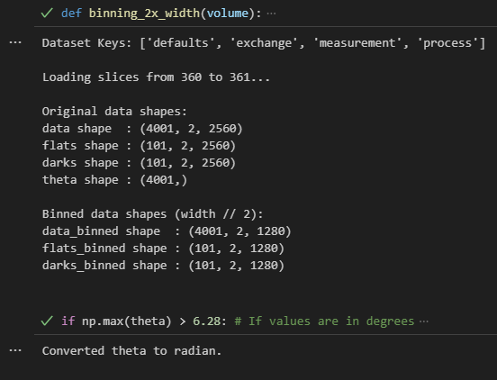
Results
In the coding projections are same and remaining 2 index are reduced. I took only 2 slices for time saving less computational cost.
Reconstructed result of Gredrec algorithm after binning dataset width (1280x1280)

Slide 21
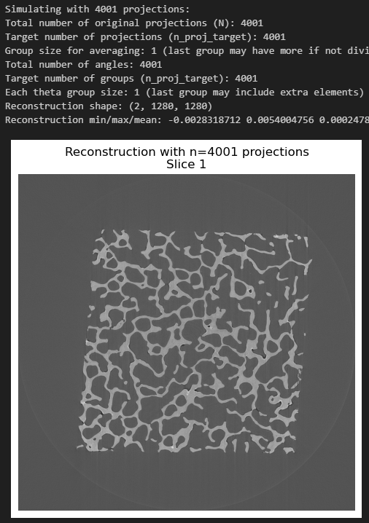
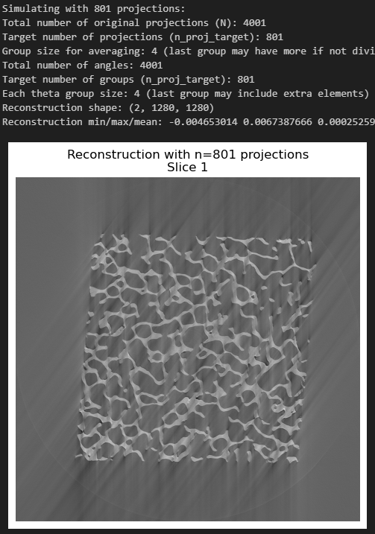
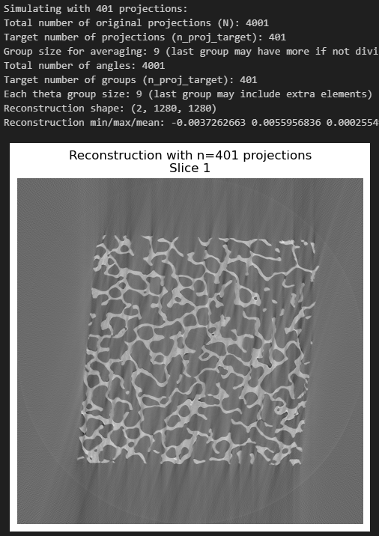
Results
Using 4001 projections
Using 801 projections, here I averaged (4001/n) frames. N is 801.
Using 801 projections, here I averaged (4001/n) frames. N is 401.

Slide 22
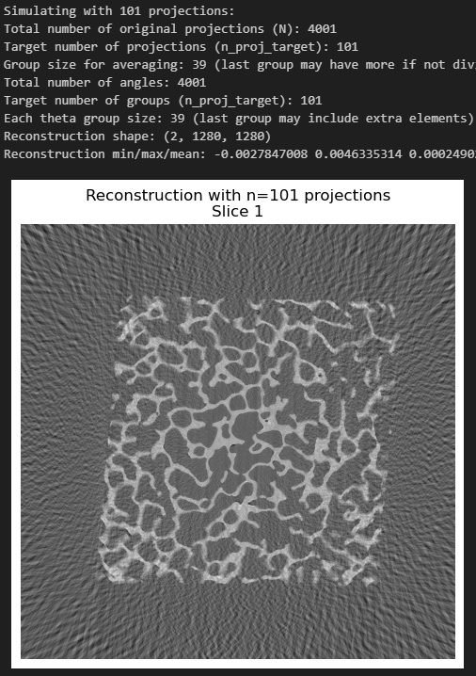
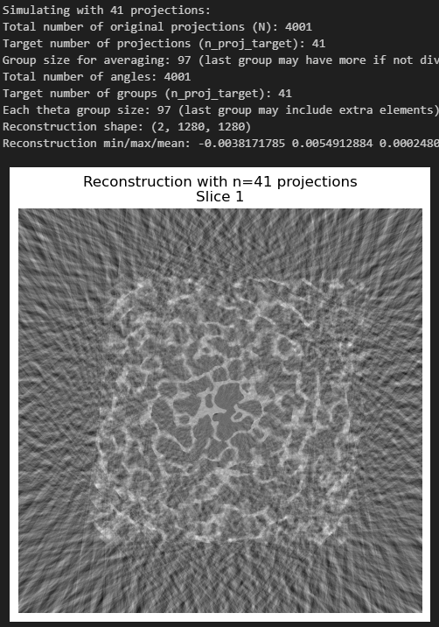
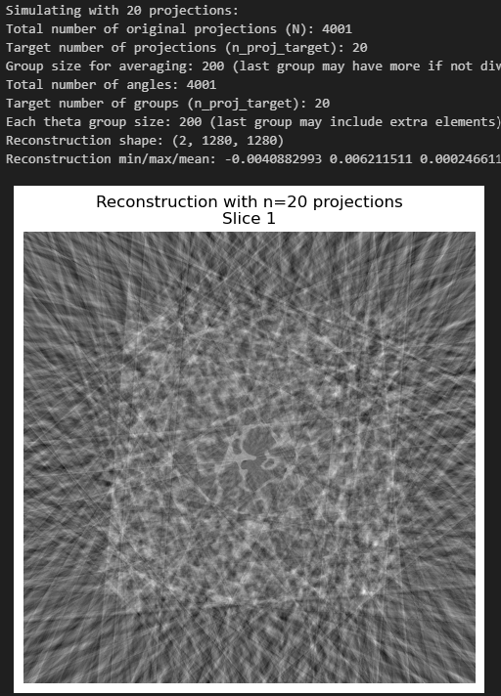
Results
Using 101 projections, here I averaged (4001/n) frames. N is 101.
Using 41 projections, here I averaged (4001/n) frames. N is 41.
Using 20 projections, here I averaged (4001/n) frames. N is 20.

Slide 23
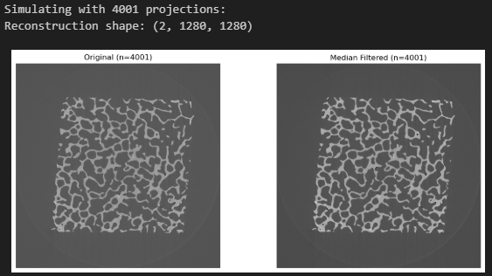
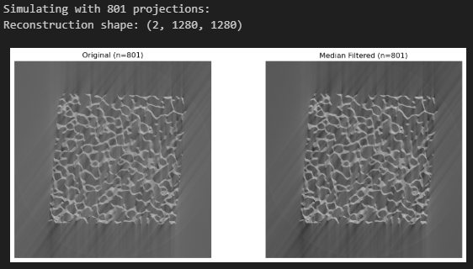
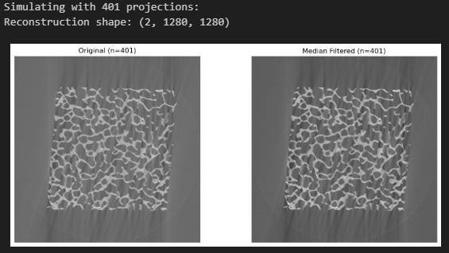
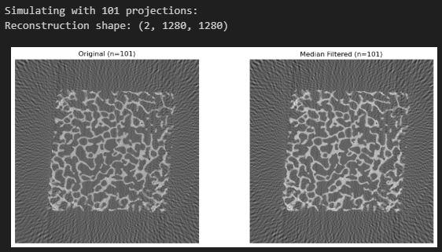
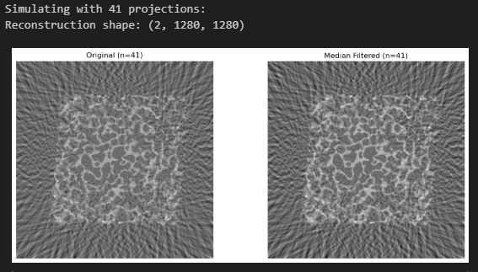
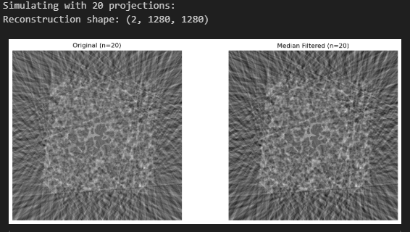
Original and median filtered image: (why I applied median because it make edges bit sharp so I noticed better binary Thresholding after applying median filter)
Using 4001 projections
Using 801 projections
Using 401 projections
Using 101 projections
Using 41 projections
Using 20 projections

Slide 24
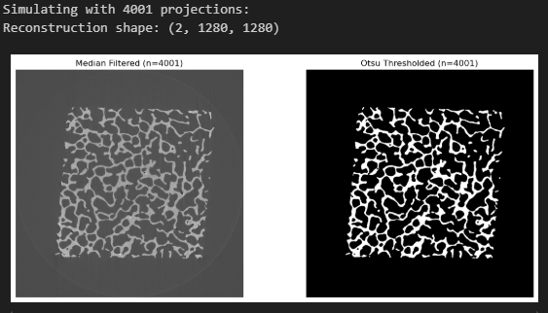
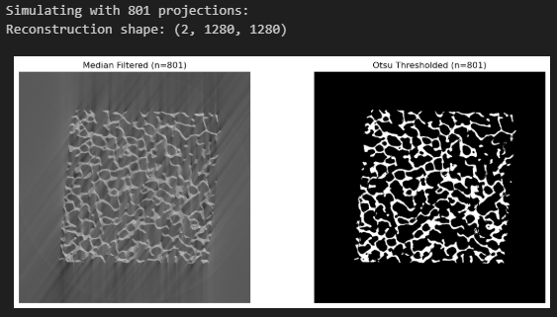
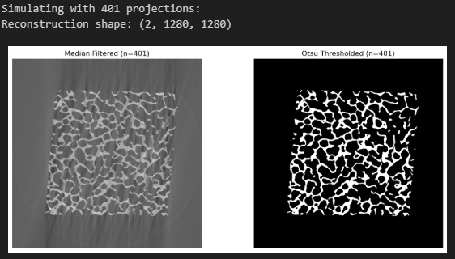
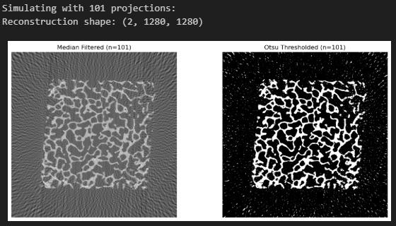
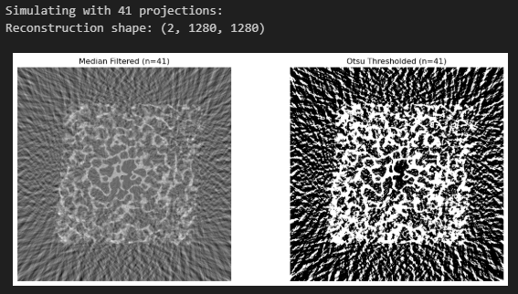
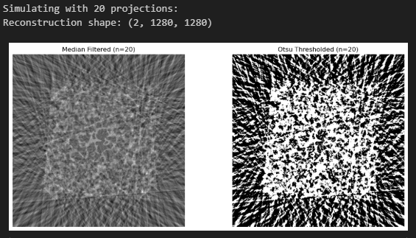
Reconstructed Image and Otsu thresholding (different no of projection):
4001 projections
801 projections
401 projections
101 projections
41 projections
20 projections

Slide 25
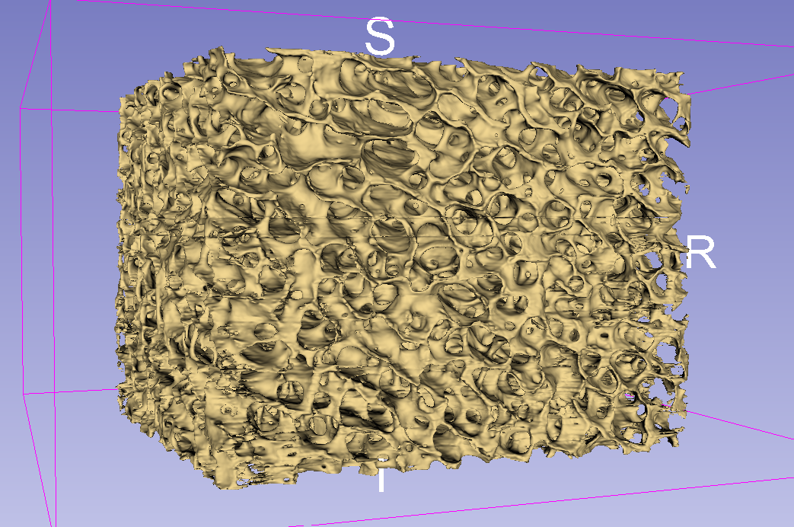

Slide 26
THANKYOU! QUESTIONS?

