Slide 1
first tests with pyAML at MAX IV
pyAML 15/11/2014
M. Apollonio
M. Sjöström
A. Al-Sakeeri
R. Nieuwenhuis
R. Rocca
15/11/2024
pyAML zoom meeting
1

Slide 2
pyAML testing at MAX IV
Our team:
2 members of Accelerator Development (Matlab, MML)
3 members of Operations (Python, pyAT)
MAX IV AccDev commitment mainly focused on MAX-4U upgrade
Operators main task is ensuring a performing machine
not 100% on this task / ctrl room activities when possible
Opted for a gradual approach
Inspiration from previous work
steal-in-style
try few simple tests to get a grip on python/tango use with typical ML problems
In GitHub repo
Sirius (PyACAL) <<< main structure
ESRF/EBS (pyAML) <<< test cases + use of tango
Implemented tests
Orbit Response Matrix measurements at R1 (1.5 GeV) and R3 (3GeV)
Chromaticity measurement
Dispersion measurement
Check also https://elogy.maxiv.lu.se/logbooks/133/entries/41401/
15/11/2024
pyAML zoom meeting
2

Slide 3
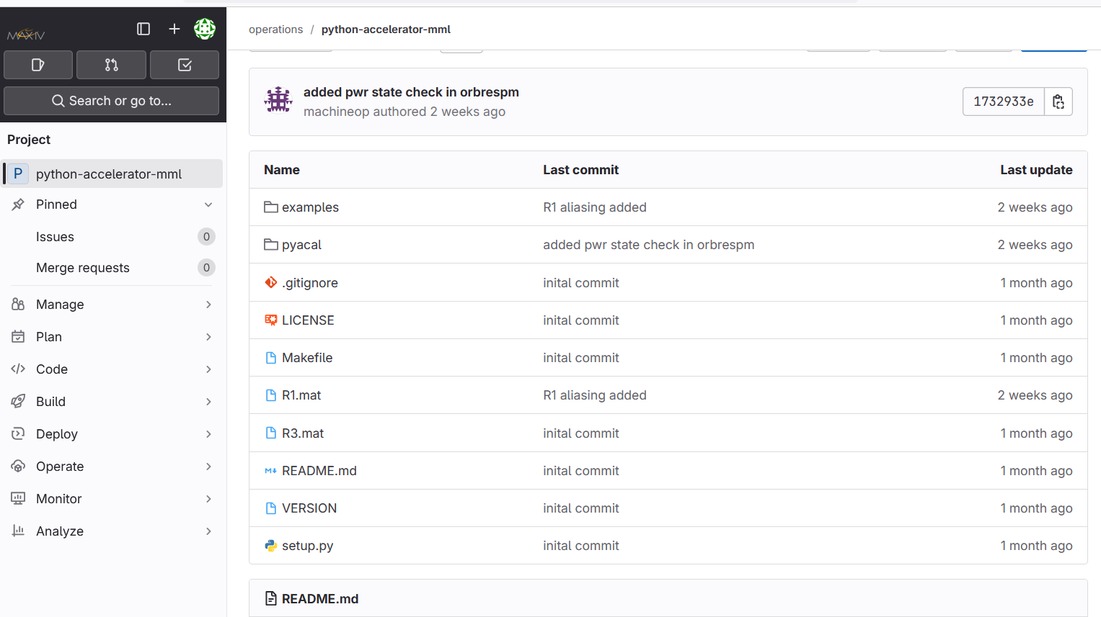
15/11/2024
pyAML zoom meeting
3

Slide 4
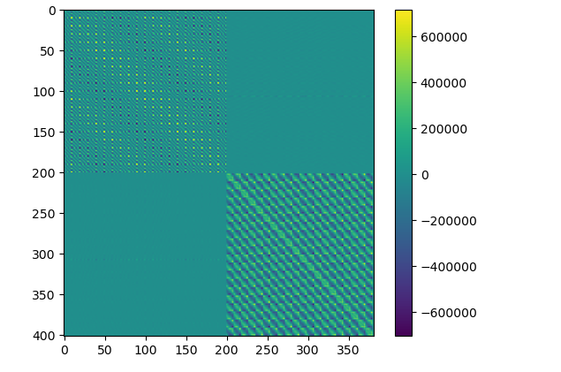
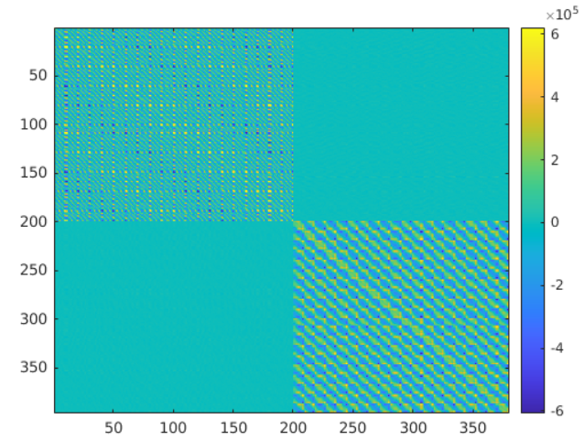
BPM response matrix – R3
400 (BPM) x380 (CM) [H/V]
+ / - excitation of CMs
SOFB activated between readings
5 readings per BPM (average)
1hr53m (long)
SOFB on, correct orb. for 2s
SOFB off, sleep 1s
Orbit readout (t=?)
1 reading per BPM
1h15m (long)
About 10s observed for every measurement
Without orb. Corr ~ 1hr
NOTE : in MML 3-4 sec x 380 < 1500s = 30min
Visually good comparison with MML, but little scale mismatch
Investigating the nature of the long
acquisition time
R3 - pyAML
R3 - MML
15/11/2024
pyAML zoom meeting
4

Slide 5
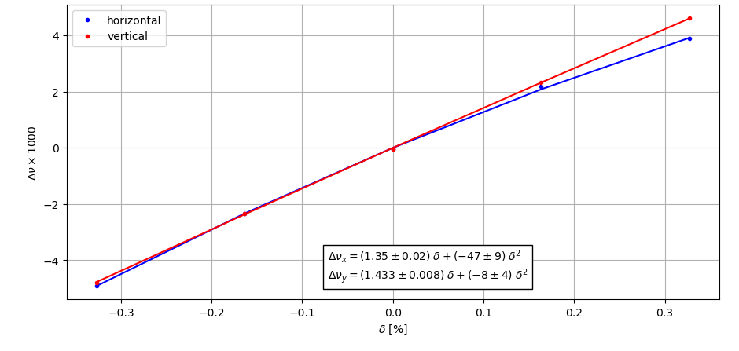
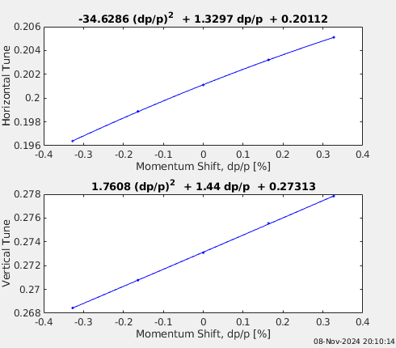
chromaticity measurement – R3:
tune readings over 5 RF point scan
pyAML : ξ = 1.35 / 1.43
ξ₂ = -47 / -8
MML (measchro) : ξ = 1.33 / 1.44
ξ₂ = -34 / 1.8
15/11/2024
pyAML zoom meeting
5

Slide 6
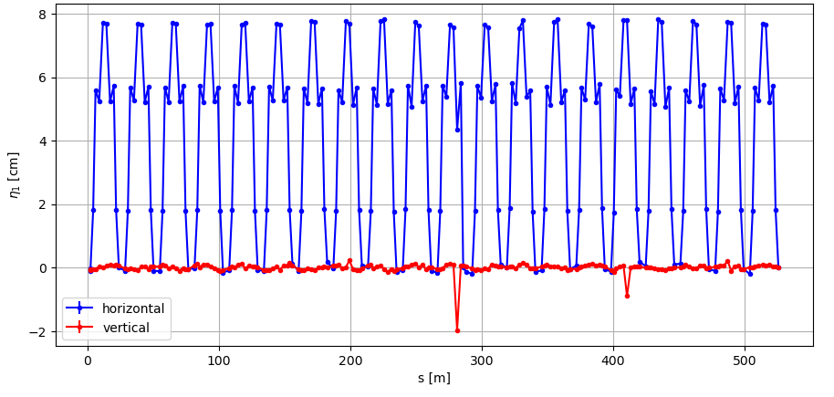
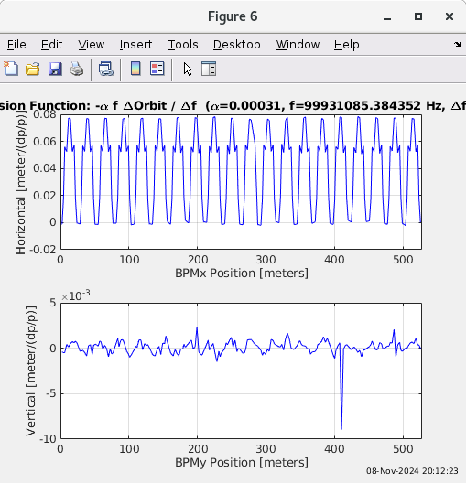
dispersion measurement – R3
pyAML
found scale pb, um2m → nm2m
corrected, good match with MML
MML (measdisp)
15/11/2024
pyAML zoom meeting
6

Slide 7
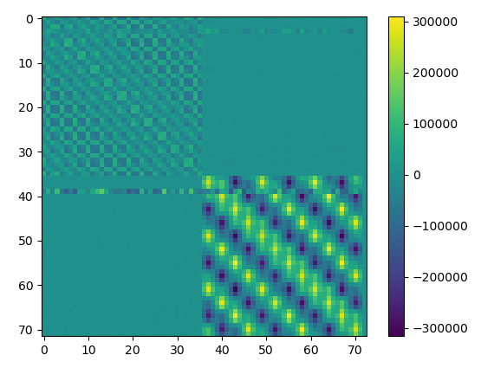
notes on tests at R1
at MAXI IV we have two rings operating at 1.5GeV and 3GeV
Eventually we will need to easily switch from one case to another
We had a first go measuring the ORM,
Almost working but need to check how to mask-off CMs too close to saturation values
Also noticed some noisy lines, which are object of investigation
We tested also the measurement of chromaticity/dispersion
while scanning freq. for R1 we actually … acted on R3 (dumping the beam)!
this was due to a hardcoded section of rfgen.py, selecting the 1st element of a vector
(‘R3RFgen’, ‘R1RFgen’)
the mistake looks a bit embarrassing, but tells us to be careful since we have two SR
R1 - pyAML
15/11/2024
pyAML zoom meeting
7

Slide 8
Using the Tango SOFB with pyAML
At MAX IV the SOFB is ran via a TANGO device
This TANGO device is not a PV: it doesn't have a set point/readback
We simply wish to execute commands on it (on/off)
Current hack:
Define an SOFB device with the property 'state'
Access the TANGO DS directly to execute commands
This is horrible practice!
The point of a ML is to not access DSs directly
It is not sustainable to do this for many devices
How should we handle this with pyAML?
15/11/2024
pyAML zoom meeting
8

Slide 9
conclusions
early days at MAX IV with pyAML
main scripts taken from work developed at Sirius and ESRF
we tried some basic typical functions needed in the ctrl room
ORM measurement
dispersion measurement
chromaticity measurement
good results on ring R3
code issues when acting on the RF generator at R1
minor problem, but hardcoding spotted
need care when developing a system for >1 machines
longer than MML time to measure ORM with pyAML
under investigation
at present: PV writing + waiting for read-back matching setpoint
speeding up by fixing readtime? This has been quite optimised in MML (M.S.)
ensure BPMs are grouped or reading is synchronized
medium term
build up an ML structure
e.g. getsp, setsp addressing families and locations (achromat, element)
15/11/2024
pyAML zoom meeting
9
Notes:
This was because when writing to a PV, pyAML waits for a readback from that PV. In this case, pyAML writes to a powersupply, then continuously reads the power until this matches the new set point. This takes a long time to update in the TANGO device, so it's not entirely a pyAML issue I think. The way to prevent this and speed up the runtime is to not wait for the readback, but to instead just wait some fixed amount of time. I am not sure how Matlab MML does

