Slide 1
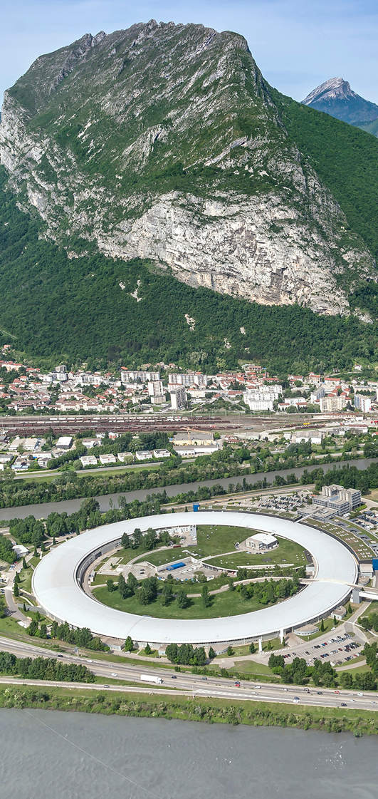
Databases supporting X-ray optics simulations
Manuel Sanchez del Rio
Advanced Analysis & Precision Unit, MEG/ISDD, ESRF
Monday 23 September, 2024

Slide 2
Contents
Motivation
Basic calculations: lenses, mirrors, crystals
Data providers
X-rays
DABAX
Xraylib
Metrology
DABAM (1D)
2D
IDs for EBS-ESRF

Slide 3
The refraction index
CPMU14.4
CPMU18
CPMU14.4
Notes:
Comparison some examples

Slide 4
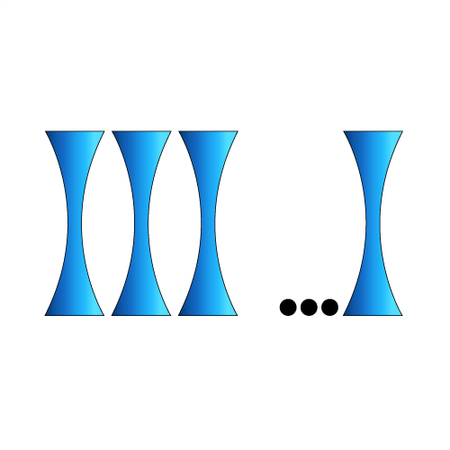
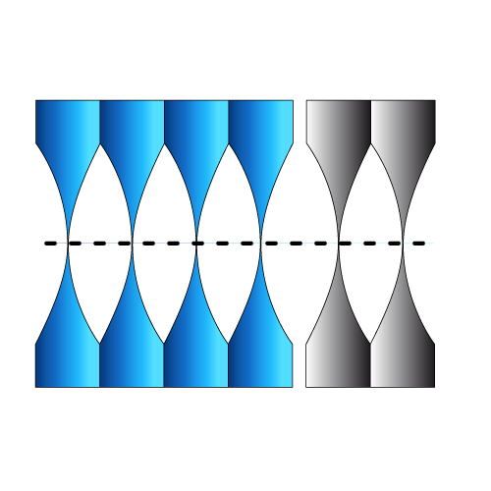
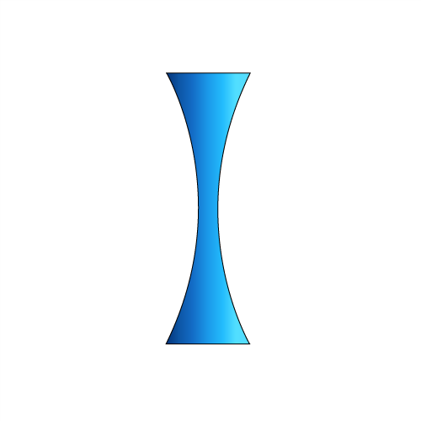
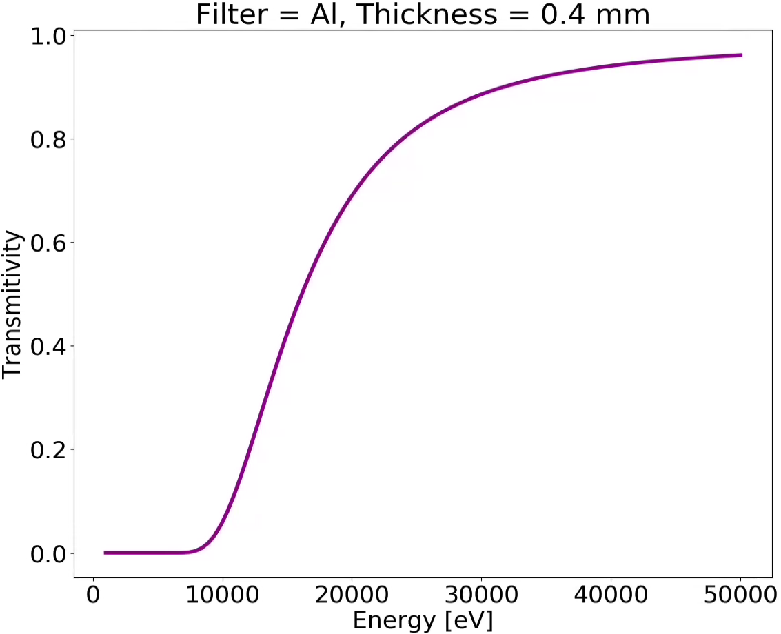
Examples
Compound Refractive Lens (CRL)
Single interface
Lens
Transfocator
X-ray refractors
0.4 mm
CPMU14.4
CPMU18
CPMU14.4
Attenuators (filters)
X-ray beam
Al
Notes:
Comparison some examples

Slide 5
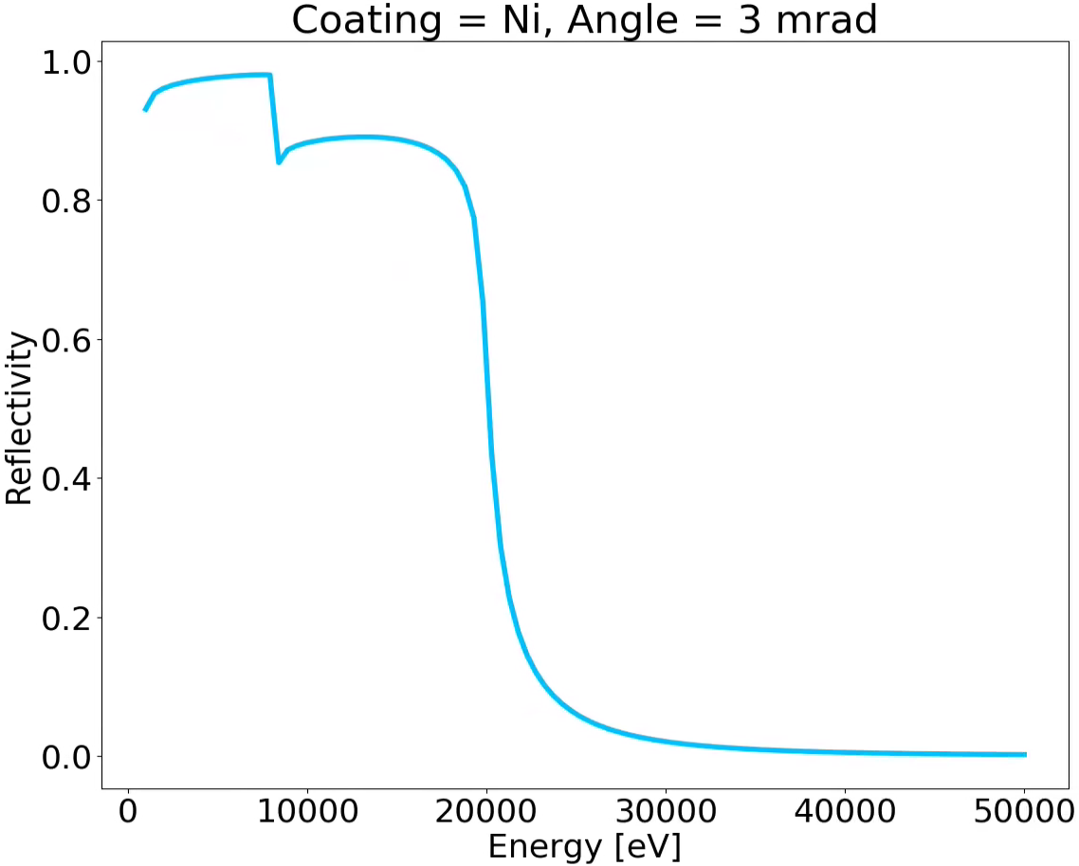
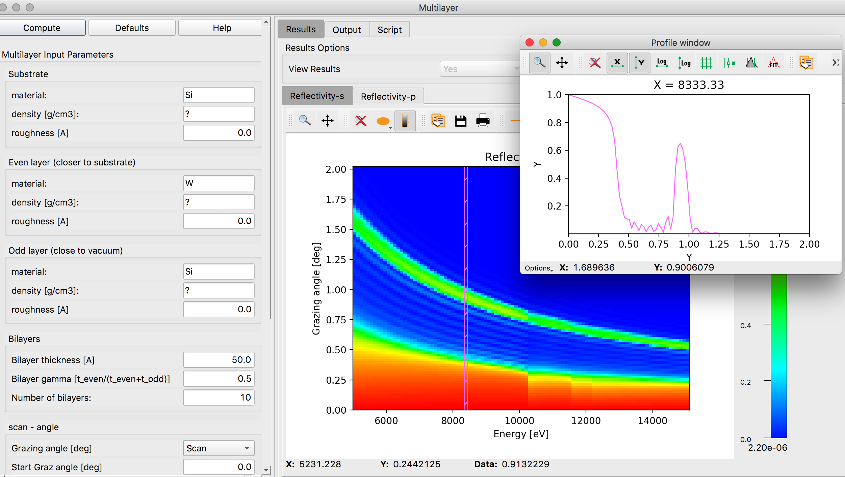
Examples
X-ray beam
Mirrors
Grazing Angle
Ni coating
Multilayers
Notes:
Comparison some examples

Slide 6
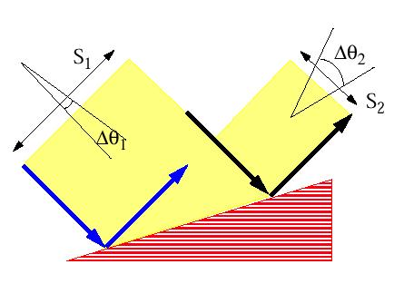
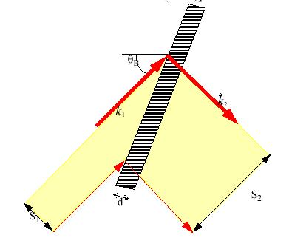
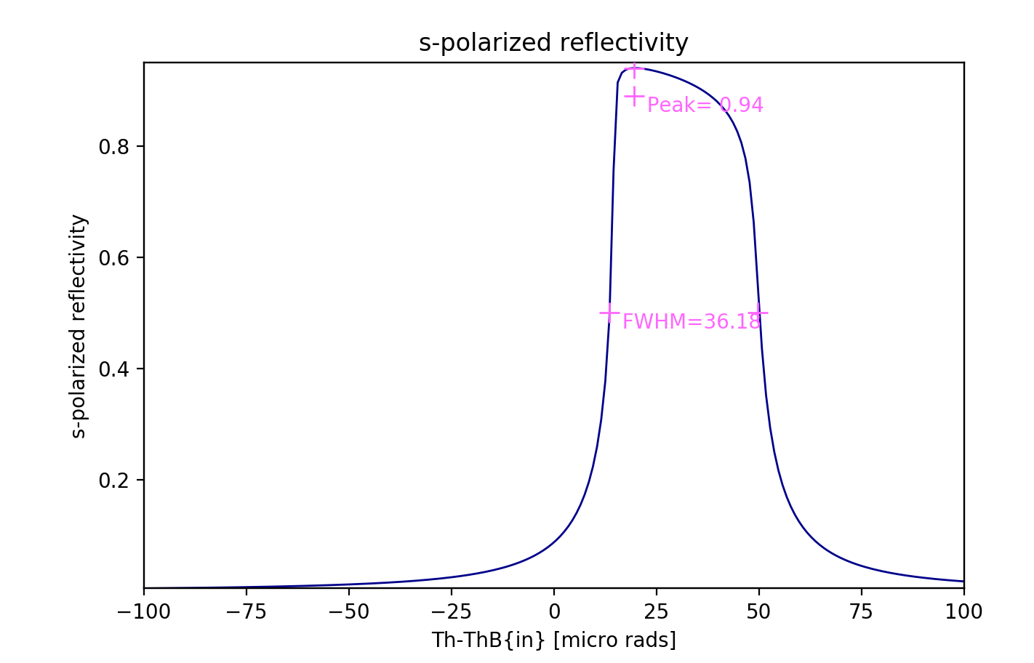
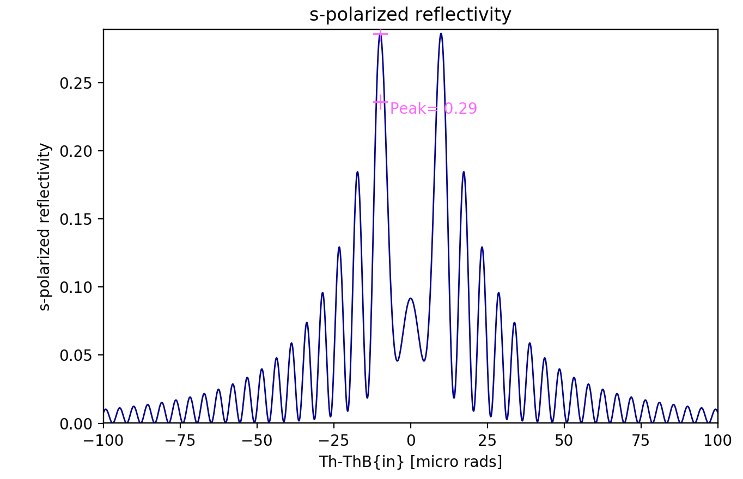
Examples
Crystals
BRAGG or reflection
LAUE or transmission
Notes:
Comparison some examples

Slide 7
Crystals: Dynamical theory for plane crystals
BRAGG or reflection
LAUE or transmission
7

Slide 8
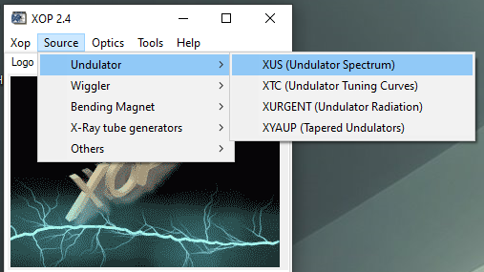
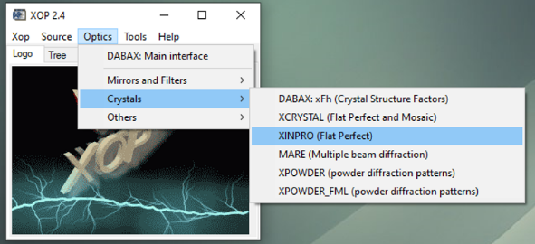
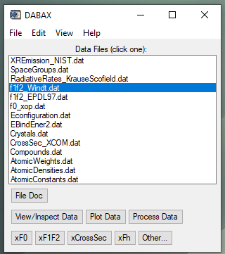
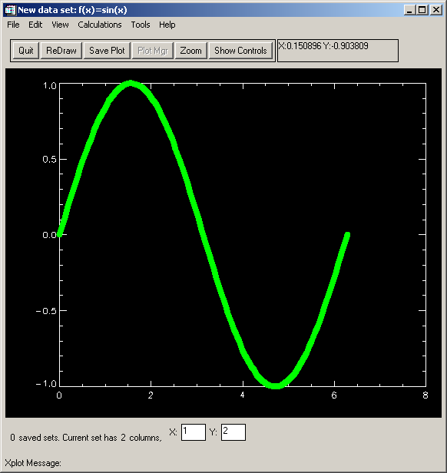
Developed during the early 1990s to suit local needs at the ESRF and the APS (efforts officially merged 1995; now 30 years… 2020 end of life)
XOP Extensions
X-Ray Sources
X-Ray Optics and Photon -Atom Interactions
SHADOWVUI
Interface to the SHADOW ray-tracing code (Cerrina et al.)
IMD
Multilayer software (Windt)
TOPO
Surface topography (Windt)
General Purpose Tools and Documentation
XPLOT

Slide 9
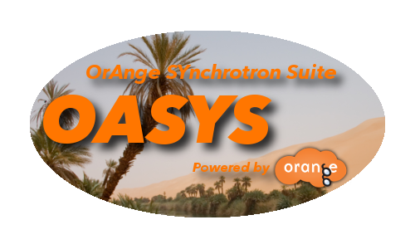
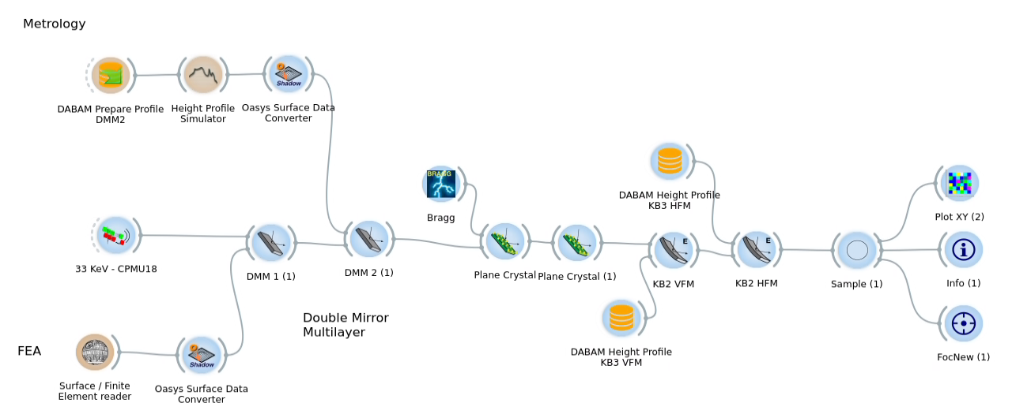
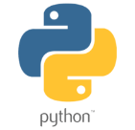
Calculation tools: OASYS
https://oasys-kit.github.io/
XOPPY
SRW
WOFRY
SHADOWOUI
SYNED
Luca Rebuffi (ANL) & Manuel Sánchez del Río (ESRF)
Orange
GUI (Python)
ESRF Add-Ons
Utilities

Slide 10
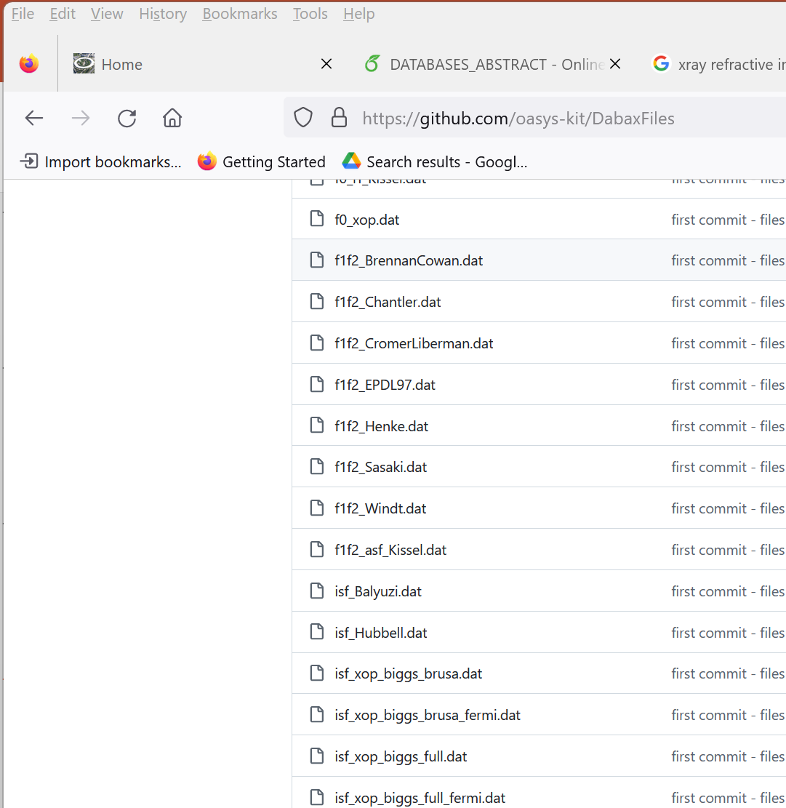
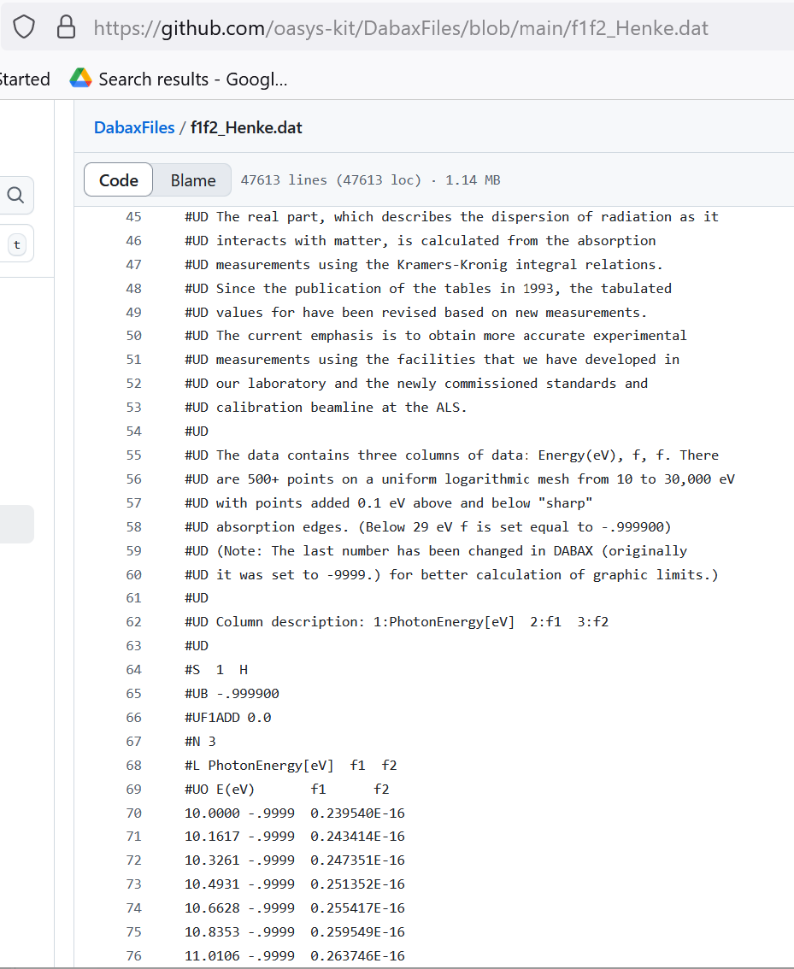
DAtaBAse for X-rays (DABAX)
https://github.com/oasys-kit/DabaxFiles
CPMU14.4
CPMU18
CPMU14.4
Notes:
Comparison some examples

Slide 11
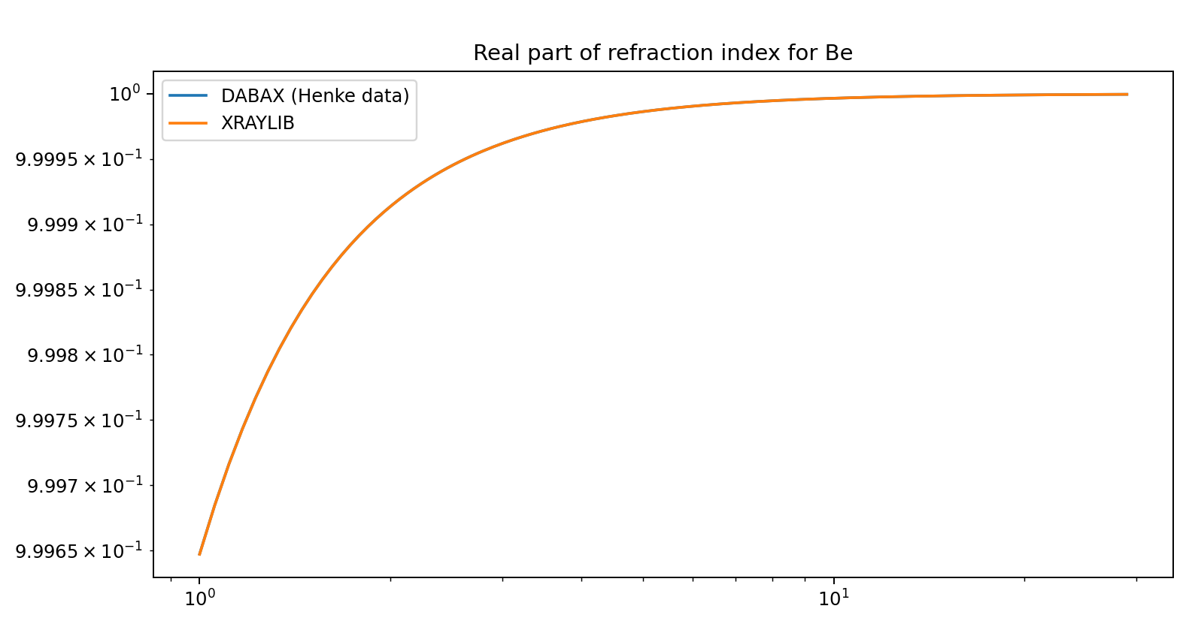
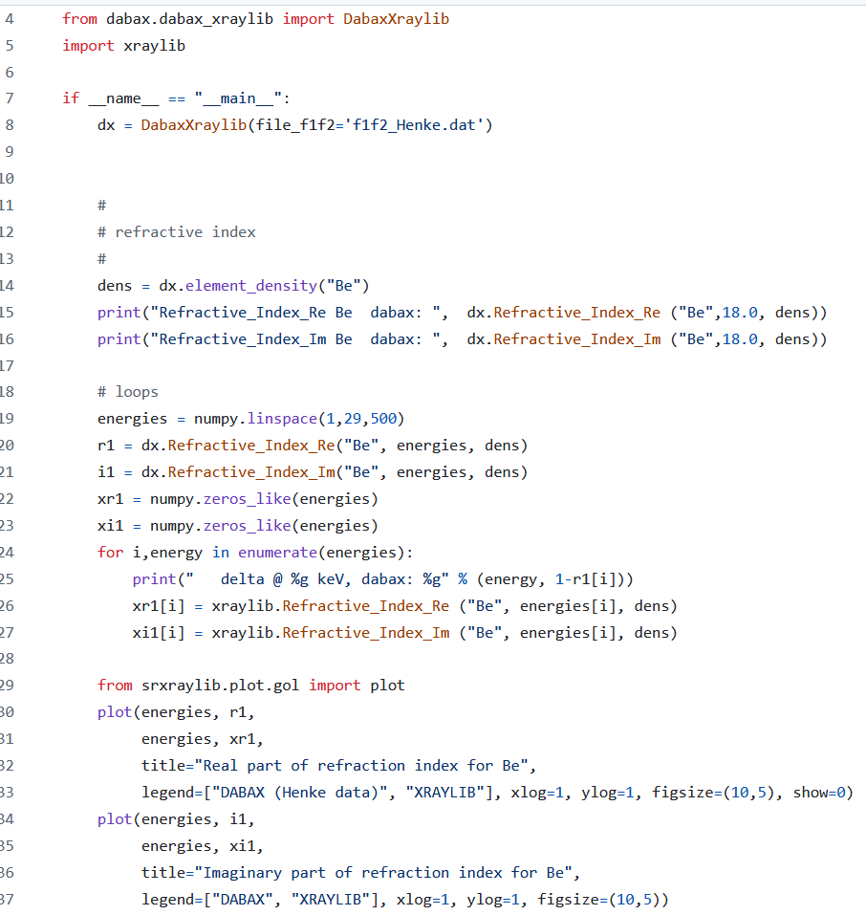
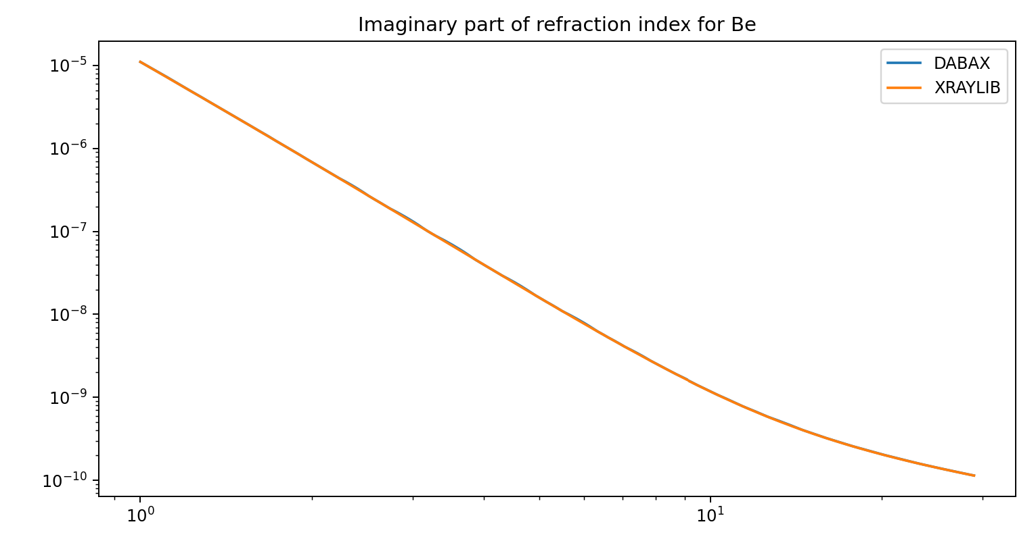
DABAX python lib
https://github.com/oasys-kit/dabax
CPMU18
CPMU14.4
Notes:
Comparison some examples

Slide 12
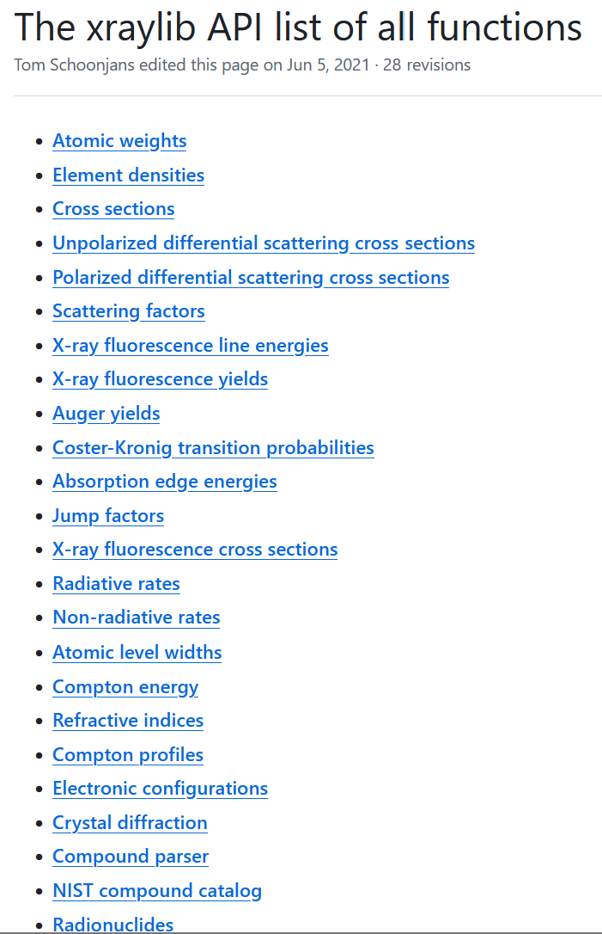
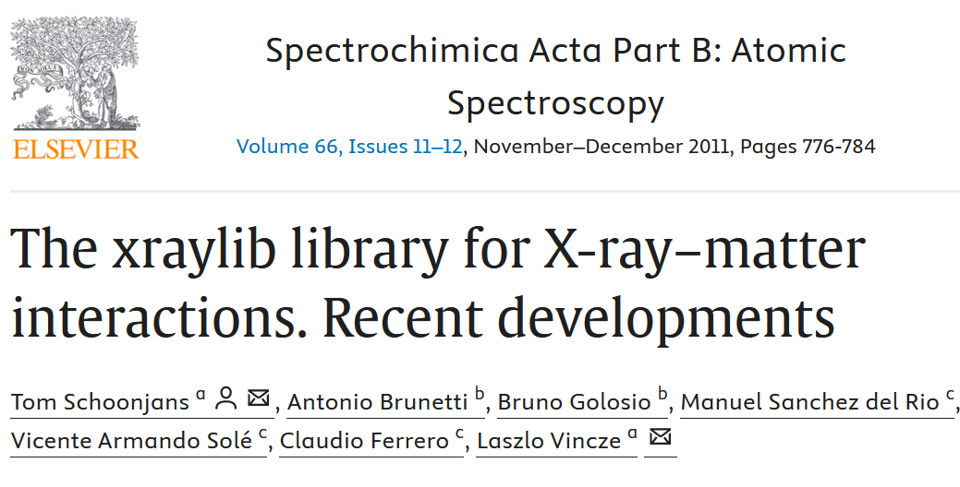
Xraylib (Tom Schoonjans)
http://github.com/tschoonj/xraylib
CPMU14.4
CPMU18
CPMU14.4
Notes:
Comparison some examples

Slide 13
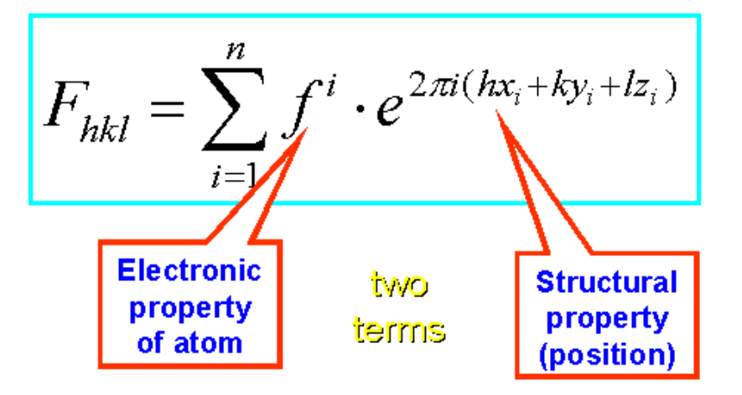
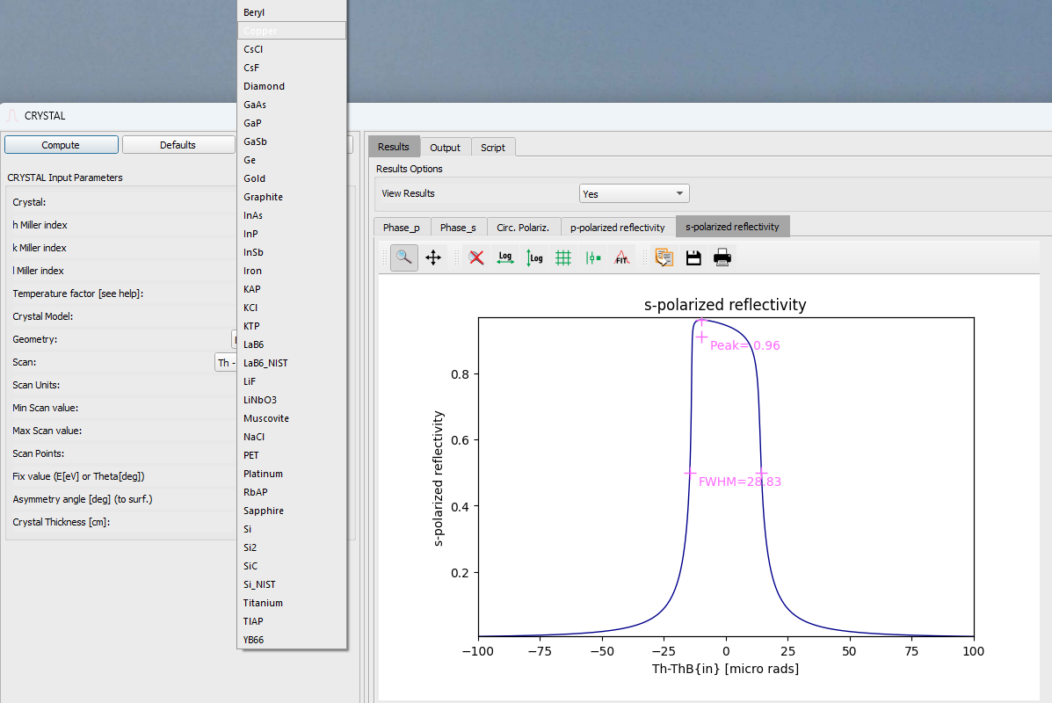
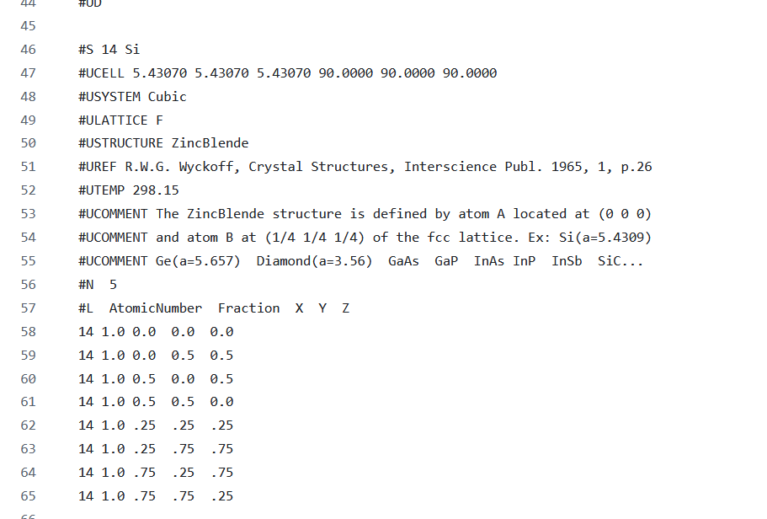
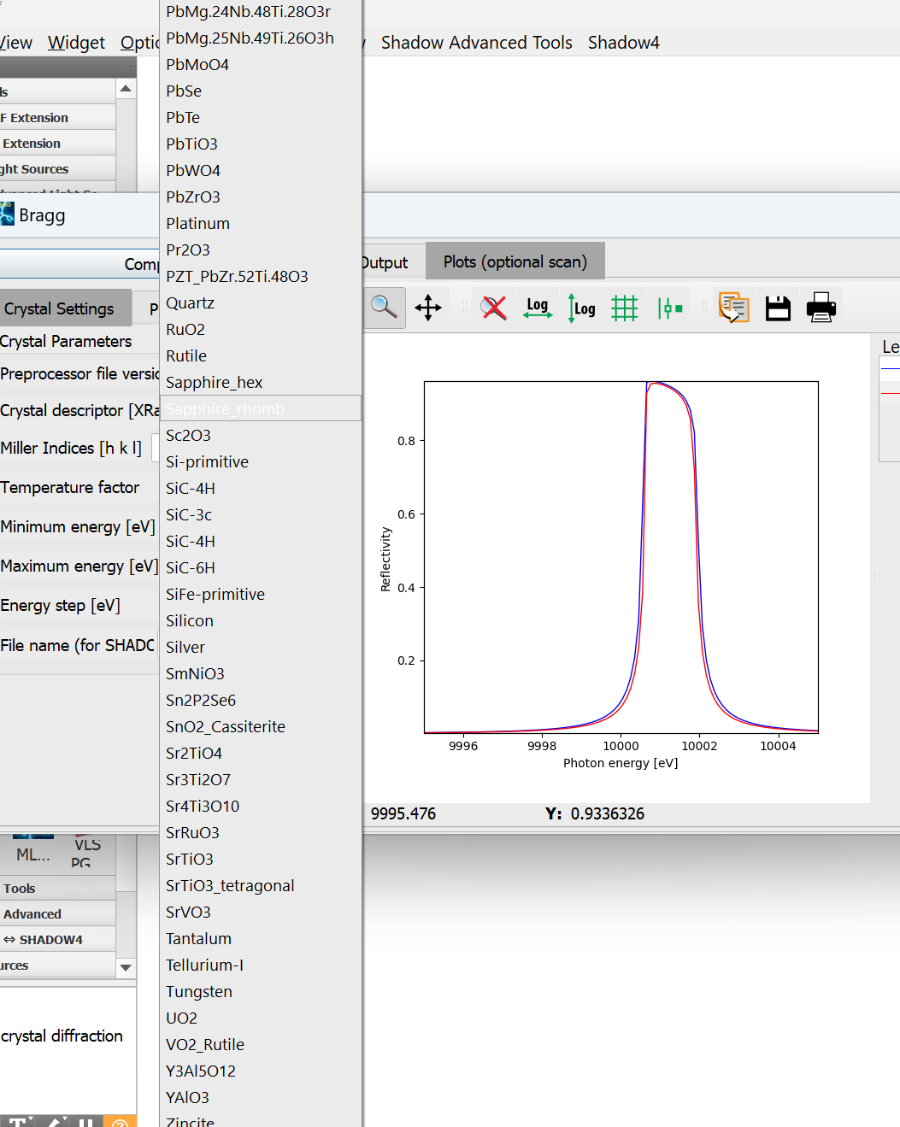
Crystals
CPMU14.4
CPMU18
CPMU14.4
https://x-server.gmca.aps.anl.gov/
Notes:
Comparison some examples

Slide 14
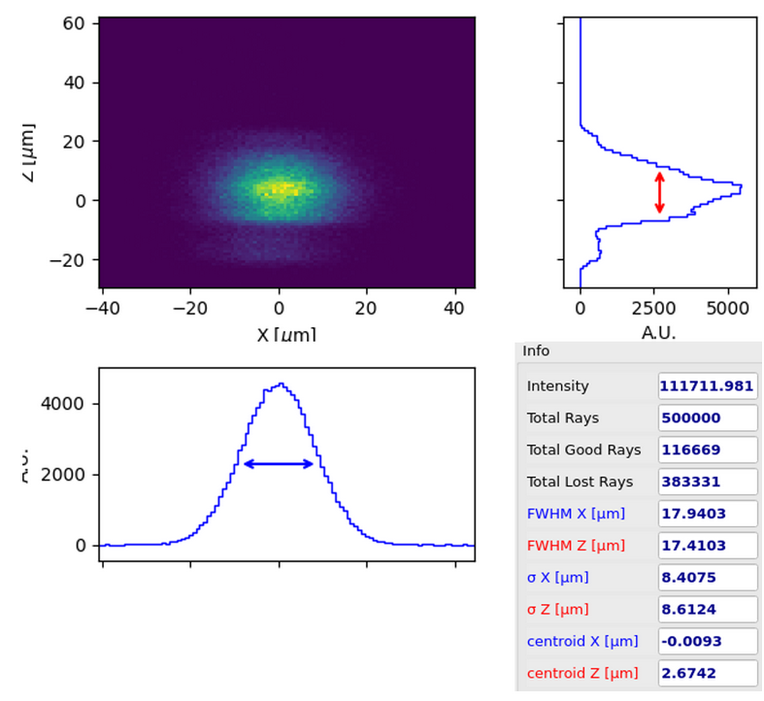
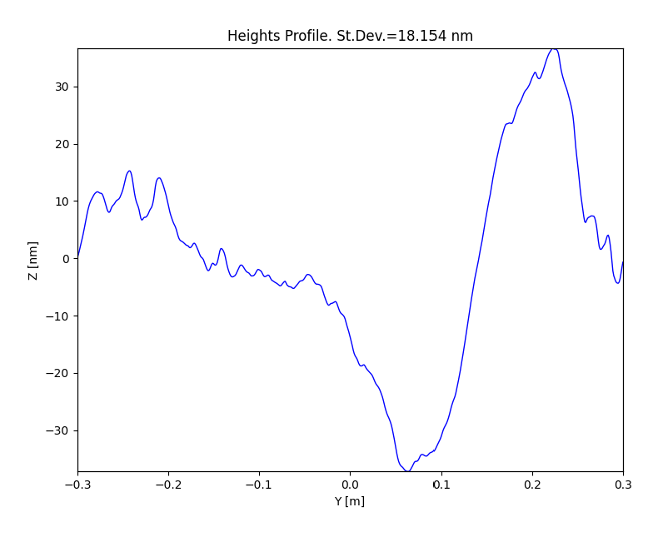
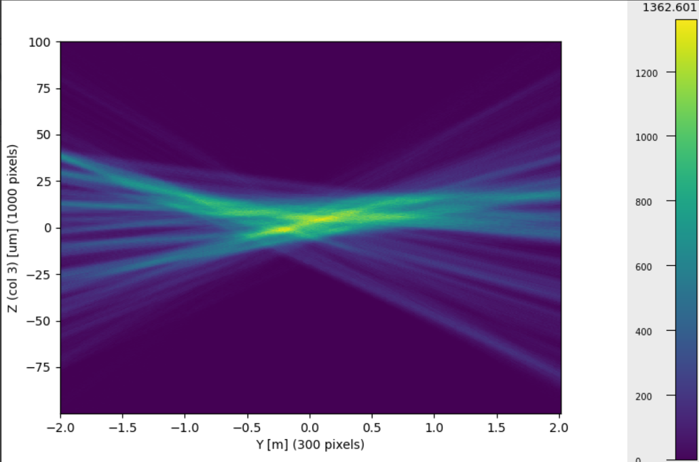
Performance of beamlines is limited
by the surface finish of the optics:
Residual surface errors (figure)
Roughness
CPMU14.4
Notes:
Comparison some examples

Slide 15
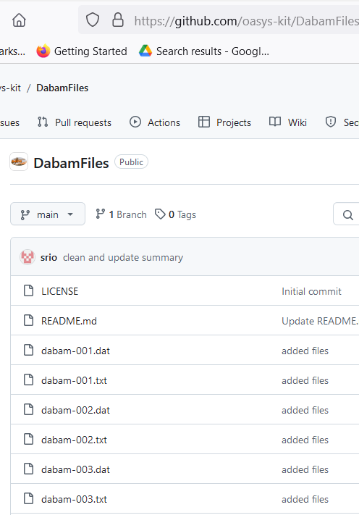
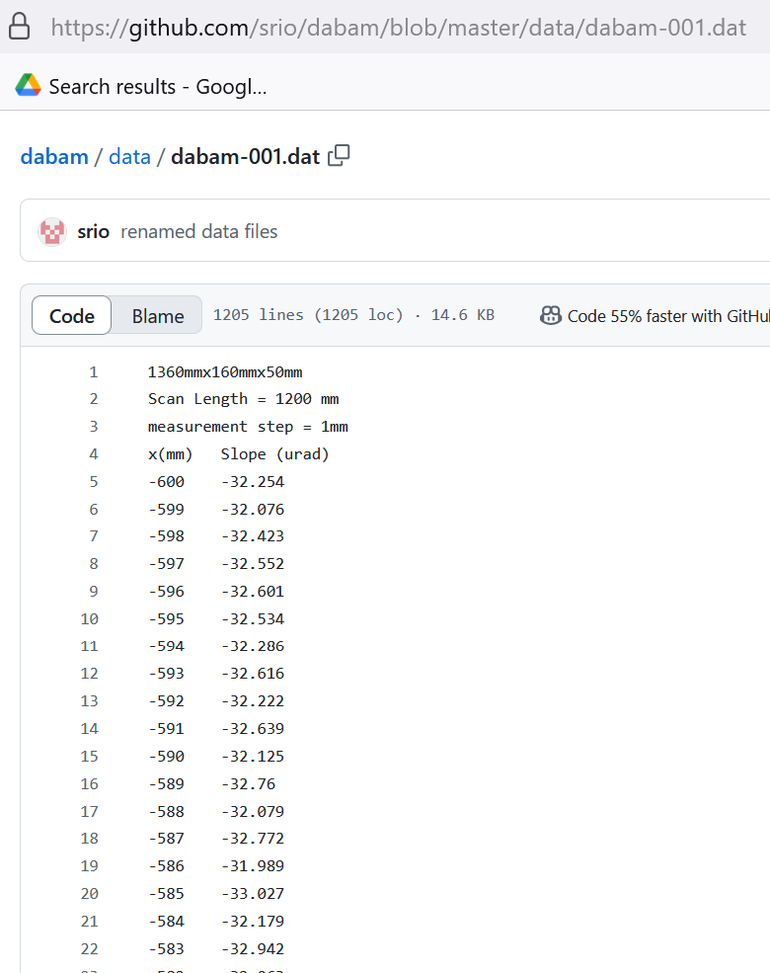
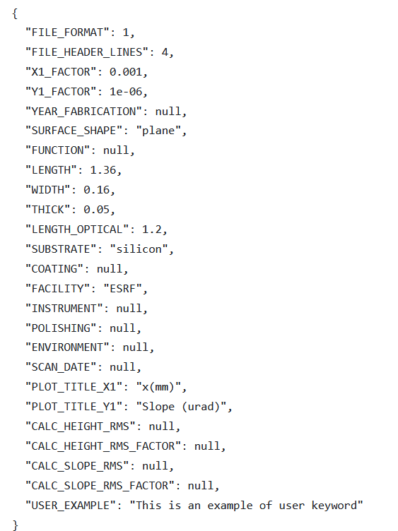
DABAM
https://github.com/oasys-kit/DabamFiles
CPMU14.4
Notes:
Comparison some examples

Slide 16
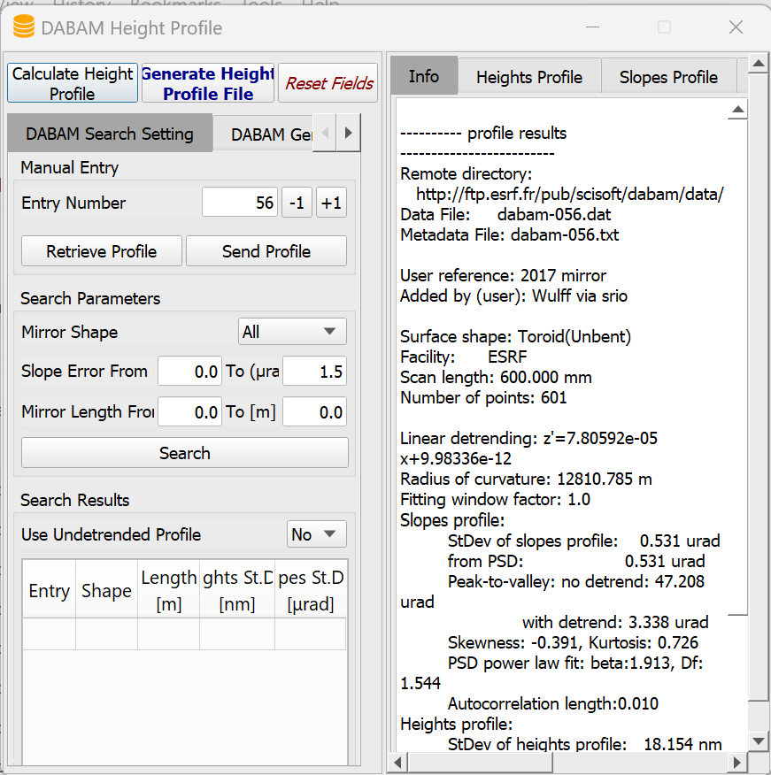
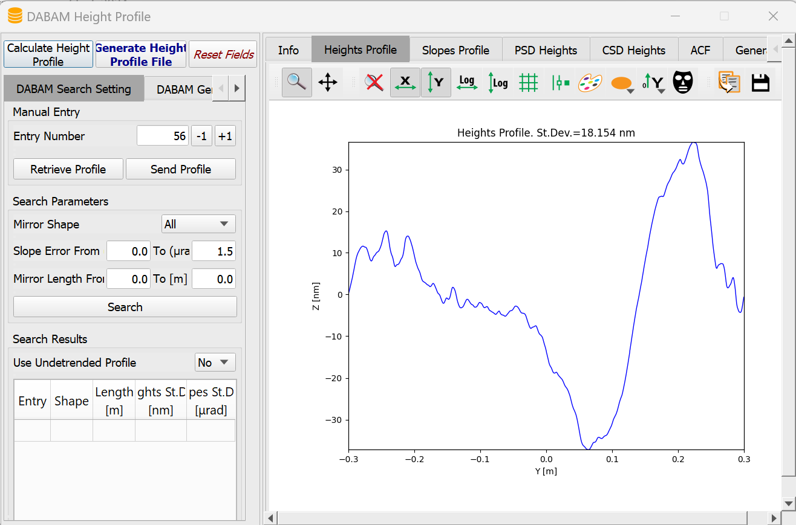
DABAM
CPMU14.4
Notes:
Comparison some examples

Slide 17
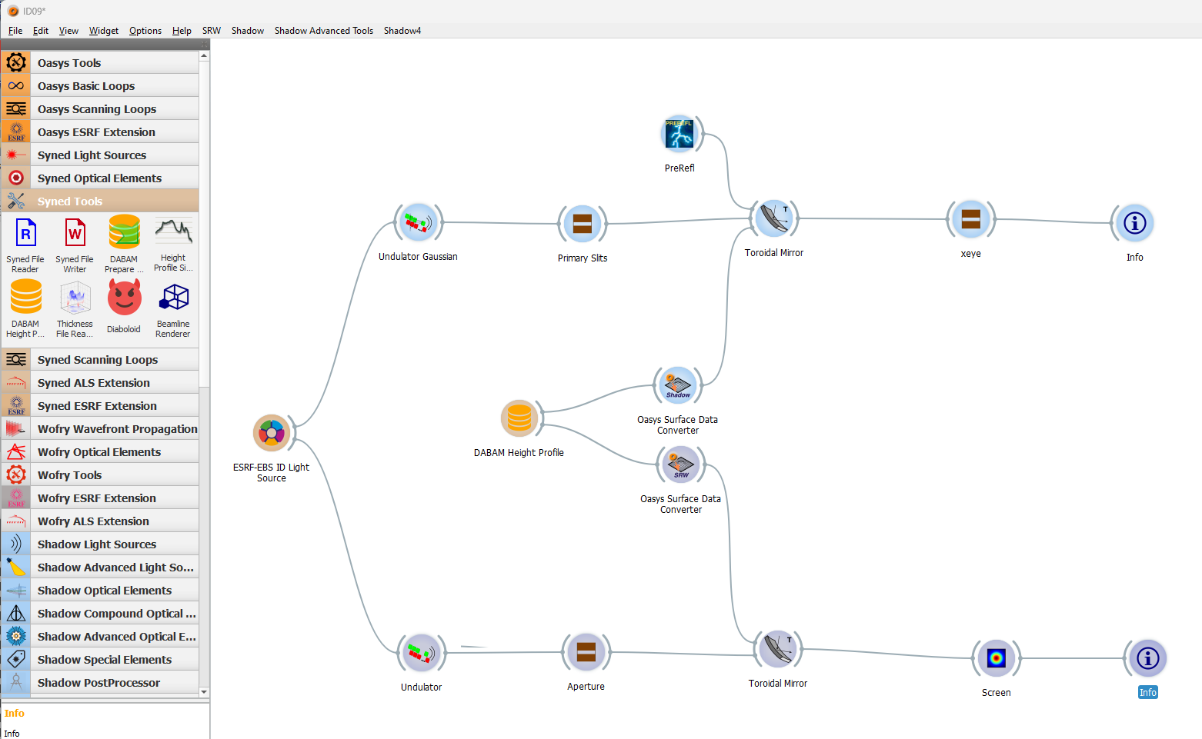
DABAM in OASYS
Ray tracing (SHADOW)
CPMU14.4
Wave optics (SRW)
Notes:
Comparison some examples

Slide 18
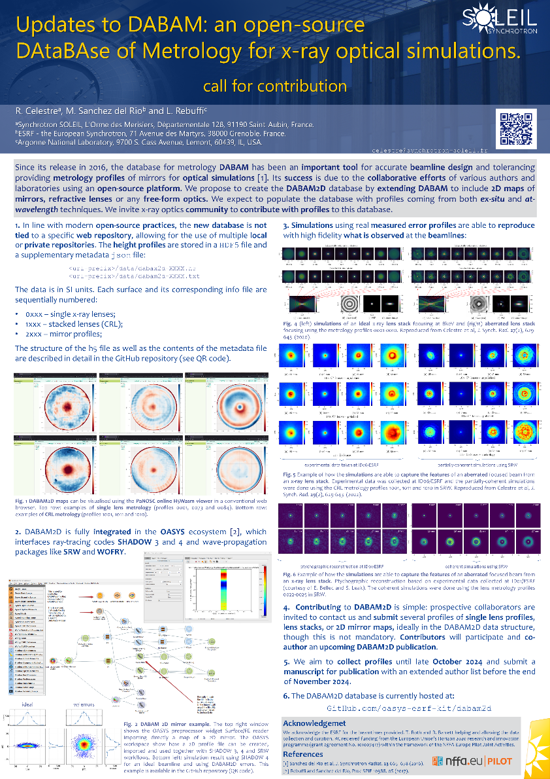
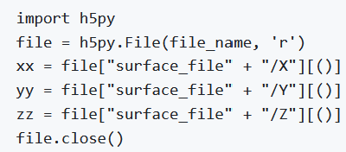
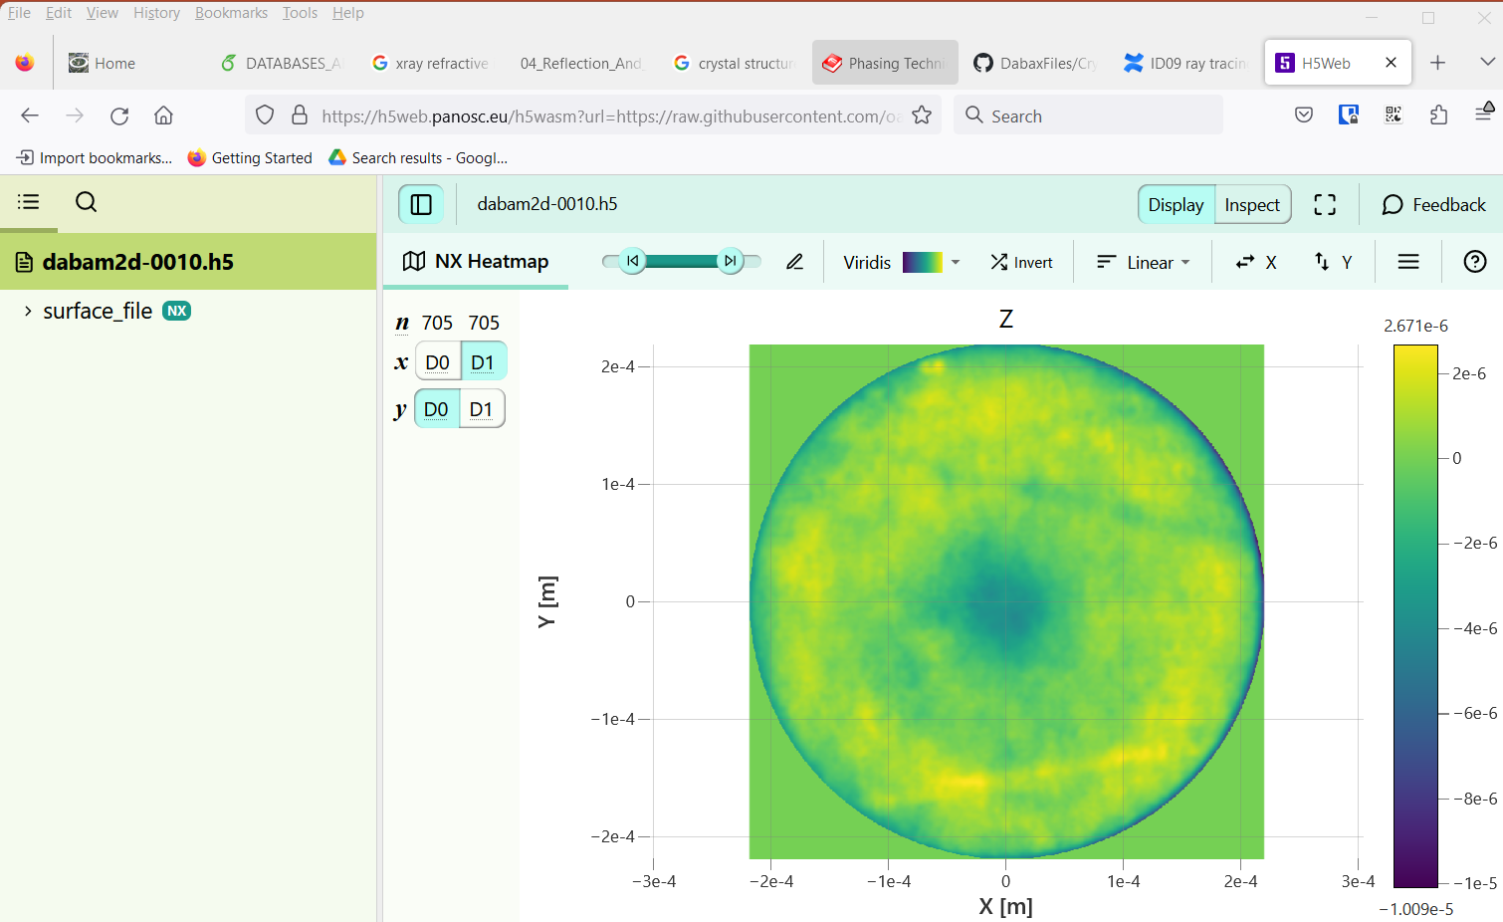
DABAM2D (UNDER DEVELOPMENT)
CPMU14.4
Notes:
Comparison some examples

Slide 19
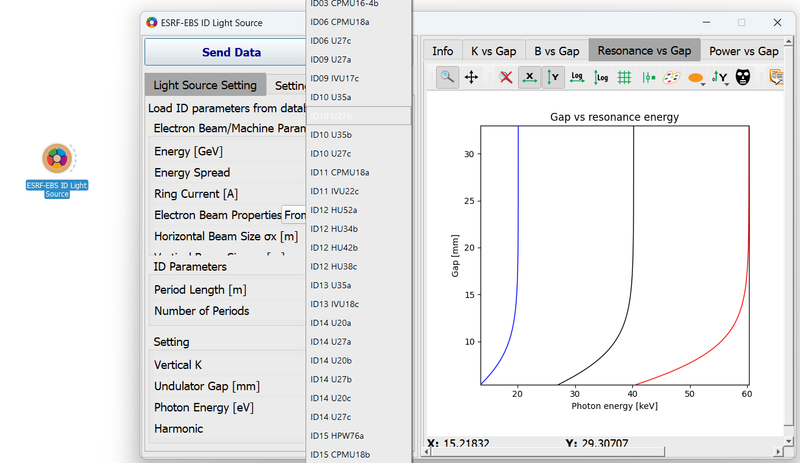
ID application
CPMU14.4
Notes:
Comparison some examples

Slide 20
SUMMARY
X-ray applications (DABAX, xraylib)
Optics Metrology (DABAM, DABAM2D)
Focus on data
Python access (used in OASYS)
CPMU14.4
Notes:
Comparison some examples

