Slide 1
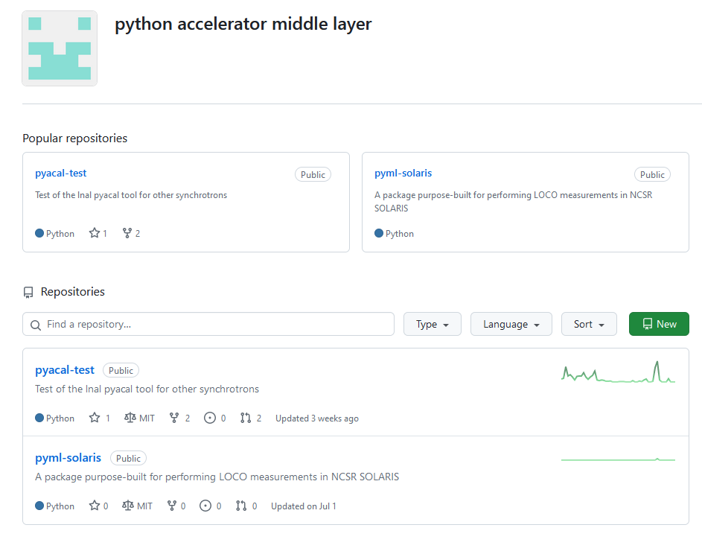
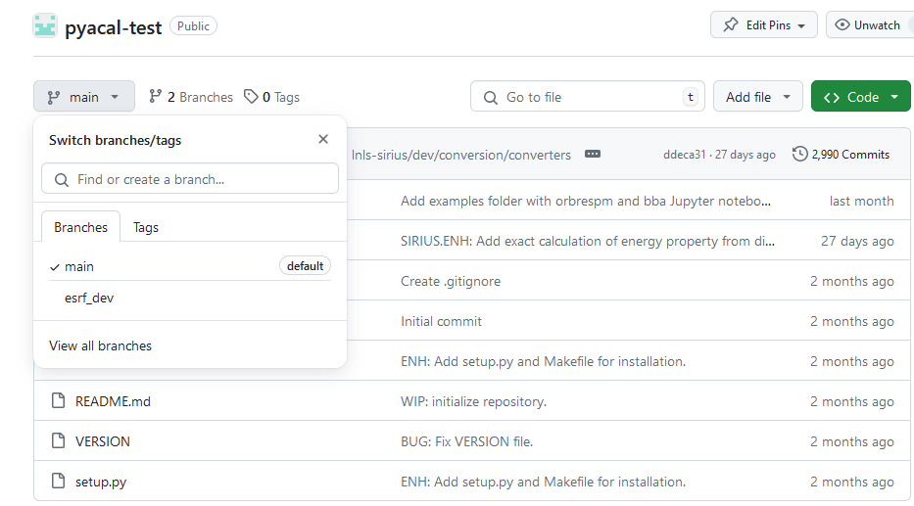
GitHub repository
Workshop outcome: test the SIRIUS implementation: pyacal-test repository
SIRIUS team proposed a standalone working test version
ESRF-DEV branch used for test at ESRF
Code public and visible
Created python accelerator middle layer github organization to host development projects

Slide 2
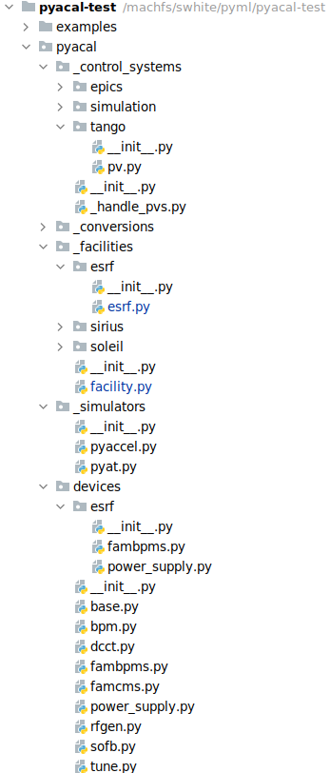
What needed to adapted for ESRF
To get it working at ESRF few features had to be added modified:
It took a total 3 days of work + 1 meeting for the SIRIUS team to have some thing running on the ESRF simulation
New features:
TANGO interface
pyAT interface
ESRF facility definition
ESRF specific devices
Few additional minor modifications to load AT model from file for example
This implementation should be usable by any TANGO/pyAT users as long as the facility is defined in the subpackage facilities

Slide 3
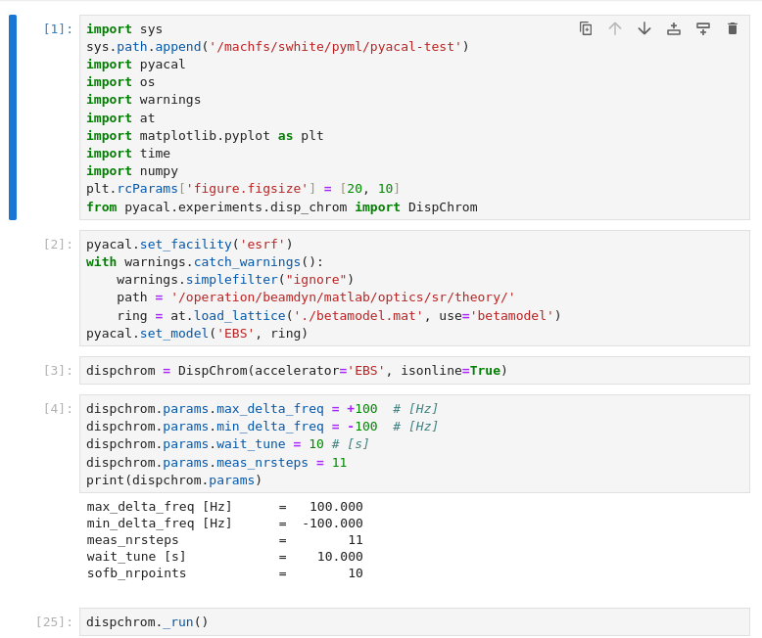
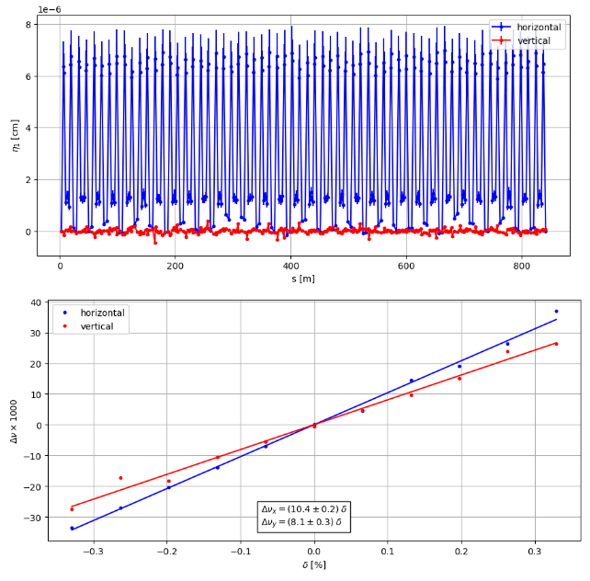
ESRF test
Once debugged on the ESRF simulator PYACAL could be launched on the ESRF-EBS machine without any further modifications
Tested 2 experiments:
ORM measurement
Dispersion and chromaticity measurement
Those are the simplest examples provided
Chromaticity and dispersion measurement notebook and results

Slide 4
Feedback and next steps
Some remarks:
It was relatively straight forward to adapt PYACAL to ESRF-EBS
Once the TANGO and pyAT interface had been implemented all “higher” level applications worked out of the box
PYACAL was developed with EPICS in mind with the present architecture we cannot profit form certain TANGO features such as Devices or Family Devices: for the test workaround were implemented to make it work
PYACAL give access to a full suite of measurements and controls scripts with potentially minor or no modifications needed
Next steps:
Run more complex experiments: BBA, Orbit feedback?
We would be very interested in testing pyQT GUI at ESRF
Can we run experiments on the model? Is the switch to simulation implemented in the test version?

