Slide 1
VISA at ESRF
Sept 2024 status.

Slide 2
Infrastructure 2024 - Openstack
OpenStack Caracal 2024.1 (Kolla, Neutron, Nova, Keystone, Cyborg, Cinder)
Try to follow OpenStack releases
3 CEPH servers (3 replica)
3 Control Servers (Neutron, Keystone, Nova Scheduler, …)
5 Compute servers:
Nvidia GPU: 24x A16, 6x A40
Cores: 320
RAM: 10TB
Linux bridge (Due to initial performance difficulties with Open vSwitch, subject to change)
Small SLURM cluster dedicated to VISA (4 compute nodes)
Monitoring: Check_mk
Issues: Cyborg does not always free up GPU resources

Slide 3
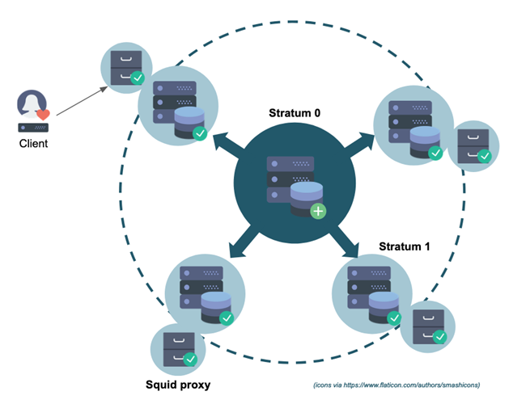
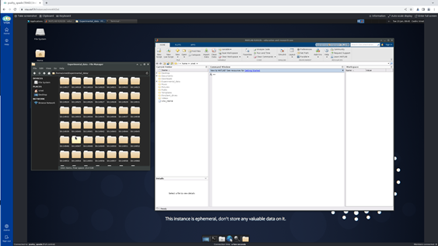
Images 2024
Ubuntu 20.04, migration to 24.04 for the end of the year
local home dir ( ≠ users’ central home directories ) – Long debate …
Access to central experimental data storage (IBM Storage Scale) through dedicated NFS gateway
Data access control based on NFSv4 ACLs (like for any other data services)
No root access or sudo access for users
Monitoring: Prometheus (node_exporter) -> Grafana
Software distribution based on CVMFS

Slide 4
Scientific Software on VISA
Apptainer images (but not only) can be run using the Applications and Science menu in the VISA virtual machine
OR
VISA and the HPC clusters can load the software as Modules with the option to choose specific versions

Slide 5
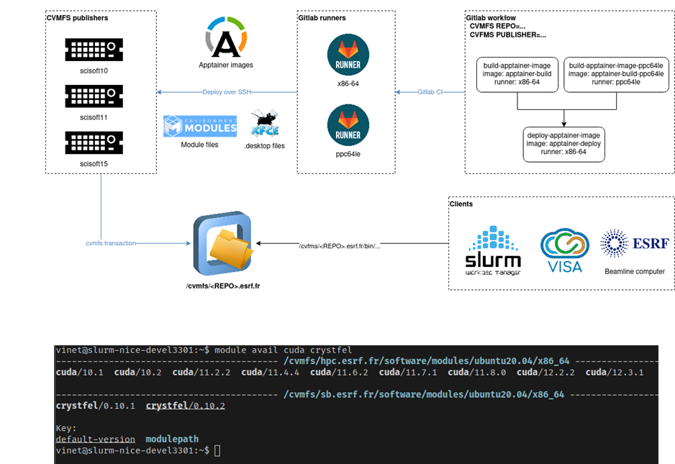
https://apptainer.gitlab-pages.esrf.fr/admin/templates/
CVMFS used for deployment of Apptainers containers but also software difficult to containerized.
Adopted by IT and Scientific Dev teams

Slide 6
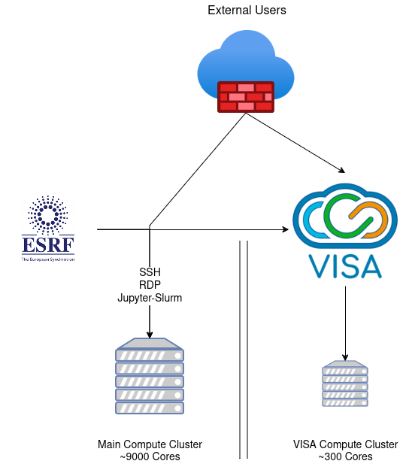
Currently, 2 compute clusters
Issues with the main Cluster:
Many user entry points (Guacamole, RDP, SSH, Jupyter-Slurm)
Crowded & hard to manage frontend nodes.
Managing 1 cluster is enough maintenance.
Visa cluster is too small for some users.
2 Clusters is less efficient than 1.
We would like to migrate these usages to VISA to secure and standardize compute cluster access.
Prerequisites:
Homogeneous home dir.
Improve network filtering on the main compute cluster.

Slide 7
UserS’ adoption
Typically 40 active sessions per day (more during trainings). Initially staff, more and more ESRF users
Organisation of dedicated meeting per BLs (20% of the BL so far got this meeting)
Features requested by Scientists so far:
Windows VM (ID12, ID28, ID27, ID16A, BM05, BM18, …)
Access to the central storage and their private data area (All)
SLURM Central cluster access (ID27, BM05, BM18, ….)
Better documentation (All)
Resources booking (BM32)
Ability to zoom in, extend graphical resolution (ID32)
Ability to create more than 2 instances, when acting as local contacts (ID32)
Central home dir as VM home dir (all BLs + Scientific dev)
UI Latency improvement (general)

