Slide 1
VISA COLLABORATION Beyond PanOSC&ExPaNDS projects
Majid Ounsy
NOBUGS CONFERENCE 2024
VISA Workshop

Slide 3
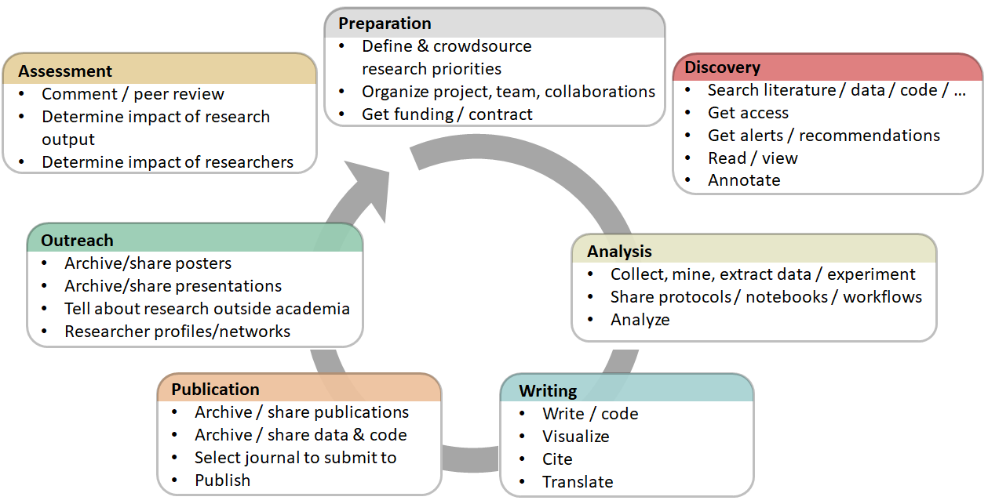
Benefits of Open Data/Open science with ExPaNDS
The goal of the ExPaNDS project and the EOSC is to make data from publicly funded research in Europe
Findable, Accessible, Interoperable and Reusable (FAIR).
Open Science Basics
https://open-science-training-handbook.gitbook.io/book/open-science-basics
Adopting FAIR principals is a step towards Open Science
Open Research Data and Material
Open Research Software and Open Source
Reproducible Research and Data Analysis
Open Access to Published Research Results
Open Licensing and File Formats
Collaborative Platforms
…….
…….
VISA Platform

Slide 4
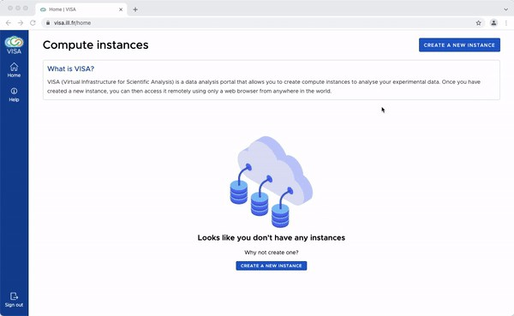
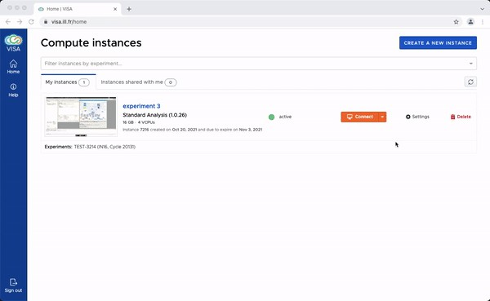
VISA: the PaN Remote Data Analysis Platform
Software provided by ILL
WEB application: run it on your laptop
Nothing to install
Remote: Run your Data Analysis near your data location
Compute Resource allocation transparent to the user
Integrated Authentication and Authorisation access
Umbrella (eduTEAMS) using facility IdP, ORCID…
Can link to Data Catalogues
Team working / shared sessions
Accessible from the EOSC marketplace

Slide 5
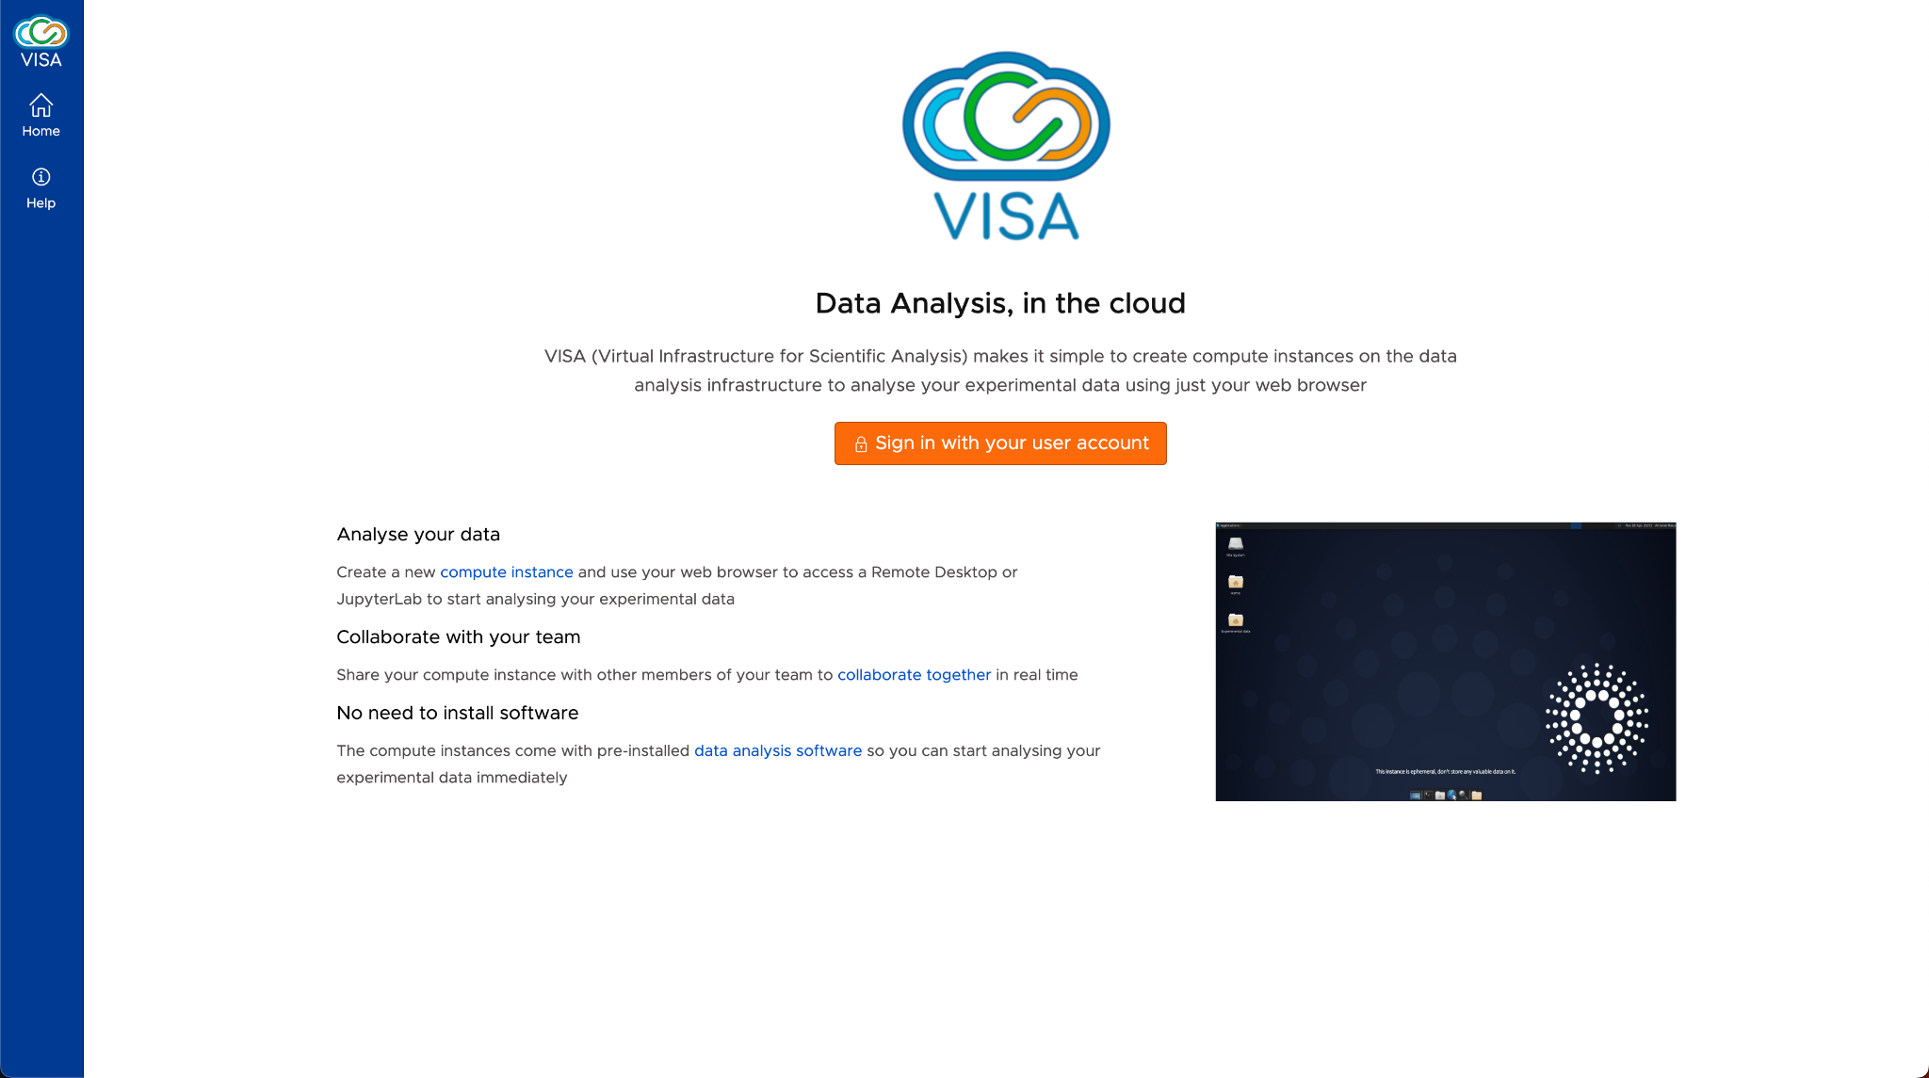
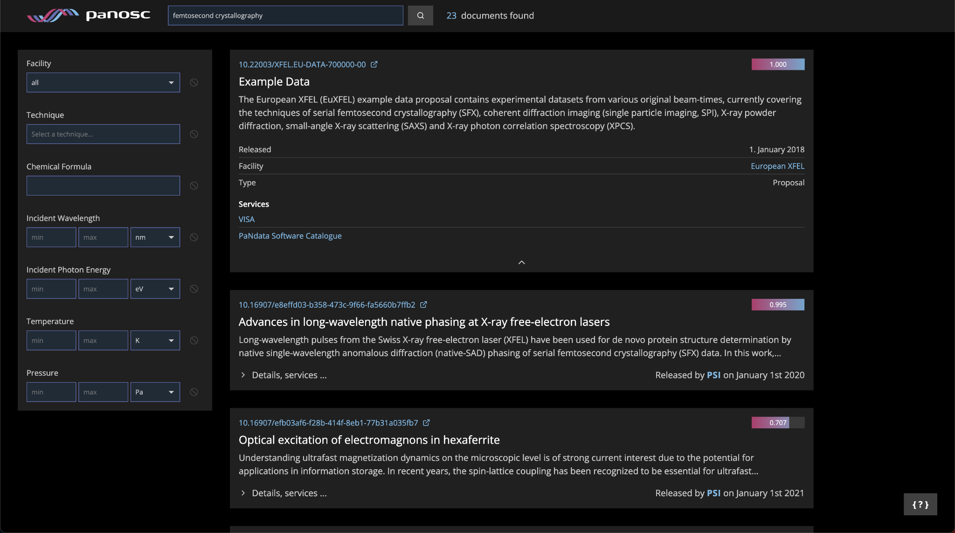
VISA: A user Scenario
Open the VISA instance at
facility hosting data
https://visa.desy.de/login?returnUrl=%2Fhome
Run your application
Open the Data Portal
https://data.panosc.eu
Locate your Data
PaN portal on EOSC marketplace
(
common portal deployed and maintained by PaNOSC
)
Different at each facility
WP3 metadata
ExPaNDS PaN facility
Common Photon and Neutron portal
Infrastructure front end
Authentication
(
PaN portal deployed by PaNOSC
WP3 metadata
)
(
local or federated
(
NoMachine, FastX, VNC, JupyterLab/Hub, ssh, ...
)
)
Same API to outside
Compute infrastructure
(
HPC, K8, ...
)
Container registry
Required:
Downloadable
Portable container (or virtual machine)
• Data locator (desy.de://pnfs.desy.de/exfl/...)
dependencies
(
eg: eosc-pan-git.desy.de
• Infrastructure locator (max-display.desy.de)
/data
Common standard
/scratch
)
Optional:
• User credentials (username, federated ID, ...)
• Container locator (eosc-pan-git.desy.de://....)
• Service type (Jupyter, remote desktop, web...)
Data store
Working space
Other facility
(
disk
)
(
scratch
(
network copy
)
Want to analyse data acquired years ago
)
Data archive
(
tape
)
Repeat at each ExPaNDS facility

Slide 6
VISA Sustainability
Used at ILL in daily operation since many years!
In operation at ESRF!
Adopted by many partners of the PanOSC/ExPanDS projects:
ALBA, DESY, ESRF, ESS, EuXFEL, HZDR, ILL, MAX IV, PSI, and SOLEIL
A Memorandum of Understanding is about to be signed to continue the collaboration on VISA between all the above partners.
Draft paper on “LEAPS Data Strategy” (EPJP-D-22-04955) submitted to the European Physical Journal on behalf of the IT PaN community and presenting VISA as a major outcome of the PaNOSC/ExPaNDS projects.

Slide 7
CONTINUING THE COLLABORATION
MoU
ALBA, DESY, ESRF, ESS, EuXFEL, HZDR, ILL, MAX IV, PSI, and SOLEIL
Topics For Collaboration
Web Front End (https://github.com/ILLGrenoble/visa-web)
API Server (https://github.com/ILLGrenoble/visa-api-server)
Accounts (https://github.com/ILLGrenoble/visa-accounts)
Jupyter Proxy (https://github.com/ILLGrenoble/visa-jupyter-proxy)
Docs (https://github.com/ILLGrenoble/visa-docs)
Pluggable Authentication Module (PAM) (https://github.com/ILLGrenoble/visa-pam)
Cloud Web Provider OpenStack (https://github.com/ILLGrenoble/visa-cloud-web-provider-openstack)
Guacamole Common JS NPM module (https://github.com/ILLGrenoble/visa-guacamole-common-js) This library provides the low level handling of the guacamole protocol through socket.io.
Security Groups Example (https://github.com/ILLGrenoble/visa-security-groups-example)
Demo (https://github.com/ILLGrenoble/visa-demo)
Image Template Example (https://github.com/ILLGrenoble/visa-image-template-example)
VISA DB ETL Python Library (https://github.com/ILLGrenoble/visa-db-etl-py)
VISA Deploy Scripts (https://github.com/ILLGrenoble/visa-deploy-scripts)
VISA Cloud Web Provider Proxmox (https://github.com/ILLGrenoble/visa-cloud-web-provider-proxmox) The VISA Cloud Web Provider Proxmox provides a RESTful web service for interacting with the Proxmox API.

Slide 8
CONTINUING THE COLLABORATION
MoU
ALBA, DESY, ESRF, ESS, EuXFEL, HZDR, ILL, MAX IV, PSI, and SOLEIL
To summerize:
Agreement to share common goals
Mutualise (best effort) resources
No commitment to engage personal or finance
Share knowledge and tooling
Intellectual Property preservation
Meet Regulary
Nominate Representatives
Vote for newcomers
Rules of Collaboration
GENERAL UNDERTAKING OF THE PARTIES
ENTRY INTO FORCE - DURATION – TERMINATION
PRINCIPLES OF THE COLLABORATION
CONFIDENTIALITY
FINANCIAL PROVISIONS
REVIEW MEETINGS
COLLABORATION MEMBERSHIP

