Slide 1
Handling Fast Data through Pipelines Karabo Developer Workshop 2024
Gero Flucke
(based on slides from Raul Costa)
Controls Group @ European XFEL
Satellite Workshop: An introduction to developing in the Karabo SCADA Framework

Slide 2
Outline
Introduction: Pipelines and their uses
Hands-On Exercises

Slide 3
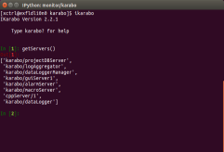
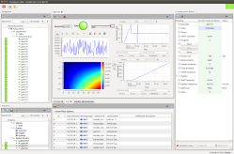
Karabo: Device Based Communication via a Message Broker
Interface for Users and Operators
Equipment
Control
Self-describing Karabo Devices
Equipment control, e.g. motors, valves,…
Detectors
e.g. cameras
Online data analysis
Data Logging
Other system services
GUI entry point
DAQ for big/scientific data (not shown)
Command Line
Interface
Graphical
User Interface
GUI Server
e.g. motor, pump, valve, sensor
DAQ
Equipment
and other service devices like configuration manager
Message Broker
Data Logging
Node
Analysis
Node
e.g. commercial camera
TCP/IP data pipelines for
big/fast data
e.g. calibration, image processing
storage of control data and configurations

Slide 4
Introduction – Pipelines and their Uses
GUI Server
Karabo data can be split in 2 categories:
Slow Data and Fast Data.
Slow Data: exchanged via broker (AMQP)
Device properties (configurations and read-only params)
Logged by (InfluxDB) data loggers
Instantiations, shutdowns, state changes, …
Fast Data
Sent directly from one device to another (no broker)
High throughputs must be supported
Camera images, digitizer data
Saved by the DAQ on request
Camera
Image
Processor
DAQ

Slide 5
Introduction – Pipelines and their Uses (ctd.)
GUI Server
Pipelines:
Direct TCP between two Karabo devices for fast Data flows
Two ends:
OutputChannel: produces data
InputChannel consumes data
Karabo devices can have any number of Input- and OutputChannels
InputChannel is the active part
Establishes connection to configured OutputChannel
Main configuration of data flow
Tells OutputChannel that ready to receive more
Always keeping some data being transferred
Camera
Image
Processor
DAQ

Slide 6
Hands-On Exercises - Outline
Connect a skeleton MDL device to a simulated camera
Code Part I: Process data sent by the camera
Step 1: Show the number of frames sent by the camera
Step 2: Show the min, max and average of the pixels of each frame
Step 3: Add PROCESSING and ERROR states, handle end-of-stream (optional)
Code Part II: Forward processed data via an output channel
Step 4: Forward min, max and average of the pixels of each frame
Step 5: Capture and forward frame timestamp (optional)
Step 6: Forward camera acquisition cycles (end-of-stream events) (optional)

Slide 7
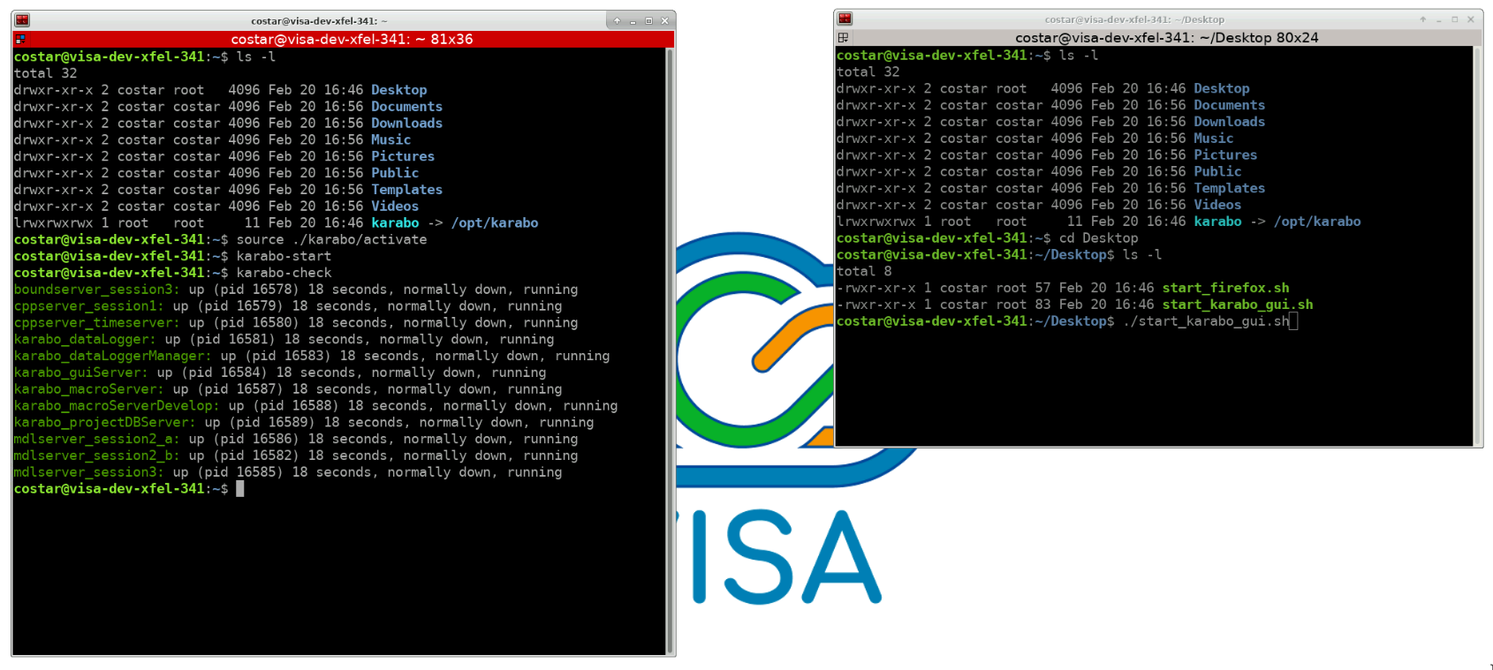
Start Karabo’s Working Environment on the VISA VM
> cd ~/Desktop
./start_karabo_gui.sh
(Login as admin or expert)
[to launch the GUI client – and see any error output]
> cd ~/karabo
> source ./activate
> karabo-start
> karabo-check
[to activate and start Karabo services]

Slide 8
Launch and Explore the Simulated Camera
In the VISA VM, activate the Karabo GUI Client and open the project Session_3.
Find the simulated camera device – its name is SIM_BL_SYS/CAM/CAM - and instantiate it.
Double-click on the simulate camera device node in the project tree – the scene for the camera will be displayed. This scene will be used multiple times throughout the exercises.
In the Configuration Editor, expand the Output property of the simulated camera. This is the camera’s output channel. Click on the Table Element button in front of the Output > Connections properties – those are the input channels currently connected to the camera’s output channel. One connection should be present – the connection used by the device scene to show the camera image.
Still in the Configuration Editor, expand the Output > schema property. This shows how the data the camera sends through its output channel is structured. Take a look at the Data > Image > Pixel Data path of the schema.

Slide 9
Instantiate the Skeleton MDL Device and connect it to the camera
Still in the project Session_3 opened in the previous step, find the device we will be working on, PIPELINE/PROC/1, and select it (no instantiation yet).
In the Configuration Editor, check that the Input > Configured Connections property has the value SIM_BL_SYS/CAM/CAM:output. This the ID of the simulated camera output channel, formed by the concatenation of the DeviceID of the channel hosting device, a ‘:’, and the ID of the output channel.
Check the Output > Connections property of the simulated camera: the connection to PIPELINE/PROC/1:input should be there. If the simulated camera scene is open, it should be also listed there (image below).
Pressing the Acquire and Stop buttons in the camera scene doesn’t do anything on our device ... not for long!

Slide 10
Coding Part I Process Data Sent by the Camera

Slide 11
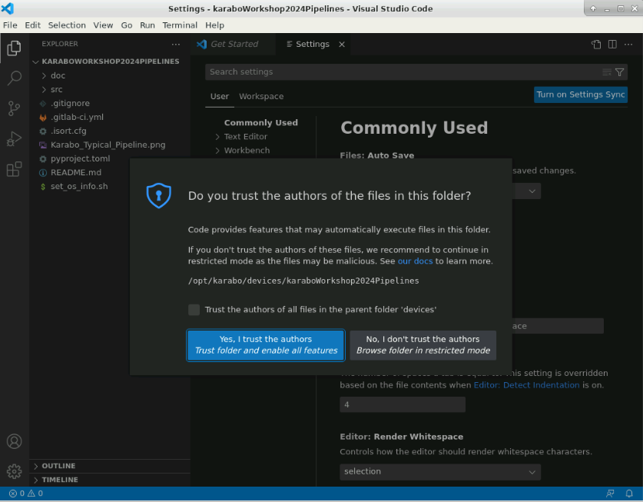
Step 1 – Show the number of frames sent by the camera
Issue a [> karabo -g https://git.xfel.eu develop karaboWorkshop2024Pipelines]
i.e. git checkout to ~/karabo/devices/karaboWorkshop2024Pipelines and pip install -e
Go to that that directory
[> cd ~/karabo/devices/karaboWorkshop2024Pipelines]
Launch VS code: [> code .]
Trust us ;-)

Slide 12
Step 1 – Show the number of frames sent by the camera (ctd.)
The initial version of our camera image processing device already comes with a input channel defined: the @InputChannel decorator for the async def input coroutine defines an input channel property for the device and establishes the coroutine as the handler for data received from an output channel.
When the input channel is connected to a camera, each frame sent by the camera will activate the input coroutine once, passing the frame data via the data parameter. The structure of the parameter matches the schema of the camera’s output channel. The second parameter, meta, is unused for now; it’ll be used in Step 4.
The task of this step is to add a framesAcquired property of type UInt32 to our device - the number of frames received from the camera since the device instantiation.
To test your progress, shutdown the device server of our device on the GUI client. As soon as the device server is back, instantiate the processing device - this syncs the running device with its latest version saved in Visual Studio Code.
[> git diff hands_on_1_initial hands_on_1_done] will display the solution for this step.

Slide 13
Step 2 – Show the min, max, and average of the pixels values of each frame
Issue [> git checkout hands_on_1_done] in terminal (in …/karaboWorkshop2024Pipelines directory.
The method async def process_image(self, pixels) currently does nothing. It’s called from the async def input coroutine, which sends it the pixels of the current frame sent by the camera as the value for the pixels parameter.
The task of this step is to add the properties pixelMean (of type Double), pixelMin (of type UInt16), and pixelMax (of type UInt16) to our device. Those properties values should be the average, minimum, and maximum values of the pixels of the most recent frame sent by the camera. Hint: the pixels argument passed to process_image is an object of type ndarray and has the methods min(), max(), and mean().
[> git diff hands_on_1_done hands_on_2_done] will display the solution for this step.

Slide 14
Step 3 (optional) – Add PROCESSING and ERROR states, handle end-of-stream
Do [> git checkout hands_on_2_done].
An end-of-stream event is sent by a camera when it stops acquiring images. To handle end-of-stream events, an input channel has to declare an async input(self, output_channel_id) method decorated with @input.endOfStream.
The task of this step are:
Add a PROCESSING state to the device to indicate that data is being received from the camera.
Add an ERROR state to the device to indicate any error while processing data sent by the camera. Error details should be shown in the device’s status property. Successful processing data while in ERROR state should take the device back to PROCESSING state.
Handle end-of-stream events from the camera by putting the device back in ON state and indicating that no processing is taking place by showing IDLE in the device’s status property. Reset the framesAcquired value when the camera starts a new acquisition cycle.
[> git diff hands_on_2_done hands_on_3_done] will display the solution for this step.

Slide 15
Coding Part II Forward Processed Data Via an Output Channel

Slide 16
Step 4 – Forward min, max and average of the pixels of each frame
Do [> git checkout hands_on_4_initial]
We start with the device already with an output channel: its data structure is defined by class DataNode (line 22), which becomes the field data of class ChannelNode (line 39). Channel Node is then specified as the schema of the output OutputChannel (line 88).
The task of this step is to forward the values computed for the pixelMean, pixelMin, pixelMax properties of the device through its output channel. Hint: reinstantiate the device after shutting down its device server. Take a look at the Output > schema > data property of the device in the Configuration Editor to see how the data must be structured. Await for the self.output.writeData() coroutine to send the data.
[> git diff hands_on_4_initial hands_on_4_done] will display the solution for this step.
The forwarded content can be seen in the scene PIPELINE_PROC_1_OUTPUT in the same project that has our device and the simulated camera

Slide 17
Step 5 (optional) – Capture and forward frame timestamp
Do [> git checkout hands_on_4_done]
The metadata (data about data) for the data received by an input channel is available as the second parameter of the async def input handler coroutine – meta parameter in line 50.
The timestamp of the data received can be accessed within the input handler method as meta.timestamp.timestamp.
The task of this step is to forward the timestamp of the data received by the input channel of our device to its output channel. Hint: the self.output.writeData call, currently using no argument, supports a keyword parameter called timestamp which allows specifying a timestamp for the data being written to the output channel.
[> git diff hands_on_4_done hands_on_5_done] will display the solution for this step.

Slide 18
Step 6 (optional) – Forward camera acquisition cycles (end-of-stream events)
Do [> git checkout hands_on_5_done].
The task of this step is to forward any end-of-stream event received from the camera to the output channel of the device. Hint: the output channel has a coroutine that sends an end-of-stream through the channel. For our device it can be invoked with self.output.writeEndOfStream().
[> git diff hands_on_5_done hands_on_6_done] will display the solution for this step.

