Slide 1
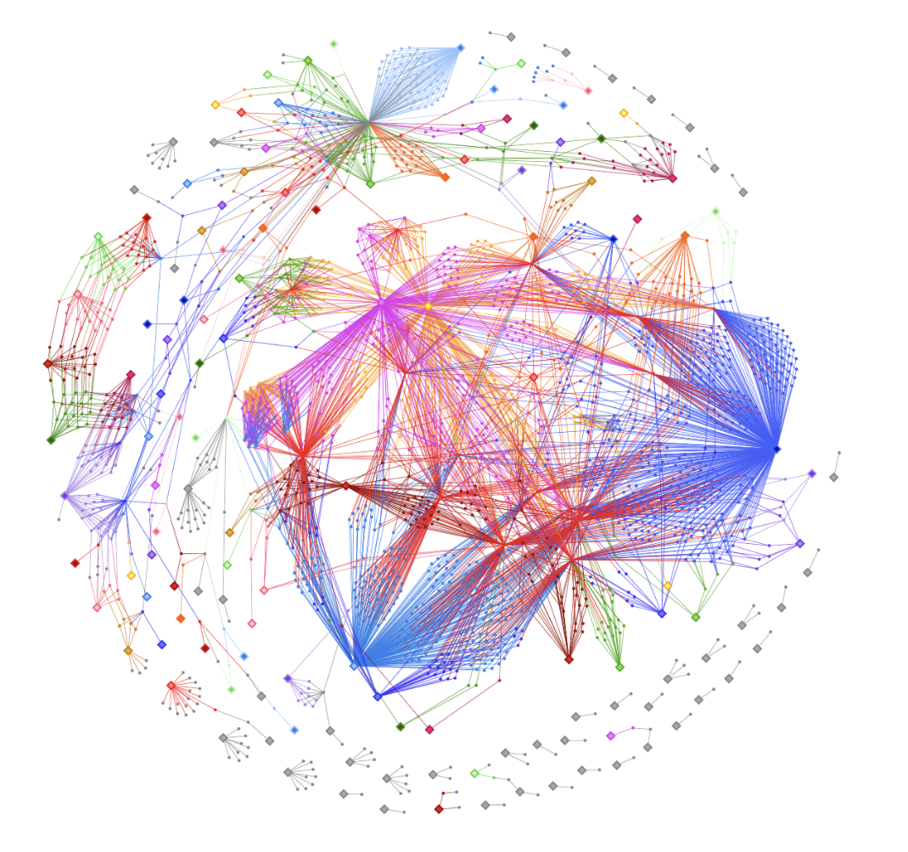
The Karabo Ecosystem at the European XFEL
Steffen Hauf
Group Leader Controls
European XFEL GmbH

Slide 2
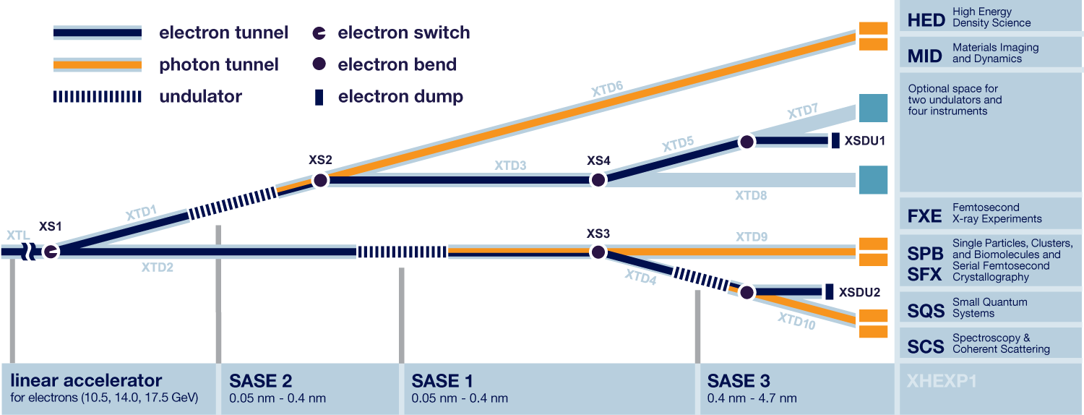
Beamline layout and experiment stations
Karabo
DOOCS
DOOCS

Slide 3
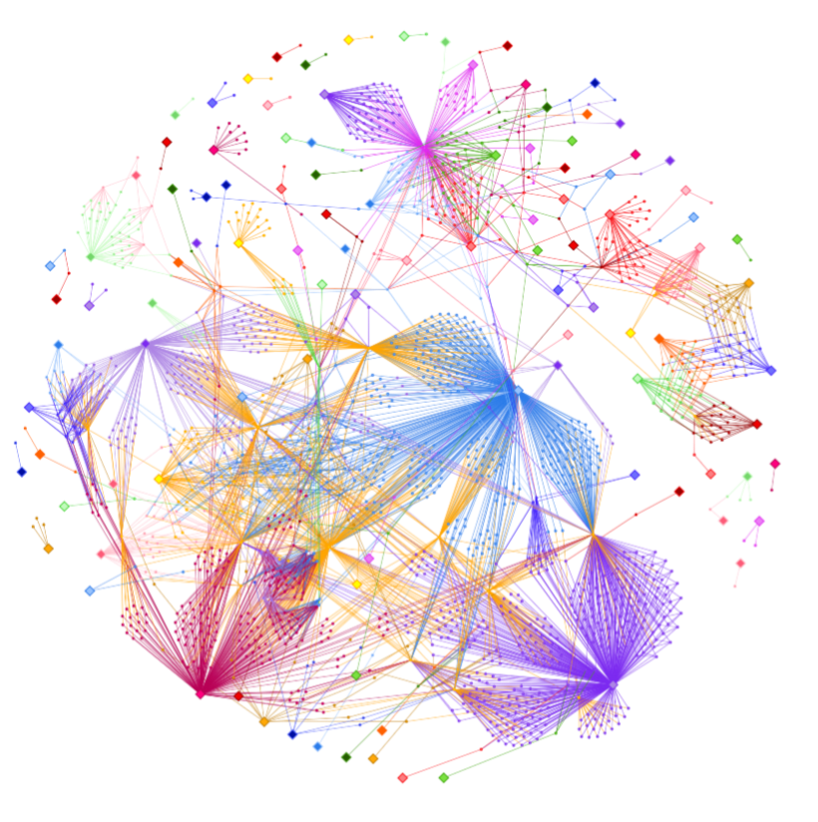
The Karabo SCADA systems connects them all – Example: MID Instrument
Time server
Key features to look out for in all topics:
  Timeserver: a central communication point for timing information
  Large Beckhoff loops, often interconnected via middlelayer devices and interlock conditions
  Processing pipelines, e.g. detector calibration
AGIPD Online Calibration
Beckhoff

Slide 4
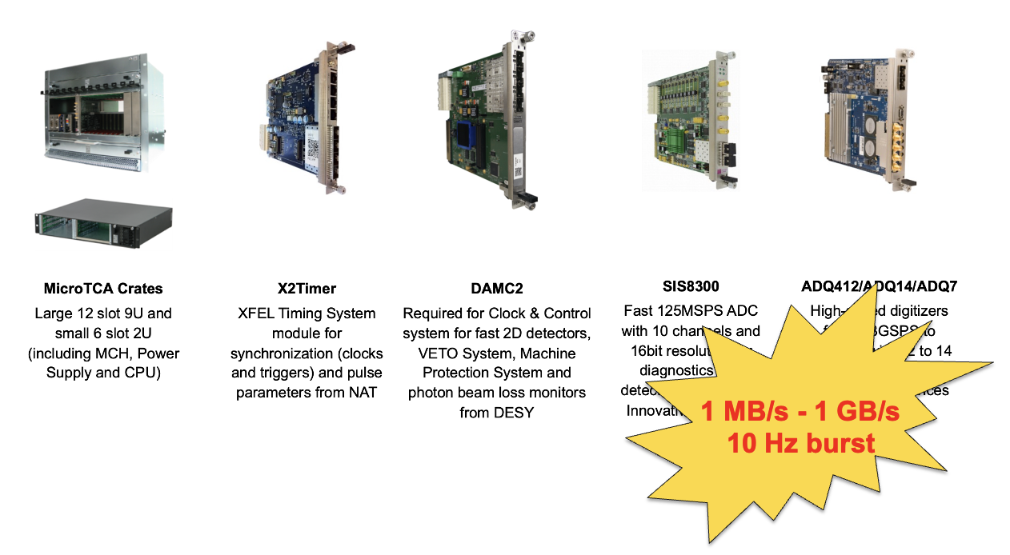
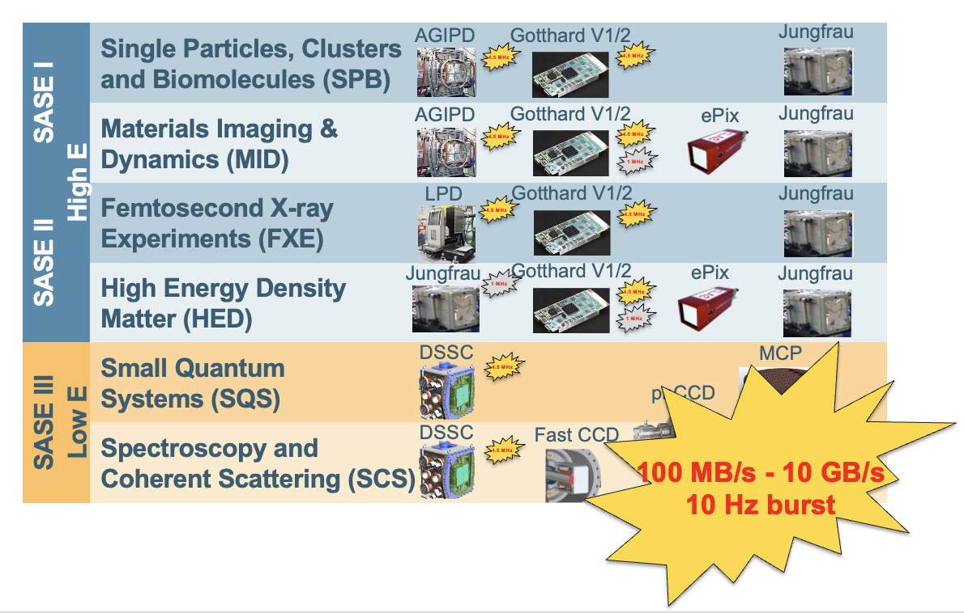
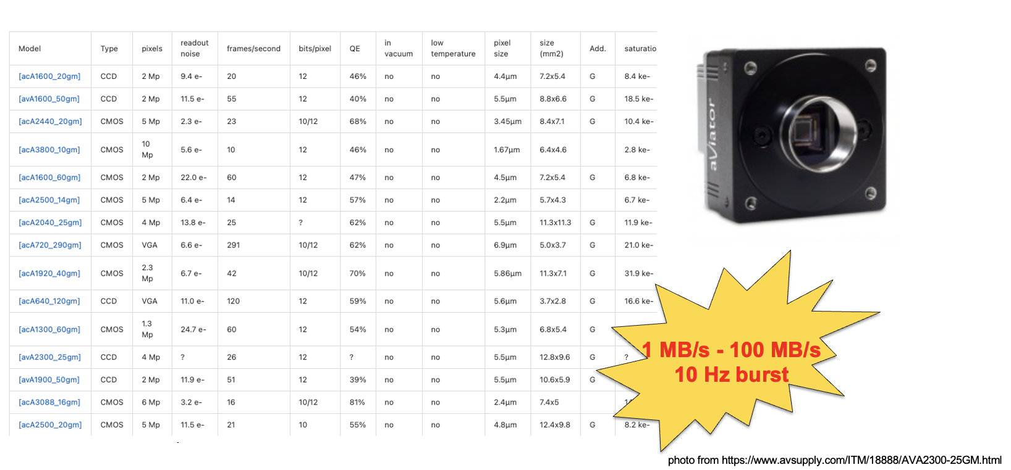
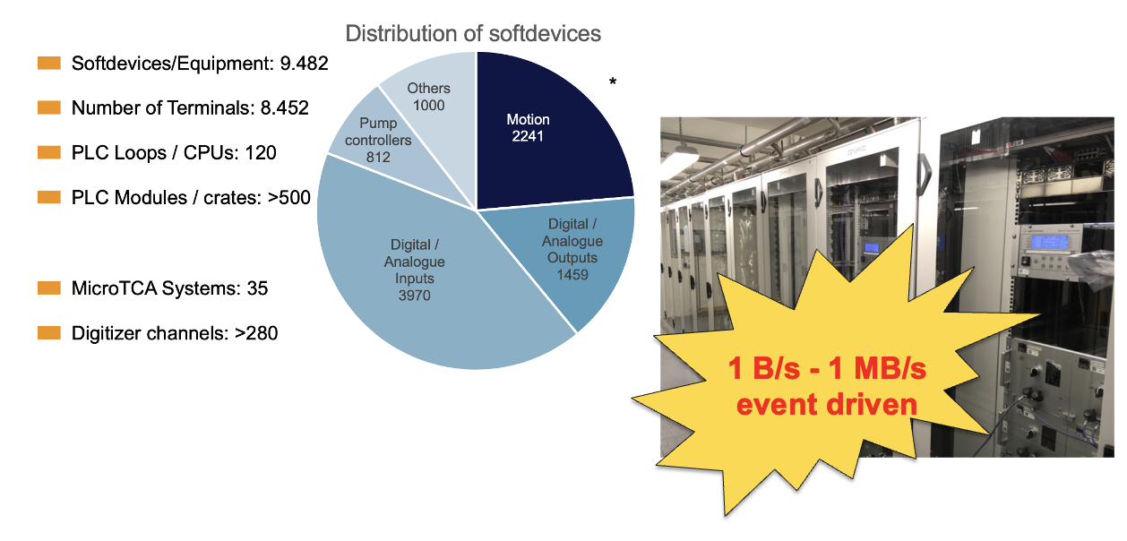
Data Drivers at the Facility
Custom Digitizer and FPGA solution
X-ray Detectors
2% of facility – 5% of data
3% of facility – 90% of data
Commercial Cameras
PLC systems and other “slow” data
90% of facility
< 1% of data
5% of facility – 5% of data

Slide 5


Karabo - A SCADA Framework: Framework Design
General | C++ API | Python Bound API | Middlelayer API
Event driven Asynchronous Self-descriptive Common, hierarchic data container supporting attributes on leafs: Karabo Hash Binary and XML serialization Extensible: core + “Devices“ | C++14 and Boost Smart pointers Template-heavy Boost.asio Eventloop based Devices are threads on a single server Aimed at high-performance devices | Exposes C++ API via Boost.Python Devices are separate processes Was aimed at p2p heavy devices which e.g. need numpy Not always pythonic | Python asyncio Decorators annotate Karabo structures Emphasis on interaction with other devices Pythonic

Slide 6
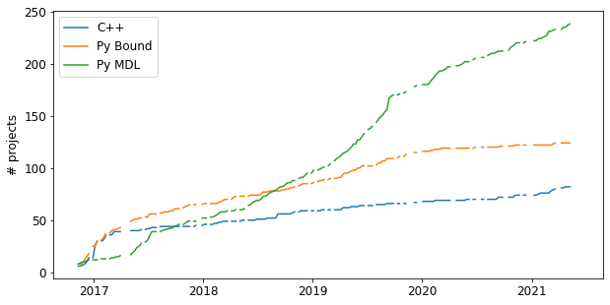
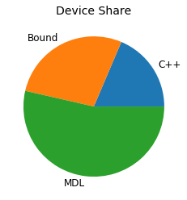
The Karabo Ecosystem – Usage of the three APIs
Nowadays, very often the Python middlelayer API, as “fastest time to market instrument”

Slide 7
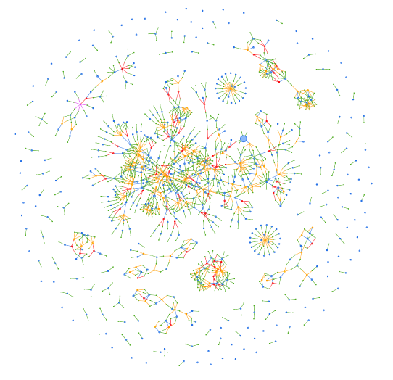
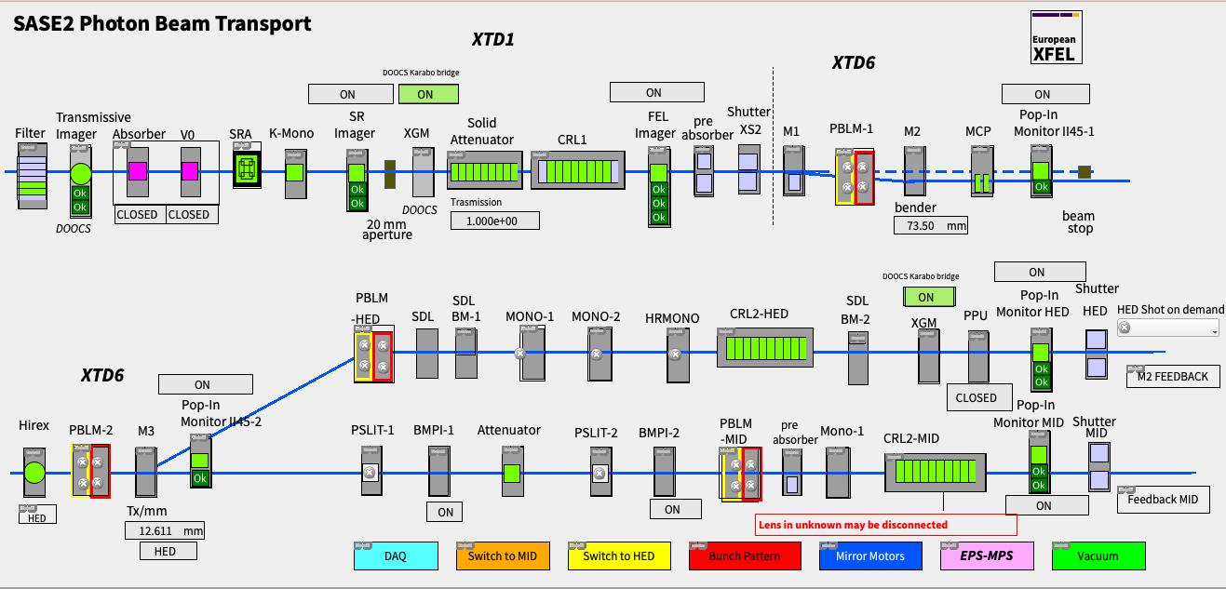
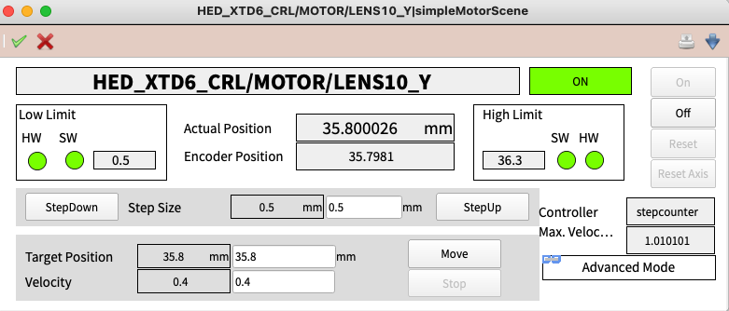
The Karabo Ecosystem – Highlights of the three APIs: Karabo Beckhoff Interface
API: C++
Builds upon: boost
Special because:
  Controls almost all PLC solutions at the facility
  Partially self-descriptive rendering via Karabo Schema injection
  Event-driven, up to 1kHz updates on some devices

Slide 8
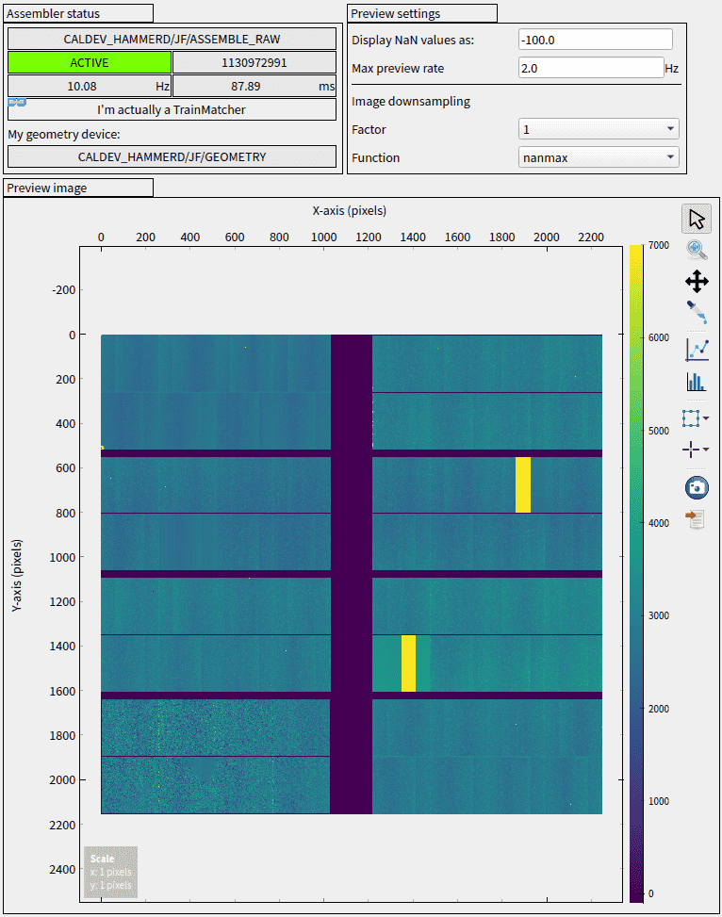
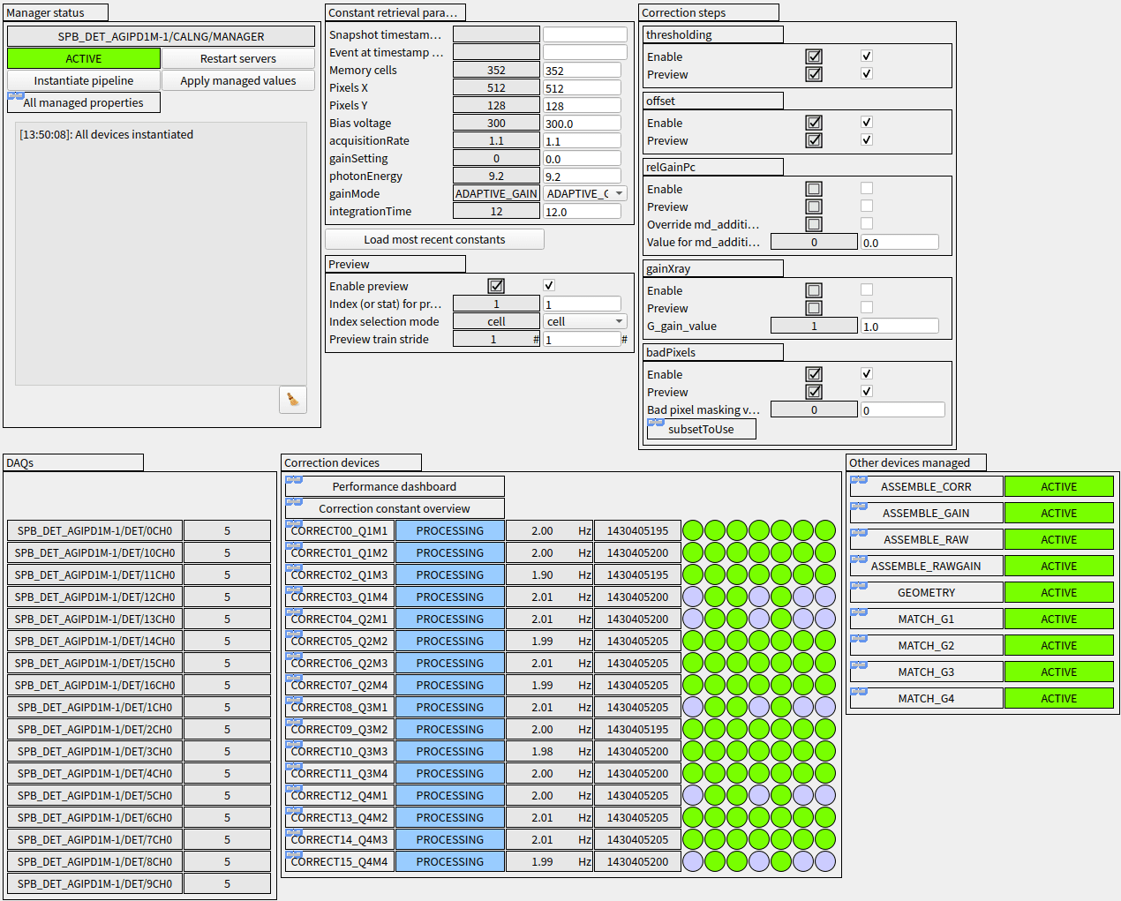
The Karabo Ecosystem – Highlights of the three APIs: Online Calibration
API: Bound and MDL
Builds upon: boost, numpy, CUDA, pyCUDA
Special because:
  online correction of up to 4kHz images
  Highly configurable

Slide 9
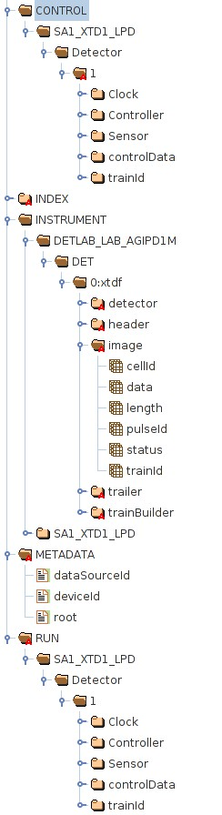
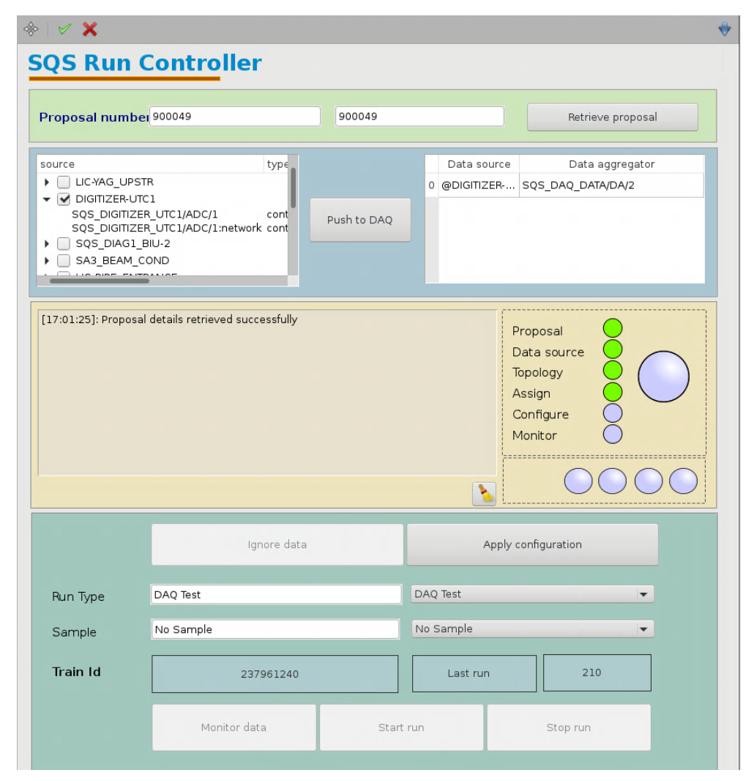
The Karabo Ecosystem – Highlights of the three APIs: Data Acquistion
API: C++
Builds upon: boost, hdf5
Special because:
  Data rate of ~20 GB/s
  Versatile in that almost any Karabo exposed parameter can be stored

Slide 10
Centralized Data Acquisition
Motor
Gauge
Motor
Gauge
Detector module
Detector module
Detector module
Cam
Detector module
Cam
Central DAQ instance per instrument/installation
Distributed ”Data Aggregators”
  1 per MHz detector module (e.g. 16 total)
  ~5-10 for remaining data
    Fast pipeline data: Imagers, digitizers
    Slow broker data
Data acquisition is run-based. A run is a period of (semi-) static experimental conditions
  Importantly, data shapes* and Karabo device schema do not change
Broker
10G UDP
p2p
XTDF Data Aggregator
XTDF Data Aggregator
XTDF Data Aggregator
XTDF Data Aggregator
Data Aggregator
Data Aggregator
Run N
HDF5
HDF5
HDF5
HDF5
Seq 0
HDF5
HDF5
…
Seq N
* Except along pulse axis
HDF5
HDF5
HDF5
HDF5
HDF5
HDF5
Run N-1
HDF5
HDF5
HDF5
HDF5
HDF5
HDF5

Slide 11
Centralized Data Acquisition
Motor
Gauge
Motor
Gauge
Detector module
Detector module
Detector module
Cam
Detector module
Cam
Implemented as Karabo Devices (C++)
Up to ˜30 GB/s for a full installation
Single aggregator can handle a few 1000 slow control properties
Within one sequence file all sources are aligned by train id in the rows of the HDF5 tables
Current work: refactoring to facilitate integration of online data reduction using RDMA offloading of processing.
Broker
10G UDP
p2p
XTDF Data Aggregator
XTDF Data Aggregator
XTDF Data Aggregator
XTDF Data Aggregator
Data Aggregator
Data Aggregator
Run N
HDF5
HDF5
HDF5
HDF5
Seq 0
HDF5
HDF5
…
Contacts: Alessandro Silenzi/Dennis Goeries
Seq N
HDF5
HDF5
HDF5
HDF5
HDF5
HDF5
Run N-1
HDF5
HDF5
HDF5
HDF5
HDF5
HDF5

Slide 12
Centralized Data Acquisition
Motor
Gauge
Motor
Gauge
Detector module
Detector module
Detector module
Cam
Detector module
Cam
Online Processing
(Karabo)
Broker
10G UDP
p2p
TCP
Monitor Out
XTDF Data Aggregator
XTDF Data Aggregator
Monitor Out
XTDF Data Aggregator
XTDF Data Aggregator
Data Aggregator
Data Aggregator
Run N
HDF5
HDF5
HDF5
HDF5
Seq 0
HDF5
HDF5
…
Contacts: Alessandro Silenzi/Dennis Goeries
Seq N
HDF5
HDF5
HDF5
HDF5
HDF5
HDF5
Run N-1
HDF5
HDF5
HDF5
HDF5
HDF5
HDF5

Slide 13
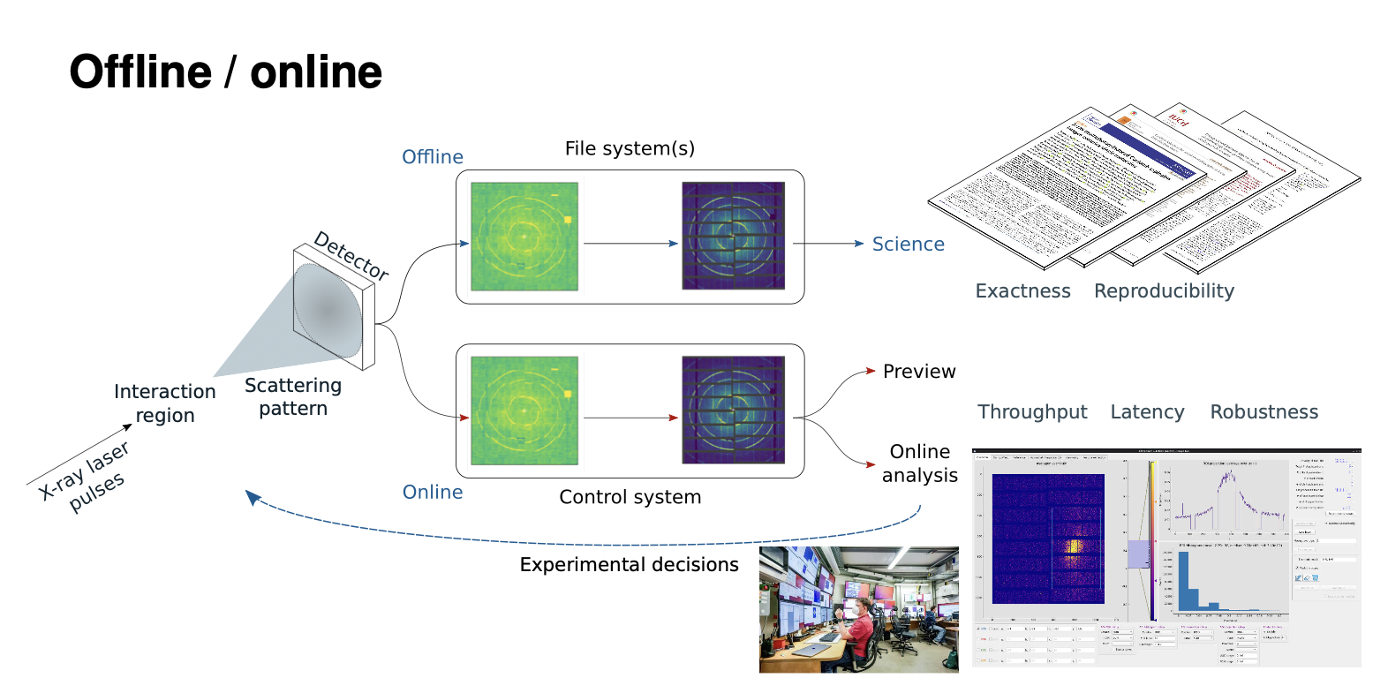
Importance of Facility-Side Processing: Calibration

Slide 14
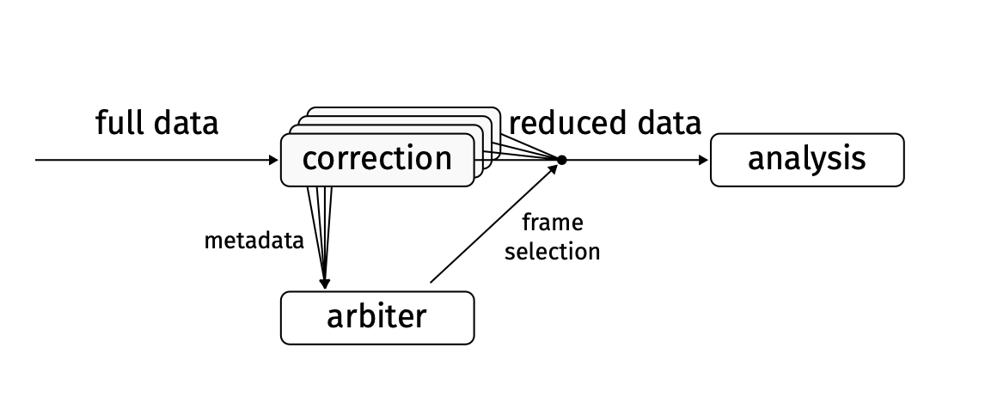
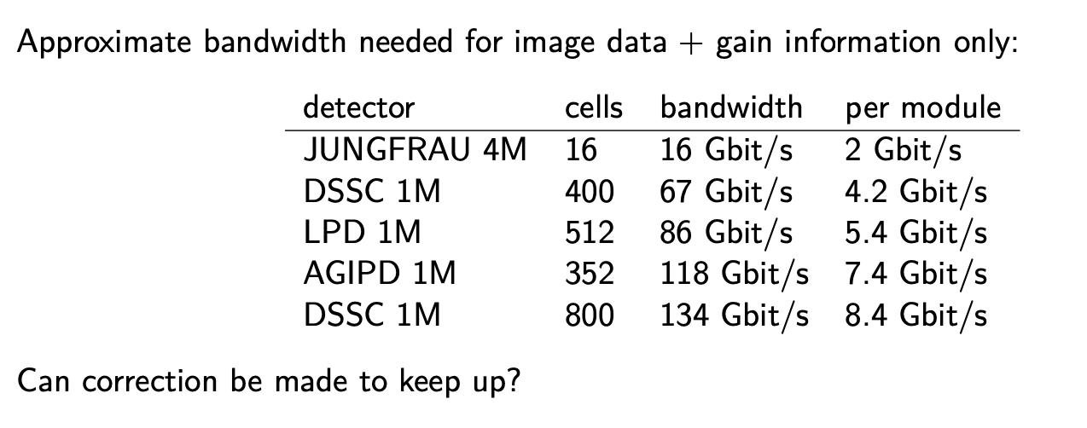
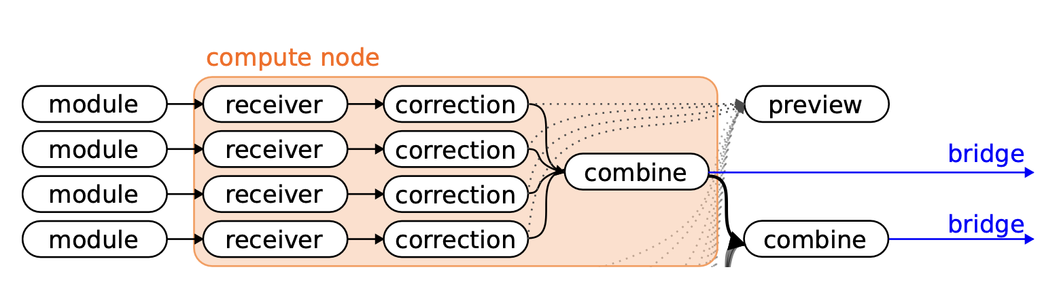

Importance of Facility-Side Processing: Online Calibration and Data Reduction
Contact: Egor Sobolev (Data Analysis)

Slide 15
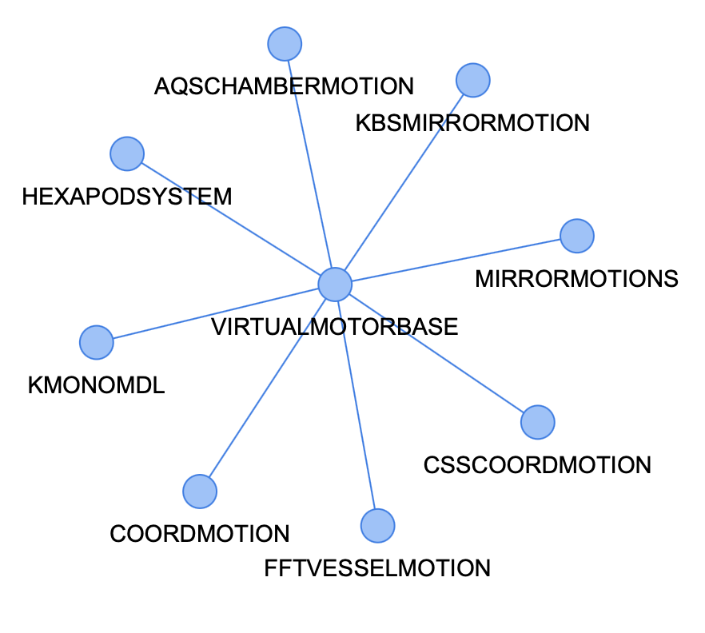
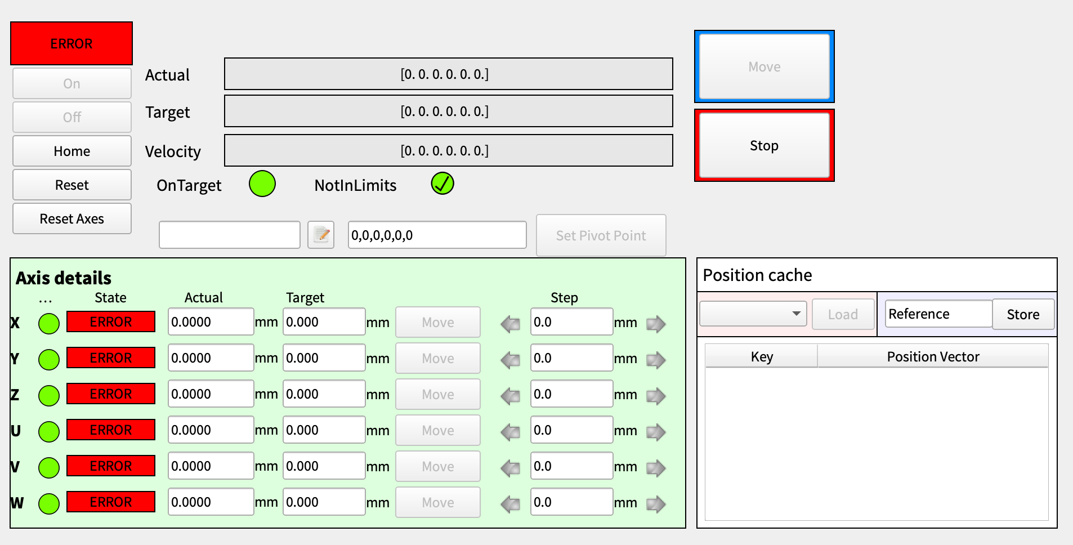
The Karabo Ecosystem – Highlights of the three APIs: VirtualMotorBase MDL
API: MDL
Builds upon:
Special because:
  Exemplary usage of MDL proxy capabilities for coordinated motion on multiple axes
  Hierarchical, extensible and pluggable, while maintaining a single interface

Slide 16
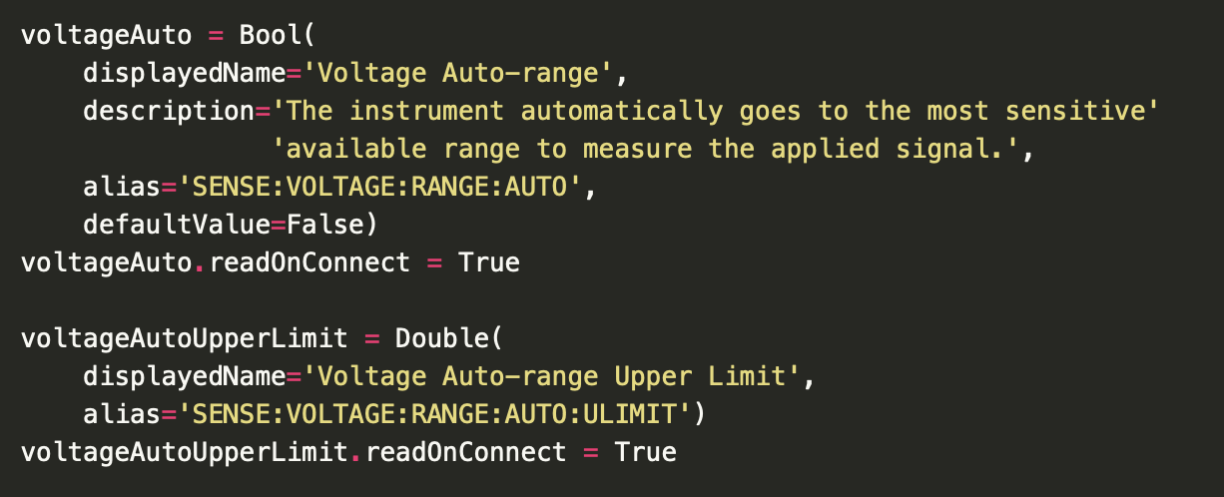
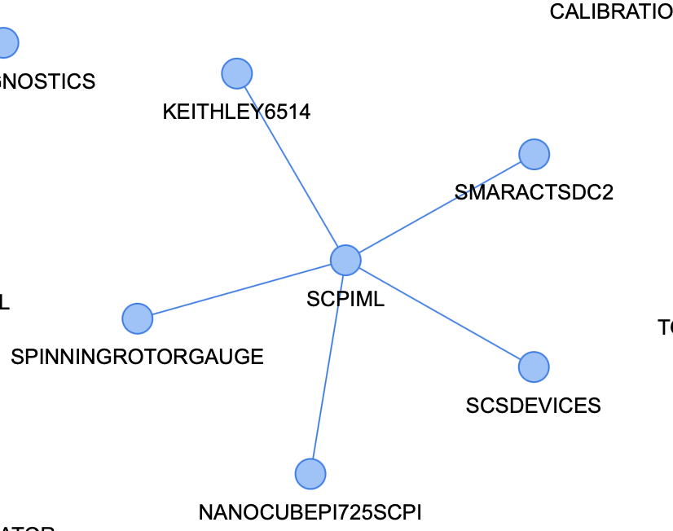
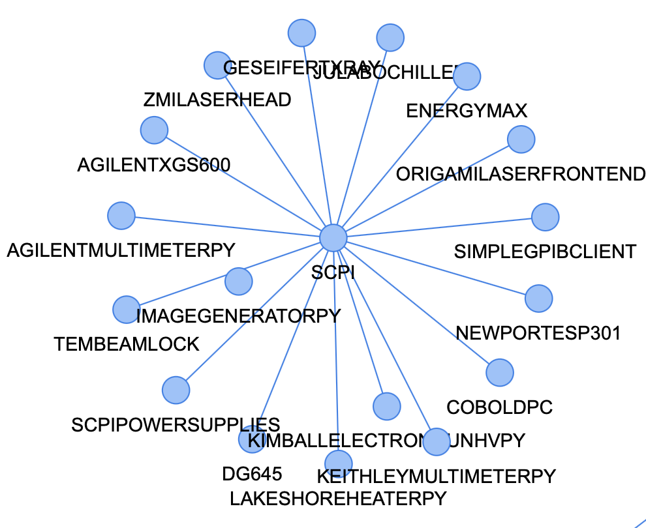
The Karabo Ecosystem – Highlights of the three APIs: SCPI MDL and SCPI Bound
API: MDL and Bound
Builds upon:
Special because:
  Generic and rapid integration through SCPI identifiers
  Karabo Parameters determine types

Slide 17
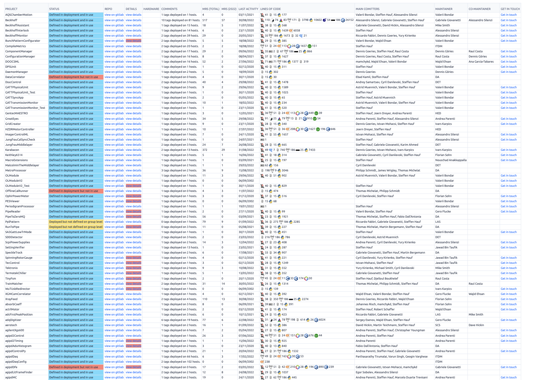
Not Covered (much): Devices
Also not covered in much detail: devices - there’s >400 projects in active use in our git repos...
Many small ones but others in ~50k lines of code, e.g. Beckhoff integration
Many contributions by other groups at the facility as well.

Slide 18
Karabo Hardware Devices – an incomplete list of what is supported
Core Services
Motion
Commercial Cameras
X-ray Detectors
Scopes and …meters
Data Logging
Data Acquisition
Gui Server
Alarms & Notification
Recovery Portal
Motor Configurator
Scan Tool
Beckhoff MC2*
Smaract
Hexapod
NanoCube
…
Basler via Aravis
Genicam
GreatEyes
PI MTE3
Andor Zylar, …
Shimadzu HPvx
Jungfrau
Gotthard
Epix
AGIPD
LPD
DSSC
Timepix3
…
OceanOptics
GENTEC
Tetronix
LeCroy
MCS Beam Stab.
…
Digitizers
Power Supplies
Vacuum Components*
Chillers & Thermo Contr.*
Bridging
SP devices ADQ 412
SP devices ADQ 7
SP devices ADQ 14
FastADC
Wiener MPOD
Keithley
Agilant
Adixon
Pfeiffer
Infinicon
Agilant
Huber
K2
Julabo
Keithley
Lakeshore
…
SCPI
DOOCS
EPICS (in progress)
Tango (in progress)
* via Beckhoff PLC integration

