Slide 1
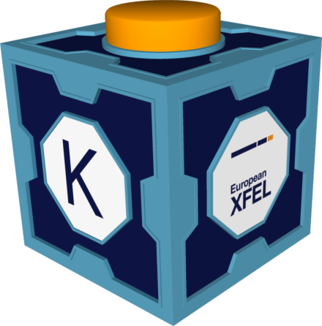

Karabo Overview
Dr. Gero Flucke
for the Controls group @ European XFEL GmbH
Satellite Workshop:
An introduction to developing in the Karabo SCADA Framework

Slide 2
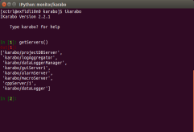
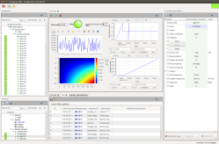



Karabo: Device Based Communication via a Message Broker
Interface for Users and Operators
Equipment
Control
Self-describing
Karabo Devices
Equipment control,
e.g. motors, valves,…
Detectors
  e.g. cameras
Online data analysis
Data Logging
Other system services
  GUI entry point
  DAQ for big/scientific data (not shown)
Command Line
Interface
Graphical
User Interface
GUI Server
e.g. motor, pump, valve, sensor
DAQ
Equipment
and other service devices like configuration manager
Message
Broker
Data Logging
Node
Analysis
Node
e.g. commercial camera
TCP/IP data
pipelines for
big/fast data
e.g. calibration,
image processing
storage of control data
and configurations

Slide 3
Core Components of Karabo
Device
  Core controllable object, providing e.g.
    Equipment control: interface to motor, pump, valve, camera, etc.
    Data provider: camera, spectrometer, customized 2D detectors
    Data analysis: calibration, beam position extraction, etc.
    Coordination of other devices (“middlelayer”)
    System service: data logging, GUI server, project (configuration, etc.) database,…
  Self-description (schema):
    Properties (read-only, init-only, reconfigurable), commands – device state aware
Device server: Program “hosting” devices (detail: in bound Python API launches them)
Broker: Core (3rd party) component distributing control messages
Command line client (both Python APIs): ikarabo, karabo-cli
Generic, but customizable GUI

Slide 4
Karabo Communication Patterns
1-to-1: Request and reply
  Device registers methods as “slots”.
  Request from remote with up to four arguments
    Reply if done with up to four values.
    Requester can suppress reply (fire-and-forget)
1-to-all: Broadcast
  Always fire-and-forget
  Still costly, so used rarely:
    System topology: instance new and gone
    Problematic device states (UNKNOWN, ERROR)
Request
slot
Device1
Notify
Device2
Notify
Reply
Device2
Device3
Notify
Notify
Device1
Call
slot
Notify
Device4
Notify
…
Notify
DeviceN

Slide 5
Karabo Communication Patterns (ctd.)
Publish/subscribe
  Devices (2 & 5) subscribe slots to a remote “signal”.
  When signal is “emitted”,
  all subscribed slots are called.
    No publishing overhead for “popular” devices
    Karabo framework is completely event-driven:
    regular polling obsolete.
Device2
Notify
Device3
Device1
Emit
signal
Device4
Notify
Device5

Slide 6
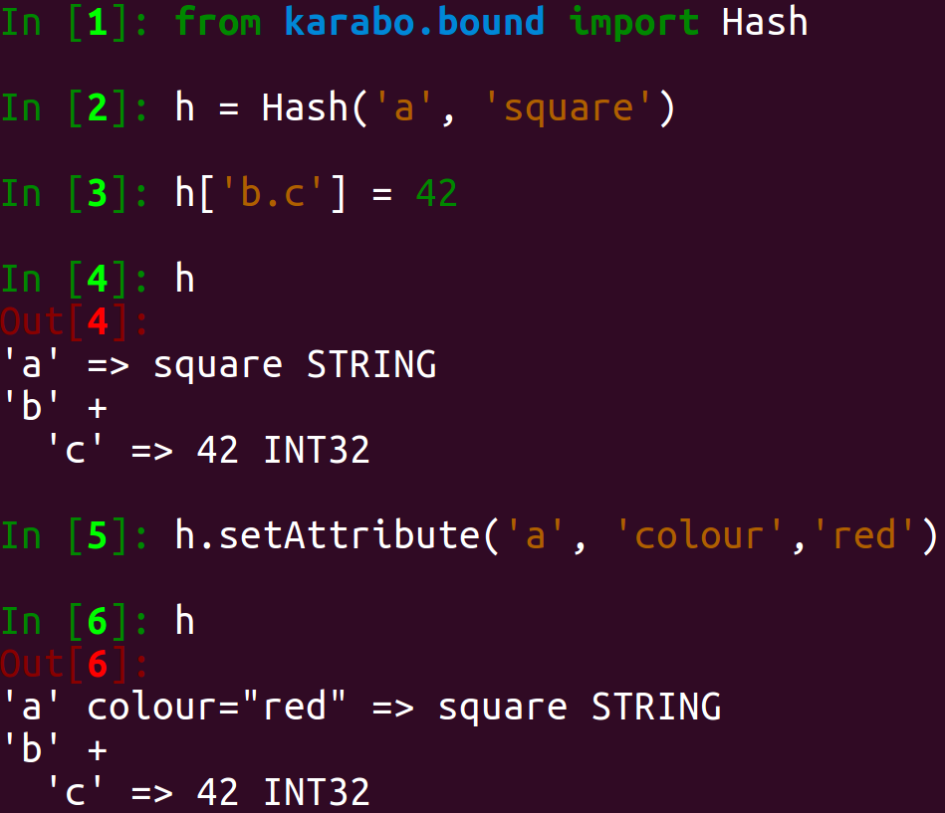
Hash: Karabo’s Flexible Data Container
A nested key-value container with attributes:
  key: string
    direct nested access: separate key levels by dot: h.get(“key1.key2.key3”),
  value: any type,
  attributes per value: another key-value container.
Hash available in all three Karabo APIs:
  C++
  Python
    “Bound” (C++ bindings)
    “Middlelayer” (pythonic)
Serialisation to XML and binary format.
  Supported data types:
    Scalars, complex, strings, Hash
    and vectors thereof,
    “NDArray” for pipelines,
    “ImageData”: NDArray and meta data

Slide 7
Remotely Callable Methods: Slots and Commands
Slots can have up to four arguments and return values
  Scalars, bool, string, Hash (and vectors of any of these)
This flexibility should be restricted to framework functionality and some specific protocols
  These protocols nowadays usually just use “Hash-in, Hash-out”
Slots exposed in device schema (i.e. exposed to GUI): “commands”
  No arguments
    E.g. for motor: 1) set “targetPosition”, 2) execute “move” command
  Return value mostly irrelevant/ignored (in doubt return device state?)
  Can be restricted to specific device states
  Should quickly return (<< 5 seconds)
  Longer actions like slow movements are just “triggered”:
    “move” command sets state to MOVING, starts movement and returns
    when target reached, go back to state ON
    “targetPosition” can be reconfigured again, but not while in state MOVING

Slide 8
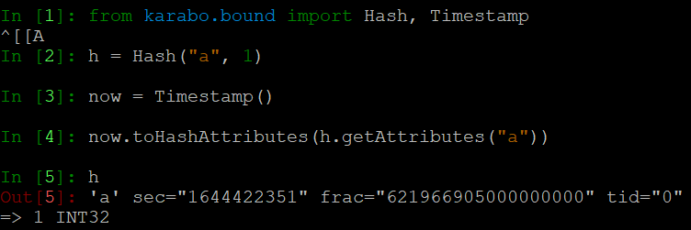
Timestamps in Karabo
Timestamps consist of three uint64 numbers
  full seconds of unix epoch (since Jan 1st, 1970): “sec”
  attoseconds (10⁻¹⁸): “frac”
  train id (“tid”) – uniquely identifies each of the 10 Hz trains of up to 2700 photon pulses
  Stored as Hash attributes of device
  properties
Timing sources:
  Ideally hardware source synchronized
  with XFEL accelerator timing system
  Property update without specified stamp:
    “sec” and “frac” from local system
    clock (usually synchronized within few ms via NTP)
    “tid” extrapolated from “signalTimeTick” that provides time, train id and train repetition frequency
    (distributed at 1 Hz by TimeServer)
µs

Slide 9
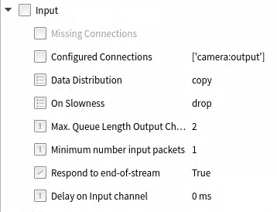
Karabo Pipelines for Data Processing
GUI Server
Complement broker communication
  Using direct TCP/IP connections.
Designed for (large) multi-D data.
  Sent only when receiver ready for it.
  Serialisation of NDArray avoids
  any copies.
Offer flexible configuration
  Get copy of all data
  or share with others
  Drop or queue if receiver slow
  GUI server throttles to 2 Hz
  …
Camera
CPU intense
Analysis
Node B1
Analysis
Node A
Collecting
Analysis
Node C
CPU intense
Analysis
Node B2

Slide 10
Karabo: Three APIs
C++ (C++17 standard)
  The start of Karabo, based on a lot of the boost libraries
  (Still) most service devices (data logging, GUI server)
  Devices that require high performance (digitizers)
Bound Python
  Python bindings on top of C++ (now using pybind11, few things pure Python)
  Partially not „pythonic“, but more following underlying C++ patterns
  Pipelining more performant than the one of Middlelayer
Middlelayer Python
  Complete re-write, based on asyncio
  Especially designed to interact with other devices (therefore “middlelayer”)
    Nowadays most popular API, not only for middlelayer devices
  Used as macro language (without need for asyncio‘s await)

Slide 11
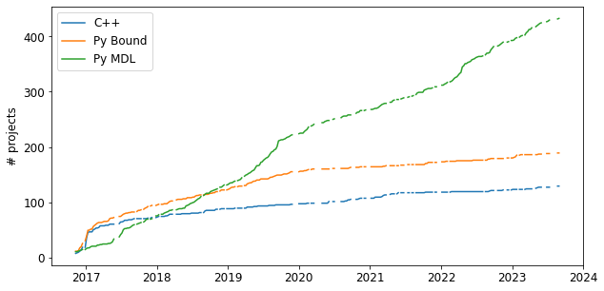
Usage of the Three APIs
Middlelayer API
  often has the most expressive syntax
  shortest “time-to-market”.
C++ and Python Bound
  actively maintained
  new devices are still being implemented
    especially in high-performance fields.

Slide 12
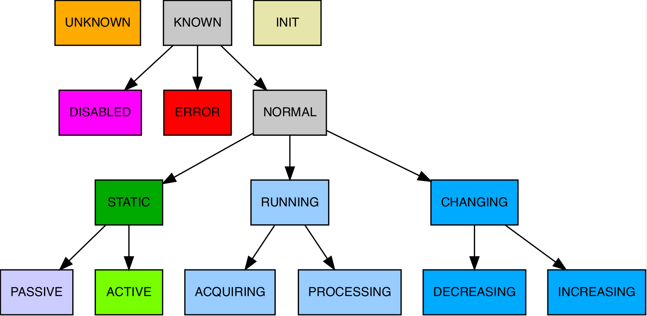
Unified Device States
Predefined list of device states
Device schema
  can restrict access to its commands / reconfigurable properties to some states
Inheritance system
  E.g. ERROR is more concrete than KNOWN
State significance order for state aggregation
Unified colour representation in the GUI
About 60 more states inheriting (e.g. GUI colour) from those of the last row.

Slide 13
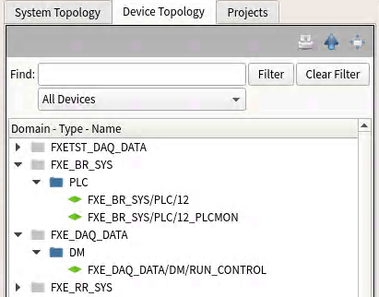
More Device Concepts
European XFEL naming convention, e.g.
  Not enforced by Karabo (but GUI’s “Device Topology”
  ignores devices that don’t have 2 slashes)
Device locking
  A device can lock other devices to reject commands and
  reconfigurations from others
  Soft lock on purpose: to avoid operational deadlock, slotClearLock can be called by everybody
Capabilities exposed via “instanceInfo”
  provides_scenes, provides_macros, provides_interfaces
Interfaces
  motor, multi axis motor, trigger, camera, processor, device instantiator
  An interface promises some commands and proeprties
  Where is documented what exactly which interface requires?

Slide 14
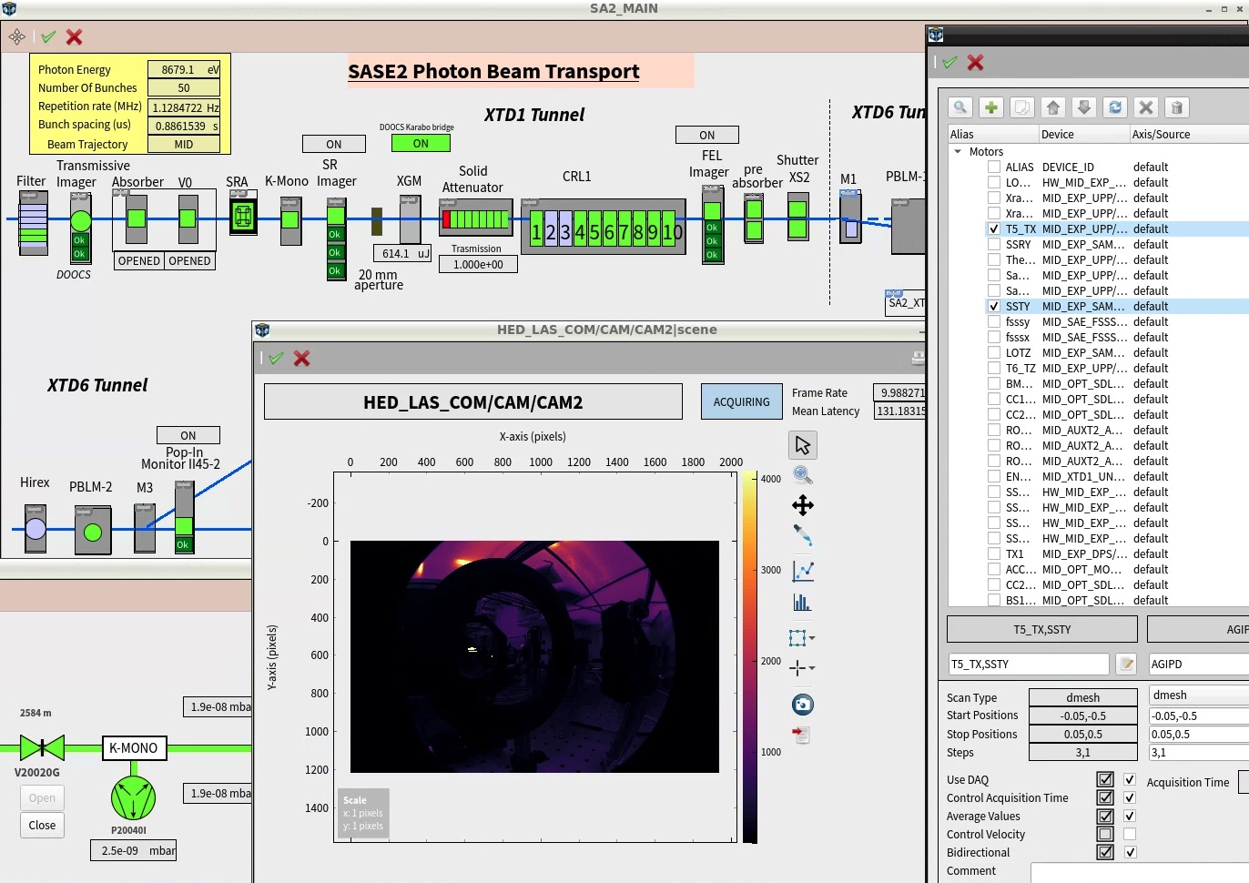
Generic, Extendible Karabo GUI:
Graphical
User Interface
Broker
GUI Server
Separate Python Package
  Shares Hash with MDL
  Well matched to the framework
  PyQt5-based
Connects to Karabo via the GUI-server (tcp, point-to-point)
Extendible via “gui-extensions”
Distinguishing features:
  GUI scene builder (drag‘n‘drop)
  Projects to logically group devices, scenes and macros

Slide 15
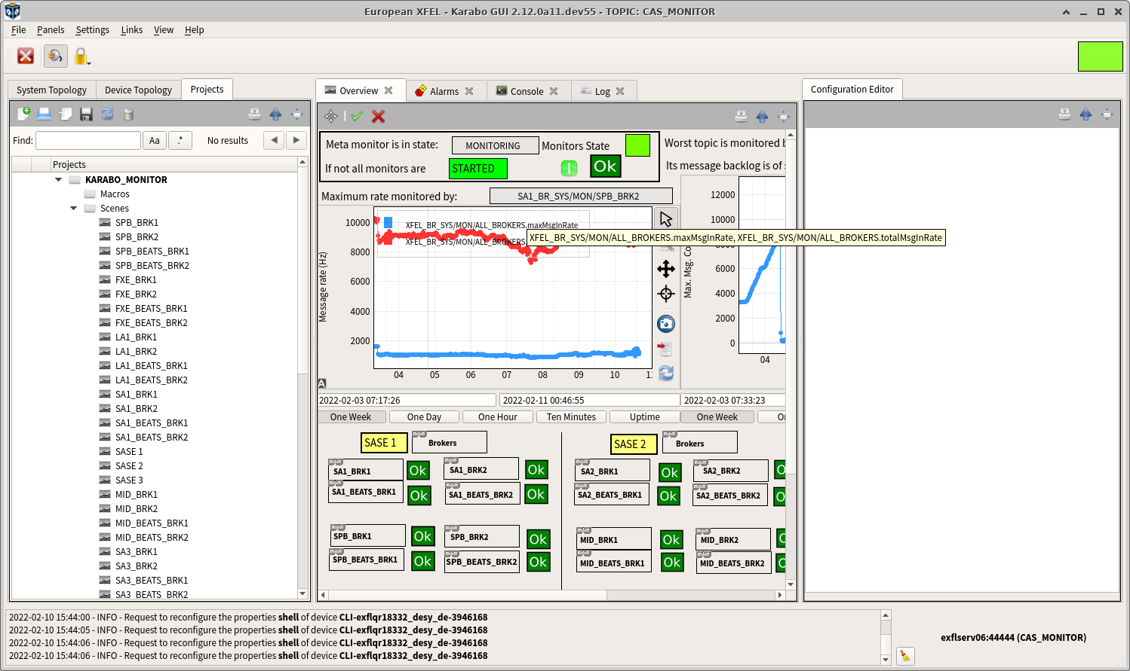
GUI as Project Interface
Project data:
  device configurations,
  scenes,
  macros,
  sub-projects.
Projects stored in
central data base as XML files.
  local storage option

Slide 16
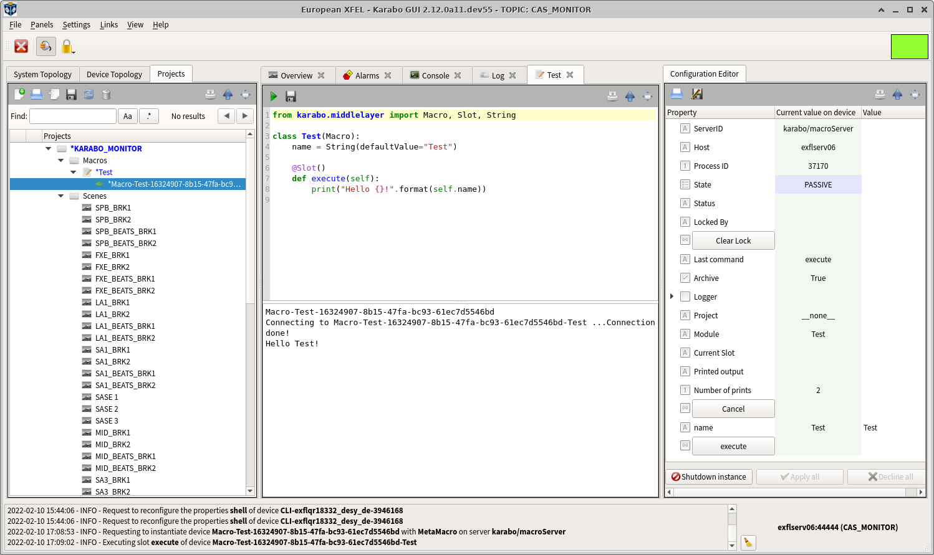
GUI as Macro Interface
Macros
Aim for (simple) procedures
  By scientists
  Middlelayer syntax
Run on special macro server
  Gives control if macro runs havoc
Code injected via GUI
  Stored in projects
  Output in GUI
More complex and matured macros often converted to Middlelayer devices

Slide 17
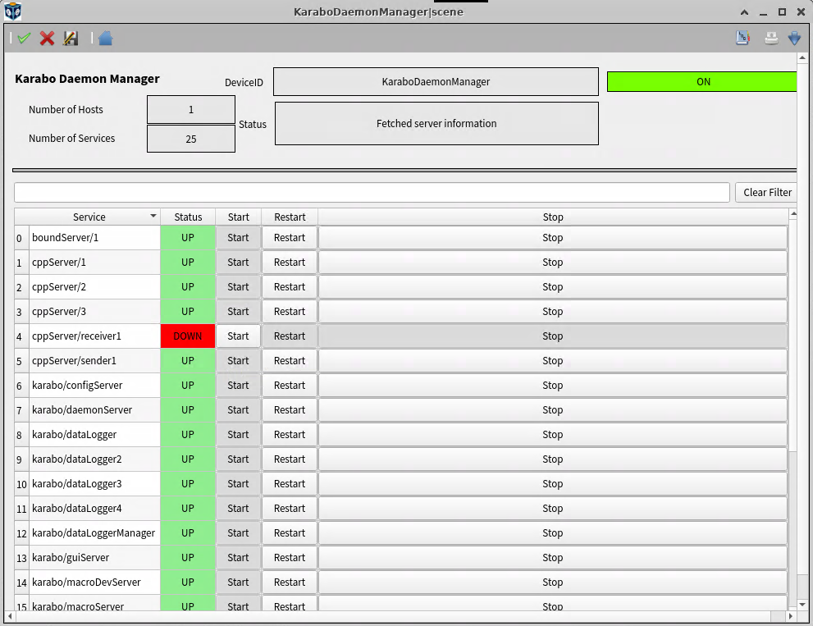
System Service:
Service Manager
Special device exposes running services (servers) of an installation
  Start, restart, stop (kills if needed)
Needs special service running on each host with a Karabo installation
  Communicates via web protocol with service manager

Slide 18
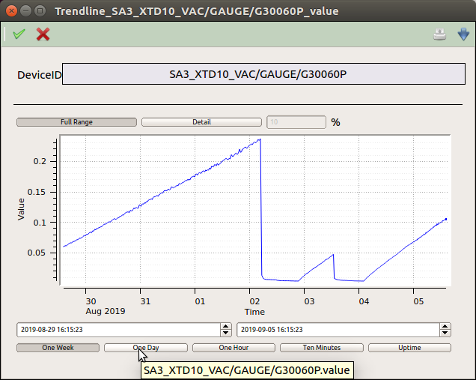
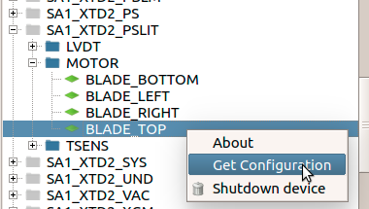
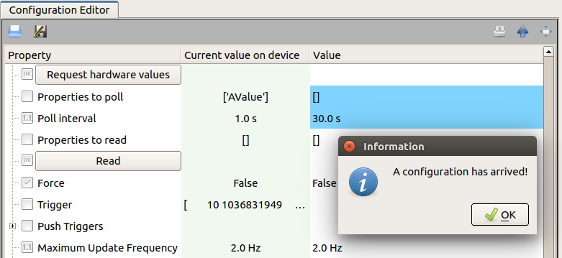
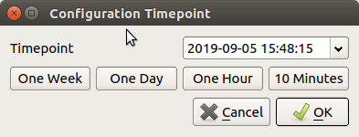
Framework Service: Data Logging
In-built data logging and retrieval mechanism.
  Control data only, no pipelines.
  Implemented via data logger service devices
  (text file or InfluxDB time series database).
Main control use cases:
    Past data for trendlines: single scalar property vs time.
    Past configurations: all device properties at point in time.

Slide 19
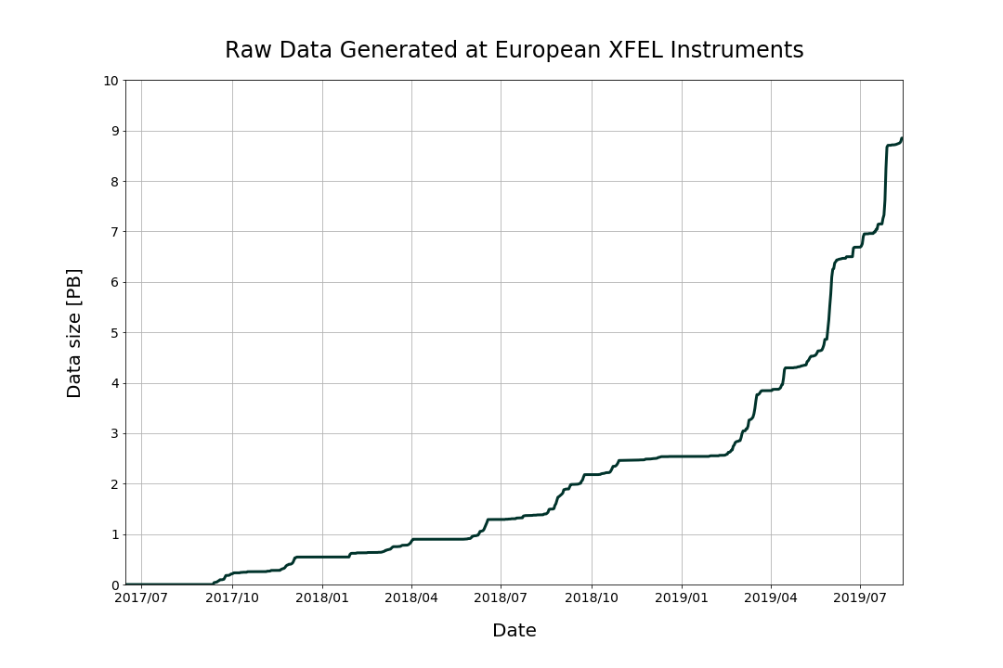
Karabo Data Acquisition (DAQ) Integration
Commercial
camera
Pipeline
Data Storage
Node
Focus on scientific instrument data with long term storage: EuXFEL data policy
Support for different types of data sources:
  Control data with train resolution: e.g. sensors, motors → slow data
  2D or pulse resolved data: e.g. pipeline from cameras, digitizers
  → fast and/or medium sized data
  MHz-capable 2D detectors (XFEL train data format - XTDF)
  → big & fast data
Data stored in HDF5 files, indexed per train
  9 PB raw data (Oct. '19) stored since experiments started
  12 GB/s achieved (600 images per train)
Provide data stream for online display and analysis:
  Calibration of big 2D detectors (1.8 GB/s, 2s latency),
  External tool via Karabo-to-ZeroMQ bridge
Control
MHz-capable
2D detector
XTDF
DAQ
Control
Raw Data Generated at EuXFEL
DM
DA
9
8
7
6
5
Data size (PB)
4
3
2
1
July
2017
Jan.
2018
July
2018
Jan.
2019
July
2019

