Slide 1



ICAT Future Developments
Patrick Austin
27 Sept 2024

Slide 2


Areas of work
1 icat.server
  Schema changes
  Cloud native
  Performance and authorization
2 icat.lucene
  Additional functionality
  Removal of current limitations
  Efficiency improvements
3 Python ICAT
  Query refacrtors
4 DOI Minting
  New non-core component
Image © STFC Alan Ford
Notes:
Note: these are only the developments I know about (only found out about this presentation last Thursday…)
Have not included anything on DataGateway (STFC developed frontend) or ICAT+ and the ESRF frontend as Louise and Alex had their own talks (and know more than I do…)

Slide 3
icat.server overview
Main component containing business logic
Requests come from frontend/API components
Interfaces with underlying relational database
Delegates authentication, but handles authorization for (meta)data
Defines the schema for metadata entities

Slide 4
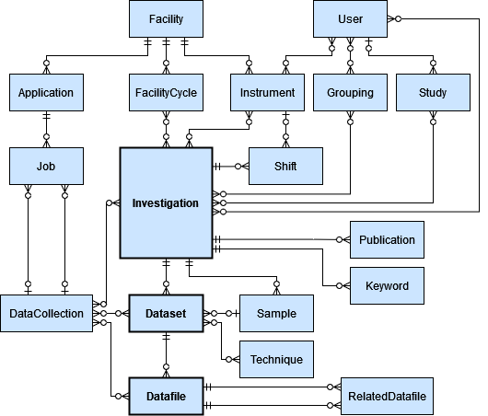
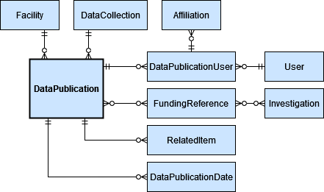
icat.server v7 schema changes
Add Subjects as a new entity related to DataPublications
Allow Samples to belong to multiple Investigations
Allow SampleType.molecularFormula to be null
Add SampleType.pid
Notes:
A few proposed changes to the ICAT schema, which will be released in the next major version of ICAT
DataPublication is focused on representing DataCite metadata for the purposes of minting DOIs
Currently has a single string field for “keywords”, but a full Subject entity will allow a more direct mapping and allow pids for each subject/keyword
Other changes around how samples are represented:
The same Sample may be “investigated” multiple times
Not all Samples have molecular formulae
Adding persistent identifiers generally, and here specifically to avoid reducing uniqueness constraints
End of 2024?

Slide 5


icat.server cloud native
Use Quarkus as alternative/replacement to Payara:
K8s native
Quicker deployment
Improve testing framework
Will require:
Changes to all core Java components (not just ICAT server)
Replacing EJB with CDI
Removal of Singletons to make threadsafe
Notes:
Contexts and Dependency Injection
Mid 2025?

Slide 6
icat.server database efficiency
Datafile table largest in the database, causing concern:
Survey of current database engines, hardware, and table sizes
Discussions about possibility of:
  Sharding
  Restricting Datafile level access
  Hot/cold data
  Policy changes
Notes:
Not a specific piece of work yet, but ongoing discussions around these topics
Typically Oracle for production, up to 5 billions rows in Datafile table
Discussion is early days, and likely Facility dependent rather than core to the collaboration
This has been a worry for years (longer than my involvement)
Historically, there have been ad hoc workarounds when needed…

Slide 7
icat.server authorization
Allows creates, reads, updates, deletes (CRUD) to be performed on entities
Can be applied to users from specific groups, or everyone
Logic is defined as the field “what”:
Datafile
SELECT df FROM Datafile df JOIN df.dataset d JOIN d.investigation i JOIN i.investigationInstruments ii JOIN ii.instrument inst JOIN inst.instrumentScientists instSci JOIN instSci.user u WHERE d.name='raw' AND u.name = :user
Notes:
Authorization in ICAT is not conventional (ACL, Role based etc.)
Rules are defined in the Database, which enable access to the metadata and data
Without a Rule (or an admin account), nothing can be accessed
Simple Rule might apply to a whole table (this User group can create Datafiles)
Or, be templated to allow substitution of the user’s credentials

Slide 8
icat.server authorization
Main impact of the large Datafile table is when performing authz:
SELECT * FROM (SELECT a.*, ROWNUM rnum FROM (
SELECT t0.ID AS a1, t0.NAME AS a2, t0.LOCATION AS a3, t0.CREATE_ID AS a4, t0.MOD_ID AS a5 FROM DATAFILE t0 WHERE (
(
((t0.DATASET_ID = :1 ) AND (t0.LOCATION IS NOT NULL)) AND (t0.ID BETWEEN :2 AND :3 )
) AND (
(t0.ID IN (
SELECT t1.ID FROM INVESTIGATION t3, DATASET t2, DATAFILE t1 WHERE ((t3.VISIT_ID IN (:4 , :5 )) AND ((t2.ID = t1.DATASET_ID) AND (t3.ID = t2.INVESTIGATION_ID)))
) OR t0.ID IN (
SELECT DISTINCT t4.ID FROM INVESTIGATIONINSTRUMENT t7, INVESTIGATION t6, DATASET t5, DATAFILE t4, USER_ t10, INSTRUMENTSCIENTIST t9, INSTRUMENT t8 WHERE ((t10.NAME = :6 ) AND ((((((t5.ID = t4.DATASET_ID) AND (t6.ID = t5.INVESTIGATION_ID)) AND (t7.INVESTIGATION_ID = t6.ID)) AND (t8.ID = t7.INSTRUMENT_ID)) AND (t9.INSTRUMENT_ID = t8.ID)) AND (t10.ID = t9.USER_ID)))
)) OR t0.ID IN (
SELECT DISTINCT t11.ID FROM INVESTIGATION t13, DATASET t12, DATAFILE t11, USER_ t15, INVESTIGATIONUSER t14 WHERE ((t15.NAME = :7 ) AND ((((t12.ID = t11.DATASET_ID) AND (t13.ID = t12.INVESTIGATION_ID)) AND (t14.INVESTIGATION_ID = t13.ID)) AND (t15.ID = t14.USER_ID)))
)
)
)
) a WHERE ROWNUM <= :8 ) WHERE rnum > :9
Original query
Clauses from Rules
Notes:
Obviously, this JPQL is horrible, but that’s kind of the point
Essentially, the original query has the JPQL from the previous slide appended as it passes through ICAT server
Can see that we have 3 Rules here: one allowing two specific visitIds to be public
One for instrument scienctists (aka Facility staff)
One for investigation users (aka Facility users)
Bottom line is, this is a big, complex query, and it can be expensive to evaluate depending on the user

Slide 9
icat.server authorization
Review Rules in the database
  Check for duplicate/redundant Rules
Reduce number of calls to database
  Refactor authz for Lucene search component
  Cache (more) Rules
Work arounds in other places
  Optional use of functional accounts at API levels
  Optional use of Dataset rather than Datafile level checks
Expand use of PublicSteps
Notes:
Not a well defined approach yet, but expect some changes in this area in the future. These are all still possibilities, and would be modifications of the current system rather than a complete change
PublicStep essentially identifies related entities that can be included if the parent entity is readable. A lot of queries would be more efficient with this, but it would require queries to target high level entities rather than Datafiles directly.

Slide 10
icat.lucene overview
In addition to JPQL querying on the database, support free text searching
Separate component using Lucene library
Builds searchable indexes for Investigation, Dataset, Datafile
Requests to create and read documents come via icat.server
icat.server performs authz checks
Notes:
That covers most of the technical work aspect of our journey to expand Galaxy into XAS use cases at STFC.
We’ve not spoken about all the work needed, so a quick summary of other things we do (or plan to do):
READ FROM SLIDE
TODO: Summary of work needed and context of EU project?
TODO: Challenges.
TODO: Acknowledgements/funding/summary?

Slide 11
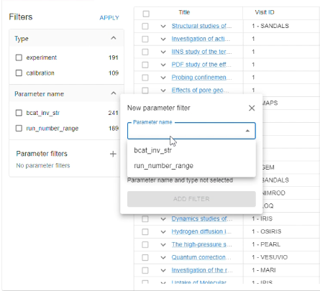
icat.lucene v3 changes
Currently released as a snapshot build, full release soon*
Basic sharding to allow more then 2 billion documents to be searchable
More metadata searchable, and searchable by field
Support for facets and synonym injection
Improvements to (authz) efficiency
More sorting options (not just “score”)

Slide 12



icat.lucene future changes
Also included some direct integration with Open/Elasticsearch
  Experimental, but may be revisited
Proposed authorization changes include:
  Reduced number of database calls
  Timeouts
  Embedding user’s name as part of the Lucene query
More changes may be needed to keep performant in production

Slide 13
Python ICAT v2
Python API for queries to ICAT server
Dependency of many non-core Python APIs developed for ICAT
In v2:
Support for icat.server schema changes
Changes to the Query module
Notes:
That covers most of the technical work aspect of our journey to expand Galaxy into XAS use cases at STFC.
We’ve not spoken about all the work needed, so a quick summary of other things we do (or plan to do):
READ FROM SLIDE
TODO: Summary of work needed and context of EU project?
TODO: Challenges.
TODO: Acknowledgements/funding/summary?

Slide 14

DOI Minting
New API component to allow automated/user minting of DOIs
Uses DataPublication and associated entities to map to DataCite schema
Currently being developed as a “non-core” component for Diamond
Will be supported by STFC’s DataGateway frontend
Representative of current ICAT development: additional components developed on top of the core icat.server functionality

