Slide 1
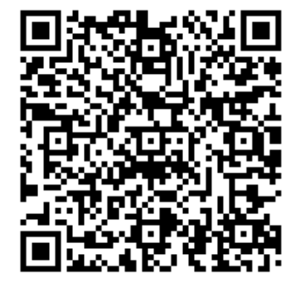
SHARE: Synchrotron X-ray analysis of Heritage Accessible to and Reusable by Everyone
Raw X-ray diffraction data
Data steward position open!!!!
Info about the sample/ object
Database to search and find data and metadata
Info about the instruments and about data acquisition
New knowledge about our heritage!
Software + interface to populate and utilize this database

