Slide 1
FAIR DATA MANAGEMENT COLLABORATION
Beyond PanOSC&ExPaNDS projects
NOBUGS CONFERENCE 2024
SATELLITE MEETING

Slide 2
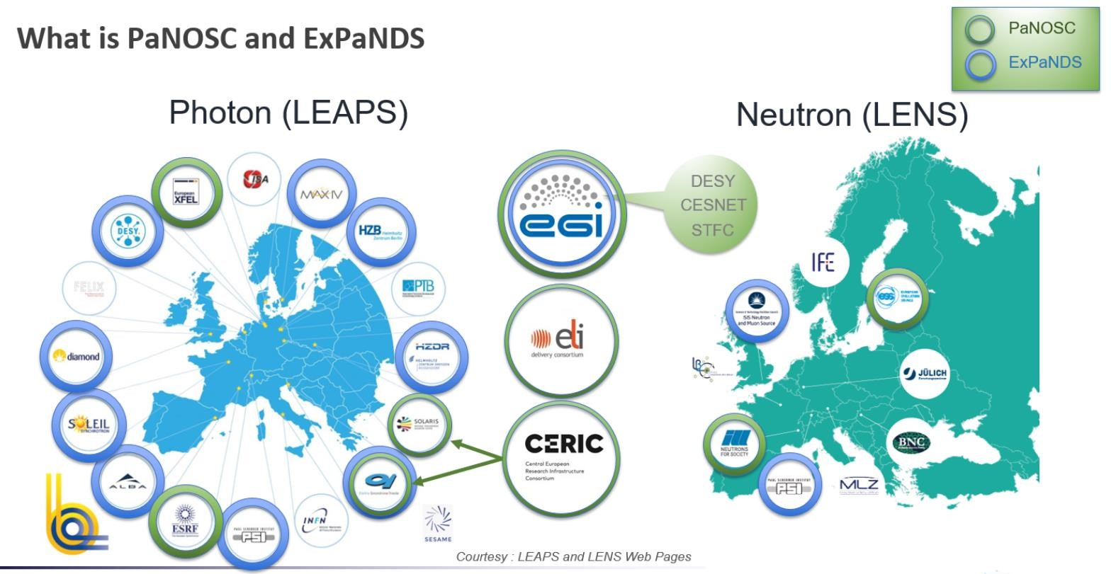


Slide 3

PaNOSC lustrum – 5 years of PaNOSC
PANOSC: the photon and neutron open science cloud
Photon and Neutron FAIR Data Commons: PaN Data Portal - https://data.panosc.eu
FAIR data policy and DMPs → 90% of PaN RIs (15)
Standardised metadata (Nexus/HDF5) → ALL PaN Ris (18)
Federated search API for data catalogues → 8 PaN RIs
Open Data portal for FAIR data → 8 PaNs RIs
Community AAI UmbrellaId → 90% PaN RIs (15)
JupyterLab notebooks service → 90% PaN RIs, 100s users daily
Nexus/HDF5 web visualization → ALL PaN RIs, 1000s worldwide
Remote data analysis with VISA → 8 PaN RIs, 100s users monthly
Simulation software (ViNYL) → 4 PaN RIs, 10s users monthly
PaN-learning platform (pan-learning.org) → 100s users monthly

Slide 4
CONTINUING THE COLLABORATION
MoU
ALBA-CELLS, CERIC-ERIC, DESY, DLS, ELI-ALPS, ELETTRA, ESRF, ESS, FAIRmat, HZB, HZDR, ILL, MAX IV, PSI and SOLEIL : DLS and EUXFEL joigning
Topics For Collaboration
Data Policy
Final Data Policy Framework for Photon and Neutron RIs
https://zenodo.org/record/5205825#.Y-PJ4q2ZNPZ
MetaData
Final Recommendations for FAIR Photon and Neutron Data Management
https://zenodo.org/record/6799106#.Y-V71q2ZNPZ
DMPs
DMP Template for facility users
https://zenodo.org/record/5639428#.Y-WE6K2ZNPY
PIDs
Advanced infrastructure for PIDs in Photon and Neutron RIs
https://zenodo. org/record/5905351#.Y-WRS62ZNPY
Search API
Report on integration of metadata catalogs
https://zenodo.org/record/5744913#.Y864ya2ZNPZ
Ontologies
PaNET Ontology (https://github.com/ExPaNDS-eu/ExPaNDS-experimental-techniques-ontology )
Data Portal
Catalog Service https://www.panosc.eu/wp-content/uploads/2022/03/PaNOSC_D3.3_Catalogue_Service_20220321.pdf

Slide 5
CONTINUING THE COLLABORATION
MoU
ALBA-CELLS, CERIC-ERIC, DESY, DLS, ELI-ALPS, ELETTRA, ESRF, ESS, FAIRmat, HZB, HZDR, ILL, MAX IV, PSI and SOLEIL : DLS and EUXFEL joigning
To summerize:
Agreement to share common goals
Mutualise (best effort) resources
No commitment to engage personal or finance
Share knowledge and tooling
Intellectual Property preservation
Meet Regulary
Nominate Representatives
Vote for newcomers
Rules of Collaboration
GENERAL UNDERTAKING OF THE PARTIES
ENTRY INTO FORCE - DURATION – TERMINATION
PRINCIPLES OF THE COLLABORATION
CONFIDENTIALITY
FINANCIAL PROVISIONS
REVIEW MEETINGS
COLLABORATION MEMBERSHIP

Slide 6
CONTINUING THE COLLABORATION
MoU
ALBA-CELLS, CERIC-ERIC, DESY, DLS, ELI-ALPS, ELETTRA, ESRF, ESS, FAIRmat, HZB, HZDR, ILL, MAX IV, PSI and SOLEIL : DLS and EUXFEL joigning
Ongoing initiatives:
MetaData Catalogs (Andy:ESRF)
https://indico.esrf.fr/event/149/
Icat Data Catalog: ICAT Metadata Ingest using python-icat (Rolf:HZB)
https://indico.esrf.fr/event/114/contributions/804/
Ontology management for the SciCat catalog using LinkML (Paul&Tim:DESY)
https://indico.esrf.fr/event/114/contributions/804/
Navigating the Data Patchwork: Strategies for Integrating Metadata Catalogs, Data Publications, and Archives (Oliver Knodel:HZDR)
https://indico.esrf.fr/event/114/contributions/761/
Latest news from the SciCat ecosystem: ElasticSearch integration and Job sub-system (Massimiliano Novelli:ESS)
https://indico.esrf.fr/event/114/contributions/760/
Rolling out a sample lifecycle and experimental data catalog at SOLEIL (Patrick&Gwenaelle:SOLEIL)
https://indico.esrf.fr/event/114/contributions/760/
SciLog – An Electronic Logbook for User Experiments: Live at PSI (Carlo Minotti:PSI)
https://indico.esrf.fr/event/114/contributions/760/

Slide 7

CONTINUING THE COLLABORATION
MoU
ALBA-CELLS, CERIC-ERIC, DESY, DLS, ELI-ALPS, ELETTRA, ESRF, ESS, FAIRmat, HZB, HZDR, ILL, MAX IV, PSI and SOLEIL : DLS and EUXFEL joigning
Ongoing Projects:
ROCK-IT: (Remote, Operando Controlled, Knowledge-driven, and IT-based)
https://www.rock-it-project.de/
OSTRails: (Open Science Trails: Streamline FAIRness, interconnectivity and machine actionability across Planning, Tracking and Assessing research phases)
https://ostrails.eu/
DAPHNE4NFDI: DAta from PHoton and Neutron Experiments.
  https://www.daphne4nfdi.de/english/index.php
FAIRMAT/NOMAD: Materials science data managed and shared.
  https://nomad-lab.eu/nomad-lab/
And Others Upcoming:

