Slide 1
HiZPAD workshop
October 18th, 2022
Welcome

Slide 2
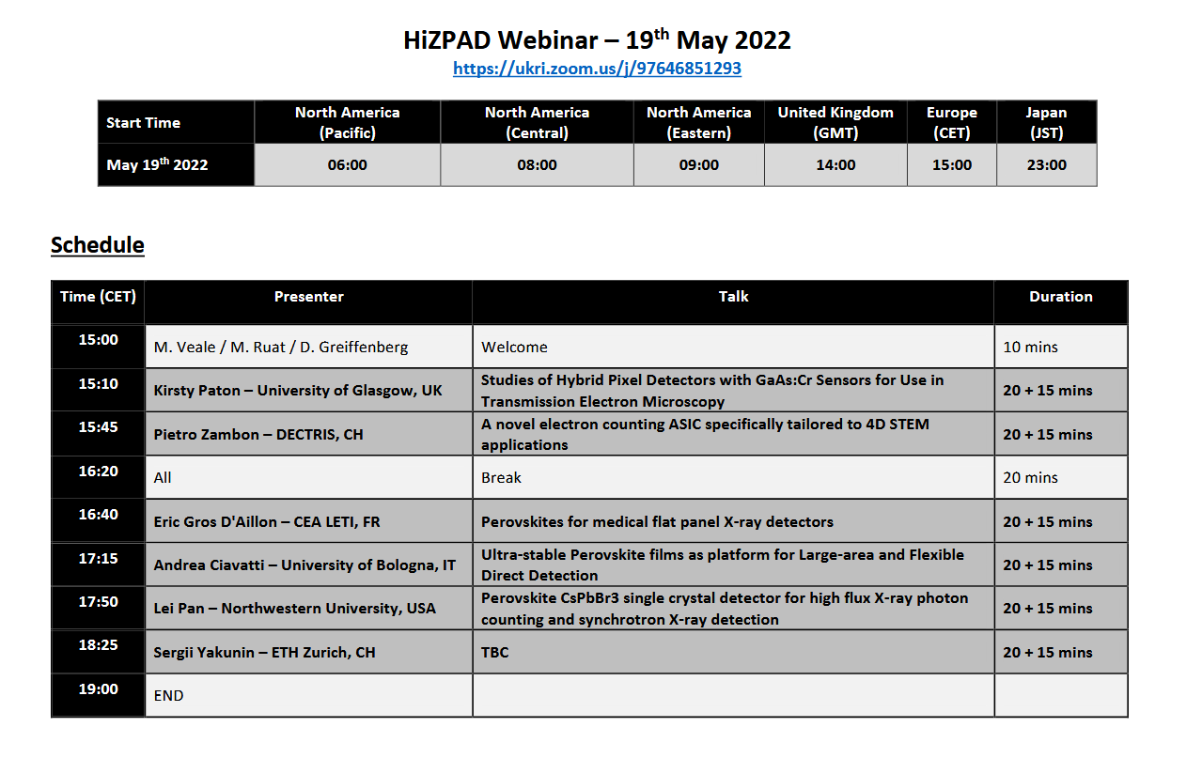
Previously on HiZPAD….
2 topics:
TEM
Perovskites
Attendance up to 50 people
Notes:
MK comment: could be a “template” for presenting Smartpix & Jungfrau evaluation; likely need for 2 slides

Slide 3
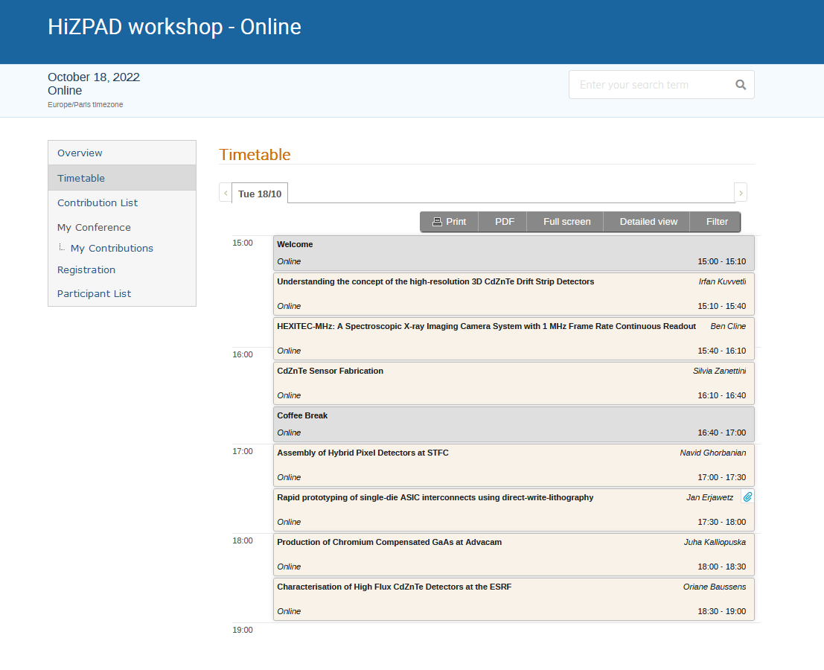
Indico page
Indico page:
Program at a glance
Possibility to upload material
Useful statistics for us
Up to date mailing list!
Notes:
MK comment: could be a “template” for presenting Smartpix & Jungfrau evaluation; likely need for 2 slides

Slide 4
Today’s workshop
Multi-topics session:
Application
ASICs
Sensor fabrication
Sensor processing & Interconnects
Sensor material characterization
Mixed session industrial / academic
Notes:
MK comment: could be a “template” for presenting Smartpix & Jungfrau evaluation; likely need for 2 slides

Slide 5
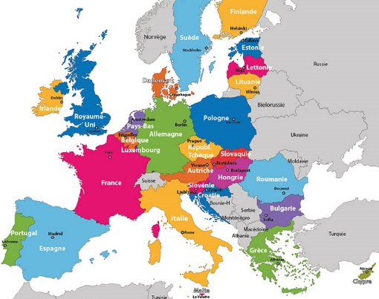
In person workshop?
✓ Traveling
!
⇧ “Only” 2 days
Interpersonal dynamics are different
Crucial, especially for early career scientists
Combining formal and informal moments
 Funding for an in-person workshop in Europe!
Mid-End of March 2023
Notes:
MK comment: could be a “template” for presenting Smartpix & Jungfrau evaluation; likely need for 2 slides

Slide 6
Let’s go!

Slide 7
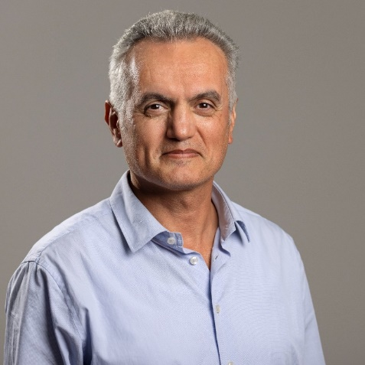
https://www.linkedin.com/in/irfan-kuvvetli-4054144/
Irfan Kuvvetli
Senior scientist @
Working on radiation detectors and measurements in the hard X-ray and gamma-ray field.
Development of scientific instrumentation for high-energy astronomy and medical imaging.

Slide 8
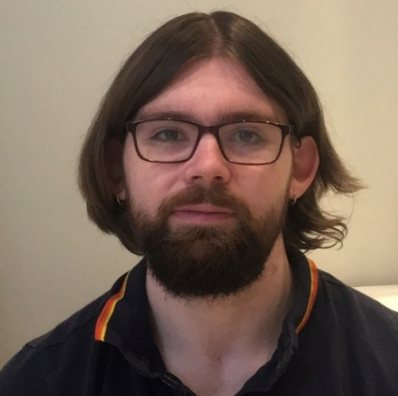
https://www.linkedin.com/in/ben-cline-182109160/
Ben Cline
Detector Development Scientist @
Development of the HEXITEC_{MHz} spectroscopic imaging detector
Simulation of radiation detectors

Slide 9
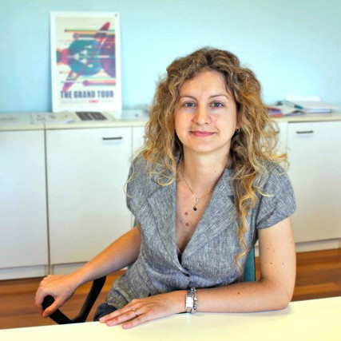
https://www.linkedin.com/in/silvia-zanettini-047bab87/
Silvia Zanettini
Material scientist and R&D engineer @
Due2lab was born in 2014 as a spin-off of
The company designs and realizes systems & prototypes for radiation measurements (X and γ rays) based on Cadmium Zinc Telluride (CZT) technology.

Slide 10
For enquiries or sharing presentation material:
hizpad.community@gmail.com

Slide 11
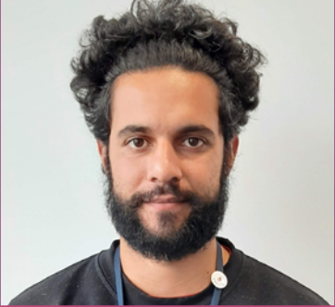
Navid Ghorbanian
Interconnect Engineer @
Development of novel detector interconnect techniques
Assembly of radiation imaging instrumentation (LPD, HEXITEC…)

Slide 12
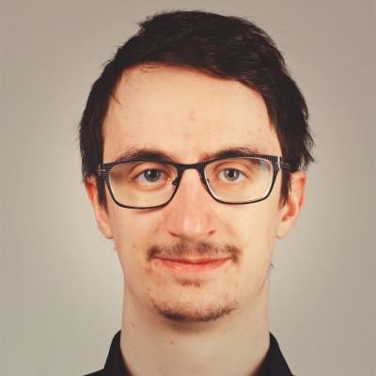
https://www.linkedin.com/in/jan-erjawetz-4a9b92184/
Jan Erjawetz
Working as process development specialist for
XRnanotech is a spin-off of the Paul Scherrer Institut (PSI) founded in 2020, manufacturing high-quality X-ray optics and offering engineering services.
Jan is an expert in laser lithography and data science.

Slide 13
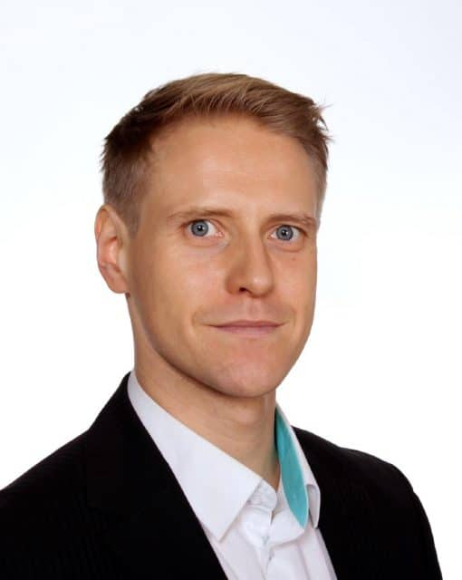
https://www.linkedin.com/in/juha-kalliopuska-12075713/
Juha Kalliopuska
CEO of
ADCACAM has two branches: Semiconductors in Finland and Cameras in the Czech Republic. “Traditionally” the Finnish section (spin-off of VTT in 2012) offers silicon sensor manufacturing and micro-packaging services.
For few years now, they have been looking into the development of chromium-compensated GaAs sensors.

Slide 14
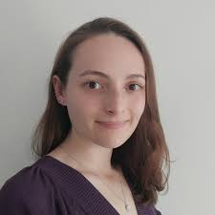
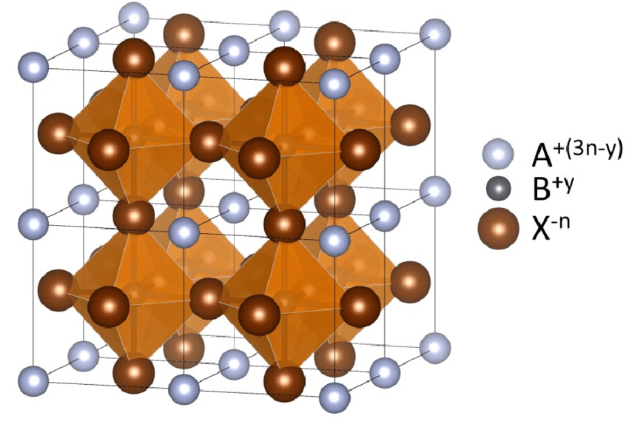
https://www.linkedin.com/in/oriane-baussens-970239b6/
Oriane Baussens
PhD on new perovskites for medical radiography @
Now working on characterization of high-Z material (CdTe, CZT, GaAs) for synchrotron applications @

