Slide 2
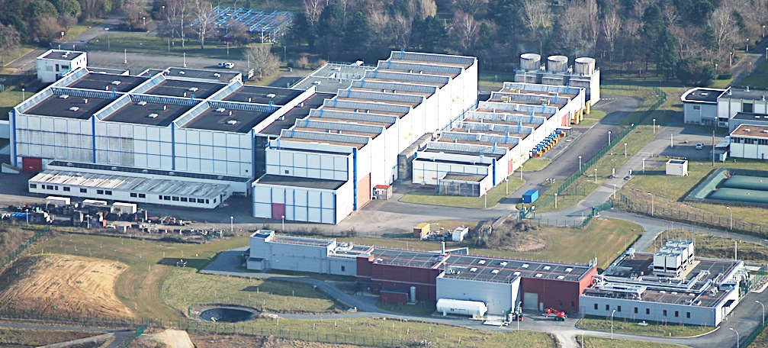
GANIL Accelerator plant
Scope of my presentation
Control Room
5 Cyclotrons
technical premises
9 experimental rooms
DESIR experipmental room under construction
NFS & S3
experimental rooms
SPIRAL2 superconducting LINAC
technical premises

Slide 3
Cyclotrons Control System Architecture
SW
PLC
Services
HMI
Supervisions
Panels
Eth
Field network
RT controler
PLC
Misc server (boot …)
Data Base (Ingres)
Alarms - Archiver
File System
Elogbook (J5 logbook)
I/O cards
Field network
> 3000 Devices

Slide 4
Cyclotrons Control System Architecture
Typical Use cases
Ions Sources Spectrum analysis
Beam steering Magnet tuning & cycling
Beam accel. Cavities amp/phase
Beam diag. Intensity/Position/Phase
Misc Monitoring/Alarms

Slide 5
Cyclotrons Control System Architecture
Technologies
Ions Sources Spectrum analysis
Beam steering Magnet cycling
Beam accel. Cavities amp/phase
Beam diag. Intensity/Position/Phase
Misc Monitoring/Alarms
45 HMI
ADA/MOTIF/XRT
31 RT applications
MVME CPU/ADA

Slide 6
ADA Control System issues
XRT/MOTIF
Setting the service U&R with new Linux machines more difficult
Knowledge lost due to retirements
No real framework/IDE, even light modifs take time
=> Obsolescence risk HMI may become incompatible with next generation of Linux machines

Slide 7
Strategy going forward
Requirement:
Ensure CS availability for at least the next 2 decades
Strategy:
Replace MOTIF/XRT by a web technology

Slide 8
Strategy going forward
Replace MOTIF/XRT by a web technology
Refactoring from spaghetti to layered architecture
Presentation (1 MLoC)/Application (900 kLoC)/Persistance
Keep the core application code in ADA (30 years maturity)
Develop Web services & HMI
Call for tender to outsource part of the work

Slide 9
OnGoing & Planned developements
Part of a GANIL CYREN (CYclotron RENovation) project
Budget granted
Replace MOTIF/XRT by a web technology
Call for tender in preparation
Expect contract signature for Q2 2025 (for ~3 years)
Web technology not chosen yet
FLUTTER used for prototyping
1 HMI prototyped and tested, 2 more on going

Slide 10
Challenges / Takeaways
Define efficient organization with sub-contractor
Making a success of the code refactoring
Not too much regression
Selection criteria for the web technology:
User & Developer experience
Dart/Flutter vs JS + HTML+ CSS => Angular vs React vs VueJs … others ?
Learning curve / testability / maintainability / performance / sustainability … ?
Make a step forward in testing
Automated HMI testing
Automated component testing
CI/CD
Making a success of the commissioning

Slide 11
Thank you

