Slide 1
Unified Beamline Control: Leveraging BlissData To Connect Sardana, Bluesky, With Daiquiri and BLISS.
Controls and Acquisition GUI Strategies Satellite Workshop at NOBUGS 2024 | 23 September 2024
Dr. Udai Singh | Research Software Scientist | FS-EC | DESY
Experimental Control Group HEAD: Dr. Linus Pithan

Slide 2
Adapting to Future Control System Needs at DESY
PETRA IV Project Delays: With the PETRA IV upgrade timeline extended, we have the opportunity to reassess and improve our software control systems before the new infrastructure is implemented.
Current Control System At DESY: Sardana serves as the main control system for beamline operations. While it has proven effective, we need to evaluate whether it can fully meet the more advanced demands of future beamlines.
Exploring New Solutions: We are investigating possible candidates for future control and visualization systems to complement or replace existing tools:
Sardana: As the incumbent system, Sardana remains a strong contender, with its proven reliability and supported by a larger community which includes several other laboratories and individuals (ALBA, DESY, MaxIV, Solaris, ESRF).
Bluesky: Offers powerful experiment orchestration with flexible data handling capabilities.
BLISS: Focuses on device control with robust data acquisition workflows.
Daiquiri: A versatile GUI that can unify experiment control and visualization for better user experience.
Objective: It was proposed to integrate Sardana, Bluesky, Blissdata, and Daiquiri in order to identify the best combination of control and visualization systems for PETRA IV, that will ensure DESY’s beamlines remain efficient, flexible, and ready for the future demands of scientific discovery.

Slide 3
Data
Blissdata is a library to store and access scan data at any moment of their life cycle.
It is developed at ESRF for BLISS ( BeamLine Instrumentation Support Software) .
It is bases on REmote DIctionary Server (redis) .

Slide 4
Queueserver
What is Bluesky Queueserver?
Bluesky Queueserver is a tool designed for managing and executing experimental plans in a queue-based fashion.
It is developed at Brookhaven National Laboratory.
It provides a reliable and structured workflow for managing experiment execution, ensuring that tasks are performed in a controlled and sequential manner.
Key Features:
Queue Management: Organizes experimental plans into a queue, enabling users to submit, modify, or cancel tasks dynamically.
Remote Control: Allows remote access to manage and control experiments, making it easier for multiple users to interact with the system.

Slide 5
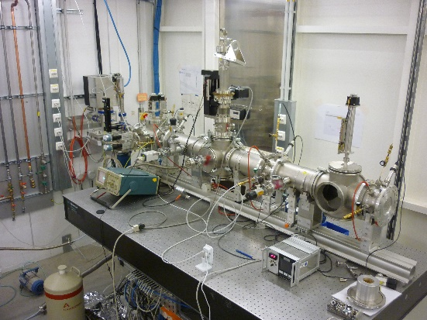
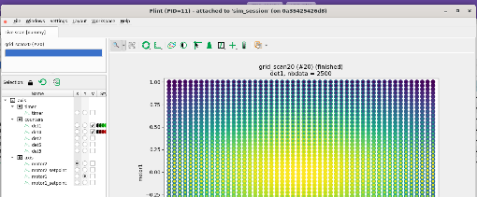
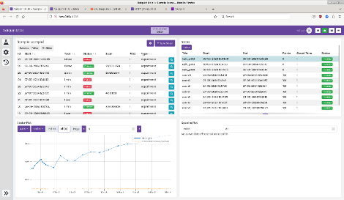
Integration of Blissdata with Bluesky for Real-Time Data Visualization
P65 | Applied X-ray Absorption Spectroscopy Beamline
Blissdata is a database utilized by Daiquiri and Flint to display real-time experimental data.
We have created a module that integrates BlissData with Bluesky, ensuring smooth data flow between the systems.
Testing and Implementation:
Currently being tested at the P65 beamline at DESY,
demonstrating practical application in a real
experimental environment.
Flint (Qt)
Data
QueueServer API
Daquiri (Web)

Slide 6
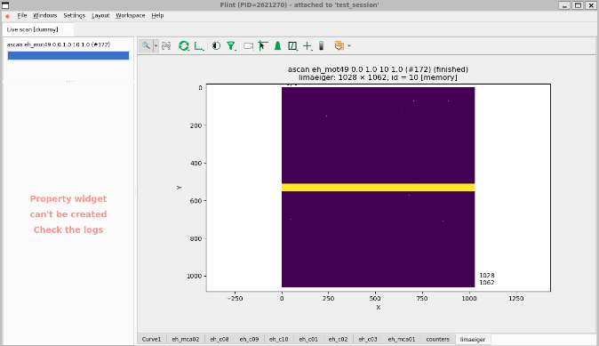
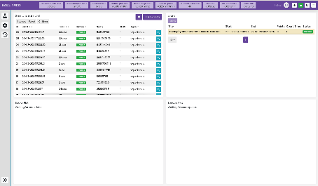
Integration of Blissdata with Sardana for Real-Time Data Visualization
P08 | High Resolution Diffraction Beamline
A similar approach has been proposed for Sardana, where a modified Bluesky Queueserver and Blissdata provide a unified data layer under the Daiquiri interface.
Key Developments:
LimaCCD has been modified to support data output to Blissdata, ensuring compatibility with the new system.
A Blissdata Recorder from ALBA has been modified to handle 2D data from LimaCCD, enabling more comprehensive data capture and analysis.
Next Steps:
We will conduct a test run at the P08 beamline in November 2024 to validate this setup in a real-world environment.
Flint (Qt)
Data
QueueServer API
Daquiri (Web)

Slide 7
Summary
Integration of various System has been done :
We have successfully integrated Bluesky, Blissdata, Daiquiri to streamline control and data visualization.
We have also successfully integrated sardana, Blissdata, Daiquiri control and data visualization.
Testing at Desy beamlines:
Currently, testing is underway at the P65 (Bluesky + Bluesky-queuesever + BlissData + Daiquiri ) and P08 (sardana+Bluesky-queuesever+ BlissData+ Daiquiri) beamlines, with future tests planned for P25 (Bliss with daiquiri).
This work may be help us deciding which way to go for PETRA IV

