Slide 1
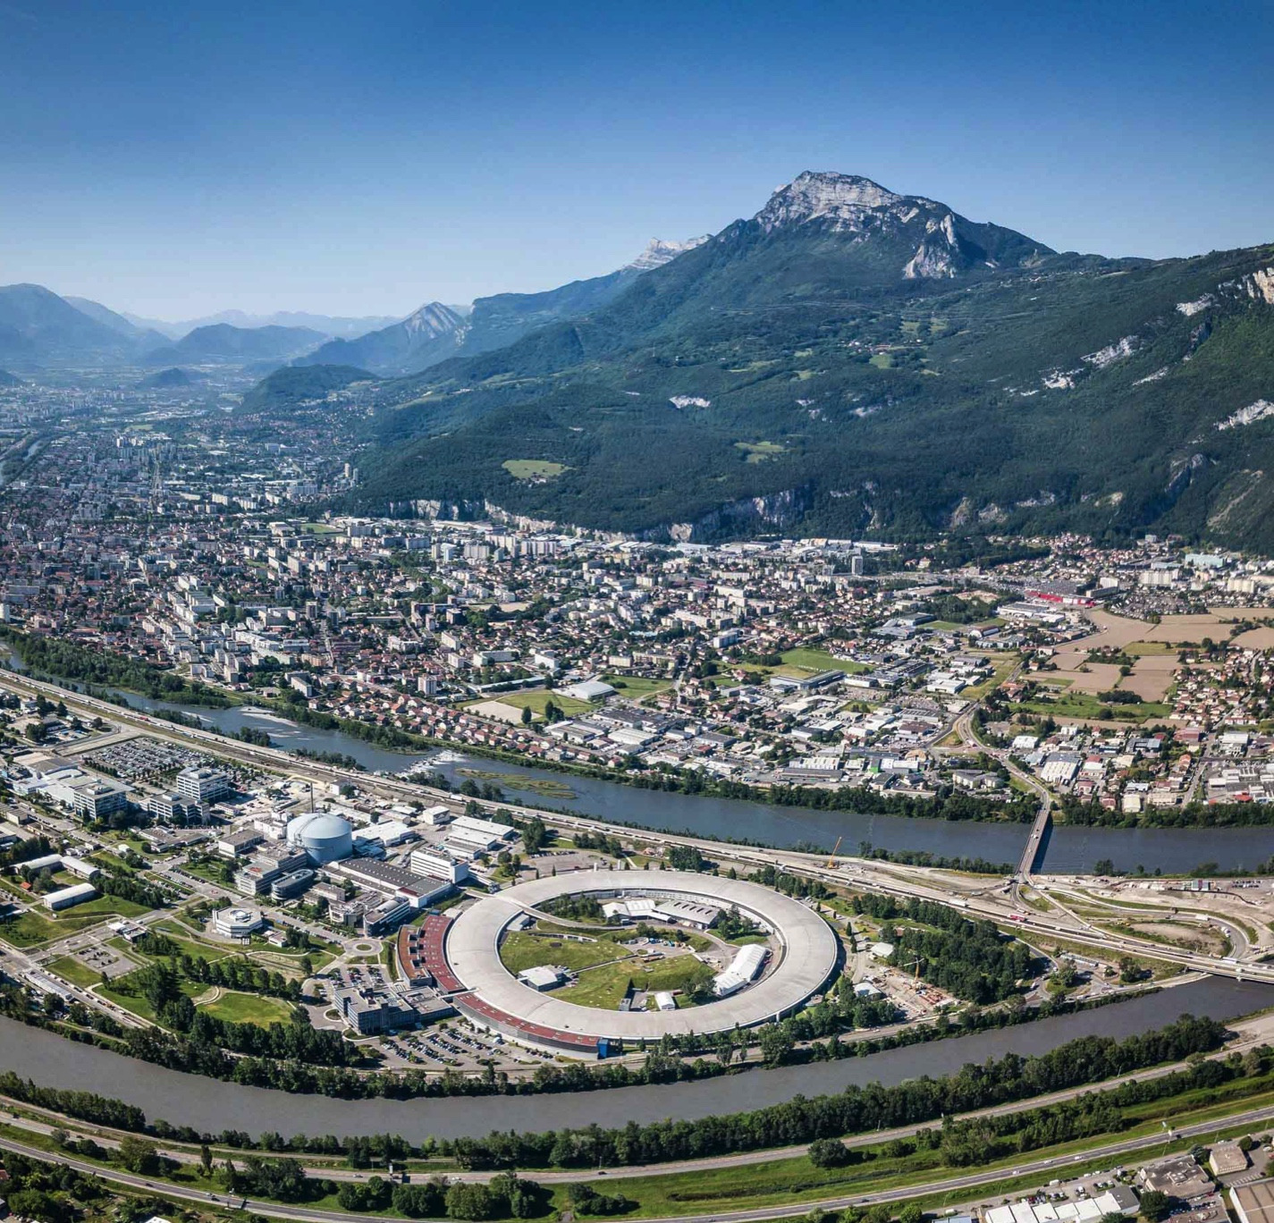
























3rd Workshop on Controls and Acquisition GUI Strategies
-----------------
Workshop Summary
Stuart Fisher (ESRF)
Chris Roderick (CERN)
23rd September 2024
PIONEERING SYNCHROTRON SCIENCE

Slide 2
Welcome
60+ Participants from ~23 Institutes
ALBA Synchrotron
ANSTO - Australian Nuclear Science and Technology Organisation
ANL - Argonne National Laboratory
BNL - Brookhaven National Laboratory
CERN
DESY - Deutsches Elektronen-Synchrotron
DLS - Diamond Light Source
EMBL Grenoble
ESRF
Elettra Sincrotrone Trieste
European XFEL
Fermilab
GANIL - Grand Accélérateur National d'Ions Lourds
HZB - Helmholtz-Zentrum, Berlin
IHEP - Institute of High Energy Physics
ISIS - Neutron and Muon Source
KIT - Institute of Catalysis Research and Technology
Jagiellonian University
LNLS - Brazilian Synchrotron Light Laboratory
MAX IV
PSI - Paul Scherrer Institut
S2Innovation
Synchrotron SOLEIL
Thank you for joining us !

Slide 3
Motivation and aims
GUIs have the potential to make peoples work much easier, for developers, staff, and users.
GUIs present many challenges, including UX design, choice of technology, and inevitable accelerating technology evolution. There are social challenges as well, staff competences, resistance to change, etc.
1st GUI Strategies Workshop in 2022 → a lot of interest and some topics to be followed-up:
Charting, Data Decimation, Synoptics, Web application packaging, Zero/Low code GUI platforms
2nd GUI Strategies Workshop in 2023 → 50+ participants, some topics to be followed- up:
UI Testing
This workshop aims to bring the interested people together again, in person, as a community, to
share knowledge, discuss, and hopefully make new connections and get inspired
This is a workshop – targeting plenty of discussion
→ please take part & share your questions, ideas, feedback, experience...

Slide 4
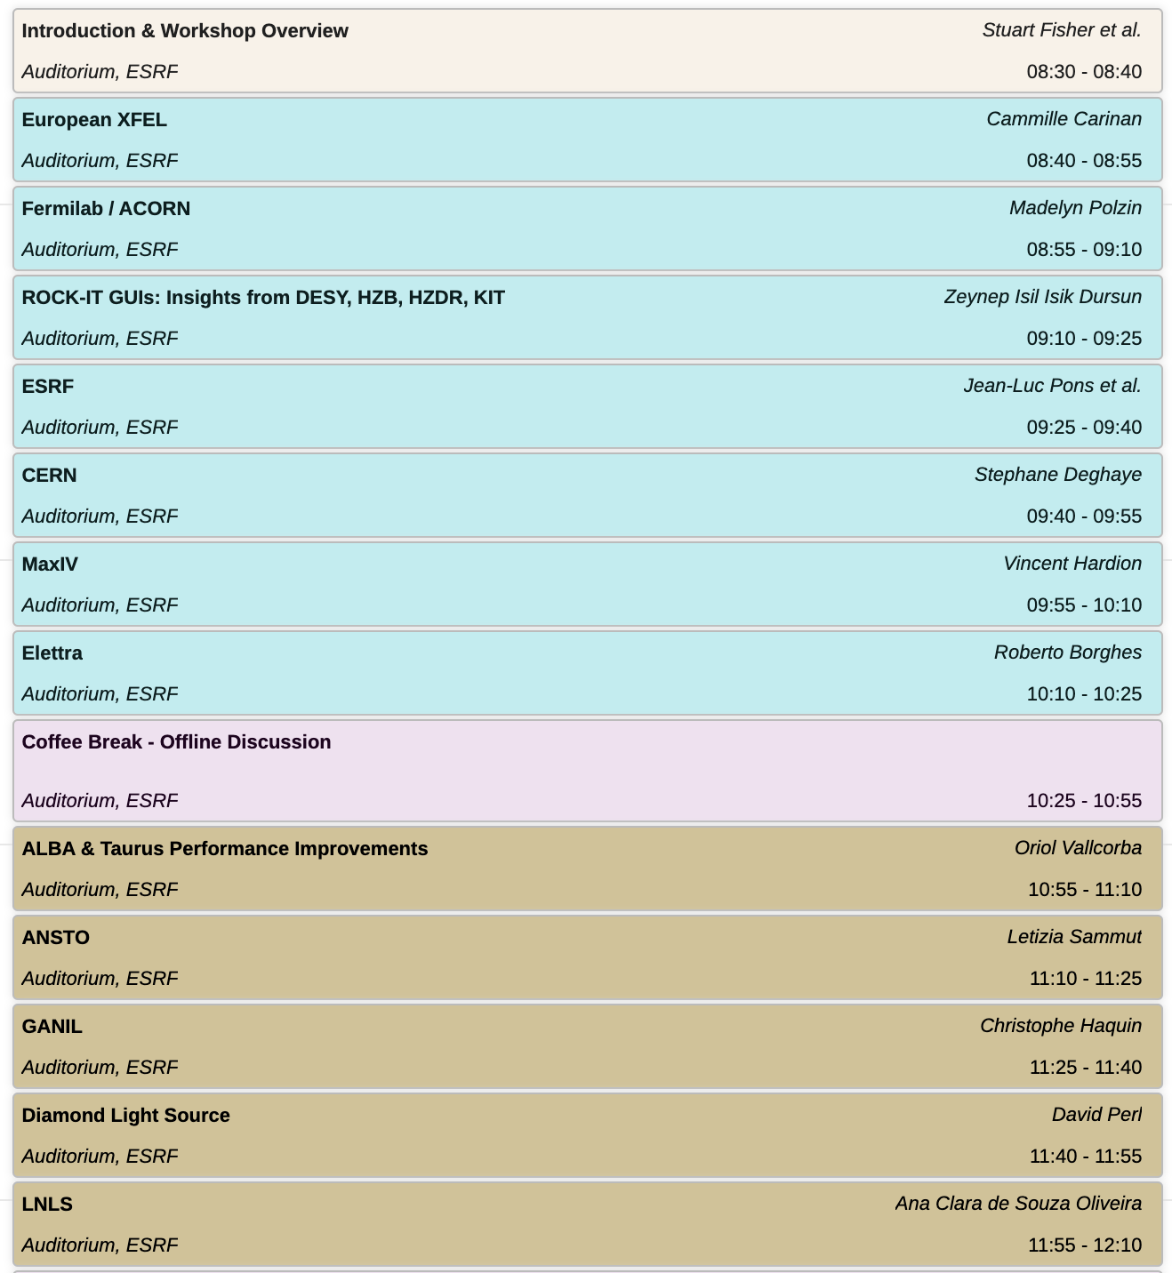
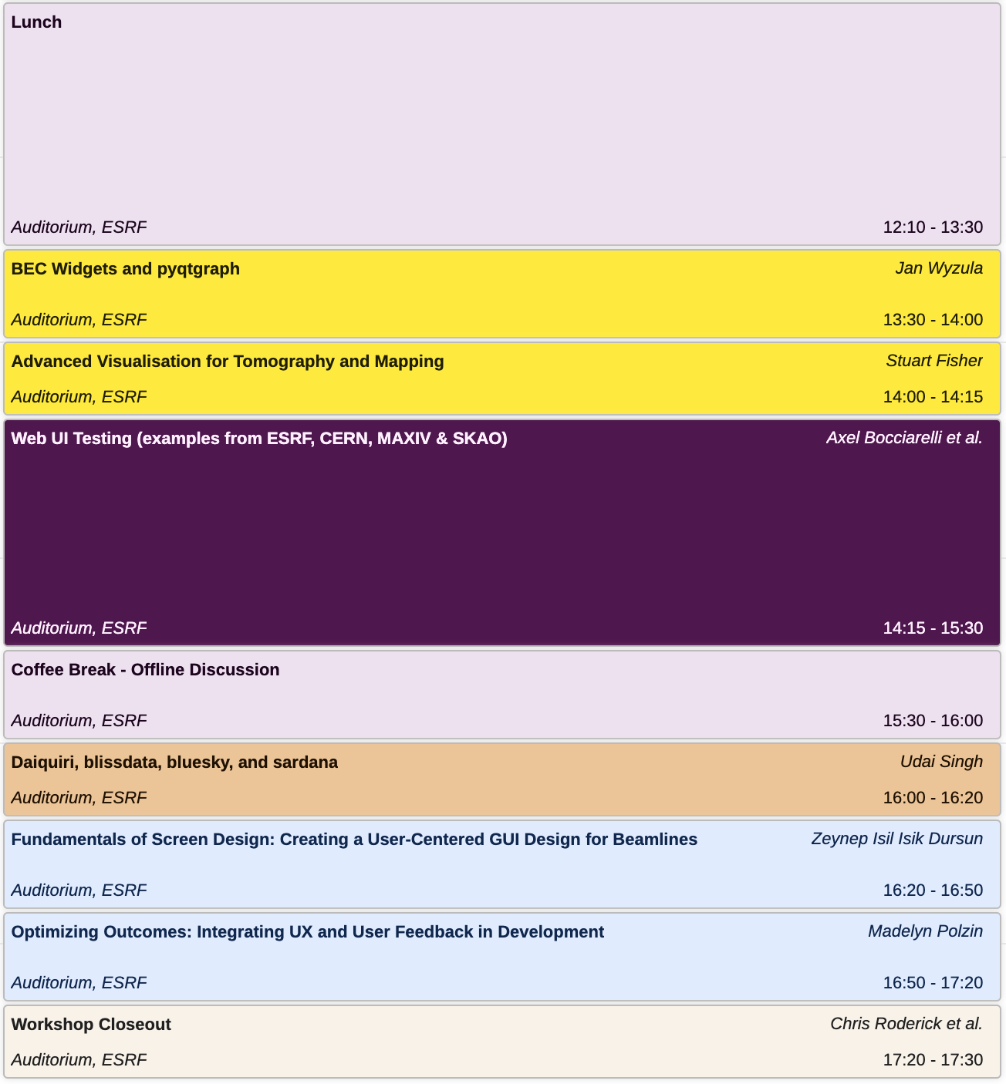
programme
Technologies & Evolution Plans
Plotting and Advanced Visualisation
Testing
Integrated Environments
User Experience (UX)

Slide 5
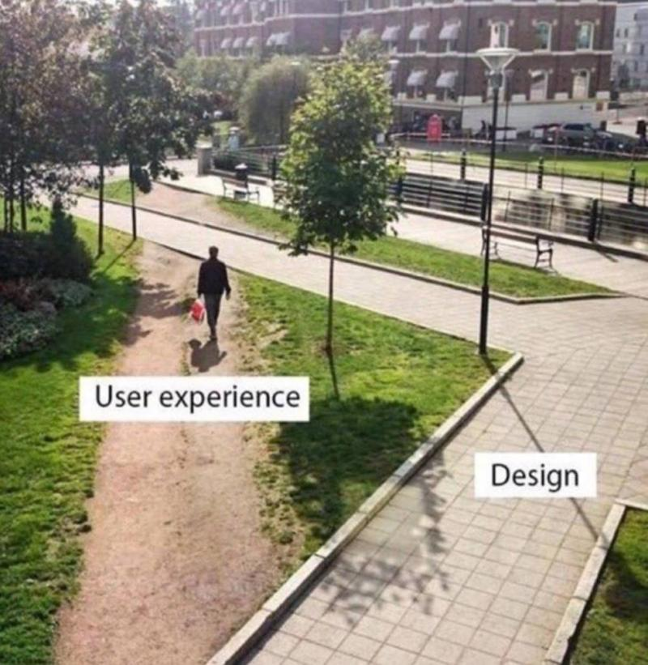
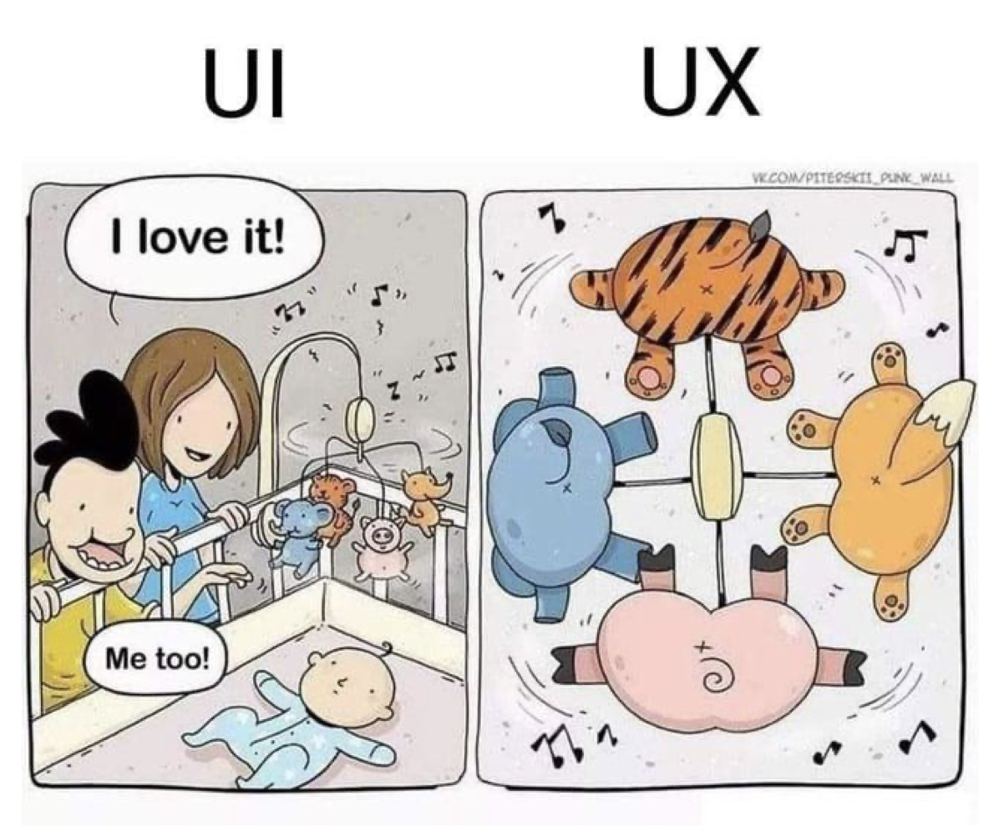
High level SUMMARY
Most institutes are in a similar situation:
(Py)Qt5, some Java (ESRF, CERN), looking to increase their portfolio with Web tech
      So far, this is usually an addition, rather than a full replacement (non–technical reasons), few exceptions:
        Fermilab: aiming for the Web with Flutter
        GANIL, looking to fully move to the Web
        MaxIV: Taranta (Web) is their “North Star”
      Mainly React & Material as Web UI tech (Flutter & Angular also in use)
      Moving to Qt6 is on the horizon, raising the question of PyQt or PySide as Qt Python binding
      Wide use of SVGs for synoptics
Quite some investment in PyQt performance (e.g. Taurus & PyQtGraph), leveraging OpenGL
Rapid / low-or-no-code- development is widely sought (Karabo, Taurus, Taranta, WRAP, PUMA, DonkiWeb, BEC Widgets, etc.)
Testing is not straightforward
      Requiring compromises / pragmatism.
      Institutes investing in testing have similar approaches
    UX is a challenge, but there are experts out there!

Slide 6
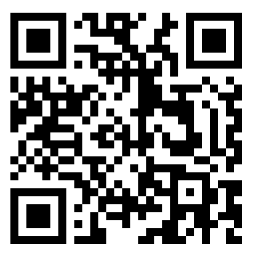

Potential TOPICs for next meeting
Managing application/business logic in an easy and sustainable way?
Managing application inventory & lifecycle?
Practical look at capturing & using telemetry data?
Optimising adoption of new technologies?
Deeper dives into examples of specific production applications on the Web & challenges faced?
Deeper dive into SVG based synoptics, technical aspects of Device Control integration?
Ideas or examples for further practical collaborations (e.g. how does it work for Taranta)?
Streaming real-time / large data from similar sources?
Chat channel to refine & share ideas in general: https://cern.ch/gui-workshop-channel
or flash this:
See you at

Slide 7

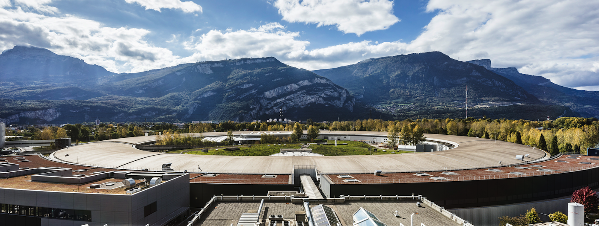
PIONEERING SYNCHROTRON SCIENCE
THANK YOU VERY MUCH! SEE YOU NEXT TIME...

