Slide 1
EBS SR lattice with all known multipoles along s
S.M.Liuzzo, G. Le Bec, J.Chavanne

Slide 2
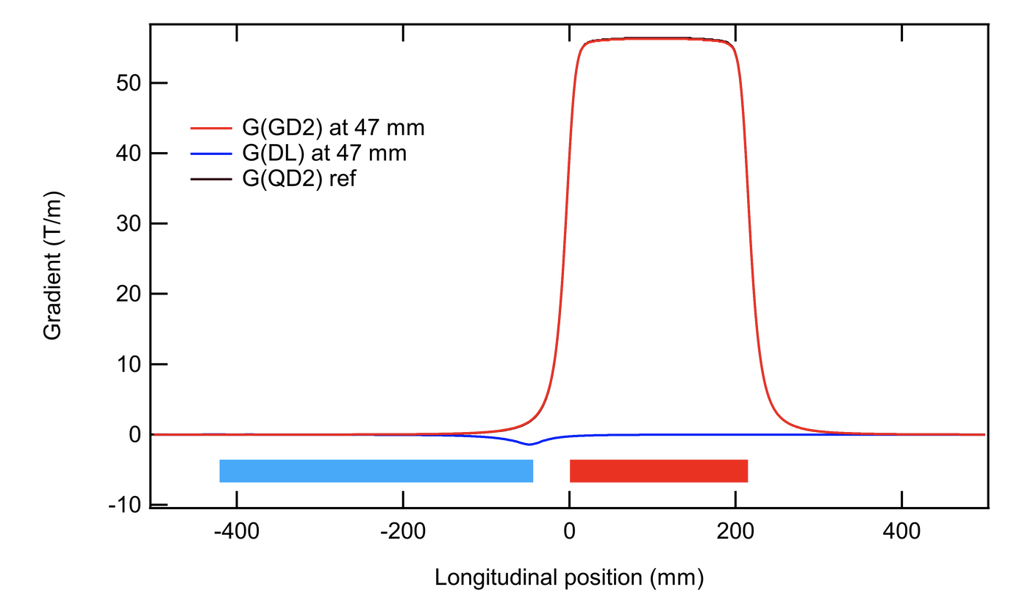
Strategy and objective
1a) Define New model to include: Detailed field of all multipole vs S, Cross-Talks vs S.
1b) Define/Adapt matching scripts for new model: We need a lattice model that may be used for optics matching. Already introducing the new multipoles, requires re matching the optics.
2) Compare to present measurements.
3) Provide a minimal/simplified lattice model for daily use.
OBJECTIVE: Lattice model better reproducing measured quantities (chroma., dispersion, mom.comp. etc…)
Compare the computed gradients with the new lattice model with the correction strengths in the SR.
Set the sextupole strengths of the SR in the new model and obtain the measured chromaticity
Simulate correctly dispersion and momentum compaction factor (better optics matching)
TODAY: QUADRUPOLES ONLY
NEW MODEL:
DIPOLES, QUADRUPOLES, SEXTUPOLES

Slide 3
Available / missing information
Inj QF2
https://confluence.esrf.fr/display/IDMWS/Magnet+cross-talks (by G. Le Bec)
Also for Inj.Cell.
Reqeusted data to Joel Chavanne or Gael Le Bec
June 2017
/machfs/liuzzo/RADIAtrackingCROSSCHECK/MagneticLengths2017_integratedGradientProblem/DQ
Some VERY old data
+ Sextupole in DQ (30 May 2017)
DL1_5 modules are designed to be stronger than in the model due to field lost in QD2.
Not considered presently

Slide 4
Lattice structure
Today elements not overlapping.
“Easy” for matching, but with this scheme it is not possible to model
For example, here there is a main dipole and a main quadrupole generated by the cross-talk
Make sure there are no artificial effects added up, such as dipole fringe fields. Model made of Bends with EdgeEffects = 0, a part at entrance and exit of real magnet, if needed (see with Gael)
The data provided replaces any concept of magnet/iron length. The total magnet length is not needed, nor retrievable in the model.
Add markers to specify location of physical elements.
Think about the complete lattice from the beginning: injection, canted cells and BM have to work.

Slide 5
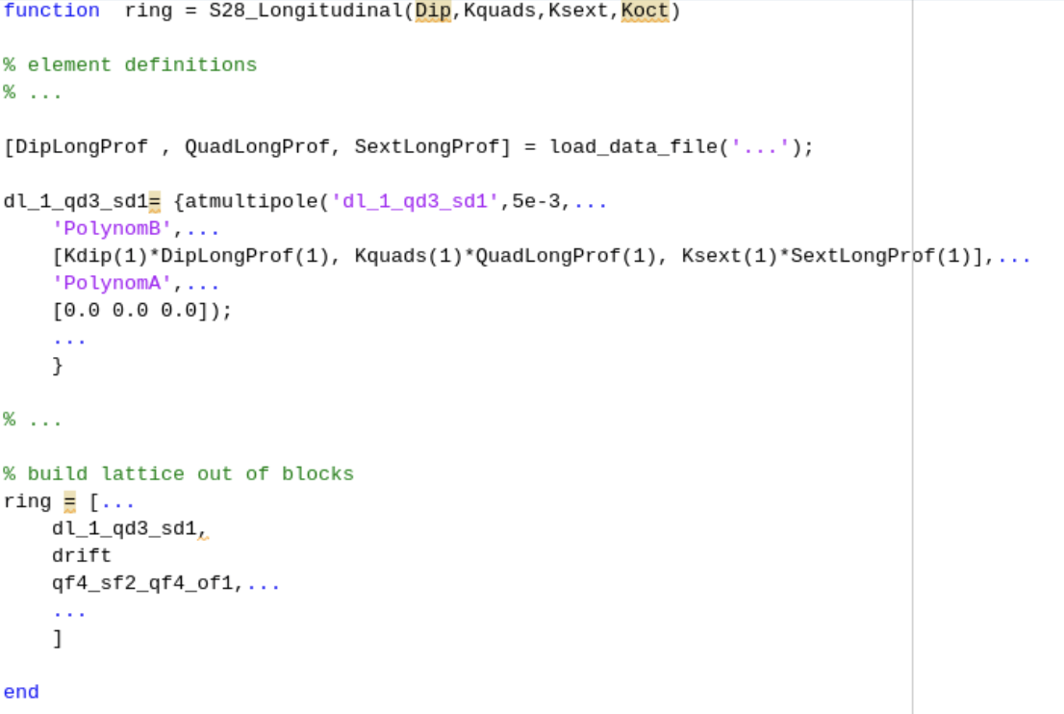
Proposed MADX-Like AT lattice file
Reduced physical variables for matching
Fully detailed model, easy to read
PSEUDO-CODE PSEUDO-CODE
PSEUDO-CODE PSEUDO-CODE
PSEUDO-CODE PSEUDO-CODE
PSEUDO-CODE PSEUDO-CODE
PSEUDO-CODE PSEUDO-CODE
PSEUDO-CODE PSEUDO-CODE
PSEUDO-CODE PSEUDO-CODE
PSEUDO-CODE PSEUDO-CODE
And functions to define gradients along s based on files directly.

Slide 6
Step zero could be: sextupoles only
Likely it will not give much better results, but a zeroth order simple step is to take the Sextupole Cross talks and plug them as additional lenses in the model as for the quadrupoles.
This may give indications, but is likely not going to answer the problem. Dipole longitudinal distribution will change dispersion. Quadrupole and sextupoles longitudinal distribution will change chromaticity.
There is no way to model the sextupole reduction of field due to cross talk . This value may be set in the Control System and will lead to updated strengths computation for the same currents. This can be tested easily in the simulators. The CrossTalk factor for sextupoles must be retrived from data first (not already available in confluence, easy to deduce).
Approx.: SD1A/E +2.45% SF2A/E +1.86% SD1B/D +2.56%
Waiting for this data we can answer:
what would be the required calibration factors to fix the measured-model chroma discrepancy?
If ~2% of the sext field leaks on the near by quads, this alone will solve the chromaticity issue.
This information is unfortunately NOT available in the files online https://confluence.esrf.fr/display/IDMWS/Magnet+cross-talks (June2022)

Slide 7
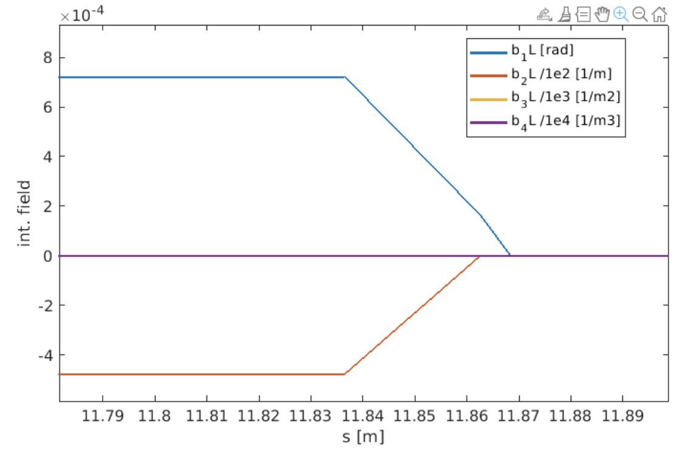
Present Hard edge model

Slide 8
Dummy smoothed lattice gradients
USE THIS WHILE WAITING FOR DATA
TABLE of
S, b1,b2,b3,b4 along one cell.
32 files, one for each cell eventually.
DUMMY (matlab smoothing)

Slide 9
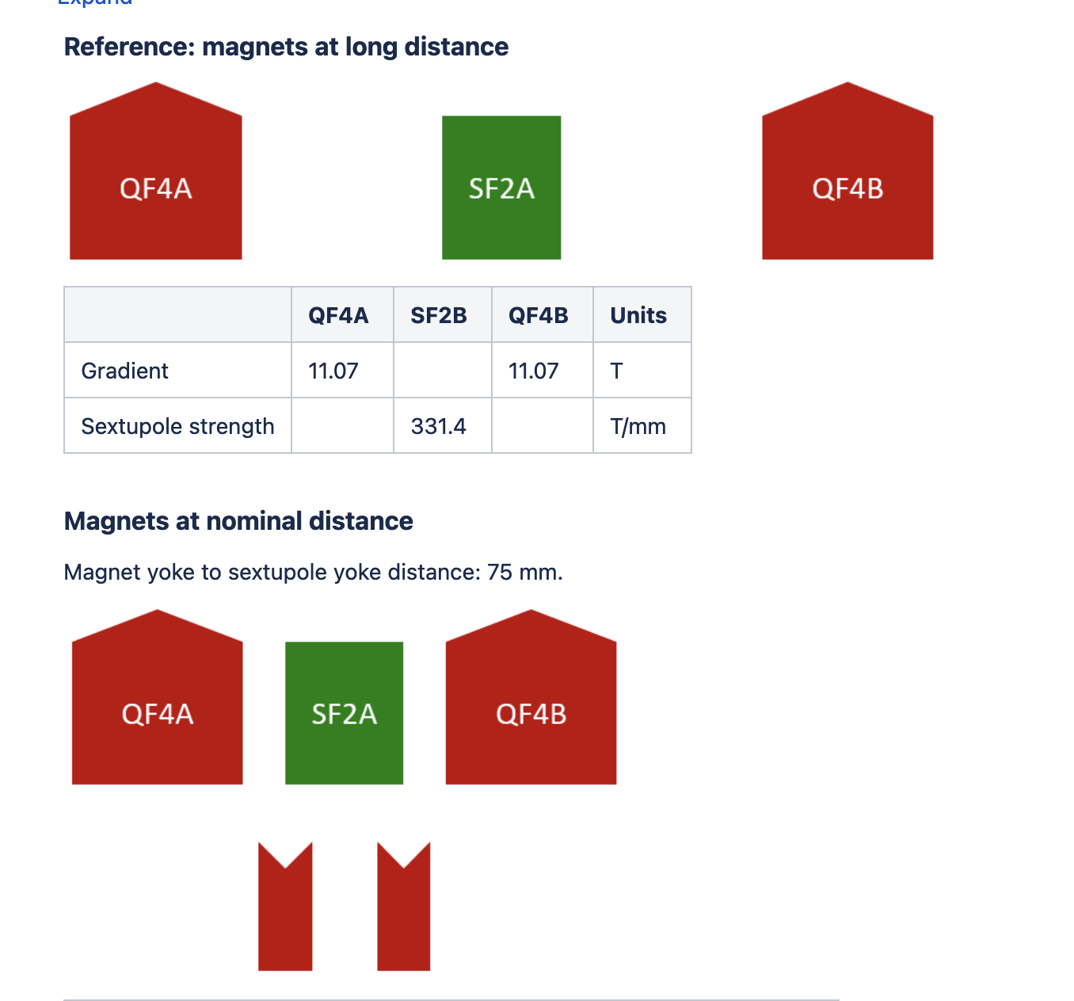
Sextupole cross talks
This is what happens to the quadrupole field.
What about the sextupole?
If there is a reduction of field of the sextupoles because of leakage to the neigbouring quadrupoles, this may give:
A correction factor of the calibration curve (different strengths for the same currents)
Different chromaticity
In the optics model
SEXTUPOLE
The reduction of main field instead is a calibration factor scaling, not present in the model. This correction acts on the strengths red from the control system
QF4

Slide 10
CALIBRATION CROSS TALK FACTORS ARE APPLIED correctly??
CALIBRATION CROSS TALK FACTORS ARE APPLIED correctly??
Cross talks makes such that a given gradient is actually lower than expected. The calibration curve is multiplied by this factor, such that it represents a calibration as if it had been done with all the neighboring magnets at their place. Finally the model strength will lead to larger currents that those for the non corrected calibration curve. So the calibration curve should get the same factor as the magnet cross talk.
The larger current in the magnet will actually modify the cross talk it self (computed for a given set of currents). This effect is neglected.
In terms of lattice model, the improvement here is on the machine side. For the same currents, updating the CrossTalk main multipoles calibration factors will modify the strengths that we use to update the model, thus giving different optics parameters.

Slide 11
Test of Dummy field profiles
Normalize field profiles to their integral. So the scaling can be Profile(s)*KL.
One profile curve for each magnet, normalized to the integrated gradient.
The curves, OVERLAP. As expected in reality

Slide 12
Optics of 1 cell with smoothed fields: Real data may really give us further understanding
Dashed = hard edge
Full = smoothed fields along s
The cell is NOT matched.
There is a potentially large change of optics that is linked to the longitudinal distribution of the multipoles. It leads to changes in optics at the sextupoles and different dispersion at the sextupoles, so : chromaticity, mom. Comp., dispersion, etc…

