Slide 1

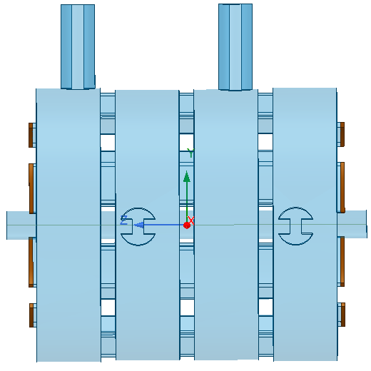
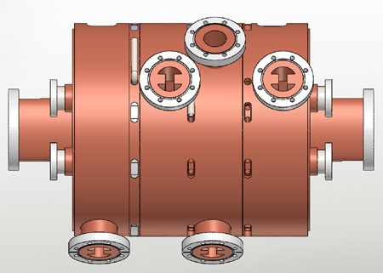
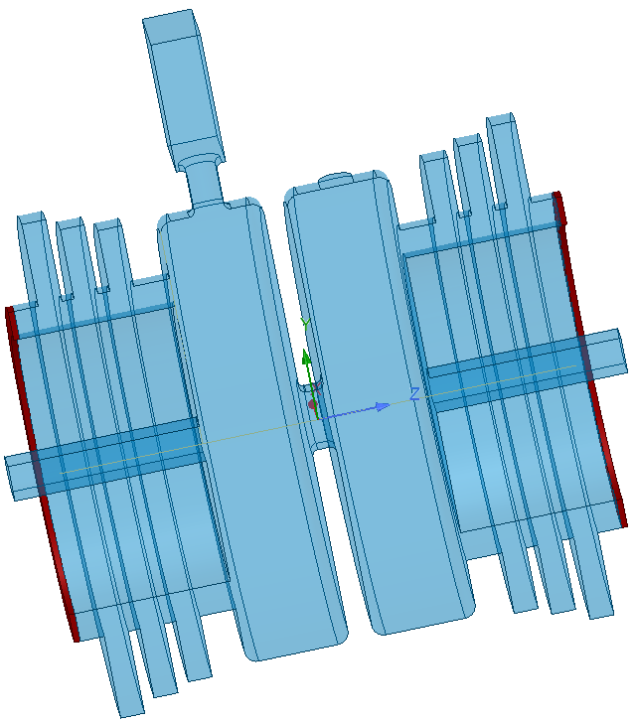
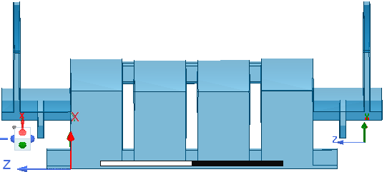
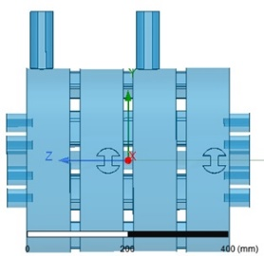
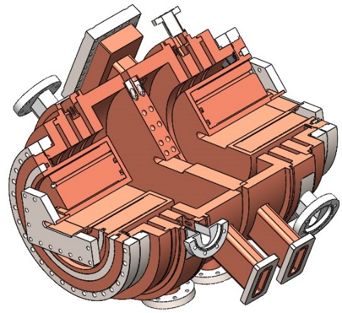
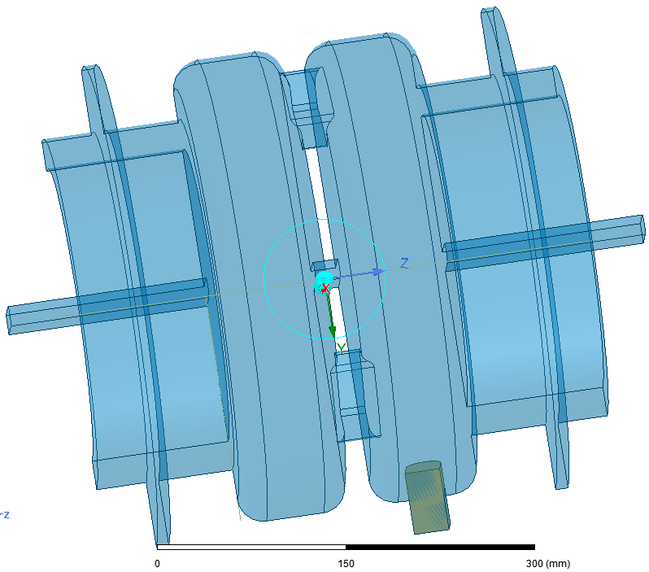
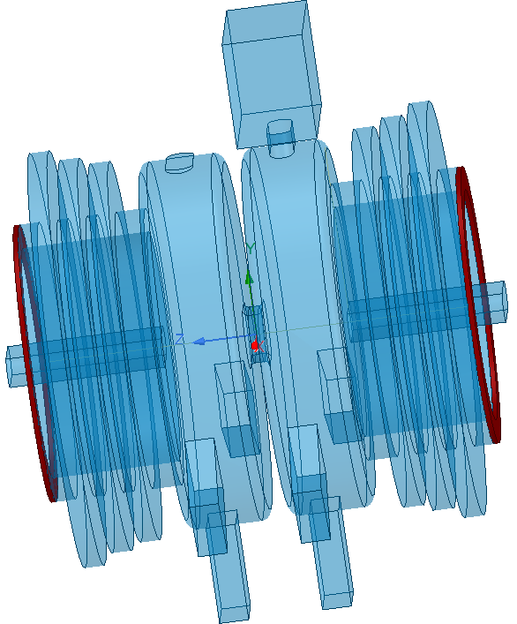
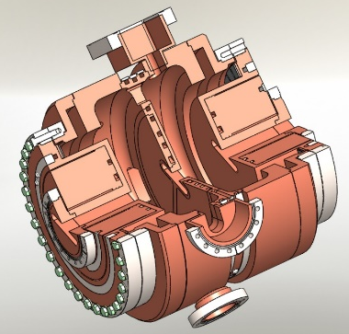
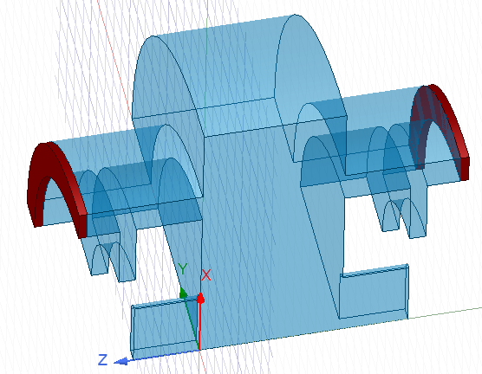
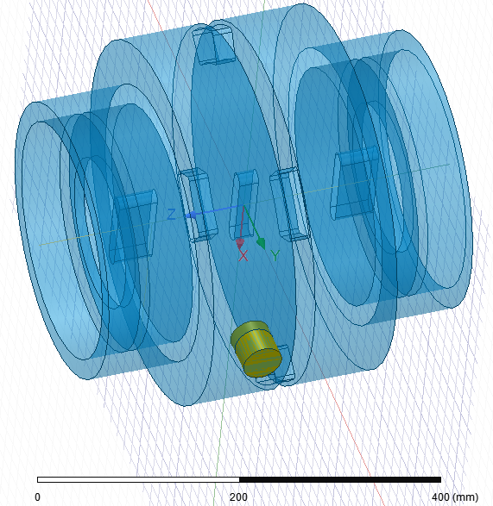
4th Harmonic Cavities in TM020 for ESRF-EBS and SOLEIL-II
A. D’Elia, V. Serrière, J. Jacob and P. Borowiec
ESRF

Slide 2
Outline of the talk
Motivations;
Design and main features of different TM020 structures;
EBS-ESRF Case;
SOLEIL-II Case.

Slide 3
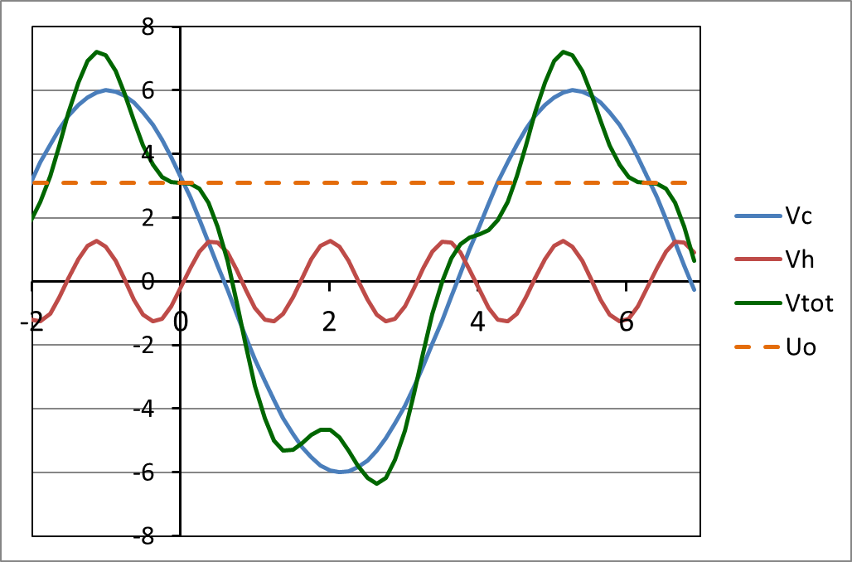
Motivations of a 4th harmonic cavity at the ESRF
    1st Priority for high current/bunch (16b and 4 x 10 mA)
    Reduced Touschek scattering, IBS and microwave instability:
      Increased lifetime → less frequent injections, reduced loss rate and radiation load
      Improved overall stability
      Room for smaller In-Vacuum ID gaps
      alleviate possible impact from future lattice developments like mini-beta straights
      Reduced emittance and energy blow up
    Reduced heat-load and stress of critical chambers, like ceramic chambers or In-Vacuum IDs
    2nd step: for multibunch operation
    Intrinsically less Touschek scattering, very low IBS, no MWI
    7/8 filling → strong transient beam loading (TBL) almost impossible to avoid
    Project delayed to start in 2027
V [MV]
Vtot
Vc = 6.5 MV
Uo = 2.52 MV
Vh,opt = 1.49 MV
ω_{RF} t
Principle: 4th harmonic RF system for bunch lengthening on EBS
J. Jacob
4th Harmonic (1.41GHz):
Better availability of RF power sources;
Provide for a bunch lengthening by a factor between 2.5 and 3;
V_{opt,h}=1.49MV* for a 4th harmonic system, to be compared with V_{opt,h}=1.98MV* for a 3rd harmonic.
* Considering V_{main RF}=6.5MV, initial EBS working point, presently lowered to 5.5MV (➔ V_{opt,h}=1.21MV) and U=2.52MeV/turn

Slide 4
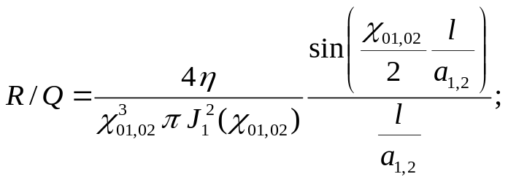
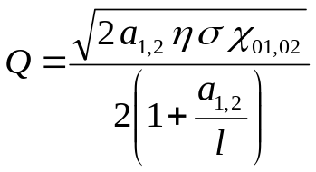
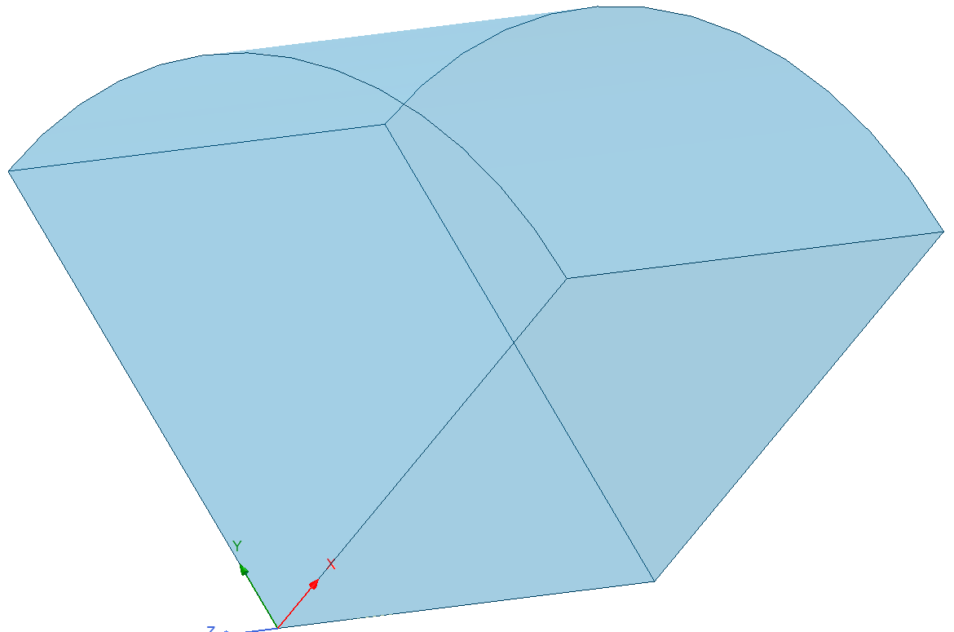
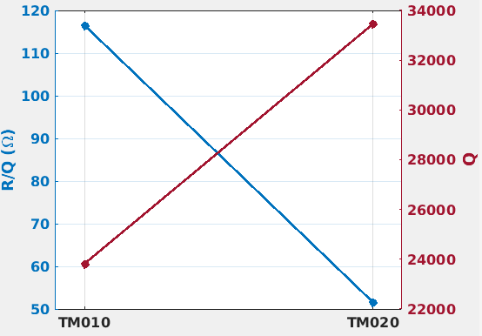
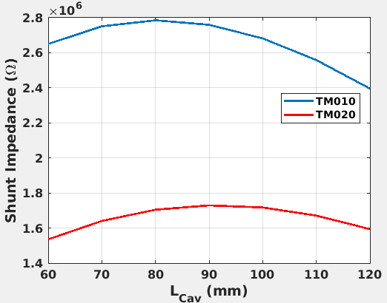


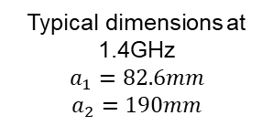
RF performances of the Tm020 vs tm010
Index 1, 2 refers to TM010, TM020, respectively
Typical dimensions at 1.4GHz
$$a_{1}=82.6mm$$
$$a_{2}=190mm$$
a_{x}
$η=377$Ω; $σ=5.8x{10}^{7} S/m$
$χ_{01}=2.405; χ_{02}=5.52$;$J_{1}\left(χ_{01}\right)=0.52; J_{1}\left(χ_{02}\right)=−0.34$
$$l$$
A TM020 needs about +40% more power of a TM010

Slide 5
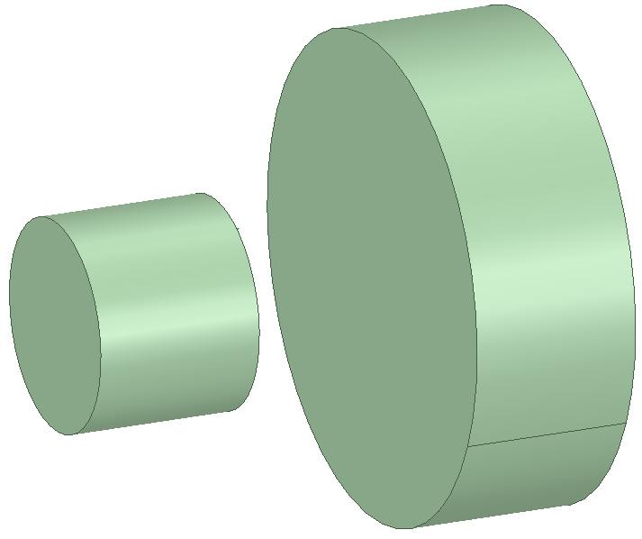
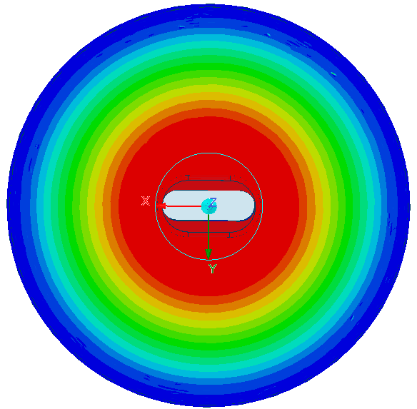
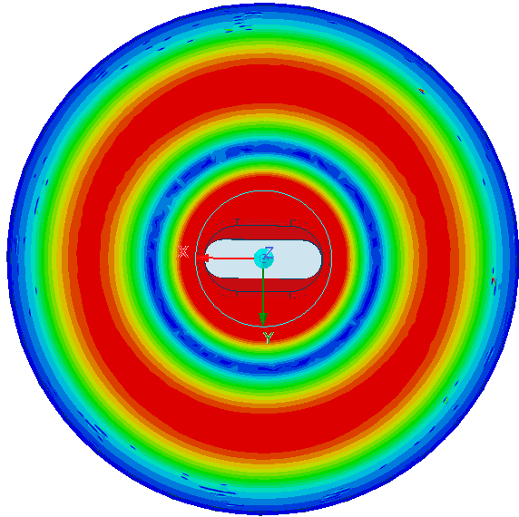
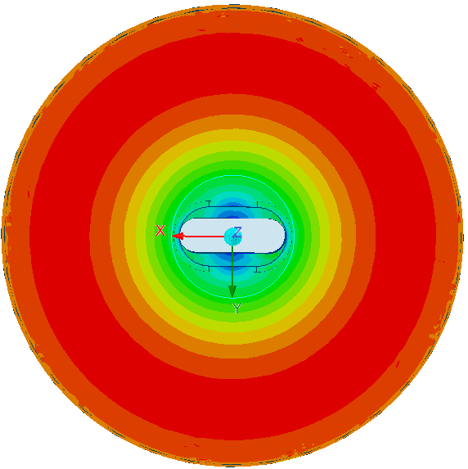
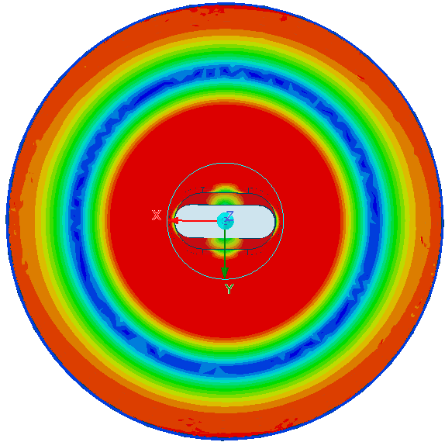
Some “engineering” consideration
TM010
E-Field
TM020
TM020
TM010
H-Field
Larger dimensions allow to mitigate the tight mechanical tolerances for relatively high working frequencies and ease the distribution of all the necessary ancillaries all around the outer surface (and also reduce their perturbation that lowers down on the Q₀);
Of course the TM010 becomes a parasitic mode at a lower frequency (Lower Order Mode=LOM).

Slide 6
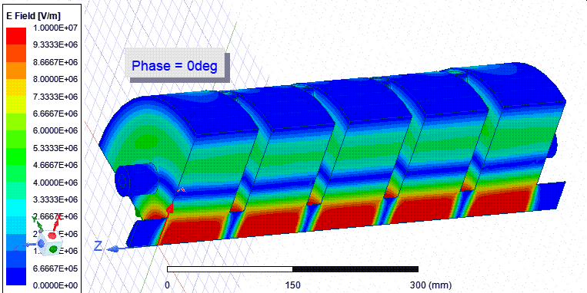
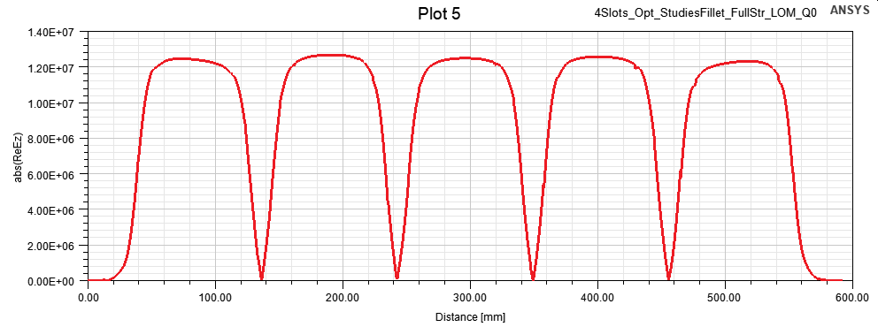
Multicell design
With the aim of pushing the compactness of the structure and to minimize the ancillaries per cell, we initially went for a slot coupled (magnetic coupling) multi-cell structure.
|E_{z}-Field|

Slide 7
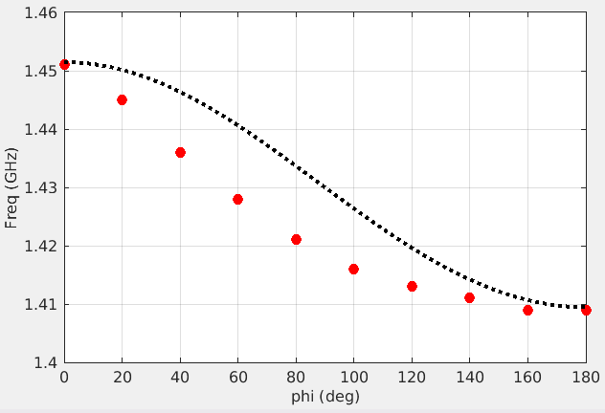
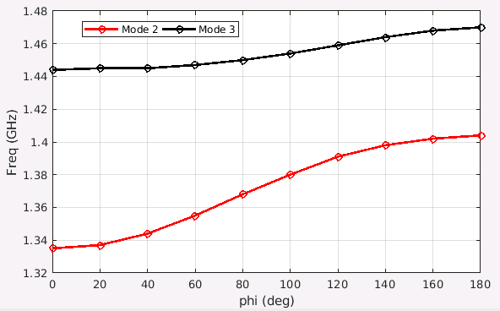
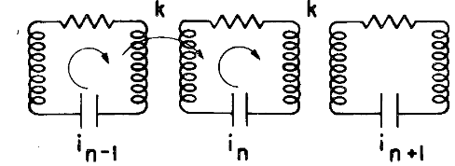
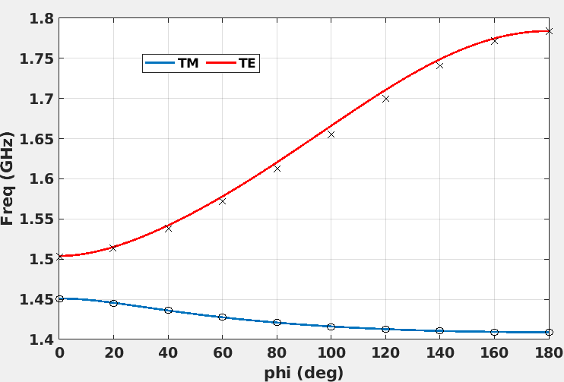
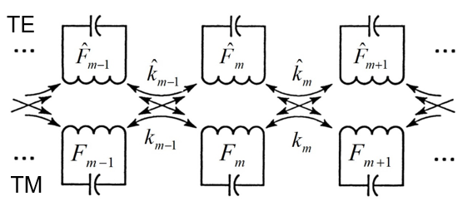
Circuit model and TE-TM coupling
Disp. curves prediction vs HFSS data
Band mixing
Disp. curve prediction vs simulation data
Single chain of coupled circuits
TE
TM020
TM020
Mixing region
TE
Disp. curves prediction vs HFSS data
The coupling between TE and TM bands needs to be considered. This coupling asymmetries the Brillouin diagram with an immediate consequence of a reduced distance between the π-mode and its closest neighbours. When the coupling becomes very strong, the two bands may definitely mix.
This interaction between TE and TM020 modes must be taken into account also in the case of a single cell cavity.
Double chain of coupled circuits

Slide 8
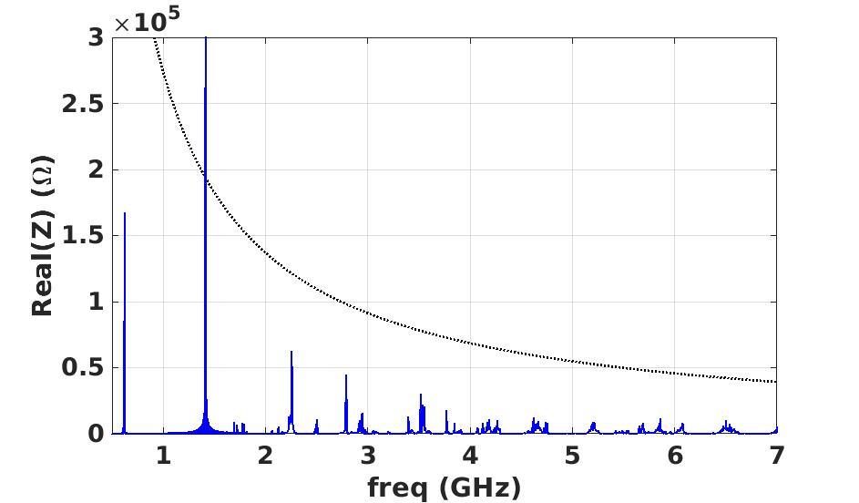
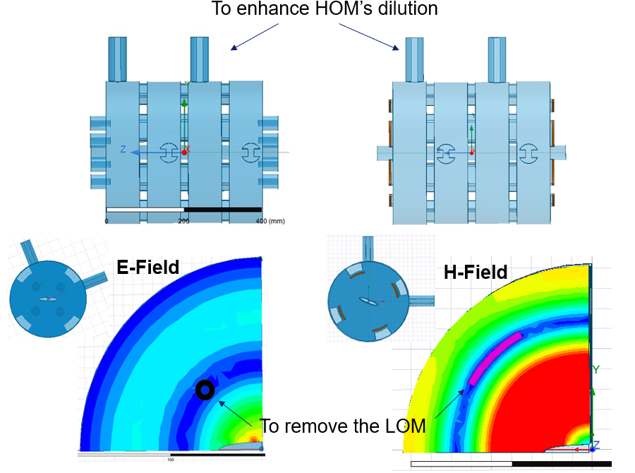
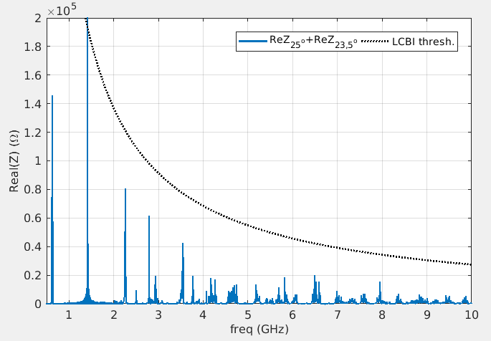
Damping scheme: Lom+hom damping+DetuniNg
Coax Antennas
23.5deg+25deg
Ferrite slots
Rather than providing for 2 identical structures, we can enhance the damping of the unwanted modes by building 2 different cavities. In this case what is used for the detuning is the coupling slot aperture.

Slide 9
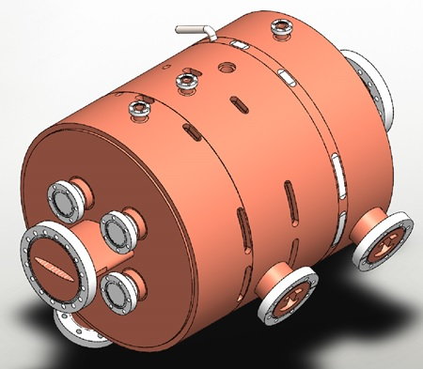
In practice: quite problematic Mechanical integration
Both structures were meeting all criteria in terms of power and LOM/HOM dilution and the engineering integration started but not easy to integrate the LOM absorbers:
Coax antennas: needed a very high precision positioning and difficulties to cool them down (water cooling needed);
Ferrite slots: needed also a very high precision positioning and at the limits of the capability of the ferrite in terms of sustainable density power

Slide 10
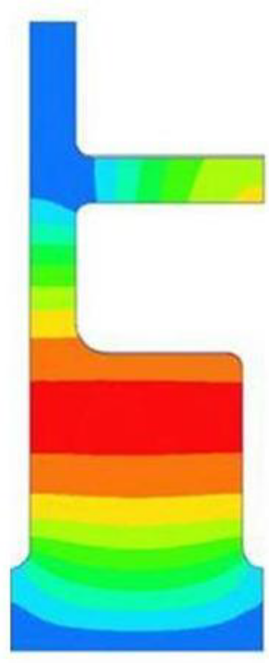
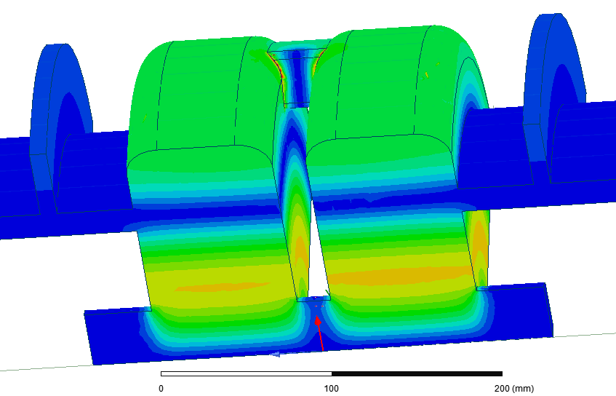
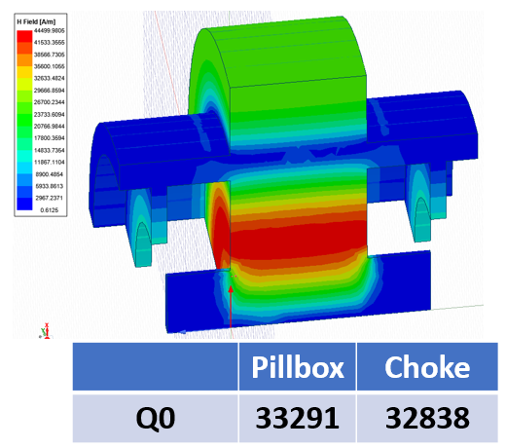
Moving forward: Variation of a choke mode cavity
H-Field
Standard
Coaxial choke mode cavity
Profiting of the fact that our working mode is a TM020, instead of a radial line on the outer wall (standard design), a coaxial line is open on the node of the H-field. The combination with a stub filter tuned at the working frequency will leave the Q0 unperturbed. It is also possible to couple two cells together for a 2-Cell structure.

Slide 11

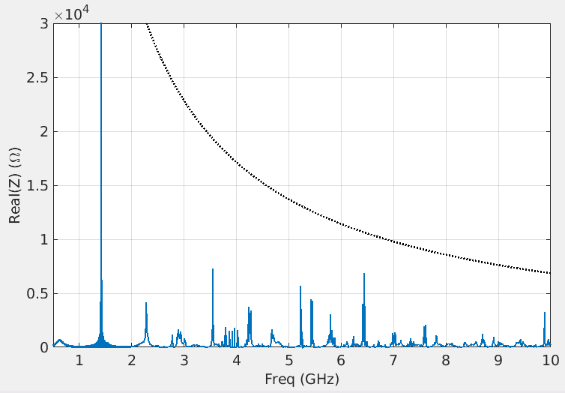
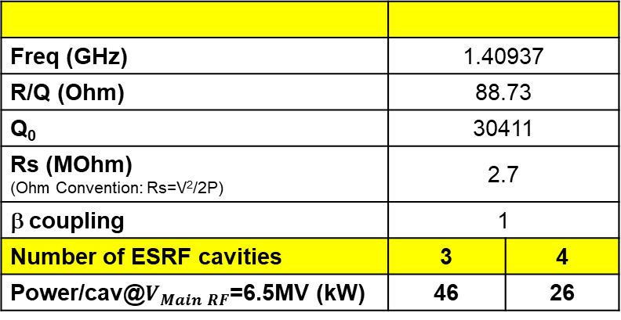
First attempt…
Freq (GHz) | 1.40937
R/Q (Ohm) | 88.73
Q₀ | 30411
Rs (MOhm) (Ohm Convention: Rs=V²/2P) | 2.7
β coupling | 1
Number of ESRF cavities | 3 | 4
Power/cav@$V_{Main RF}$=6.5MV (kW) | 46 | 26
The overall cavity design was pretty much advanced.
The cooling performances are definitely limited by the presence of the coupling slots and only a configuration with 4x2-Cell is acceptable with very small margins of improvement.
To fit 4 cavities in the ring we need to remove one monocell (max available length becomes ~2.5m).
4 Cavities

Slide 12
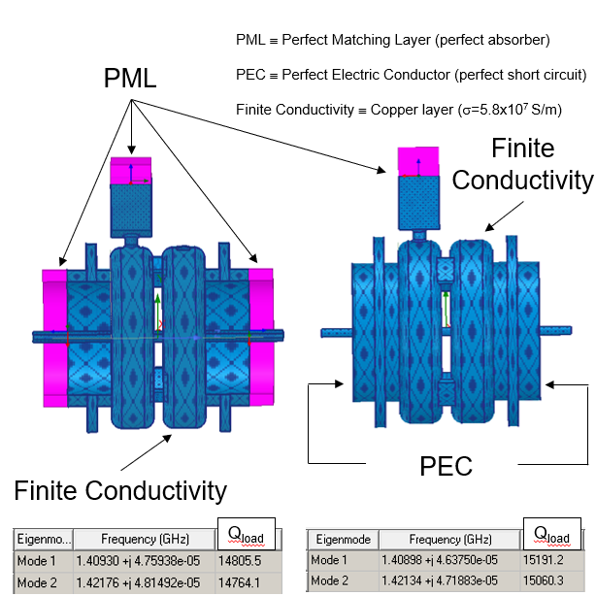
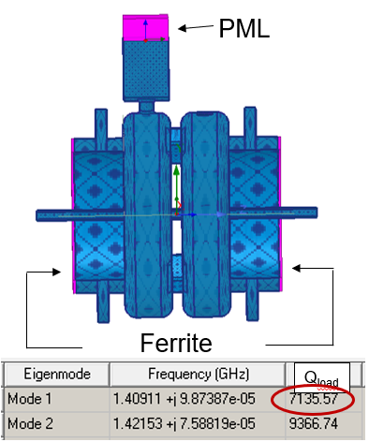
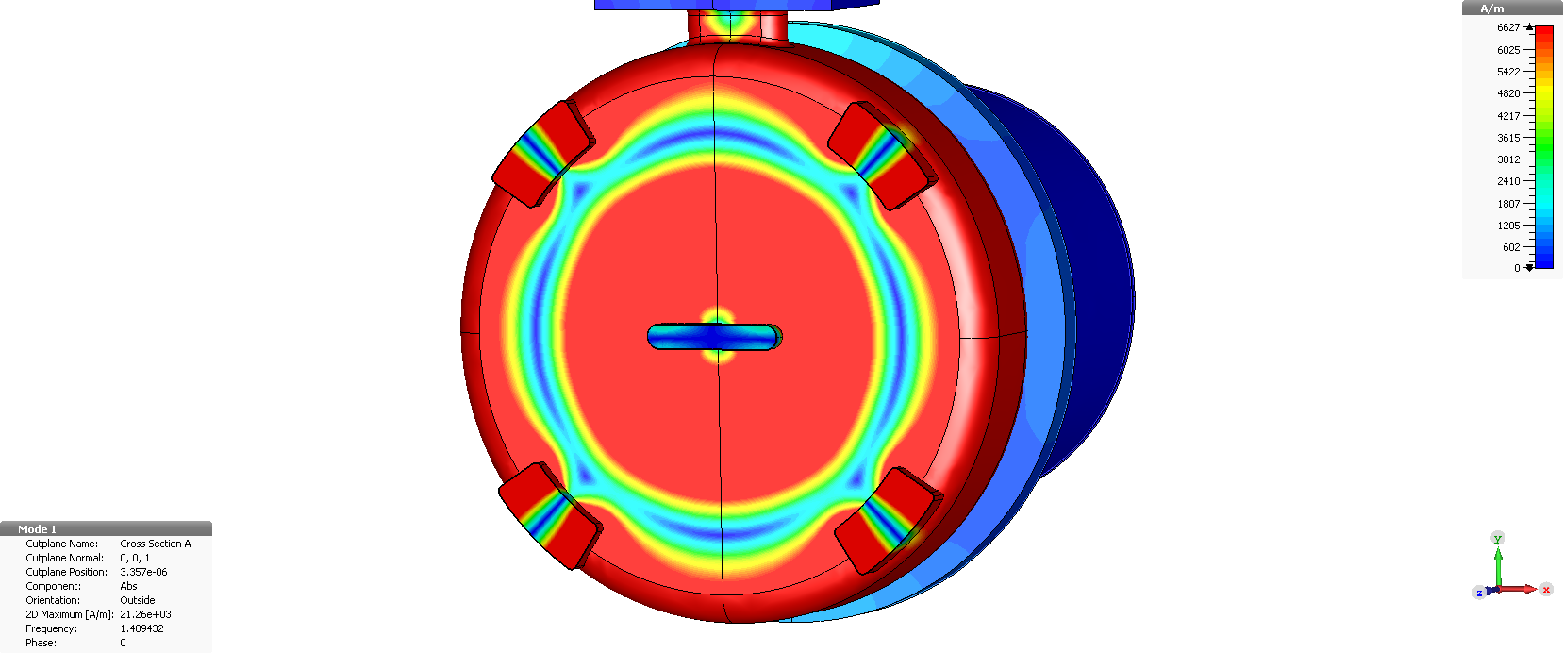
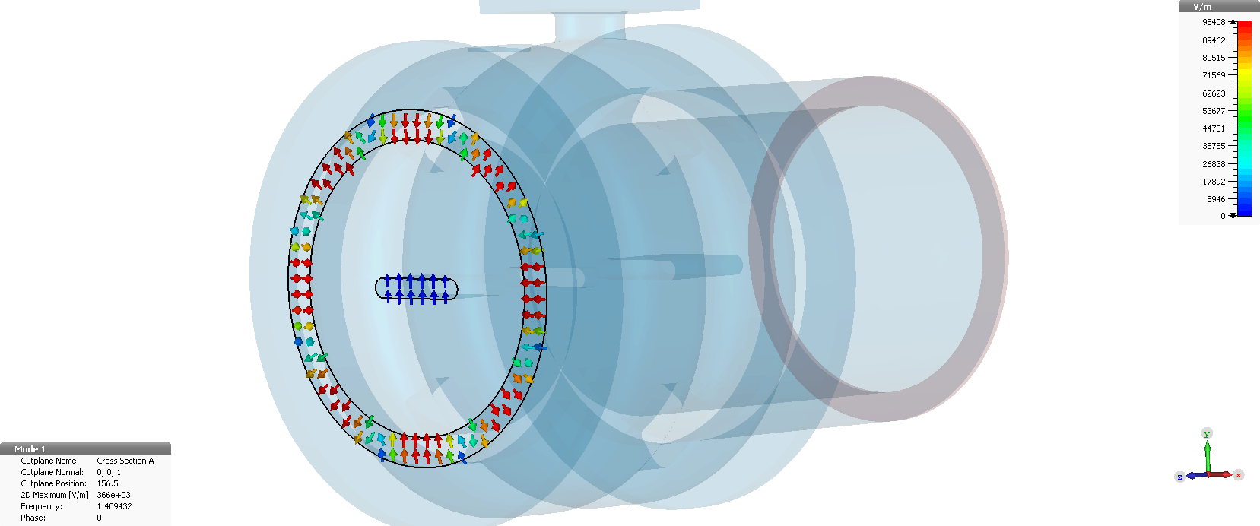
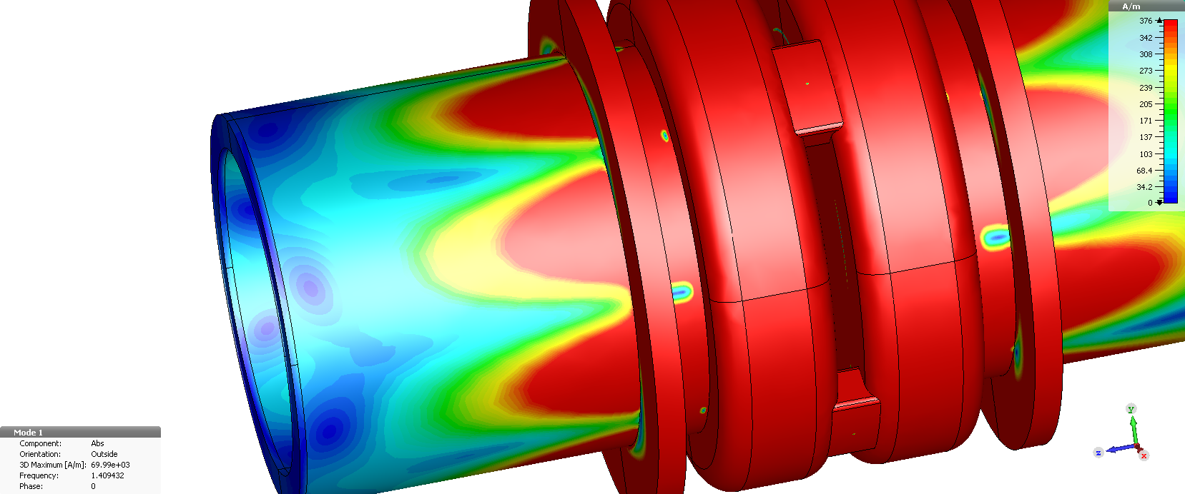

TM020 performances with a real ferrite load
H-Field mode π
E-Field after the choke: TE41
Evanescent mode but able to propagate until the ferrite load: penetration length $≈$125mm!!!
Cut-off: 1450 MHz
Non uniform field in the slot: large field perturbation
Do you remember TE-TM coupling?
Page 12

Slide 13
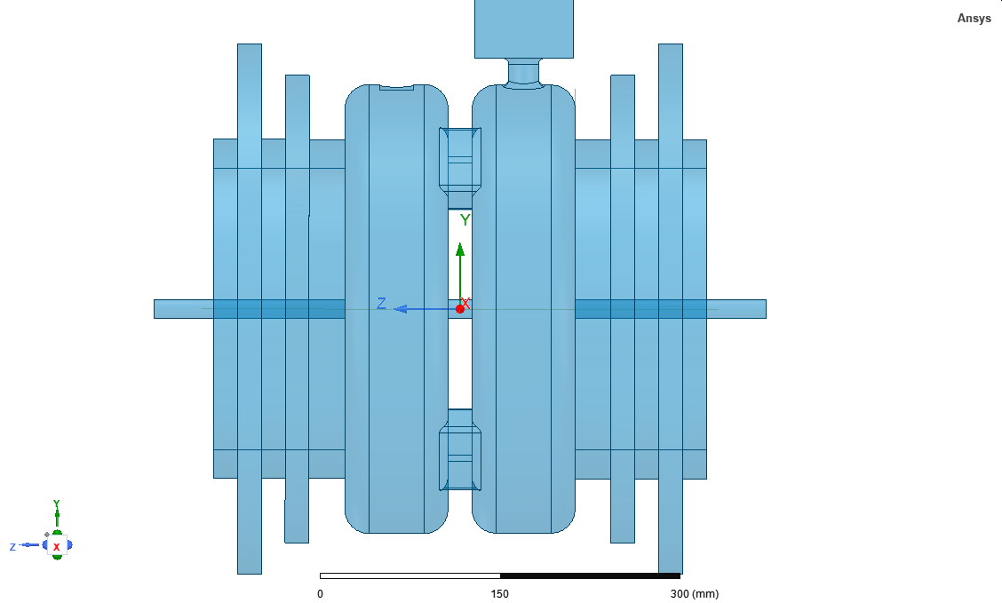
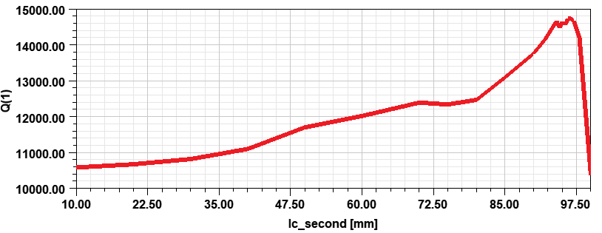
possible solution:
Install an additional choke to filter out the TE41 mode.
Additional choke
Even though the Q₀ is almost recovered:
Longer structure: very difficult to install 4 structures;
With only 3 structures, very difficult to provide for an efficient cooling of the central disk that remains the bottle neck of this design;
The peak of the power density on the ferrite load is still close to the limit of 15W/cm².
lc_second
We have been stacked for a long period to overcome this impasse!
NB: in parallel the development of a single cell solution never stopped!!!

Slide 14
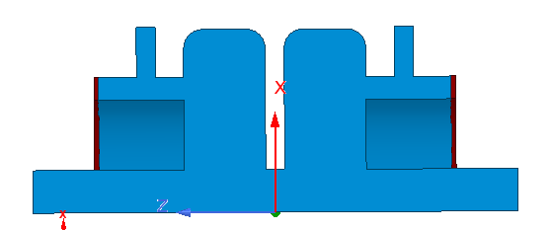
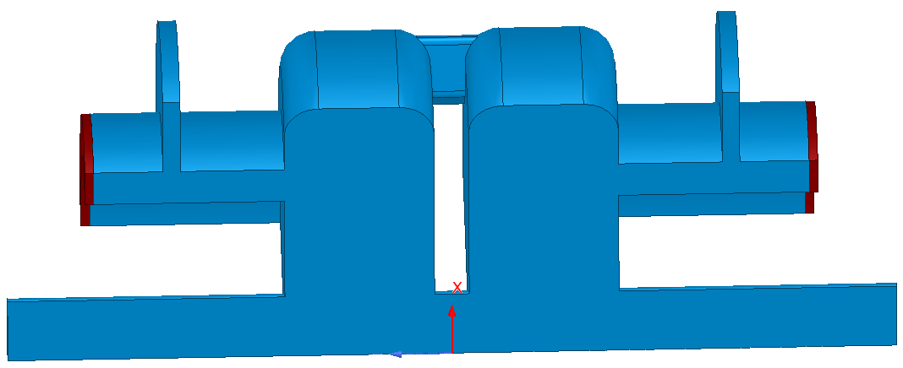
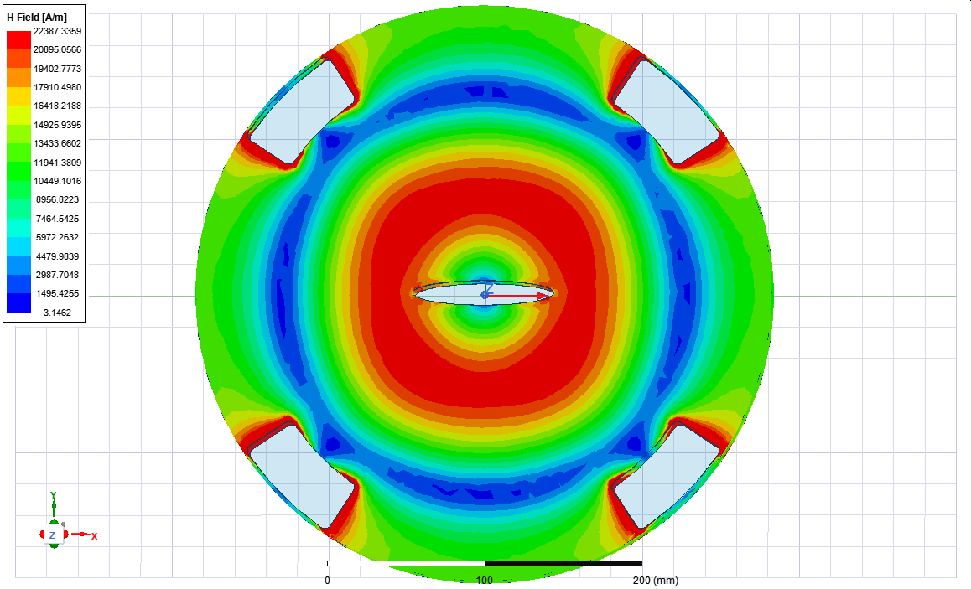
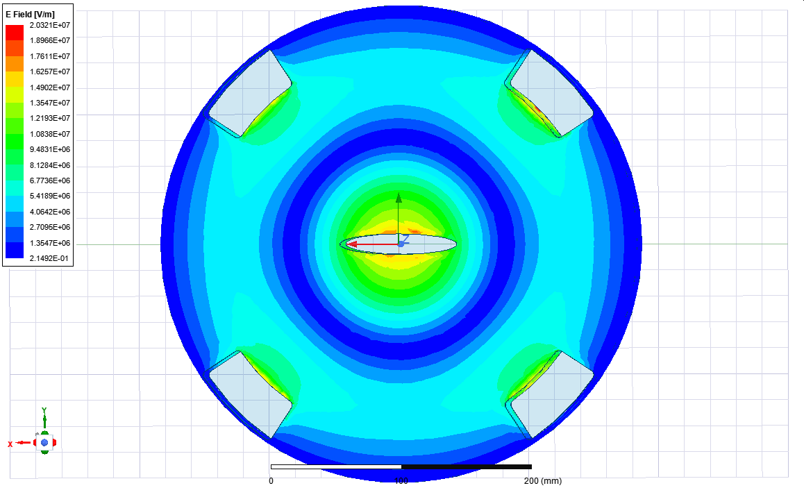


The electric coupling
Magnetic Coupling
Electric Coupling
If the problem comes from the coupling slots, probably the simplest solutions is: to remove those slots and going for an electric coupling ➔ This allows to go for only 3 cavities
Magnetic Coupling
Electric Coupling
H-Field
E-Field
H-Field
E-Field

Slide 15




Effect of the ancillaries: additional stubs
The ancillaries, in particular the coupler/s (main and HOM), make the fields asymmetric again. The perturbation is not that strong as the one induced by coupling slots but is enough to heat locally the ferrite load above the limit threshold of 15W/cm².
The root cause of all our problems is that the coaxial line at 1.40948GHz, supports, besides the TEM, the propagation of 3 TE modes plus the TE41 that even if evanescent, can reach the load.
24W/cm2
* TE41 is evanescent but its penetration length is $≈$125mm ➔ it can reach the load

Slide 16


Longitudinal Impedance
Magnetic Coupling
ESRF 3 Cav
ESRF 4 Cav
ESRF 3 Cav

Slide 17



Again: quite advanced status of the overall design
Coupling | Electric | Magnetic
R/Q (Ohm)/cavity | 65.84 | 88.73
Q₀ | 35054 | 30411
Rs (MOhm)/cavity (Ohm Convention: Rs=V²/2P) | 2.31 | 2.7
Number of cavities | 3 | 3
Power/cavity@500kV (kW) V_{main RF}=6.5MV | 54.2* | 46*
* We contacted a supplier of RF windows who guaranteed that they could provide for windows able sustain up to 75kW CW. Values dropped to 40kW after tests of these windows in other facilities. This implies the use of two couplers is obliged at this stage.

Slide 18




But: Higher harmonic voltage needed!!
Since the beginning we designed the cavity for V_{h_opt}=1.5MV (V_{main_RF}=6.5MV) considering this a suitable margin w.r.t. our present working point of V_{main_RF}=5.5MV (➔V_{h_opt}=1.21MV).
But our beam dynamics colleagues asked for a margin of +10% (after Lee’s studies reviewed to 18% ☺) on top of the V_{h_opt}=1.5MV ➔ severe issues on the cooling of the central disk.
Possible Solutions
Improved 2-Cell cavity
Single Cell cavity
10mm
16mm
20mm
v1
v2
v1
(f_{c}≈3.57GHz)
v2
30mm
(20mm)

Slide 19








Improved 2-Cell cavity design v1
Old
3x2-Cell
New
Old design-500kV
New design-550kV
Structure | Original | Higher Voltage
R/Q (Ohm) | 65.84 | 75.78
Q₀ | 35054 | 34898
Powe/cavity (kW)@500kV | 54.2 | 47.3
Power/cavity (kW)@550kV | 65.5 | 57.2
A second coupler is required due to the limit on the power of the RF window of 40kW CW. Its impact on the Q₀ is negligible. Difficult to provide for 590kV.

Slide 20




Improved 2-Cell cavity design v2
Thickness=20mm
Thickness=30mm
550kV
3x2-Cell
φ_{Cool}=8mm
φ_{Cool}=16mm
Structure | Original | High Volt. v1 | High Volt. v2
R/Q (Ohm) | 65.84 | 75.78 | 72.19
Q₀ | 35054 | 34898 | 31100
Power/coupler (kW)@550kV | 32.75 | 28.6 | 33.7
Power/coupler (kW)@590kV | 37.7 | 32.9 | 38.75
Max T_{Disk} (°C)@550kV | 57.1 | 51.4 | 45.3
Max T_{Disk} (°C)@590kV | - | - | 48.8
30mm
(20mm)

Slide 21

4 single cell TM020cavities, f =1409.45 MHz - Initial design and updated version for overstretching operation - 2 LOM (HOM) damping schemes
Initial design: V_{hhc_tot} = 1.5 MV → V_{hhc} = 375 kV/cavity
Overstretching op.: V_{hhc_tot} = 1.65 MV → V_{hhc} = 413 kV/cavity
1 Ferrite Loaded Coaxial Line for LOM (HOM) damping with 3 stub filters to fully decouple 1.4 GHz TM₀₂₀ accelerating mode for 3st TE coaxial modes with cut off at:
F_{c-TE11} = 370 MHz
F_{c-TE21} = 746 MHz
F_{c-TE31} = 1100 MHz
F_{c-TE41} = 1500 MHz (evanescent at 1.4 GHz)
In both cases - 3 HOM dampers for TM_{m2p} modes and few others HOM…
3 Ferrite Loaded Waveguides for LOM (HOM) damping with only 1 stub filter → simplified stub tuning, to fully decouple 1.4 GHz TM₀₂₀ accelerating mode for 1st waveguide mode with cut off at:
F_{c-TE11} = 867 MHz
F_{c-TE21} = 1734 MHz (evanescent at 1.4 GHz)
(H-Fields)
 | R/Q [W] | Q | R [MW] | Vcav [kV] | Pcav [kW]
Initial | 44 | 33500 | 1.47 | 375 | 48
Updated | 45 | 40500 | 1.82 | 413 | 47
19TH MAC MEETING – 7/8 NOVEMBER 2023 – Paweł BOROWIEC et al
Interesting parameters and design but a second coupler is needed or additional cavities.

Slide 22

Soleil-II case
EBS-ESRF
LCBI Thresholds
SOLEIL-II
SOLEIL-II with Corr
For SOLEIL-II a harmonic system is mandatory therefore a second cavity for redundancy is of great importance. The harmonic cavity must be able to work in passive mode (driven by the beam) and in active mode (driven by an external generator).
Each cavity must provide for 250kV in active mode but a redundancy is required for the passive case ➔ one cavity able to provide at least 425kV with beam ➔ cooling circuit needs to be dimensioned accordingly.

Slide 23



Two options initially proposed
2-Cell Cavity
6 HOM couplers
Single Cell Cavity
60º
60º
Retained
R/Q (Ohm)/cavity | 65.65 (65.4)
Q₀ | 32826 (33054)
Rs (MOhm)/cavity (Ohm Convention: Rs=V²/2P) | 2.16 (2.16)
Number of cavities | 1
Power/cavity/coupler@500kV (kW) | 29 (58)
R/Q (Ohm) | 31.09
Q₀ | 33537
Power/cavity (kW)@V_{h}=250kV | 30
Number of cavities | 2 or 3
Very difficult to provide for a redundancy

Slide 24




Initial design
With SOLEIL we agreed to start a design with R/Q=37Ω/cavity. This parameter is not definitive.
Most critical HOMs

Slide 25



Hom studies
A full campaign to study the effect of several geometrical parameters on the cavity behaviour especially on the HOMs (mainly Z₁ and Z₂). Here below it is just a small example. Please, note that we need to add a third HOM coupler.
x size=30mm
Z₁
x size=40mm
Z₁

Slide 26




With ferrite loads
A third HOM Absorber is needed
Beam pipe vertical size | 32mm
R/Q (Ohm) | 36.6
Q₀ | 31324
Power/cavity (kW)@V_{h}=250kV | 26
Number of cavities | 2
Q₀ is lowered by about 3.3% per HOM coupler

Slide 27



And with tapers (2 cavities)
This is the impedance for 2 cavities with “real” ferrite loads and input/output tapers (no optimization done). TM020 main parameters remains as in slide #32.
120mm
Ferrite Loads

Slide 28
conclusions
The 4th Harmonic Cavity Project remains of a high priority at the ESRF but due to a major budget review has been delayed to 2027;
All the studies performed in the last years on cavities working on a TM020 mode allow a deep understanding of all the weak and strong points of several designs and options;
The main activity of this year is to finalize the design of a TM020 cavity for SOLEIL-II that will allow us to validate the technical aspects of such a design and to finally test the real performances;
The design of the ESRF-EBS cavity will strongly profit from this collaboration and the implementation of the final design between the ones presented during this talk, or in any case very close to, will depend also upon the results of the collaboration with SOLEIL.

Slide 29


Thanks for your attention

Slide 30
Spare slides

Slide 31


TM020 Lumped circuit model
A circuit model is of fundamental importance to guide the design of a multicell structure. Indeed, a chain of resonators when coupled, loose their individuality and the whole system can resonate only at certain frequencies each one characterized by its own field phase advance from cavity to cavity.
We use a double chain of coupled resonators*. Indeed, the TM020 band interacts with its closest neighbour TE band and this interaction needs to be included in the model.
TE
TM
Relation dispersion can be promptly found considering all parameters independent on the cell number m. F is the single cell frequency, f the modal frequency with phase advance φ from cell to cell and k the coupling constant.
* K. Bane and R. Gluckstern, SLAC-PUB-5783, slightly modified to our purposes.

Slide 32



Remainder of the working principle: a simple transmission line model
Choke reflection frequencies:

Slide 33





Optimum choke lengths at 1.40948GHz
TEM
TE11
TE21
TE31
TE41

Slide 34

Pumping ports

Slide 35






HOM Ferrite Load Design
Abs 2
Abs 1
Several shapes have been tested. The best ones are those outlined:
͏Abs 1 exhibits the best S11 parameters in a large frequency range but very complicated shape to be mechanically integrated within the waveguide (especially to provide for coolings); in addition to this, absorbing performances very sensitive to the dimensions of the tip;
͏Abs 2 exhibits very good parameters and is much easier to be integrated within the waveguides: this is the one we select.

Slide 36



Optimization of the Optimum Shape
1
2
L_{taper}
L_{flat}
y_size
Port 1
Parametric analysis of S11 as a function of the quantities in the pictures. We identify two regions that deserve a particular interest:
Region 1 that corresponds to the frequencies of the TM021 mode;
Region 2 where a bump occurs in all cases.

Slide 37



Optimization of the Optimum Shape
1
2
2.25GHz
L_{taper}
L_{flat}
Region 1 is strongly affected by y_size (waveguide cut-off): farther the cut-off, lower the S11. Not a big influence on the Region 2. See the plot right above. L_{taper} and L_{flat}, and, y_size, are completely independent parameters.
The effect of L_{taper} and L_{flat} on the S11 at 2.25GHz (TM021 region) and at 3GHz (“HOM region”) is described by the level curves on the right side (y_size=80mm in this case). We see that while a L_{flat}>45mm gives satisfactory values for both 2.25GHz and 3GHz, a 40mm<L_{taper}<50mm is a good compromise for the two regions. We set then:
L_{flat}=45mm;
L_{taper}=50mm
3GHz
y_size
Port 1

Slide 38




Tuning curves
37Ω
32mm
All these studies provided also for these “tuning” (or “design”) curves that will help to go faster in the final design when the final parameters come up from SOLEIL simulations/studies

Slide 39





Beta coupling variation? Why not
I think is feasible and in air: motorization?
Port 1
AIR
R=30mm
500mm
RF Window
Vacuum
212.4mm
110mm

Slide 40





Multipacting
TEM Choke
Coupling Slot

Slide 41

Basic Cavity description and main tuning knobs
The basic cavity is composed by three main bodies: the Main Cavity where the TM020 mode resonates, the Coaxial line+Choke (or stub) where all the unwanted modes except the TM020 mode (filtered by the choke) can propagate and ferrite loads where LOM+HOMs are absorbed.
The frequency will be, of course, tuned by changing the outer radius of the main cavity. The other main knobs to optimize the main figures of the structure are:
lc and y_coax_pos to maximize the Q0;
R_in used to control the coupling;
R_pipe used to maximize R/Q*.
* Note that large values of R_pipe help to dilute the impedance spectrum (higher HOMs will flow out through the beam pipe).

Slide 42




R/Q, ΔF and Q0 as a function of R_{in}
Working point
Working point
2 x R_in (mm)
2 x R_in (mm)
Imposed by the X-ray trace
Wall thickness=20mm;
R_pipe=15mm.
Working point
Electric coupling vs. magnetic coupling:
~25% lower R/Q;
~17% higher Q.
Hence Rs will be ~12% lower (P_{cav} will increase accordingly).
2 x R_in (mm)

Slide 43



Impedance: max tuner penetration
Total tuning range≅2.05MHz
ESRF 3 Cav
Tuning sensitivity≅102.4kHz/mm
TM020-0 mode pops up when detuning with a single tuner
The penetration of the tuner does not deteriorate the impedance spectrum (on the contrary it looks even beneficial).
However the use of only one tuner unbalance the field flatness that results in an enhancement of the TM020-0 mode impedance that definitely pops up when the tuner is inserted.

Slide 44






An additional complication for SOLEIL: Mode 0 of the TM020
TM020-0
TM020-0
Nominal
Tuner=+20mm
Field Flatness=95%
Field Flatness=70%
In SOLEIL case a possible instability can be generated by the TM020-0 mode in the parking position: it looks mandatory to provide for two tuners to control the Rs of the TM020-0 when detuning.
NB: The impedance is not the same as in previous slide because this is an older version but the considerations here developed do not change.

Slide 45




LOM+HOM Ferrite Losses from GdfidL
* Bunch Form Factor, see V. Dolgashev and S. Tantawi: https://www.osti.gov/servlets/purl/1441166
For 16 bunches, the bunch length had been measured to be 10-12mm** ➔ Power/ferrite ring≅636W.
Considering a total surface of 197.54cm2 per ferrite ring ➔ <Power density>/ferrite ring≅3W/cm² (limit=15W/cm²).
A study of the power dissipation detailed per HOM or band of HOMs is also available (not shown here).

Slide 46

chart of the diss. power on ferrite loads
chart of the diss. power on ferrite loads
From GdfidL for σ_{bunch}=11mm*:
P_{tot in 16B}=1662W ➔ ~3W/cm²
=1270W (LOM+HOM)+392W(TM020)
k_{loss tot}=1.1163V/pC
* Measured bunch length in 16B is around 10-12mm
TM020
P_{in 16B}=392W
K_{loss tot}=0.263V/pC
TM021
P_{in 16B}=226W
K_{loss tot}=0.152V/pC
P_{in 16B}=54W
K_{loss tot}=0.036V/pC
P_{in 16B}=89W
K_{loss tot}=0.06V/pC
Σ _{individ. Modes} =1629W+22W (freq>7GHz)
Choke Ref.
P_{in 16B}=135W
K_{loss tot}=0.091V/pC
NB: this is the total power on both ferrite rings
P_{in 16B}=213W
K_{loss tot}=0.143V/pC
TM010
P_{in 16B}=380W
K_{loss tot}=0.255V/pC
P_{in 16B}=68W
P_{in 16B}=12W
P_{in 16B}=60W
Power dissipation profile on ferrite load has been detailed for the red, named, modes (not shown in this presentation)

Slide 47





Dedicated script to analyse in detail LOM+HOM loads
Wakefield FFT
Core
This script was conceived to evaluate the weight of the 1st HOM dipole band w.r.t. the “higher” HOM dipole bands in the transverse wakefield of CLIC DDS linacs.
The “raw” output data of GdfidL (basically wakefield+bunch distribution) are used to perform a home-made FFT (that includes also features like 0-padding of the data). The idea was to window (a very simple rectangular window) the bands of interest in the frequency spectrum and to FFT, to obtain the corresponding wakefield contribution.
Here the core of the script remains the same (just some minor modification/improvement). The evaluation of the loss factors and corresponding power loss calculations have been added.
Kloss, Power loss
New

Slide 48






Reproducing GdfidL results
One of the first test to be done is to verify that, if the full spectrum is windowed, one gets back the original GdfidL wakefield (σ=5mm).
ΔU_{script}=1.9275332e-12 VAs
ΔU_{GdfidL}=1.9273e-12 VAs
The effect of the windowing can be only seen in the bottom plot on the left. However the impact on the final signal is negligible and indeed ΔU is the same at the third digit.
The script can work either using the whole symmetric (mirrored) spectrum or with one half, the result is exactly the same. However working with only half spectrum is much easier and avoids any possible issue coming from a bad mirroring of the windowed signal (namely shift in phase of the reconstructed wakefield).
NB: Bunch data are also coming from GdfidL but they are scaled for plotting purposes. To get the correct values a scaling factor, SF=1/(sqrt(2*pi)*sigma)*1e-12*1/FAC must be applied, where FAC can be found in the output file of GdfidL.

Slide 49





Single mode (TM020)
The energy change calculated by the script matches rather good with the calculation of HFSS by applying a form factor (Gaussian).
ΔU_{TM020}=0.2857e-12 VAs (σ=5mm)
From HFSS:
ΔU_{TM020}=0.2914e-12 VAs (No Form Factor)
ΔU_{TM020}=0.28512e-12 VAs (Form Factor, σ=5mm)

