Slide 1
3rd Harmonic Active EU-HOM damped cavity commissioning results
P. Solans on behalf of ALBA, HZB and DESY
19/03/2024

Slide 2
Outlook
Introduction
Motivation
History
Test with beam
Voltage stability
HOM dampers capability
Single bunch Touschek lifetime
Multibunch current test
Maximum voltage with beam
LLRF control loop
Summary

Slide 3
Introduction

Slide 4
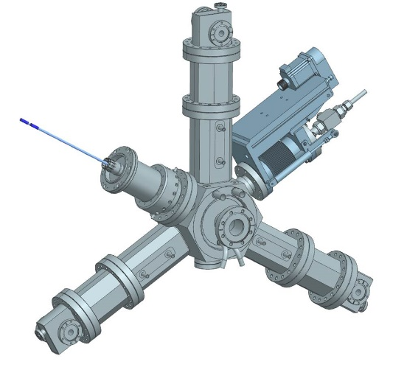
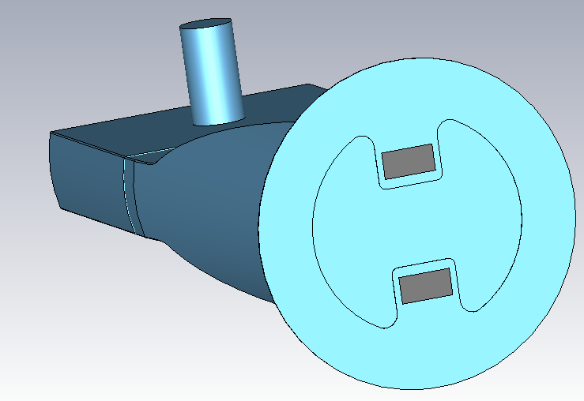
Active harmonic system motivation
Harmonic system needed for upgrade ALBA-II for lifetime improvement.
Allows lengthening in the full current range, either multibunch or single bunch.
Better precision of the amplitude and phase due to control loop.
Feedback compensation for instabilities and transient beam loading.
ALBA solution is an optimized down scaled version of the 500 MHz HOM Damped EU cavity with HOM waveguide to coaxial transitions: Transdampers.
Harmonic EU-HOM damped cavity
Transdamper

Slide 5
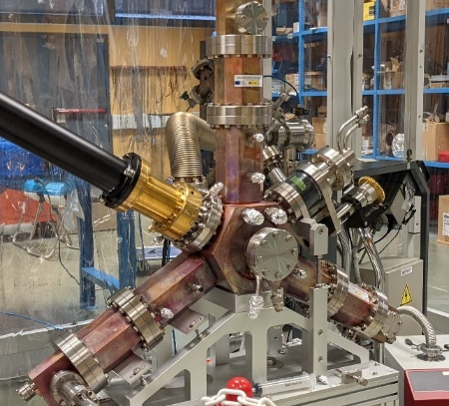
History
2015: ALBA starts 3HC design.
September-19: Prototype construction awarded to AVS-VITZRO
December-21: SAT approved at ALBA
Feb. to April-22: Bead-pull and high power conditioning.
May-22: 3HC installed in BESSY-II.
Parameter | Value
Frequency | 1499 MHz
Tuning range | 12.4 MHz
Qo | 13000
Shunt impedance | 1.1 MOhm
Maximum voltage | 200 kV*
Installation length | 0.3 m
Cavity during the SAT at ALBA
*by design
Cavity installed in BESSY-II
Notes:
Bead pull measurements confirmed the shunt impedance and quality factor for fundamental mode.

Slide 6
Test with beam

Slide 7
Voltage stability
The voltage precision over time (amplitude and phase) with beam was assessed, both in passive and active operation modes
The maximum voltage deviation in active mode is 1.1 kV, 3.5 smaller than in passive mode
By working in active mode, voltage setting can be set closer to instability threshold, therefore increasing the lengthening performance.
RMSD = ± 0.14 kV
Precision = 0.12 %
ΔV max = 1.1 kV
RMSD = ± 1.1 kV
Precision = 0.85 %
ΔV max = 3.9 kV
Data and graphs courtesy: I. Bellafont, ALBA
Notes:
Recorded during 1 hour

Slide 8
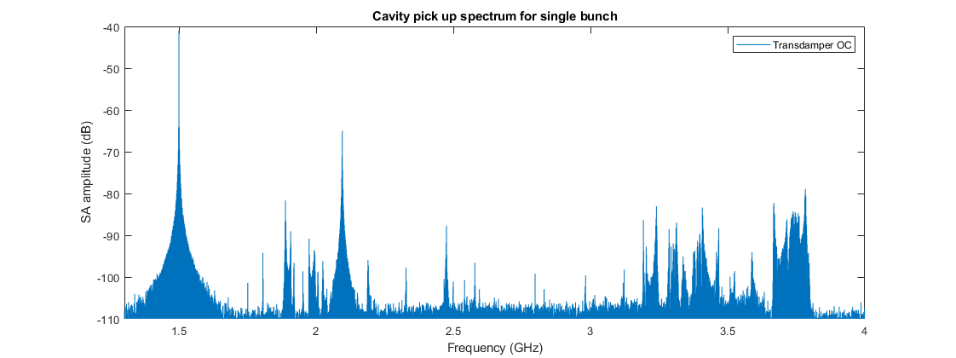
HOM dampers
Pick up antenna spectrum in single bunch operation w/o Transdamper termination.

Slide 9
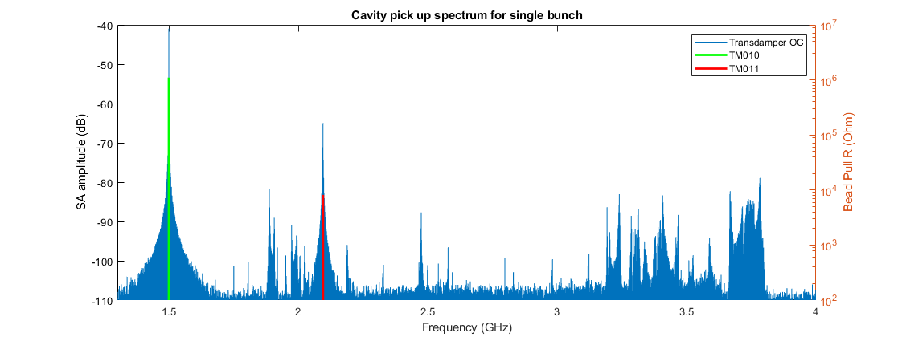
HOM dampers
Pick up antenna spectrum in single bunch operation w/o Transdamper termination.
TM010 and TM011 clearly identified as during the bead-pull measurements.
Bead pull data courtesy from A. Matveenko, HZB
CST mode study courtesy from W. Müller, TEMF

Slide 10
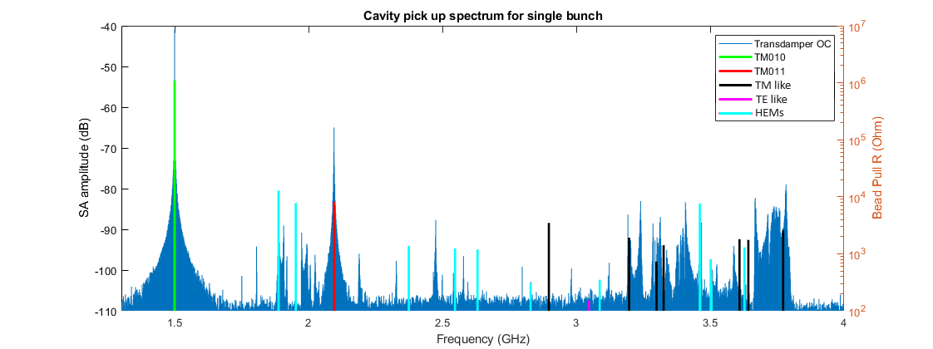
HOM dampers
Pick up antenna spectrum in single bunch operation w/o Transdamper termination.
TM010 and TM011 clearly identified as during the bead-pull measurements.
TM, TE and hybrid modes (HEM) present due to strong Transdamper coupling are also observed.
Bead pull data courtesy from A. Matveenko
CST mode study courtesy from W. Müller, TEMF

Slide 11
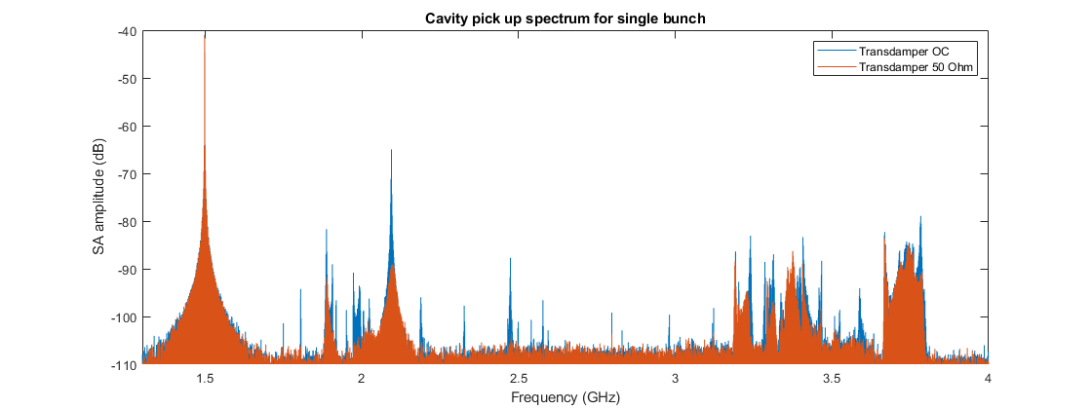
HOM dampers
Spectrum recorded with Transdamper terminations in order to evaluate the damping capability.

Slide 12
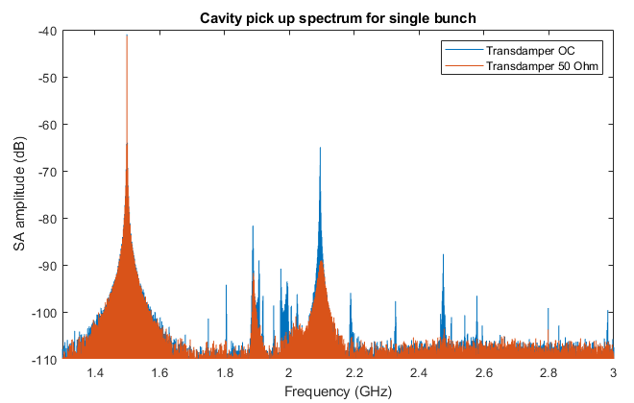
HOM dampers
Spectrum recorded with Transdamper terminations in order to evaluate the damping capability.
A reduction of >65% of the associated Q_{L} to the higher order modes (HOMs) was measured below 3 GHz.
TM010 fitting
TM011 fitting
Mode | Frequency | Frequency shift | Q_{L} reduction
TM010 | 1.5 GHz | 26.5 kHz | ~10 %*
TM011 | 2.09 Mhz | 5 MHz | 93 %
* large fitting error
Fitting analysis courtesy from J. Ocampo, ALBA

Slide 13
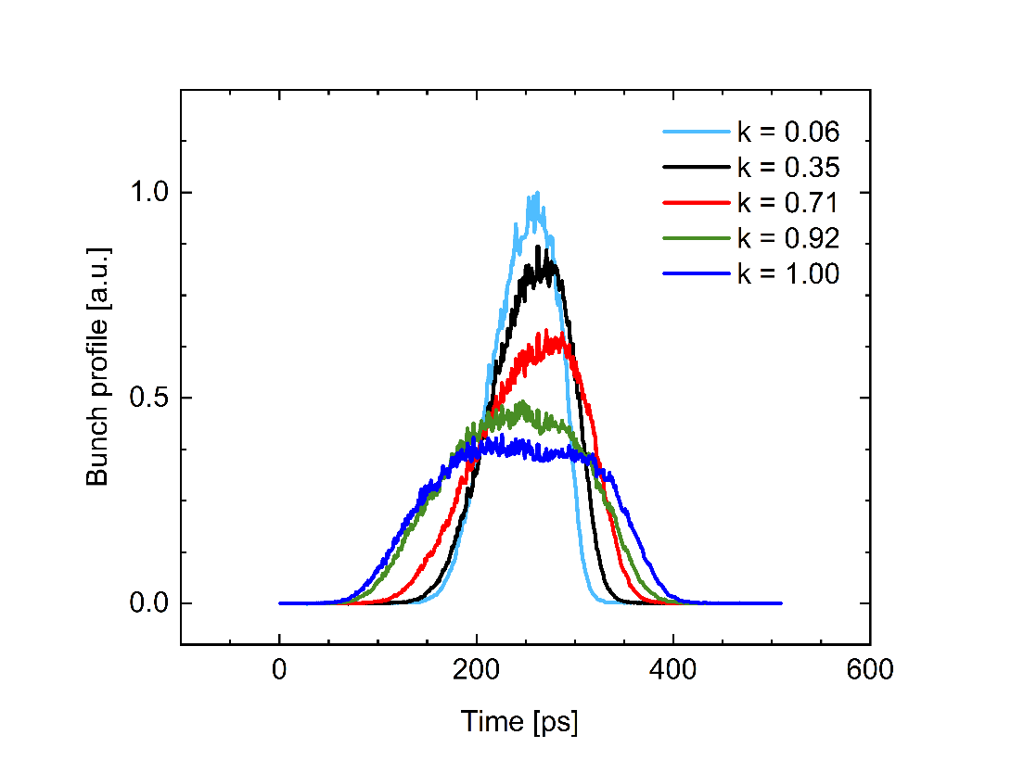
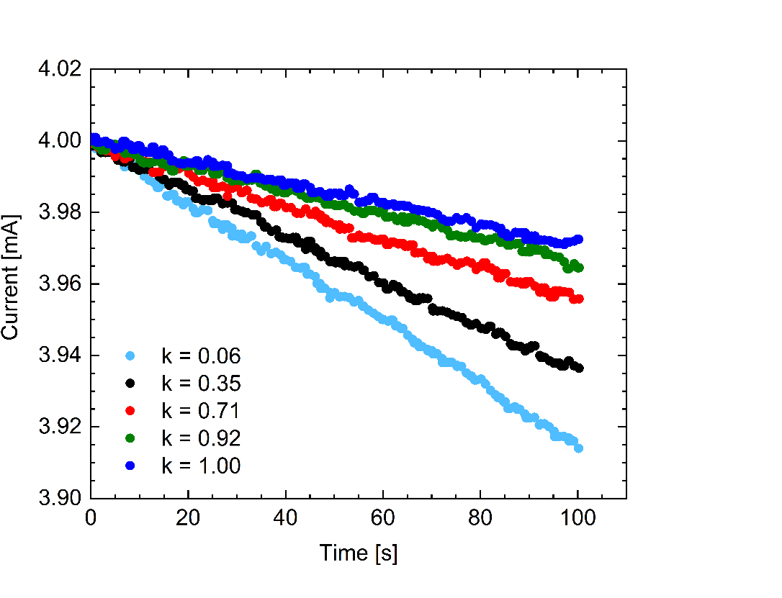
Single bunch: touschek lifetime
Single bunch lifetime measurement performed at different lengthening factors.
Touschek lifetime increased factor 3.
Gas scattering lifetime component evaluated and subtracted by spreading the same amount of current in homogeneous filling pattern.
Main RF = 450 kV, Max. harmonic RF = 130 kV
x3
Single bunch
Single bunch
$$k=\frac{V_{h}}{V_{h opt }}$$
τ_{T} =4.31 h
τ_{T} =3.62 h
τ_{T} =2.66 h
τ_{T} =1.79 h
τ_{T} =1.36 h
Graphs courtesy from I. Bellafont, ALBA

Slide 14
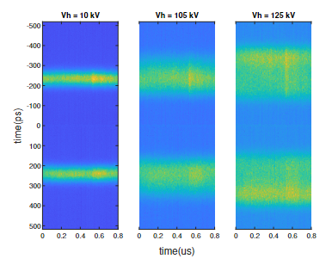
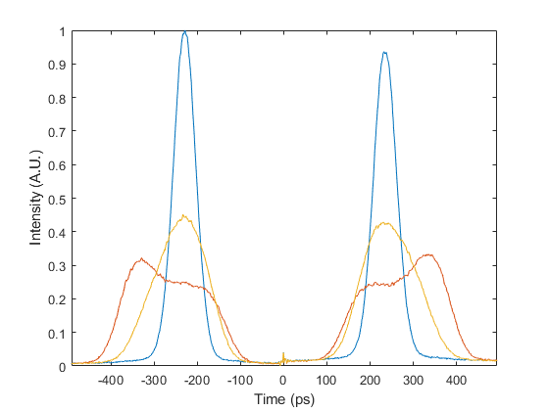
Multibunch current test
Lengthening performance tested in the high current regime under homogenous filling pattern.
Two strategies were applied
Increase current at flat potential
Drop main RF voltage at high current
Undetermined instability prevented to reach 300 mA in perfect flat potential (k=1).
Reason is still under study:
Mode-1 (PTBL).
DC-Robinson
Main and harmonic DLLRF loop crosstalking
???
Homogeneous filling pattern
# | Current | Main voltage | Harmonic voltage | k
1 | 60 mA | 460 kV | 130 kV | 1.0
2 | 300 mA | 615 kV* | 130 kV | 0.75
*corrected from previous presentations!!
12 mA, 400 kV main RF voltage

Slide 15
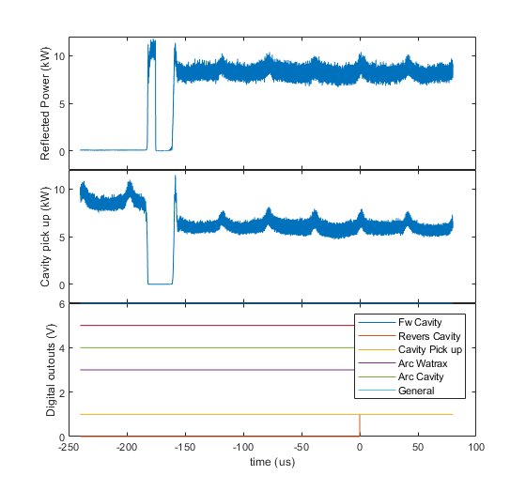
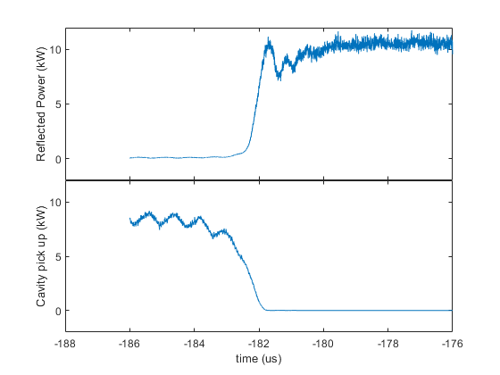
Maximum voltage with beam
During conditioning in HZB bunker (HoBiCat) stable 14 kW operation demonstrated during 60 hours (V = ~140 kV).
No higher voltages achieved due to SSPA power limitation.
Operation with BESSY-II parameters (300 mA and 10 % gap) is stable for voltages < 140 kV.
Interlock example 1: Reflected power at 160 kV
Notes:
Some interlocks have been triggered so far at higher voltages. More conditioning with beam is needed.

Slide 16
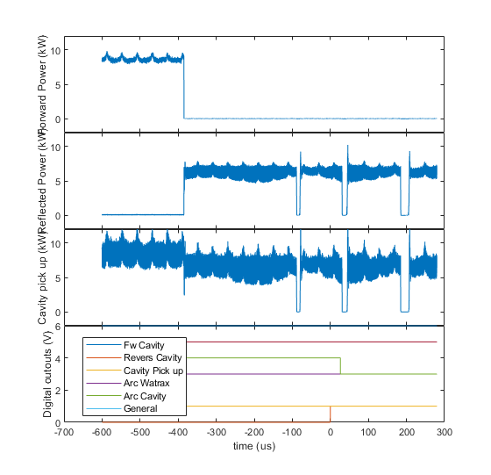
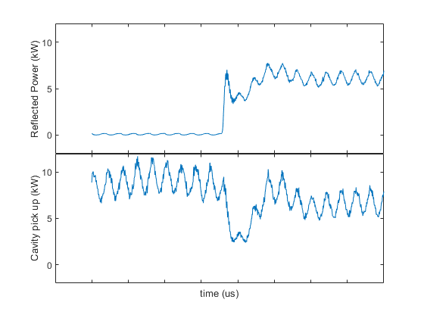
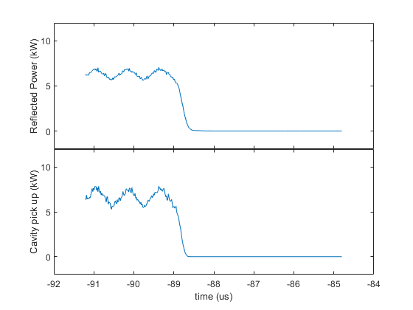
Maximum voltage with beam
During conditioning in HZB bunker (HoBiCat) stable 14 kW operation demonstrated during 60 hours (maximum voltage is 140 kV ~160 kV).
No higher voltages achieved due to SSPA power limitation.
Operation with BESSY-II parameters (300 mA and 10 % gap) is stable for voltages < 140 kV.
Interlock example 2: Reflected power with light detected at 140 kV
Notes:
More conditioning with beam is needed.

Slide 17
LLRF: Constant Power Phase Loop
CPPL keeps the forward power amplitude constant and controls the cavity voltage amplitude by means of forward power phase.
Bunch length control in the NSLS VUV ring, R. Biscardi, Nucl. Instrum. Methods Phys. Res. A 166 (1995) 26-30

Slide 18
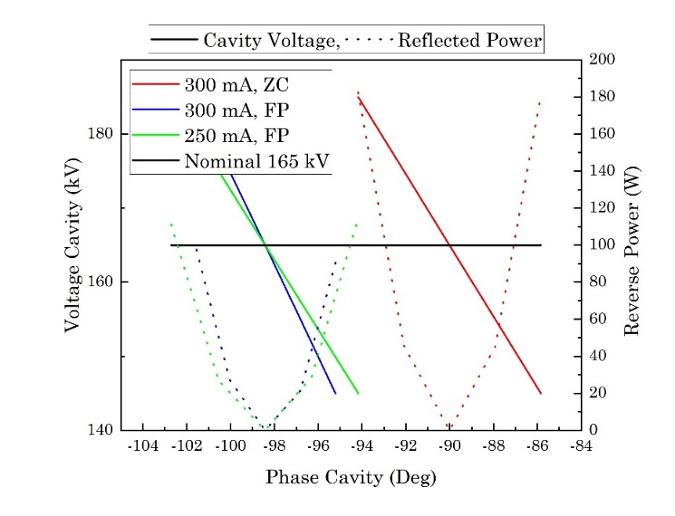
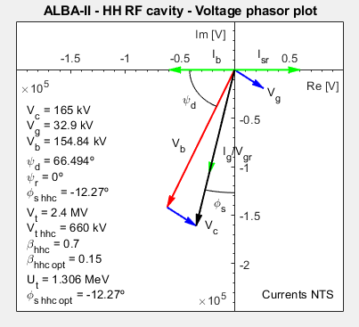
LLRF: Constant Power Phase Loop
CPPL keeps the forward power amplitude constant and controls the cavity voltage amplitude by means of forward power phase.
It is useful for main RF voltages sweeps or transients in the beam, to keep the harmonic phase locked to beam phase.
Assuming the total current to be constant, it compensates for the beam loading.
Bunch length control in the NSLS VUV ring, R. Biscardi, Nucl. Instrum. Methods Phys. Res. A 166 (1995) 26-30

Slide 19
Summary
An active harmonic cavity at 1.5 GHz has been design and built by ALBA and tested under the ALBA/HZB/DESY collaboration.
Active harmonic system can lead to better amplitude and phase precision.
Transdamper HOM associated Q_{L} damping is > 65% for frequencies up to 3 GHz.
Touschek lifetime component increased by a factor x3.
Maximum homogenous filling pattern current is 60 mA in flat potential conditions. Limiting factor still to be identified.
Some trips during operation at high current seem to point to more conditioning with beam is needed.
Constant Power Phase loop is able to track beam phase and therefore, to keep the cavity voltage constant despite the beam loading changes due to phase.

Slide 20
Acknowledgments
The prototype design was co-funded by ALBA and the CERN through the collaboration agreement KE2715/BE/CLIC for the development of CLIC Damping Ring Technologies (2015-2018).
The prototype construction was co-funded by ALBA and the European Regional Development Fund (ERDF) within the Framework of the Smart Growth Operative Programme 2014-2020.
The prototype tests were co-funded by ALBA, HZB and DESY through the collaboration agreement RCN-CIN202100124 (2020-2023).
Team:
HZB: W.Anders, T.Birke, J.Borninkhof, M.Dirsat, V.Dürr, M.Edling, D.Engel, H.Hoffmann, H.Huck, S.Keckert, S.Klauke, O.Kugeler, V.Laux, T.Löwner, A.Matveenko, I.Müller, L.Pichl, F.Pflocksch, M.Ries, D.Rückert, A.Schälicke, L.Shi, G.Schiwietz, B.Schriefer, M.Schuster, H.Stein, T.Struppert, Y.Tamashevich, A.Tsakanian, A.Velez
DESY: K.Cottel, M.Ebert, N.-O.Fröhlich, K.Heuck, P.Hülsmann, R.Onken
TEMPF: W.Müller
ALBA: I.Bellafont, B. Bravo, A.Gomez, J.Ocampo, F.Perez, A.Salom, P.Solans

Slide 21
Summary
Thanks for the attention

