Slide 1
Experimental Documentation of the Mode-1 Instability driven by Landau Cavities
Francis Cullinan, Åke Andersson, Jonas Breunlin, Miriam Brosi,
Pedro Fernandes Tavares
(MAX IV Laboratory, Lund, Sweden)
HarmonLIP, ESRF, Grenoble, March 2024.

Slide 2
Overview
MAX IV 3 GeV ring and its Landau cavities
Mode 1 instability
Mode 1 at MAX IV
Dedicated measurements

Slide 3
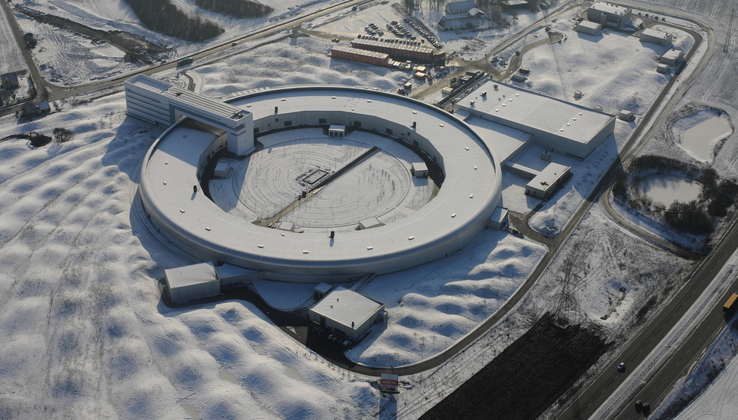
MAX IV 3 GeV Ring
Parameter | Value
RF frequency (MHz) | 100
Landau-cavity (LC) harmonic | 3
Shunt impedance per LC (MΩ) | 2.75
HC quality factor | 20800
Delivery beam current (mA) | 400
RF voltage (MV) | 1.0
Natural RMS bunch duration (ps) | 40.4
…with ideal HC lengthening (ps) | 199
Harmonic number | 176
Number of main (landau) cavities | 5 (2)

Slide 4
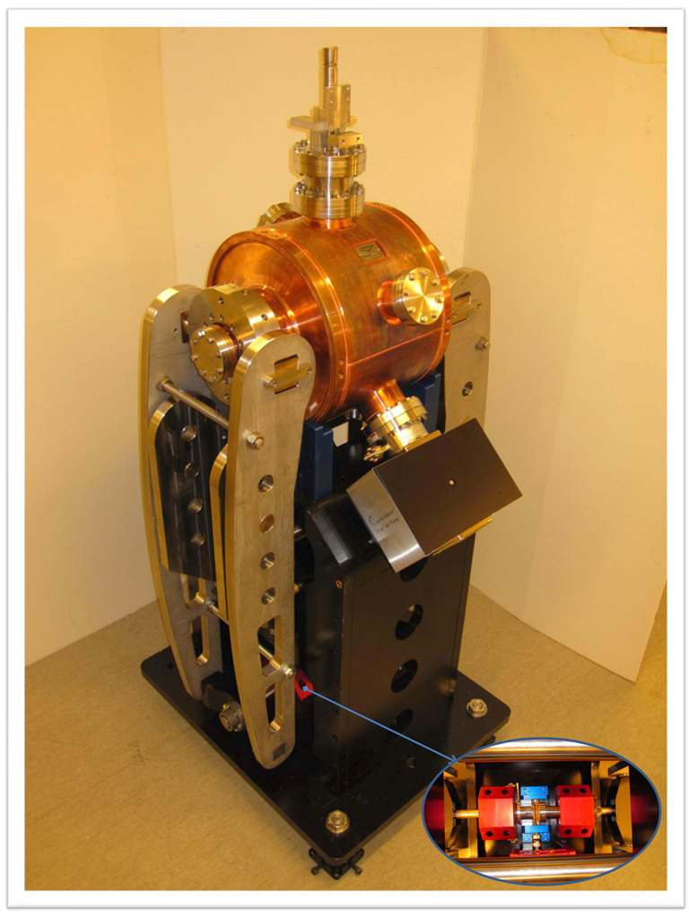
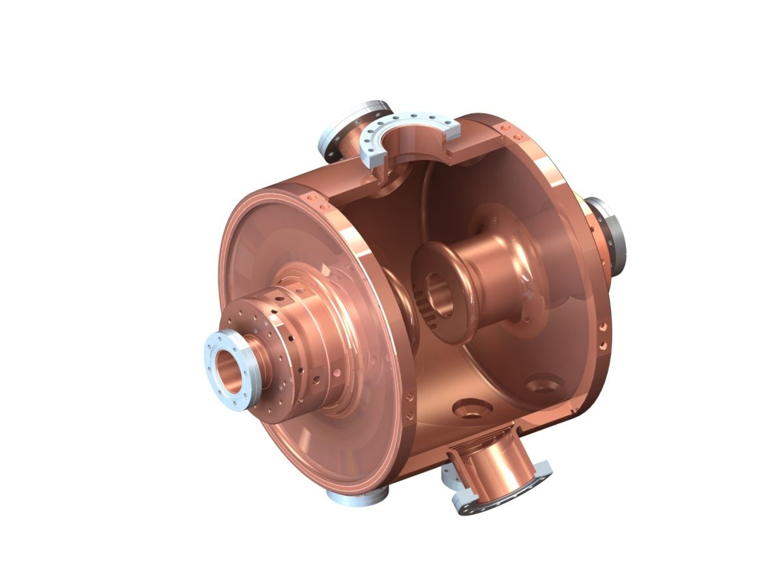
Our 300 MHz 3rd Harmonic Cavities
Å. Andersson
Inner length/diameter: 312mm/400mm
Theory R_{sh}/Q: 2.85 MΩ/21600
(Definiton: R_{sh} = V²/2/P)
Measured Q: Around 20900 ➔
R_{sh} = 2.75 MΩ
Mechanical design, Elsayed Elafifi, MAX-lab

Slide 5
Mode 1

Slide 6
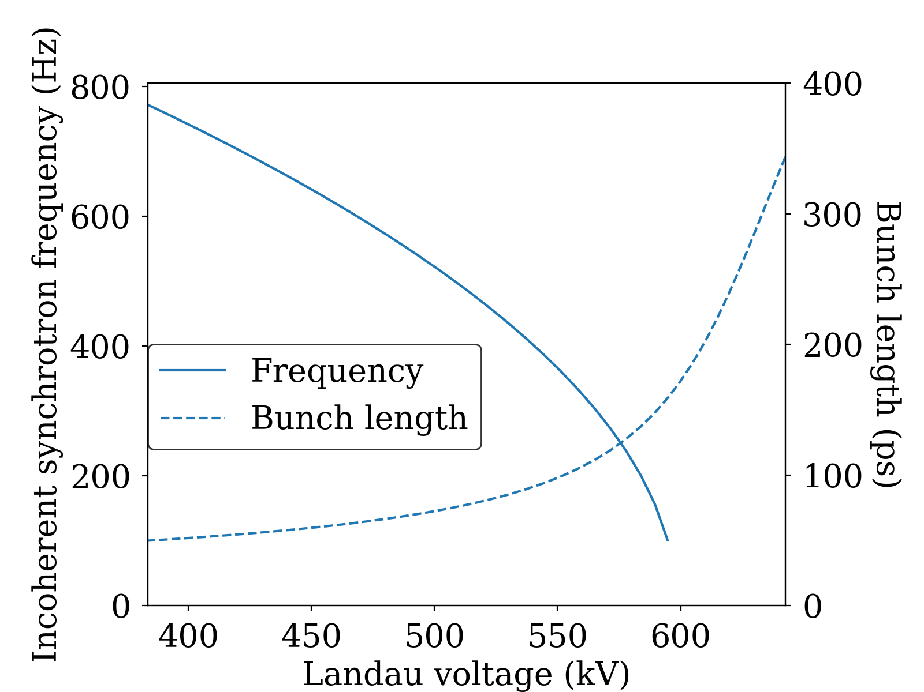
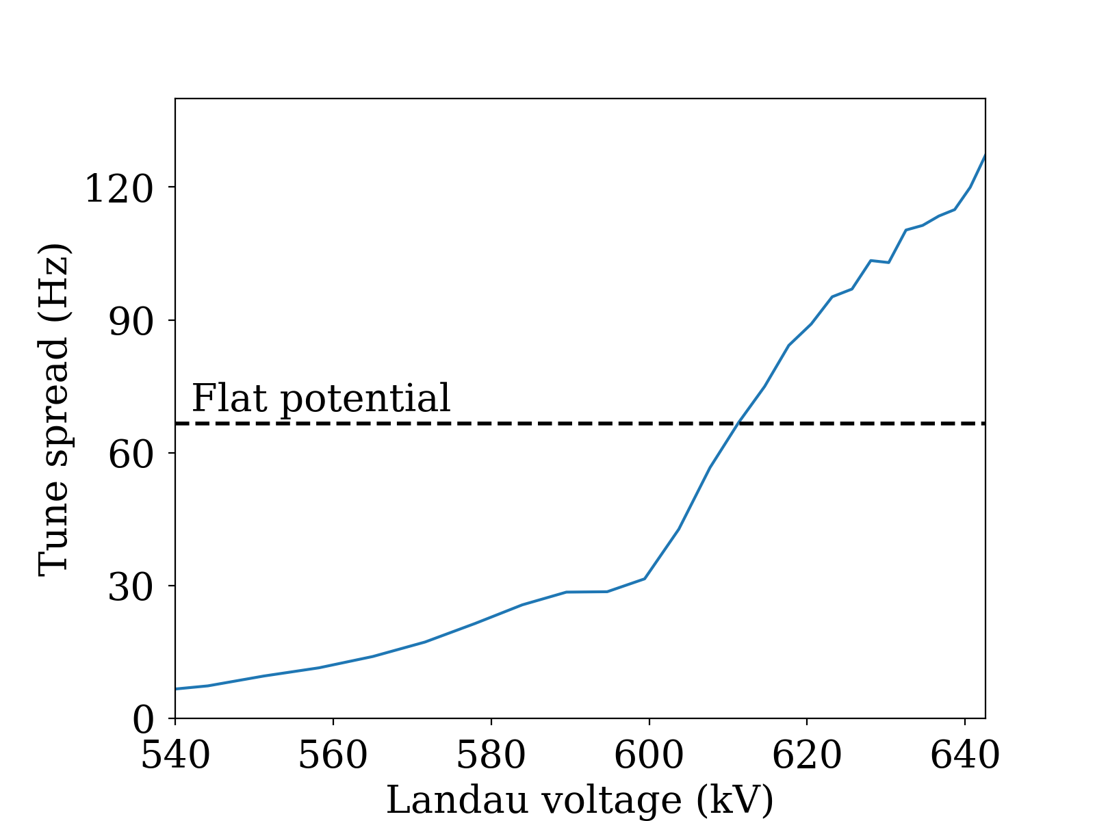
Synchrotron tune
MAX IV parameters, 500 mA current
Main RF voltage, 1.8 MV (flat potential with 3 LCs)
T. Olsson, F. Cullinan & Å. Andersson, PRAB 21 120701 (2018)
P. F. Tavares, Å. Andersson, A. Hansson & J. Breunlin, PRSTAB 17 064401 (2014)
Notes:
Plots
Incoherent synchrotron tune and intrabunch tune spread as a function of HC detuning + bunch length
Two cases: Flat potential vs. Semiflat

Slide 7
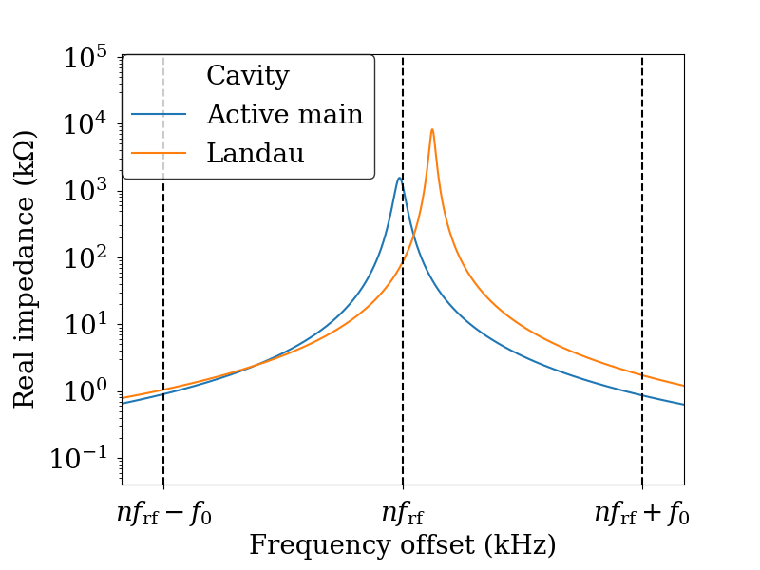
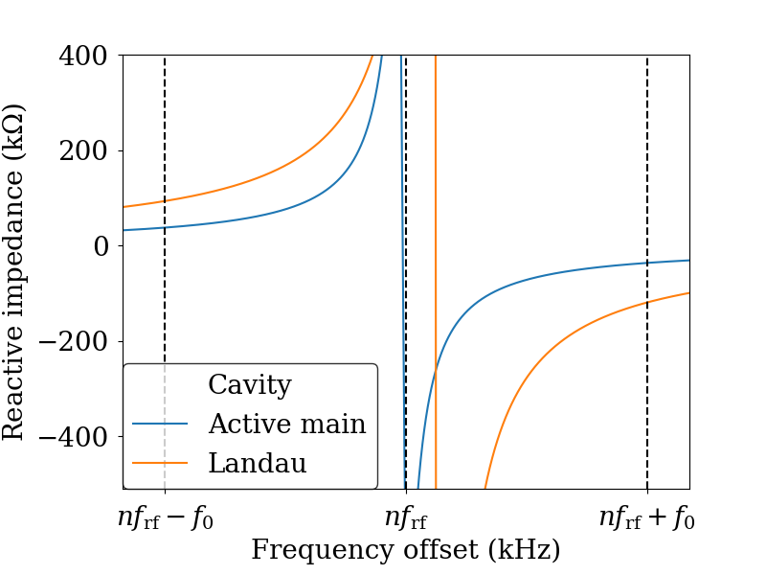
Impedances
3 Landau cavities, flat potential at 200 mA with RF voltage of 1 MV
Notes:
Check image impedances (2 or 3 Landaus?) and remove the parked main cavity

Slide 8
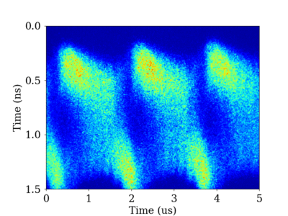
Mode 1 Instability
Characterised by low coherent frequency
Sometimes referred to as ‘periodic transient beam loading’*
R. A. Bosch, K. J. Kleman & J. J. Bisognano, PRSTAB 4 074401 (2001).
M. Venturini, PRAB 21, 114404 (2018).
A. Gamelin, 8th LER Workshop, Frascati (2020, remote).
*T. He, PRAB 25 024401 (2022).

Slide 9
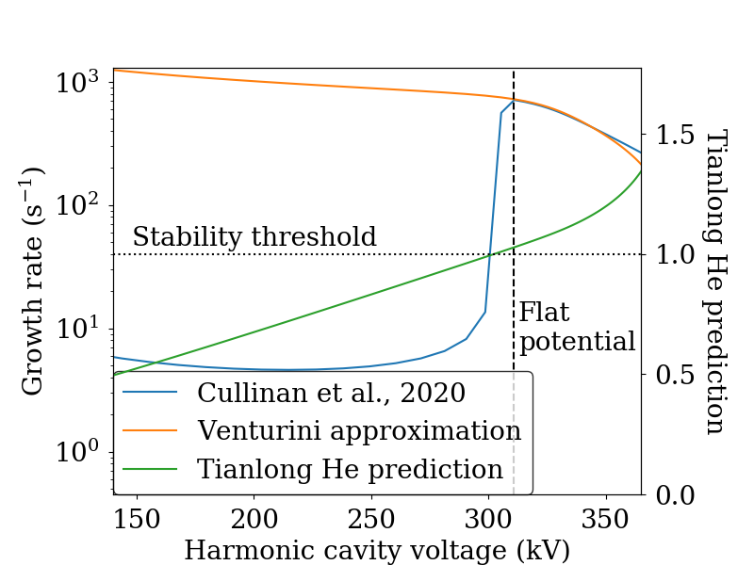
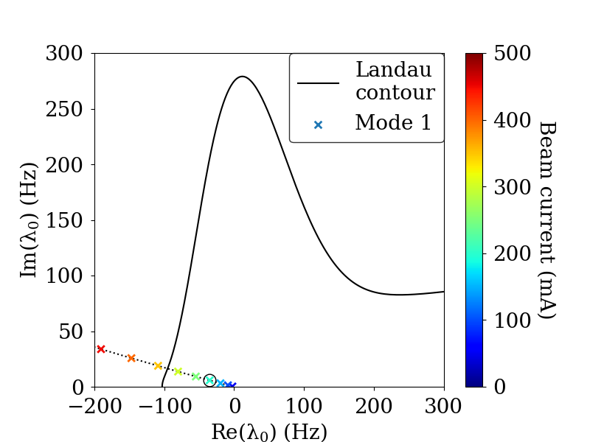
Mode 1 approximations
Landau damping
200 mA current,
Vrf=1 MV
200 mA
F. J. Cullinan, Å. Andersson & P. F. Tavares, PRAB 23 074402, (2020).
M. Venturini, PRAB, 21 114404, (2018).
T. He, W. Li, Z. Bai, and W. Li, PRAB, 26 064403, (2023).
S. Krinsky & J. M. Wang, Part. Accel. 17 109 (1985)
R. R. Lindberg, PRAB 21 124402 (2023).

Slide 10
Mode 1 at MAX IV

Slide 11
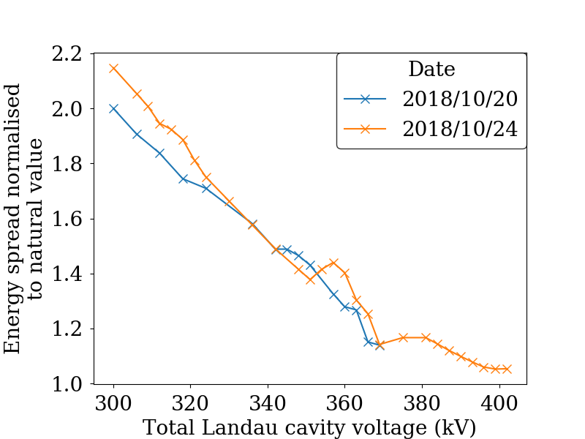
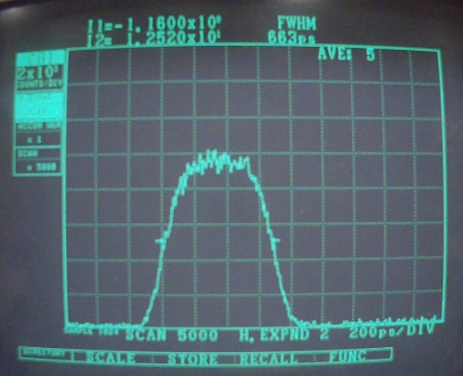
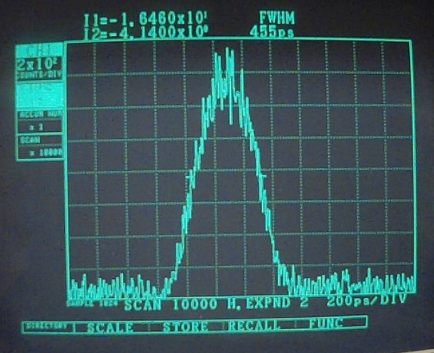
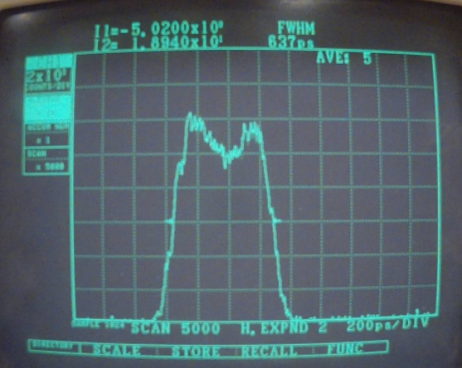
IPAC 2020: Suppression of Coupled Bunch Instabilities and Bunch Lengthening
149 mA current,
uniform fill
Slow-oscillating coupled-bunch mode:
Bucket number
At lower current → stable beam, flat potential conditions
F. Cullinan, Å. Andersson, and
P. F. Tavares, IPAC2020, WEVIR05.
Notes:
Need to distinguish high current and low current cases somehow DONE
Remake plot and if possible, one plot for high current, one for low. Get rid of OSO images.
Fix the black and blue screenshot
Put in a flattened profile for 57 mA

Slide 12
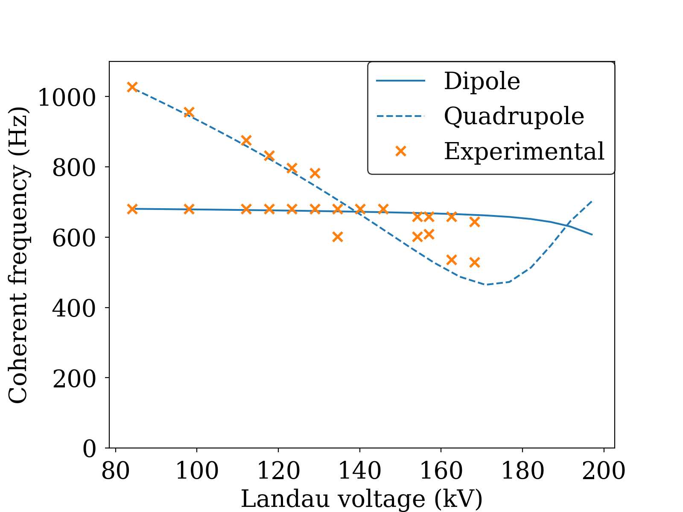
Mode Coupling Investigations
Theory: R. A. Bosch et al, PRSTAB 4 074401, 2001
Excitation by Dimtel bunch-by-bunch feedback system, response observed on spectrum analyser
Experimental LC voltage rescaled (possible calibration error)
Mode 0 damper* required to suppress instability caused by coupling of Robinson modes
Now FPGA based and using 2 main cavities as actuators
*D. McGinnis, LLRF2019/218, LLRF 2019, Chicago.

Slide 13
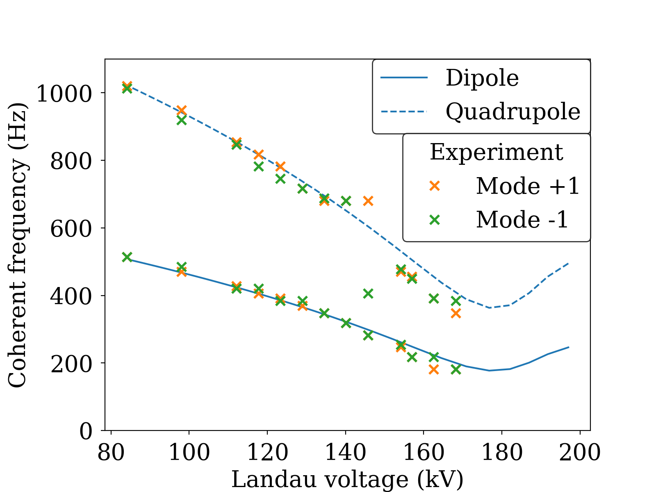
Mode Coupling Investigations
Theory: R. A. Bosch et al, PRSTAB 4 074401, 2001
Excitation by Dimtel bunch-by-bunch feedback system, response observed on spectrum analyser
Experimental LC voltage rescaled (possible calibration error)

Slide 14
Diagnostics
Streak camera
Bunch by bunch phase detection
Fill-Pattern monitor
Hamamatsu
Dimtel Inc.
PicoQuant

Slide 15
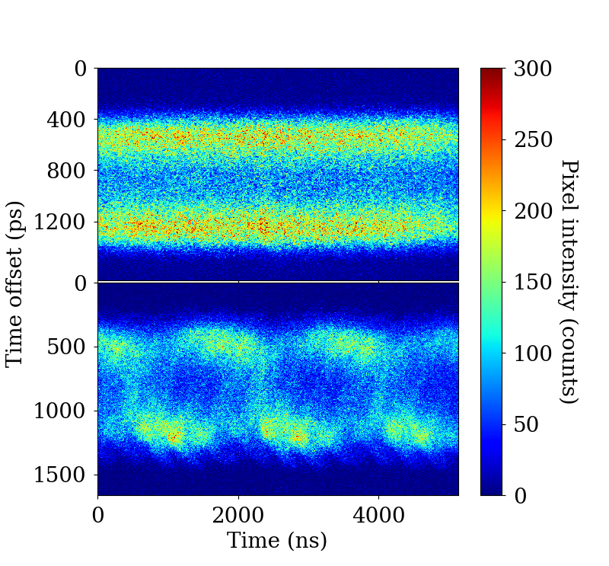
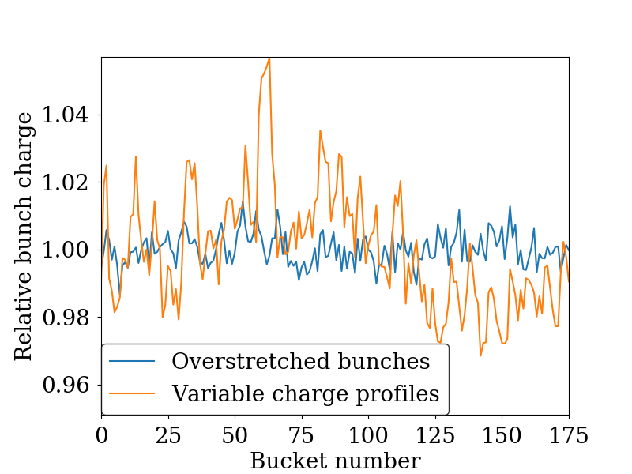
Fill Pattern Considerations
2 Landau cavities,
RF voltage of 1.13 MV,
300 mA
Inhomogeneous beam loading can look like Mode 1 instability and alter threshold

Slide 16
Measurements with 3 Landau cavities

Slide 17
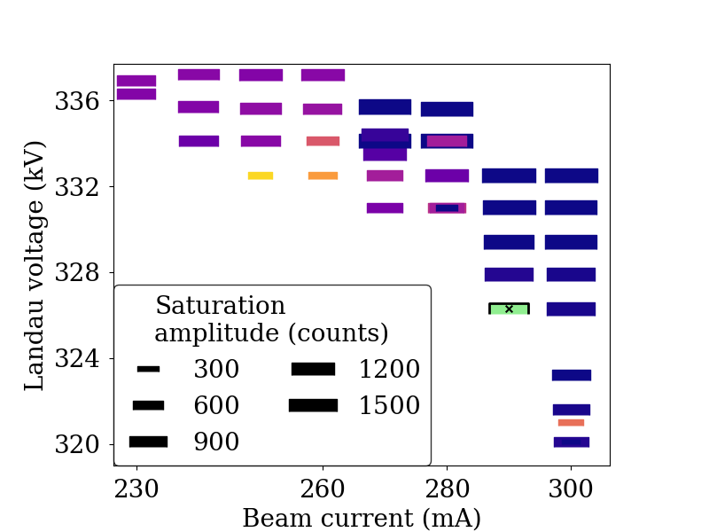
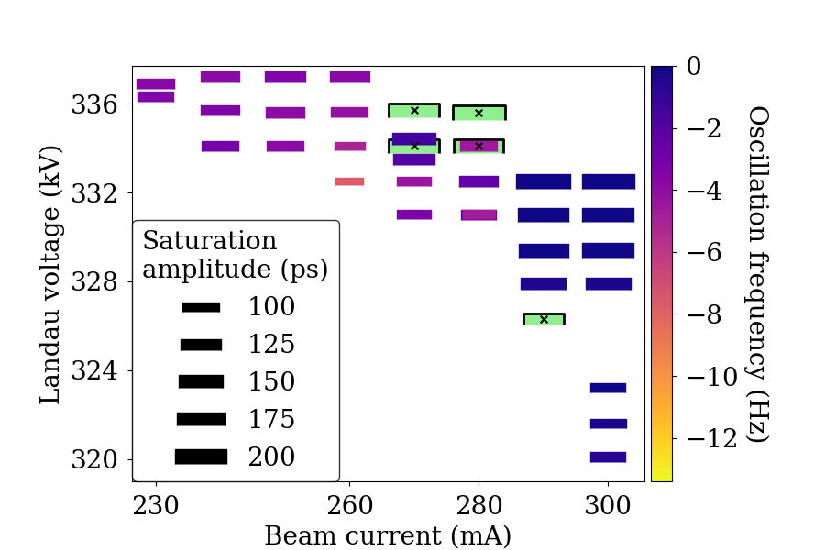
Three Landau Cavities
3 Landau cavities and an RF voltage of 1 MV
6 main cavities (5 active, 1 parked)
Bunch-by-bunch phase detection
Streak camera

Slide 18
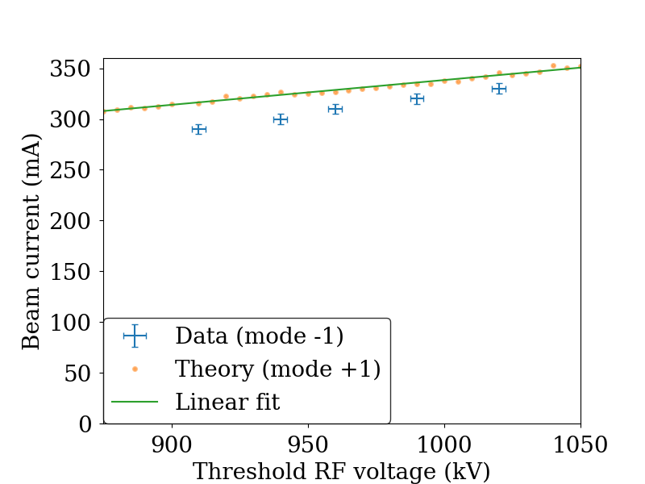
Flat potential conditions
3 Landau cavities
Notes:
Replace with image without Tianlong He prediction

Slide 19
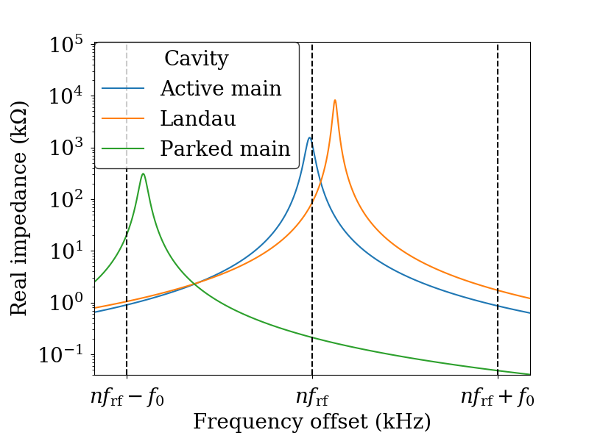
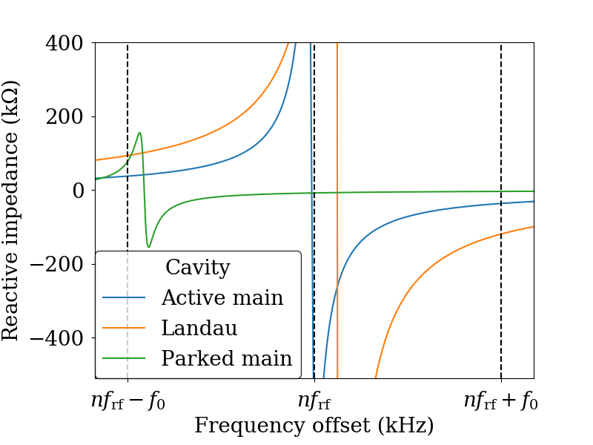
Parked main cavity
3 Landau cavities, flat potential at 200 mA with RF voltage of 1 MV

Slide 20
Measurements with 2 Landau cavities

Slide 21
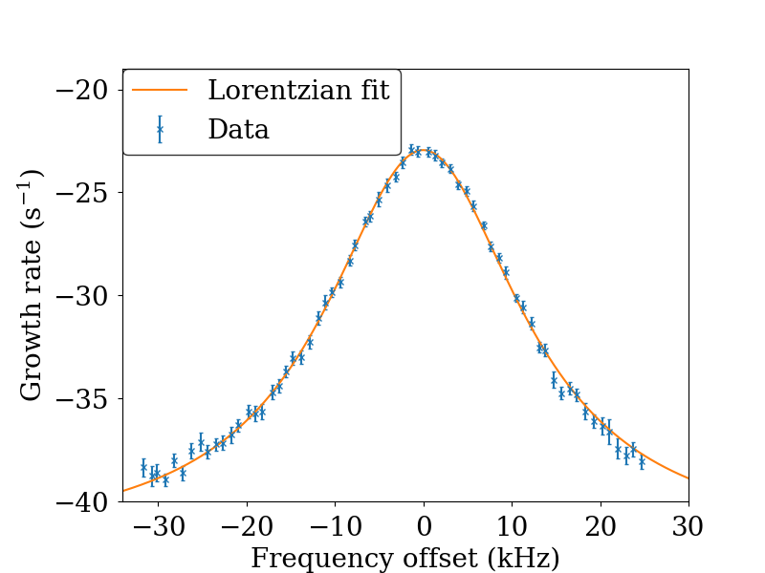
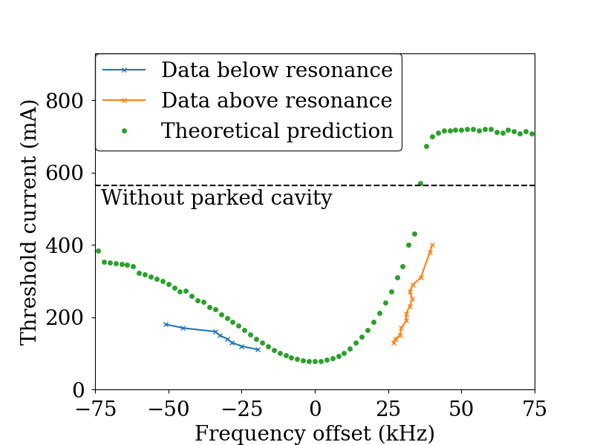
Parked Main Cavity
5 main cavities (4 active, 1 parked)
Drive-damp measurements
20 mA, no lengthening
Flat-potential conditions
RF voltage of 1.13 MV

Slide 22
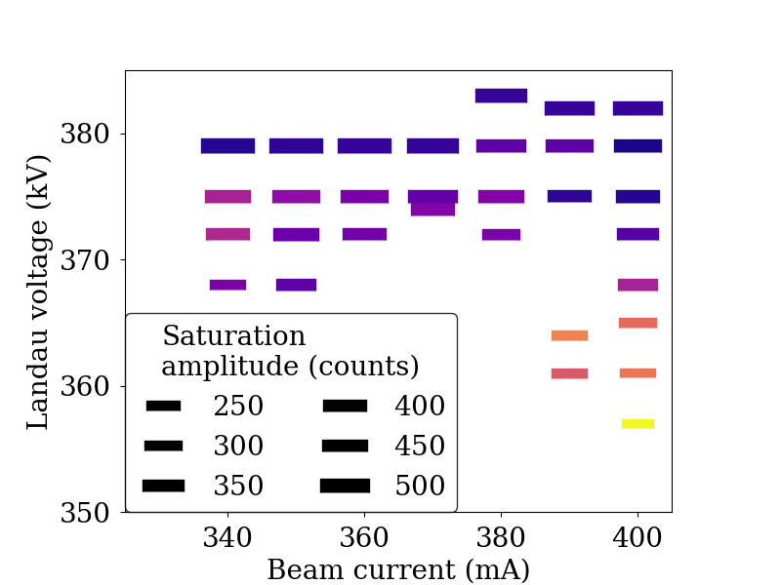
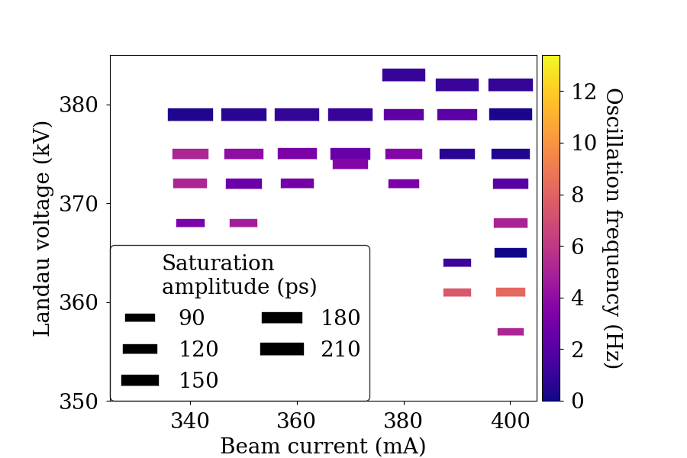
Two Landau Cavities
2 Landau cavities and an RF voltage of 1.13 MV
Bunch-by-bunch phase detection
Streak camera

Slide 23
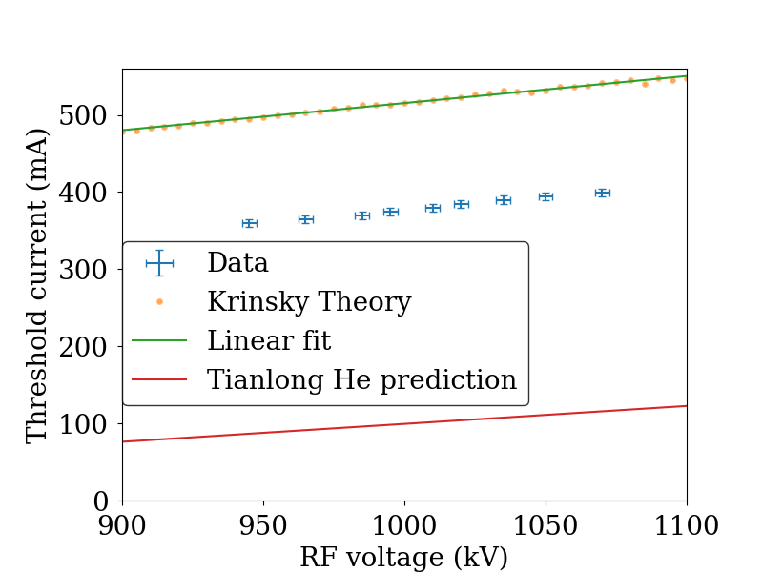
Flat potential conditions
2 Landau cavities
Notes:
Replace with image without Tianlong He prediction

Slide 24
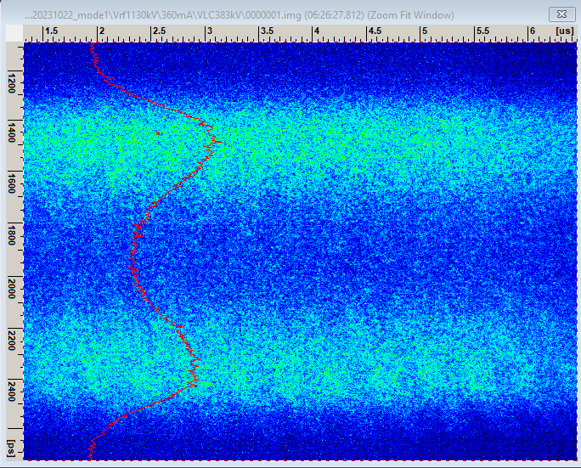
Beyond Mode 1
At a Landau voltage beyond flat potential, mode 1 goes stable and overstretched bunches are reestablished

Slide 25
Conclusion
Reactive impedance of Landau cavities dominant in the destabilisation of coupled-bunch mode +1
Methods that neglect Landau damping are prone to underestimate the threshold current
Extensive measurements of the mode-1 instability have been made at the MAX IV 3 GeV ring confirm this
Mode-1 stable regime found with overstretched conditions

Slide 27
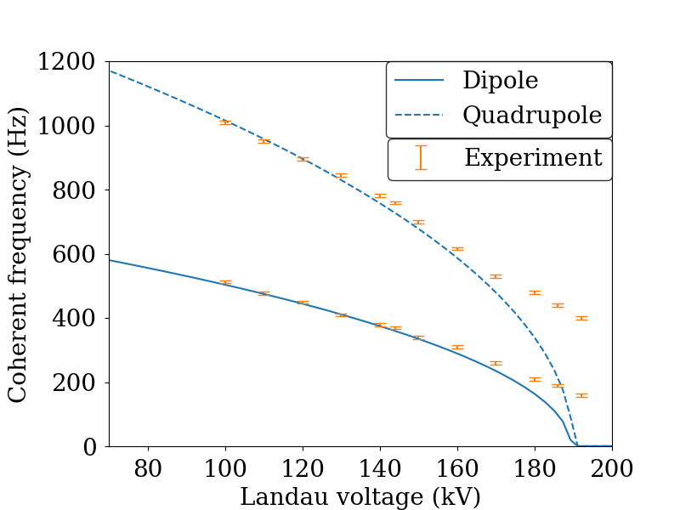
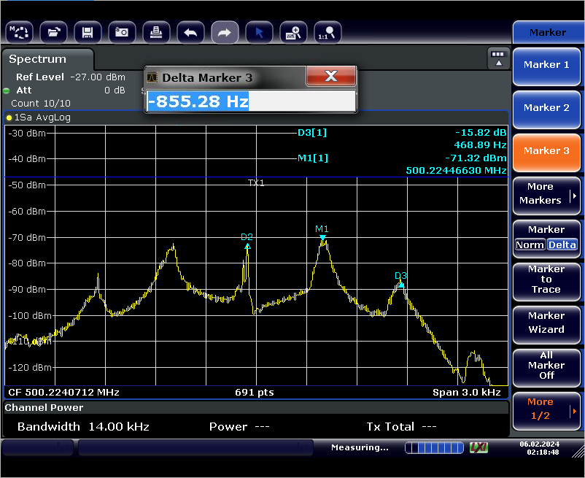
Coherent Frequency (below threshold)
90 mA, 690 kV RF voltage

Slide 28
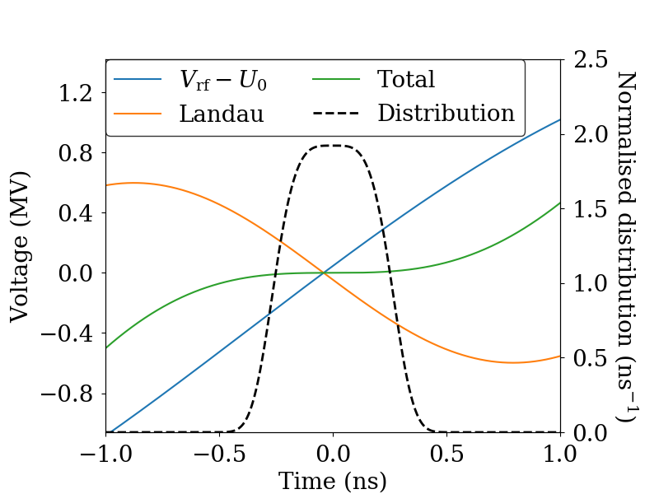
Landau (harmonic) Cavities
Landau cavities used to flatten the RF potential to lengthen the bunches
Longer Touschek lifetime
Less intrabeam scattering
Reduced heating of vacuum components
J. M. Byrd & M. Georgsson, PRSTAB 4 030701 (2001)
M. Georgsson, Å. Andersson & M. Eriksson, NIM A 416 2-3 pp 465-474 (1998)
Notes:
Can also reach semi flat potential

