Slide 1

HarmonLIP 2024, ESRF, Grenoble, 18–20 Mar 2024
Bunch lengthening affected by the short-range effect of resonant modes in RF cavities
Tianlong He (NSRL, USTC)
2024/03/19
htlong@ustc.edu.cn

Slide 2
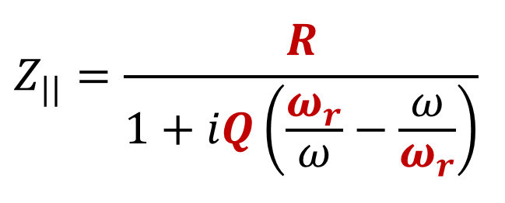
Outline
In this talk, I will show you the short-range effect of beam-cavity resonant modes can significantly affect the bunch lengthening in the case of high bunch-charge filling. To accurately evaluate the bunch lengthening in the presence of harmonic cavity, this short-range effect is an important ingredient and must be taken into account.
Cavity
Bunch distribution
Beam-cavity interaction
at the present passage
The ring
(1)

Slide 3
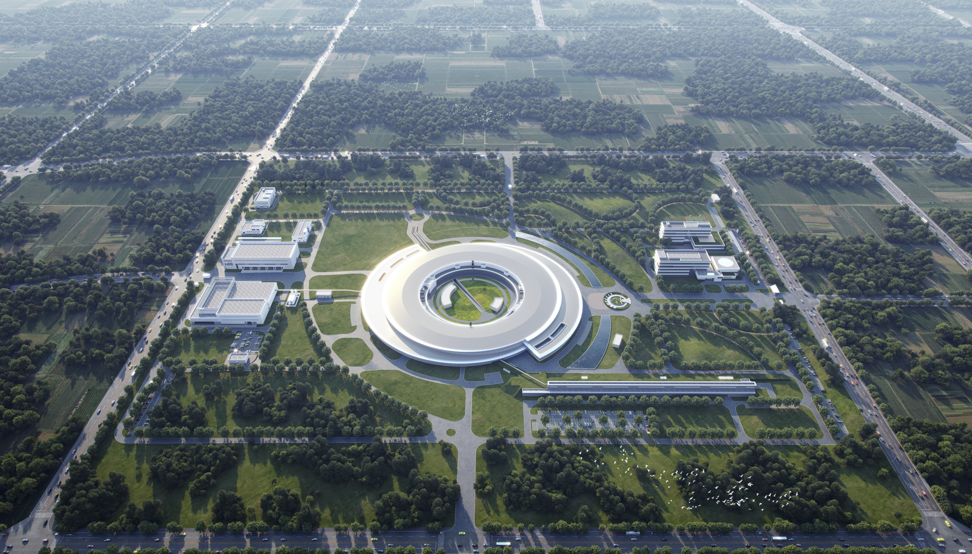
Hefei Advanced Light Facility (HALF)
Main parameters:
E = 2.2 GeV
I₀ = 350 mA
a_{c} = 9.4e-5
U₀ = 400 keV (w/ ID)
σ_{e} = 7.5e-4
τ_{z} = 14 ms
V_{mc} = 1.2 MV
(2)

Slide 4
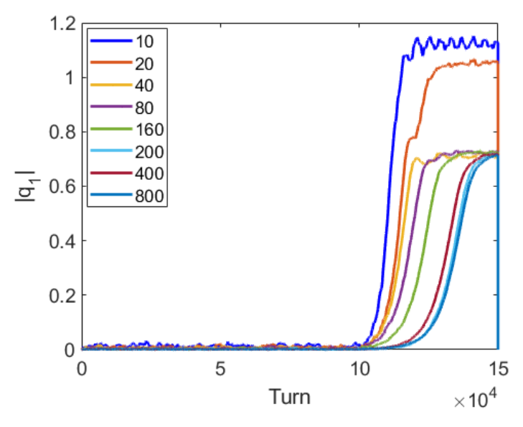
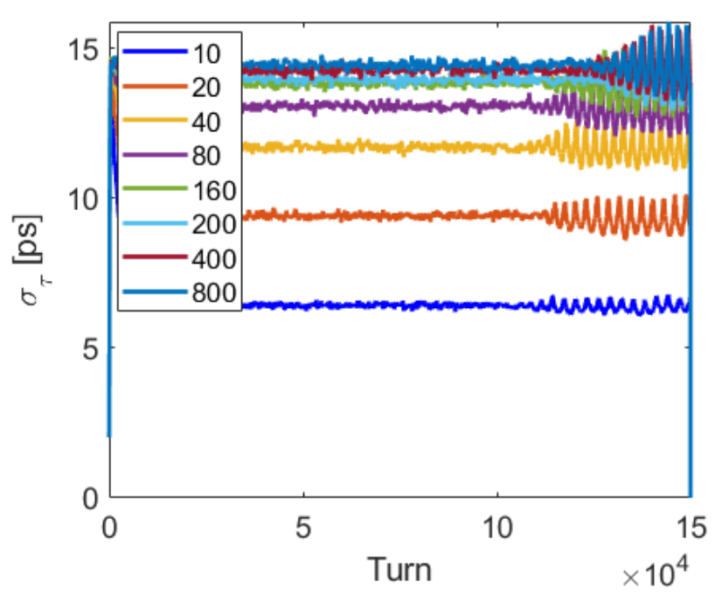
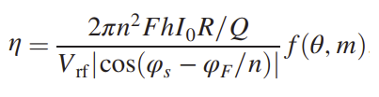
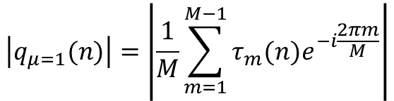
A tracking story for HALF bunch lengthening
Mode 1 instability was studied through tracking simulation for a passive NC HC case
R/Q=160 Ω, Q=36e3, dfr = 290 kHz
Using Bassi’ method to evaluate the time evolution of the coupled-bunch mode 1:
G. Bassi, IPAC2019 MOPGW099
$$\left|q_{μ=1}(n)\right|=\left|\frac{1}{M}\sum_{m=1}^{M−1}{τ_{m}(n)e^{−i\frac{2πm}{M}}}\right|$$
Modal coordinates of μ=1
It was observed that the fewer bunches there are, the stronger the mode 1 instability. (Q1: Why?)
That is because of the shorter bunch length for the case of fewer bunches. (Q2: Why?)
T. He, PRAB 25, 094402 (2022)
@350 mA, equally spaced filled bunches
(3)

Slide 5
A tracking story for HALF bunch lengthening
Bunch lengthening was studied through tracking simulation for a passive SC HC case
R/Q=40 Ω, Q=2e8, dfr = 55 kHz
@350 mA, MC: R/Q=45 Ω, Q_{L}=1e5
Beam-cavity interaction is intentionally categorized into two terms of the long- and short-range interactions in the STABLE tracking code.
The short-range term can be turned on or off when tracking for bunch lengthening study.
3 cases: with only SR of HC, with both SRs of HC and MC, w/o any SR.
It is evident that the near-optimum bunch lengthening can be significantly degraded by the short-range interaction of beam-cavity fundamental modes for the case of fewer bunches.
high bunch charge >> strong short-range interaction >> must be considered
low bunch charge >> weak short-range interaction >> can be neglected.
(4)

Slide 6


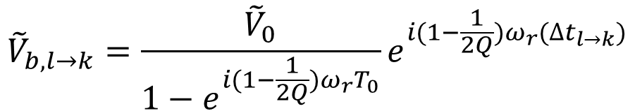
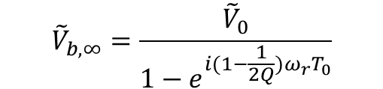




Beam-cavity interaction
Beam induced voltage
Rotation
Decaying
$${\tilde{V}}_{b,n+1}={\tilde{V}}_{b,n}e^{i(1−\frac{1}{2Q})ω_{r}T_{0}}+{\tilde{V}}_{0}$$
Single bunch in a simple ring
$$\tilde{F}qω_{r}R/Q$$
Addition
Ring: T₀
To reach steady state
Bunch: q
$${\tilde{V}}_{b,∞}=\frac{{\tilde{V}}_{0}}{1−e^{i(1−\frac{1}{2Q})ω_{r}T_{0}}}$$
Cavity: R/Q, Q, f_{r}
Matrix formulation
T. Olsson et al., PRAB 21, 120701 (2018)
$${\tilde{V}}_{b,n}$$
$${\tilde{V}}_{0}$$
$${\tilde{V}}_{b,n+1}$$
The voltage seen at bucket k contributed by the bunch at bucket l:
$${\tilde{V}}_{b,l→k}=\frac{{\tilde{V}}_{0}}{1−e^{i(1−\frac{1}{2Q})ω_{r}T_{0}}}e^{i(1−\frac{1}{2Q})ω_{r}{(∆t}_{l→k})}$$
$${∆t}_{l→l}=0$$
Bunch in point form
N.B. The beam-loading voltage matrix consists of the present passage voltage phasor
(5)

Slide 7



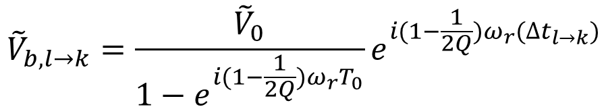
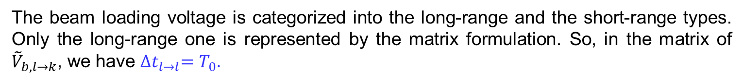

Beam-cavity interaction
Matrix formulation
The beam loading voltage is categorized into the long-range and the short-range types. Only the long-range one is represented by the matrix formulation. So, in the matrix of ${\tilde{V}}_{b,l→k}$, we have ${∆t}_{l→l}=T_{0}$.
Single bunch in a simple ring
T. He et al., PRAB 24, 044401 (2021)
Ring: T₀
$${\tilde{V}}_{b,l→k}=\frac{{\tilde{V}}_{0}}{1−e^{i(1−\frac{1}{2Q})ω_{r}T_{0}}}e^{i(1−\frac{1}{2Q})ω_{r}{(∆t}_{l→k})}$$
$${∆t}_{l→l}=T_{0}$$
Bunch: q
Cavity: R/Q, Q, f_{r}
Bunch in distribution form
$${\tilde{V}}_{0}$$
The short-range one is treated as a kind of short-range wake function, so we do its convolution with the bunch distribution
$${\tilde{V}}_{b,n}$$
$${\tilde{V}}_{b,n+1}$$
Short-range potential of beam loading.
(6)

Slide 8


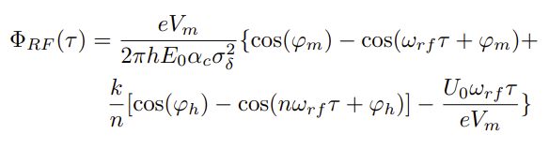

Bunch equilibrium determined by the double RF systems
The double RF voltages:
Main cavity
Harmonic cavity
For a given bunch distribution, we can compute the double RF voltages
The active cavity voltage is the sum of the generator current and the beam induced (long-range) voltages.
The passive HC voltage is determined fully by the beam.
The total longitudinal potential:
Including the generator voltage potential and the long-range beam loading voltage potential
Representing the short-range beam loading voltage potential
(7)

Slide 9
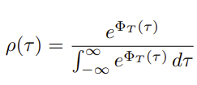
Bunch equilibrium determined by the double RF systems
The equilibrium distribution:
An iteration is required to find the final convergent bunch equilibrium, which is not difficult.
As for now, only generator and beam loading voltages are considered to compute the bunch equilibrium !
(8)

Slide 10
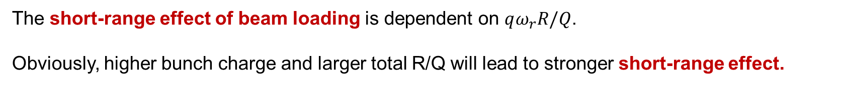
The short-range effect of beam loading
Recall the tracking story that I just told you…
Low bunch charge >> weak short-range effect >> can be neglected
High bunch charge >> strong short-range effect >> must be considered
Stronger SR
Weaker SR
8 equally spaced bunches vs. 800 uniformly filled bunches: the bunch lengthening is reduced by nearly half of the near optimum bunch lengthening.
For the case of 4 equally spaced bunches, mode 1 occurred (not shown).
Unrealistic case for HALF
@350 mA
MC: R/Q=45 Ω, Q_{L}=1e5
HC: R/Q=40 Ω, Q_{L}=2e8
In practice, the HALF will not choose the 4 or 8 equally spaced bunches filling at 350 mA.
But for other rings, the short-range effect of beam loading is possibly strong enough to affect the bunch lengthening.
The short-range effect of beam loading is dependent on $qω_{r}R/Q$.
Obviously, higher bunch charge and larger total R/Q will lead to stronger short-range effect.
(9)

Slide 11
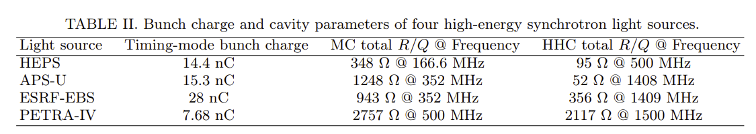
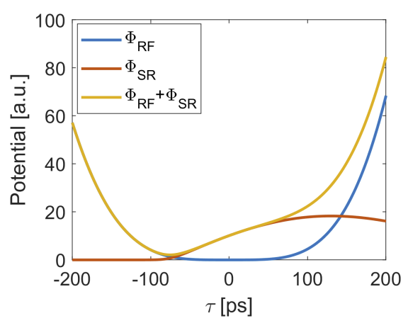
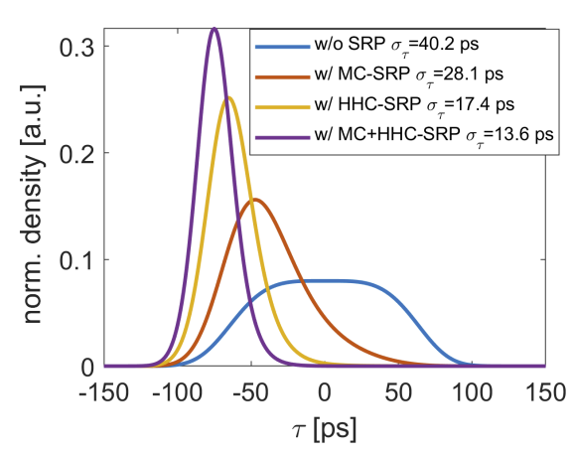
A realistic case to show
the short-range effect of beam loading
High energy storage ring light source: high bunch charge & multiple RF cavities
Different from HALF, the PETRA-IV uses the active NC HCs to achieve the optimum bunch lengthening.
Assuming the double RF cavities of PETRA-IV are set to meet the optimum bunch lengthening condition, what would happen for the high bunch charge (7.68 nC/ per bunch) case?
Not surprisingly, the short-range potentials of the double RF cavities can significantly distort the desired flat potential. The bunch lengthening is thus dramatically degraded (40 ps → 13.6 ps).
(10)

Slide 12
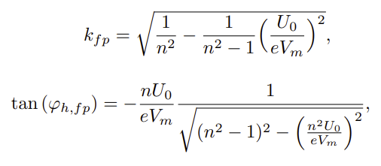
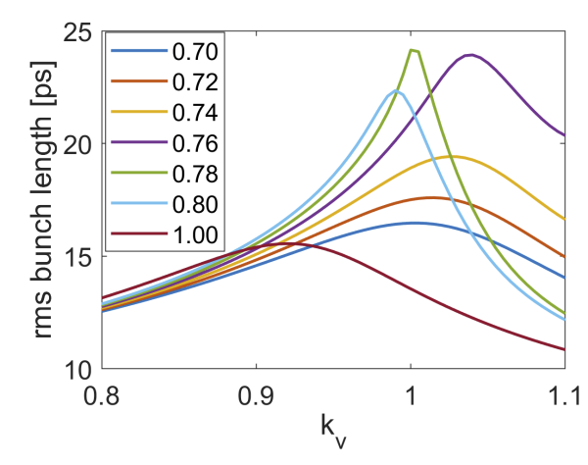



Bunch lengthening optimization for PETRA-IV
First of all, it should be noted that we only consider the beam-loading effect to perform this optimization.
The bunch center is largely deviated from the zero point ! The bunch lengthening may be improved by shifting the bunch center to the zero point. Let us do it… by adjusting the HC voltage and phase based on the flat-potential setting at zero current.
Define that:
$$k=k_{v}k_{fp}$$
$$φ_{h}=k_{φ}φ_{h,fp}$$
Scan $k_{v}$ and $k_{φ}$ in an range around 1, we can obtain:
Bunch center
Zero point
Flat-potential condition at zero current: $k_{v}$=1 and $k_{φ}$=1
We do optimize the bunch lengthening for the high bunch charge case of PETRA-IV.
Let us see more details about the bunch lengthening optimization…in the next slide.
(11)

Slide 13
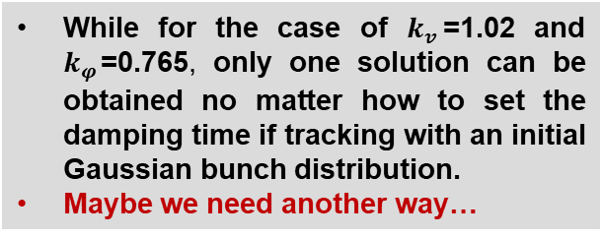
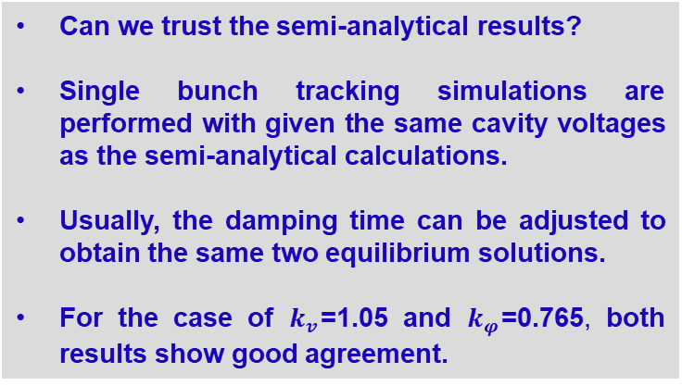




Two equilibrium solutions
$$k_{φ}=0.765$$
$$k_{V}=1.02,k_{φ}=0.765$$
Can we trust the semi-analytical results?
Single bunch tracking simulations are performed with given the same cavity voltages as the semi-analytical calculations.
Usually, the damping time can be adjusted to obtain the same two equilibrium solutions.
For the case of $k_{v}$=1.05 and $k_{φ}$=0.765, both results show good agreement.
$$24.47 ps$$
$$16.99 ps$$
We can find two equilibrium solutions
While for the case of $k_{v}$=1.02 and $k_{φ}$=0.765, only one solution can be obtained no matter how to set the damping time if tracking with an initial Gaussian bunch distribution.
Maybe we need another way…
(12)

Slide 14
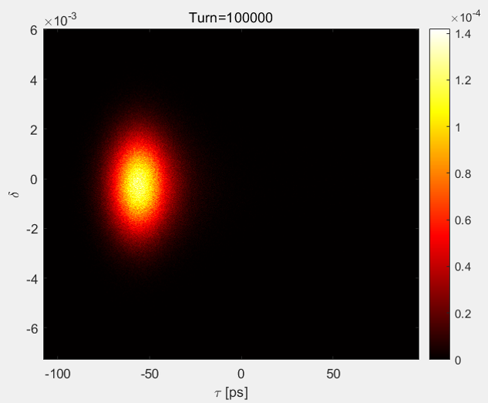
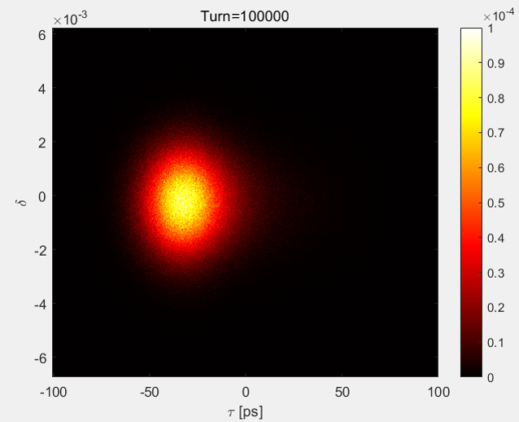


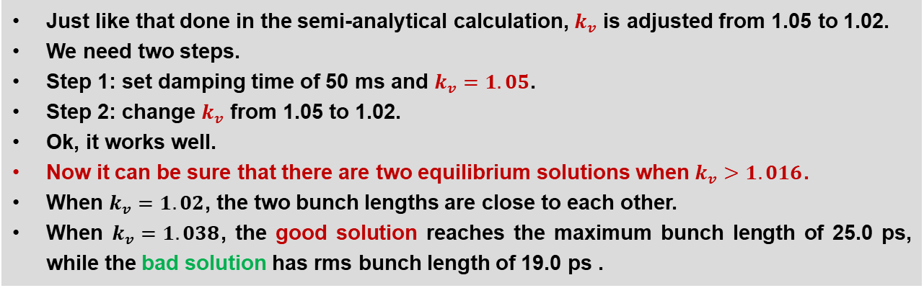

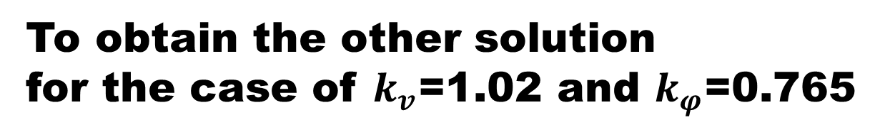

To obtain the other solution
for the case of $k_{v}$=1.02 and $k_{φ}$=0.765
Good
Just like that done in the semi-analytical calculation, $k_{v}$ is adjusted from 1.05 to 1.02.
We need two steps.
Step 1: set damping time of 50 ms and $k_{v}=1.05$.
Step 2: change $k_{v}$ from 1.05 to 1.02.
Ok, it works well.
Now it can be sure that there are two equilibrium solutions when $k_{v}>1.016$.
When $k_{v}=1.02$, the two bunch lengths are close to each other.
When $k_{v}=1.038$, the good solution reaches the maximum bunch length of 25.0 ps, while the bad solution has rms bunch length of 19.0 ps .
Bad
$$k_{v}=1.038$$
$k_{v}$=1.02
$k_{v}$=1.05
$k_{v}$=1.02
(13)

Slide 15


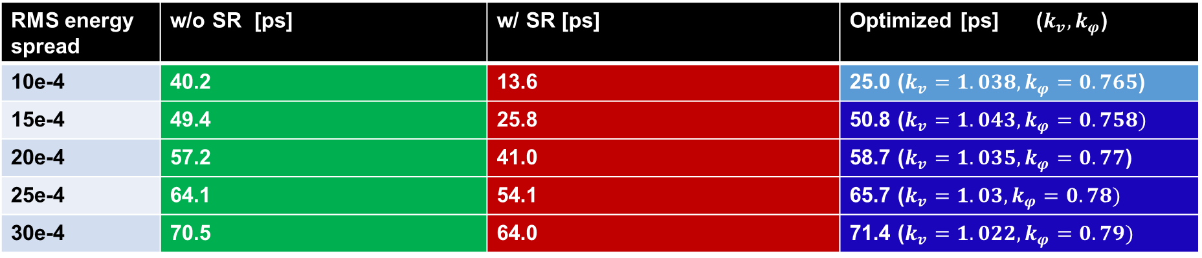

Effect of the increase in bunch energy spread
RMS energy spread | w/o SR [ps] | w/ SR [ps] | Optimized [ps] ($k_{v}, k_{φ}$)
10e-4 | 40.2 | 13.6 | 25.0 ($k_{v}=1.038, k_{φ}=0.765$)
15e-4 | 49.4 | 25.8 | 50.8 ($k_{v}=1.043, k_{φ}=0.758)$
20e-4 | 57.2 | 41.0 | 58.7 ($k_{v}=1.035, k_{φ}=0.77$)
25e-4 | 64.1 | 54.1 | 65.7 ($k_{v}=1.03, k_{φ}=0.78)$
30e-4 | 70.5 | 64.0 | 71.4 ($k_{v}=1.022, k_{φ}=0.79)$
w/o SR at the flat-potential setting
w/ SR at the flat-potential setting
Back to near-flat-potential distribution
$${10}^{−4}$$
$${10}^{−4}$$
$${10}^{−4}$$
(14)

Slide 16
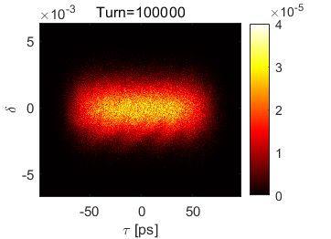
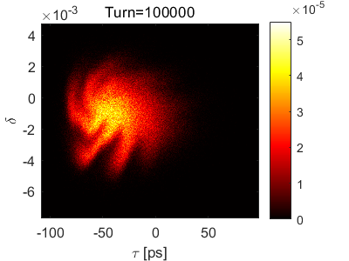
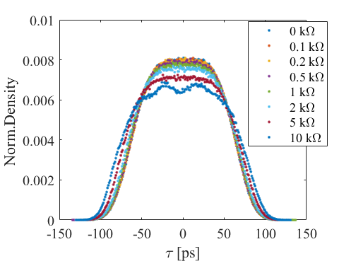
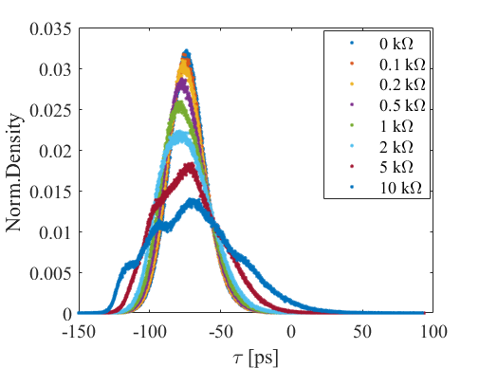
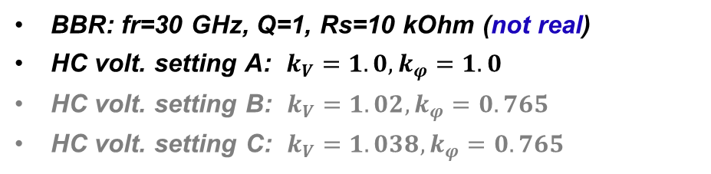


Effect of the broadband impedance
Assume a broadband resonator (BBR) to represent the total broadband impedance of PETRA-IV
BBR: fr=30 GHz, Q=1, Rs=10 kOhm (not real)
HC volt. setting A: $k_{V}=1.0,k_{φ}=1.0$
HC volt. setting B: $k_{V}=1.02,k_{φ}=0.765$
HC volt. setting C: $k_{V}=1.038,k_{φ}=0.765$
Setting A, w/o SR
Setting A, w/ SR
$σ_{τ}≈$47 ps $σ_{δ}≈$0.00102
$σ_{τ}≈$30 ps $σ_{δ}≈$0.00131
w/o SR
w/ SR
zero-current flat-potential condition
Bunch profiles at the last turn
Rs
Rs
(15)

Slide 17
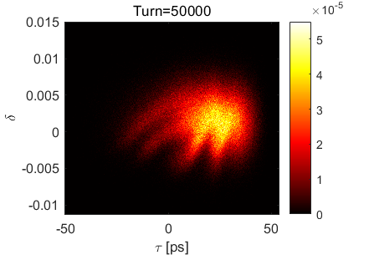
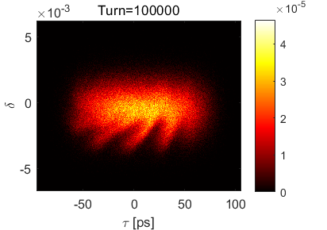
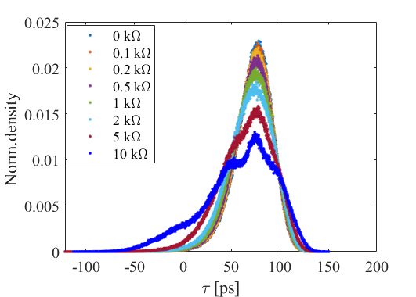
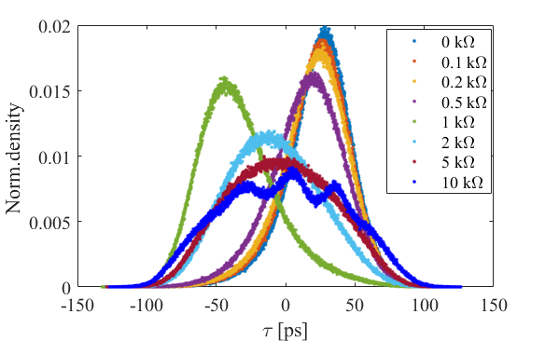
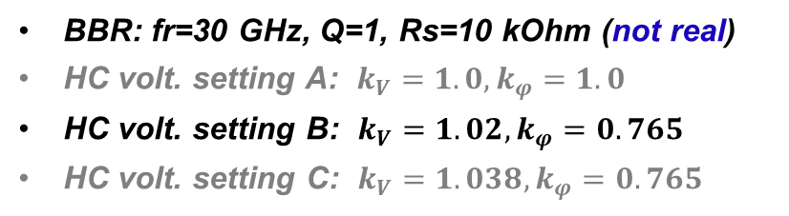


Effect of the broadband impedance
Assume a broadband resonator (BBR) to represent the total broadband impedance of PETRA-IV
BBR: fr=30 GHz, Q=1, Rs=10 kOhm (not real)
HC volt. setting A: $k_{V}=1.0,k_{φ}=1.0$
HC volt. setting B: $k_{V}=1.02,k_{φ}=0.765$
HC volt. setting C: $k_{V}=1.038,k_{φ}=0.765$
Setting B, wo SR
Setting B, w/ SR
$σ_{τ}≈$36.6 ps $σ_{δ}≈$0.00122
$σ_{τ}≈$43 ps $σ_{δ}≈$0.00107
w/o SR
w/ SR
Rs
Rs
(16)

Slide 18
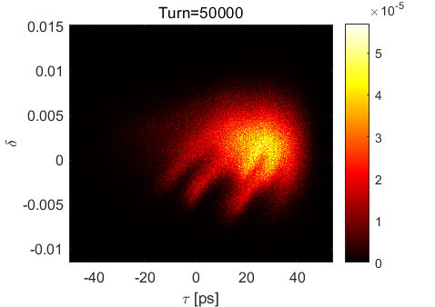
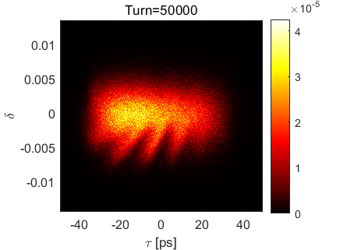
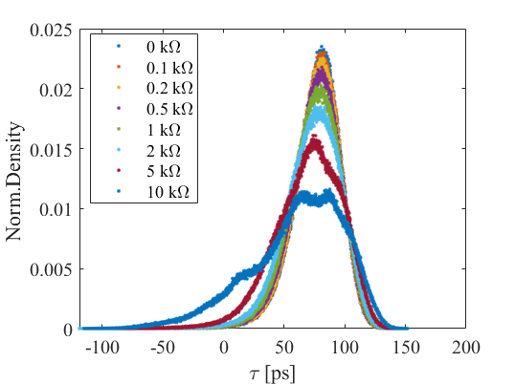
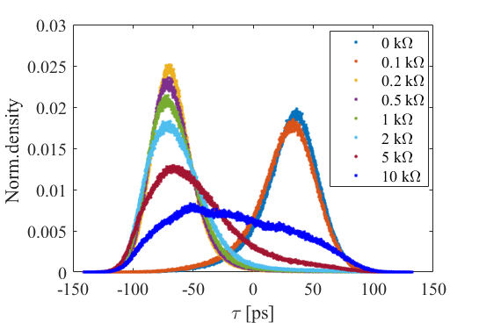

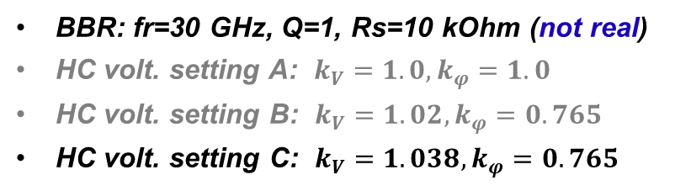

Effect of the broadband impedance
Assume a broadband resonator (BBR) to represent the total broadband impedance of PETRA-IV
BBR: fr=30 GHz, Q=1, Rs=10 kOhm (not real)
HC volt. setting A: $k_{V}=1.0,k_{φ}=1.0$
HC volt. setting B: $k_{V}=1.02,k_{φ}=0.765$
HC volt. setting C: $k_{V}=1.038,k_{φ}=0.765$
Setting C, wo SR
Setting C, w/ SR
$σ_{τ}≈$37.8 ps $σ_{δ}≈$0.00122
$σ_{τ}≈4$7.7 ps $σ_{δ}≈$0.00103
w/o SR
w/ SR
When considering the BBR:
The SR of beam-cavity resonant modes can still significantly affect the bunch state.
The bunch lengthening can also be improved by optimizing the HC voltage setting rather than the ideal flat-potential setting.
Rs
Rs
(17)

Slide 19
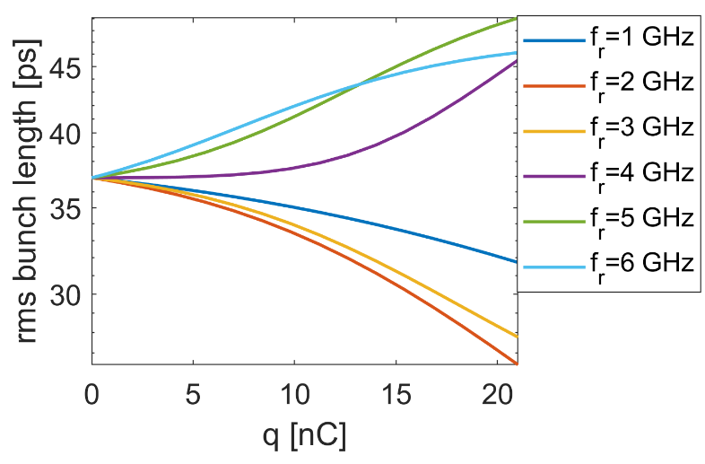
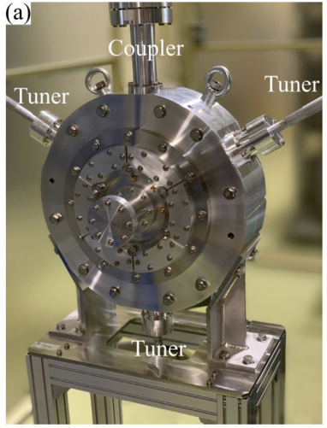
Parasitic modes
For HALF
R/Q = 39, Q = 2e8
Because the SR effects of parasitic modes (HOM,LOM) can be superimposed, although single parasitic mode’s R/Q is not large, all of them should be taken into account.
# APS-U 12 NC main cavities
fr [MHz] | R/Q [Ohm] | QL/1e3
324 | 113 | 9.1
921 | 5.85 | 106
1205 | 5.27 | 94
1500 | 4.45 | 89
1645 | 9.8 | 24
1700 | 8.1 | 37
# TM020 NC harmonic cavities
Lower order modes
TM010 | TM020
>80 ? | 34
~580 | ~1500
34-38 | 31400
5 HOMs
R/Q [Ω]
fr [MHz]
Q
Higher order modes
T. Yamaguchi et al., NIMA 1053 (2023)
R. Lindberg, PRAB 21 124402 (2018)
(18)

Slide 20
Summary
For the case of high bunch-charge filling, it has been shown that the short-range effect of beam-cavity interaction should be taken into account for predicting correctly the bunch lengthening.
Similar to the fundamental modes, the lower (e.g.TM020 cavities) or higher order modes should also be considered if their total R/Q is not small.
(19)

Slide 21
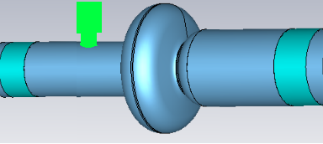
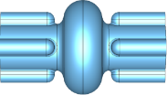










simulation tool for arbitrary filled bunch lengthening study
STABLE
PI FB
$${\tilde{I}}_{g0}$$
PI Controller
$${∆\tilde{I}}_{g}$$
+
$${\tilde{V}}_{set}$$
+
+
$${\tilde{I}}_{g}$$
$${\tilde{V}}_{c}$$
-
$$\frac{∆\tilde{V}}{R_{L}}$$
Desired voltage
$$k_{p}+\frac{k_{i}}{s}$$
Main cavity
Harmonic cavity
$${\tilde{V}}_{c}$$
$$<{\tilde{V}}_{c}>$$
$$e^{jφ_{d}}$$
HOMs
Cavity
Z_{HOMs}
Averaged voltage
Delay
Bunch
(ω_{r}, R_{L}, Q_{L})
Short range wake
W_{L}
GPU-accelerated, run in MATLAB
A realistic PI FB for the main cavity
Available via
Any questions for STABLE
https://github.com/hetianlong-afk/STABLE
htlong@ustc.edu.cn
(20)

Slide 22

Thanks for your attention

Slide 23
Backup slides

Slide 24
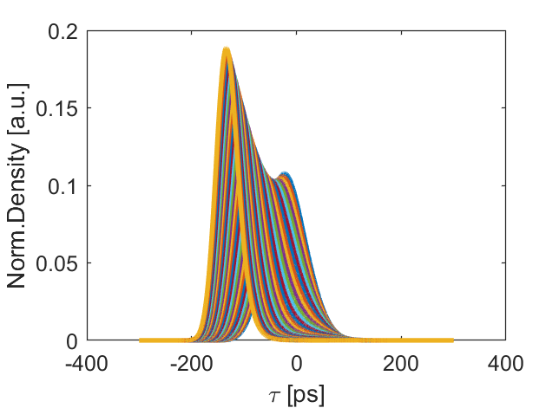
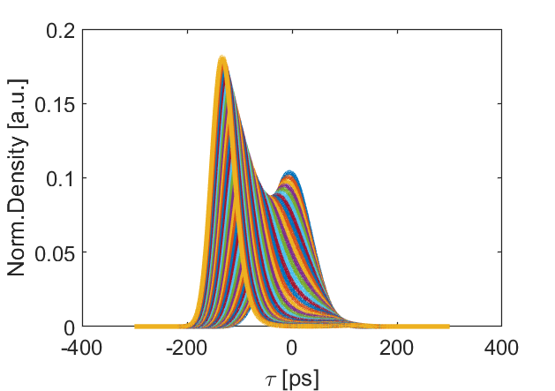
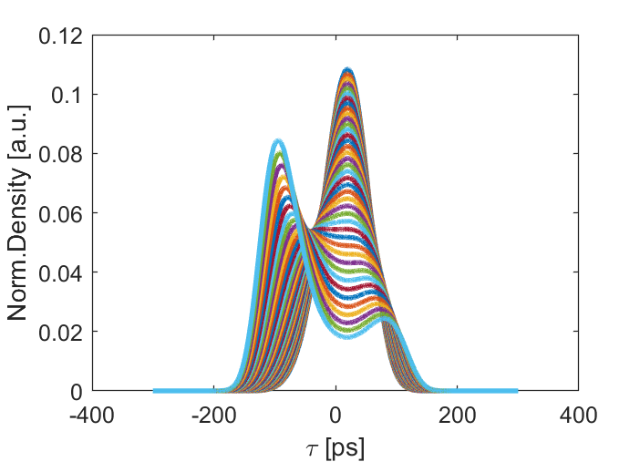
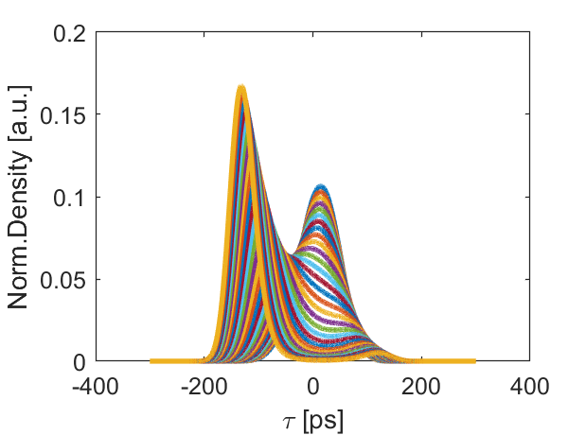
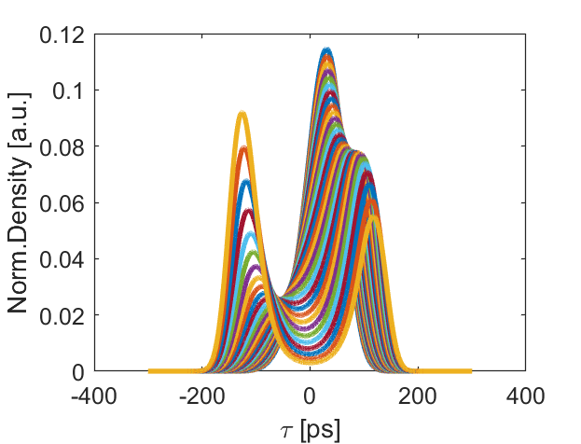







RMS energy spread 20e-3
$k_{v}$~0.9:0.005:1.1
$k_{φ}$=1.0
$k_{φ}$=0.9
$k_{φ}$=0.8
$k_{φ}$=0.7
$k_{φ}$=0.77
Flat-potential distribution
$k_{v}$~1.035

